Slide 1
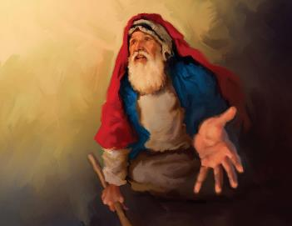
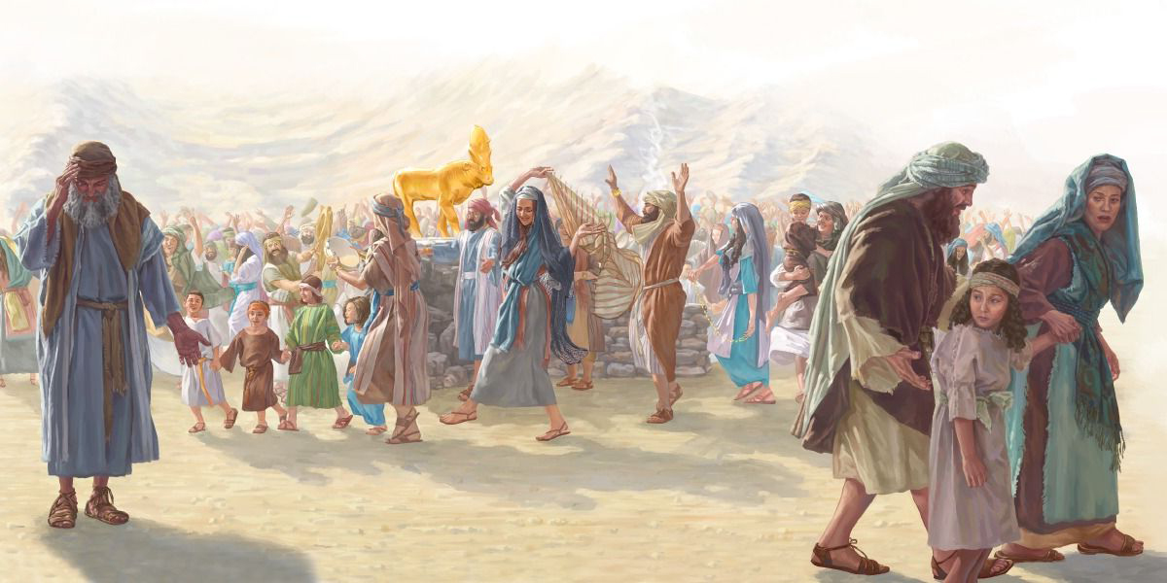
UKUHLUBUKA LO KUMELA
Isifundo setshumi lanye kuMpandula ilanga letshumi lantathu ku2025

Slide 2
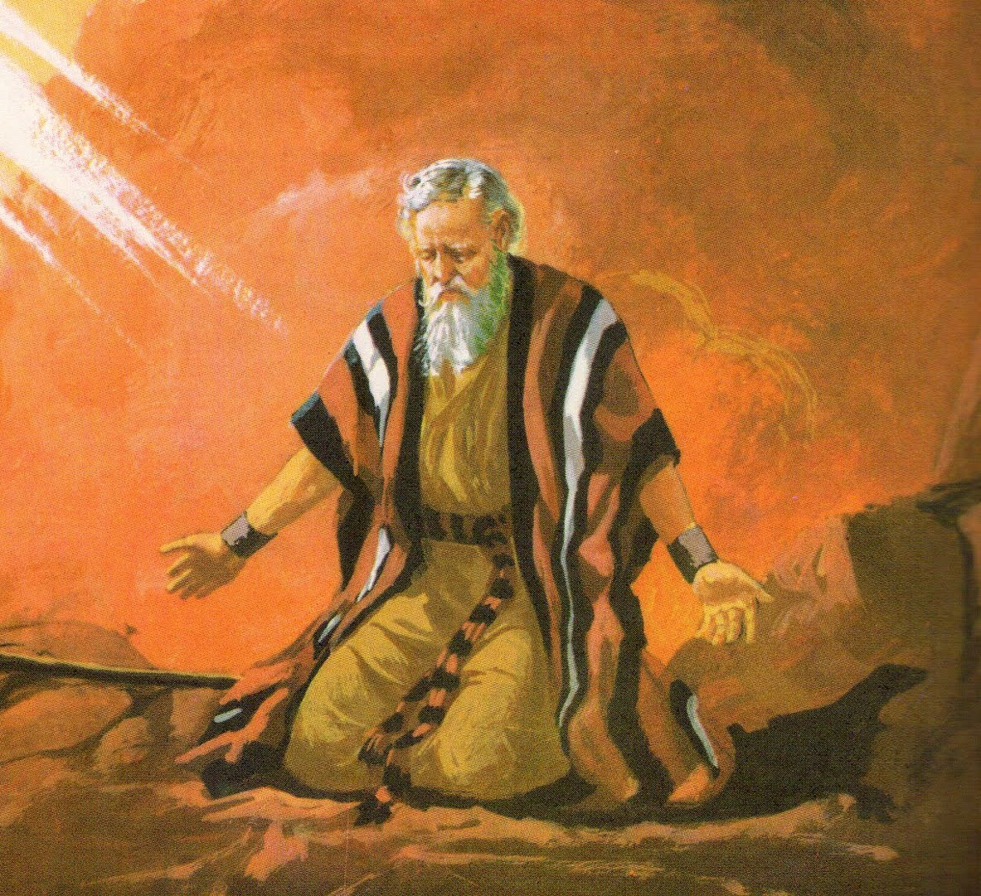
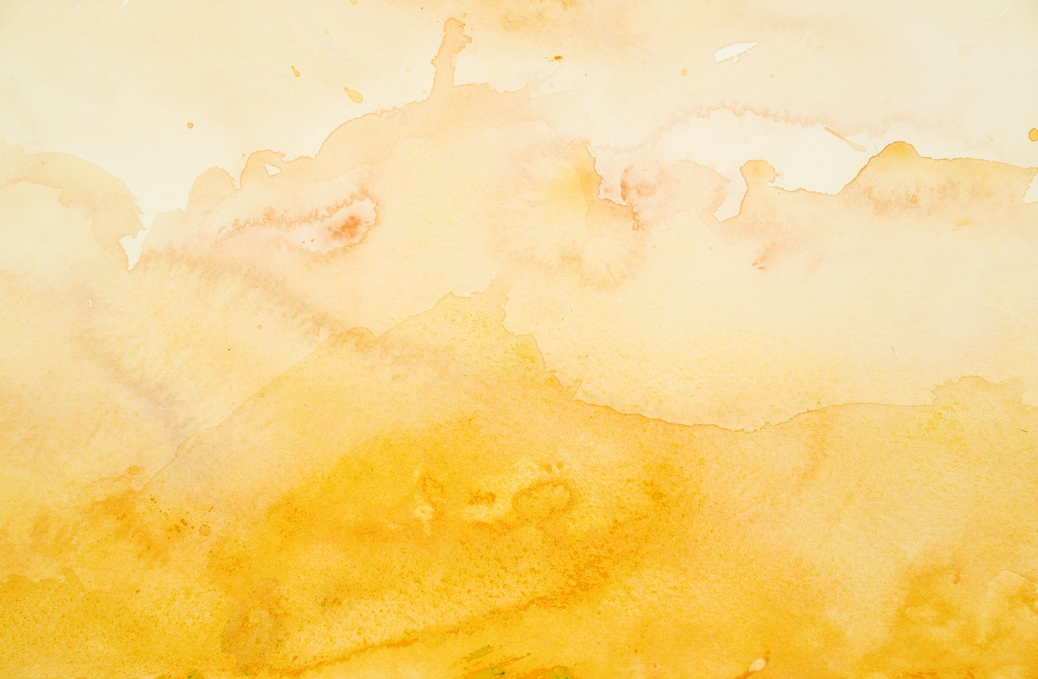
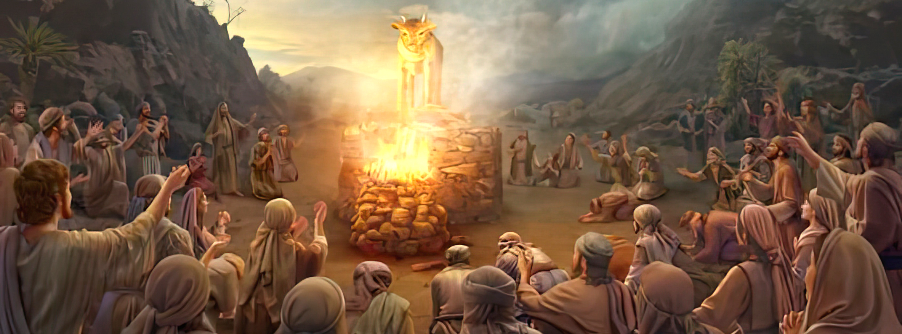
“UMose wabuyela kuJehova, wathi: ‘O, lababantu benzile isono esikhulu, bazenzele unkulunkulu wegolide; lokho manje, uma ubathethelela isono sabo—kepha uma kungenjalo, ngicela ungesule encwadini yakho oyilobileyo’ ” Eksodusi 32:31-32 .

Slide 3

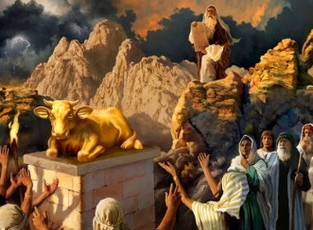
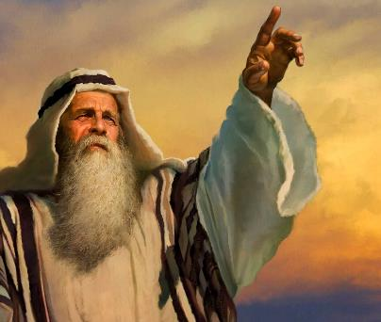


“Baphangisa ukufulathela lokho engabalaya ngakho” (Eks. 32:8 NIV).”
Ngemva nje kokuthola iMilayo Elitshumi, futhi ephindaphindwa umlayo oqondileyo wokungazenzi izithombe ( Eks. 20:23 ), uIsrayeli wenza ithole legolide ukuze alikhulekele..
Ebhekane lalokhu kuhlubuka, uNkulunkulu wacela uMose imvumo yokubhubhisa u-Israyeli futhi amenze isizwe esitsha (Eks. 32:10). Ngaphezu kokuhlubuka kwabantu, uMose wancenga kabili phambi kukaNkulunkulu ecela intethelelo eyayingabafanele
Ukuhlubuka:
  Ubuthakathaka buka-Aroni ( Eksodusi 32:1-5 )
  Umkhosi Wethole (Eksodusi 32:6)
  Ukonakala kokukhonza izithombe ( Eksodusi 32:7-8 )
Ukuncengela:
  “Phenduka entukuthelweni yakho evuthayo!” ( Eksodusi 32:9-29 )
  “Angesule encwadini oyibhalileyo!” ( Eksodusi 32:30-32 )

Slide 4

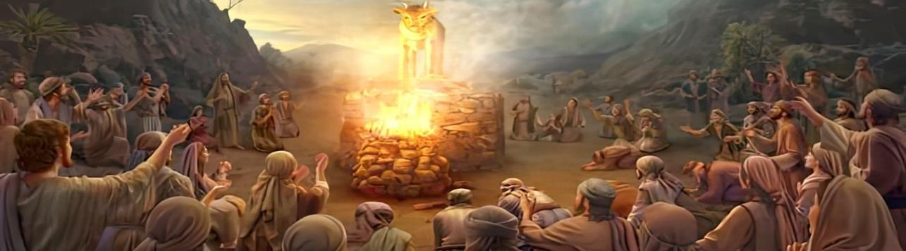
UKUHLUBUKA

Slide 5

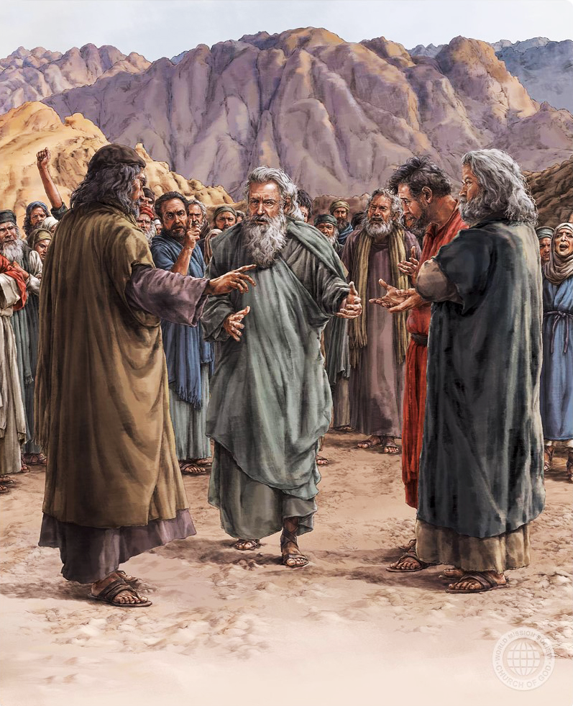
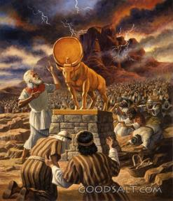
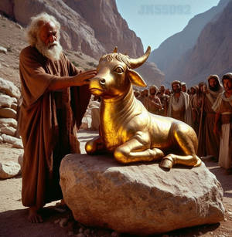
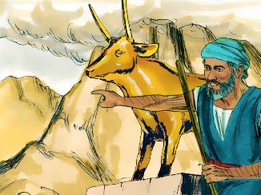
UBUTHAKATHAKA BUKA ARONI
“Lapho u-Aroni ekubona lokhu, wakha i-altare phambi kwethole futhi wamemezela: “Kusasa kuzoba lomkhosi kaJehova.”— Eksodusi 32:5
Lanxa igama lesiHeberu elithi elohim liyibuningi begama elithi “nkulunkulu,” ngokuvamileyo lisetshenziselwa ukukhangela kuNkulunkulu oyedwa: “NginguJehova uNkulunkulu wakho [elohim], owakukhipha ezweni laseGibhithe” ( Eks. 20:2 ).
Lapho uMose engekho, abantu bacela u-Aroni ukuba abenzele unkulunkulu obonakalayo ababengamkhonza. ( Eks. 32:1 ). Base bekhohlwe masinyane imilayo ababeyitholile kanye lokuzibophezela ababekwenzile ukuyilalela ( Eks. 24:7 ).
Ukuthandabuzaza kuka-Aroni kokuqala ezama ukuxoxisana labantu ( Eks. 32:2 ) kwamholela ekuholeni ukuhlubuka, kulokukuqeda
Kulokuba abakhumbuze ngomthetho owenqabela ukwenza izithombe, u-Aroni wabenzela ithole legolide, futhi wathi: “Lo ungunkulunkulu wakho [elohim] Israyeli, owakukhuphula ezweni laseGibithe!” (Ex. 32:4 MEV).

Slide 6
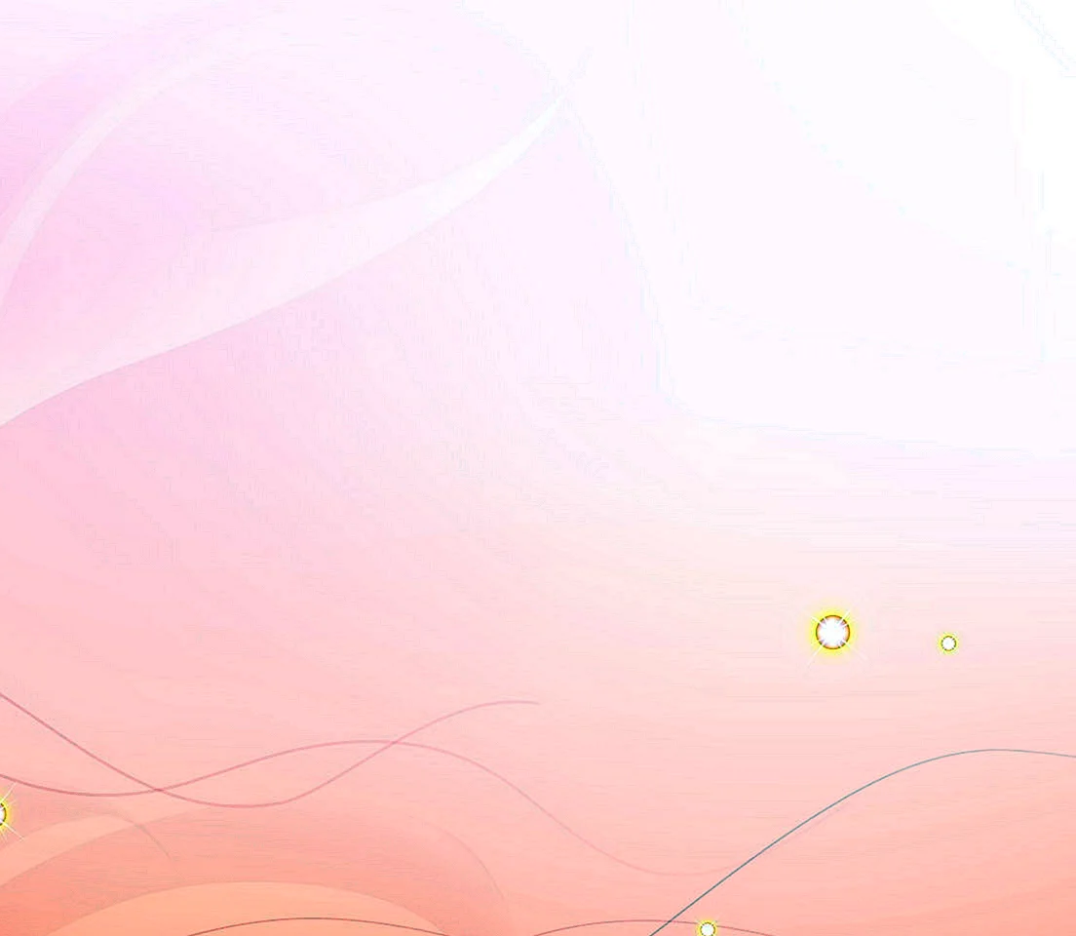
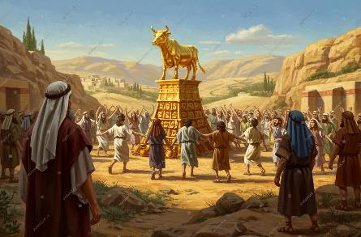
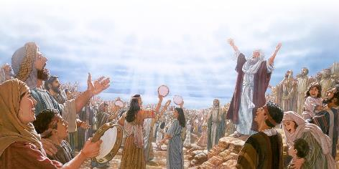

UMKHOSI WETHOLE.
“Ngakusasa abantu bavuka ekuseni, banikela ngeminikelo yokutshiswa, baletha iminikelo yokuthula, ngasemuva bahlala phansi ukuba badle, baphuze, basukuma ukuba bazitike.”— Eksodusi 32:6“)
Ngokwenza isithombe esilesimo sethole, ama-Israyeli anciphisa uNkulunkulu uSomandla wamenza umfanekiso wenyamazana, akhulekela isidalwa esikhundleni soMdali ( Roma 1:23 ).
Ngokungenangqondo bacabanga ukuthi isithombe esibaziweyo singabahola. Kungenzeka lokuthi babecabanga ukuthi u-elohim ngokwakhe wayesephenduke ithole! ( Eks. 32:24 )
Eqinisweni, basuka ekukhonzeni uNkulunkulu bakhonza amademoni (Dut. 32:17). Lapho bekhulekela uNkulunkulu, bakhula ekuziphatheni kwabo, ngoba bafana loNkulunkulu
Ngokukhonza amademoni, baqala ukuzehlisa, ngoba babefana lamademoni ababewakhonza.
Lapho singanikeli izinhliziyo zethu kuMdali, kodwa kulalokho sikhonza esinye isithixo (futhi ziningi), ngokuphangisa loba kamuva kuzasidonseola ekuweni kokuziphatha.

Slide 7

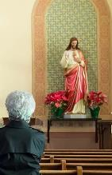
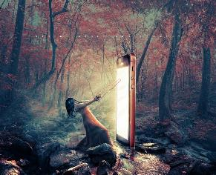
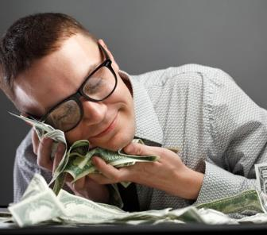

UKONAKALA KOKUKHONZA IZITHOMBE
““Khona-ke uJehova wathi kuMose: “Yehla, ngokuba abantu bakho owabakhipha eGibithe bonakalisile.” ( Eksodusi 32:7 ) Ngakho, uJehova wakhuluma loMose, wathi: “Hamba!
Ukukhothama phambi kwesithombe (ngitsho loba simelela uNkulunkulu uqobo Lwakhe, uKristu, loba abangcwele baKhe) kuyikweqa uMthetho kaNkulunkulu ( Eks. 20:3-6 ) futhi, ngenxa yalokho, ukungena esonweni lasekonakaleni.
Kuyini ukukhonza izithombe kwekhulu lama-21? Ukukhonza izithombe kuyikukhonza okuthile esikhundleni sikaNkulunkulu. Isithixo siyiloba yini ethatha umcabango wethu, uthando, isikhathi, lengqondo ngaphezu kukaNkulunkulu, futhi egqilaza ukucabanga kwethu.
Yiziphi izithixo esizikhonzayo? Ungenza uhlu lwakho. Ezinye iziphakamiso: ukuziqhenya, imali, amandla, ucansi, ukudla, umsebenzi, inkundla yezokuxhumana.
Kuhlanganisani ukukhulekela lezi zithixo? Ubuntu bethu, indlela yethu yokucabanga, imizwelo, ngitsho lokuphila kwethu komphakathi kuyantshintsha. Sintshintshana ngobudlelwano beqiniso loNkulunkulu ukuze senze izinto eziyize lezingelanjongo ezingelakusisindisa

Slide 8

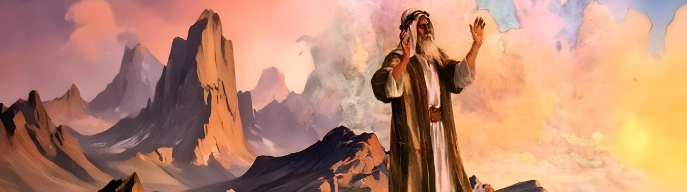
UKUMELA

Slide 9

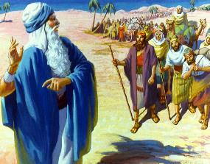
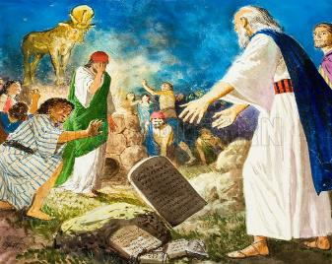
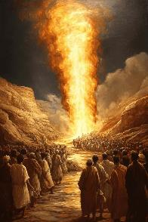
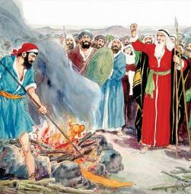
“GUQUKA EKUTHUKUTHENI KWAKHO OKULOLAKA!”
“Kungani abaseGibhithe kufanele batsho ukuthi, ‘Wabakhipha ngenjongo embi, ukuze ababulalele ezintabeni futhi abaqothule ebusweni bomhlaba,’ na?” Phenduka entukuthelweni yakho evuthayo, uguquke, ungabehlisi abantu bakho! (Funda u-Eksodusi 32:12.)
UNkulunkulu watshela uMose ukuthi: “Ngenxa yokuthi abantu bakho, owabakhuphula eGibhithe, bonakalisile.” ( Eks. 32:7 ).
UMose wasabela ngendlela efaneleyo: “Akusibo abantu bami, kodwa ngabakho, akusimi engibakhiphileyo kodwa nguwe” ( Eks. 32:11 ). UNkulunkulu wayemcela ukuba amvumele abhubhise u-Israyeli ( Eks. 32:10 ), kodwa uMose wala ukuyipha leyo mvumo
Ulaka lukaNkulunkulu lwalulungile, kodwa uMose wayazi ukuthi “isihe siyanqoba ukwahlulela” ( Jakobe 2:13 ). Ngemva kokukhulumela u-Israyeli, futhi eqiniseka ukuthi uNkulunkulu wayeyidambisile intukuthelo yakhe, (ethukuthele) wehla entabeni ( Eks. 32:12-15 ). Ebona ukuhlubuka, wephula uphawu lwesivumelwano: izibhebhe zamatshe ( Eks. 32:19 ).
Ngemva kokulalela izaba ezibuthakathaka zomfowabo, uMose wathatha inyathelo eliyisijuqu sokunqanda ubudlova ( Eks. 32:20-28 ).

Slide 10

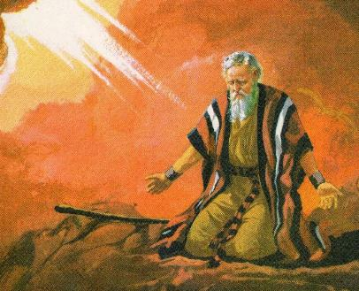
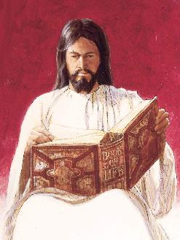
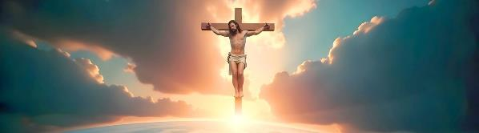
“NGICITSHE ENCWADINI OYIBHALILEYO!”
““Kepha manje ake uthethelele isono sabo, kepha uma kungenjalo, ngesule encwadini yakho oyilobileyo. (Funda u-Eksodusi 32:32.)
Ngokuncenga kwakhe kokuqala, uMose wavimba ukubhujiswa kwabantu. Kodwa kwakusobala ukuthi uNkulunkulu wayengeke esababusisa ngemva kwalesi sono. Ngakho-ke, wanquma ukwenza ukunxusa kwesibili (Eks. 32:30).
UMose wayezimisele ukulahlekelwa yinsindiso yakhe aluba abantu bengathethelelwa ( Eks. 32:31-32 ). Ngakho, lokhu kwakungeyona intethelelo evamile uMose ayicela, ngoba akazange asebenzise igama lesiHeberu elivamile elisho “thethelela.” Wacela ukuba uNkulunkulu “athwale” izono zabantu.
Lokhu kwakusitsho ukuthi uNkulunkulu wayezazithathela isono futhi asithwale, akhokhe inani laso: ukufa ( Isaya 53:6; Roma 6:23 ). Yilokhu kanye uJesu akwenza esiphambanweni. Wathatha izono zethu phezu kwakhe ukuze afe ngokufanele thina (1 Pet. 2:24).

Slide 11

EGW (Patriarchs and Prophets, p. 315)
“Ngalesi sikhathi sokulinda, kwaba lesikhathi sokuba bazindle ngomthetho kaNkulunkulu ababewuzwile, futhi balungise izinhliziyo zabo ukuze zamukele ezinye izambulo ayezazenza kubo. Babengelaso isikhathi esinengi kakhulu salo msebenzi; futhi ukube babelokhu befuna ukuqonda okucace kakhudlwana ngezimfuneko zikaNkulunkulu, futhi bezithoba izinhliziyo zabo phambi Kwakhe, babengeke bavikeleke esilingweni futhi abazange baphangise bakwenze lokhu. abangelamthetho.
Bezizwa bengelakuzisiza lapho umholi wabo engekho, babuyela ezinkolelweni zabo zakudala. […] Abantu babefisa isithombe esithile esizomela uNkulunkulu, futhi sihambe phambi kwabo esikhundleni sikaMose.”

