Slide 1
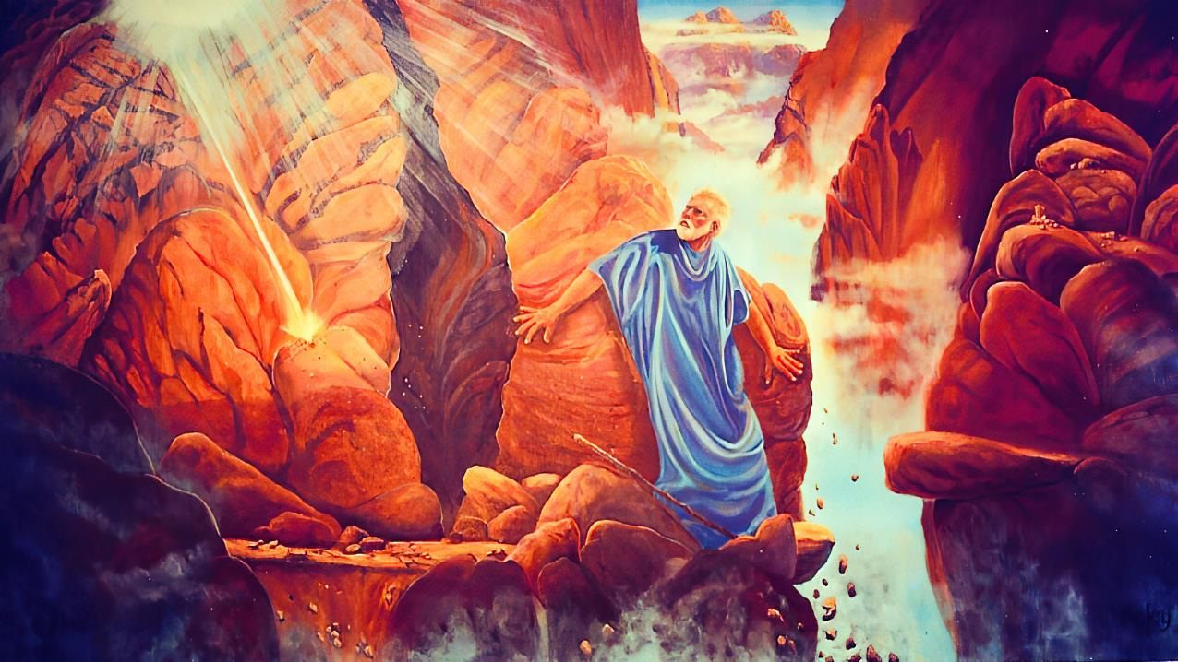
“NGICELA, UNGIBONISE INKAZIMULO YAKHO”
Isifundo setshumi lambili ku Mpandula ilanga lamatshumi amabili ku2025

Slide 2
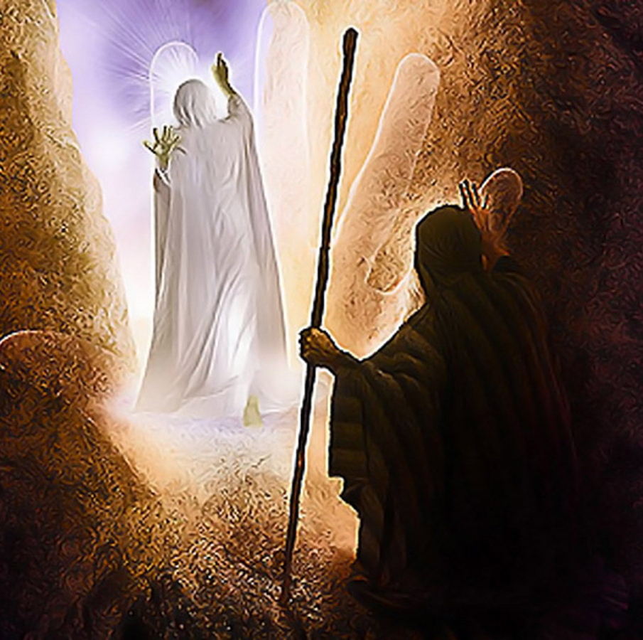
“UJehova wadlula phambi kwakhe, wamemezela, wathi: “UJehova, uJehova, uJehova, ogcwele olesihe, olomusa, obekezelayo, lovamé umusa leqiniso, ogcinela abayizinkulungwane umusa, othethelela ububi leziphambeko lezono, angayekeleli olecala, ehambela ububi baboyise kubantwana lakubantwana babantwana kwaze kwaba sesizukulwaneni sesithathu lesesine; Eksodusi 34:6-7., NKJV

Slide 3

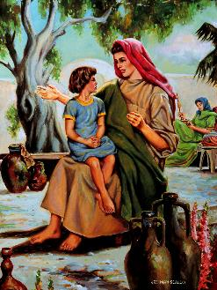
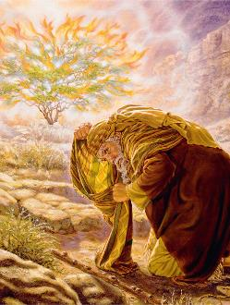

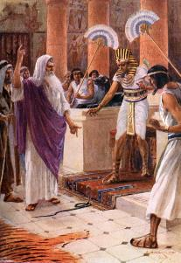
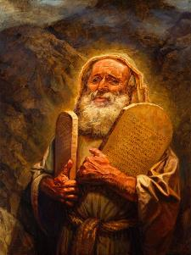

Akukho kuthandabuza ngakho. UNkulunkulu loMose baba ngabangane abakhulu.
Lokhu akwenzekanga ngokuphazima kweso. Kwakuyinqubo ehamba kancane. Kwaqala lapho esemncane, lapho unina ekhuluma laye ngoNkulunkulu omangalisayo ababemkhonza
Ubungane babo baqiniswa ngesikhathi sokuhlangana okuhlukahlukene ababelakho entabeni yaseSinayi, futhi baqhubeka bukhula kwaze kwaba usuku uNkulunkulu abiza ngalo uMose ukuba aphumule
Izahluko 33 no-34 zika-Eksodusi zibhala ngomzuzu okhethekileyo kulobu buhlobo obuqinileyo: Isicelo sikaMose sokubona inkazimulo kaNkulunkulu.
UNkulunkulu loMose:
  Ukuhlangana loNkulunkulu (Eksodusi 33:7-11)
  Ukumazi Kangcono UNkulunkulu (Eksodusi 33:12-17)
Inkazimulo kaNkulunkulu:
  Isifiso sokwazi inkazimulo kaNkulunkulu (Eksodusi 33:18-23)
  Umbono wenkazimulo kaNkulunkulu (Eksodusi 34:1-28)
  Umphumela wokubona inkazimulo kaNkulunkulu (Eksodusi 34:29-35)

Slide 4

UNKULUNKULU LOMOSI

Slide 5

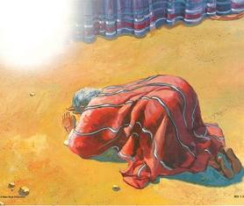
UKUHLANGANA LONKULUNKULU
UMose waba yinceku kaNkulunkulu ethembekileyo ( Heb. 3:5 ), isibani esingelakucimeka ebumnyameni, lomprofethi oyisibonelo.
UNkulunkulu wambiza esesihlahleni esibhebhayo
UMose wabona indlela uNkulunkulu anqoba ngayo onkulunkulu baseGibhithe
Wabona ukuhlukana koLwandle Olubomvu ukuze akhulule u-Israyeli
Wabona uNkulunkulu ethungamela u-Israyeli eSinayi
Bachitha izinsuku ezingu-40 ndawonye entabeni
Ubuhlobo babo baqhubeka bukhula nsuku zonke
UNkulunkulu waphefumulela uMose ukuba alobe uJobe loGenesise
“Kwathi lapho uMose engena etendeni, insika yefu yehla, ime ngasemnyango; uJehova wakhuluma loMose.” ( Eksodusi 33:9 )
UMose wahlangana loNkulunkulu etabernakele, lapho akhuluma Laye ubuso lobuso (Eks. 33:7-11).
Incazelo: inkulumo ethi “ubuso lobuso” yayingatsho ukuthi babebonana ngokoqobo, kodwa kunalokho babelengxoxo ebalulekileyo (lanxa uMose engazange abubone ubuso bukaNkulunkulu).
UMose waba yinceku kaNkulunkulu ethembekileyo ( Heb. 3:5 ), isibani esingelakucimeka ebumnyameni, lomprofethi oyisibonelo.

Slide 6


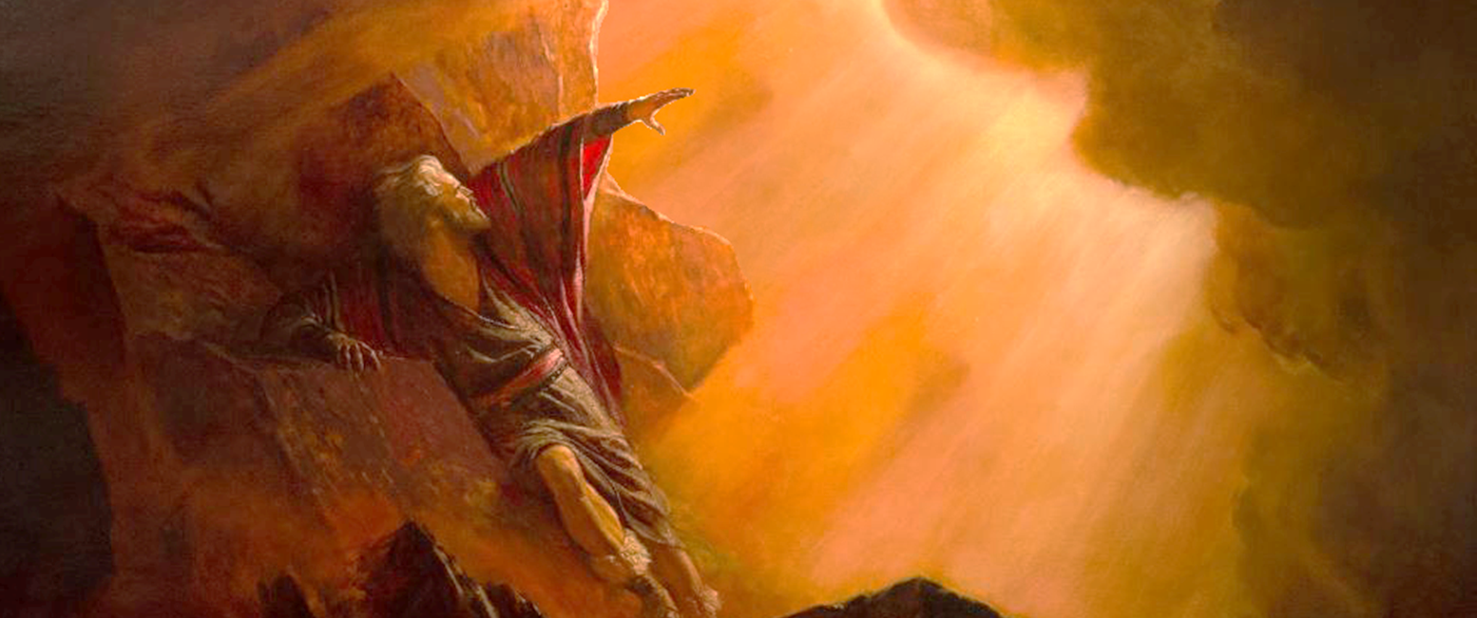
UKWAZI GCONO UNKULUNKULU
“Uma uthokoza ngami, ngifundise izindlela zakho ukuze ngikwazi, ngizuze umusa kuwe, ukhumbule ukuthi lesi sizwe singabantu bakho.” ( Eksodusi 33:13 )
Lapho uNkulunkulu etshela uMose ukuthi wayengeke ahambe labantu baye eKhanani ( Eks. 33:1-3 ), kwaba lengxoxo ethakazelisayo (Ex. 33:12-17 NIV):
Nkulunkulu
Mosi
Nkulunkulu
Mosi
Mosi
Nkulunkulu
Ungumngane wami futhi ulomusa wami
Uma kunjalo ngempela, ngifundise indlela yakho, ukuze ngikwazi
UBukhona Bami buyohamba lawe, futhi ngizokunikeza ukuphumula
Uma uBukhona bakho bungahambi lathi, ungasikhiphi lapha
Uma ungahambi lathi, umuntu uzokwazi ngani ukuthi uyathokoza ngami?
Kulungile, ngizokwenza lokhu okucelayo, ngoba ulomusa wami futhi ngikuthatha njengomngane wami.
UMose wayesechithe izinsuku ezingu-40 loNkulunkulu, ethola iMiyalo Elitshumi leziqondiso zokwakha indlu engcwele. Manje wayesephinde futhi phambi kukaNkulunkulu, ekhulumela abantu. Wayebonakala emazi kahle uNkulunkulu, ngoba wayekhuluma laye ngendlela evamileyo. Ngawuphi umqondo, pho, kwakudingeka amazi Yena ( Eks. 33:13 )? Kuyiwuphi umqondo lawe odinga ukumazi Yena?

Slide 7

INKAZIMULO KANKULUNKULU

Slide 8


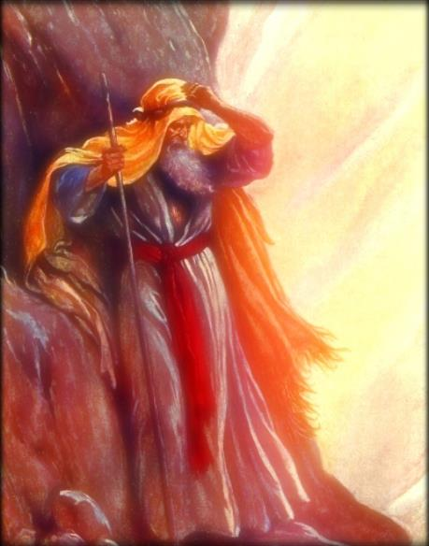
ISIFISO SOKWAZI INKAZIMULO KANKULUNKULU
“Khona-ke uMose wathi, “Manje ngibonise inkazimulo yakho.” ( Eks. 33:18 )
UMose wabuza: “Ngibonise inkazimulo yakho (Ex. 33:18)
UNkulunkulu waphendula: Ngizokubonisa okuhle kwami (Ex. 33:19)
Inkazimulo kaNkulunkulu yinhle yakhe, okungukuthi, isimilo sakhe.
Lokho uNkulunkulu ambonisa kona kwakuyisimo sakhe (Ex. 34:6-7)
U-Ellen G. White wengeza ngokuthi inkazimulo kaNkulunkulu ihlanganisa ukunika abantwana bakhe amandla; ukugona izoni eziphendukayo; kanye lokuhlinzeka ngakho konke okudingekayo ekuguquleni kwabo..
Ngakho, “inkazimulo” yethu iyikubonakalisa isimo sikaNkulunkulu ezimpilweni zethu (2 Kor. 1:12; 3:18).
Uma sibheka esiphambanweni, silesambulo esikhulu kulazo zonke senkazimulo kaNkulunkulu, ubuhle bakhe, kanye nesimo sakhe.

Slide 9

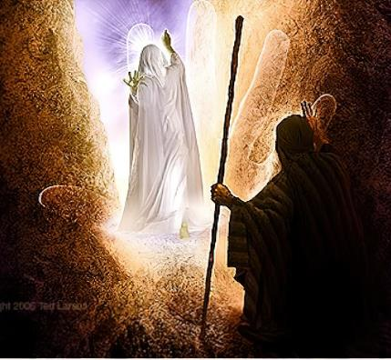
UMBONO WENKAZIMULO KANKULUNKULU
“Wadlula phambi kukaMose, wamemeza, “UJehova, uJehova, uNkulunkulu olobubele lolomusa, ophuza ukuthukuthela, ogcwele uthando lokuthembeka.” ( Eksodusi 34:6 )
UNkulunkulu wabonisa inkazimulo yakhe kuMose ngesikhathi sesikhombisa ekhuphuka eNtabeni yaseSinayi. Kungaziphi izikhathi langayiphi injongo uMose azibeka phambi kukaNkulunkulu?
1
2
3
4
5
6
7
Ukwamukela izisekelo zesivumelwano (Ex. 19:3-7)
Ukuze aphe impendulo yabantu futhi athole iziyalezo ngomzimba weNkosi yaseSinayi (Ex. 19:8-14)
Ukuze uthole iziqondiso ezintsha (Ex. 19:20-25)
Ukuthola imithetho ehambisanayo (Ex. 20:21; 24:3)
Ukwamukela iMithetho Elitshumi ebhalwe ngomunwe kaNkulunkulu, kanye lesifanekiso seNdawo Engcwele (Ex. 24:12, 18; 32:15)
TUkukhulumela isono sethole legolide (Ex. 32:30)
Ukuze uNkulunkulu ambonise inkazimulo yakhe, futhi amukele izibhebhe ezintsha ezineMithetho Elitshumi (Ex. 34:1-5)
Umbono wenkazimulo kaNkulunkulu wabonakala uyikuzimemezela yena ngokwakhe isimo sikaNkulunkulu ( Eks. 34:6-7 ). Ngalamazwibela othando lukaNkulunkulu, uMose wakhonza ( Eks. 34:8; 1 Johane 4:19 ). Ekugcineni, uNkulunkulu wasiqinisekisa isivumelwano sakhe lo-Israyeli futhi wasithethelela isigameko sethole.

Slide 10

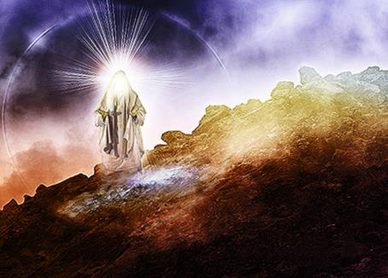
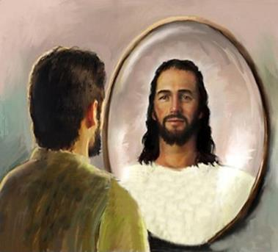
IMPUMELA WOKUBONA INKAZIMULO KANKULUNKULU
“Kwathi uMose esehla entabeni yaseSinayi ephethe izibhebhe ezimbili zomthetho ezandleni zakhe, wayengazi ukuthi ubuso bakhe babukhazimula, ngokuba wayekhulumile loJehova. ( Eks. 34:29 )
UMose wayekhulume loNkulunkulu “ubuso lobuso” izikhathi ezinengi ngaphambilini, futhi kuze kube yileso sikhathi, ubuso bakhe babungakaze bukhanye. Yini eyayishintshile kulokhu? Qaphela, ngaphezu kwalokho, ukuthi untshintsho lwaqhubeka phakathi kwesikhathi eside (Ex . 34:34-35).
Manje uMose wayesemazi kangcono uNkulunkulu. Ubungane bakhe base bufinyelele ukuvuthwa. Wayecabangisise ngenkazimulo kaNkulunkulu, futhi leyo nkazimulo yamguqula.
Enanela lesi siqephu, uPawulu usimema ukuba silingise uMose futhi sizindle ngenkazimulo kaNkulunkulu ukuze aguqulwe njengaye ( 2 Kor. 3:12-18 ).
UMose uyisibonelo esibonisa lokho uNkulunkulu angasenzela kona lapho simvumela ukuba aguqule ubuntu bethu futhi asibumbe sifane naye.

Slide 11

EGW (In Heavenly Places, August 22)
“Ucabanga ukuthi uNkulunkulu wamsola uMose ngokucabangela kwakhe na? Hatshi, ngempela. UMose akazange enze lesi sicelo ngenxa yokufuna ukwazi. Wayelenhloso. Wabona ukuthi ngamandla akhe wayengeke akwazi ukwenza umsebenzi kaNkulunkulu ngokwamukelekayo. Wayesazi ukuthi uma engathola umbono ocacileyo wenkazimulo kaNkulunkulu, wayezavunyelwa ukuba aqhubekele phambili emsebenzini wakhe obalulekileyo, hatshi ngamandla akhe onke, ngaphandle komphefumulo wakhe wonke, kodwa adonsele iNkosi ngamandla akhe onke amandla kaNkulunkulu. UNkulunkulu wayefisa ukwazi okwengeziwe Ngaye, ukuze ezwe ukuba khona kwaphezulu kuseduze kuzo zonke izimo eziphuthumayo loba ukudideka okwabangela uMose ukuba acele ukubona inkazimulo kaNkulunkulu.”

