Slide 1

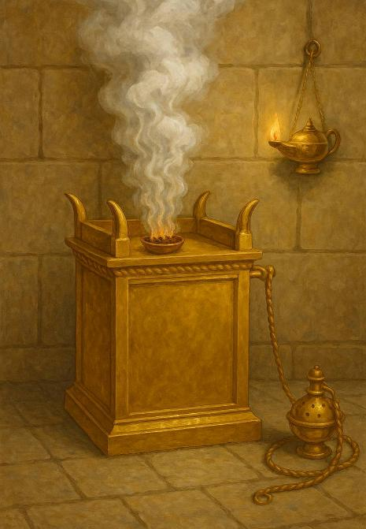
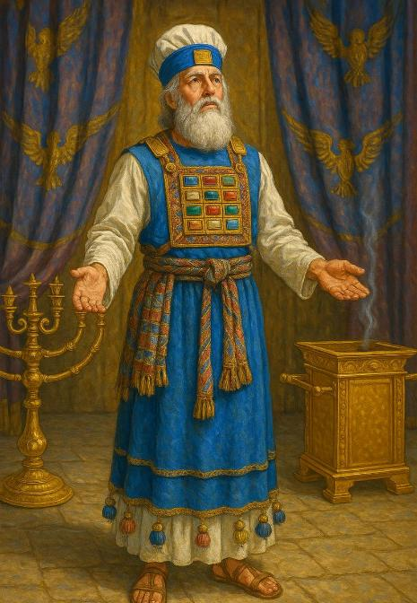
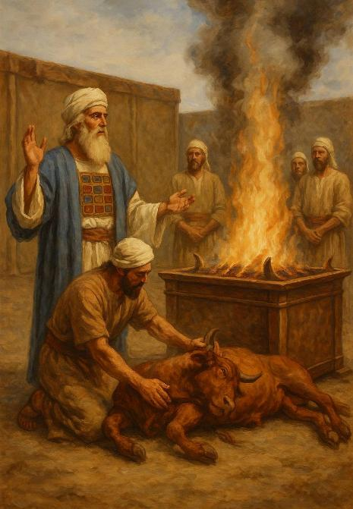
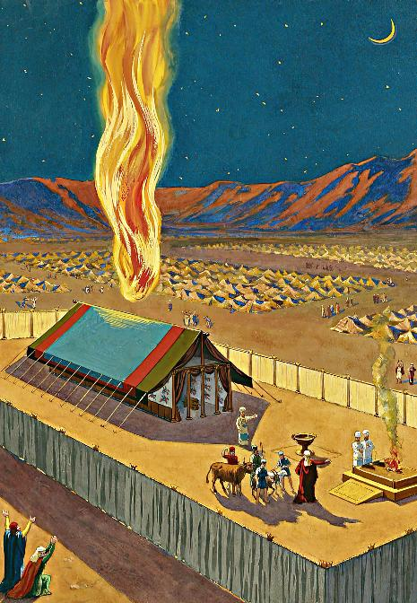
ITABENEKELE
Isifundo setshumi lantathu Mpandula ilanga lamatshumi amabili lesikhombisa ku2025

Slide 2
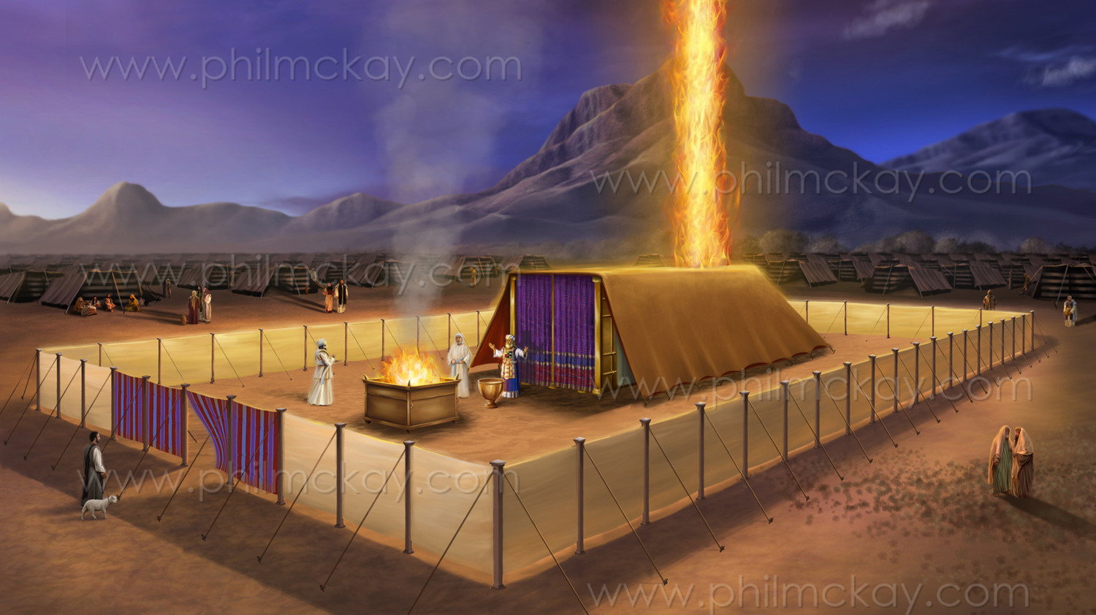
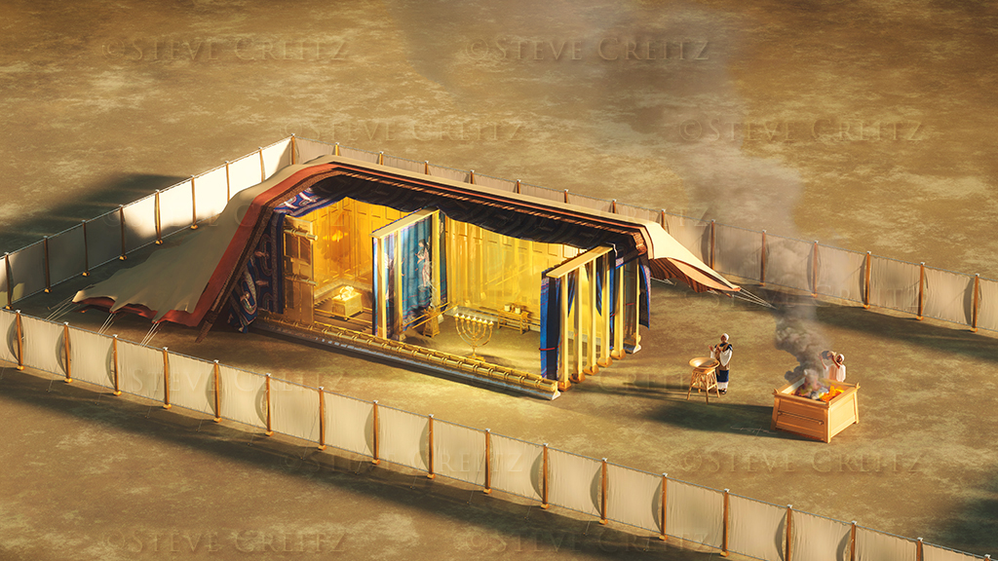
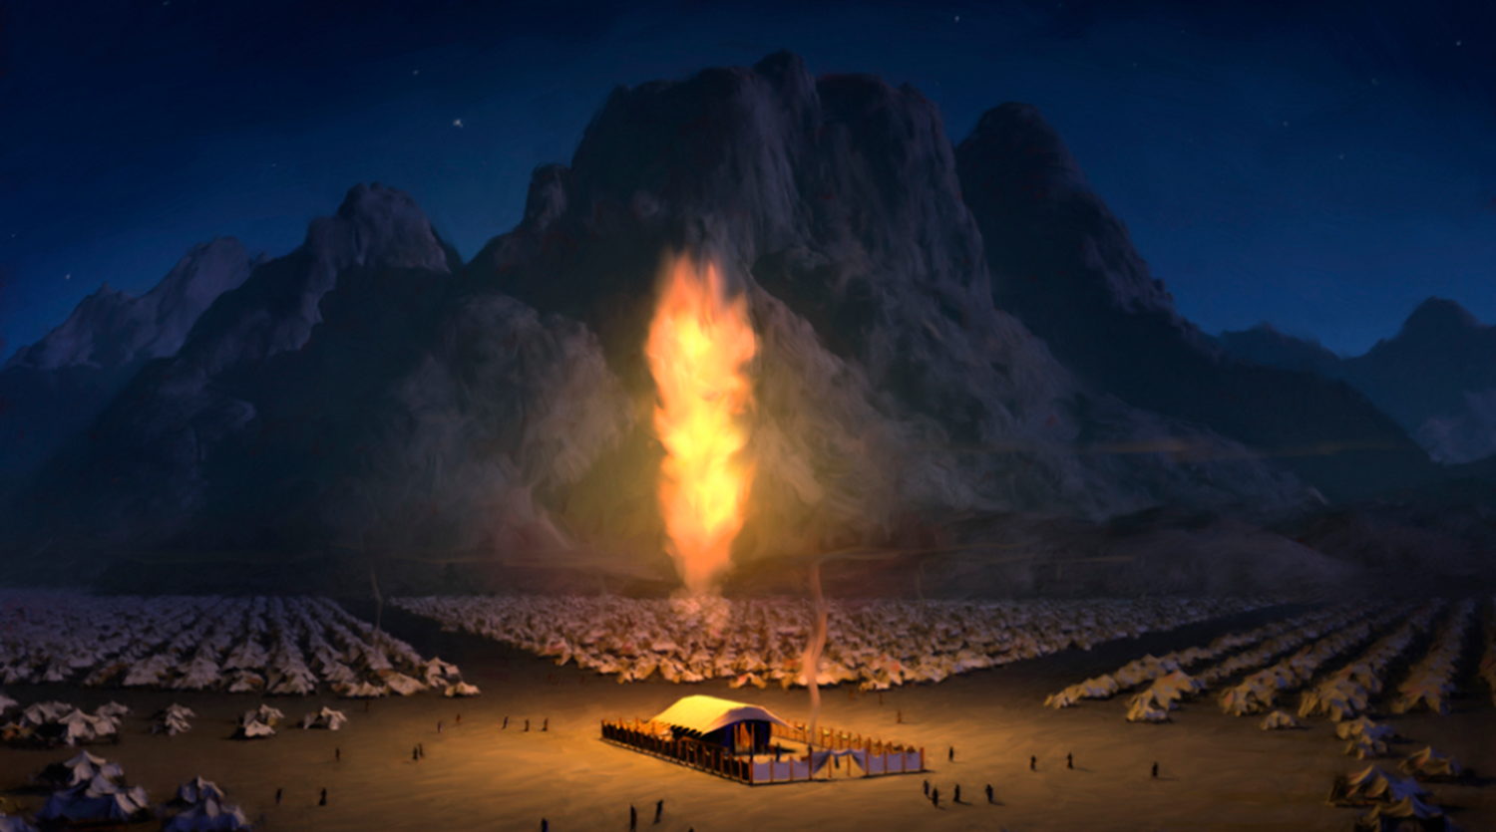
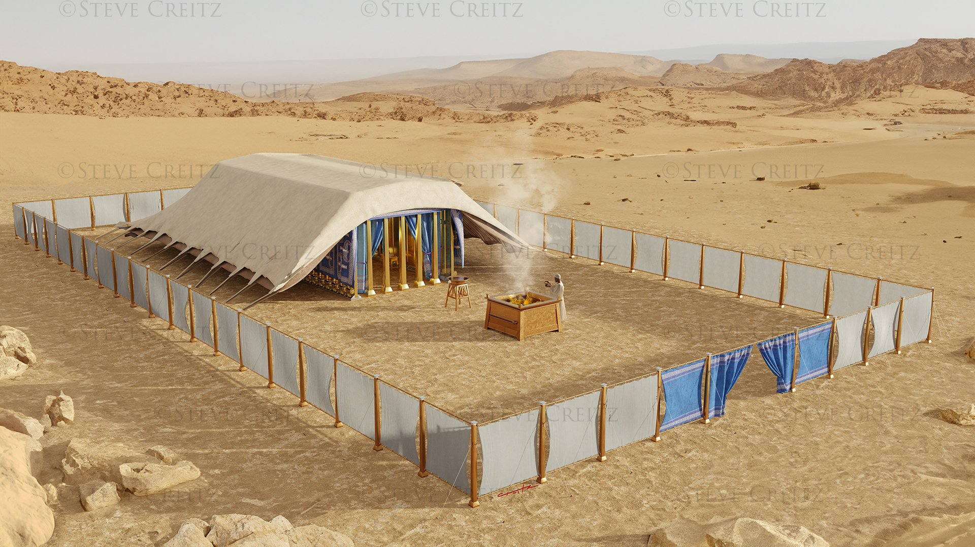
““Khona iyezi lasibekela itabernakele, inkazimulo kaJehova yagcwalisa itabernakele. […] Ngokuba iyezi likaJehova laliphezu kwetabernakele emini, lomlilo wawuphezu kwalo ebusuku, phambi kwamehlo ayo yonke indlu ka-Israyeli ezinkambeni zabo zonke.
Eksodusi 40:34, 38

Slide 3

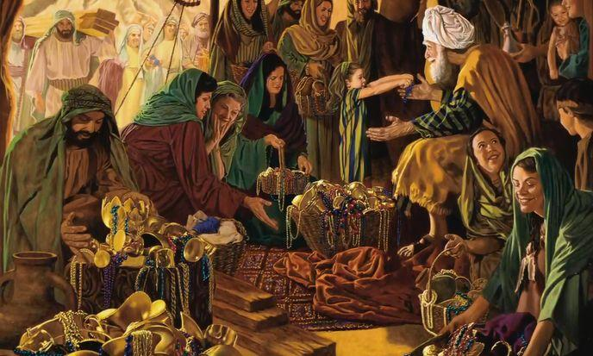

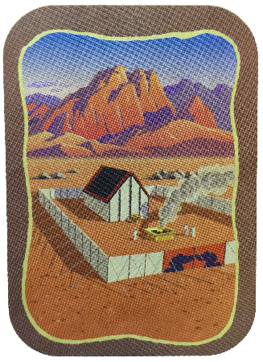
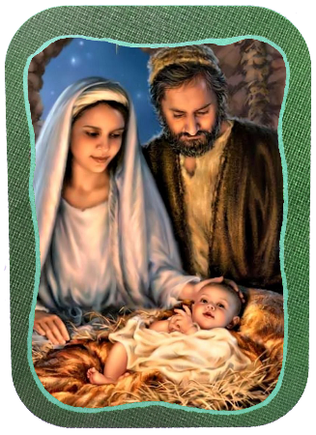
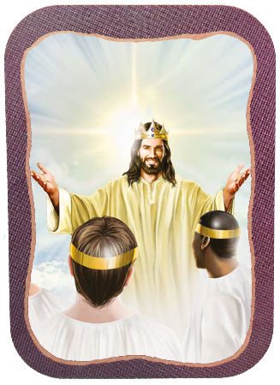







Izahluko zokugcina zika-Eksodusi zinikezwe incazelo ecacileyo yokwakhiwa lokunikelwa kweTabernakele.
Lezi kwakuyizikhathi ezikhethekileyo, lapho abantu bahlanganyela ngenjabulo, benikela—lowo lalowo ngendlela ababengenza ngayo—kulo msebenzi omkhulu kaNkulunkulu.
Isizathu esikhulu uNkulunkulu asinikezayo sokwakhiwa kwaleliThempeli eliphathekayo isifiso Sakhe sokuhlala phakathi kwabantu Bakhe (Eks. 25:8). Lesi sifiso sagcwaliseka kumuntu kaJesu, futhi siyofezeka ngokugcwele lapho sonke silaye eMhlabeni Omutsha
Ukulungiselela
  Isabatha (Eksodusi 35:1-3)
  Umnikelo wesihle (Eksodusi 35:4-36:7)
Itabanekele:
  Ukwakha (Eksodusi 36:8-39:43)
  Ukuzimisela (Eksodusi 40:1-38)
Amanye amaTabanekele:
  UJesu leJerusalema elitsha

Slide 4
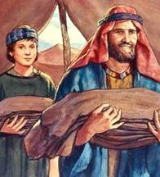
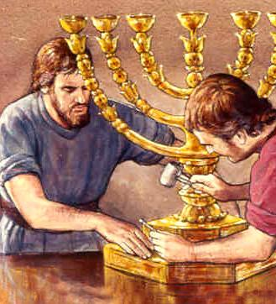
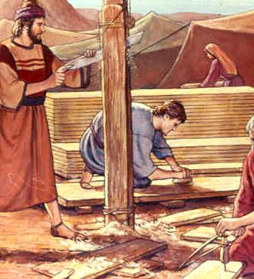
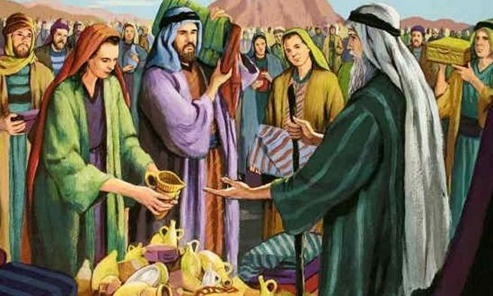
UKULUNGISELELA

Slide 5

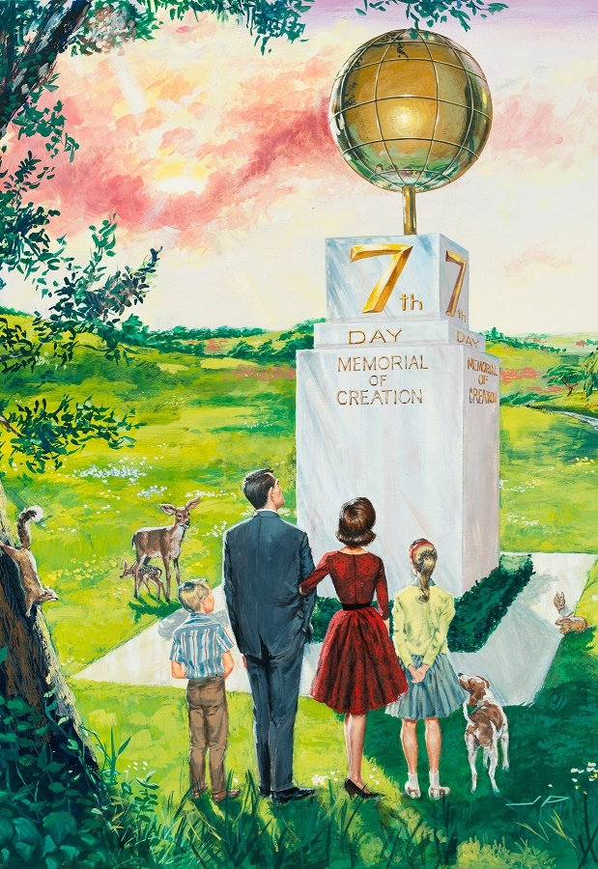
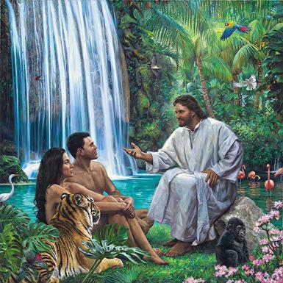
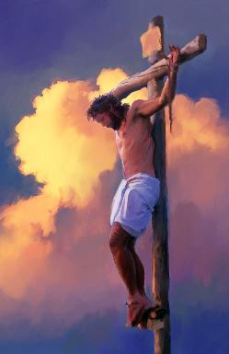
ISABATHA
“Izinsuku eziyisithupha kuyakwenziwa umsebenzi, kepha usuku lwesikhombisa luyakuba lungcwele kini, usuku lwesabatha lokuphumula kuJehova, yilowo lalowo owenza umsebenzi ngalo makabulawe” ( Eksodusi 35:2 ).
Ngemva kokubona inhlansi yenkazimulo kaNkulunkulu, uMose wadlulisela kubantu “lokho uJehova alaye ngakho” ( Eks. 35:1, 4 ). Le milayo ihlanganisa ubuhlobo loNkulunkulu ngesikhathi (iSabatha) lasemkhathini (iTabernakele).
UNkulunkulu wabekela eceleni iSabatha njengesikhathi esikhethekileyo sokuba sijabulele ukuba laye eNdalweni ( Gen. 2:1-3; Eks. 20:11 ), futhi wakhumbuza uIsrayeli ngalokhu ngaphambi nje kokuba amemezele iMithetho Elishumi ( Eks. 16:22-29 ).
ISabatha lisikhumbuza ukuthi uNkulunkulu unguMdali loMhlengi wethu ( Dut. 5:15 ), futhi lisiyisa esikhathini esizayo lapho singajabulela ukuba naye phakade ( Isaya 66:22-23 ).

Slide 6

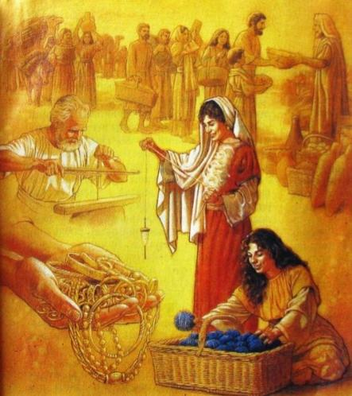
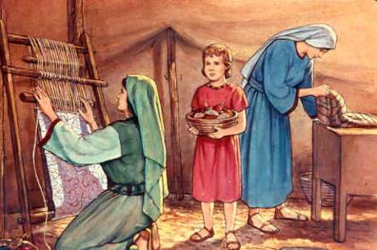
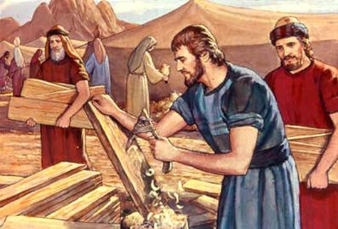
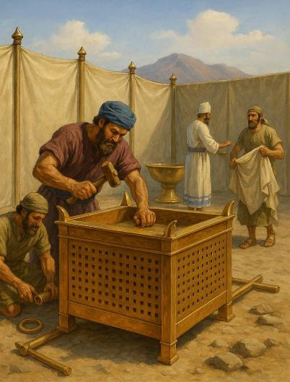
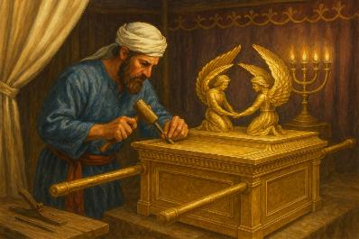
UMNIKELO NGOKUTHANDA
““Kulokho elilakho lithathele uJehova umnikelo, yilowo lalowo othanda ukuletha kuJehova umnikelo wegolide, lesiliva, Lowethusi [ ...] bonke abahlakaniphileyo phakathi kwenu kabeze, benze konke uJehova alaye ngakho” ( Eksodusi 35:5, 10 )
Kwakulezindlela ezimbili zokunikela emsebenzini wetabernakele: ukunikela ngezinto zokwakha kanye Lomsebenzi wokwenza.
Kwasetshenziswa ngaphezu kwethani legolide, amathani angaba ngu-3,75 esiliva, lamathani angaba ngu-2,5 ethusi, ngaphezu kokhuni lamalembu ezihlukahlukeneyo ( Eks. 38:21-31 ).
Kuvelaphi konke lokhu? Okunengi kwakho kwavela kulokho u-Israyeli akuthatha kwabaseGibhithe lapho behamba (Eks. 11:2).
Ngaphezu kwalokho, kwakudingeka umsebenzi wabasiki bengqephu, abathungi nabathungi, ababazi, ababazi bezinkuni, abakha ubucwebe, njalonjalo
Bonke babezimisele ukusebenzelana Labanye kangangokuthi uBhezaleli, u-Aholiyabe, Lezinye izisebenzi bacela uMose ukuba avimbele abantu ekuletheni iminikelo ( Eks. 36:3-7 ).
Ukuze kufezwe umsebenzi, uMoya oNgcwele wanika zonke izisebenzi ezihilelekile izipho ( Eks. 35:30-36:2 ). Ngokufanayo, uyaqhubeka ngokuphaa izipho ezidingekayo kubo bonke ababambisene lomsebenzi kaNkulunkulu

Slide 7

“UNkulunkulu ubeke amadoda labesifazane ukuba babe lezipho eziligugu. Kwabahlukahlukeneyo Uphe izipho ezihlukahlukeneyo. Akubona bonke abalamandla afananayo obuntu loba ukujula kolwazi okufanayo. Kodwa yilowo lalowo kufanele asebenzise izipho zakhe enkonzweni yeNkosi, kungakhathaliseki ukuthi lesi sipho singase sibonakale sisincane kangakanani. Umphathi othembekile uhweba ngokuhlakanipha ngempahla ayiphathisiwe.”
E.G.W. (The Upward Look, December 31)
EGW (The Upward Look , December 31)

Slide 8
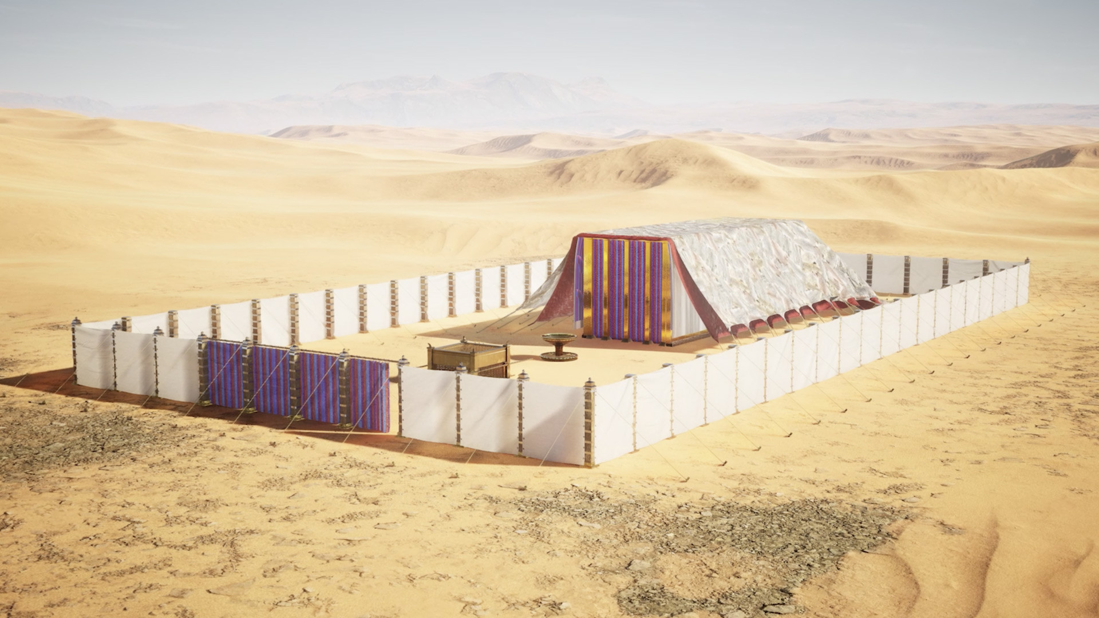
ITABENEKELE

Slide 9

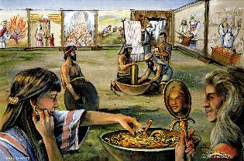
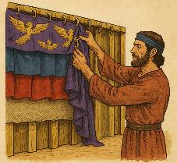
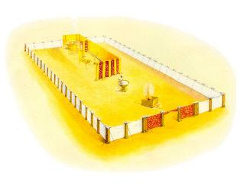
UKWAKHIWA
““UMose wawukhangela umsebenzi, bheka, ukuthi bawenzile njengalokho uJehova emyalile, uMose wababusisa.” ( Eksodusi 39:43)
Yiziphi izici ezazidingeka ukuze iTabernakele lebandla liigcwalise imisebenzi yalo?
Itabernakele (Ingcwele leNgcwelengcwele)
UMphongolo wegolide
Itafula lesinkwa
Uthi lwesibani
I-altare lempepho
I-altare lomnikelo wokutshiswa
Udengezi lethusi
Igceke langaphandle
I-efodi
Isikhwama sesifuba
Izingubo eziseleyo

Slide 10

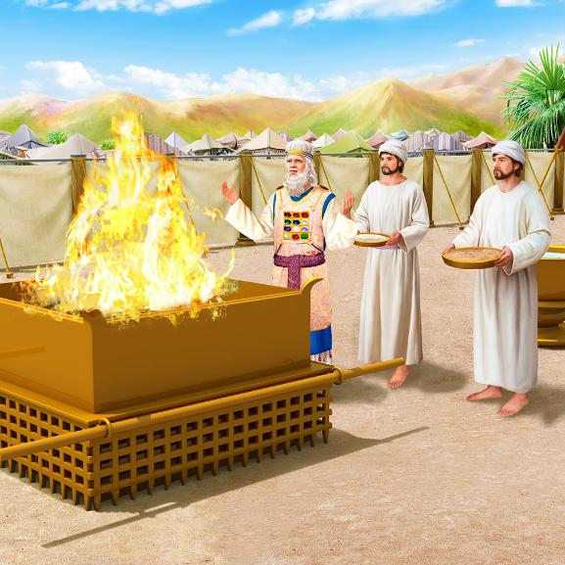
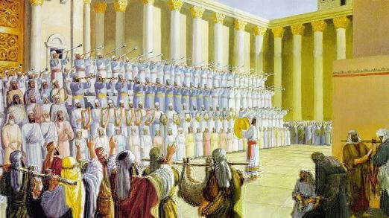
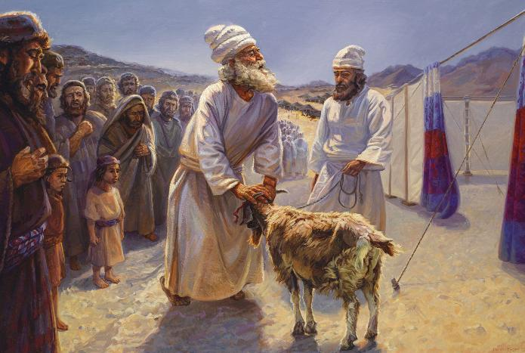
UKWAKHIWA
Lapho selakhiwe, kwenziwa izinkonzo ezimbili ezihlukeneyo endaweni engcwele (iTabernakele legceke): usuku losuku. Imikhosi yabo eyahlukeneyo, ehlanganiswe ndawonye, isifundisa ukuthi:
UNkulunkulu uyasizonda isono
UNkulunkulu usindisa isoni
UNkulunkulu uzabhubhisa ababi
UNkulunkulu usiqinisekisa ngekusasa elikhazimulayo
Ngenkonzo yansuku zonke, uNkulunkulu wabonisa indlela athethelela ngayo ngomusa isoni: ngokufa kwenyamazana ezingelacala, “iWundlu likaNkulunkulu elisusa izono zezwe” (Joh 1:29).
Ngenkonzo yaminyaka yonke (uSuku Lokubuyisana), uNkulunkulu wabonisa indlela ayosiqeda ngayo isono endaweni yonke, ebonisa ikhambi lokugcina lenkinga yobubi ( IHu. 73:17 ).
INdawo Engcwele futhi yayiyindawo yokukhulekela uNkulunkulu, ukumdumisa, lokubonisa ukubonga.

Slide 11

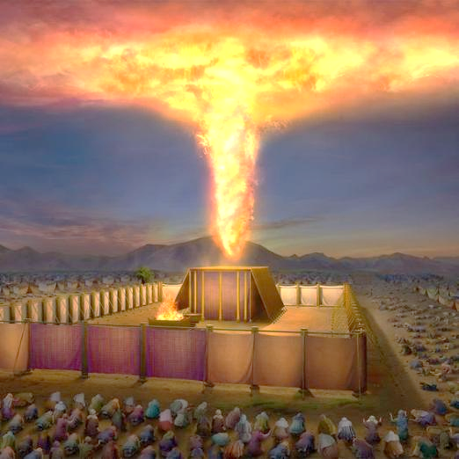
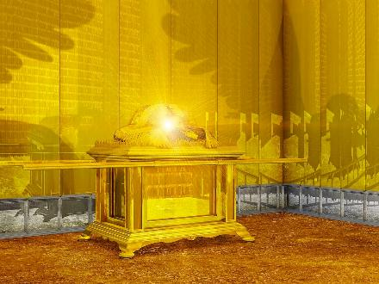
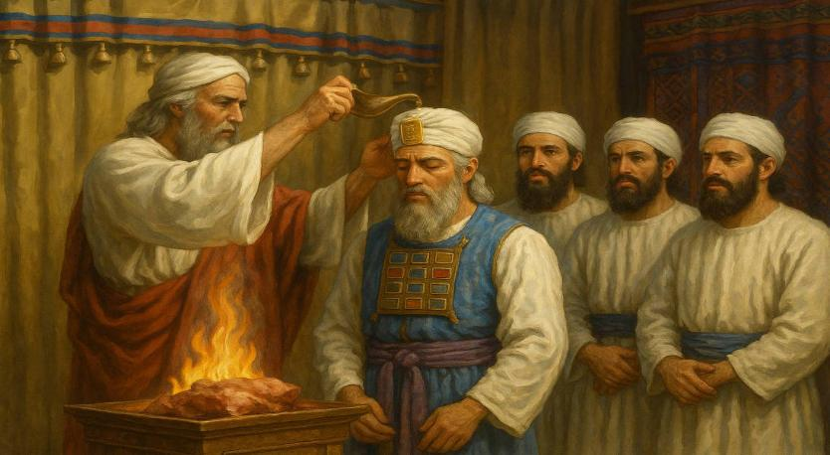
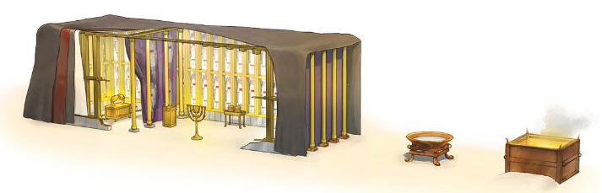
UKUZINIKELA
“Iyezi lasibekela itende lokuhlangana, inkazimulo kaJehova yagcwalisa itabernakele.” ( Eksodusi 40:34 )
Incwadi ka-Eksodusi icina ngokunikelwa kweNdawo engcwele labapristi bayo. Umlingiswa oyinhloko walesi sahluko ngokungathandabuzekiyo nguNkulunkulu, ogcwalisa yonke into ngobukhona bakhe obukhazimulayo (Eks. 40:34). LobuBukhona baqhubeka buhambisana letabernakele efwini laseShekina (ukubonakala kwenkazimulo kaNkulunkulu phakathi kwamakherubi omphongolo).
Ngemva kwezinyanga zomsebenzi, indawo engcwele yamiswa ngosuku lokuqala lwenyanga yokuqala yomnyaka wesibili ngemva kokuphuma kwabo eGibhithe (Eks. 40:2, 17). Konke kwahlelwa ngohlelo (umphongolo, iveli, itafula, uthi lwesibani, i-altare legolide, i-altare lethusi, umcengezi), futhi kwangcweliswa (Eks. 40:9).
Ekugcineni, u-Aroni lamadodana akhe bagqokiswa izingubo zabo zobupristi, futhi begcotshelwe umsebenzi wabo (Eks. 40:12-15).

Slide 12

EGW (Patriarchs and Prophets, p. 349)
“Alukho ulimi olungachaza inkazimulo yesehlakalo esivezwa endlini engcwele—izindonga ezinamekwe ngegolide ezibonisa ukukhanya okuvela othini lwezibani lwegolide, imibala ekhazimulayo yamakhethini afekethiswe ngokucebileyo lezingelosi zawo ezikhazimulayo, itafula, le-altare lempepho, elibenyezela ngegolide; ngale kweveli lesibili umphongolo ongcwele, locwecwe lwawo olucwebezelayo, locwecwe lwawo lwe-Shekins. ubukhona bukaJehova; konke kodwa ukubonakaliswa kalufifi kwenkazimulo yethempeli likaNkulunkulu ezulwini, isikhungo esikhulu somsebenzi wokuhlenga umuntu.”

Slide 13
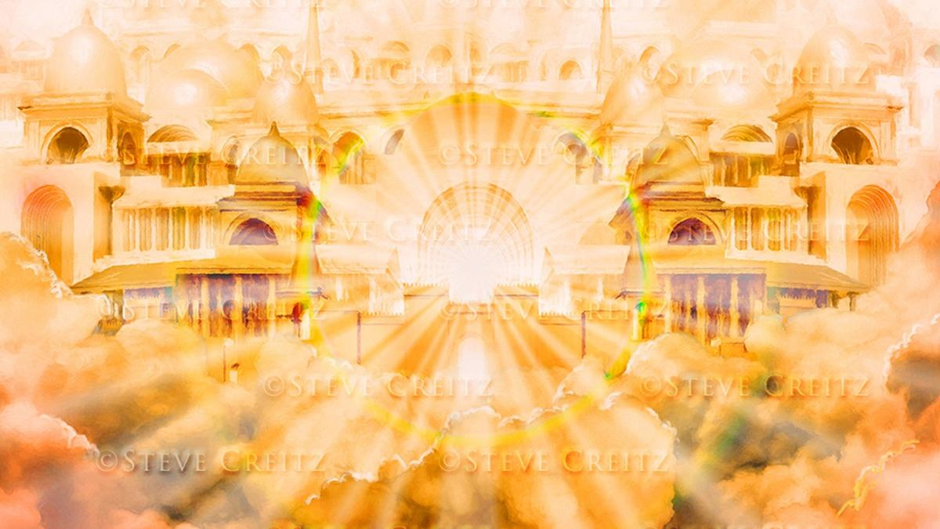
AMANYE AMATABELENEKE

Slide 14
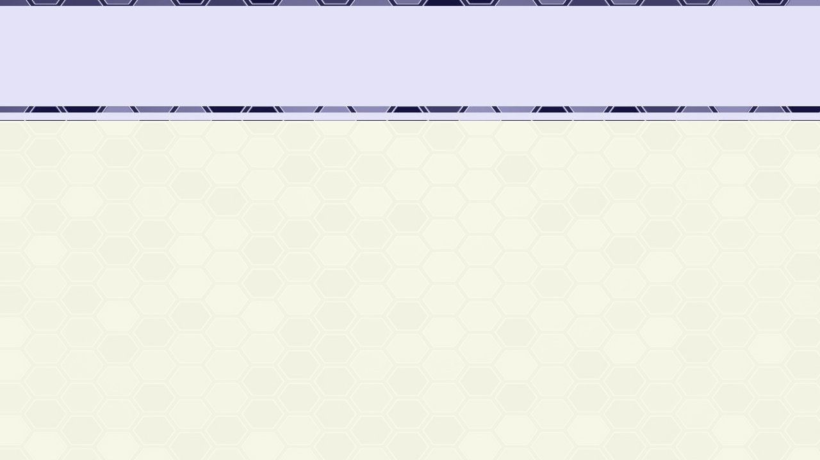
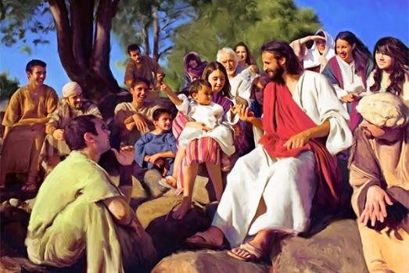

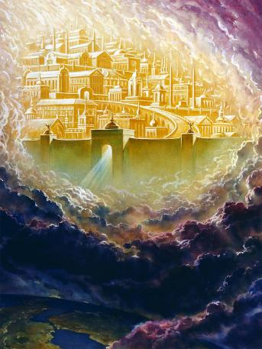
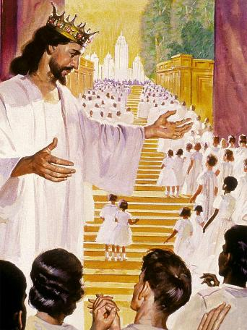
UJESU LEJERUSALEMA ELITSHA
“ULizwi waba yinyama, wakha phakathi kwethu” (Johane 1:14a)
“Ngezwa izwi elikhulu livela esihlalweni sobukhosi lithi: “Bheka! Indawo yokuhlala kaNkulunkulu manje isiphakathi kwabantu, futhi uyohlala labo. Bayoba ngabantu bakhe, futhi uNkulunkulu ngokwakhe uyoba labo futhi abe nguNkulunkulu wabo’” ( IsAmbulo 21:3)
UJohane 1:14 utsho ngokwezwi lezwi ukuthi uJesu waba yinyama futhi “wahlala itabernakele”, (wayitabernakele) phakathi kwethu. Ngokuthatha kwakhe isimo somuntu, uJesu, uNkulunkulu ongunaphakade, wagcwalisa isifiso sakhe sokuhlala ngokwenyama phakathi kwethu. Waba nguEmanuweli, uNkulunkulu unathi (Mt. 1:23).
NgoMoya oNgcwele, uNkulunkulu uyaqhubeka ehlala nathi namuhla (Mt. 18:20; 1 Korinte 3:16).
Kodwa usuku luzofika maduze lapho siyokwazi khona ukuma ubuso nobuso noNkulunkulu wethu futhi sihlale Naye etabernakele lobukhosi asilungisele lona: IJerusalema Elisha (IsAm. 21:3).
Lokhu kuzokwenzeka lapho uHlelo Lwensindiso seluqediwe, futhi ububi buqedwa ngokuphelele..

Slide 15

EGW (The Desire of Ages, p. 23)
“UNkulunkulu wamlaya uMose ngo-Israyeli, wathi: “Mabangenzele indlu engcwele; ukuze ngihlale phakathi kwabo” ( Eksodusi 25:8 ) Wahlala endaweni engcwele phakathi kwabantu Bakhe. Kukho konke ukukhathala kwabo enkangala, uphawu lobukhona Bakhe lwalulabo. Ngakho-ke uKristu wamisa itabernakele Lakhe phakathi kwethu kobuntu. Wamisa itende Lakhe eceleni kwetende futhi Asenze sijwayelane lesimilo Sakhe, ukuze asenze sijwayelane labantu Bakhe.”

