Slide 1
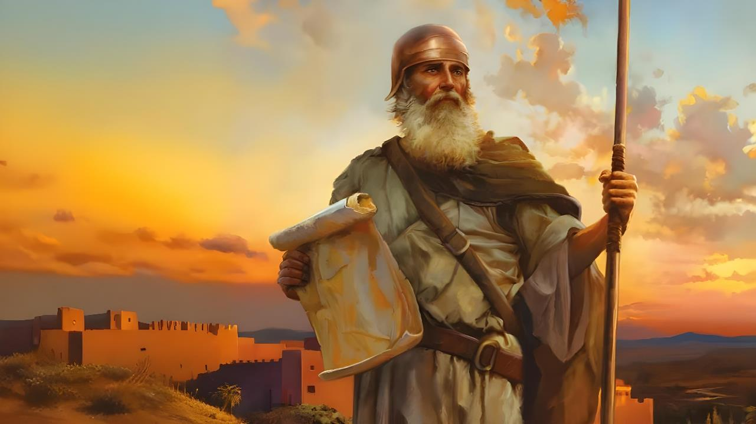

INDLELA YEMPUMELELO
Isifundo sakuqala kuLwezi ilanga lesine ku2025

Slide 2
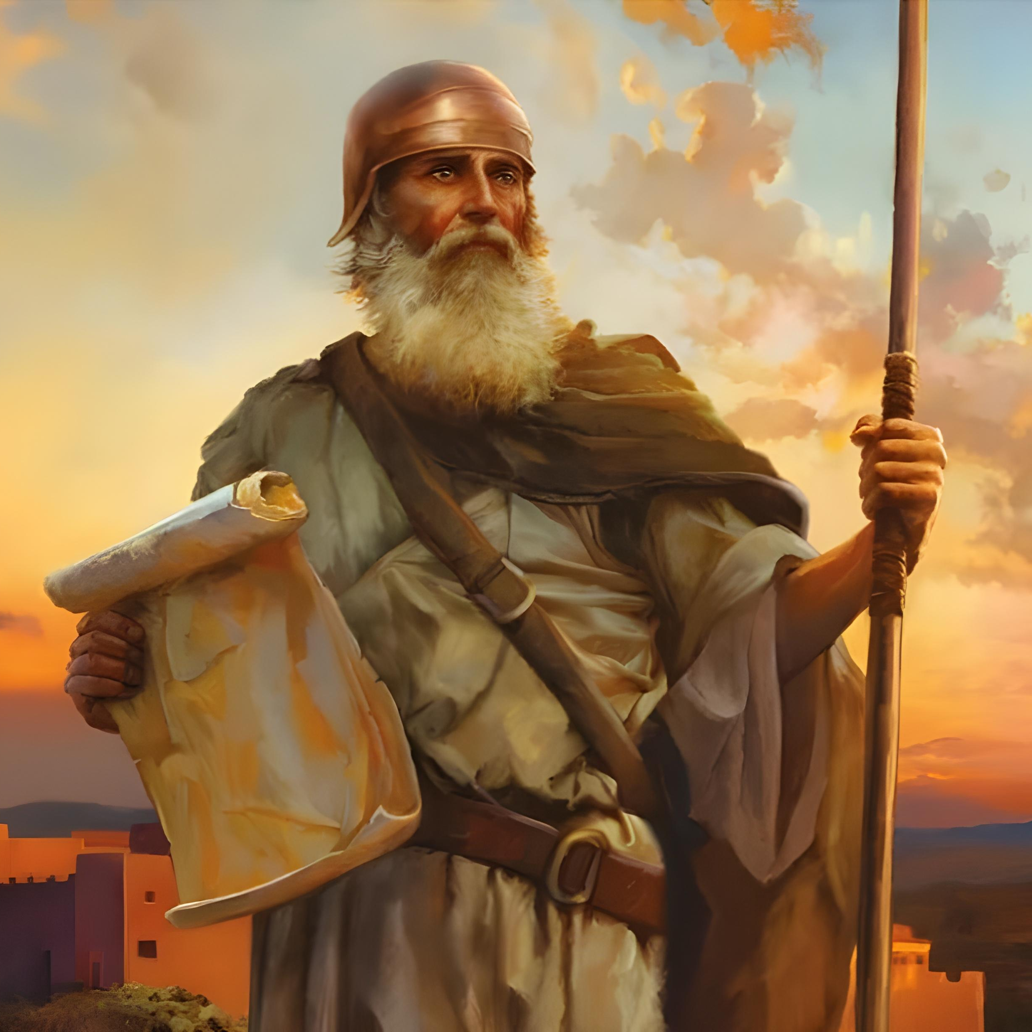
“ ‘Qina kuphela, ume isibindi kakhulu, ukuze uqaphele ukwenza ngokomthetho wonke uMose inceku yami yakulaya ngakho; ungaphambuki kuwo uye kwesokunene loba ngakwesokhohlo, ukuze uphumelele lobaphi lapho uya khona’ ”. Joshuwa 1:7

Slide 3

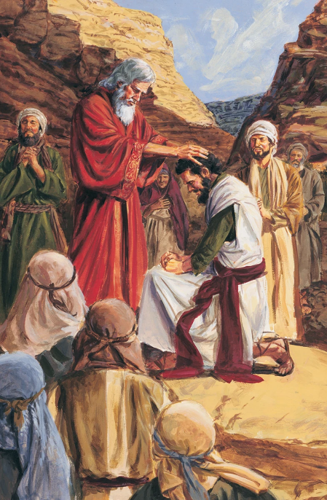
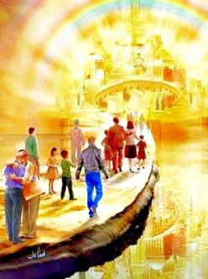


Ngemva kweminyaka engu-40 yokuzulazula, kuye kwavela isizukulwane esitsha, futhi sesifikile isikhathi sokunqoba iZwe Lesithembiso. UMose ufile, futhi umholi omutsha okhethwe nguNkulunkulu kulo msebenzi: nguJoshuwa.
Ngaphambi kokuqala ukunqoba, bobabili umholi omutsha lesizukulwane esitsha babizelwe ukuthembela ngokupheleleyo kuNkulunkulu.
Njengoba isizukulwane samanje (thina) simi emngceleni weKhanani lasezulwini, isimemezelo saphezulu sisakhala ngamandla: “Qina kuphela, ume isibindi kakhulu” ( Josh. 1:7 ).
Isingeniso ( Joshuwa 1:1-3 ):
UMose loJoshuwa
Isakhiwo sencwadi
Umsebenzi kaJoshuwa (Joshuwa1:4-9):
  Ilifa lezithembiso
  Amandla lesibindi
  Impumelelo yomsebenzi

Slide 4

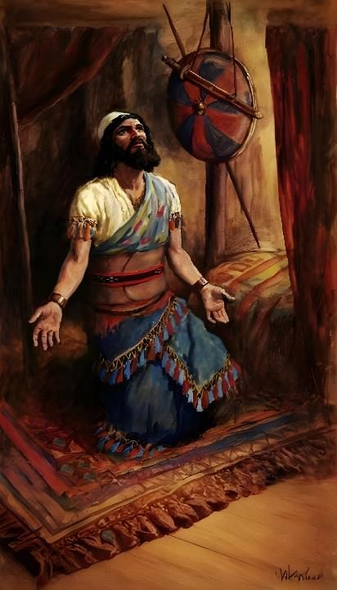
ISINGENISO
(JOSHUWA 1:1-3 )

Slide 5







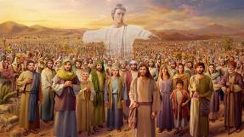
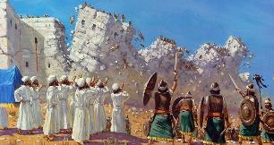








UMOSI LO JOSHUWA
UNkulunkulu wabonakala kubo ( Eks. 3:2-5; Josh. 5:13-14 ).
Bacelwa ukuba bakhumule izicathulo zabo ( Eks. 3:5; Josh. 5:15 )
UNkulunkulu wabathembisa ukuthi uzakuba labo (Ex. 3:12; Josh. 1:5)
Benzaumkhosi wePhasika Ex. 12:21-23; Josh. 5:10)
(Badabula emanzini emhlabathini owomileyo Ex. 14:21-22; Josh. 3:14-17)
Kokunye kwafika imana, kwelinye laphela (Ex . 16:4-5, 31; Josh. 5:11-12)
Bathumela izinhloli ukuba ziyohlola izwe (Num. 13:1-3; Josh. 2:1)
“Kwathi emva kokufa kukaMose inceku kaJehova, uJehova wathi kuJoshuwa indodana kaNuni, inceku kaMose.” (Joshua 1:1)
Esahlukweni sokuqala sikaJoshuwa, kukhulunywa ngoMose izikhathi ezilishumi lanye, futhi igama lakhe livela ngokuphindaphindiweyo kuyo yonke incwadi
Kulokufanana okunengi phakathi kwalaba baholi ababili:
Langoba isahluko sokuqala sikaJoshuwa sibhala ngoguquko phakathi kwabaholi ababili abakhulu bakwa-Israyeli, akasuye umlingiswa weqiniso wale ncwadi. Umuntu obaluleke kakhulu nguNkulunkulu uqobo, amazwi akhe avula incwadi, futhi obuholi bakhe buyisoqokoqela sendaba. Akuthandabuzeki ukuthi wayengubani umholi weqiniso ka-Israyeli

Slide 6

“UJoshuwa manje wayesengumholi owaziwayo wakwa-Israyeli.Wayesaziwa kakhulu njengeqhawe, futhi iziphiwo zakhe lemfanelo zakhe zazibaluleke kakhulu kulesi sikhathi emlandweni wabantu bakhe.Isibindi, ukuqina, lokuphikelela, okutshetshayo, ukungonakali, ukunganaki izithakazelo zobugovu ekunakekeleni kwakhe labo ababezinikele esandleni sakhe, futhi, ngaphezu kwakho konke, uNkulunkulu ophilayo wayephefumulelwe ngumuntu ophilayo. ekhethwe ngokwaphezulu ukuba ahole amabutho akwaIsrayeli ekungeneni kwawo eZweni Lesithembiso ehlane wayesebenze njengondunankulu kuMose, futhi ngokwethembeka kwakhe okulokuthula lokungazenzisi, ukuqina kwakhe lapho abanye bentengantenga, ukuqina kwakhe ukuze alondoloze iqiniso phakathi kwengozi, wayephe ubufakazi bokufaneleka kwakhe ukuba athathe isikhundla sokuba lizwi likaNkulunkulu esikhundleni sikaMose.”.
EGW (Patriarchs and Prophets, p. 481)

Slide 7

ISIMISO SENCWADI
UMose inceku yami usefile, manje wena labo bonke laba bantu zilungiseleleni ukuwela umfula iJordani lingene ezweni engizabanika lona, abantwana bakwa-Israyeli.”
Incwadi kaJoshuwa iveza ukugcwaliseka kwezithembiso uNkulunkulu azenza kuIsrayeli lapho ebakhipha eGibhithe, okuyikuthi, ukubanika iKhanani. Kokubili isethulo (isahluko 1) kanye lencwadi ngokwayo zihlukaniswe izigaba ezine ezinkulu:
UKUWELA EKHENANI
Joshuwa 1:1-9
Joshuwa 1:1-5:12
THATHA IKHENANI
Joshuwa 1:10-11
Joshuwa 5:13-12:24
GABA UMHLABA
Joshuwa 1:12-15
Joshuwa 13:1-21:45
UKUSEBENZA ngokuthobela uMthetho kaNkulunkulu
Joshuwa 1:16-18
Joshuwa 22:1-24:33

Slide 8
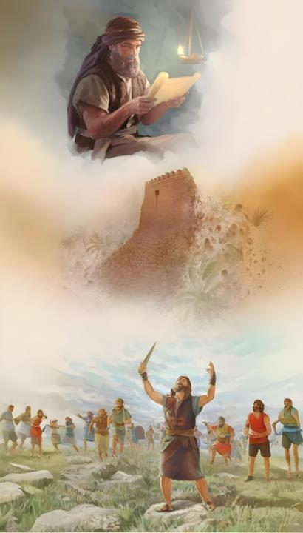
UMSEBENZI KAJOSHUWA
( JOSHUWA 1:4-9 )

Slide 9

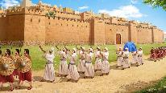
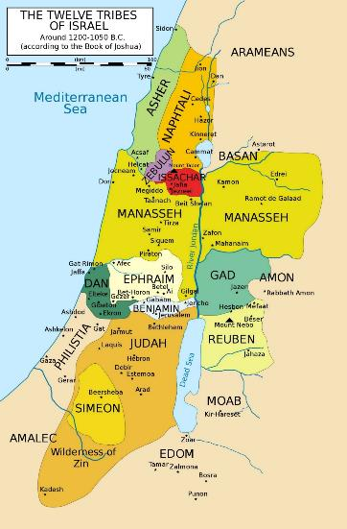
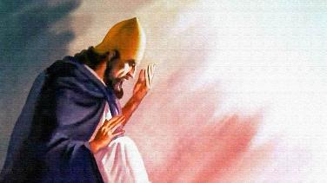
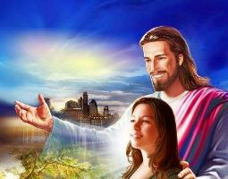
UKWAMUKELA ILIFA LEZITHEMBISO
“Ngiyakulinika zonke izindawo eliyakunyathela kuzo ngenyawo zenu, njengalokho ngathembisa uMose” (Joshuwa 1:3)
KuJoshuwa 1:3, uNkulunkulu ukhuluma esikhathini samanje esingokwesiprofetho. Ukhuluma ngeKhanani njengokungathi selinikezwe u-Israyeli kakade. Lokhu kutsho ukuthi uNkulunkulu wabapha isiqinisekiso esipheleleyo sokuphumelela kokunqoba.
EUPHRATES
Wasebakhumbuza ngemingcele ukunqotshwa okuyofinyelela kuyo ( Josh. 1:4 ): isiqetshana esiphakathi koMfula iJordani (empumalanga) loLwandle LwaseMedithera (entshonalanga), kusukela enkangala (eningizimu) kusiya eMfuleni i-Ewufrathe (enyakatho).
Uthe esephendukela kuJoshuwa futhi amqinisekise ukuthi uma elamandla futhi elesibindi, akekho oyokwazi ukumelana laye ( Josh. 1:5-6 ).
MEDITERRANEAN
JORDAN
Kodwa ukunqoba akugxilanga emizamweni kaJoshuwa, kodwa phambi kukaNkulunkulu. Wamqinisekisa, njengoba eqinisekisa ngamunye wethu: “Ngizoba lawe.” ( Josh. 1:5; Math. 28:20 ).
INKANGALA

Slide 10

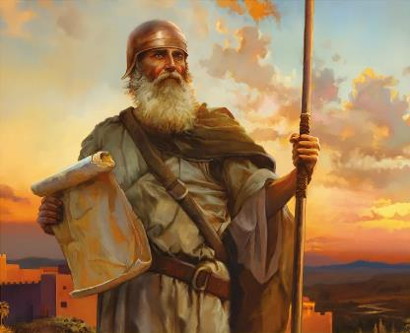
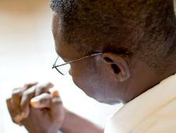
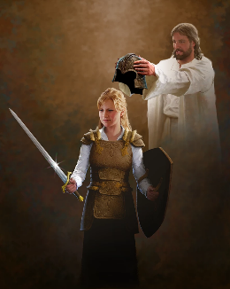
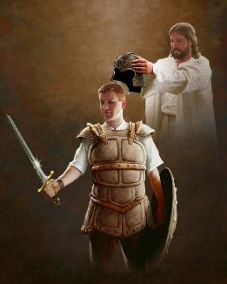
AMANDLA LESIBINDI
“Angikulayanga yini na? Qina, ube lesibindi, ungesabi, ungapheli amandla, ngokuba uJehova uNkulunkulu wakho ulawe lobangaphi lapho oya khona. ( Joshuwa 1:9 )
Ngaphambi kokuba acele uJoshuwa amandla lesibindi empini ( Josh. 1:9 ), uNkulunkulu wamcela ukuba amnike amandla lesibindi sokulalela uMthetho ( Josh. 1:7 ).
Kunjalo lalamuhla. UNkulunkulu usicela ukuthi silwele ukugcina umthetho Wakhe (Samb. 14:12). Lokhu kudinga isibindi esikhulu ngakithi..
Ngokwengxenye yakhe, uthembisa ukuthi “uzoba lawe lobangaphi lapho oya khona.” ( Josh. 1:9 ) Esisiza ukuba silwe impi esibhekene layo. Hatshi impi engokwenyama, kodwa “lababusi, lamandla, amandla obumnyama balesi sikhathi, ngokumelene lobubi bomoya ezindaweni eziphakemeyo.” ( Efe. 6:12 ) Ukwenza lokhu, usinikeze izikhali ezidingekayo (Efe. 6:13-17).
Isihluthulelo sempumelelo siyikuthembela ngokugcweleyo kuNkulunkulu. Futhi ukwenza lokho, sidinga ukuzihlanganisa Laye nsuku zonke (Efe. 6:18).

Slide 11


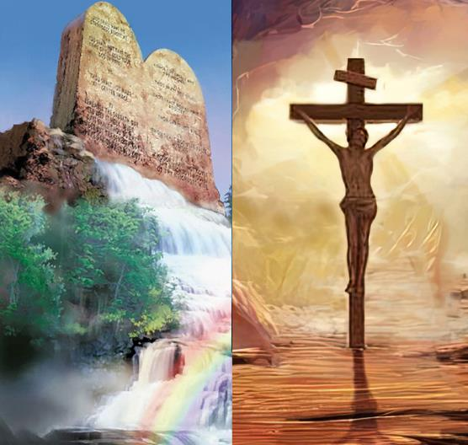
IMPUMELELO YOMSEBENZI
“Le ncwadi yomthetho mayibe sezindebeni zakho njalo, uzindle ngayo imini lobusuku, ukuze uqaphele ukwenza konke okulotshwe kuyo, ube lempumelelo, uphumelele. ( Joshuwa 1:8 )
Impumelelo ngokombono kaNkulunkulu ayihambisani lempumelelo ngokombono womuntu.
Impumelelo edlula ngokuphangisa kulomhlaba ingafinyelelwa ngokwephula imithetho kaNkulunkulu leyabantu, kodwa impumelelo yeqiniso leyaphakade ayilakukwazi ( Josh. 1:8 )
Sizaphumelela uma silandela izimiso lezindinganiso eziseMthethweni kaNkulunkulu. Kodwa lokhu akusiyo yini insindiso ngemisebenzi?
Lutho neze. Ukukholwa loMthetho akuhlukani, kodwa kuyaphelelisana (Roma 3:31). Lapho sikhuluma ngoMthetho, sisuke sikhuluma ngendlela okufanele siphile ngayo, hatshi indlela esisindiswa ngayo. Ubuhlobo bethu loNkulunkulu bubonakala ngokulalela kwethu intando yakhe.

Slide 12

“UmKristu ulomsizi olamandla njalo eNkosini. Indlela yokusiza kweNkosi kungenzeka asiyazi; kodwa lokhu esikwaziyo: Kasoze abalahle ithemba labo abathembela kuye. Ingabe amaKristu ayengaqaphela ukuthi kukangaki iNkosi iwahlelele indlela yawo, ukuze izinjongo zesitha ngawo zingafezeki, ayengeke akhubeke ngokukhononda. Ukholo lwabo lwaluzahlala kuNkulunkulu, futhi akukho ukulingwa okwakuzoba lamandla okubatshukumisa. Babezamamukela njengokuhlakanipha lokusebenza kahle kwabo, futhi Wayezakwenza lokho afisa ukukufeza ngabo.”
EGW (Prophets and Kings, p. 576)

