Slide 1
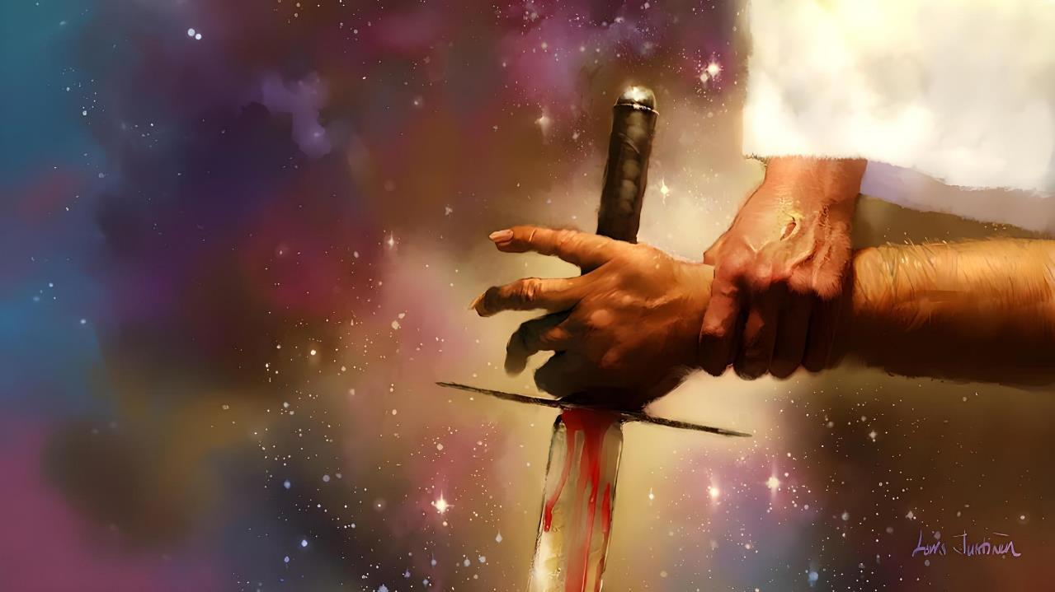
IMPIKISANONGASEMUVA KWAYO YONKE
INXABANO
Isifundo sesine kuMfumfu ilanga lamatshumi amabili lasihlanu ku2025

Slide 2
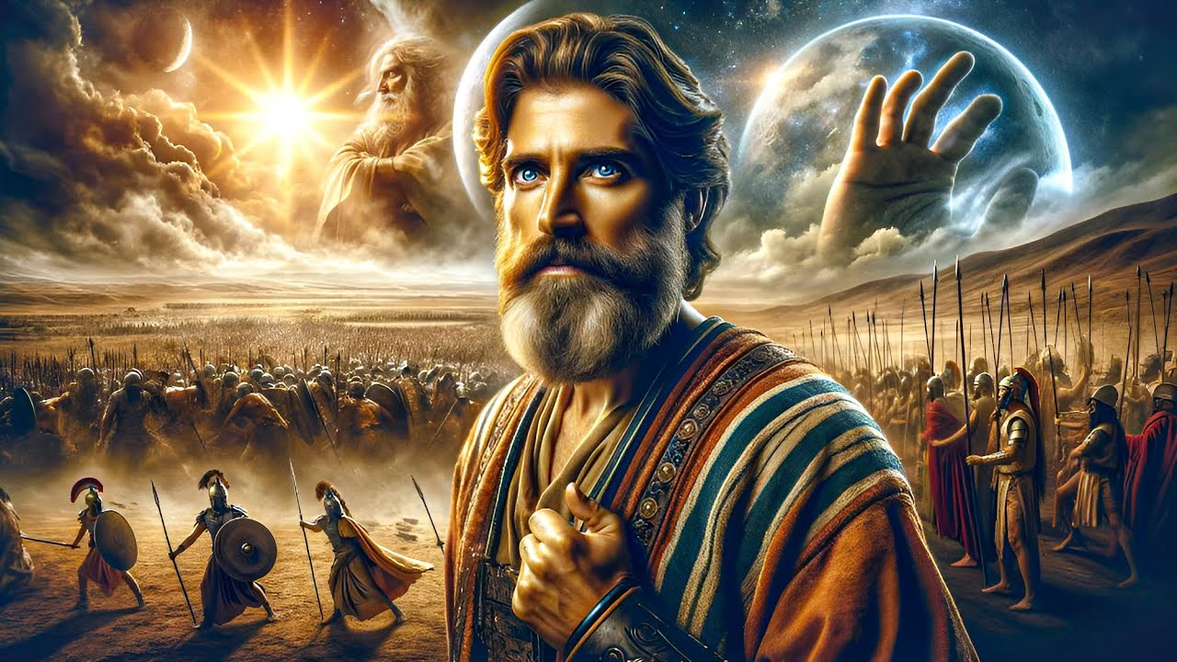
“Alukaze lube khona usuku olunjengalo ngaphambilini langemuva kwalokho, lapho uJehova esizwa izwi lomuntu, ngokuba uJehova wamlwela u-Israyeli.” Joshuwa 10:14

Slide 3

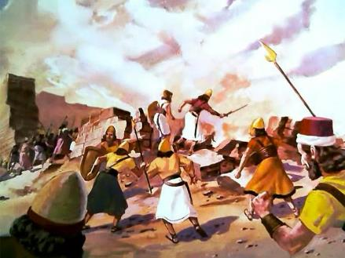
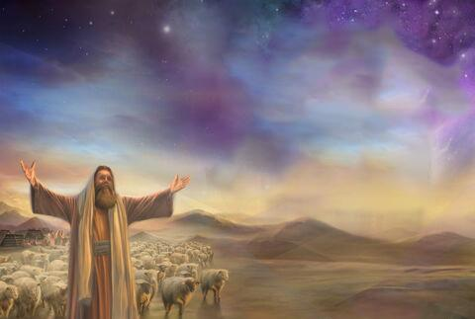
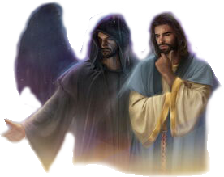
Ukunqotshwa kweKhanani kwakuyimpi yokuqothula eyayiyalwe nguNkulunkulu. Kodwa uma uNkulunkulu eluthando, kungani alaya isibhubhiso esinjalo?
Ukuze sithole ukulunguza ngezizathu zale micimbi, sidinga ukusondeza isithombe.
Kumele sandise umbono wethu ngale kokubonakalayo, size sibone impikisano ebangela zonke izingxabano (kuhlanganise lokunqotshwa kweKhanani): impi enkulu phakathi kukaKristu loSathane, phakathi kokuhle lokubi.
Inhlangothi ezilempikisano:
INkosana yebutho likaNkulunkulu.
Inkosazana yebutho lobubi.
Iqhawe elilamandla kakhulu.
Amasu empikisano:
UNkulunkulu esilwela.
Silwela uNkulunkulu..

Slide 4
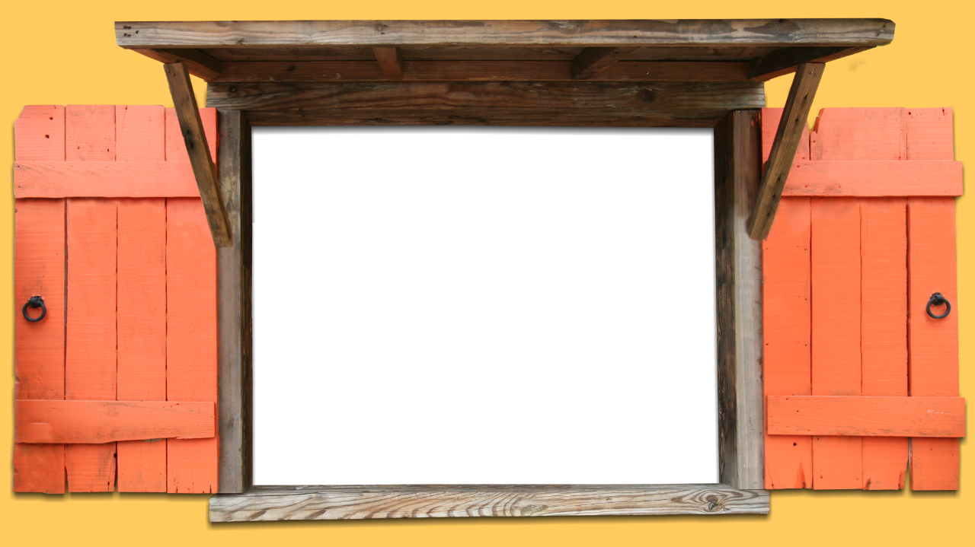
INHLANGOTHI EZILEMPIKISANO

Slide 5


INKOSANA YEBUTHO LIKANKULUNKULU
“futhi,” waphendula, “kodwa manje ngifikile njengenduna yebutho likaJehova.” UJoshuwa wawa ngobuso emhlabathini, wakhuleka, wathi kuye: “Ilombiko bani iNkosi yami encekwini yayo na? (Joshuwa 5:14 )
Njengoba uJoshuwa wayekhuleka eduze kwaseJeriko efuna isiqondiso saphezulu sokuthatha umuzi, iqhawe elihlomileyo lema phambi kwakhe ( Josh. 5:13 ).
Lapho ebuzwa uJoshuwa, le ndoda yaphika ukuthi izihlanganisa laloba yiliphi ibutho lasemhlabeni. WayenguMthungameli webutho likaNkulunkulu ( Josh. 5:14 ).
Ngokufuna ukukhulekelwa ngenkani, wabonisa ukuthi wayenguNkulunkulu ngokwakhe, enguJesu—owaziwa ngokuthi uMikayeli encwadini kaDaniyeli ( Josh. 5:15; Dan. 12:1 ).
Umthandazo wawusuphenduliwe. Okwamjabulisa uJoshuwa, uNkulunkulu ngokwakhe owathatha izintambo zokuhlinza. Njengomkhuzi obonakalayo wakwa-Israyeli, uJoshuwa kwakumelwe alandele kuphela iziyalezo zomlawuli wangempela mpela: uNkulunkulu.

Slide 6

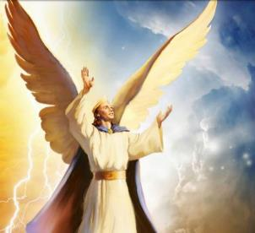
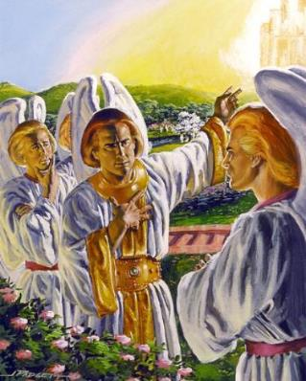
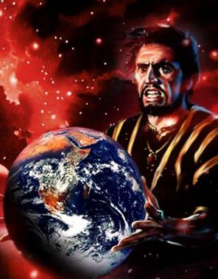
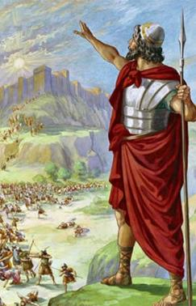
INKOSANA YEBUTHO LOKUBI
“Yeka ukuwa kwakho ezulwini, khwezi, ndodana yokusa, waphonswa emhlabeni; wena owake wawisa izizwe.” ( Isaya 14:12 )
Singatsho ukuthi nguye owasungula impi. Wazalwa eyinkosana; ikherubi lezinga eliphezulu; ngaso kanye eceleni kukaNkulunkulu; ukuhamba phezu kwamalahle avuthayo; yigugu; ephelele… (Hez. 28:12-15).
Enikezwe inkululeko yokuzikhethela - njengazo zonke izidalwa ezihlakaniphileyo ezadalwa nguNkulunkulu - uLusifa wanquma ukuhlubuka lokuhwaba isihlalo sobukhosi sikaNkulunkulu (Isaya 14:12-14).
Langoba ukuhlubuka kwakhe kwehluleka, indawo yonke ibilokhu ivimbezwe yimpi kusukela ngaleso sikhathi. Ngemva kokuthatha umhlaba, uSathane lezingelosi zakhe banenhloso eyodwa: ukubhubhisa amacebo kaNkulunkulu okusindisa uluntu.
Ukunqotshwa kweKhanani kwakuyimpi ebalulekileyo ezimpini.

Slide 7

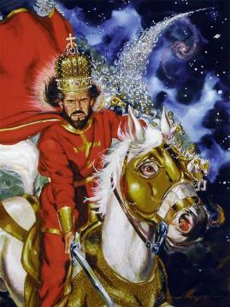
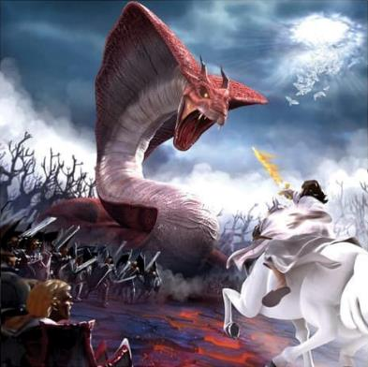
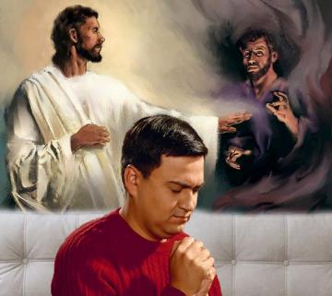
IQHAWE ELILAMANDLA KAKHULU
“UJehova uliqhawe; uJehova ligama lakhe” (Eksodusi 15:3, NIV)
UNkulunkulu ngokwakhe uvezwa “njengendoda yempi,” iqhawe elilamandla kulawo wonke empini ( Eks. 15:3; IHu. 24:8 ).
Kodwa uNkulunkulu akalwi labantu, kodwa ulwa lamandla omoya ababambelele kuwo. Ngakho-ke, izinhlupho zivezwa njengempi emelene lonkulunkulu baseGibhithe, okuyikuthi, amademoni ( Eks. 12:12; Dut. 32:17 ).
UNkulunkulu ufisa ukuqeda ububi emhlabeni. Ngakho-ke, Wabaxotsha eKhanani labo ababekhethe ukubambana loSathane, futhi wanika izwe kubantu ababesohlangothini Lwakhe.
Lamuhla impi isaqhubeka, kodwa hatshi phezu kwendawo. Impi ingeyomndeni ngamunye, ngeyomuntu ngamunye. Ayikho indawo engathathi hlangothi. Kuphakathi kokuthi siloNkulunkulu loba lesitha

Slide 8
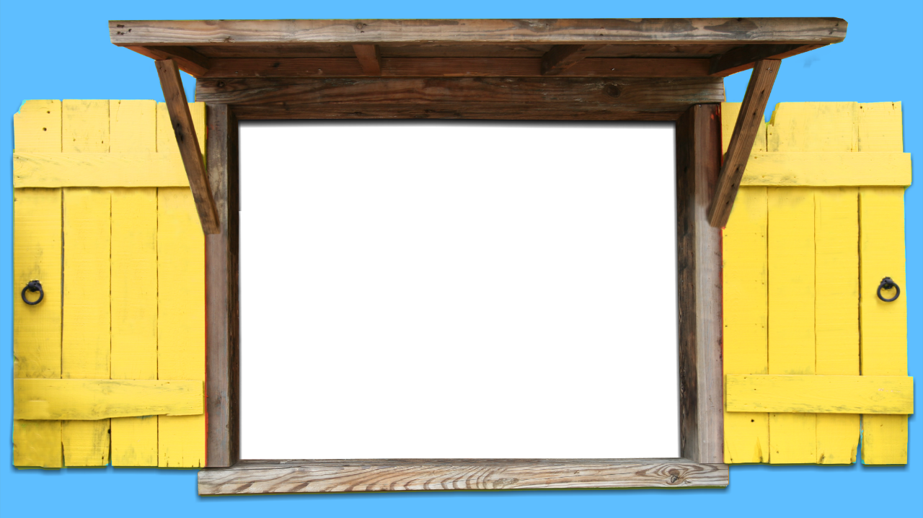
AMASU EMPIKISWANO

Slide 9

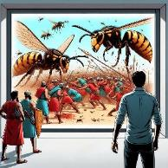
UNKULUNKULU USILWELA
“UJehova uyakulilwela; thulani lina” (Eksodusi 14:14).
Wacwilisa ibutho laseGibhithe oLwandle Olubomvu ( Eks. 14:24-28 )
HWasebenzisa isichotho ngokumelene lamaKhanani ( Josh. 10:11 )
Wabhubhisa labo ababedelela u-Eliya (2 AmaKhosi 1:9-10)
Wathumela amabhere kulabo ababeklolodela u-Elisha (2 AmaKhosi 2:23-24)
Wazuza ukuthula ngokuphuphuthekisa ibutho laseSiriya (2 AmaKhosi 6:14-23)
Wenza ukuba abakwa-Amoni labakwaMowabi balwe bodwa (2 IziKr. 20:15-17, 22-24)
Wabulala ama-Asiriya ayizi-185,000 ngobusuku obubodwa (2 AmaKhosi 19:35)
Wathumela isifo esibulalayo kuHerode (IzEnzo 12:21-23)
Icebo likaNkulunkulu lasekuqaleni kwakuyikunqoba iKhanani ngamandla angaphezu kwawemvelo, ngaphandle kokuthi u-Israyeli alwe (Eks. 23:28). Aluba bekungasi kungakholwa kwabantu ngabe lokhu kwenzeka
IBhayibheli lilandisa ngezibonelo zalokho uNkulunkulu angakwenza ukuze akhulule abantu bakhe, ngaphandle kokuba bathathe izikhali ngokumelene lezitha zabo:

Slide 10

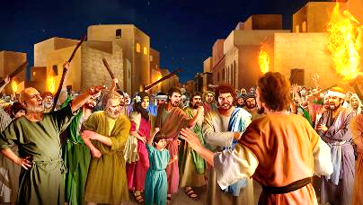
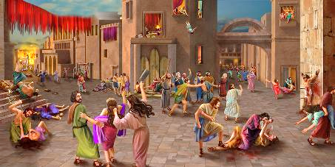

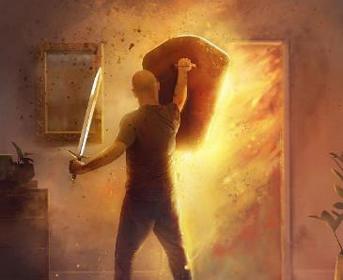
SIYAMLWELA UNKULUNKULU
“Banikela umuzi kuJehova, bachitha ngenkemba yonke into ephilayo kuwo, abesilisa labesifazana, abatsha labadala, lezinkomo, lezimvu, lezimbongolo” (Joshuwa 6:21).
Njengangezinsuku zangaphambi kukazamcolo, loba ngeSodoma leGomora, amaKhanani ayeqile imingcele yomusa, abambana loSathane (Gen. 6:5; 18:20-21; 15:16).
Bonke babemiselwe ukufa kwesibili, ukufa okuphakade. Ukwelula ukuphila kwabo lapha kwakungeke kuntshintshe isiphetho sabo sokugcina. Futhi uNkulunkulu wavumela uIsrayeli, kulesi senzakalo (ukuthunjwa kweKhanani), ukuba abe lengxenye enkulu ekuhlatshweni..
Kungani angenzi Yena uqobo, njengoba wayehlelile? Ngenxa yokungakholwa kwabo. U-Israyeli waqala ukuzwa impi ngemva kokutsho ukuthi, “Ingabe uJehova uphakathi kwethu, loba hatshi?” ( Eks. 17:7-9 ).
Ngokuhlanganyela ngenkuthalo empini (engokwenyama kubo, engokomoya kithi), sihlakulela ukuthembela okungelakuthandabuza osizweni lukaNkulunkulu.

Slide 11

“Izimpi kufanele zilwe nsuku zonke. Impi enkulu iyaqhubeka phezu kwayo yonke imiphefumulo, phakathi kombusi wobumnyama loMbusi wokuphila.... Njengamanxusa kaNkulunkulu kufanele lizinikele Kuye, ukuze ahlele futhi aqondise futhi alilwele impi, ngokubambisana kwenu. INkosana yokuphila iyinhloko yomsebenzi Wayo. Kufanele abe lawe empini yakho yansuku zonke lawe, ukuze ube leqiniso esimisweni; ukuze inkanuko, ekulweni, ithotshiswe ngomusa kaKristu; ukuthi liphume lingaphezu komnqobi ngaye owasithandayo.”
EGW (Conflict and Courage, April 21)

