Slide 1
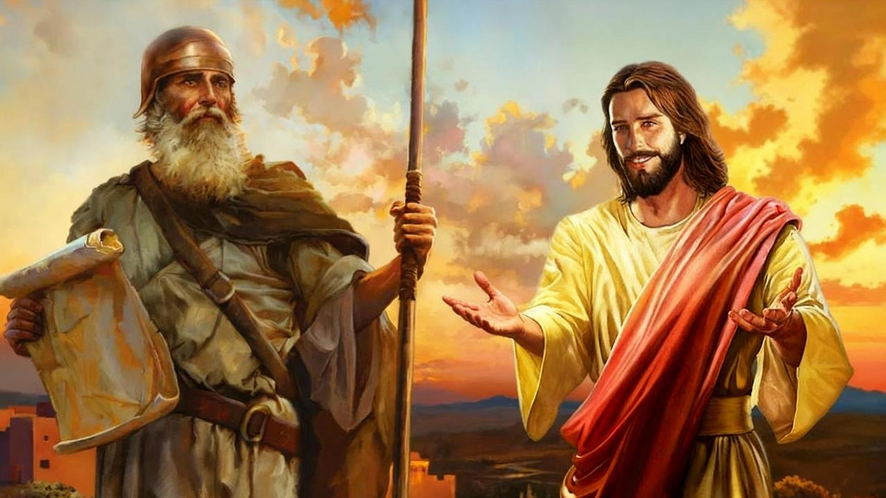
UJOSHUWA WEQINISO
Isifundo setshumi kuMpalakazi ilanga lesithupha ku2025

Slide 2
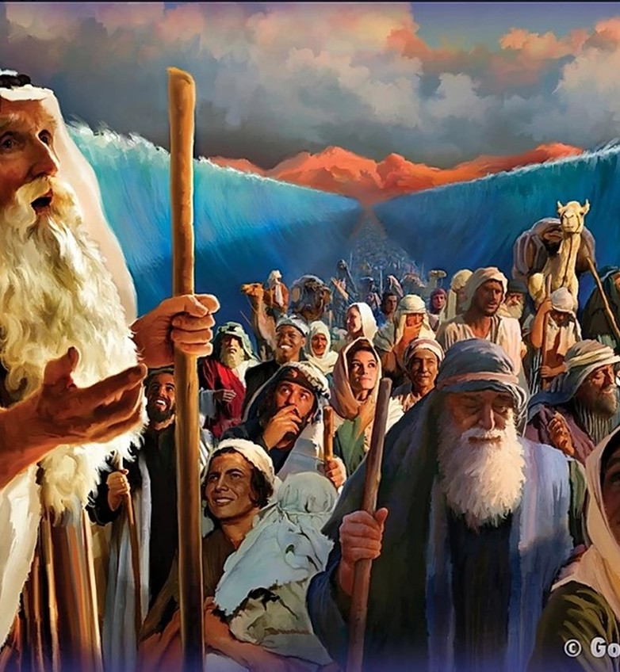
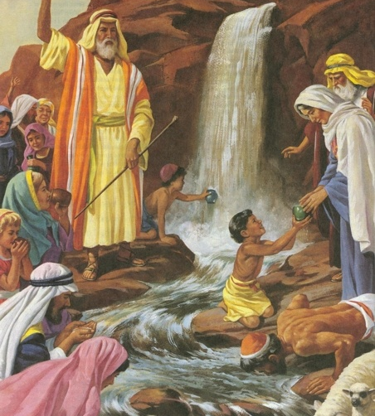
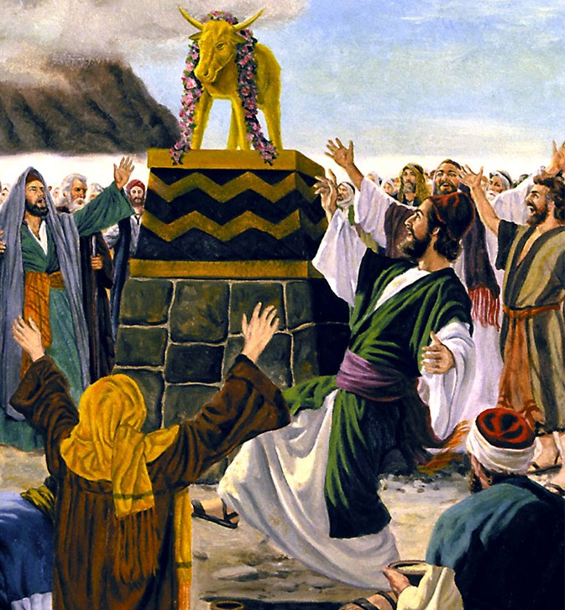
“Lezozinto zabehlela bona kube yisibonelo, kodwa zalotshelwa ukuba kufundiswe thina, osekufike kithi ukuphela kwezikhathi. ( 1 Korinte 10:11 )

Slide 3

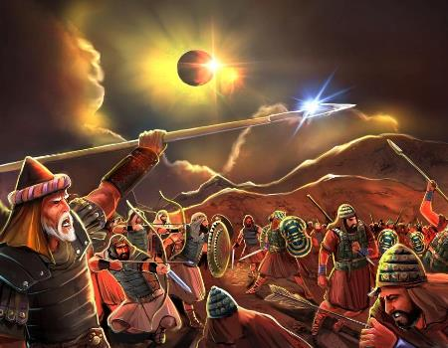
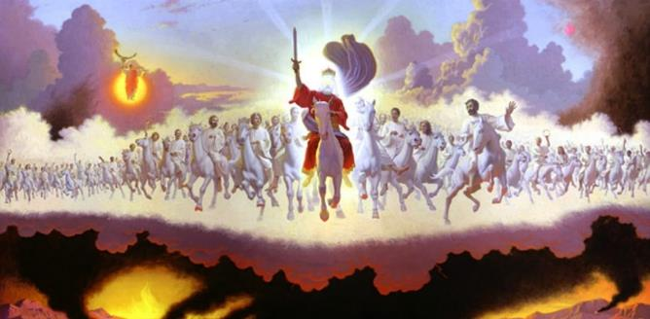







Singafunda ukuphila kukaJoshuwa, okuchazwe kuyiPentateuch lasencwadini kaJoshuwa ngokwayo, ngezindlela ezimbili ezihlukeneyo (kanye leziphelelisanayo): njengomlando langokomfanekiso.
Ukuze senze incazelo engokomfanekiso efaneleyo yomfanekiso kaJoshuwa, kufanele siqale sazi imithetho elawula ukufaniswa kweBhayibheli: izinhlobo lezifaniso.
Uma lokhu sekwenziwe, sizalandela umkhondo kaJoshuwa kulo lonke iBhayibheli ukuze sithole imilayezo uNkulunkulu asishiyele yona ngeZwi laKhe maqondana “loJoshuwa ongumfanekiso”.
Imifanekiso yeBhayibheli:
  Iyini indlela yokwehlukanisa?
  Inhlelo ze-nhlobo
Isifanekiso sikaJoshuwa :
  UJoshuwa njengomfanekiso
  Isifaniso sikaJoshuwa.
  UJoshuwa njengomfanekiso weBandla

Slide 4

UKUFANISWA KWEBHAYIBHELI

Slide 5


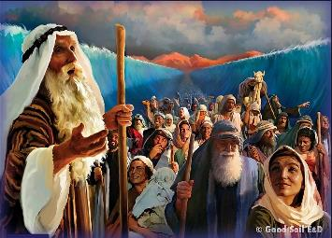
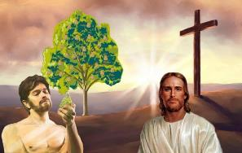
IYINI I-INDLELA YOKWEHLUKANISA
“Manje lezo zinto zabehlela bona kube yisibonelo, kodwa zalotshwa ukuze kufundiswe thina, osekufike kithi yikuphela kwezikhathi” ( 1 Korinte 10:11 )
UPawulu - labanye ababhali beBhayibheli - basebenzisa igama elithi "uhlobo" ukuze babhekisele kumuntu ngokwembali loba isenzakalo esimele okuthile loba othile wesikhathi sakhe kanye/loba ikusasa (okuthiwa “isifaniso”).
Ngokwesibonelo, eyabaseRoma 5:14 ikhuluma ngo-Adamu njengomfuziselo [“umfanekiso” kuyi-KJV] “walowo owayezakuza,” okuyikuthi, uJesu—ngumfuziselo
Uhlobo
UDavida (Ihubo 22:1)
Isikhangiso somfuziselo
UDavide omutsha
(Jer. 23:5)
Isifaniso
UJesu (Mt. 27:46)
Isifaniso
Imihlatshelo ( Lev. 1:3-5 )
Isikhangiso somfuziselo
Inceku Ehluphekayo
( Isaya 53:5-7 )
Isifaniso
Ukufa kukaJesu (Jn. 19:16-18)
Ezikhathini eziningi, eTestamenteni Elidala sithola inkomba yokuthi izimilo zabathile loba izehlakalo ziyizinhlobo zento ethile ezayo. Ake sikhangele izibonelo ezimbili:

Slide 6

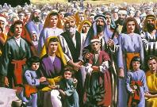
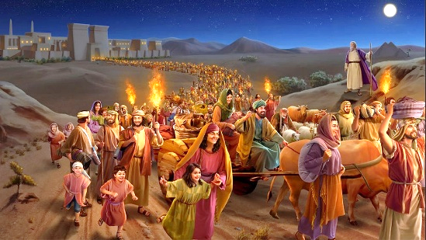
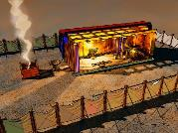
UKUHLELA NGOHLOBO
“lapho ahlala khona kwaze kwaba sekufeni kukaHerode, kwagcwaliseka-ke lokho okwatshiwo yiNkosi ngomprofethi ukuthi: “Ngayibiza indodana yami ukuba iphume eGibithe” (Mathewu 2:15).“
Izinhlobo zeTestamente Elidala zikhomba ezinhlotsheni ezintathu ezihlukeneyo zomfuziselo eTestamenteni Elitsha: uKristu; iBandla; lezikhathi zokugcina.
IZINHLOBO LEZIFANEKISO
UIsrayeli
UKuphuma
Indlu engcwele
UKrestu
Ibandla
Izikhathi zokuphela
UKrestu
Ibandla
Izikhathi zokuphela
UKrestu
Ibandla
Izikhathi zokuphela
Athathwa wasiwa eGibhithe
UMatewu 2:13-15
U-Israyeli omutsha
Abasegalathiya 6:16
Abangu-144,000
Isambulo 7:4
Izinsuku ezingamatshumi amane enhlane
UMatewu 3:16-4:2
Wabhapathizwa futhi wasekelwa nguKristu
1 Abasekhorinte 10:1-6
Ukuphuma emabandleni ahlubukayo
Isambulo 18:4
Kwakufana lethempeli phakathi kwethu
Johane1:14; 2:21-22
Thina silithempeli likaNkulunkulu
1 Abasekhorinte 3:16-17
IJerusalema Elitsha, ithempeli lethu
Isambulo21:2-3
UHLOBO
OKUNGASIHLOBO

Slide 7

UMFANEKISO KAJOSHUWA

Slide 8


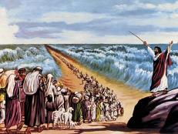
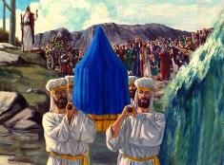
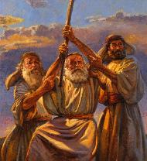
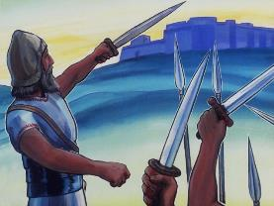
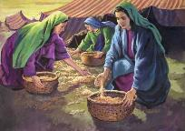
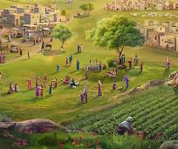
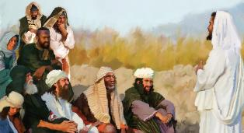
UJOSHUA NJENGOHLOBO
“UJehova uNkulunkulu wenu uyakulivusela umprofethi onjengami phakathi kwenu phakathi kwabafowenu, limlalele.” ( Duteronomi 18:15 )
UJoshuwa wagcwalisa ingxenye yesiprofetho sikaMose mayelana lomprofethi wesibili owayezahola abantu ( Dut. 18:15-19 ).
NjengoMose, uJoshuwa wathola izigijimi eziqondileyo ezivela kuNkulunkulu; wagubha iPhasika; wawela amanzi; wabona iNgelosi yeNkosi; isandla sakhe eseluliweyo saletha ukunqoba; wamema abantu ukuba bahlale bethembekile ngemva kokufa kwakhe; njalo.
Kwathi imana laqala ukuba ngaphansi kukaMose, lasuswa ngaphansi kukaJoshuwa. Ngaphezu kwalokho, uJoshuwa wazigcina iziyalezo eziphathelene lokuhlukaniswa kwezwe lemizi yesiphephelo uMose ayeyiphiwe.
Kodwa abantu baqonda ukuthi isiprofetho sikaMose sadlulela ngalé kukaJoshuwa (Johane 1:21). Ngakho, bobabili uMose loJoshuwa baba izifanekiselo zomfuziselo weqiniso owasiqaphela ngokugcwele isiprofetho esanikezwa uMose mayelana ‘loMprofethi’: uJesu ( IzEnzo 3:22-26 ) .

Slide 9


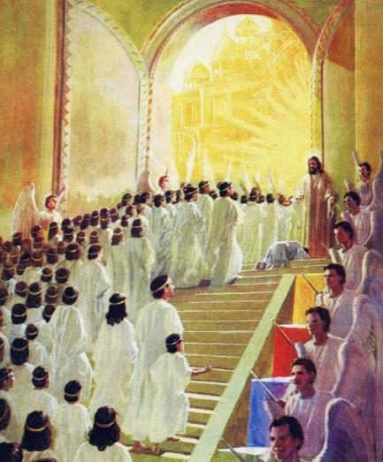
UMFANEKISO KAJOSHUWA
“Ngesikhathi somusa wami ngiyakukuphendula, langosuku lwensindiso ngizokusiza, ngikugcine, ngikwenze ube yisivumelwano sabantu, ubuyisele izwe, uhlukanise ilifa lalo eliyincithakalo.”— Isaya 49:8 .
Injongo yezimpi ezaziholwa uJoshuwa yayikukufaka ama-Israyeli eZweni Lesithembiso. U-Isaya uveza umsebenzi kaMesiya njengohlanganisa ukwabela “ilifa eliyincithakalo [abantu bakhe].” ( Isaya 49:8 , NIV ) esebenzisa igama elifanayo lelencwadi kaJoshuwa.
Impilo lomsebenzi kaJoshuwa (njengomfanekiso) kubonakala ngawuphi umqondo ekuphileni lasemsebenzini kaJesu (umfuziselo)?
Ngemva kokubhapathizwa kwakhe eJordani, uJesu walwa lamandla obubi
Waqala umsebenzi wakhe ngemva kwezinsuku ezingamatshumi amane enhlane
Wanqoba isitha esiphambanweni
Usenza sinqobe izitha zethu ezingokomoya
Usinika ukuphumula kweqiniso
Usabela ilifa elingenakonakala

Slide 10

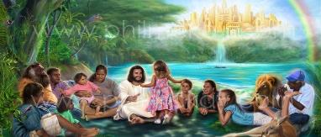
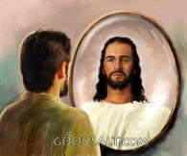
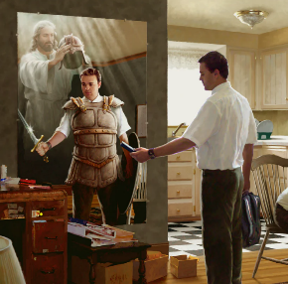

UJOSHUWA NJENGOHLOBO LWEBANDLA
Ngokuba asibambene legazi lenyama, kodwa sibambene lababusi, lamandla, lamandla alobu bumnyama bezwe, lamandla omoya ababi emkhathini. ( Efesu 6:12 )
UJOSHUWA LEBANDLA
Lamuhla silempi okufanele siyilwe, lapho siholwa “uJoshuwa” wethu, osihlomisa ngezikhali ezidingekayo (Efe. 6:10-12).
Ngaphezu kwalokho, usesabele kakade ilifa, futhi usigcwalisa ngezibusiso ezingokomoya ( Efe. 1:3, 11 ).
UJOSHUWA KANYE LEZIKHATHI ZOKUPHELA
Kodwa ukugcwaliseka okupheleleyo okungokomfanekiso kukaJoshuwa kuzoba sekupheleni, lapho zonke izixuku zobubi zibhujiswa, futhi sithatha ilifa lethu ngokugcweleyo: izwe lapho singahlala khona ngokuqiniseka ( IsAm. 20:7-9;
Hez. 28:26 ).
Kuze kufike leso sikhathi, masikhule emseni njengoba kwenza uJoshuwa, sivumele uNkulunkulu ukuba asiguqule ukuze sifane Laye kancane usuku losuku.

Slide 11

“U-Israyeli kaNkulunkulu, ehambela eKhanani lasezulwini, uloMphathi owayengadingi ukufundiswa komuntu ukuze amlungiselele umsebenzi Wakhe njengomholi ongcwele; lokho wenziwa wapheleliswa ngezinhlupheko; futhi “ngokuba Yena ngokwakhe ehluphekile elingwa, ulamandla okusiza abalingwayo.” Heberu 2:10, 18. UMhlengi wethu akazange abonise ubuthakathaka loba ukungapheleli komuntu; lokho wafa ukuze asitholele indawo yokungena eZweni Lesithembiso.”
EGW (Patriarchs and Prophets, p. 480)

