Slide 1
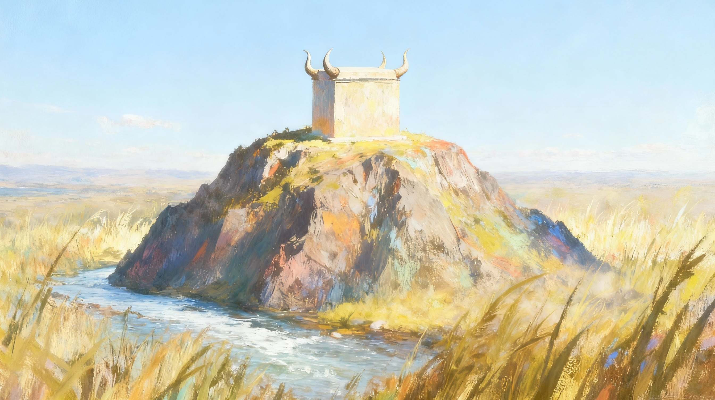
UKUHLALA EZWENI
Isifundo setshumi lanye kuMpalakazi ilanga letshumi lantathu ku2025

Slide 2
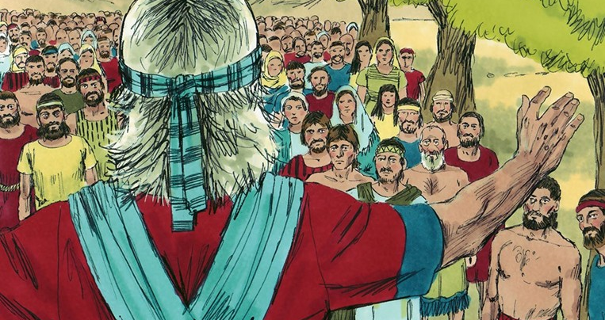

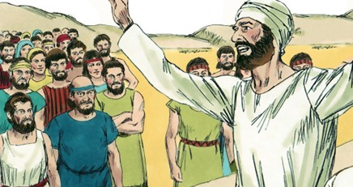
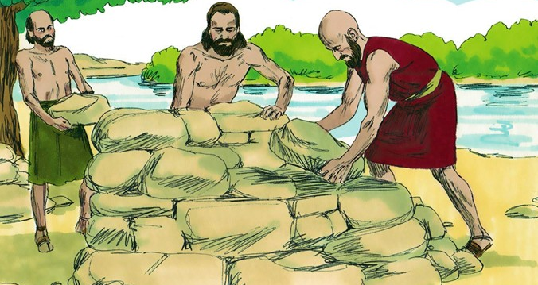
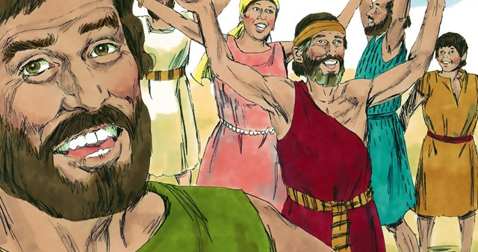
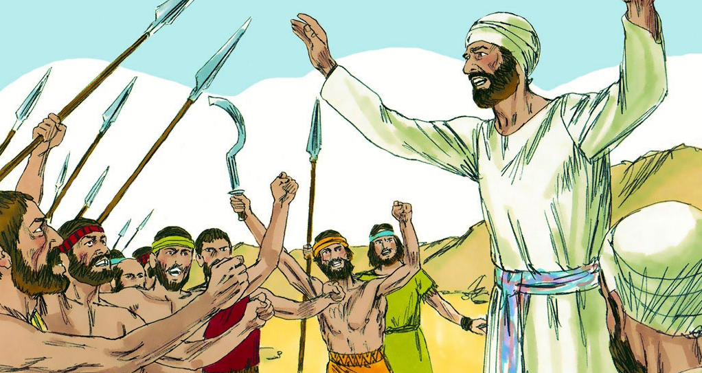
“Impendulo ethobileyo isusa ulaka, kepha izwi elilukhuni livusa ulaka.” (IzAga 15:1, NIV)

Slide 3

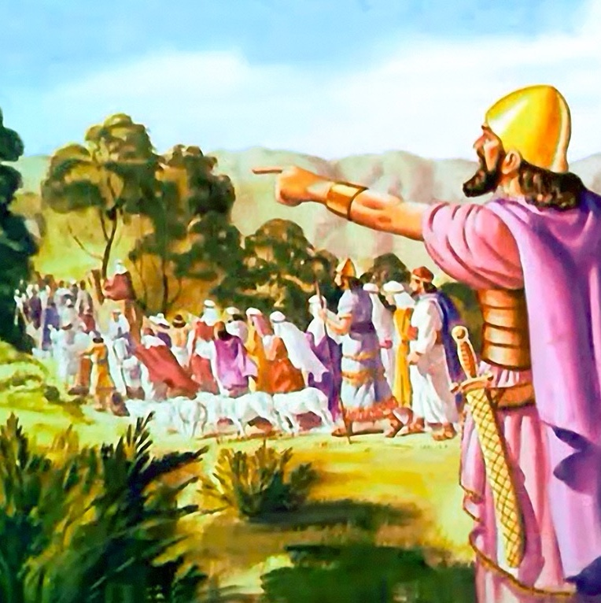
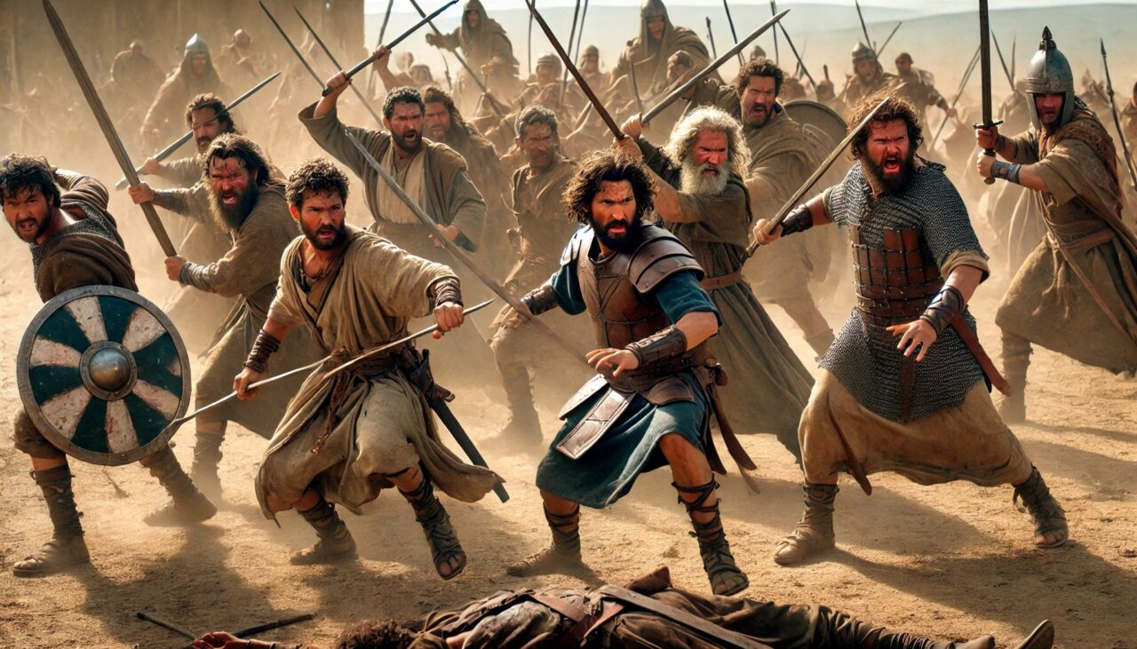





Ngemva kweminyaka eminengana yempi, u-Israyeli wayeselinqobile iKhanani, langoba kwakungaxotshwanga zonke izakhamuzi zakhona.
Izizwe ezimbili lengxenye ezazidle ilifa lengxenye esempumalanga (uRubeni, uGadi lengxenye yesizwe sakwaManase), futhi ezaziwele iJordani ukuze zisize ekunqobeni, zazikufezile ukuzinikela kwazo ngokwethembeka.
Ekugcineni, sase sifikile isikhathi sokuhlukana. Ngemva kokuwabusisa lokuwayala ukuba aqhubeke endleleni kaNkulunkulu, uJoshuwa wabaxotsha. Kodwa ukuvalelisa kwasibekela ukungezwani okungathi sína okwakungaqeda kalula ubunye babantu bakwa-Israyeli
Inkulumo yokuvalelisa ( Joshuwa 22:1-8 )
Isizatho sovukela ( Joshuwa 22:10-12 )
Ukubekwa icala (Joshuwa 22:13-20)
Impendulo yomusa ( Joshuwa 22:21-29 )
Ukubuyisana ( Joshuwa 22:30-34 )

Slide 4


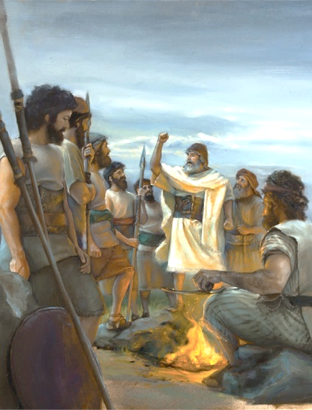
INKULUMO YOKUVELELISA
“Kepha qaphelani kakhulu ukuba ligcine umyalo lomthetho uMose inceku kaJehova alinika wona: ukuthanda uJehova uNkulunkulu wenu, ukuhamba ezindleleni zakhe, ukugcina imiyalo yakhe, lokunamathela kuye, lokumkhonza ngayo yonke inhliziyo yenu langawo wonke umphefumulo wenu.” ( Joshuwa 22:5 )“
Njengoba iJordani lalizobangela ukwehlukana phakathi kwezizwe, uJoshuwa wapha iseluleko esihlakaniphile ezizweni ezimbili nengxenye ukuze zihlale zithembekile ( Joshuwa 22:5 ):
Ukuthanda uJehova uNkulunkulu wakho
Ukuhamba ngokumlalela
Ukubambelela kuye
Ukumkhonza ngayo yonke inhliziyo yakho langawo wonke umphefumulo wakho
Uthando luyisimiso okufanele sisiholele kuNkulunkulu. Siyamthanda ngoba yena wasithanda kuqala (1 Johane 4:19)
Le yindlela uJoshuwa abonisa ngayo ukuziphatha okulindeleke kulabo abakhetha ukuhamba loNkulunkulu.
Kumele sinamathele kuNkulunkulu ngaphandle kokuvumela loba yisiphi isiphazamiso siphule leso sibopho.
Sithola injongo yethu yangempela, ukwaneliseka lokuphila okuchichimayo lapho sikhonza uMdali wethu ngothando ngokuzithandela
Ukugcina imithetho yakhe
Okulalela kungumphumela wemvelo wenhliziyo ebongayo ekuqondayo lokho uNkulunkulu akwenzileyo

Slide 5


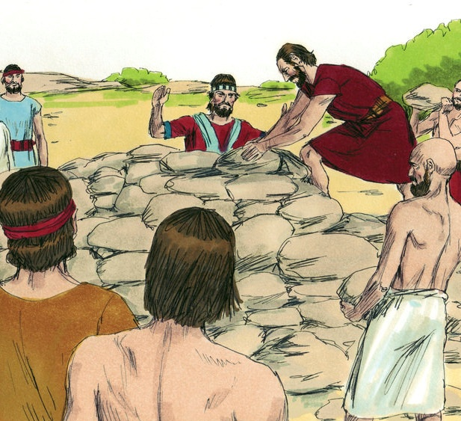
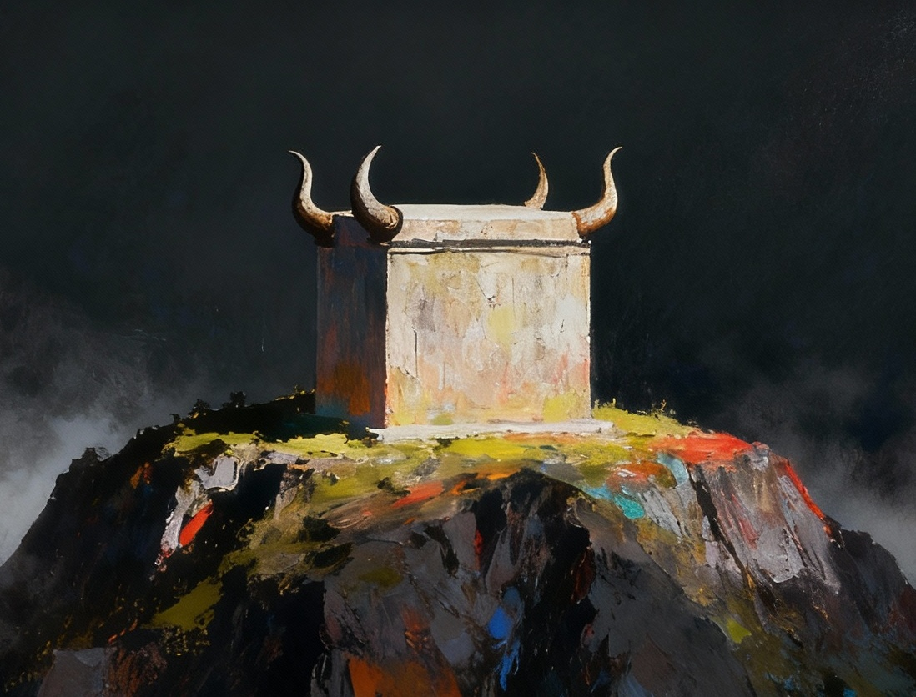
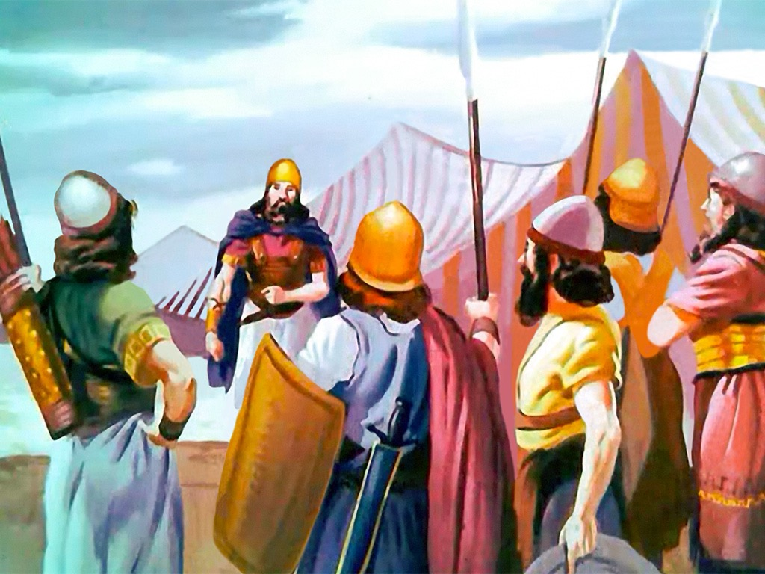
ISIZATHO SOMVUKELA
“Kwathi lapho befika eGeliloti ngaseJordani ezweni laseKhanani, abakwaRubeni, labakwaGadi, lengxenye yesizwe sakwaManase bakha khona i-altare elihle ngaseJordani” ( Joshuwa 22:10 ) “
Eduze kwendawo lapho uJoshuwa ayemise khona isikhumbuzo sokuwela iJordani ngokuyisimangaliso, izizwe ezimbili lengxenye zakha i-altare elifana le-altare leNdawo Engcwele ( Josh. 22:10, 28 ).
Lesi senzo sahunyutshwa njengokweqa umthetho owawuvimbela ukunikela imihlatshelo kwenye indawo ngaphandle kwe-altare leminikelo yokutshiswa eNdaweni Engcwele (Lev. 17:8-9).
Amanye ama-Israyeli anquma ukusiqeda lesi sono ngokuhlasela abafowabo (Josh. 22:12). Kodwa uNkulunkulu wangenela ukuze avimbele impi yombango eyachitha igazi. Wavusa abantu abakhetha ukungahluleli ngaphandle kobufakazi; banikeze inzuzo yokungabaza; futhi banquma ukunikeza abafowabo ithuba lokuzichaza ( Josh. 22:13-14 ).
Njengoba kwenzeka, iphutha lakhe kuphela kwaba ukungabazisa abafowabo ngezinhloso zakhe… kodwa lokho akusiso sono

Slide 6

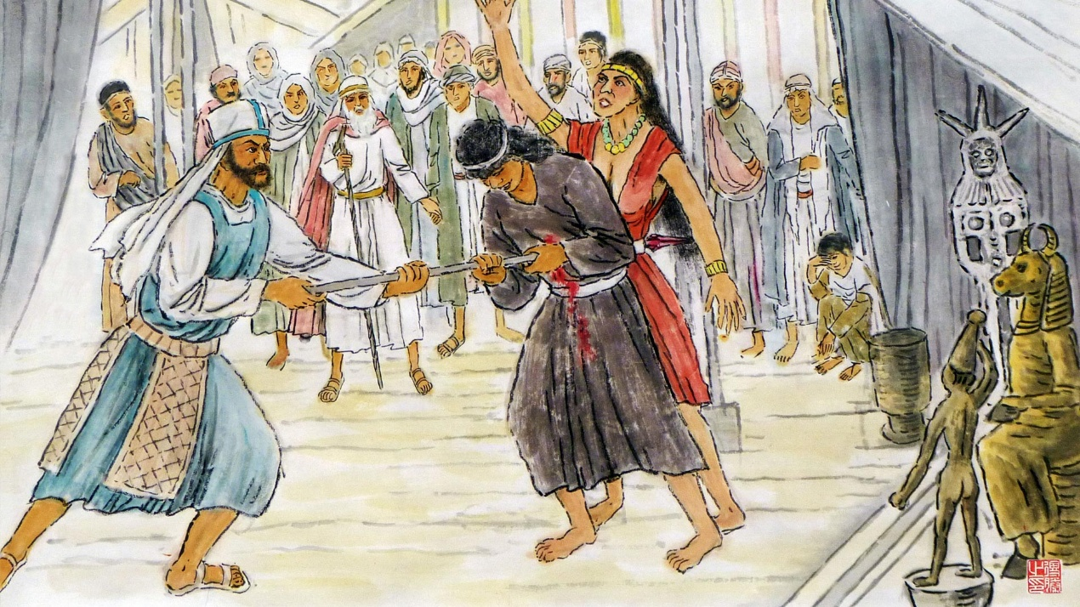
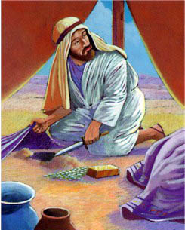
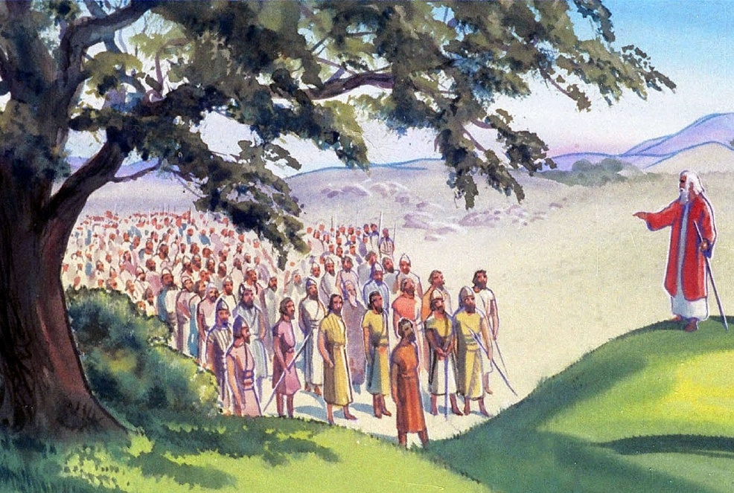
UKUBEKWA ICALA
““Ibandla lonke likaJehova lithi: ‘Lingakholwa kanjani kuNkulunkulu ka-Israyeli kanje, na?
( Joshuwa 22:16 )
Kungani uFinehasi akhethwa ukuba ahole ikomiti ephenyayo ( Josh. 22:13-14 )?
UFinehasi, indodana yompristi omkhulu, akazange ayeke ukuvimba isono sikaBali Peyori ( Num. 25:7-8 ). Enkulumweni yakhe, wahlobanisa lesi sono lesono sika-Akhani futhi wasifanisa lalesi okuthiwa senziwe izizwe ezimbili lengxenye ( Josh. 22:16-20 ).
Inkulumo kaFinehasi yayinengqondo. Uma imihlatshelo yayinikelwa e-altare elalisanda kumiswa, uNkulunkulu wayezojezisa wonke u-Israyeli ngalokho (Josh. 22:18b).
Ngakho, wabanikeza ithuba lokulungisa leli phutha, ngaphambi kokuba benze isono: wabapha ithuba lokubuyela ngaseJordani lapho iNdawo Engcwele yayikhona (Josh. 22:19

Slide 7


IMPENDULO ELOMUSA
“Uma sizakhele i-altare lethu ukuba sifulathele uJehova, sinikele iminikelo yokutshiswa leminikelo yempuphu, loba sinikele phezu kwalo iminikelo yokuthula, uJehova ngokwakhe makasenze silandise.” ( Joshuwa 22:23 )
Izizwe zakwaRubeni, lezakwaGadi, lenxenye yesizwe sakwaManase, zabekwa icala, zenza isibonelo;
Bathula balalela amacala
Babiza uNkulunkulu njengofakazi wabo
Ukujeziswa uma bonile Bavuma
Baveze izisusa zabo zangempela
Lapho ama-Israyeli engazazi izisusa zabafowabo zokwakha i-altare, acabanga: ukuhlubuka, isifiso sokuhlukaniswa lesijeziso saphezulu.
Iqiniso laliyikuthi: isifiso sokuhlala bemunye labafowabo lokuvikela ukwehlukana kwama-Israyeli esikhathini esizayo ( Josh. 22:24-26 ).
Langabe izizwe ezimangalelwe zazingase zicasulwe yizinsolo futhi zisabele ngobudlova lapho zizivikela, ngenxa yokusabela kwazo kobungane, impi yagwenywa.

Slide 8

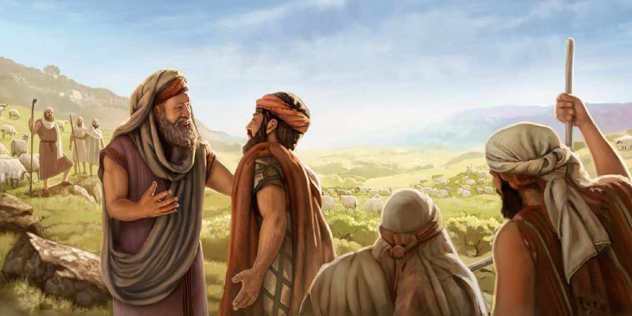
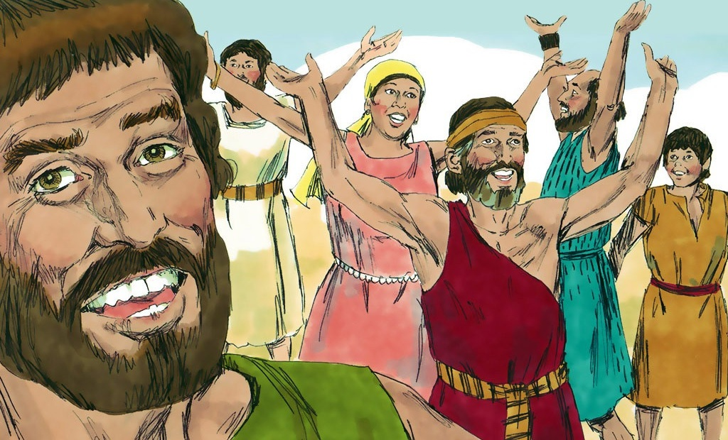
UKUBUYISANA
“They were glad to hear the report and praised God. And they talked no more about going to war against them to devastate the country where the Reubenites and the Gadites lived” (Joshua 22:33)
“Bajabula lapho besizwa umbiko, bamdumisa uNkulunkulu, futhi ababe besakhuluma ngokulwa labo ukuze bachithe izwe labakwaRubeni labakwaGadi.” ( Joshuwa 22:33 ) Ngakho-ke, uJoshuwa waphendula:
Lapho bebona ukuthi lokho kubekwa icala kwakungelasisekelo, uFinehasi leqembueqwe lama-Israyeli bakhululeka ( Josh. 22:30-31 ). Ngakolunye uhlangothi, lapho ama-Israyeli efunda iqiniso, ajabula futhi adumisa uNkulunkulu ( Josh. 22:32-33 )
Ungagijimeli eziphethweni
Khuluma ngezinkinga ngaphambi kokuthatha isinyathelo
Zimisele ukuzidela ukuze uzuze ubunye
Phana impendulo ezothileyo ekusolweni
Jabula futhi udumise uNkulunkulu lapho ukuthula sekubuyisiwe
Ukudlulisa imicabango yethu

Slide 9

“Abantwana bakwaGadi labakwaRubeni babeka phezu kwe-altare labo umbhalo oqotshiwe obonisa injongo yokwakhiwa kwalo; futhi bathi: “Kuyoba ngubufakazi phakathi kwethu bokuthi uJehova unguNkulunkulu.” Kanjalo bazama ukuvimbela ukungaqondi kahle esikhathini esizayo lokususa lokho okungase kube imbangela yesilingo.
Kukanengi kangakanani ubunzima obungathi sína buvela ngenxa yokungaqondi, ngitsho laphakathi kwalabo abatshukunyiswa yizisusa ezifaneleyo kakhulu; futhi ngaphandle kokusebenzisa inhlonipho lokubekezela, yiyiphi imiphumela engathi sína futhi ebulalayo engase ilandele […]
Akekho owake wabuyiselwa esikhundleni esingalungile ngokusolwa lokuhlanjalazwa; kodwa baqinise izinhliziyo zabo ngokumelene lokukholwa. Umoya woabanengi bayaxoshwa kanjalo endleleni elungileyo futhi baholele ekutheni musa, umusa, lesineke ungasindisa owonayo futhi ufihle inqwaba yezono
EGW (Patriarchs and Prophets, pp. 519)

