Slide 1
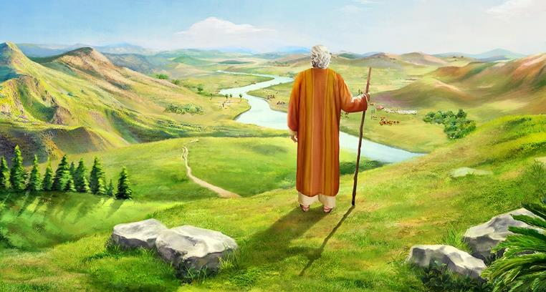
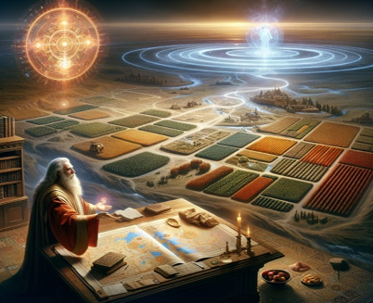
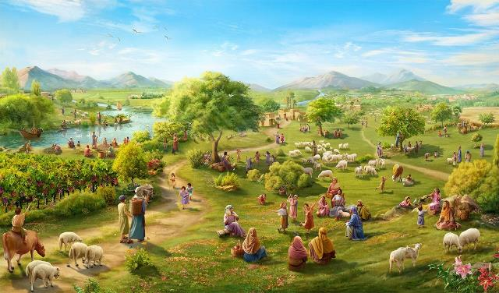
UNKULUNKULU UTHEMBEKILE!
Isifundo setshumi lambilikuMpalakazi ilanga lamatshui amabili ku 2025

Slide 2

“Akukho elinye izwi kuzo zonke izithembiso ezinhle uJehova azenzileyo endlini ka-Israyeli angazenzanga; zonke zafezeka.” (Joshuwa 21:45)

Slide 3

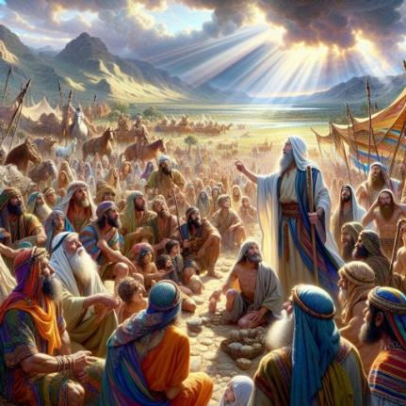
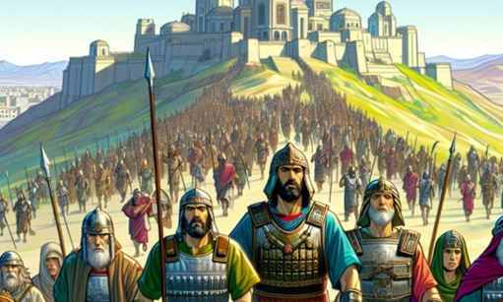
UJoshua wayesevele eseleminyaka eminengi, futhi kuselezindawo okwakumele zinqotshwe. Wahlanganisa abaholi abatsha ukubakhuthaza bayeqhubeka ngokuhlasela.
Ithuba lokuzuza ukunqoba lalingekho phakathi kwabo, kodwa lalingaphakathi kukaNkulunkulu. Ngakho wabakhumbuza ngokwethembeka uNkulunkulu ayesekubonisile futhi wabaqinisekisa ukuthi uzoqhubeka ethembekile.
Kodwa futhi wabafundisa ngezingozi. Eqinisweni, kwakukhona ingozi eyodwa kuphela, efanayo leyo okufanele sibhekane layo lamuhla: ukuyeka ukwethembeka kuNkulunkulu; ukubuyisela ukuthembeka kukaNkulunkulu ngokungathembeki kwethu..
Ubuqotho bukaNkulunkulu (Joshuwa 21:43-45)
Lokho uNkulunkulu akwenzileyo lalokho azakwenza (Joshuwa 23:1-5)
TheUmvuzo wokuba bahlale beqotho (Joshuwa 23:6-10)
Okumele sikwenze (Joshuwa 23:11-14)
Isijeziso sokungabiqotho (Joshuwa 23:15-16)

Slide 4


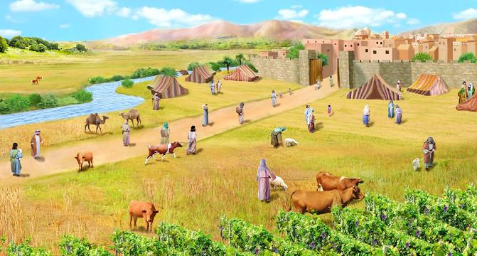
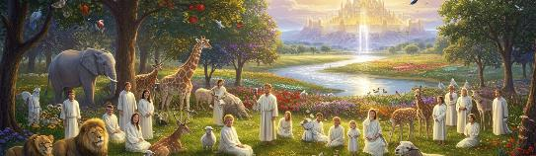
UKWETHEMBEKA KUKANKULUNKULU
“Akekho lelilodwa kuwo wonke amathuba amahle uJehova elehlulekayo awethembise ku-Israyeli; wonke agcwaliswa.” (Joshuwa 21:45 NIV)
UNkulunkulu wayenike u-Israyeli “yonke indawo” (Joshuwa 21:43 NIV) futhi wayebaphakamisela ezandleni zabo “zonke izitha zabo” (Joshuwa 21:44 NIV), ngakho-ke “konke kwaqedwa” (Joshuwa 21:45 NIV).
Ukuphindaphinda kokusebenzisa igama elithi “konke” kugcizelela ukwethembeka kukaNkulunkulu ekufezeni uNkulunkulu wayebanqobile. Babengahlala kulindawo ngoba uNkulunkulu wayewuthethe. Babengaqiniseka ukuthi bazophetha ukufuqela phandle bantu baseKhanani ababehlala khona ngenxa yokuthi uNkulunkulu wayegcina izithembiso zakhe kuze kube lamhla futhi wayezaqhubeka ezigcina esikhathini esizayo
Konke lokhu kusebenza kuhle kithi. UNkulunkulu uhlale ethembekile (Duteronomi 7:9; Amahubo 117:2; Lamenti 3:22-23). Uthembise ukusindisa thina lokusinikeza umhlaba njengelifa, futhi uzogcwalisa lezi zithembisa (Filipi 1:6; 1 Petru 1:5; Amahubo 37:29).

Slide 5

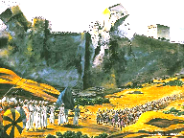
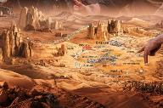
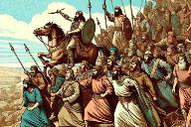
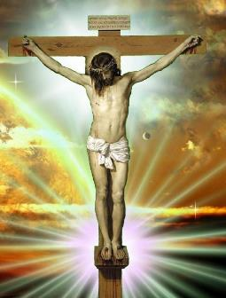
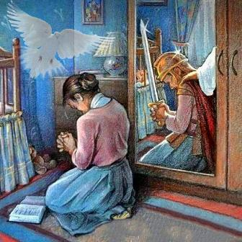
LOKHO UNKULUNKULU AKWENZAYO LAZAKWENZA
“Lina ngokwenu libonile konke uJehova uNkulunkulu wenu akwenzileyo kuzo zonke lezi zizwe ngenxa yenu; nguJehova uNkulunkulu wenu owalilwelayo” (Joshuwa 23:3, NIV).
Enkulumweni yakhe kubadala, uJoshuwa uqala ngokubatshela lokho uNkulunkulu asekwenzile lalokho Ayesezakwenza:
Ulwe lezizwe ( Josh. 23:3 ).
Uhlukanise izwe phakathi kwezizwe (Josh. 23:4)
Uzazixotsha izizwe eziseleyo (Josh. 23:5)
Konke lokhu (okwase sekwenziwe lalokho okwakusezakwenziwa) kwakungaphansi kwesimo esisodwa kuIsrayeli: ukulalela ( Josh. 23:6 ).
Imbali ka-Israyeli uyisifundo kithi lamuhla. UNkulunkulu usevele wasinqoba isono futhi usinike isiqiniseko sensindiso ngomhlatshelo kaJesu (Kol. 2:15).
Kukithi ukuqhubeka lempi, lokuthembela kuMoya oNgcwele ukuze siphile impilo yokunqoba (2 Kor. 10:3-5; Efe. 6:11-18).

Slide 6

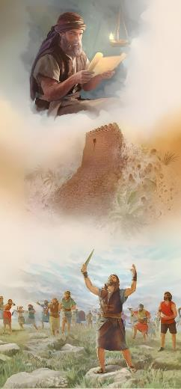
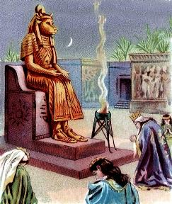
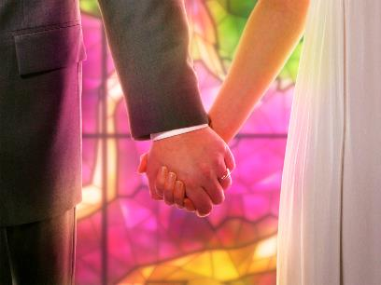
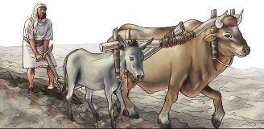
UMVUZO WOKUTHEMBEKA
“Oyedwa kini unqoba inkulungwane, ngokuba uJehova uNkulunkulu wenu uyalilwela njengokuthembisa kwakhe.” (Bala uJoshuwa 23:10.)
Umvuzo wokwethembeka kukaIsrayeli wawuyoba yikunqoba okupheleleyo ngokuphelela phezu kwazo zonke izitha zabo ( Josh. 23:6, 10 ).
Esimweni sokunqotshwa kweKhanani, ukwethembeka kuNkulunkulu kwakumele kubonakale ngezindlela ezintathu eziqondileyo:
Ungatshadi labakhileyo ezweni (Josh. 23:7a)
Ungawatsho amagama onkulunkulu babo (Josh. 23:7b)
Akufanele bakhonze onkulunkulu babo (Josh. 23:7c)
Kwakudingeka balondoloze ubumsulwa obungokomoya. Uma betshada lezakhamuzi, babeqala ukukhuluma ngonkulunkulu babo, bagcine sebebakhonza. Kwaqala kanjalo-ke ukuhlubuka kukaSolomoni ( 1 AmaKhosi 11:4 ).
Ngakho-ke, thina maKristu selulekwa ukuba silandele izincomo ezifanayo, futhi singatshadi labangakholwayo ( 2 Kor. 6:14-16 ).

Slide 7


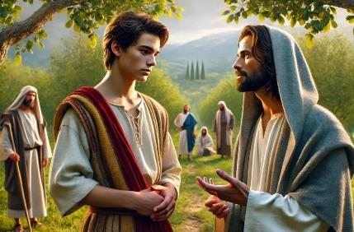
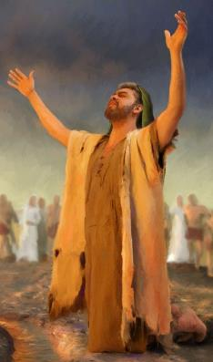
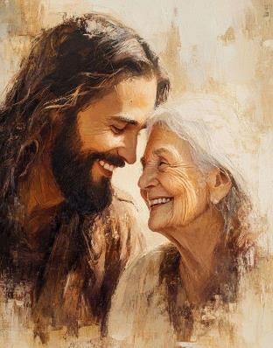
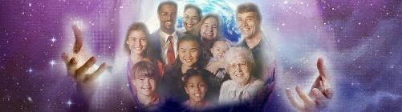
OKUMELE SIKWENZE
“Ngakho qaphelani kakhulu ukuba limthande uJehova uNkulunkulu wenu” (Joshuwa 23:11, NIV)“
Singatsho ngaphandle kokuthandabuza ukuthi umcijo oyinhloko yenkulumo kaJoshuwa utholakala evesini 11 : ukuthanda uNkulunkulu.
U-Israyeli kwakufanele abonise uthando lwakhe ngokungathandi abanye onkulunkulu, okwakuyophumela ekulimaleni okukhulu kubo ( Josh. 23:12-13 ).
Ngaphezu kwalokho, uJoshuwa uphakamisa isisusa sokukhulisa lolo thando: ukwethembeka kukaNkulunkulu ( Josh. 23:14 ).
Namuhla silesikhuthazo esikhulu kakhulu: isibonelo sikaJesu (Joh. 13:34).
UNkulunkulu ufisa ukungena ebudlelwaneni obuseduze lobomuntu siqu lawo wonke umuntu osabela othandweni Lwakhe.
Ngakho-ke, uthando Lwakhe kubo bonke liluhlaka lokubonisa uthando lwethu ngokuzithandela lothando.

Slide 8

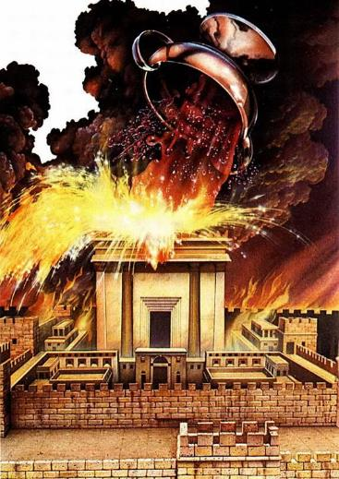
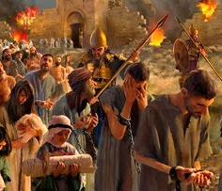
ISIJEZISO SOKUNGATHEMBEKI
“Kodwa njengoba zonke izinto ezinhle uJehova uNkulunkulu wenu azithembisile kini zifikile kini, kanjalo uyokwehlisela phezu kwenu zonke izinto ezimbi azisongelayo, kuze kube yilapho uJehova uNkulunkulu wenu eselichithile kuleli zwe elihle alinike lona. (Bala uJoshuwa 23:15.)
UJoshuwa uphetha inkulumo yakhe ngamazwi ahlabayo esixwayiso ngemiphumela yokungalaleli: ukuhlutshwa lulaka lukaNkulunkulu ( Josh. 23:15-16 ).
Kanye laseZweni Lesithembiso futhi wayeyazi ngokugcweleyo imiphumela yokuthukuthelisa ulaka lukaJehova ngokwephula ngokusobala isivumelwano.
Uthando olufanayo olwahola uNkulunkulu ukuba anikele ngeNdodana yakhe ngenxa yethu yilolo oluzibonakalisa ngokuthukuthelela labo abanamathela ngenkani esonweni (Johane 3:16; Roma 2:5)
U-Israyeli wehluleka futhi wabhekana lesijeziso sakhe. Thina lamuhla sinethuba lokubhala indaba ehlukileyo: ukuhlala sithembekile futhi sihlale othandweni Lwakhe (Johane 15:9).

Slide 9

“Yonke intokozo yakho, ukuthula, injabulo, kanye lempumelelo kulempilo kuncike okholweni lwangempela, oluthembela kuNkulunkulu.Lolu kholo luzogqugquzela ukulalela ngokweqiniso imilayo kaNkulunkulu.Ulwazi lwakho lokholo lwakho kuNkulunkulu luyisithiyo esilamandla kuyo yonke imikhuba emibi, kanye lesisusa sakho konke okuhle.
Kholwa kuJesu njengomuntu othethelela izono zakho, ofuna ujabule ezindlini azihambile ezokulungisela. Ufuna ukuthi uphile ebukhoneni Bakhe; ukuze sibe lokuphila okuphakade lomqhele wenkazimulo.”
EGW (Messages to Young People, p. 410)

