Slide 1
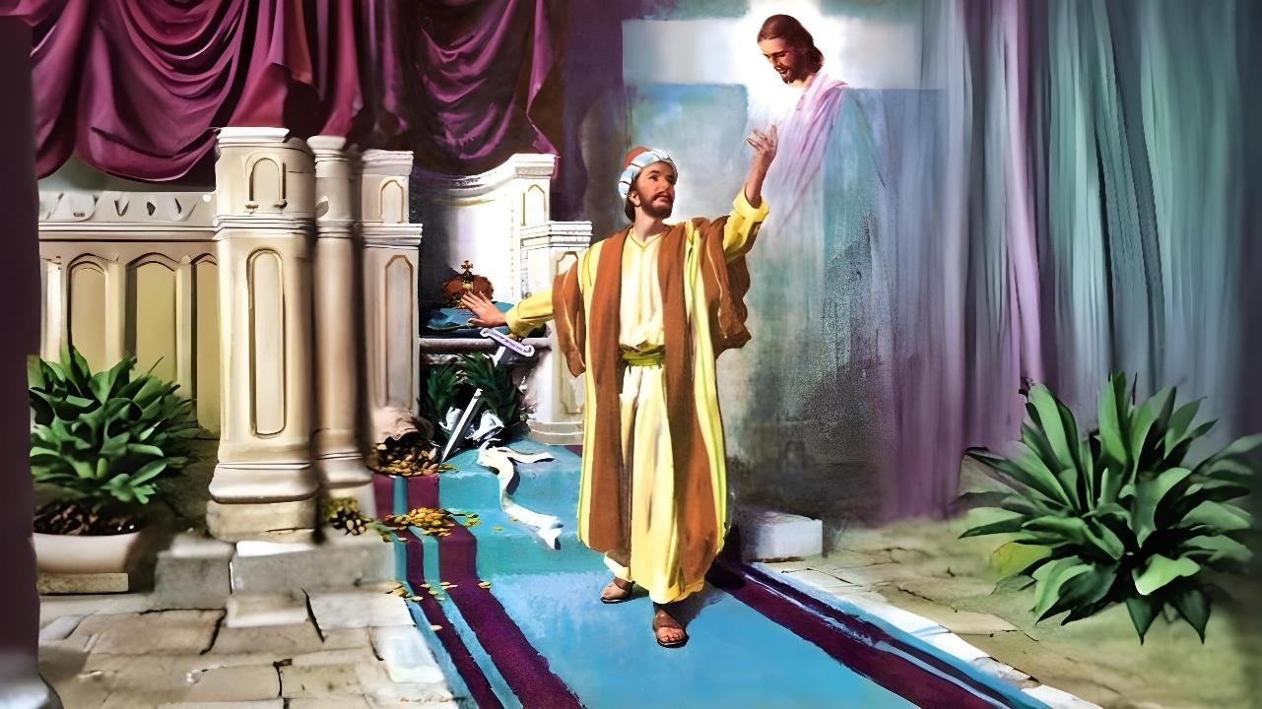
Isifundo sesithupha kuNhlolanja ilanga lesikhombisa ku2026
UKUZETHEMBA KUKRISTU KUPHELA

Slide 2


“Ukuze ngimazi yena lamandla okuvuka kwakhe, lenhlanganyelo yezinhlupheko zakhe, ngifaniswe lokufa kwakhe, ukuba mhlawumbe ngifinyelele ekuvukeni kwabafileyo.”
Filipi 3:10, 11

Slide 3










AbaseFilipi babeyazi indlela yokusindiswa, njengoba uPawulu loSilasi babetshelwe ngokucacileyo omunye wabaguquki bokuqala kulowo muzi: umgcini wejele (Izenzo 16:30-31).
Manje njengoba ibandla lase liqinisiwe, base besengozini yokudukiswa endleleni yensindiso.
Ngenxa yalesi sizathu, uPawulu ubakhumbuza ngezinsika eziyizisekelo zensindiso ngokholo
Izindlela zokuvika ukulahlekelwa yinsindiso yakho:
  Okufanele sikubalekele (Filipi 3:1-3)
  Kuyini okusele ngemuva (Filipi 3:4-6)
  Into ebalulekileyo (Filipi 3:7-8)
Indlela zokuhlala ensindisweni:
  Ukholo lukaKristu (Filipi 3:9)
  Ulwazi ngoKristu (Filipi 3:10-16)

Slide 4

AMACEBO UKUVIKELA UKULAHLEKELWA LUSINDISO LWAKHO

Slide 5

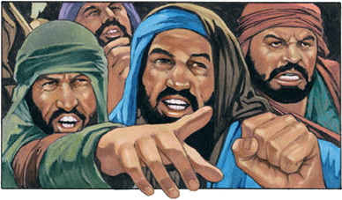

ONGAKUBALEKELA
“Xwayani lezo zinja, labo abenza okubi, labo abasika inyama.” ( KwabaseFilipi 3:2 )“
Ngaphambi kokuba akhulume ngezingozi ezisongela ukholo, uPawulu usipha iseluleko: “Jabulani eNkosini” ( Fil. 3:1a ). Kulokhu wengezelela okuthile okuqakathekileyo: kuhle ukuphinda iqiniso esilalo, ngitsho loba sesilazi kahle kukade ( Fil 3:1b ).
Ukwamukela isihe sikaNkulunkulu ( IHubo 31:7 )
Ukubeka ithemba lethu kuye ( IHubo 5:11 )
Ukwamukela izibusiso zensindiso (IHubo 9:14)
Ukugcina uMthetho KaNkulunkulu ( IHubo 119:14; Isaya 58:13, 14 )
Ukukholwa Ezwini Lakhe (IHubo 119:162)
Ukukhulisa Abantwana Abesaba UNkulunkulu ( IzAga 23:24, 25 )
Singajabula kanjani eNkosini?
UPawulu uveza ingozi enkulu eyayisongela ibandla ngaleso sikhathi: abafundisi bamanga ababefundisa ukubambelela ngokuqinileyo emthethweni wenkonzo (Fil. 3:2). Ubhekisela kuzo ngezindlela ezintathu ezihlukeneyo: izinja ( IHu. 22:16; 2 Pet. 2:21-22 ); abenzi bokubi; labalimaza inyama (ngokusoka).

Slide 6

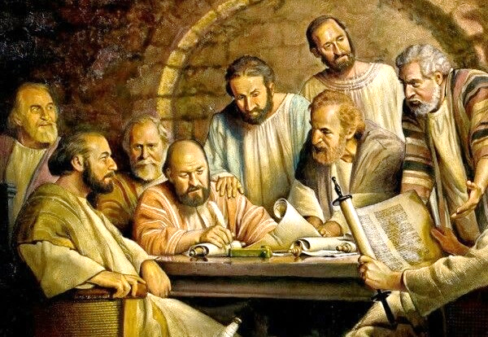
OKUSELE NGEMVA
“ ngasokwa ngosuku lwesishiyagalombili, ngingowabantwana bakwa-Israyeli, owesizwe sakwaBenjamini, umHeberu wamaHeberu, ngokomthetho ngingumFarisi” (Filipi 3:5).
EMkhandlwini waseJerusalema, kwakukhitshwe umyalo wokuthi abeZizwe akufanelanga bakhathazeke ngezindaba zomthetho wemikhosi yamaJuda (IZenzo 15:19-21). Ngalokho, abafundisi abathile babeze eFilipi befundisa ngesidingo sokusoka (Fil. 3:2-3).
Ngasokwa ngosuku lwesishiyagalombili; indodana yabazali abazinikeleyo
UmHebheru wamaHebheru; Benjaminite uqobo
Mayelana lomthetho, umFarisi oqinile kulabo bonke
Ngokuphathelene lentshiseko, wayengumtshutshisi wesonto.
Umqaphi woMthetho ongasolekiyo
Kodwa wazidla ngakho konke lokhu engakamazi uJesu. Manje wayeseyazi ukuthi wayengakaqondi ngisho noMthetho (Mt. 5:21-22). Manje wayeseyazi ukuthi uKristu kuphela osindisayo (Fil. 3:7).

Slide 7

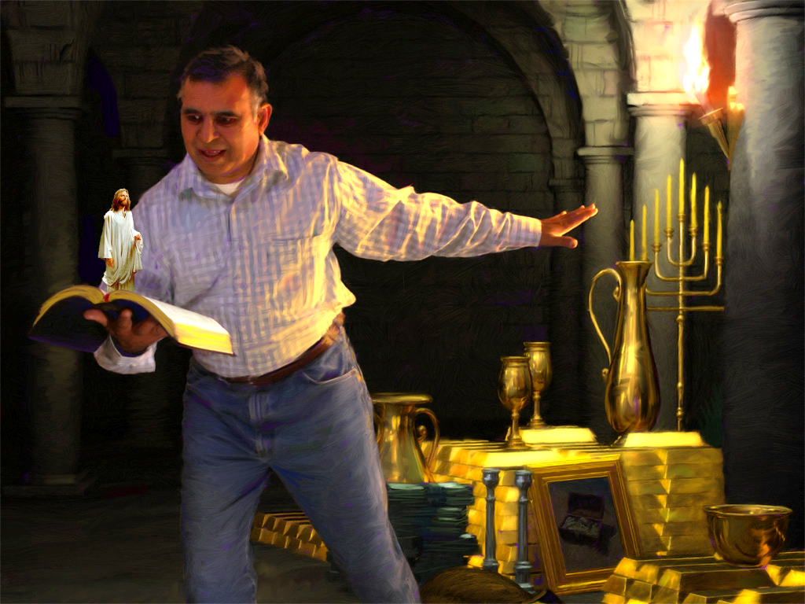



INTO EQAKATHEKILEYO
“Kepha lokho okwakuyinzuzo kimi manje ngikutshaya indiva ngenxa kaKristu” (KwabaseFilipi 3:7).
UPawulu ulinganisa impilo yakhe yangaphambili ngokumelene lempilo yakhe yamanje. Ngakolunye uhlangothi, ubeka lonke ulwazi lwakhe; ikusasa lakhe elikhazimulayo njengomfundi wenkanyezi kaGamaliyeli; izipho zakhe ezinhle zobuFarisi. Konke kuzuza
Manje, beka ngakolunye uhlangothi lwesikali impilo yakhe selokhu ahlangana loKristu. Yonke inzuzo iba udoti, ngoba akukho okungaqhathaniswa lothando lukaKristu (Fil. 3:7-8).,
Yini engaba ligugu ukwedlula ukuphila okuphakade ezulwini lasemhlabeni omutsha? Ngakho, izindinganiso zezwe ziphuphuthekisa abanengi leli qiniso. Kulokuncintisana okungokwemvelo phakathi kwezinto ezithathwa njengezibalulekile lapha lalokho iZulu elikwazisa ngempela: isimilo esinjengoKristu kanye lokusindiswa komphefumulo.

Slide 8

INDLELA ZOKUHLALA ESINDISWENI

Slide 9



UKHOLO LUKAKRISTU
“futhi ngitholakale kuye, ngingenakho ukulunga okungokwami okuvela emthethweni, kodwa lokho okungokukholwa kuKristu—ukulunga okuvela kuNkulunkulu ngesisekelo sokholo” (Filipi 3:9).
UPawulu, eqiniseka ngokulunga kwakhe siqu, waya eDamaseku ukuze abuyisele abahlubuki behlelo “leNdlela” endleleni yensindiso ( IzEnzo 9:1-2 ). Kodwa wangena eDamaseku enqotshwe okunye ukulunga, ukulunga kukaNkulunkulu: “lokho okungokukholwa kuKristu” (KwabaseFilipi 3:9).
Kusukela ngaleso sikhathi kuqhubeke, akaphindanga wathembela ekulungeni kwakhe. Ngokuba akusizi ukuthembela ezenzweni zethu ukuze sizuze insindiso (Gal. 2:16).
Wayelangazelela “ukufunyanwa [kuKristu]” ( Flp. 3:9 ). Kutsho ukuthini lokhu?
Ngokuka-1 Korinte 1:30, ukuba “kuKristu” kuhlanganisa yonke into ehlanganisa iHlelo Lokusindiswa, kusukela ekuqalekeni kokuhlakanipha kwethu okungokomoya (ukuhlakanipha), ngokulungisiswa ngokholo (ukulunga) nokulungiselela izulu (ukungcweliswa), ekugcineni, ukukhazinyuliswa ekubuyeni kwesibili (ukukhululwa).

Slide 10


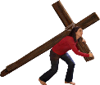




ULWAZI LUKAKRISTU
“ukuze ngimazi yena lamandla okuvuka kwakhe, lokuhlanganyela ezinhluphekweni zakhe, ngifaniswe lokufa kwakhe” (KwabaseFilipi 3:10).
Singamazi kanjani uKristu ( Fil. 3:10-16 )?
Lapho sifunda iZwi laKhe
Uma siholwa nguMoya oNgcwele
Lapho sihlanganyela ekuhluphekeni Kwakhe
Uma siqhubekela umvuzo
Impilo yobuKristu ifana lomjaho. Kumele sibe lomgomo wethu ocacileyo engqondweni. Asiphileli ukuhlala lapha futhi sijabulele lokhu kuphila. Sithemba ukufinyelela ekuvukeni kwabafileyo (Fil. 3:11).
UntilKuze kufike lowo mzuzu, silwela “ukubamba lokho uKristu Jesu angibambe ngakho”. ( Flp. 3:12 ). UJesu wangithola ukunginika umuzi; umklomelo; ukuphila okungapheli ukuhlala Naye ( Heb. 11:10; Flp. 3:14; 1 Thes. 4:17 ).

Slide 11

““Injongo enkulu eyabophela uPawulu ukuba afuqe ukuqhubekela phambili phakathi kobunzima lasebunzimeni kufanele idonsele sonke isisebenzi esingumKristu ukuba sizinikele ngokupheleleyo enkonzweni kaNkulunkulu. Izinto ezihehayo zezwe zizokwethulwa ukuze zidonsele ukunaka kwakhe kuMsindisi, kodwa kufanele aqhubekele emgawuweni, ebonisa izwe, ezingelosini, lakubantu ukuthi ithemba lokubona ubuso bukaNkulunkulu liwufanele wonke umzamo lokuzidela okudinga umzamo lokuzidela.
Umfundi kaKristu ophansi angase abe isakhamuzi sasezulwini, indlalifa kaNkulunkulu yefa elingenakonakala.”
EGW (Conflict and Courage, December 13)

