Slide 1

ISAKHAMUZI SASEZULWINI
Isifundo sesikhombisa kuNhlolanja ilanga letshumi lane ku2026

Slide 2

“Lingakhathazeki ngalutho, kepha kukho konke izicelo zenu kazaziwe nguNkulunkulu ngokukhuleka lokunxusa kanye lokubonga.”
Filipi 4:6

Slide 3


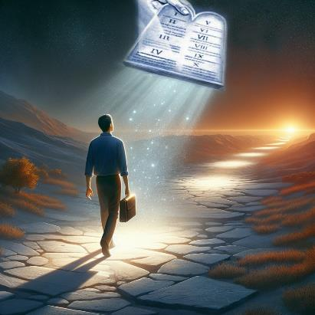


Kuzo zonke izincwadi zakhe, uPawulu ukwenza kucace ukuthi asisizo izakhamuzi zaleli lizwe. Ngokwamukela uJesu njengoMsindisi wethu, sizalwa ngokutsha. Ngalokhu kuzalwa okustha, siba yizakhamuzi zaseZulwini.
Njengokuba sizihlonipha futhi sizithoba emithethweni lasezinkambisweni zaleli lzwe, indlela yethu yokuphila, eqinisweni, ibanzi, ilokuziphatha okuphakemeyo kakhulu.
Isakhamuzi sasezulwini:
Lingisa abathembekileyo (Filipi 3:17-19)
Ukuba yisakhamuzi esigcwele (Filipi 3:20-21)
Size sifike lapho:
Ukuvumelana lokujabula (Filipi 4:1-6)
Imicabango ehlanzekileyo (Filipi 4:7-9
Ukwaneliseka ( Filipi 4:10-13, 19 )

Slide 4

ISAKHAMUZI SASEZULWINI

Slide 5
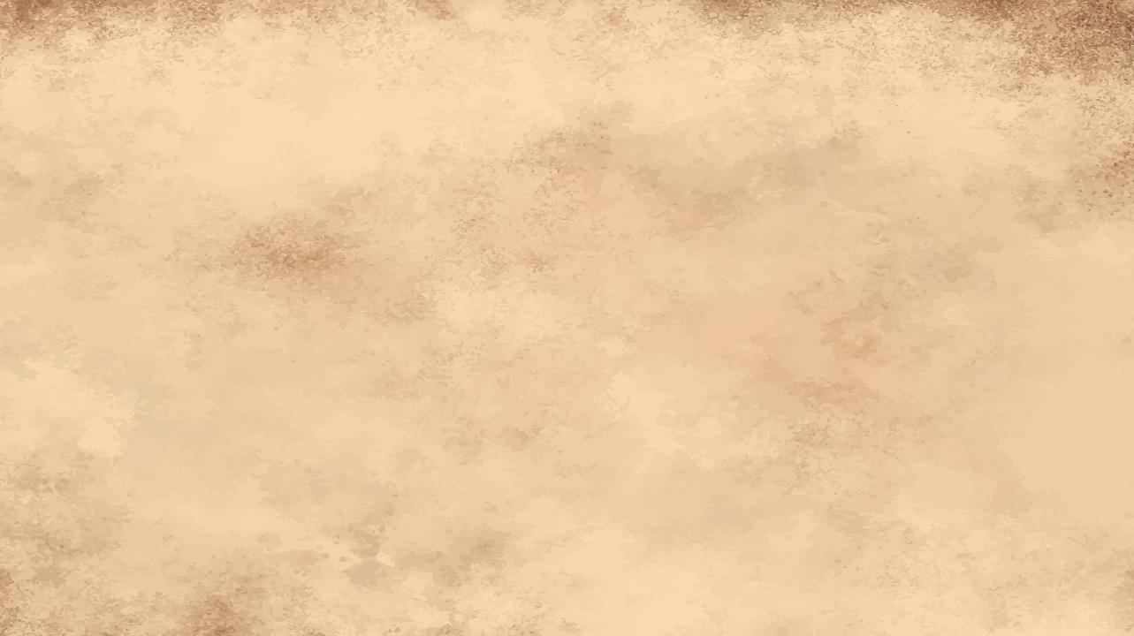

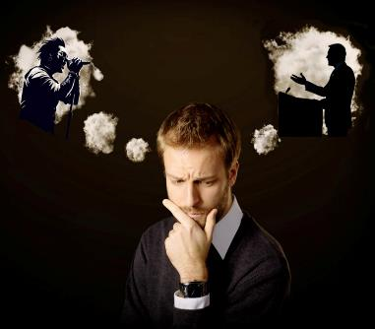
LINGISA ABATHEMBEKILEYO
“Hlanganyelani ekulandeleni isibonelo sami, bafowethu labodadewethu, futhi njengoba nje lilesibonelo kithi, gxilisa amehlo enu kulabo abaphila njengathi.” ( Filipi 3:17 )“
Sonke silabantu abalolonga ukuphila kwethu loba imicabango yethu ngendlela-thile. Mhlawumbe umculi, umgijimi, owezomculo, umhlabelisi. Mhlawumbe umfundisi, umtshumayeli, umzalwane loba udade othembekileyo.
Bana lalaba bantu "babeyisibonelo" basisize ukuthi sikhule njengabantu ngabanye, loba basiholele ezindleleni obekungafanele sizizame?
UPawulu usimema ukuba silingise labo izibonelo zabo ezisikhuthazayo futhi ezisikhuthaza ukuba sibe ngcono ( Fil. 3:17 ). Uyasixwayisa futhi ukuthi, laphakathi kwamakholwa, kulabantu abangafanele ukulingiswa (Fil. 3:18-19).
Kuyini okwenza umehluko? Abanye bacabanga ngezinto zasemhlabeni kuphela, kanti abanye bacabanga ngoJesu. Izibonelo ezinhle, nazo, zilingisa uKristu ( 1Kor. 11:1 ).

Slide 6

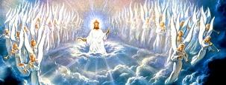

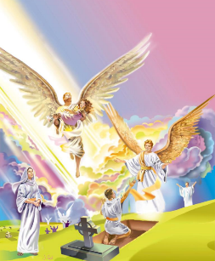
ISAKHAMUZI ESIGCWELEYO
“Kepha thina siyizakhamuzi zasezulwini, futhi silindele ngokulangazela uMsindisi ovela khona, iNkosi uJesu Kristu. ( Filipi 3:20 )
Ake sibhekane lakho. Thina maKrestu silohlupho: ubuzwe obubabili. Sobabili siyizakhamuzi zaleli zwe lezakhamuzi zasezulwini. Lokhu kudala ukungqubuzana okukhulu kithi ( Roma 7:22-23 ).
Imizimba yethu izoba ngeyakomoya, engafiyo, futhi engonakaliyo ( 1 Kor. 15:42-44, 50-54 )
) Sizakhazimuliswa ( Kol. 3:4; Flp. 3:21 )
Sizoba lomzimba wenyama, lamehlo ethu ayobona uNkulunkulu ( Jobe 19:25-27 )
Sizobuthola nini ubuzwe obugcwele? Sizayekela nini ukuba yizakhamuzi zaleli zwe elilesono? Ekubuyeni Kwesibili ( Flp. 3:20 ).
Lapho sivuswa (loba siguqulwa), futhi ukufa kungabi lamandla phezu kwethu, kuzokwenzekani?

Slide 7

SIZE SIFIKE KHONA

Slide 8



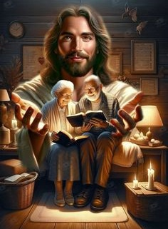
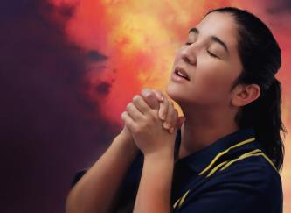
UKUVUMELANA LOKUJABULA
“Jabulani eNkosini njalonjalo, ngiyaphinda ngithi: Jabulani. ( Filipi 4:4 )
Ephetha incwadi yakhe, uPawulu uhlanganisa ukbingelela kwakhe uqobo leseluleko esilusizo. Ucela uSizigus [umngane othembekileyo] loClement ukuba basize u-Evodiya loSintike baphile ngokuvumelana. Kubo bonke, izisebenzi ezikanye loPawulu, uthi: “Amagama abo aselotshiwe kudala encwadini yokuphila” ( Fil. 4:2-3 )
Iseluleko esilandelayo singahle sidideke: “Jabulani ngaso sonke isikhathi […] Lingakhathazeki ngalutho” ( Fil. 4:4, 6 ) . Lokhu kungenzeka kanjani ezweni eligcwele izndubo lenhlupheko?
kungenzeka ngoba injabulo yethu “iseNkosini” ( Flp. 4:4a ). Siphosa inkathazo zethu kuYe, siqiniseka ukuthi angasithwala ( Mat. 6:31-34; 1 Pet. 5:7 ).
Futhi siziphosa njani izinkathazo zethu kuJesu? Ngomthandazo ( Fil. 4:6 ).

Slide 9



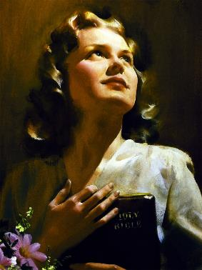
IMIBONO EHLANZEKILEYO
“Elokucina, bazalwane, konke okuliqiniso, konke okuhloniphekayo, konke okulungileyo, konke okumhlophe, konke okuthandekayo, konke okubukekayo, loba kukhona okuhle, loba kukhona okubongekayo, cabangangani ngakho.” ( Filipi 4:8 )
Kokuliqiniso
Ukukwethembeka
Kulungile
Ngendlela emsulwa
Ngomusa
Ngegama elihle
Umphumela wokuphosa izinkathazo zethu kuJesu lokujabula ekuthuleni (Fil. 4:7). Ukuthula izwe elingeke likuphe loba likuthathele (Johane 14:27; 16:33).
Lokhu kuthula, ngokukaPawulu, kuzaba yisivikelo—umlindi—wemizwa lemicabango yethu (Fil. 4:7b). Ukuze lo olindayo aphumelele, yiziphi izinto okufanele sicabange ngazo ( Fil. 4:8 )?
Ngamafitshane: “Aluba kukhona okuhle, uma kukhona okufanele ukudunyiswa, cabangani ngalezi zinto” (Fil 4:8b).

Slide 10






UKWANELISEKA
“Futhi uNkulunkulu wami uyokwanelisa zonke izidingo zenu ngokwengcebo yenkazimulo yakhe kuKristu Jesu” ( Flp. 4:19 )
Siyajabula; akukho okusikhathazayo; silokuthula; imicabango yethu ihlanzekile. Silempilo epheleleyo futhi eyanelisayo… loba thina?
Njengo-Aguri, sithemba ukuthi uNkulunkulu ngeke asinike okungaphezu kwalokho okusifaneleyo thina (IzA. 30:8-9).
Uma siphila lalokhu kuqiniseka, siyaqiniseka ukuthi “ngingakwenza konke ngaye ongipha amandla” ( Fil. 4:13 ).
Singaba lenotho; singaba lendingeko loba inhlupho. aluba, njengoPawulu, silesiqinisekiso esigcwele sokuthi uNkulunkulu uqondisa ukuphila kwethu, sizahlala siqiniseka Kuye kungakhathalekile ukuthi isimo sethu sinjani ( Fil. 4:11-12, 19 ).

Slide 11

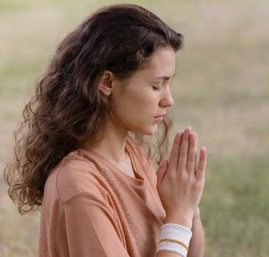
UKWANELISEKA
“Futhi uNkulunkulu wami uzakwanelisa zonke izindingo zenu ngokwengcebo yenkazimulo yakhe kuKristu Jesu” (Fil. 4:19)
Kwenzekani lapho singelakho esicabanga ukuthi siyakudinga?
Masikucele eNkosini, futhi uma kufanele ngentando Yayo, uzasipha (Jakobe 4:2b; 1 Johane 5:14-15).
Asazi njalo ukuthi esikucelayo kuvumelana lentando Yakhe, kodwa kulezicelo ezithile esiqiniseka ngazo ukuthi zihambisana lentando Yakhe ngaso sonke isikhathi:
Ukusindiswa kothandekayo loba umngane ( 1 Thim. 2:3, 4 )
Isibindi sokuhlanganyela ukholo lwethu ( IsAm. 22:17 )
Intethelelo lapho sivuma futhi sikuyeka okubi (1 Johane 1:9)s)
Amandla okulalela imiyalo kaNkulunkulu ( Heb. 13:20, 21 )
Uthando kulabo abasizondayo labasiphatha kubi ( Math. 5:44 )
Ukuhlakanipha ezimweni eziyinselela (Jakobe 1:5)
Ukuqonda iqiniso eliseZwini likaNkulunkulu (Johane 8:32)

Slide 12

“Kufanele siphilele izwe elizayo. Kudabukisa kakhulu ukuphila ukuphila okungaqondanga, okungelanjongo. Sifuna into ekuphileni—ukuphila ngenjongo. UNkulunkulu asisize sonke ukuba sizidele, singazikhangeleli, sikhohlwe ngokwengeziwe ubumina lokuzithandela; futhi senze okuhle, hatshi ngenxa yodumo esilindele ukukuthola lapha, kodwa ngoba lokhu kuyinjongo yokuphila kwethu futhi izophendula ukuphelakokuphila kwethu.”
EGW (Our High Calling, August 24 )

