Slide 1
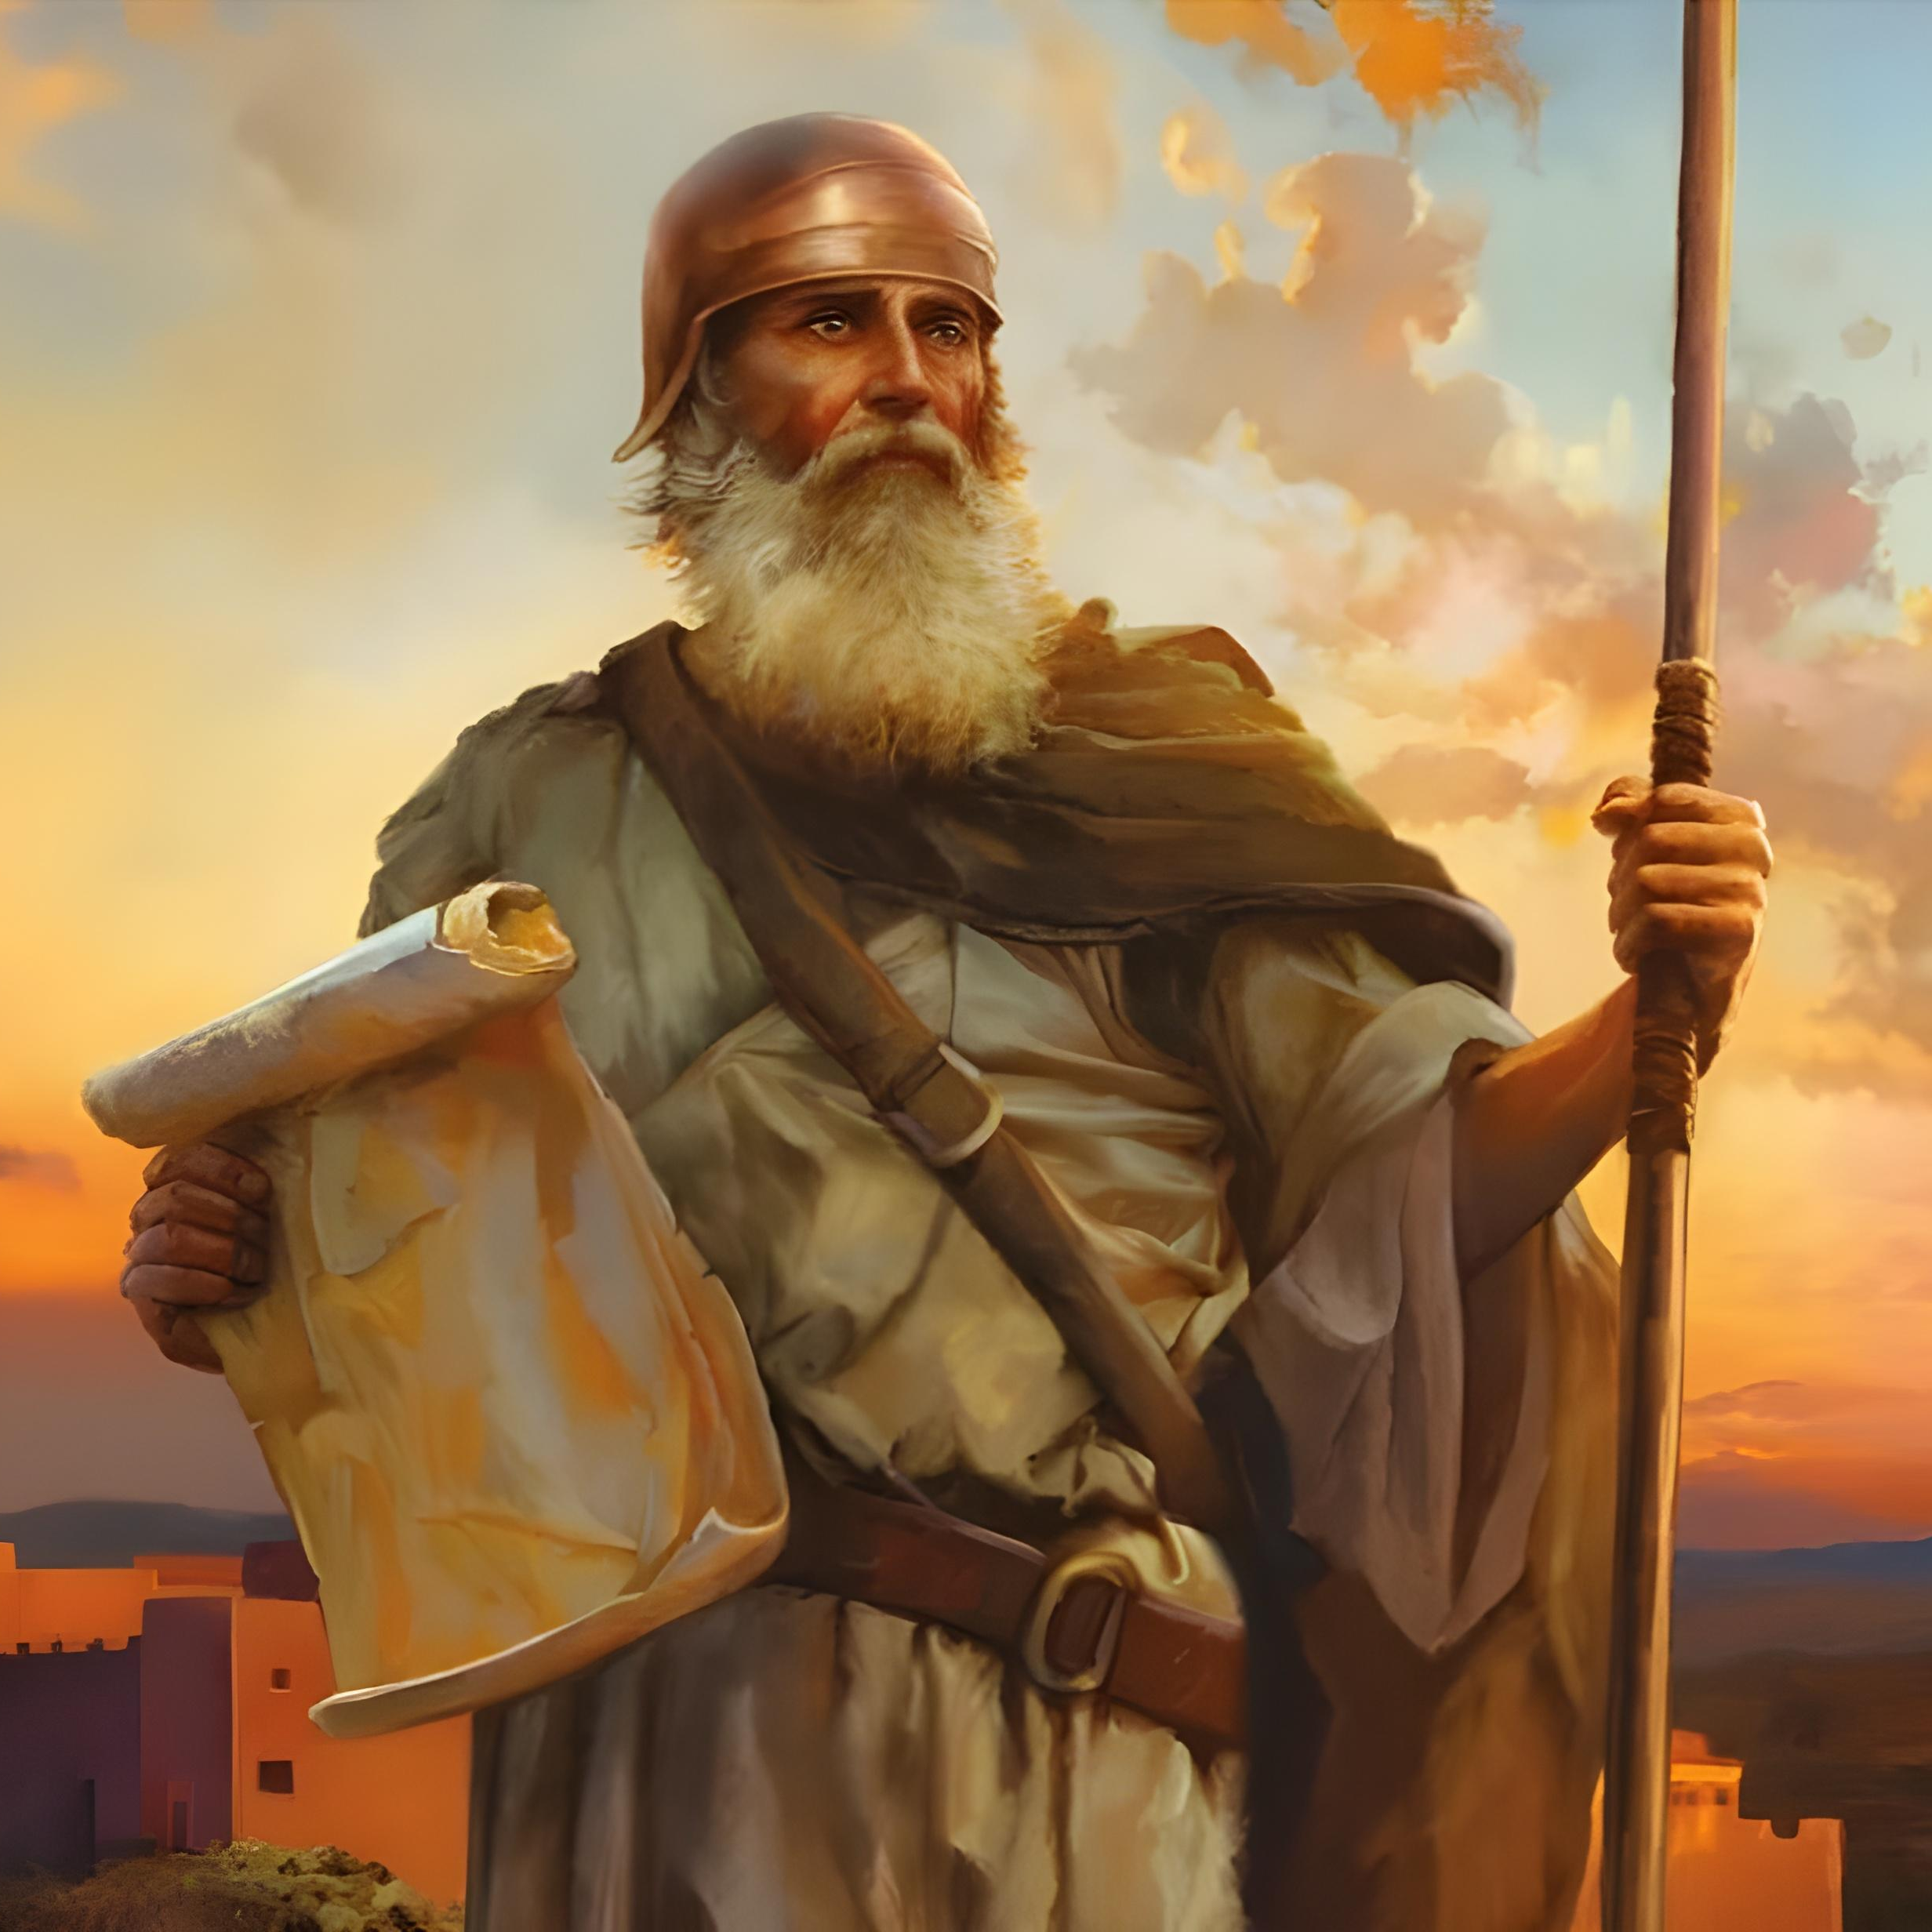
“Qina kuphela, ume isibindi kakhulu, ukuba uqaphele ukwenza ngokomthetho wonke akulaya ngawo uMose inceku yami, ungaphambuki kuwo uye ngakwesokunene loba ngakwesokhohlo, ukuze ube lempumelelo lobaphi lapho uya khona.”—
Joshuwa 1:7 , NW.

Slide 2
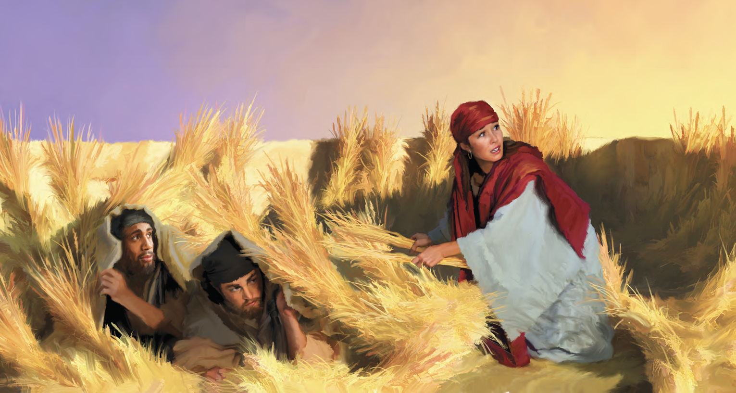
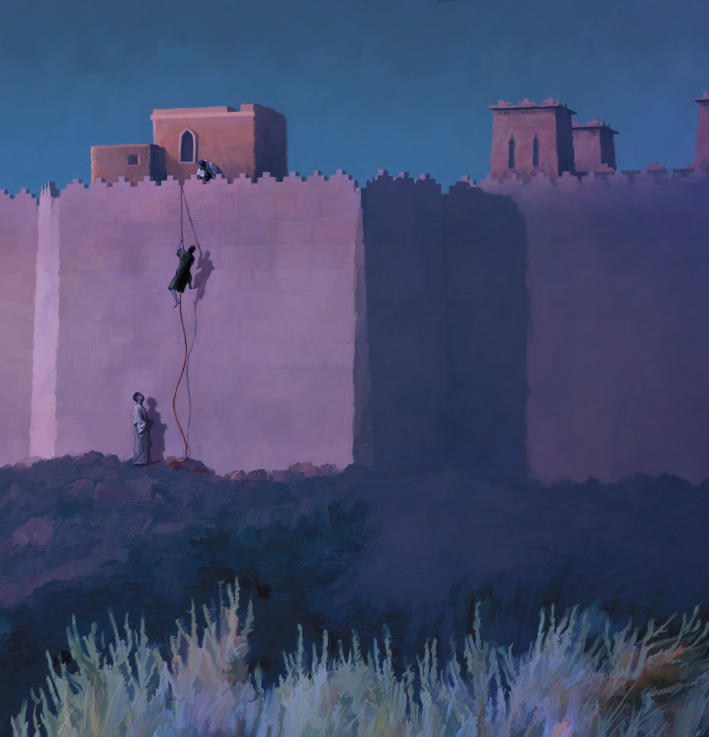
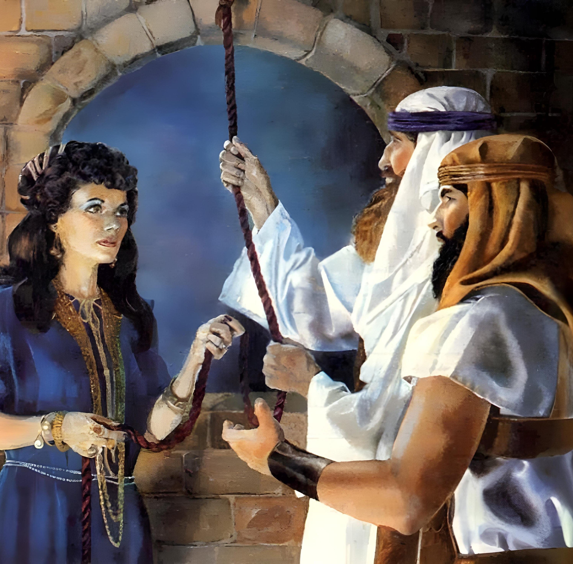
“Ngokukholwa uRahabi isifebe akabhubhanga kanye labangakholwanga, esezamukele izinhloli ngokuthula.”
(Hebheru 11:31 , NW)

Slide 3
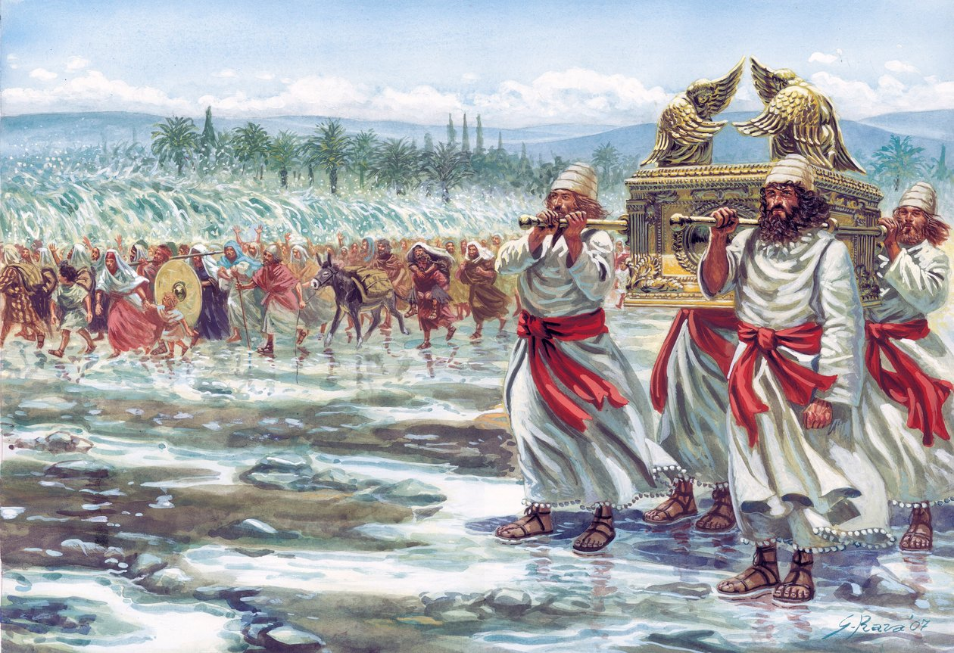
“Ngokuba uJehova uNkulunkulu wenu womisa amanzi aseJordani kini, laze lawela, njengalokho uJehova uNkulunkulu wenu esenza oLwandle Olubomvu walomisa kithi, saze sawela, ukuze zonke izizwe zomhlaba zazi ukuthi isandla sikaJehova silamandla, ukuze limesabe uJehova uNkulunkulu wenu kuze kube phakade.”
Joshua 4:23, 24, ESV

Slide 4
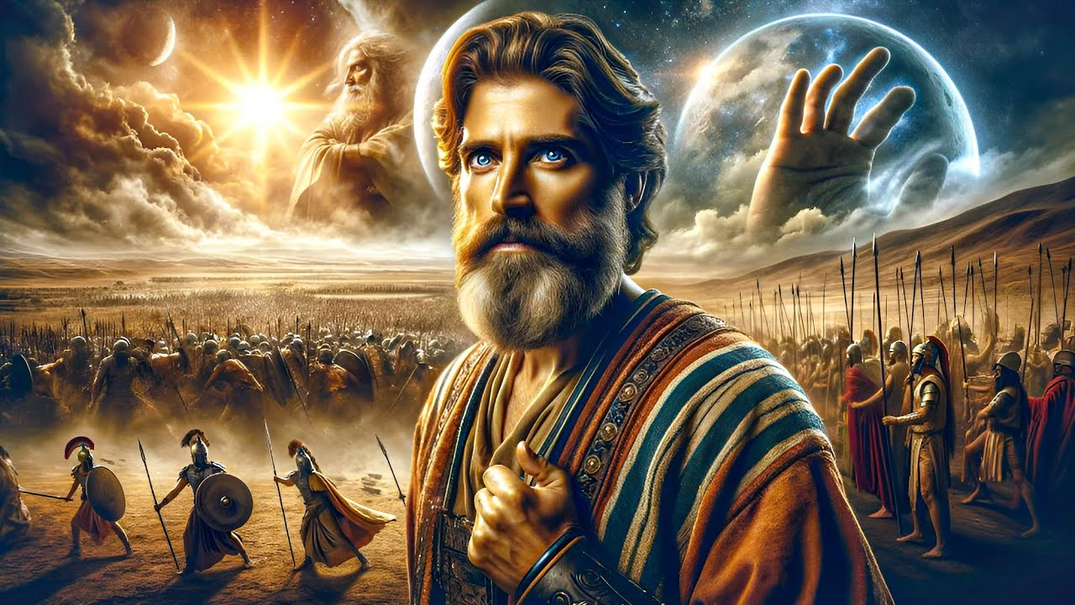
“Alukaze lube khona usuku olunjengalo ngaphambi langemuva kwalokho, lapho uJehova esizwa izwi lomuntu, ngokuba uJehova wamlwela u-Israyeli.”
Joshuwa 10:14, ESV

Slide 5
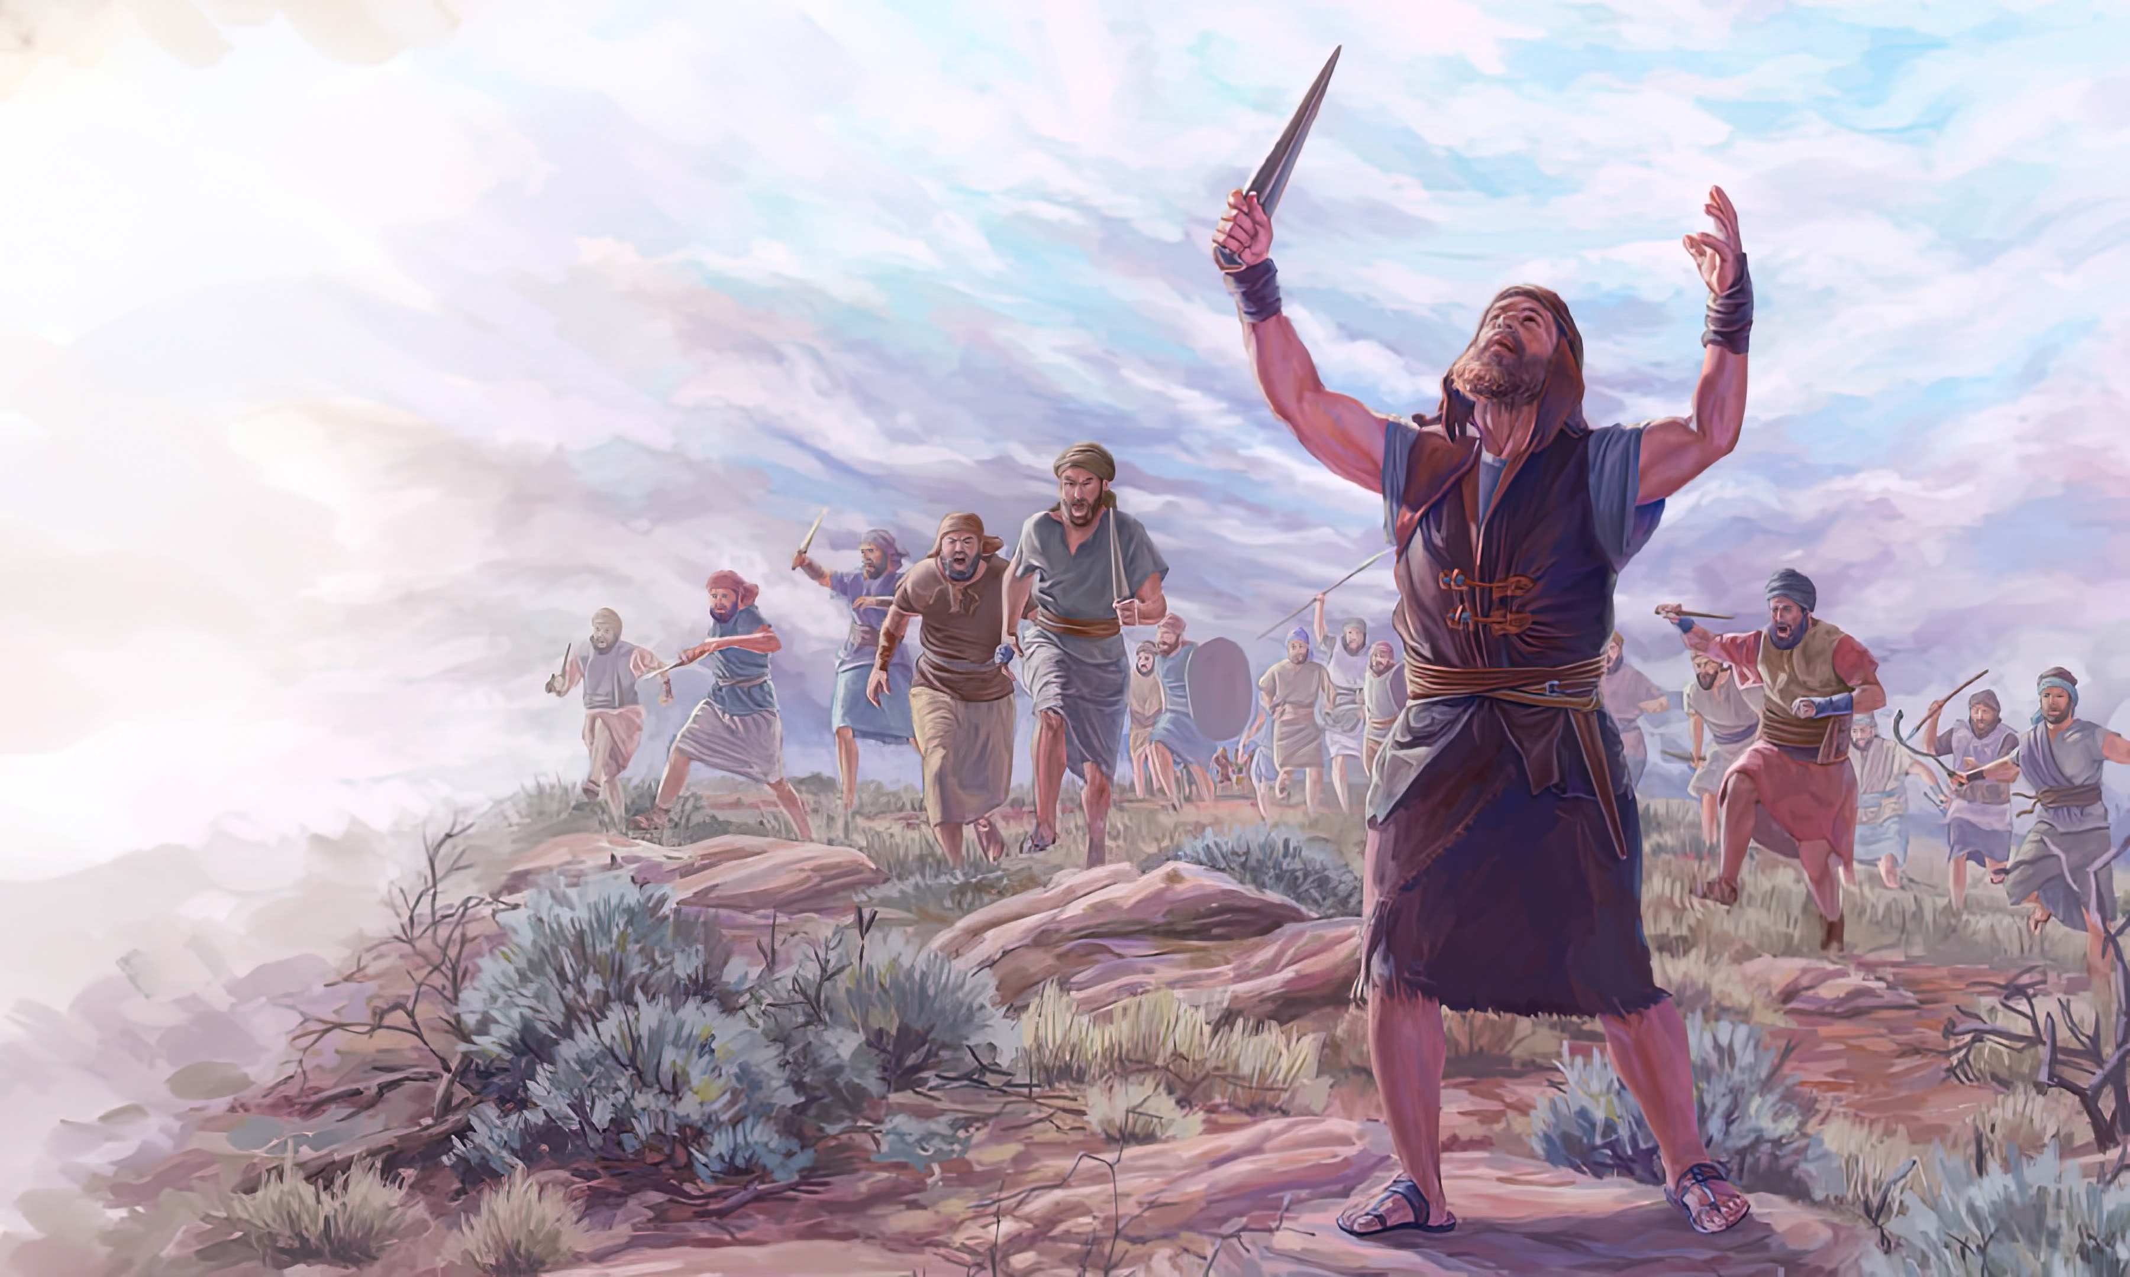
“UJoshuwa wawathumba onke la makhosi lezwe lawo ngasikhathi sinye, ngokuba uJehova uNkulunkulu ka-Israyeli wayemlwela uIsrayeli.”
Joshuwa 10:42, ESV

Slide 6


“Mina Jehova ngihlola inhliziyo, ngivivinya izinhliziyo ukuba nginike yilowo lalowo njengezindlela zakhe, njengezithelo zezenzo zakhe.”
Jeremiya 17:10, ESV

Slide 7


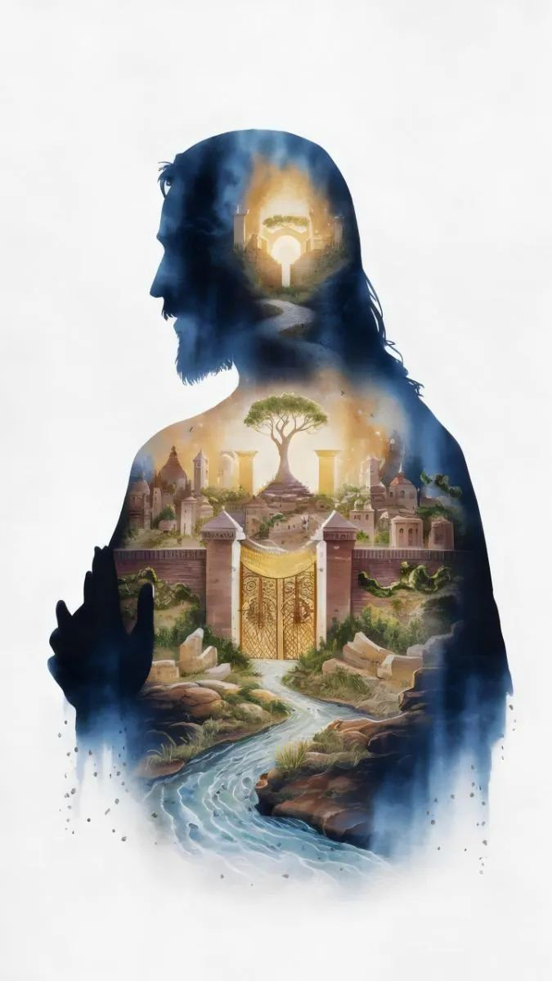
“Kodwa funani kuqala umbuso kaNkulunkulu lokulunga kwakhe, khona konke lokhu kuyakwengezelelwa lina”
Mathewu 6:33, ESV

Slide 8
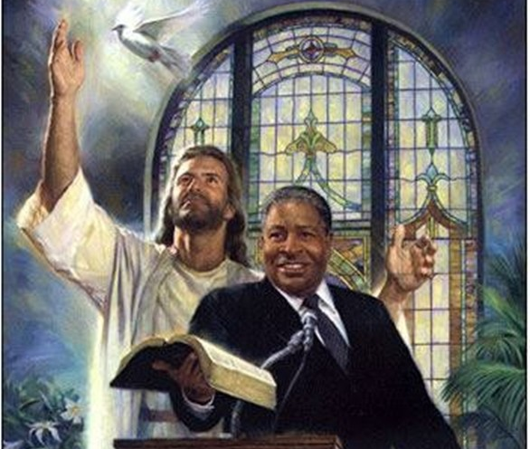
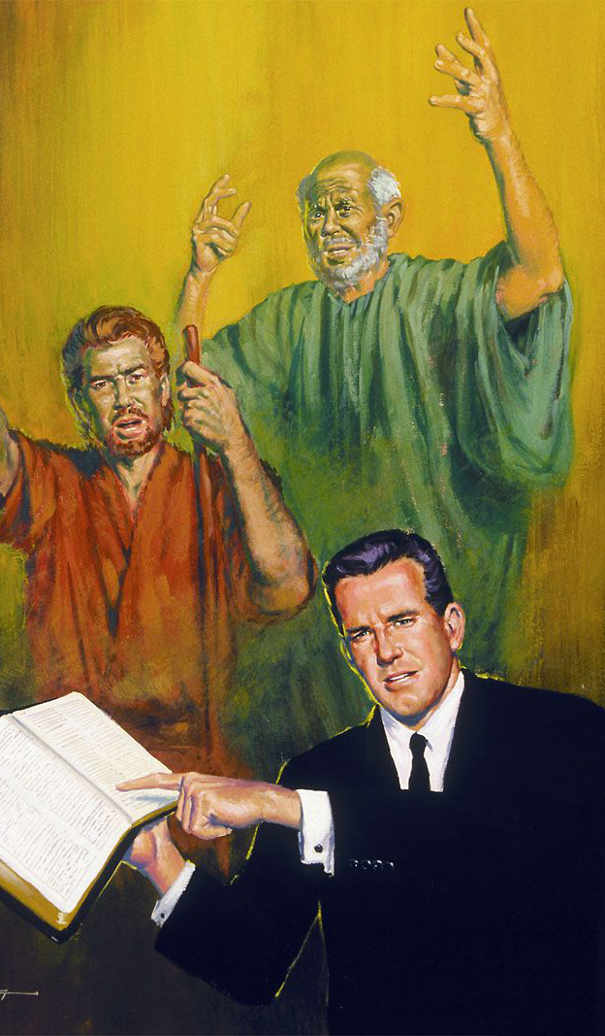
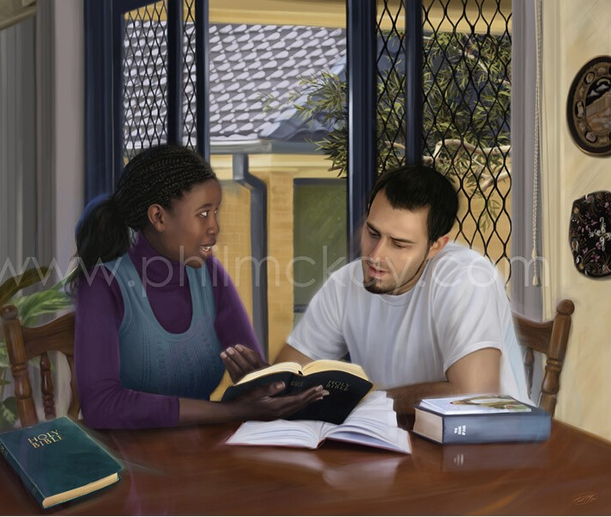
“Khumbulani abakhokheli benu abakhulume izwi likaNkulunkulu kini, libheke ukuphela kwendlela yabo, lilingise ukukholwa kwabo.
(Hebheru 13:7 , NW)

Slide 9
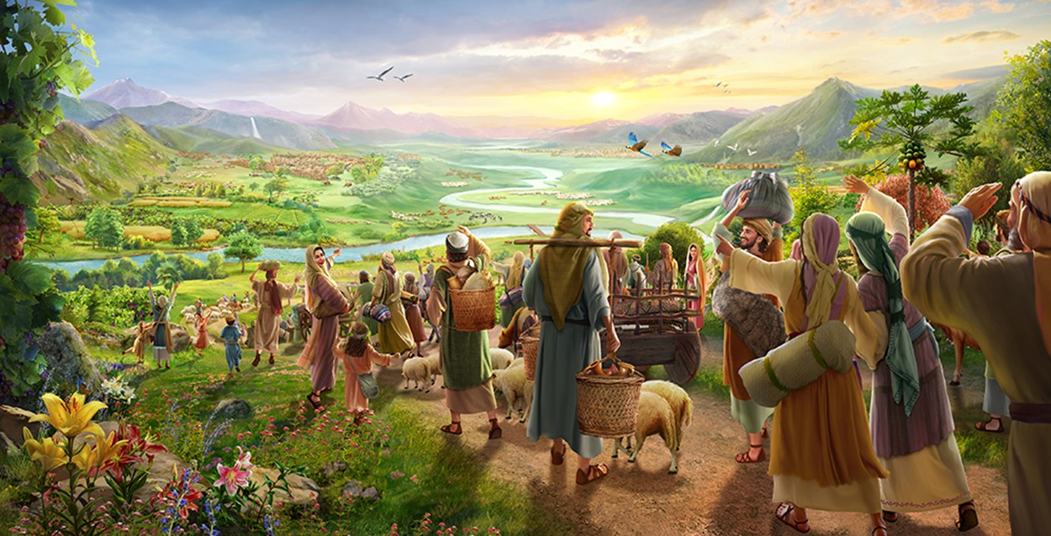
“Buyelani enqabeni yenu, lina zibotshwa zethemba; lamuhla ngiyamemezela ukuthi ngiyakubuyisela kini okuphindwe kabili”
(Zakariya 9:12, ESV)

Slide 10
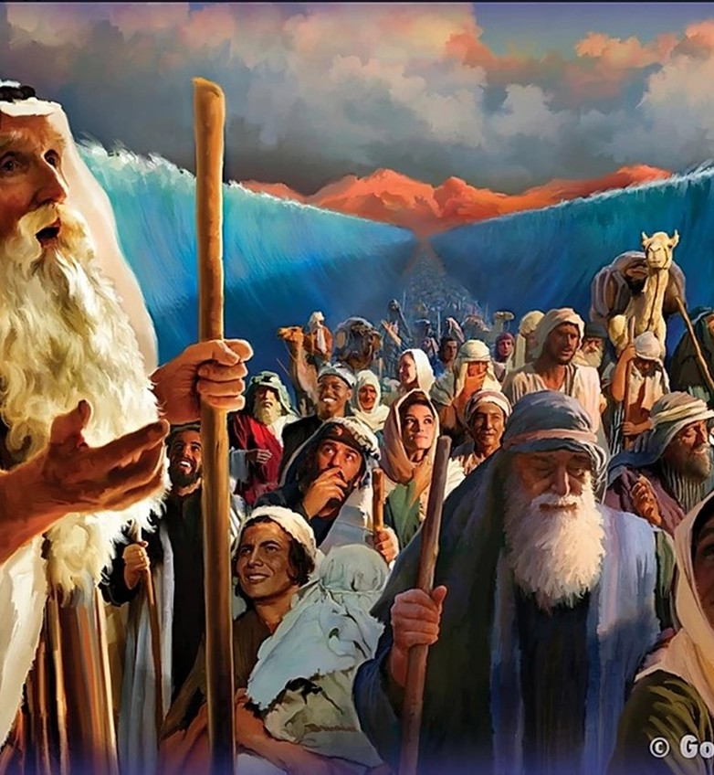
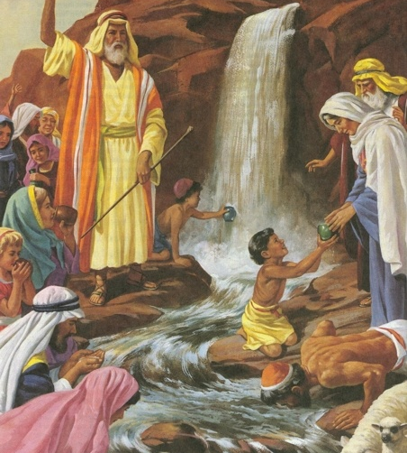
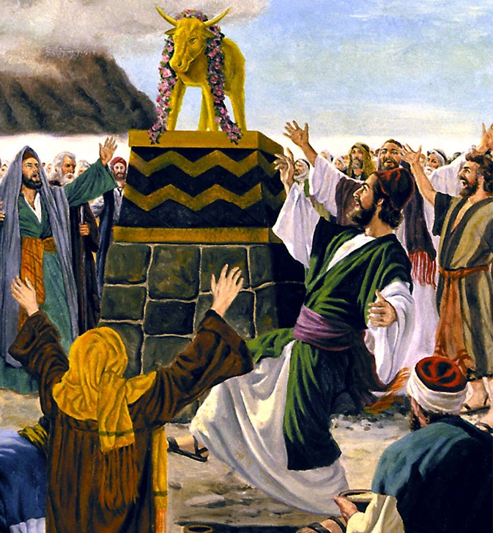
Manje lezo zinto zabehlela bona kube yisibonelo, kodwa zalotshwa ukuze kufundiswe thina, osekufike kithi ukuphela kwezikhathi.”
( 1 Korinte 10:11, ESV )

Slide 11
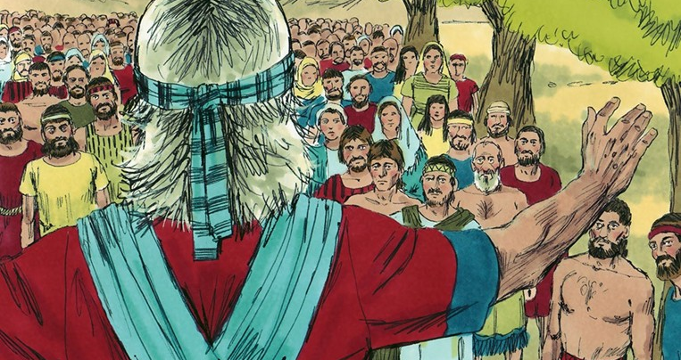
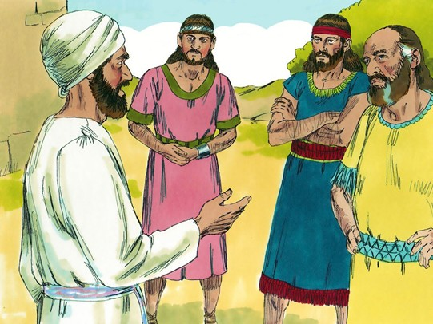
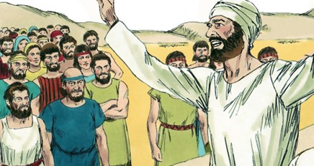
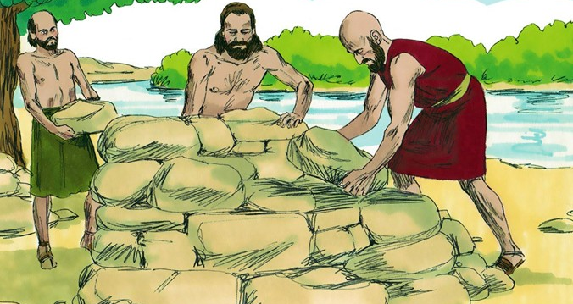
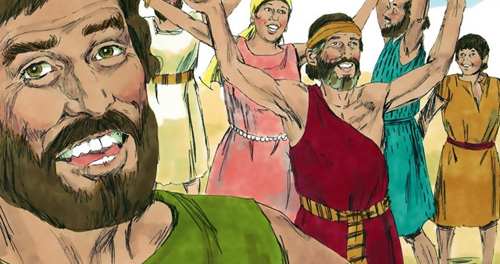
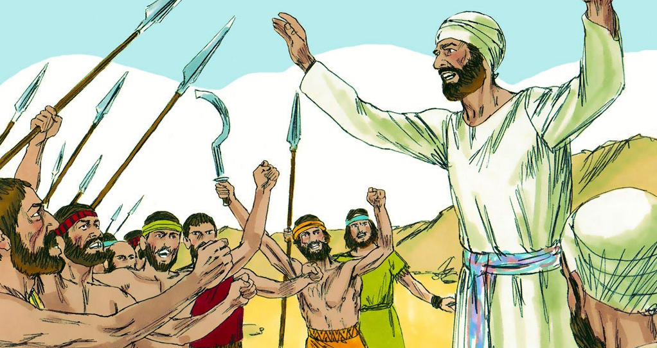
“Impendulo ethambileyo isusa ulaka, kepha izwi elilukhuni livusa ulaka.” ( IzAga 15:1, NIV )

Slide 12
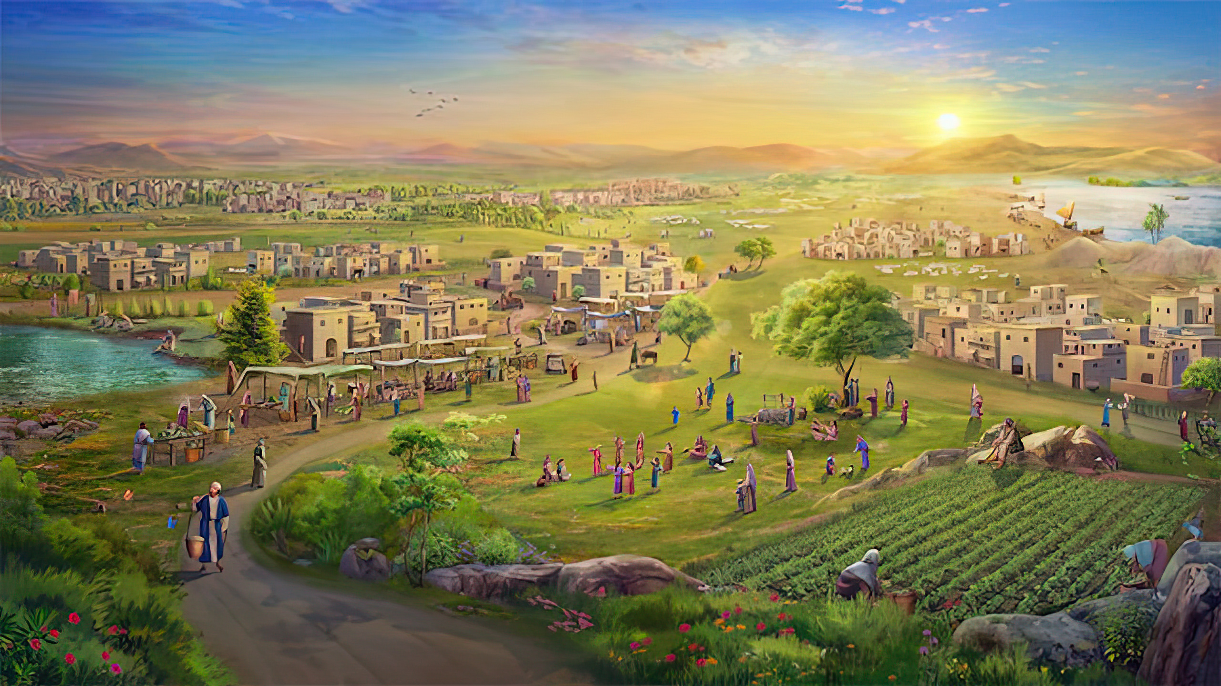
Akwehlulekanganga zwi elilodwa kuzo zonke izithembiso ezinhle uJehova ayezenzile endlini ka-Israyeli; konke kwenzeka” (Joshuwa 21:45, ESV)

Slide 13
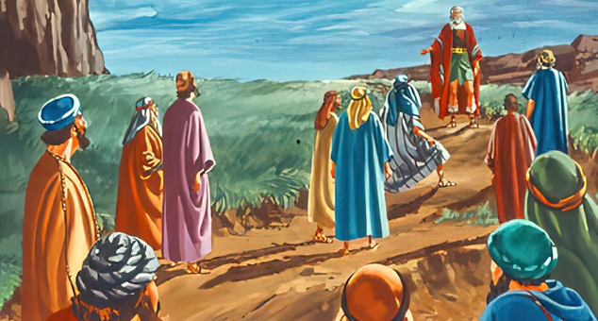
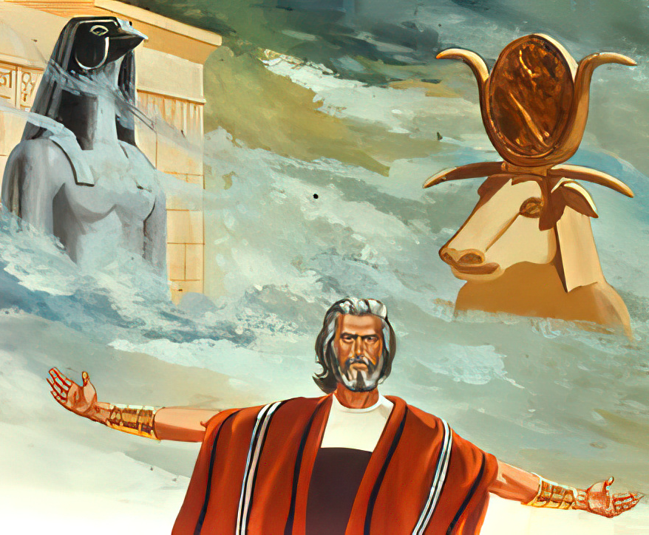
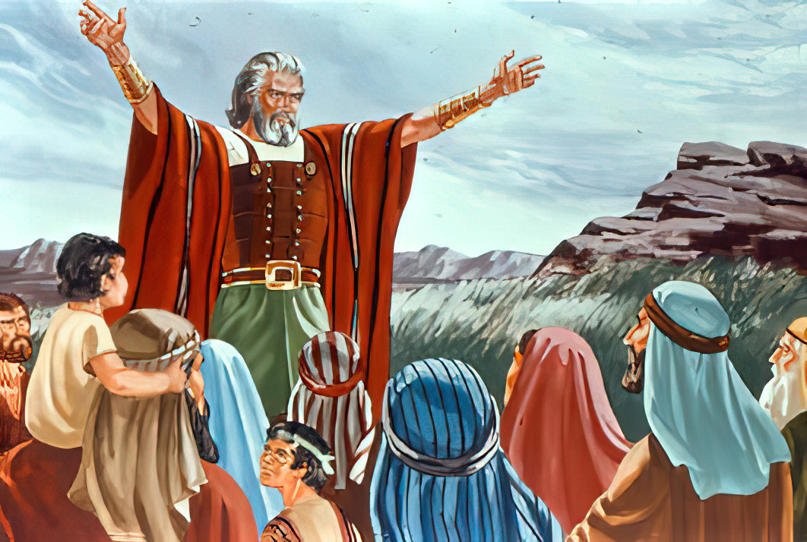
“Uma kukubi emehlweni enu ukumkhonza uJehova, zikhetheleni namuhla ukuthi ngubani eliyakumkhonza; kepha mina lendlu yami siyakumkhonza uJehova.
( Joshuwa 24:15 , NW )

