Slide 1
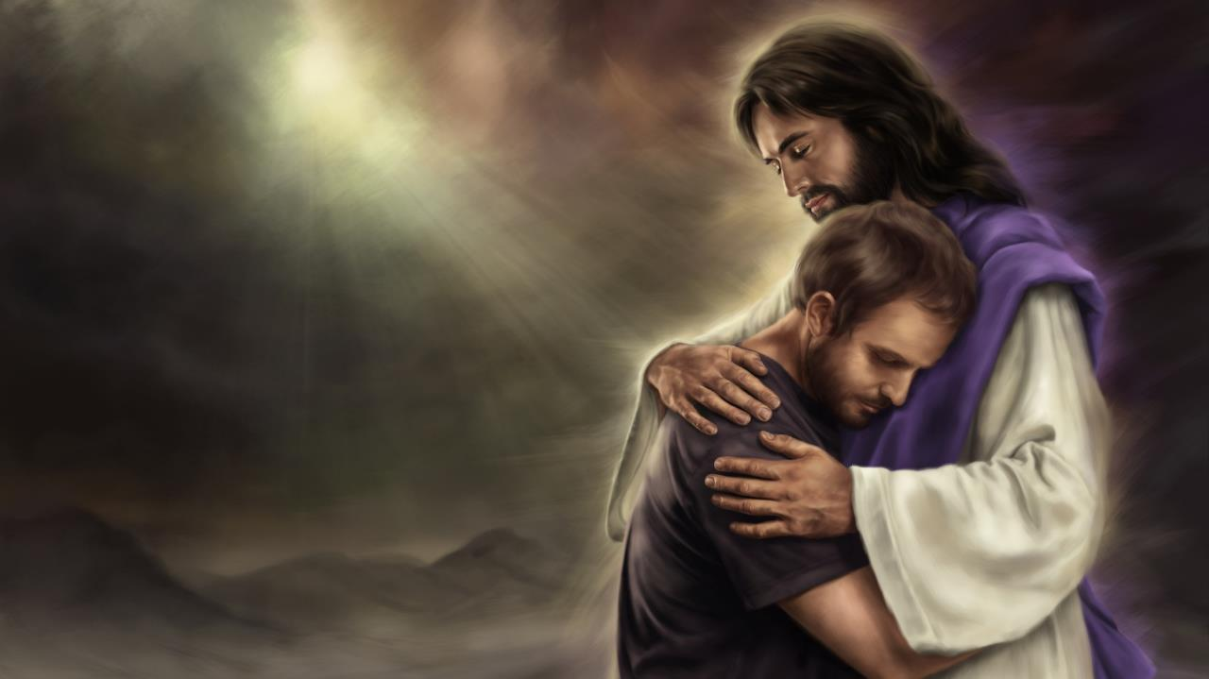
KUOTH NH&KV V LSR
X55c 1 Pvt 4, 2025

Slide 2
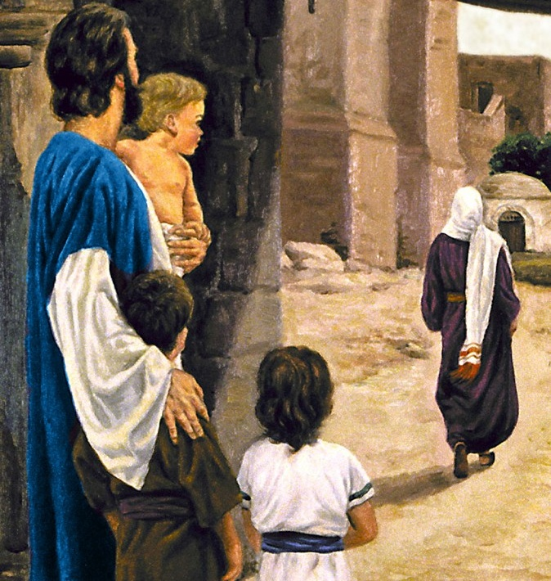

“ ‘Bä thil ŋäthädiɛn jak kä gɔaa, kä bäkɛ nhɔk kɛ lɔcdä kɛ li̱w, kɛ ɣöö cä bi lɛ ŋot kɛ mi gakä kɛ kɛ.’ ”
Ɣocä 14:4, NKJV

Slide 3


T22 kv thiecni ti xuan v lsx t5 dee ben nhial mi ruac ksn kv ku5 nh6k` Kusth kvnv lukdv kv cu]x. rvy p`thni d1x disk t5t5, bi ksn luscni g6r kv ku5 thiecni t5t5 kvnv thiecni tin ksx:
Nh6k Kusth v ku5 kvl ( m5 lot ni f66, th6pv nh6k k` /cv nh6k k`n )?
Nh6k Kusth v ni laa b` kv min ci rsdv l11t?
V puc divri kv ku5 naath?
D22 raan nh6k Kusth fer kiv derv jv gak?
Kuoth laa wee rvy maar` nh6k` mi guackv kvnv nvy tin cv cak?
Ci gak d22 w` kvvl kvnv nh6k?
Nh6k kvnv luk cux` v xu la r6mdivn?
Mi Kuoth v nh6k, v xu t3 ji``k mi diit rvy fsaa kv jv ms?
D22 raan t3 kv nh6k c3tkv Kuoth? M5 derv tusk, derv kulv tens 5d5?
Rvy xiic` nvmv, bi ksn thiecni d1x disk titi guic:
Dee nh6k Kusth lu`x kv them?
  B``lv min carkv
  Th6p kvvliw
G6r Kuoth nyusth nh6k` kvnv f66 bv jv jek?
  Kuoth nh6kv ni baax
  Nh6k mi /thivlv lusc mi caarv
D22 ksn Nh6k Kusth f2r?
  Mekdan

Slide 4

DEE NH^K KUSTH LU~X KV THEM?

Slide 5

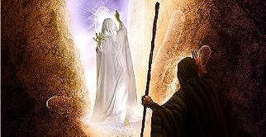
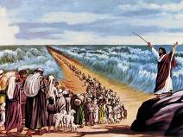
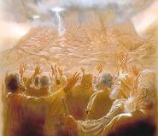
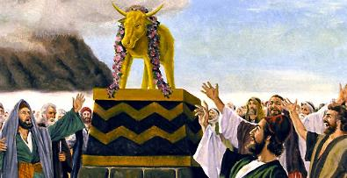

B~~LV MIN CARKV
“Kä cuɛ wee i̱, ‘Ɣän bä gɔɔydä kɛɛliw jak kä jɔc nhiamdu, kä bä ciötdä ni Kuoth Nhial nyoth nhiamdu, bi lɔcdä gɔaa kɛ ram in cä je̱k i̱ bä nyuɔ̱th gɔɔy lɔaacdä, kä bi lɔcdä kɔ̱a̱c kɛ ram in cä je̱k i̱ bä nyuɔ̱th kɔ̱a̱c lɔaacdä.’’’ (Ɣöth 33:19 NIV )
Mi ci ksn kv kuvn kv du]]p mi /ci ms a min caa kv gsr kv jv, tee kv b`thni ti dee ksn kv gu5c vn f66 l`t kvn ksn f66 nh6k Kusth v mi cu`x naath, kv f66 laa nh7kv kv gu11th in cv jv g6r 5 bv nhsk kv jv k` rsa (F6th. 33:19.)
Duxdv f66 m5 gu5c ksn l0x kvvliw. Ci Kuoth J5 I-thv-rvl k1m raar k` I-j5p kv nyuuthni ti dit. Cv ruac kv kv w55 p11m Thi-nay k` cv kv thiec kv f66 deekvn v jak k` Kuothdivn k` rsa. Kv ksr nini ti tst cu kvn rsdivn t1th ruath d`p` k` cu kvn wee 5, “ti̱ti̱ kɛ kɛn kuthku tëë ka̱mkɛ ji̱ raar muun I-jëp!” (F6th. 32:8 NIV.) cu Kuoth Mu-thv l1t f66 nvy t5t5 lot kvn ni rsdivn kv l51 (F6th. 32:9-10.)
Cu Muthv Kuoth l`x kv f66 derv kv nyusth k]1c lsaac min /ci rsdv lot kv kv (F6th. 32:11–13, 30–33.) rvy ruac vmv, ci Kuoth v nyusth Muthv v jsc vn f66 “g6r” f66 derv k]1c lsac nyusth I-thv-rvl (F6th. 33:19.) nh6k Kuoth /cv guur ni t11 c`r` min laar f66 min ci l1t v jvn bi j2k s. Nh6kdv /caa d22 luex kv them; p``rvns ni ciax k` /cv thuk. Ni baax cv Pu]th baaxdv, K]1c lsaacdv kvnv Nh6kdv th6p, cv kv k1mkv am`ni nvy tin /ci kvn r7x kv kv.

Slide 6
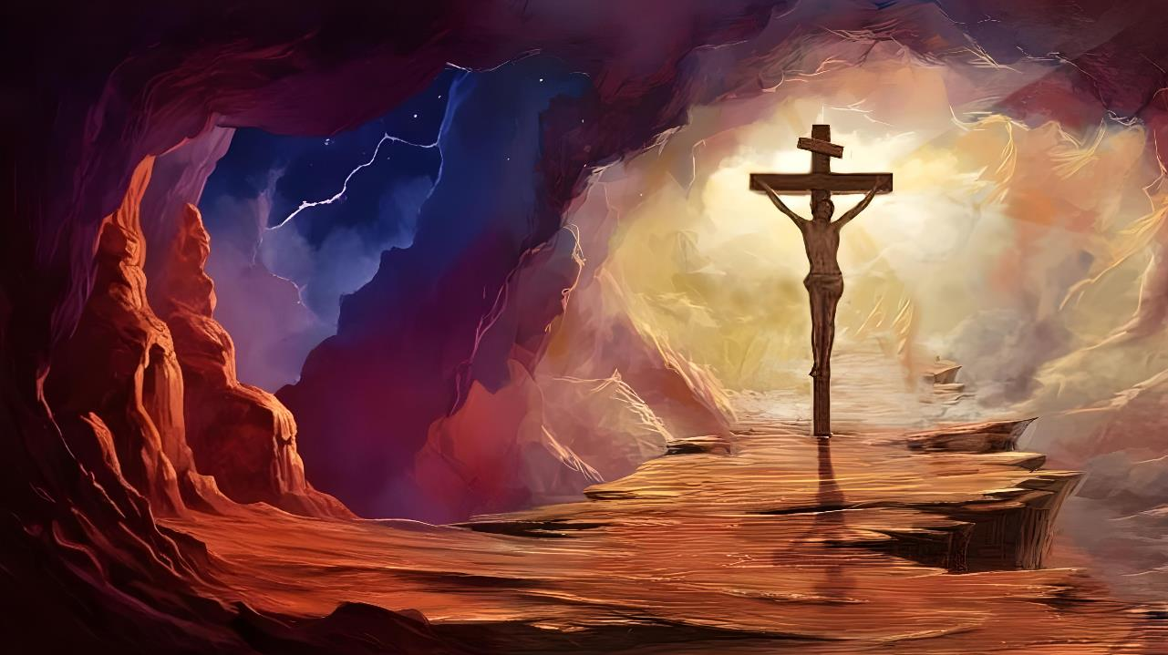
TH^P KVVLIW
“…Gat Kuɔth, min nhɔk ɣä, kä cuɛ rɔɔdɛ thöp kɛ kui̱dä”
(Gä-lëë-cia 2:20b)
J]] jiath in gvvr – gu1th in ci nh6k Kusth jssc thin - ci ksn v nvn vn f66 ci Kritho rsdv th6p kv ku5dan kv nh6kdv v lsr k` caar jvn. /Thivlv ram mi ci tekdv k1n, duxdv f66 cv jv th6p v nhsk jvn, kv ksr matd` min caa l1t R66l Nhial kv ku5 c1p k`n` mee caa l1t v /k1n wic mu]]n ni yiath piny. (J]]n. 10:17-18; 1Pi-tsr. 1:18-20.)
Nh6kdan derv cop k` pek mi nin 5d5? Derv cop ni k` f66 dee raan t2kdv th6p kv kui raam mi nhsk 5 k` g6ri f66 bi jv rsam t22k`? K` dee ran v l1t kv ku5 raam mi ju]r, kiv ram mi nyiir j5? (R6m. 5:7)
“Ci Kritho li̱w kɛ kui̱ ji̱ dueeri” (R6m. 5:6 NIV.) “Kä ci Kuoth kɔn nyuɔ̱thɛ nhökdɛ kɛ ɣöö mëë ŋuɔtnɛ ala ji̱ dueer cu Yecu li̱w kɛ kui̱dan” (R6m. 5:8 NIV.)

Slide 7
G^R KUOTH NYUSTH NH^K~ KVNV F^^ BV JV JEK?

Slide 8


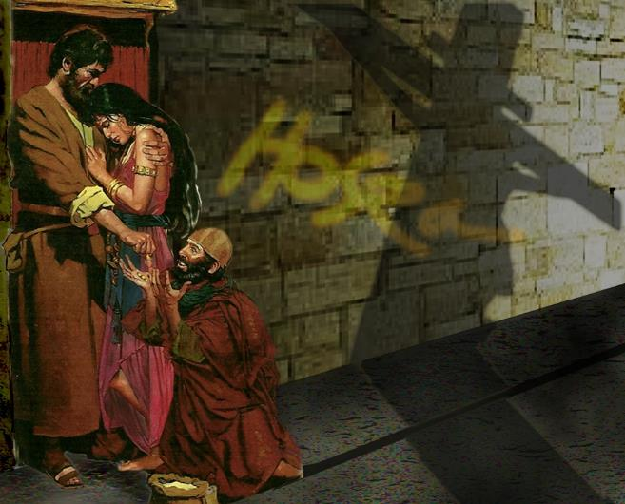
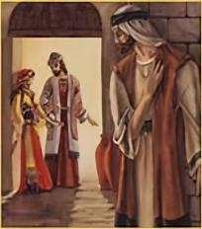
KUOTH NH^KV NI BAAX
“Bä thil ŋäthädiɛn jak kä gɔaa, kä bäkɛ nhɔk kɛ lɔcdä kɛ li̱w, kɛ ɣöö cä bi lɛ ŋot kɛ mi gakä kɛ kɛ.” (Ɣocä 14:4)
L0x kv ku5 Foc` nyuthv ksn f66 c3t nh6k Kusth kv xu. V c`x ni m22 laa ciekdv jv a jay, laa foc` jv a p`lik` gu1ths kvnv gu1th in dsx v nysk, k` xotdv b` wee kv w` nhiam kv nh6kdv kv jv
Foc` cuxv kv gu11th Kusth, k` ciekdv min thivl x1th cuxv kv gu11th nvvni Kusth. V c`x ni min w` ksn kv w` nhiam rvy dueeri kvnv b`nydivn kv Kuoth piny, xotdv wee kv w` nhiam kv nh6kdv kv ksn “kv lscdv kvliw” (Foc`. 14:4.) V xu lot nvmv jv ms?
Riet thusk Fi-bv-ru, na-da-ba, nyothv ni mi th6pkv v lsr v /thivl kok (c3tkv muc mi th6pkv v lsr.)
Kuoth th6pv nh6kdv, v c`x /thivlv mi baa lusc jv b`. Kuee laa mi gu1c 5d5 kv ciax rvvx`dan!
V xu dee a luscdu ms kv jvn nh6k v lsr vmv k` ci rsdv tiim?

Slide 9




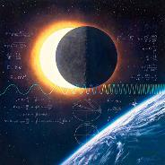

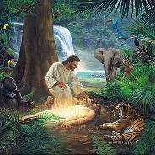
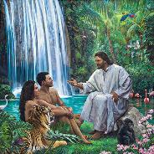
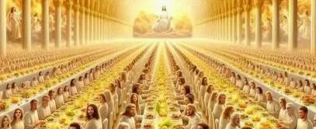
NH^K MI /THIVLV LUSC MI CAARV
“Kä ŋa̱cä diit nhial diaal, kä tin diaal tin tëk kɛ nyinkä. Kä mi ci buɔth ɣä näk, /cä yɛ dëë thiec, kɛ ɣöö ɣɔw kɛnɛ tin diaal tin te thi̱n kɛ nyinkä.” (Diit 50:11-12)
G6r Kuoth f66 bv w5c mu]]n cak kv f66 d22 jv kulv nhsk, d22 lusth kvnv f66 d22 jv pal?
Kuoth thivlv mi g6rv k` ksn (L`t 17:25.) kv thu]k, kv nvy d1x d5 x`c jv ts vn f66 tin diaal tin t3 kv kv, am`ni t2kdivn, vn f66 v muc k` Kuoth? K` kv nvy d1xd5 liakv jv k` l1r kv jv tvthlsaac s vn walv kv ku5divn?
Nh6k Kooth` t22 thin v thivlv pek v xot k1n fsw ni cak, c3tkv min ci Yecu jv nyoth v jsc m22 latdv f66 nhsk Gu1n v “/ka̱n ɣɔw ni cak” (J]]n 17:24.) kv f66 ns, /civ c1k wec mu]]n nyooth f66 t3 nh6k Kusth wans. Kv f66 ns, kvn nyin c`k` diaal kv l`t Kusth v lsr min b` k` lsar nh6k`dv min lvny dssr v /thivl pek.
Kuoth v nh6k, k` nh6kv v thivlv lusc mi caarv. Nhskv nvy tin lusc kv nh6kdv, kvnv nvy tin f2r kv jv. Kv f66 nh6kdv /thivlv jv pek cv t5 diaal l1t kv f66 d22 tin cv cak, gaatkv, t2k tvthk` lsaac mi d6raar nyuak kv Jv kvvl.

Slide 10
D@@ KSN NH^K KUSTH F@R?

Slide 11


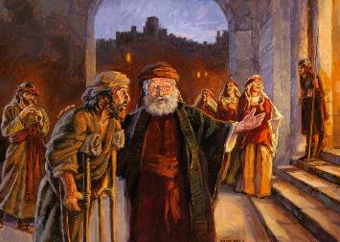
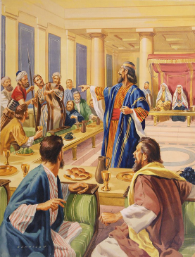
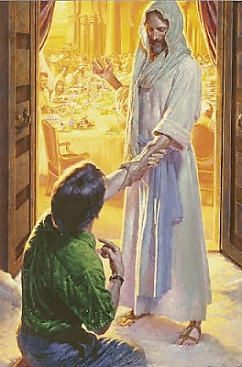

MEKDAN
“Kɛ ɣöö ca nɛy ti ŋuan cɔl, kä ca kuany ni nɛy ti tɔt” (M0-thiw 22:14)
Cu ku``r kuen gatdv rialik`, duxdv f66 cu nvy tin caa csl ci6t l6k. Cua nvy tin ksx csl k` cu kvn v nhsk, duxdv f66 rvydivn t22 kv nvy ti ken du]]p in caa l1tkv gu]]r k` cua kv tu]k raar (M0-thiw. 22:1-13.)
Du]]p in ci Yecu c``t vmv lat kv jv cv th1x naath jak k` f66 bi kvn v x`th vn f66 ci Kuoth mvvk ni tuk` kv nvy tin bi k``n kvnv nvy tin /ci bi k``n (M0-thiw. 22:14.) vn nvmv derv nyusth ni ksn f66 ci Kuoth nh6kdv k1m th1x naath, k` cv jv pen nvy tin k]x.
Vn b`th ni tuk`dv min g6rv vn f66 bv nyusth ksn v ci6t v /ci ms a mek: “ca nvy ti XUAN CSL, k` kv nvy ti tst ci CI^T NHSK.”
Kuoth cv ksn diaal mvk kv f66 nhskv ksn diaal (J]]n. 3:16.) min bi ksn jak k` f66 banv guut nik`, /civ mek Kusth, v luscdan kv ci6l in cv csl ni ksn.

Slide 12

“Ciax gssy` min thusk wec mu]]n bath, k` ci w` ni jvn rvy civx` kac` raar k` ruac Kusth kvnv ciax ji`k x`c` mi gsaa kvnv mi ji`k; k` ciax Yecu v jvn min ci l1t v bum nyoth, kv j1ydv kv rs kv f66 bv raan lusc jsk v nysk kv thi1xdv kv jv kv yi22 gssy` Kooth` kvnv nh6k mi /ci rsdv tim. M22 t22 w55 mu]]n, /civ raan wec mu]]n. V b0c mi w` kv w` nhiam vn f66 baa jv r6m kv tvr, thivl lu`x` kvnv thivl wic wiic` min ci gu1n ji`kni jv n66x rvc; duxdv f66 tee kv l1t mi bv l1t kv f66 bv raan n66x k` mat k00l kv c1p kooth`, k` bv w5c mu]]n r6m kv R6l nhial, k` /thivlv th6p kv rs mi gu5cv vn f66 ditdv v /cv jv dee lu`x kv l`tni kv f66 bi min g6rv cu]p.”
EGW (Testimonies for the Church, volume 5, page 177)

