Slide 1
GWERO LA NKHONDO ZONSE
Phunziro 1, April 6, 2024

Slide 2
“Zitatero, kumwamba kunayambika nkhondo. Mikayeli ndi angelo ake kumenyana ndi chinjoka chija. Chinjokacho ndi angelo ake anabwezeranso. Koma analibe mphamvu ndipo anagonjetsedwa nathamangitsidwa kumwambako” (Chivumbulutso 12:7, 8)

Slide 3
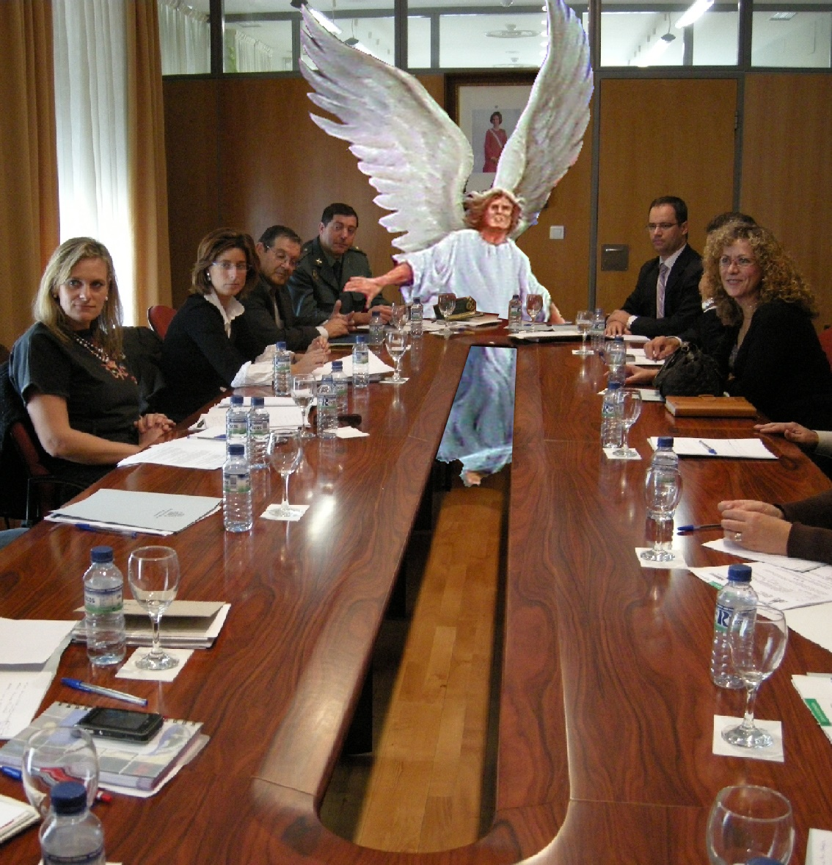
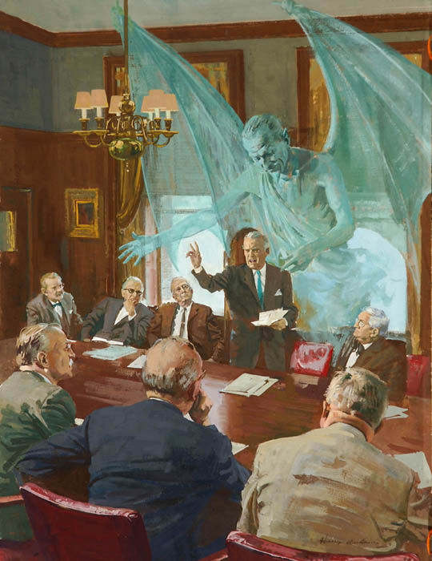
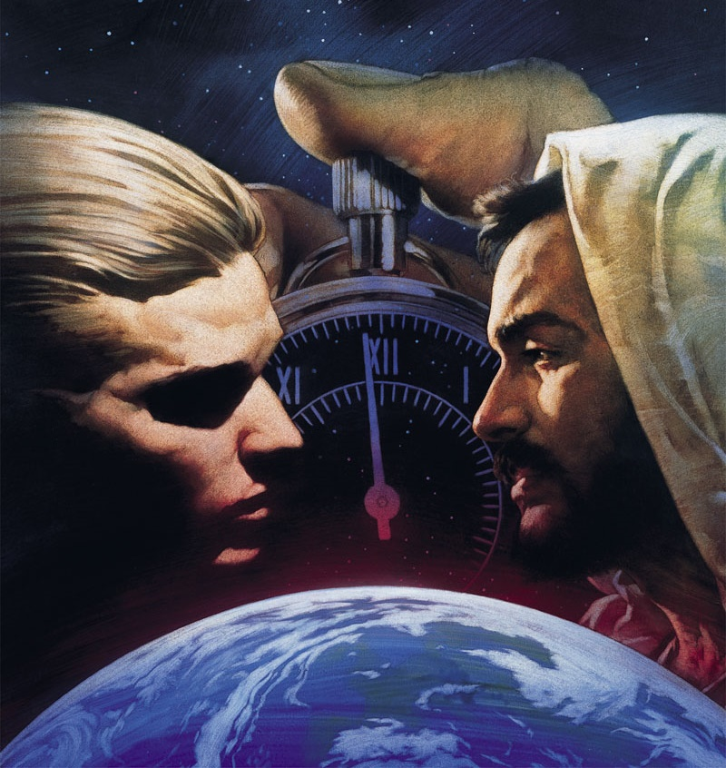
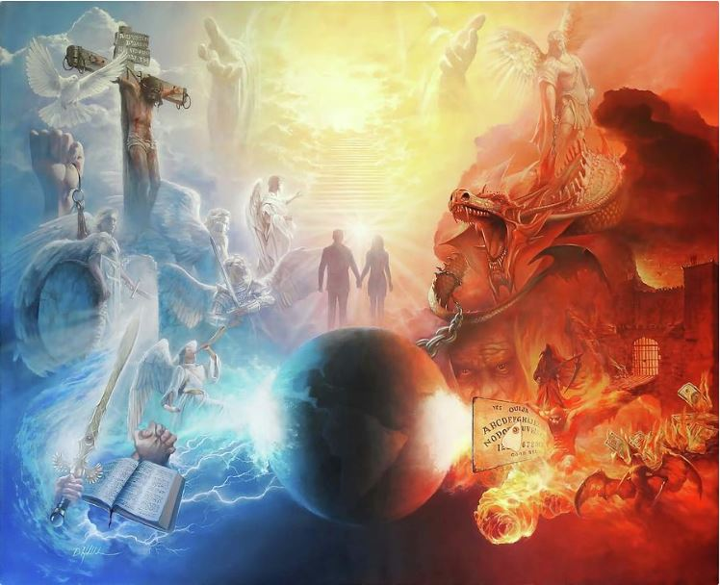
Tikukhala munthawi ya mumkangano waukulu. Ndizovuta kuti tikhulupilire zamlanganowu koma izi zikuchitikadi.
Mphamvu zolimbana ndi zauzimu, zosaoneka ndi maso (Aefeso 6:12). Koma, tikukhudzidwa ndi zotsatira za nkhondo imeneyi. Matsoka, chiwerewere, imfa …
Boma la Mulungu, kukhulupirika kwa angelo ndi maiko ena osachimwa, kunali pachiopsezo. Lero lino kukhulupirika kwa inu ndi ine kulinso pachiopsezo.
Chiyambi cha mkangano
Kupanduka kumwamba
Kupanduka pa dziko lapansi
Chikondi chibwezeretsedwa
Mkangano lero lino

Slide 4
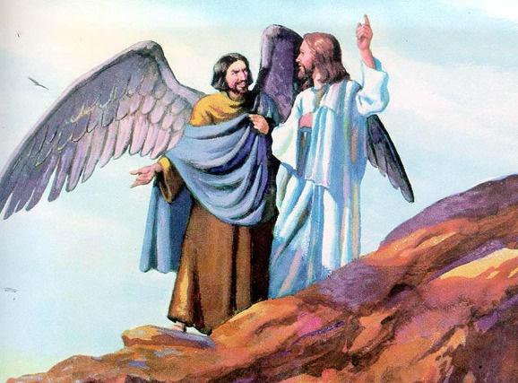
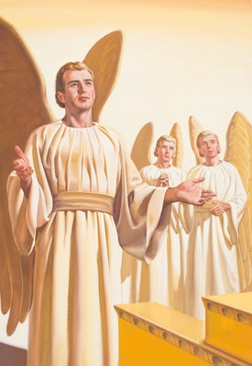
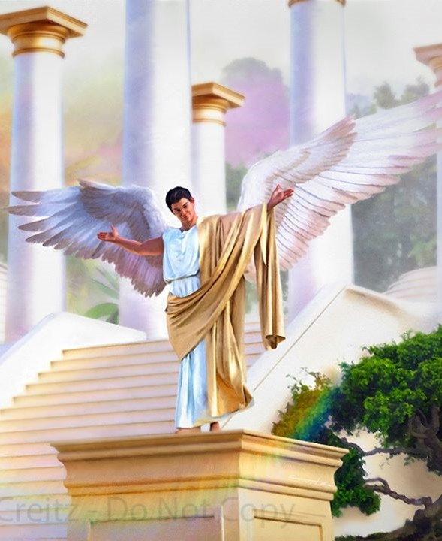
CHIYAMBI CHA MKANGANO
“Makhalidwe ako anali abwino kuyambira pamene unalengedwa, mpaka nthawi imene unayamba kuchita zoyipa” (Ezekieli 28:15)
Zoona zake nzakuti, mu Edene, munali cholengedwa china chimene chinasonkhezera Hava kukayikira Mulungu, izi zimasonyeza kuti kupandukira Mulungu kunayambika anthu asanakhaleko (Genesis 3:1).
Yesu anatcha cholengedwa chimene chinafesa kusakhulupirirana pakati pa Mulungu ndi zolengedwa zake kuti “mdani,” amene anamutchula kuti Mdyerekezi (Mateyu 13:39).
Funso loyamba lomwe tiyenera kudzifunsa ndi lakuti: Kodi Mulungu analenga Mdyerekezi, kutanthauza kuti, kodi Mulungu analenga cholengedwa choipa?
Baibulo limatiuza kuti Mdyerekezi ndi mngelo wotchedwa Lusifara (Yesaya 14:12). Mngelo ameneyu analengedwa wangwiro ndi wokongola (Ezekieli 28:12). Anakwezedwa kukhala pa mpando wapamwamba kwambiri umene mngelo akanatha kuufuna: kerubi woteteza (Ezekieli 28:13-14).
Ngati Lusifara anali wangwiro, anakhala bwanji mdyerekezi? Kodi mkangano pakati pa Mulungu ndi iye unayamba bwanji? Mulungu anampatsa iye, mofanana ndi zolengedwa zake zonse, ufulu wosankha ndipo, mosadziwika bwino, Lusifara anaganiza zopanduka, nafunitsitsa kukhala pampando wachifumu wa Mulungu (Ezekieli 28:15; Yesaya 14:13-14).

Slide 5
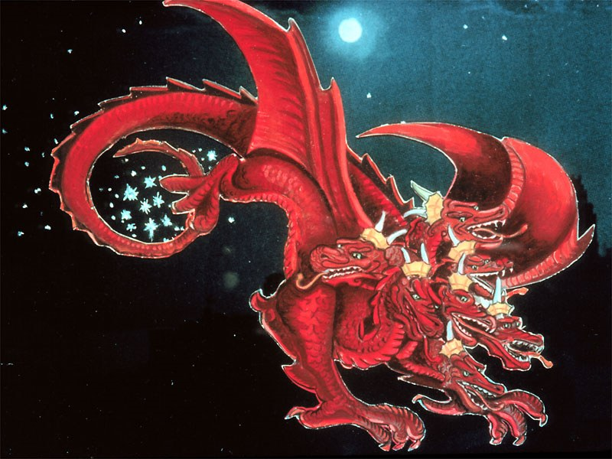
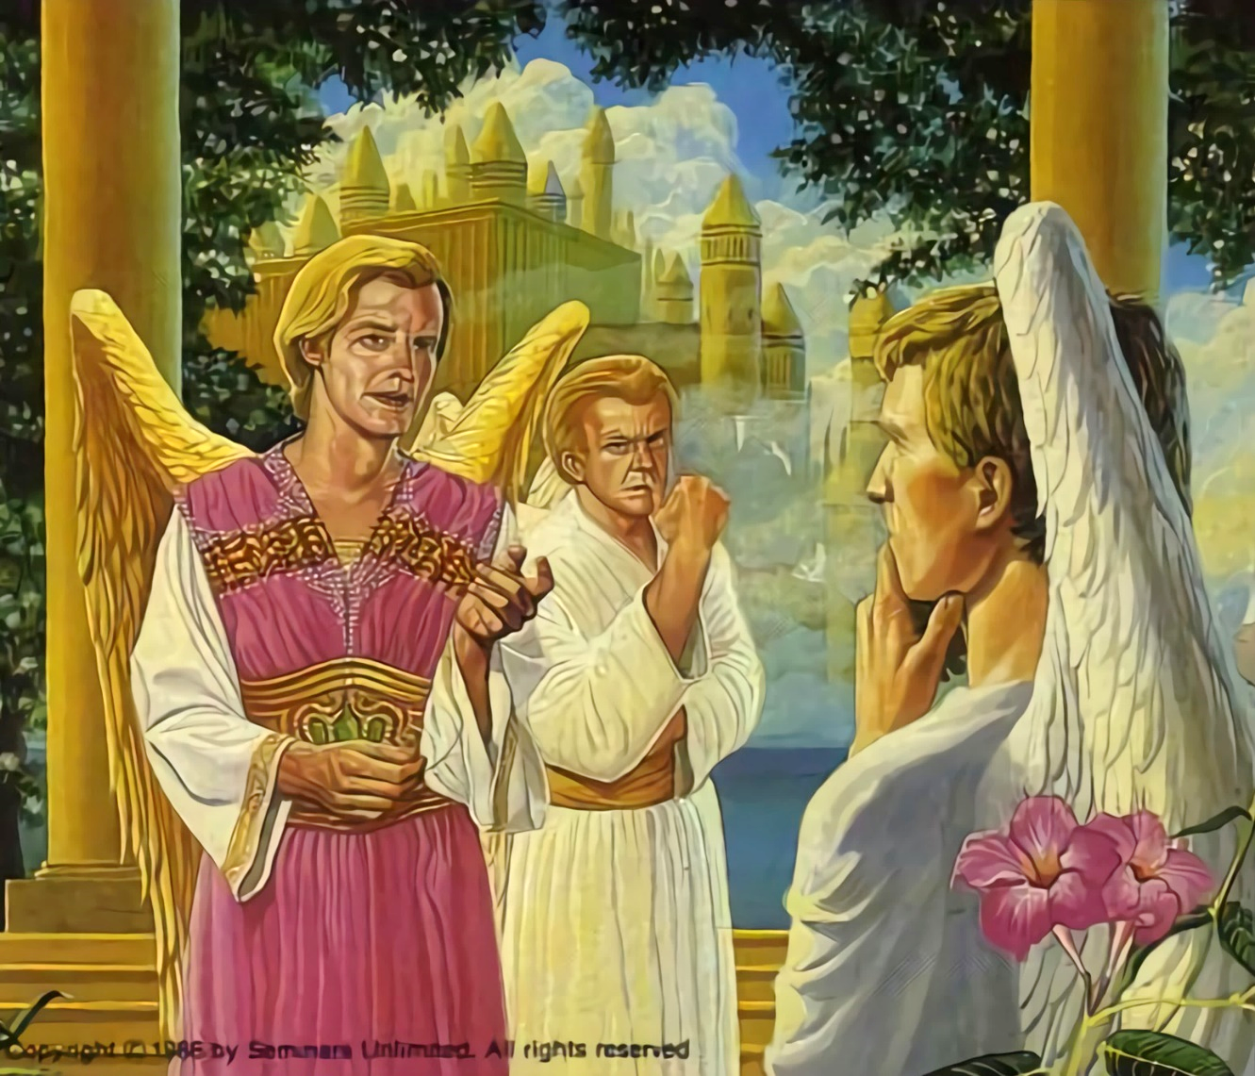
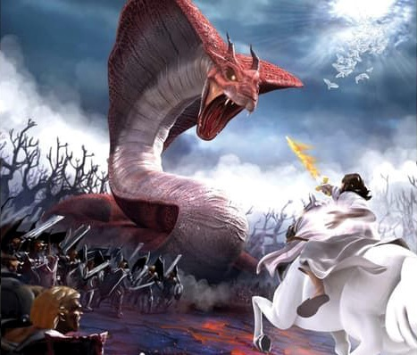
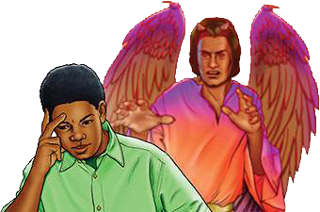
KUPANDUKA KUMWAMBA
“Mchira wake unakokolola gawo limodzi la magawo atatu a nyenyezi kuzichotsa ku thambo ndi kuziponya pa dziko lapansi …” (Chivumbulutso 12:4a)
Mukhumbo lake lofuna kulanda mpando wachifumu wa Kumwamba, Lusifara anadzutsa chikaiko pakati pa angelo ponena za chilungamo cha boma la Mulungu. Kodi onse sanali mfulu? Chifukwa chiyani ayenera kumvera malamulo okhwima, mwinanso osalungama kapena osasinthika?
Lusifara anakhala Satana, wotsutsa (Chivumbulutso 12:10; Job 1:6, 9-10). Iye anakana kuitana konse kwa Mulungu mwa chikondi kuti asinthe maganizo ake.
Kupandukako kunakhala mkangano woonekera, nkhondo imene mngelo aliyense anayenera kupanga chisankho chake. Gawo limodzi la magawo atatu a angelowo linatsatira Satana, pamene ena onse anakhalabe okhulupirika kwa Mulungu (Chivumbulutso 12:4a).
Lero lino nkhondoyi ikupitirirabe. Satana akadali wokangalika. Amayesa kukopa munthu aliyense kuti apandukire Mulungu. Pali mbali ziwiri zokha. Amene akufuna kumvera Malamulo a Mulungu, kapena amene amawakana. Chisankho ndi chathu (Deuteronomo 30:11, 16, 19; Yoswa 24:15).

Slide 6
“Mulungu wamkulu akanatha kuoneka wonyenga wamkulu ameneyu kuchokera kumwamba; koma ichi sichinali cholinga Chake. Iye anatha kupereka kwa wopandukayo mwayi woyesa mphamvu mofanana ndi Mwana Wake pamodzi ndi angelo Ake okhulupirika. Pankhondo iyi mngelo aliyense akanasankha mbali yake ndi kuwonetseredwa kwa onse. […] Mulungu akanakhala kuti anagwiritsa ntchito mphamvu zake kulanga wopanduka wamkulu ameneyu, angelo opanduka sakanaonekera; chotero, Mulungu anatenga njira ina, kuti Iye akasonyeza mowonekera kwa khamu lonse lakumwamba chilungamo Chake ndi chiweruzo Chake.”
EGW (The Story of Redemption, pg. 17)

Slide 7
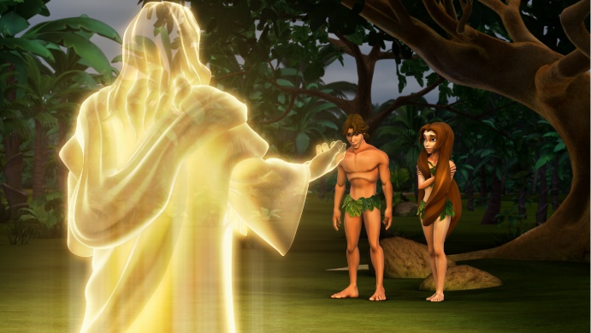
KUPANDUKA PA DZIKO LAPANSI
“Ndipo anamufunsa, “Ndani anakuwuza kuti uli maliseche? Kodi wadya zipatso za mtengo umene ndinakulamulira kuti usadye?’ ” (Genesis 3:11)
Mulungu analenga angelo m’malo opanda uchimo, angwiro. Mofanananso, Mulungu analenga anthu m’malo angwiro, opanda uchimo (Genesis 1:31).
Mofanana ndi angelo, Mulungu anatilenganso ndi mphamvu yosankha mwaufulu. Chotero, Adamu ndi Hava akanatha kugwiritsira ntchito ufulu umenewo, Iye anawapatsa lamulo losavuta : “koma usadye zipatso za mu mtengo wodziwitsa chabwino ndi choyipa, popeza ukadzadya za mu mtengowu udzafa ndithu” (Genesis 2:17).
Imeneyi inali mfundo imodzi yokha imene Satana akanawapangitsa iwo kukayikira. Mwachinyengo, iye anakwaniritsa cholinga chake. Adamu ndi Hava anakayikira Mulungu, sanamvere Mulungu, ndipo anapatuka pa gwero la (Genesis 3:6, 9-13, 19). Adamu anatsegula khomo kuti uchimo ulowe, ndipo imfa inafalikira kwa anthu onse (Aroma 5:12).
Kuyambira nthawi imeneyo, timakhala m’dziko limene ladzala ndi zowawa, matenda ndi imfa. Kodi tonsefe tikulipira tchimo la Adamu?
Aliyense amalipira tchimo lake : “pakuti onse anachimwa naperewera pa ulemerero wa Mulungu” (Aroma 3:23).

Slide 8
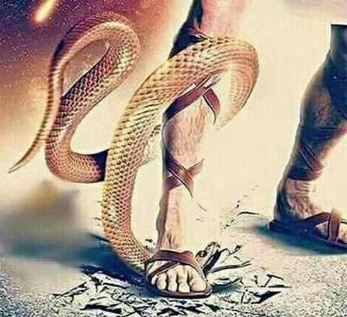
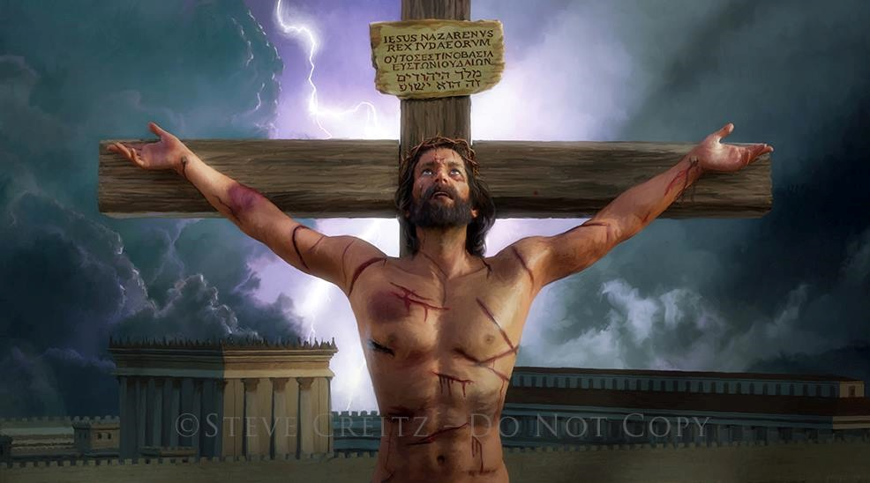
CHIKONDI CHIBWEZERETSEDWA
“Chikondi ndi ichi: osati kuti ife ndife amene tinamukonda Mulungu, koma kuti Iyeyo ndiye amene anatikonda ndipo anatumiza Mwana wake kuti akhale nsembe yopepesera machimo athu” (1 Yohane 4:10)
Ngakhale asanalengeze zotsatira za kusamvera kwawo, Mulungu anauza Adamu ndi Hava kuti pali dongosolo la chiwombolo chawo (Genesis 3:15).
Anthu mwakufuna kwawo anadzilekanitsa ndi Mlengi. Koma m’malo mosiya ana ake osayamika, Mulungu anavumbulutsa khalidwe lake lenileni powakonda mwakuya mosamvetsetseka (Yohane 3:16).
Imfa sinayenere kukhalanso mathero a munthu wochimwa. Yesu anasonyeza chikondi chake polipira mtengo wa uchimo ndi moyo wake (Aroma 5:8).
Palibe chilichonse mwa ife chimene chimatipanga kukhala oyenera chikondi cha Mulungu. Koma, chifukwa cha dontho lililonse la mwazi limene Yesu anakhetsa pa Kalvari, Mulungu amatiuza kuti: “Ndimakukonda.”

Slide 9
CHIKONDI CHIBWEZERETSEDWA
“Chikondi ndi ichi: osati kuti ife ndife amene tinamukonda Mulungu, koma kuti Iyeyo ndiye amene anatikonda ndipo anatumiza Mwana wake kuti akhale nsembe yopepesera machimo athu” (1 Yohane 4:10)
Kodi Yesu anatisonyeza bwanji chikondi chake?
Yesu analenga zonse zimene zilipo (Yohane 1:3)
Iye anasundulika cholengedwa (Yohane 1:14)
Anadutsa m’mabvuto, mazunzo, njala ndi zowawa, monga ife (Yesaya 53:3; Marko 11:12)
Anayesedwa monga ife (Ahebri 4:15)
Pokhala wolungama, Iye modzipereka anavutika chifukwa cha machimo athu (1 Petro 3:18; Yohane 10:17-18)
Pakufa ndi kuuka, Anatitsimikizira za moyo wosatha pamodzi ndi iye (Aroma 6:3-4)
Ndipo zonsezi zinali chikondi (1 Yohane 4:10)

Slide 10
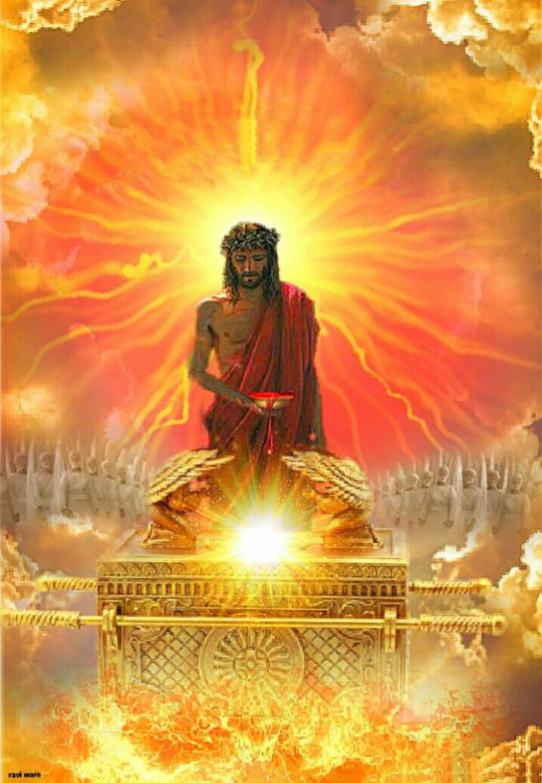
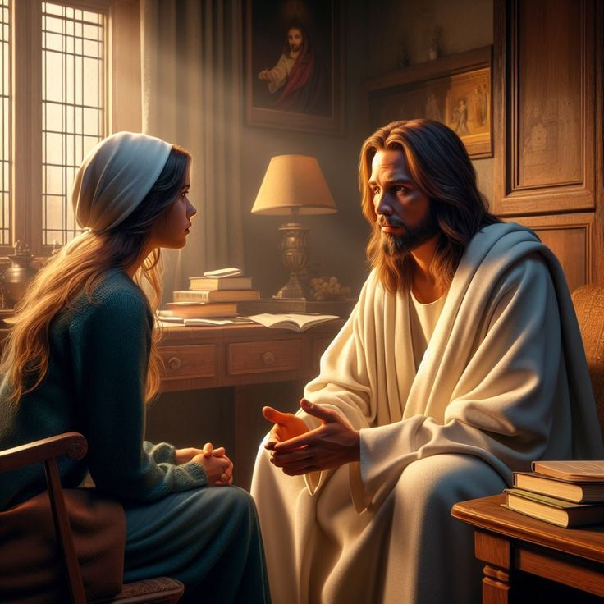
MKANGANGO LERO LINO
“Chifukwa chake Iye amapulumutsa kwathunthu amene amabwera kwa Mulungu kudzera mwa Iyeyo. Iye ali ndi moyo nthawi zonse kuti adziwapempherera iwo.” (Ahebri 7:25)
Lero lino, Yesu akutipembedzera m’Malo Opatulika a Kumwamba (Ahebri 9:24; 7:25).
Chifukwa cha mwazi wake wokhetsedwa pa mtanda, Yesu amatipereka ife pamaso pa Atate - ndi pamaso pa zolengedwa zonse- monga anthu olungama, angwiro, oyenera kukhala ndi malo Kumwamba.
Chotero, tikupemphedwa kufika kwa Mulungu podalira mwa Yesu (Ahebri 4:15-16).
Yesu amafuna kuti tizimudalira pa chosowa china chilichonse pa moyo wathu (Yohane 14:13-14). Pamene pali mantha, abweretsa mtendere; pamene pali cholakwa, amabweretsa chikhululukiro; pamene pali chofooka ndiye apatsa mphamvu.
Cholinga chachikulu cha Yesu ndicho kukhala nafe kwamuyaya (Yohane 17:24). Kodi ilinso ndi khumbo lanu lalikulu?

Slide 11
“Pamene mayesero akakugwerani, pamene zowawa, zododometsa, ndi mdima zikuwoneka kuti zazinga moyo wanu, yang'anani mbuyo pomwe mudawona kuwala komaliza. Pumulani mu chikondi cha Khristu ndi pansi pa chisamaliro chake choteteza. Pamene uchimo ukulimbana kuti ulamulire mtima, pamene uchimo umapondereza moyo ndikulemetsa chikumbumtima, pamene kusakhulupirira kuphimba malingaliro, kumbukira kuti chisomo cha Khristu ndi chokwanira kugonjetsa uchimo ndikuchotsa mdima. Kulowa m’chiyanjano ndi Mpulumutsi, timalowa mu gawo la mtendere."
EGW (The Ministry of Healing, pg. 193)

