Slide 1
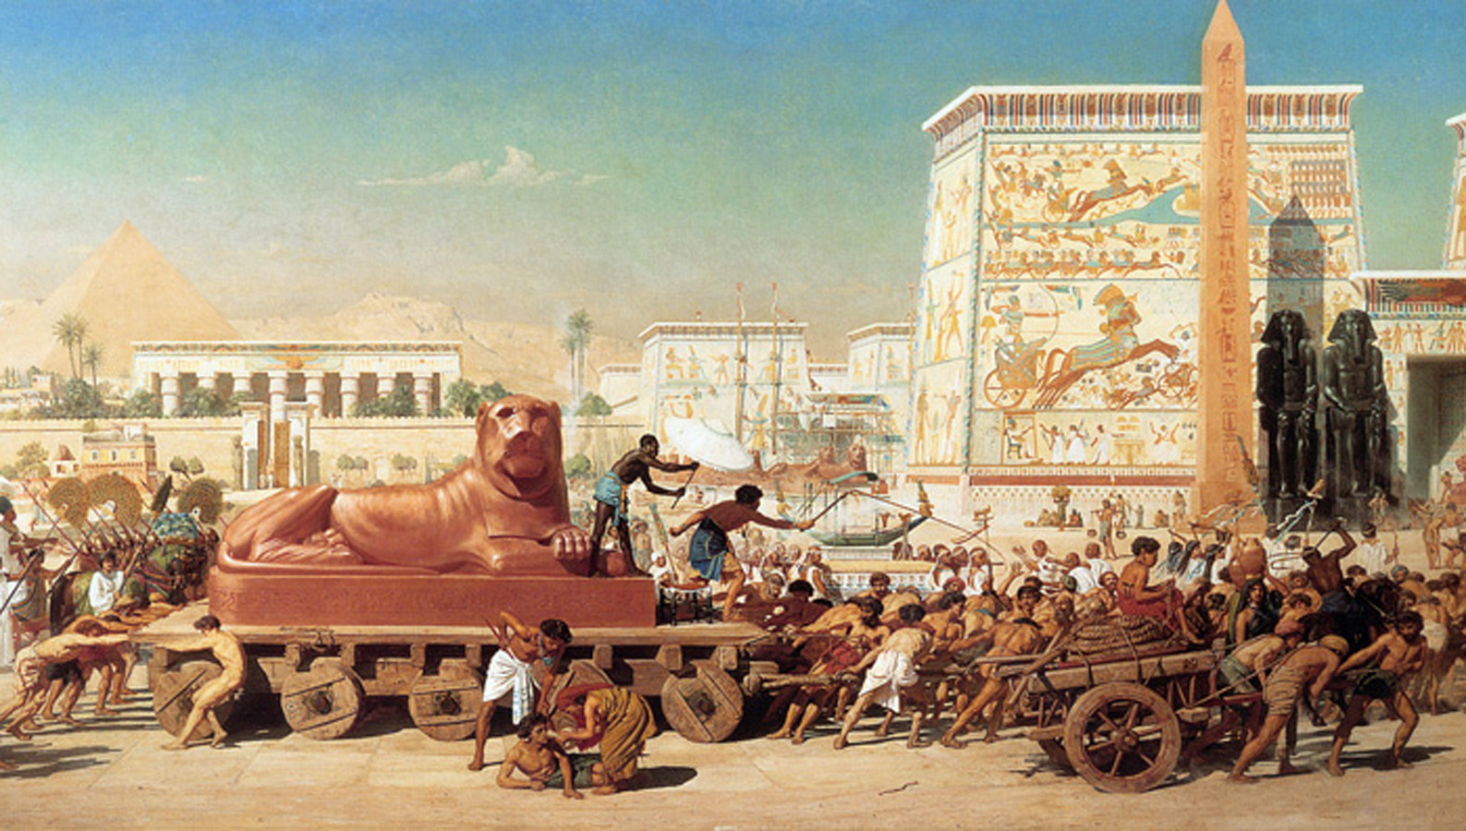
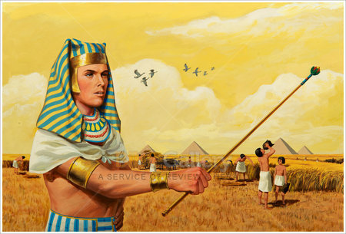
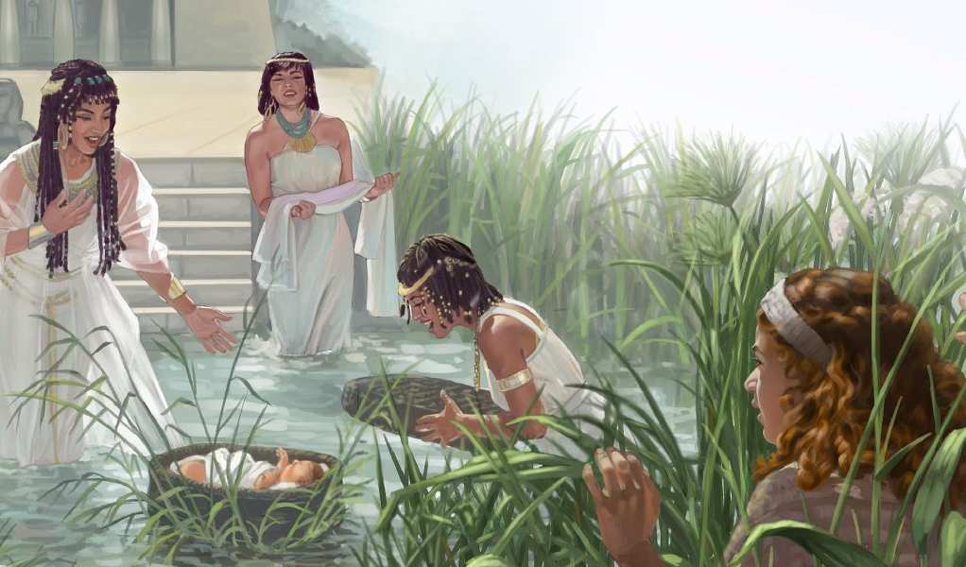
Phunziro 1, July 5, 2025
KUZUNZIDWA: MBIRI NDI KUBADWA KWA MOSE

Slide 2
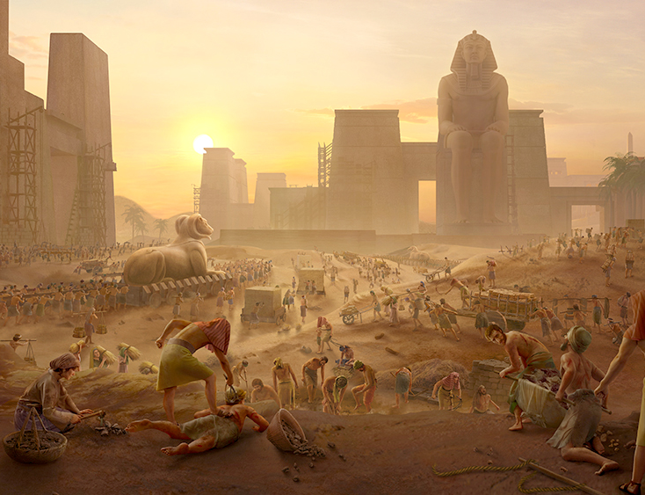
“Nthawi yonseyo nʼkuti ana a Israeli akulira chifukwa cha ukapolo wawo uja. Iwo anafuwula kupempha thandizo, ndipo kulira kwawoko kunafika kwa Mulungu. 24Mulungu anamva kubuwula kwawo ndipo anakumbukira pangano lake ndi Abrahamu, Isake ndi Yakobo. 25Mulungu ataona Aisraeli aja ndi masautso awo, Iye anawamvera chifundo”
Eksodo 2:23–25

Slide 3

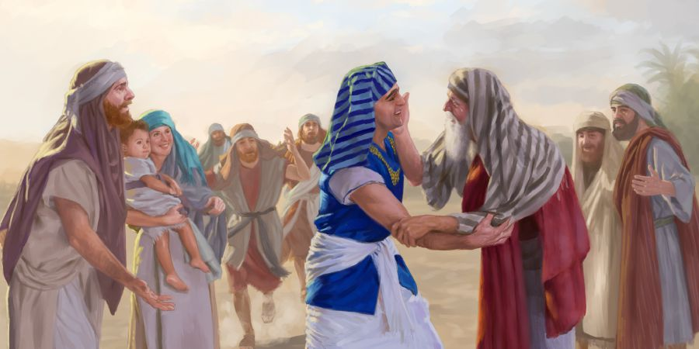
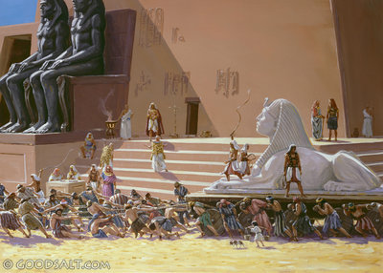
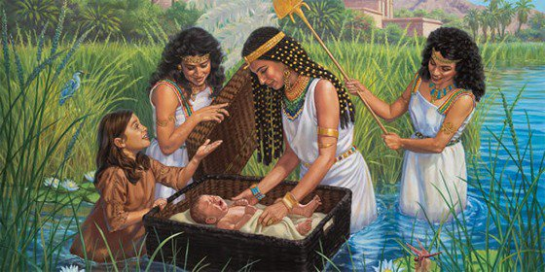





Buku la Ekisodo limayamba nkhani yake ndi banja laling'ono lomwe linakhazikika ku Igupto motsatira chilolezo choperekedwa ndi Farao.
Mwadzidzidzi, zinthu zinasintha, ndipo anakhala akapolo okakamizidwa kugwirira ntchito “mabwana”awo a ku Igupto.”
Zinthu zikadaipiraipirabe. Pakati pa zowawa, kukhulupirika kwa amayi awiri, Shifra ndi Pua, kunawala kwambiri, pamodzi ndi kuwala kwa chiyembekezo chimene Mulungu anapereka kwa anthu ake: mwana wokongola amene anapulumutsidwa m’Mtsinje wa Nailo, Mose.
Anthu a Mulungu mu Aigiputo (Eksodo 1:1-14)
Kuchokera kwa Abrahamu mpaka kwa Mose (Genesis 15:13; Eksodo 1:8)
Kupambana kwa Kukhulupirika (Eksodo 1:15-22)
Mwana wa ku Nailo (Eksodo 2:1-10)
Wopulumutsa Wolephera (Eksodo 2:11-25)

Slide 4

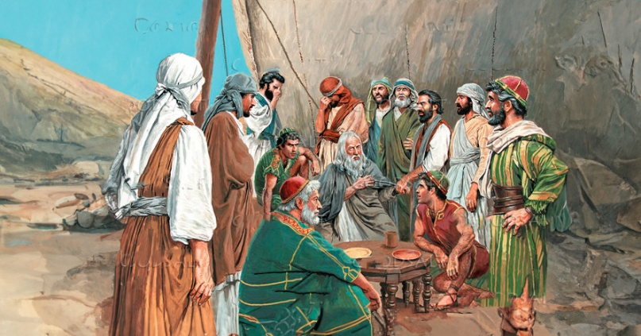
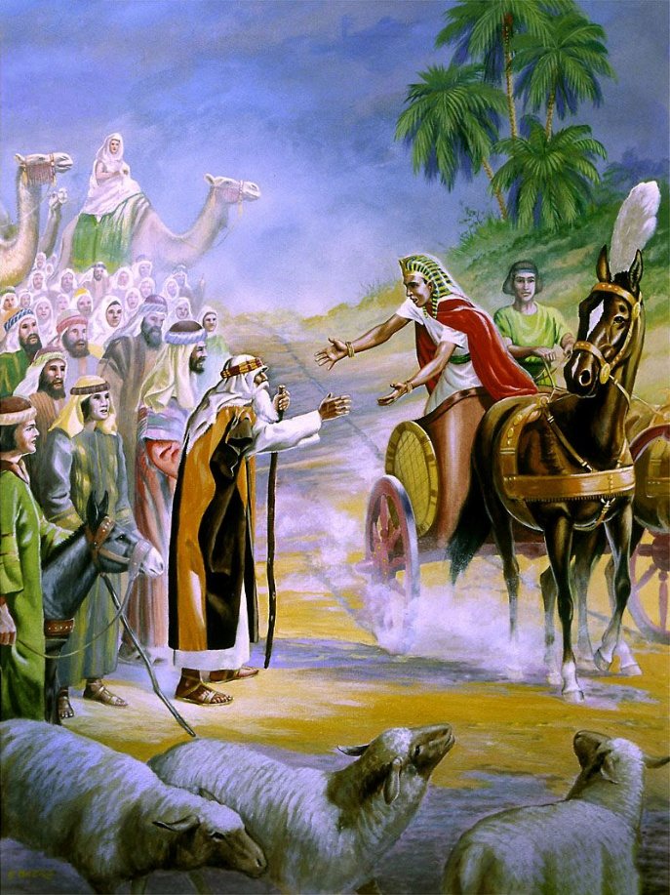
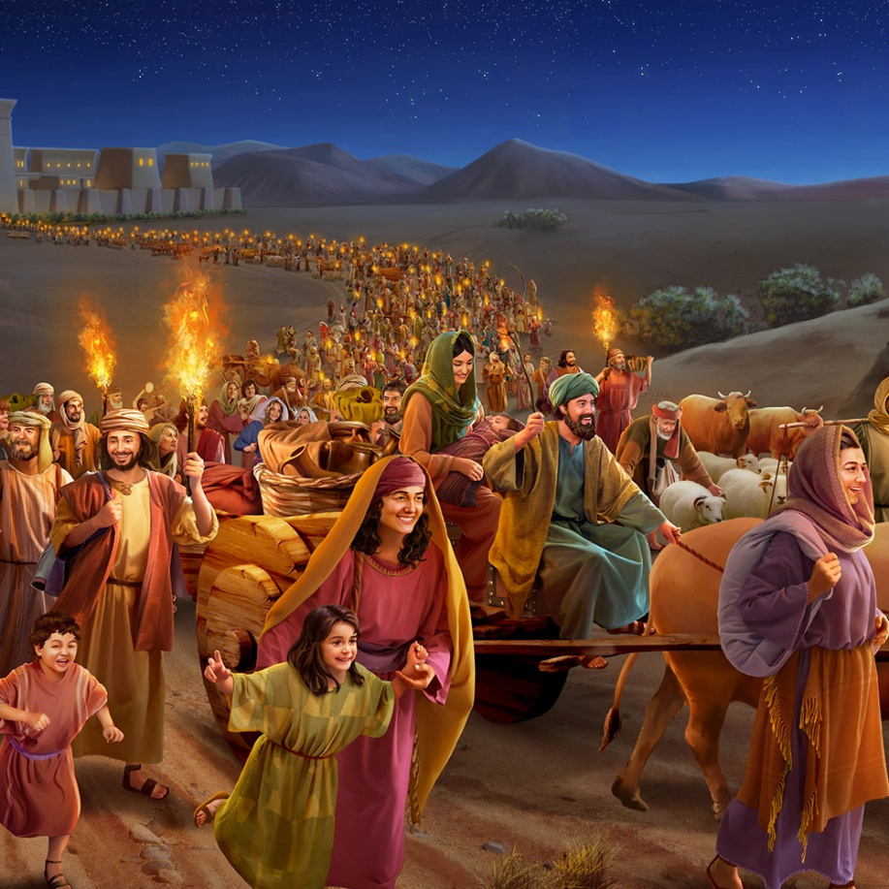
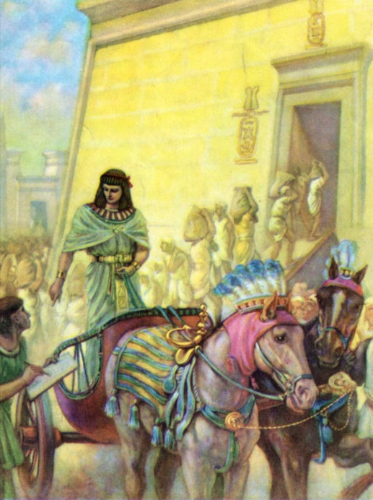
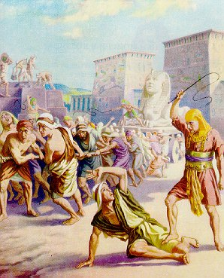
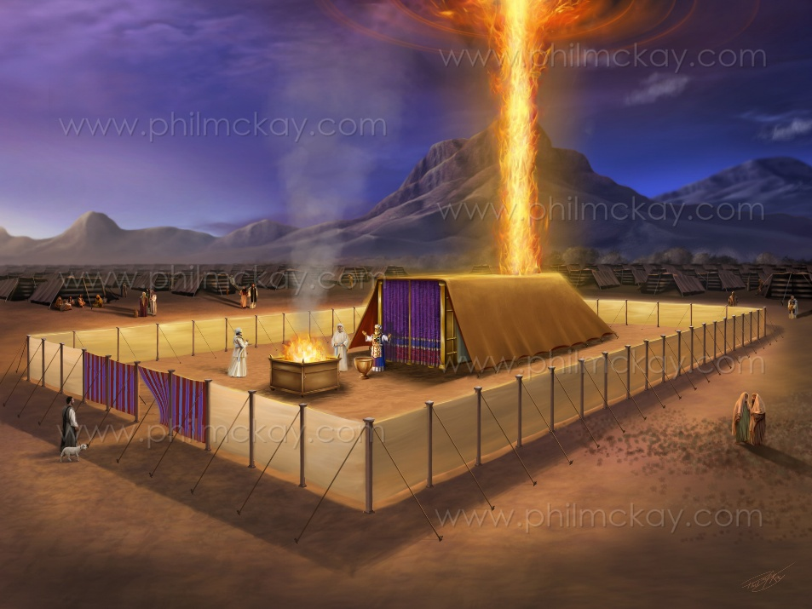
ANTHU A MULUNGU KU IGUPUTO
“Awa ndi mayina a ana a Israeli amene anapita ku Igupto pamodzi ndi Yakobo abambo awo, aliyense ndi banja lake:” (Eksodo 1:1)
Bukhu lachiwiri la Mose linkatchedwa “Eksodo” mu Chilatini chifukwa cha nkhani yake. Koma m’Chihebri limatchedwa “Shemoti” (Maina), chifukwa cha mawu ake oyambilira ( Eksodo 1:1).
“Maina” amenewa ndi a Yakobo ndi ana ake. Kagulu kakang’ono ka anthu 70 (Genesis 46:26-27; Eksodo 1:5 ). Koma patapita kwa nthawi, kanakula ndikukhala mtundu wokhala ndi ankhondo pafupifupi 600,000 (Eksodo 12:37).
Mwana wa Yakobo, Yosefe, anali nduna ya Farao wa m’mbadwa wa nambala 17 wa Hyksos, osati mbadwa ya Igupto. Pamene a Hyksos anagonjetsedwa, ufumu watsopano unayamba kulamulira ku Igupto, umene “sunkamudziwa Yosefe” (Eksodo 1:7-8 ).
Izi zinayika Aisraeli m’mavuto akulu (Ekisodo 1:9-14). Koma, kumapeto kwa bukhu la Eksodo, zinthu zikusintha kotheratu: Aisraeli amalambira mwa ufulu pamaso pa Mulungu (Eksodo 40:38). Maphunziro a buku limeneli ndi otsimikiza: Mulungu ali ndi ulamuliro; adzatipulumutsa ngakhale zinthu zikuwoneka ngati zosatheka.

Slide 5

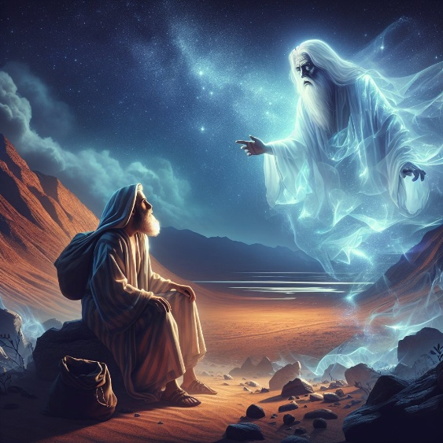
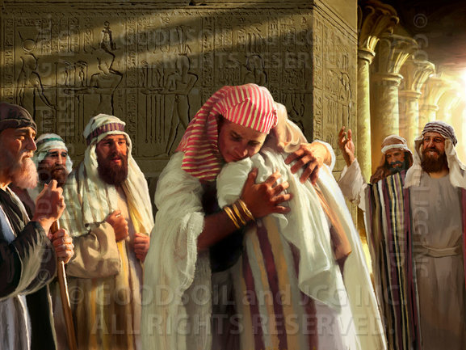
FROM ABRAHAM TO MOSES
“Tsono Yehova anati kwa iye, “Uyenera kudziwa mosakayika kuti zidzukulu zako zidzakhala alendo mʼdziko lachilendo ndipo zidzakhala akapolo ndi kuzunzidwa zaka 400.’” (Genesis 15:13)
Mulungu anali atalonjeza kuti adzapatsa Abrahamu dziko la Kanani, koma anamuchenjeza kuti dongosolo limeneli lidzachedwa kwa zaka 400 kuti likwaniritsidwe (Genesis15:13-16).
Mose ndi Paulo anawonjezera zaka 30 ku nthawi imeneyi, akuibwezeretso kunthawi yomwe anaitanidwa ku Harana (Eksodo 12:40; Agalatiya 3:17 ):
Kuchokera pa kuitana Abramu ku Harana kufikira pamene Yakobo anafika ku Igupto. Zaka 215
Kuchokela pamene Yakobo anafika ku Iguputo kufikira pamene anatuluka m’dziko la Iguputo: zaka 215:
Kodi Yakobo anafika bwanji ku Igupto? M'njira yozizwitsa kwambiri. Ngakhale kuti abale ake a Yosefe ankafuna kumupha, iye anakhala nduna yaikulu ya dziko la Iguputo. Chifukwa cha udindo wake, adatha kubweretsa banja lake lonse.
Kodi zonsezi zinachitika liti? Sitikudziwa masiku enieni koma tikudziwa zambiri zokwanira kuti tizilumikize ndi mbiri yodziwika (yomwe ilinso ndi masiku osadziwika bwinobwino).

Slide 6

KUCHOKERA KWA ABRAHAMU KUFIKA KWA MOSE
“Patapita zaka 480 Aisraeli atatuluka mʼdziko la Igupto, chaka chachinayi cha ulamuliro wa Solomoni mu Israeli, mwezi wa Zivi, umene ndi mwezi wachiwiri, Solomoni anayamba kumanga Nyumba ya Yehova.”
(1 Mafumu 6:1)
1 Mafumu 6:1 amati Kutuluka ku Igupto kunachitika zaka 480 chisanafike chaka chachiwiri cha Solomoni. Ngati tsiku limeneli ndilolondola ndipo lili m’ndandanda, izi zimatifikitsa mu 1445 BC. Ngati tilingalira izi "nambala yatunthu," ndikuganizira za imfa ya Farao, Kutulukaku kunachitika mu 1450 BC. Ndi kuwerengeratsa kumeneku, titha kudziwa nthawi zingapo zofunika m’moyo wa Mose.
Ahmose Woyamba (1575/1550). Anagonjetsa a Hyksos. Ndiye Farao amene “sadamudziwe Yosefe” ndipo anagwiritsa ntchito Aisraeli monga akapolo (Eksodo 1:8–12).
Amenofisi Woyamba (1550/1530). Anapitirizabe kuzunza Aisraeli (Eksodo 1:13–14).
Thutmose Woyamba (1530/1517). Analamula kuti ana aamuna a Chihebri aphedwe (Eksodo 1:15–22).
Mose (1530/1410). Anatengedwa ndi mwana wamkazi wa Thutmose Woyamba, Hatshepsut.
Thutmose Wachiwiri (1517/?). M’masiku a ulamuliro wake, Mose anathawa ku Igupto (1490)
Hatshepsut (?/1479). Iye anamwalira “mwana” wake asanabwerere ku Igupto
Thutmose Wachitatu (1479/1450). Ndiye Farao yemwe ankalamulira pa nthawi yomwe Aisraeli anatuluka mu Igupto. Mwana wake woyamba anali “woyang’anira ziweto,” koma sanalowe ufumu m’malo mwake, chifukwa anamwalira pa mlili wa khumi.
Amenofisi Wachiwiri (1450/1424). Anali mwana wa Thutmose Wachitatu, koma osati woyamba kubadwa

Slide 7

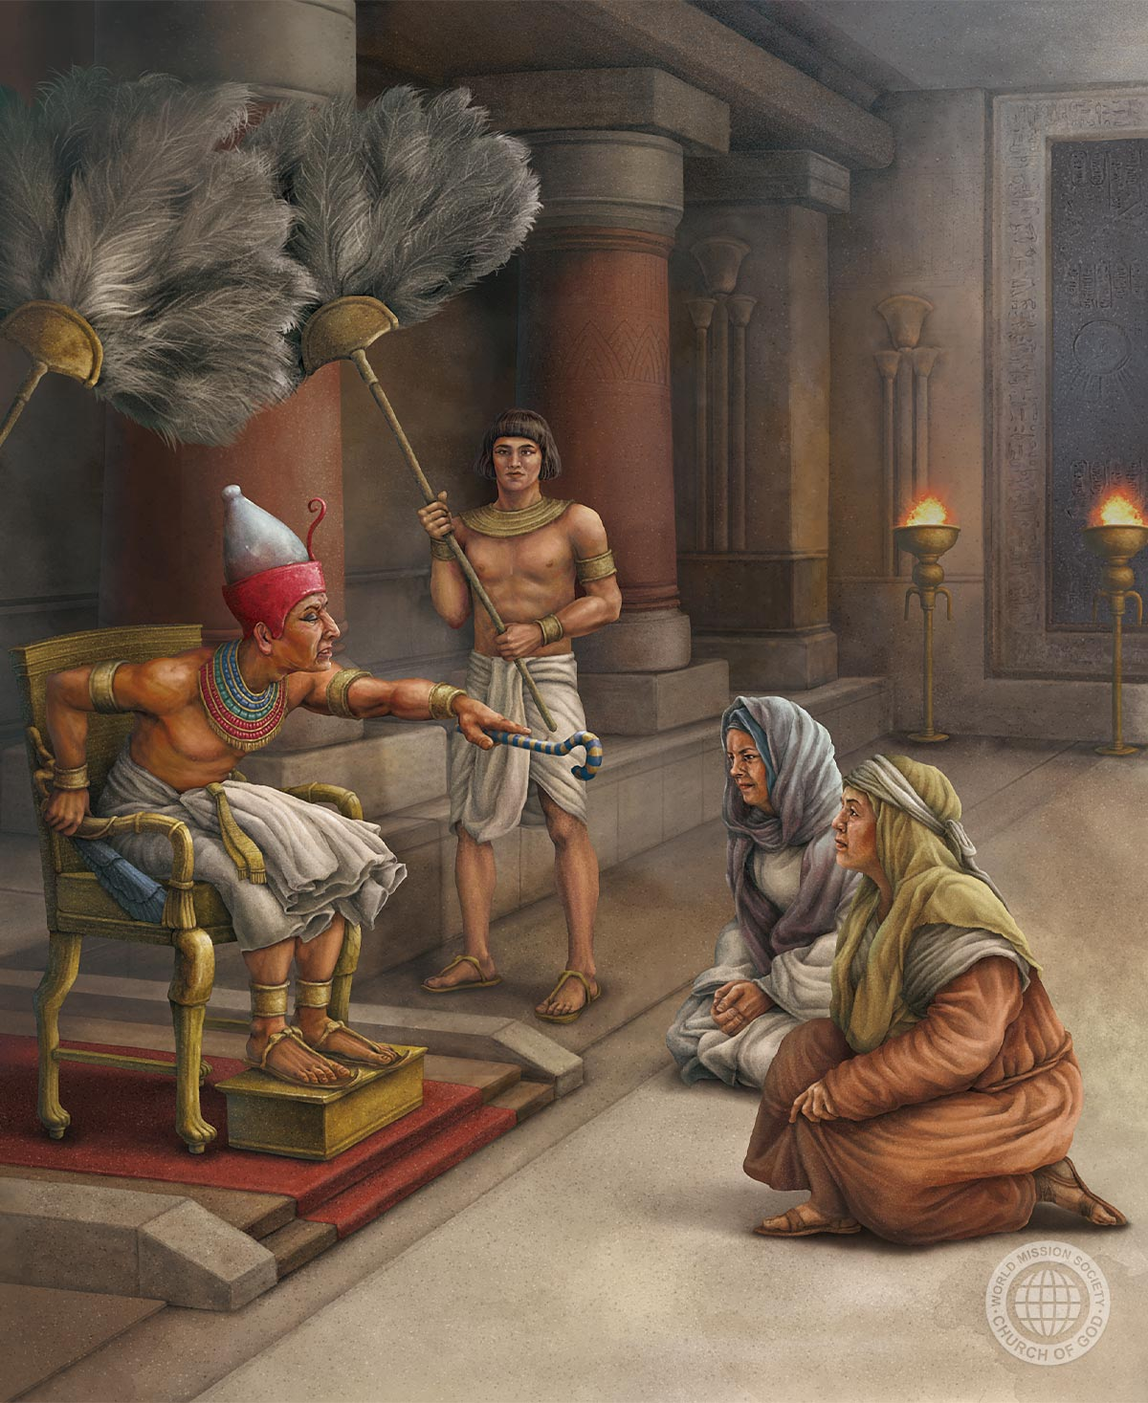
KUGONJETSA KWA KUKHULUPIRIKA
“Pakuti azambawo ankaopa Mulungu, Iye anawapatsa mabanja awoawo” (Eksodo 1:21)
Ufumu wa 18 wa ku Igupto unkadana ndi alendo. Komanso, Aisrayeli anali ochuluka moti akanatha kupanduka (Eks. 1:9-10). Kotero iwo pang'onopang'ono anawagonjetsa:
1
Anasankha anthu oti akawaumirize kumanga nyumba ( Eks. 1:11 )
Anaumitsa zofuna zawo, kuwasandutsa antchito/akapolo (Eks. 1:13-14).
Analamula kuti amuna aziphedwa pogwiritsa ntchito azamba (Eks. 1:15-16)
Pomalizira pake, analamula kuti ana aamuna aphedwe mokakamiza (Eks. 1:22)
2
3
4
M’kati mwa kusautsika kumeneku, kukhulupirika kwa anamwino, Sifra ndi Puwa, kunaonekera kwambiri ( Eks. 1:15-19 ). Mose sanatchule dzina la Farao, koma watipatsa mayina awo.
Malembo akutiphunzitsa ife momwe Mulungu adawadalitsira chifukwa cha kukhulupirika kwawo (Eks. 1:20-21).

Slide 8

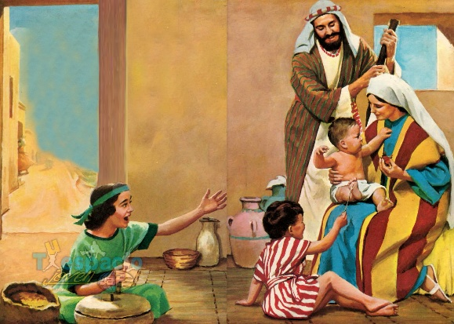
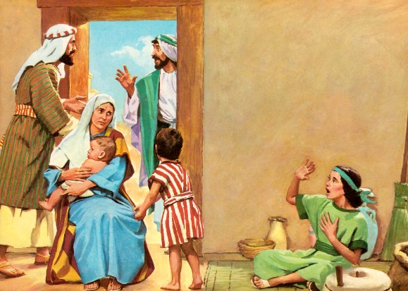
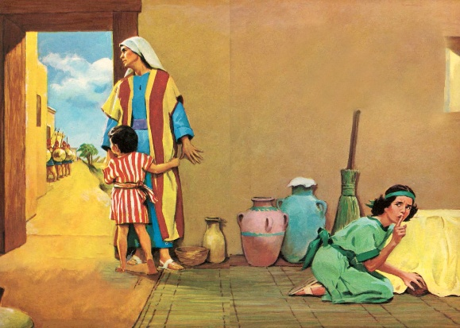
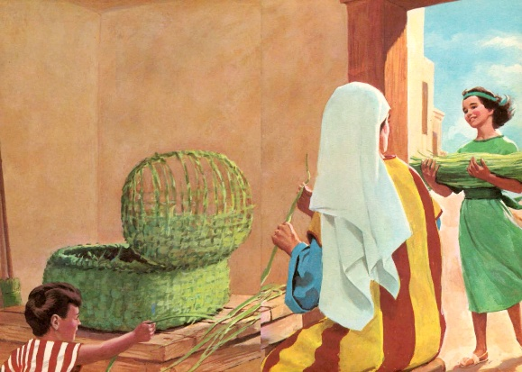
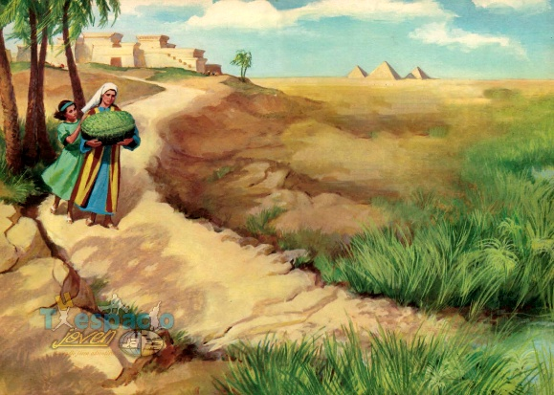
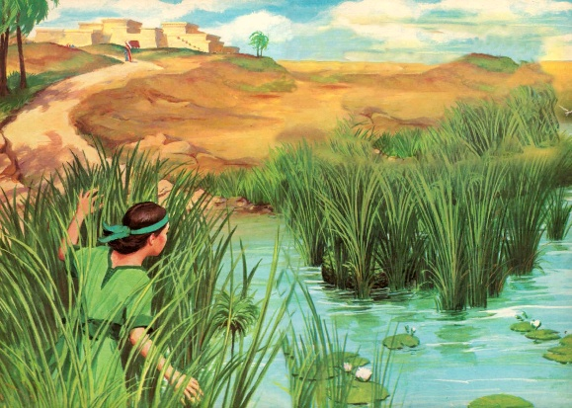
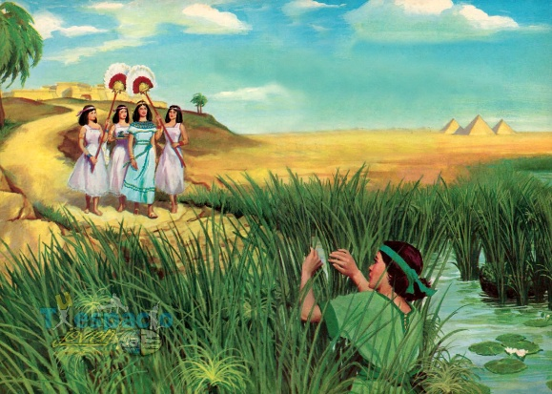
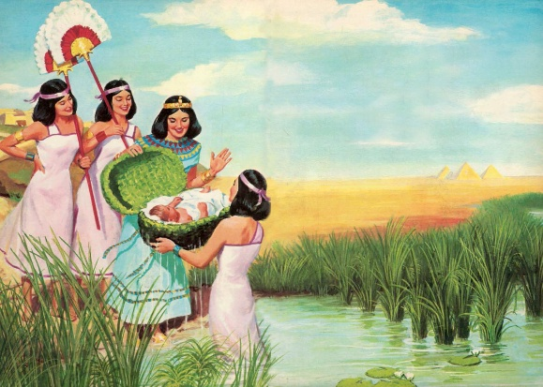
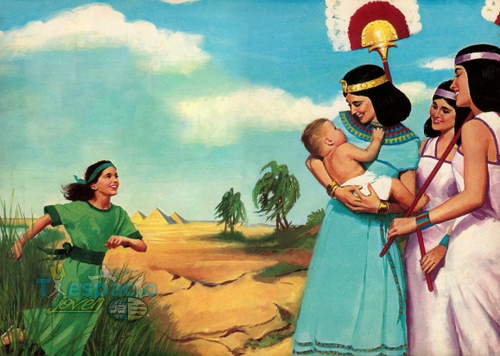
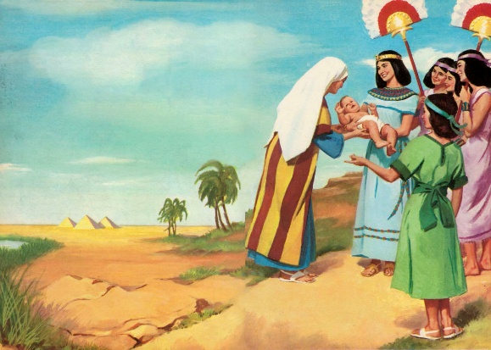
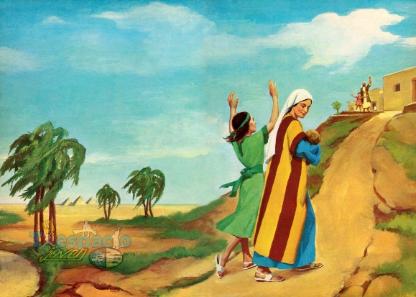
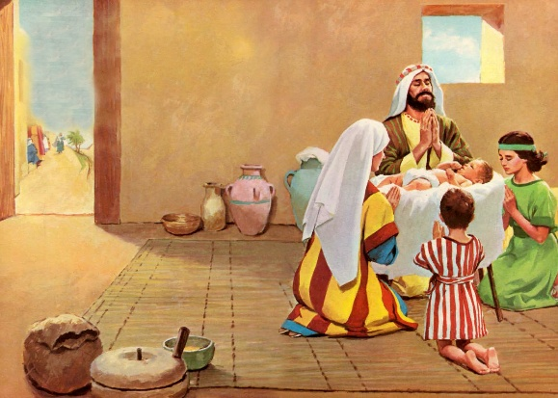
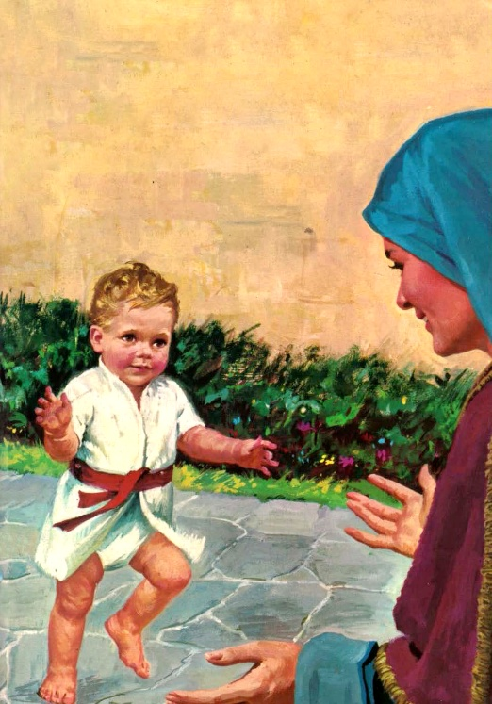
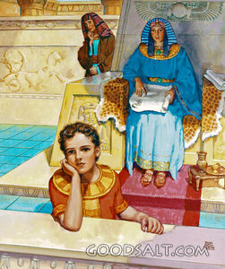
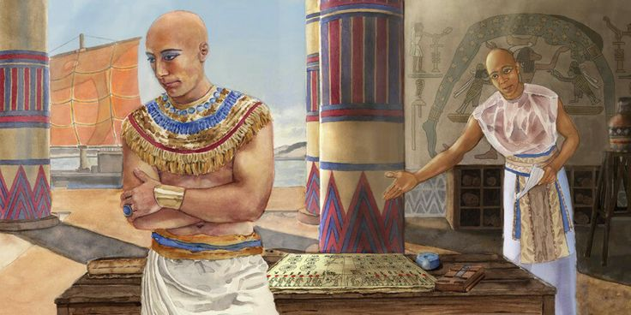
MWANA WA KU NAILO
“Mkaziyo anatenga pathupi ndipo anabereka mwana wamwamuna. Ataona kuti mwanayo anali wokongola, anamubisa kwa miyezi itatu.” (Eksodo 2:2)
Mawu oti “Wokongola” amalephera kufotokozera bwino za mwana wa Yokebedi (Eksodo 2:2 ). Mawu a Chiheberi akuti “tob” (wabwino, wokongola, wathunthu) ndi mawu omwe Mulungu amagwiritsa ntchito kufotokoza kuwonongeka kwabwino kwa chilemgedwe chake (Genesisi 1:31(Genesis 1:31).
Mulungu anali ndi cholinga chapadera kwa iye. Mayi analimba mtima; mtsikana anakhudzidwa; mwana analankhula mwanzeru… ndipo mpulumutsi wamtsogolo anapulumutsidwa ku imfa (Eksodo 2:3-7).
Sitikudziwa dzina limene makolo ake anamupatsa, koma tikudziwa dzina lomwe anamupatsa amayi olowa m’malo mwa mai ake, mwana wamkazi wa Farao: Hapimosisi (mwana wa Mulungu wa Ntsinje ya Nailo). Koma iye ankadzitchula yekha ngati “mwana,” “mosis,” Mose (Eksodo 2:10).
Amayi ake anagwiritsa ntchito bwino zaka zochepa zimene anamusamalira (Eksodo 2:8–9). Anamuphunzitsa kukhala mwana woona wa Mulungu. Ndithu, ndi ntchito yofunika kwambiri imene amayi amachita polera ana awo kuopa Mulungu!

Slide 9
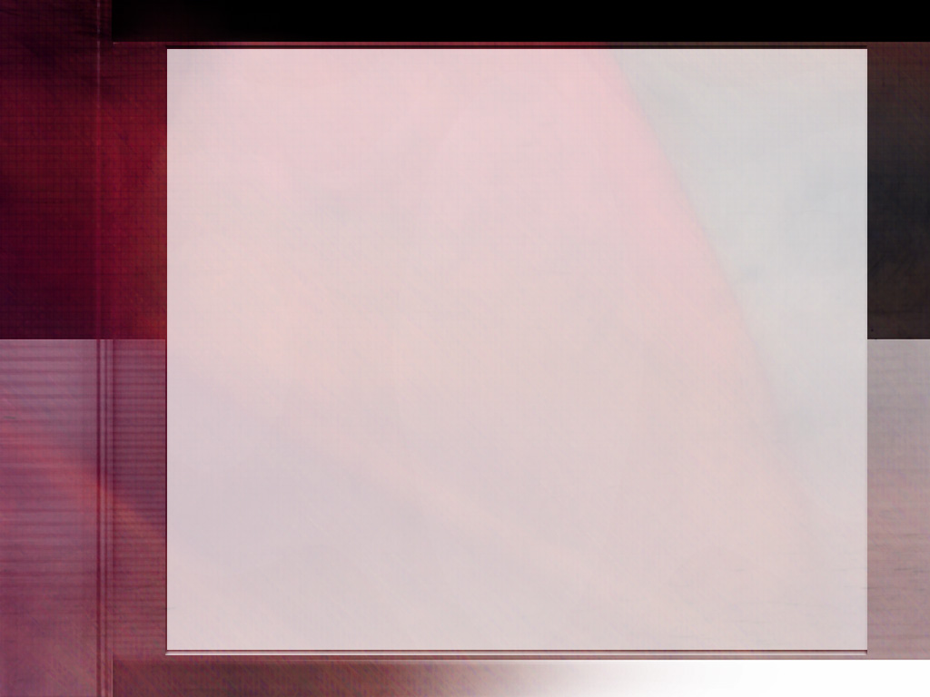
Mulungu anamva mapemphero a amayiyo; chikhulupiliro chake chinalandira mphoto. Ndi mtima wodzaza ndi chiyamiko, anayamba ntchito yatsopano—yotetezeka komanso yosangalatsa. Anagwiritsa ntchito mwayi wake mokhulupirika kuti aphunzitse mwanayo za Mulungu. Anali ndi chikhulupiliro cholimba kuti mwanayo anasungidwa kuti achite ntchito yayikulu, ndipo ankadziwa kuti posachedwa adzamupereka kwa amayi ake achifumu, kumene adzazunguliridwa ndi zinthu zomwe zikanamuchotsa kwa Mulungu. Izi zonse zinamuchititsa kukhala wakhama kwambiri komanso wosamala pa maphunziro a mwanayo kuposa ana ake ena. Anayesetsa kulowetsa mu mtima wa mwanayo mantha a Mulungu, chikondi cha choonadi ndi chilungamo, ndipo ankamupempherera mwakhama kuti asungidwe ku zoyipa zonse zomwe zikanamupatula ndi Mulungu. Ankamuwonetsa kuputsa ndi uchimo wolambira mafano, ndipo anayamba kumuphunzitsa ali mwana pang’ono kuti azapembedza ndi kupemphera kwa Mulungu wamoyo, amene yekhayo amamva ndi kuthandiza pa nthawi ya mavuto aliwonse.(tsamba 244)
EGW (Patriarchs and Prophets, p. 243)

Slide 10


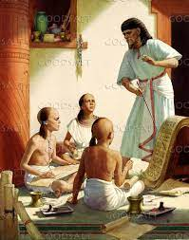
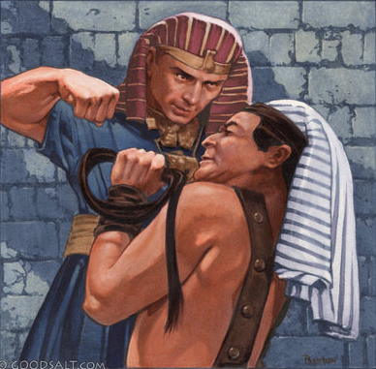
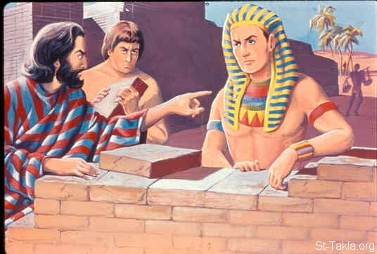
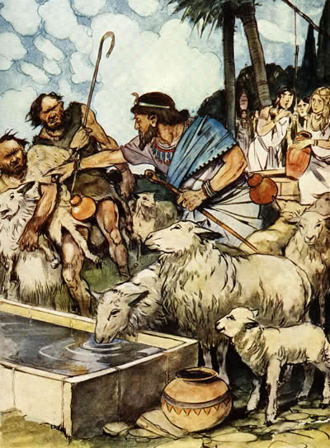
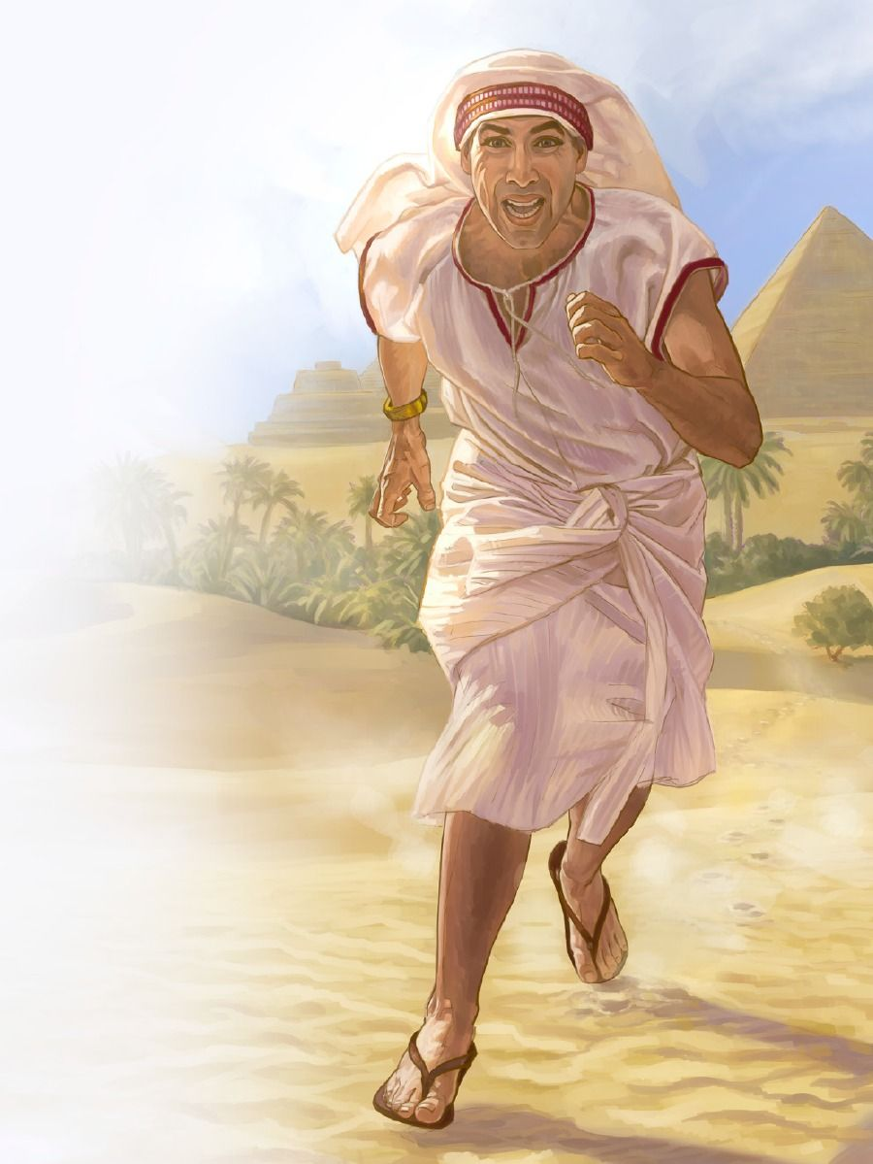
MPULUMUTSI WOLEPHERA
“Farao atamva zimenezi anafuna kuti aphe Mose, koma Mose anathawa ndipo anapita kukakhala ku Midiyani. Ali kumeneko, tsiku lina anakhala pansi pafupi ndi chitsime.” (Eksodo 2:15)
Timadziwa zochepa ponena za unyamata wa Mose. Popeza kuti ankawonedwa ngati olowa ufumu, ankalandira maphunziro okonzekera zimenezo, kuphatikizapo luso lankhondo ndi ndale(EGW , “Patriarchs and Prophets,” p. 245) .
Tikudziwa kuti Mose atangotsala pang’ono kukwanitsa zaka 40, Thutmose Wachiwiri analengezedwa kukhala Farao chifukwa cha ziwembu zandale. Pomwenepo Mose anakhulupirira kuti nthawi yakwana yoti apulumutse Aisraeli. Koma anayamba ntchitoyi molakwika—popha Mgupto. Uku kunalu kulakwitsa kwakukulu (Eksodo. 2:11-12 ). Anthu ake sanamuwone ngati mpulumutsi wawo (Eksodo 2:13-14; Mac. 7:25 ).
M’masiku ochepa chabe, Mose anachoka pokhala munthu wolemekezeka m’bwalo la Farao ndikukhala m’busa wothawa chilango (Eksodo 2:15–22). Komabe, Mulungu sanamukane Mose; anapitiriza kumudalira ngakhale analakwa.

Slide 11

“Nyumba yokongola ya Farao ndi mpando wachifumu zinali zopereka mayesero kwa Mose; koma ankadziwa kuti m’nyumba zolemekezeka zimenezo munali zosangalatsa za uchimo zomwe zimachititsa anthu kuiwala Mulungu. Anayang’ana kuposa nyumba yokongola, kuposa korona wa mfumu, ndikuona ulemu wapamwamba umene udzapatsidwa kwa oyera mtima a Wam’mwambamwamba mu ufumu wopanda uchimo.
Anaziwona mwa chikhulupiliro korona wosawonongeka, amene Mfumu ya Kumwamba adzayika pa mutu wa amene wapambana. Chikhulupilirochi chinamupangitsa kutembenukira ku anthu a dziko lapansi amene amakhala olemera ndi olemekezeka, ndipo analumikizana ndi mtundu wotsika, wosauka, womanyozeredwa—omwe unasankha kumvera Mulungu m'malo motumikira uchimo”
EGW (Patriarchs and Prophets, p. 246)

