Slide 1
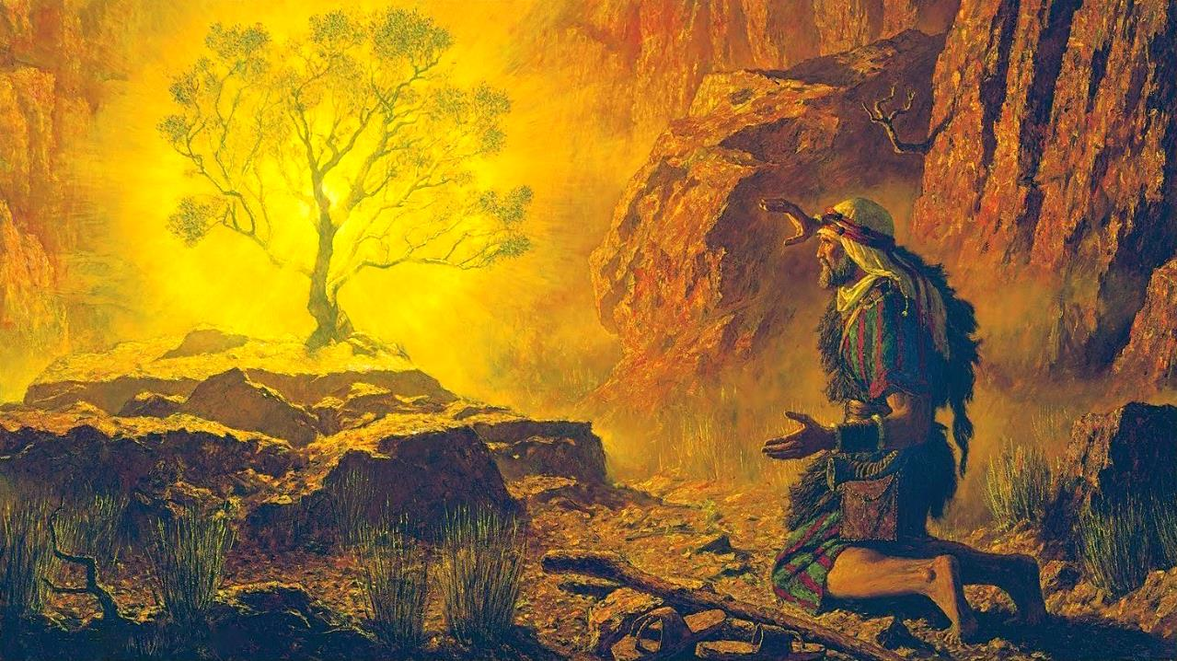
CHITSAMBA CHOYAKA MOTO
Phunziro 2, July 12, 2025

Slide 2
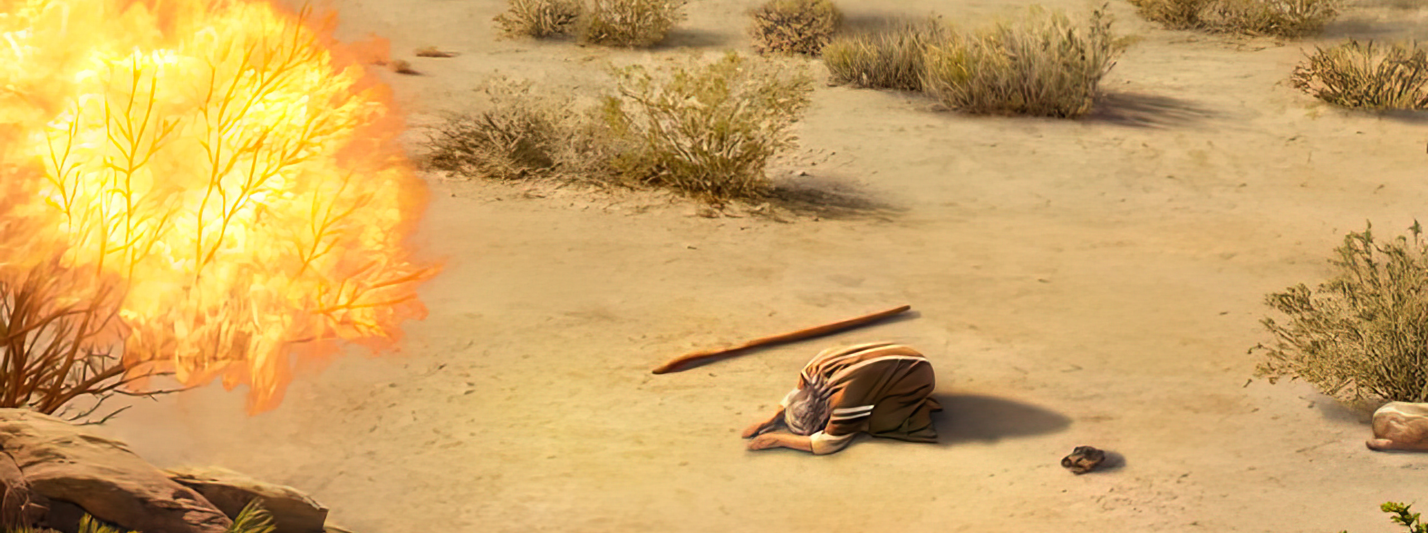
Yehova anati, “Ine ndaona ndithu mazunzo a anthu anga amene ali ku Igupto. Ndamva kulira kwawo chifukwa cha anthu amene akuwapsinja, ndipo ndakhudzidwa ndi masautso awo. Choncho ndabwera kuti ndiwapulumutse mʼdzanja la Aigupto, kuwatulutsa mʼdzikolo ndi kukawalowetsa mʼdziko labwino ndi lalikulu, dziko loyenda mkaka ndi uchi’ ” Eksodo 3:7, 8,

Slide 3

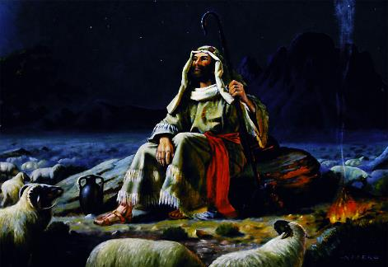
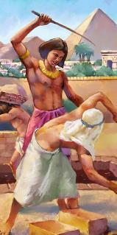
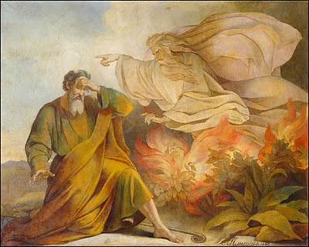







Atalephera kuyesera kupulumutsa Aisraeli, Mose anakhala zaka 40 m’chipululu cha Midiyani monga m’busa. Pa nthawi imeneyo, ngakhale anapitiriza kukhala pa ubale wapamtima ndi Mulungu, anasiya ganizo lake loti adzakhala mpulumutsi wa Aisraeli.
Koma Mulungu sanasiye ganizo limenelo. Kwa Iye, Mose anali akadali mpulumutsi wosankhidwa. Ndipo sanayiwalenso zowawa za anthu Ake. Tsopano, nthawi inakwana yotsogolera Aisraeli kuti atuluke mu ukapolo wovutawo.
Kuyitana (Eksodo 3):
  Chitsamba Choyaka (Eksodo 3:1-6)
  Malamulo a Mulungu (Eksodo 3:7-12)
  Dzina la Mulungu (Eksodo 3:13-22)
Kukwaniritsa cholinga (Eksodo 4):
  Zowiringula ndi Zowiringula Zambiri (Eksodo 4:1-17)
  Kubwerera ku Igupto Eksodo 4:18-31)

Slide 4
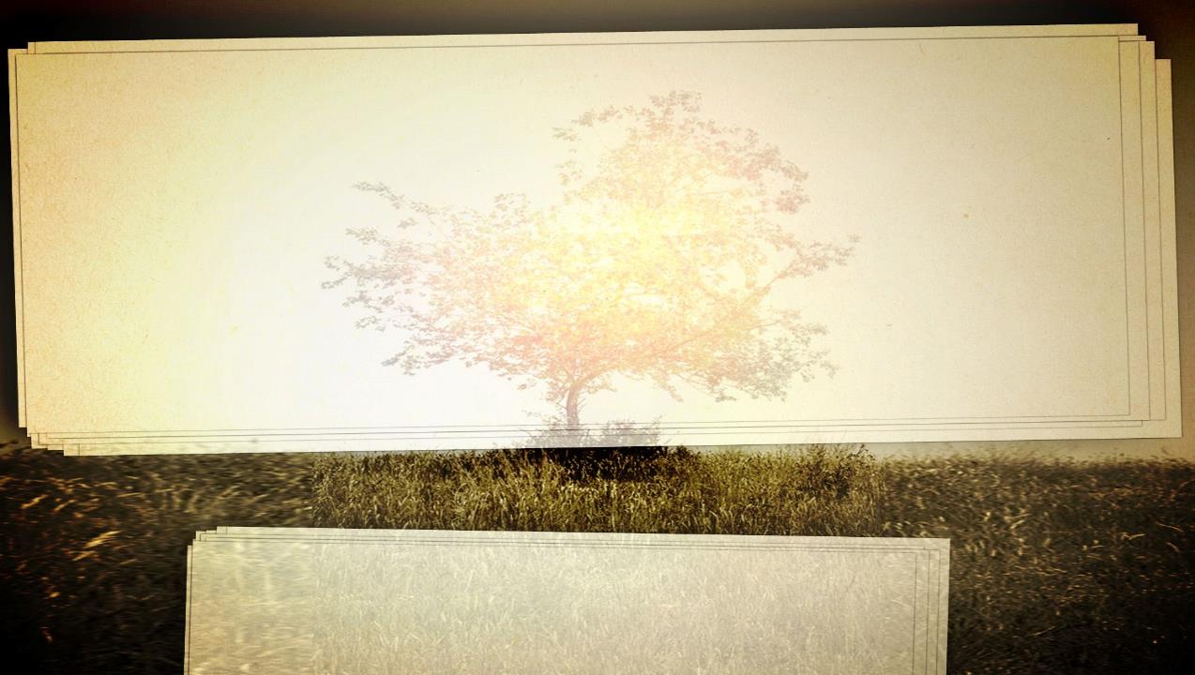
KUITANA

Slide 5

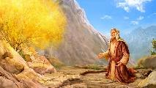
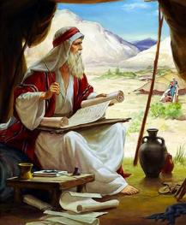
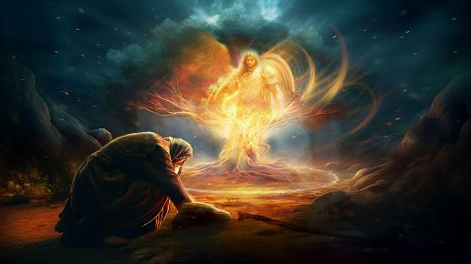
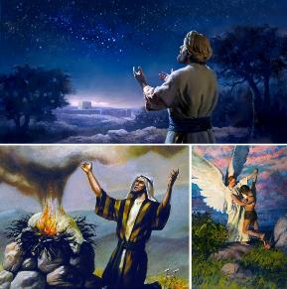
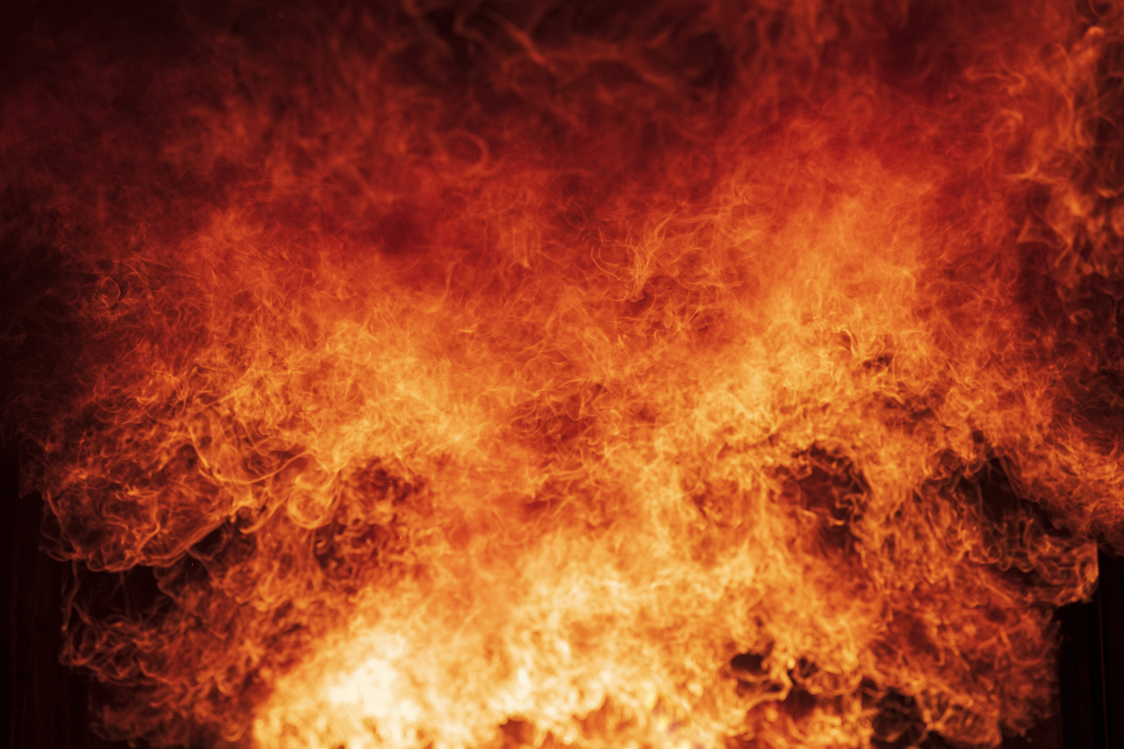
CHITSAMBA CHOYAKA MOTO
“Kumeneko mngelo wa Yehova anaonekera kwa iye mʼmalawi amoto mʼchitsamba. Mose anaona kuti ngakhale chitsambacho chimayaka koma sichimanyeka. ” (Eksodo 3:2)
Zaka 40 zimene Mose anakhala ku Midiyani tingazifotokoze mwachidule motere: anakwatira, anabereka ana aamuna awiri, ndipo anatumikira monga m’busa wa ziweto kwa apongozi ake. nagwiritsanso ntchito nthawi imeneyi polemba mabuku awiri: Yobu ndi Genesis, ofunikira kwambiri kuti timvetse mfundo zofunika za chipulumutso. Koma zinthu zinasintha nthawi yomweyo.
Ku Horebu (Phiri la Sinai), Mngelo wa Mulungu anaonekera kwa Mose m’chitsamba choyaka moto ( Eksodo 3:1-3 ). Kodi Mngelo ameneyu anali ndani? Anali Mulungu Mwiniwake ( Eksodo 3:4 ). Asanakhale munthu, Yesu anaonekera kangapo monga “Mngelo wa Yehova” ( Gen. 22:11-17; Oweruza 6:11, 16; 13:17-22; Zek. 3:1-2 ).
Polankhula ndi Mose, Mulungu anadzionetsa ngati Mulungu wa Abrahamu, Isake, ndi Yakobo. Lingaliro linali lomveka bwino: Mulungu anatsika kudzakwaniritsa lonjezo limene analonjeza kwa makolo akalewo ndi kupatsa Aisrayeli dziko la Kanani (Genesis 12:7; 26:3; 48:3-4 ).

Slide 6

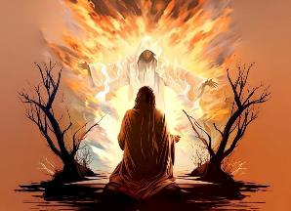
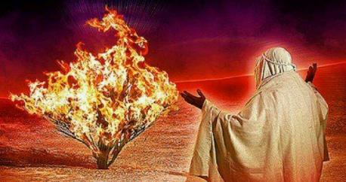
MALAMULO A MULUNGU
“Kotero tsopano, pita. Ine ndikukutuma kwa Farao kuti ukatulutse anthu anga, Aisraeli mʼdziko la Igupto.” (Eksodo 3:10)
Mulungu amadziwonetsa ngati munthu wochita zinthu, pogwiritsa ntchito aneni ochita: kuona, kutsika, ndi kutulutsa(Eks. 3:7-8).
ONANI: Mulungu sanyalanyaza mavuto. Iye amawona chirichonse. Amaona makamaka zowawa ndi kupanda chilungamo konse kumachitikira anthu ake (2 Mafumu 9:26).
KUTSIKA: Mulungu sakhala chete. Iye amabwera kudzayenda pakati pathu. Iye amakhala pakati pa anthu (Eksoodo 29:45; (Yohane 14:16-17)
KUTULUTSA: Mulungu, pa nthawi yake, amachita zinthu kuti atipulumutse ku zowawa ndiponso kukwaniritsa malonjezano ake (Yeremiya 29:11)
Mulungu anafunanso zochita zotsimikizika kuchokera kwa Mose: Pita ku Igupto ndi kutulutsa anthu anga mmenemo (Eksodo 3:10, 12). Mose anathedwa nzeru kotheratu ndi ntchitoyo. Sanafunenso kugwiritsa ntchito mphamvu zake; sanadzimvenso kuti angathe kukwaniritsa ntchitoyo; anangonena kuti, “Ndine ndani?” (Eksodo 3:11). Kudzikweza kwake kunasanduka kudzichepetsa. Ndipotu, pa nthawi imeneyi ndipamene anali wokonzeka kuchita utumiki wake.

Slide 7

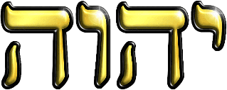
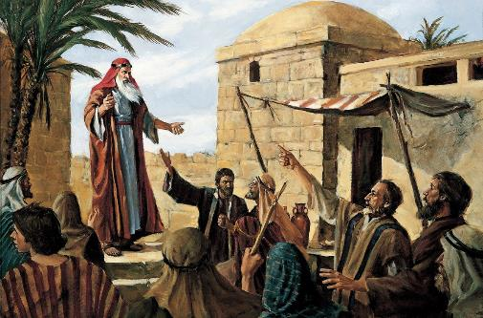
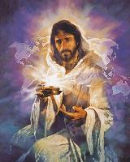
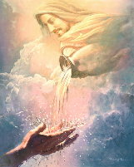
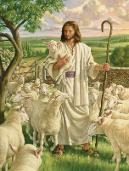
DZINA LA MULUNGU
“Mulungu anati kwa Mose, “NDINE AMENE NDILI. Izi ndi zimene ukanene kwa Aisraeli: ‘NDINE wandituma kwa inu.’” (Eksodo 3:14)
Mulungu aliyense wa ku Igupto anali ndi dzina, koma Aisraeli ankalambira “Mulungu Wamphamvuyonse” (Eksodo 6:3). Patapita zaka zambiri zadzadza ndi zonyansa za ku Igupto, Aisraeli ankafuna kudziwa dzina la Mpulumutsi wawo (Eksodo 3:13)
Pa nthawi imeneyo, dzina linkalumikizidwa ndi makhalidwe a munthu. Choncho Mulungu anazidziwitsa pogwiritsa ntchito chimodzi mwa makhalidwe ake akulu: ‘ehyeh (kukhala). Mulungu ndi wamuyaya—wakhala alipo nthawi zonse, alipo, ndipo adzakhalapobe. Ndiye “INE NDINE” (Eksodo 3:14).
M’kupita kwa nthawi, kulankhula kolondola kwa dzinali kunatayika. Mulungu analola zimenezi chifukwa chofuna kutisonyeza kuti chofunika si dzina lenileni, koma makhalidwe ake. Mulungu amasinthira malinga ndi zosowa zathu. Titha kumutchula kuti “M’busa,” “Wochiritsa,” “Wopereka,” “Atate,” … “Chikondi..”
Chofunika kwambiri ndi chakuti Mulungu akufuna tizimva kuti ali bwenzi lapafupi nafe, ndiofikirika, tiri ofunika, komanso ndi mnzathu wapafupi.

Slide 8
KWANIRITSANI CHOLINGA

Slide 9

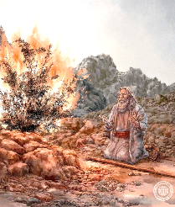
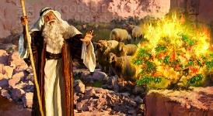
Zowiringula ndi Zowiringula Zambiri
Koma Mose anati, “Chonde Ambuye, pepani, tumani wina kuti akachite zimenezi.(Eksodo 4:13)
Asanavomereze poyera kuti sanafune kukwaniritsa ntchito imene Mulungu anam’patsa, Mose anapereka zifukwa zinayi “zangwiro” zokanira. Pachowiringula chilichonse, Mulungu adayankha ndi lonjezo.
“Ndine ndani?” (Eksodo 3:11)
“Ndidzakhala ndiiwe” (Eksodo 3:12)
Mphamvu yokwaniritsa ntchito imene Mulungu watipatsa siziri mwa ife ayi, koma kuti Mulungu amatipatsa mphamvu. Adzakhala nafe monga analiri ndi Mose.
Mulungu ndi woona, wamuyaya, ndi wamunthu; amalonjeza ndipo amasunga malonjezo ake nthawi zonse zosatha; odalirika nthawi zonse.
“Dzina lako ndani?” (Eksodo 3:13)
“Ndine Amene Ndiri.” (Eksodo 3:14)
Mulungu anapatsa Mose mphamvu zochitira zozizwitsa, ndipo anagwira ntchito m’mitima ya anthu kuti akhulupirlre zozizwitsa zimenezo. Yesu nayenso analonjeza kuti adzachita chimodzimodzi kwa ife (Marko 16:17-18).
“Sadzandikhulupirira kapena kumvera mawu anga ” (Eksodo 4:1)
“Adzakukhulupirirani chifukwa cha zizindikiro zimene mudzachita” (Eksodo. 4:8)
“Sindinakhalepo munthu womasuka kulankhula” (Eksodo 4:10)
“Ndidzakuphunzitsani zimene mudzanene
(Eksodo 4:12)
Iye amene analenga lilime adzatipatsa mawu oyenera pa nthawi yoyenera (Eksodo 4:11; Luka 12:11-12 )
Pomaliza, Mulungu anauza Mose kuti: “Zakwana ndi zifukwa zako, ukhoza kutero, ndipo uzichita.” (Eksodo 4:14-17).

Slide 10


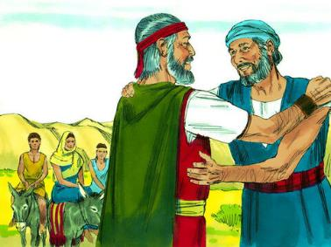
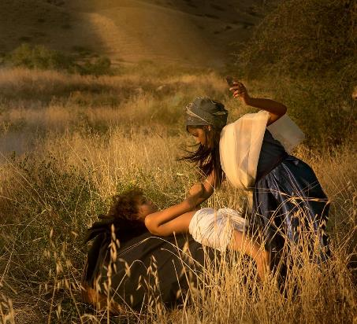
KUBWERERA KU AIGUPUTO
“Pambuyo pake Mose ali mʼnjira, pamalo wogona, Yehova anakumana naye, ndipo anafuna kumupha” (Eksodo 4:24)
Chinthu choyamba chimene Mose anachita pobwerera ku Igupto chinali kupempha chilolezo kwa apongozi ake (Eksodo 4:18 ). Anatenga banja lake, nauyamba ulendo (Eksodo 4:20 ). Koma panachitika chinthu chodabwitsa. Ali m’njira, Mulungu anafuna kumupha (Eksodo. 4:24 ).
Zipora anamvetsa zimene zinali kuchitika, ndipo anatenga njira zofunika kuti asaphedwe: anadula mwana wake wamwamuna (Eksodo 4:25).
Mose (mosonkhezeredwa ndi mkazi wake) anali asanadule mwana wake. Choncho, iye sanali kumvera malamulo a pangano limene Mulungu anakhazikitsa ndi Abrahamu (Genesis 17:10).
Kukana mwachikumbumtima kumvera lamulo lomveka bwino la Mulungu kunachititsa Mose kukhala wosayenera kutsogolera anthu. Izi zinafunika kukonzedwa asanakwanitse ntchito yake.

Slide 11

“Munthu adzapedza mphamvu ndi chipambana pa ntchito ngati amalandira udindo umene Mulungu wamupatsa, ndipo ndi mtima wonse amayesetsa kukwaniritsa bwino zimenezi. Kaya ndi m'malo osavuta kapena ndi mphamvu zochepa, munthu ameneyu adzafika pa udindo waukulu yekhayo amene, pokhulupilira mphamvu za Mulungu, amayesetsa kuchita ntchito yake mofatsa komanso molimba mtima. Mose akanadalira mphamvu ndi nzeru zake zokha, ndi kuvomereza mwachangu ntchito yayikulu imeneyi, akanawonetsera kuti sanali wokonzeka kugwira ntchito imeneyi. Chimodzi mwa zinthu zomwe zimasonyeza kuti munthu ali ndi mphamvu yochepa ndi kumvetsetsa kulemera kwa ntchito yomwe wapatsidwa, komanso kuti ayenera kupanga Mulungu kukhala mlangizi ndi mphamvu yake.”
EGW (Patriarchs and Prophets, p. 255)

