Slide 1
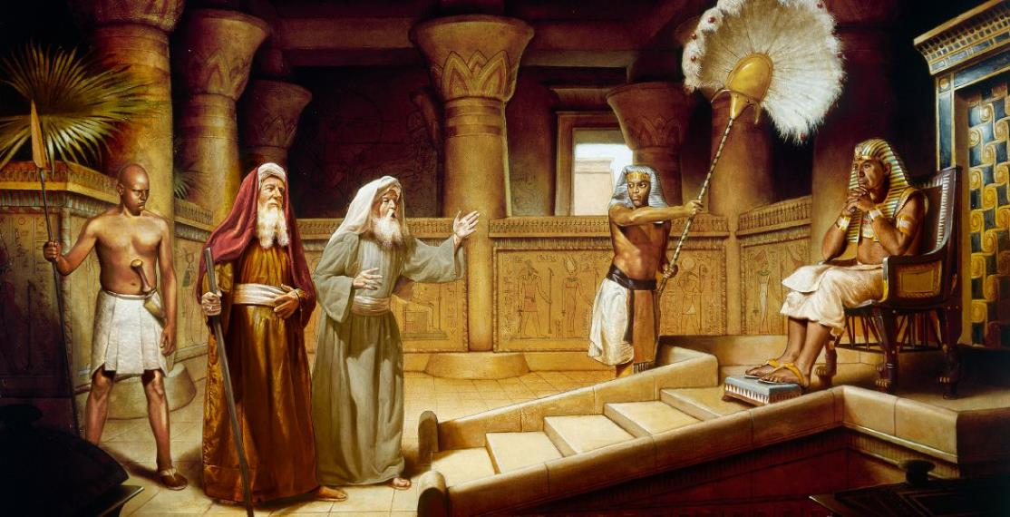
CHIYAMBI CHOVUTA
Phunziro 3, July 19, 2025

Slide 2
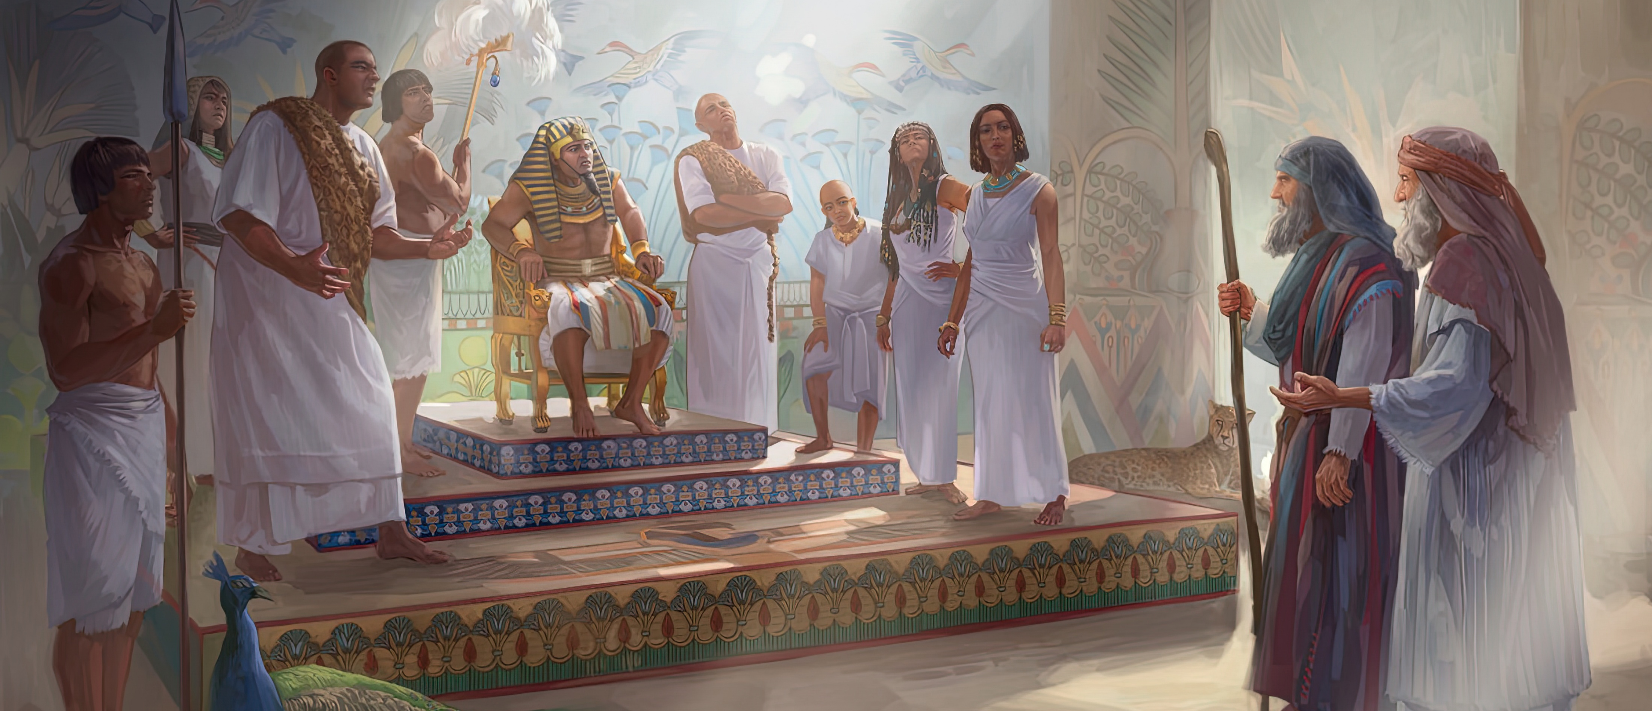
“Zitachitika izi, Mose ndi Aaroni anapita kwa Farao ndipo anati, “Yehova Mulungu wa Israeli akuti, ‘Aloleni anthu anga apite, kuti akachite chikondwerero cha Ine mʼchipululu.’ ”Koma Farao anati, “Yehova ndani kuti ine ndimumvere ndi kulola Aisraeli kuti apite? Ine Yehova sindikumudziwa ndipo sindilola kuti Aisraeli apite.” Eksodo 5:1, 2

Slide 3

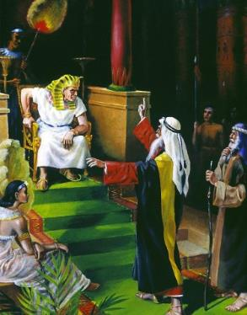
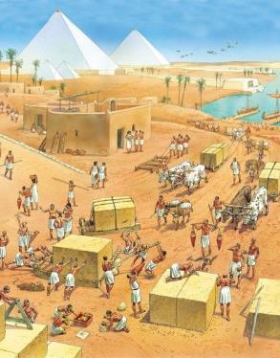
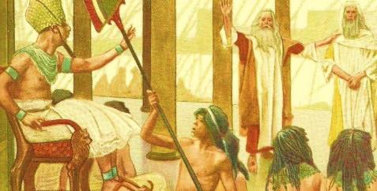




Monga mmene Mose anaonera, zinali zovuta kuti Farao alole Aisiraeli kuchoka ku Iguputo.
Komanso sizinaoneke zomveka kungolola anthu ambiri ofunikira kuti apite mwaufulu, pamene anali kugwira ntchito zomwe Aigupto sankafuna kuchita.
Choncho, chiyembekezo cha anthu chinali mu zozizwitsa zomwe zikanakakamiza Farao kuti avomereze pempho lawo.
Pempho linaperekedwa; linakanidwa; panachitika kubwezera; Mose sanachite chodabwitsa chilichonse; Mose sanachite chozizwitsa; …zokhumudwitsa.
Pempho lakuti: “Aloleni anthu anga apite.”
  Yankho la Farao (Eksodo 5:1-2)
  Yankho la anthu (Eksodo 5:3-21)
  Yankho la Mulungu (Eksodo 5:22-6:8)
  Yankho la Mose (Eksodo 6:9-13)
Udindo wa Mose ndi Aroni (Eksodo 6:28-7:7)

Slide 4

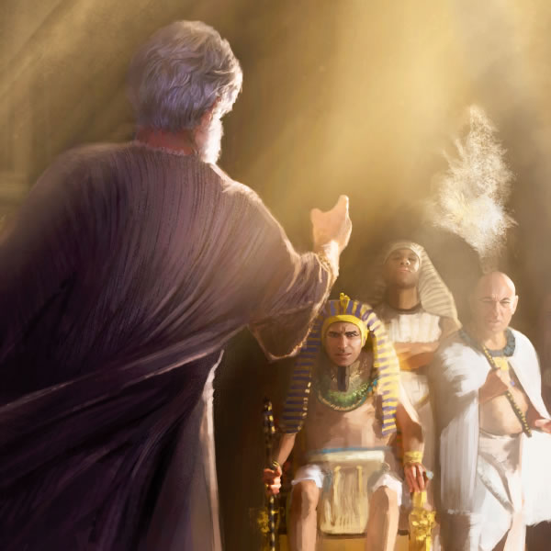
PEMPHERO:
“ALOLENI ANTHU ANGA APITE”

Slide 5


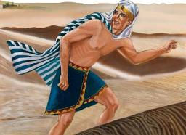
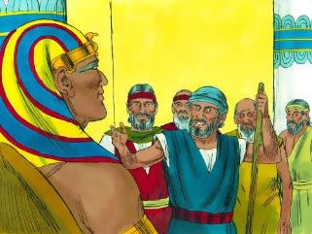
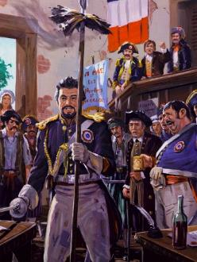
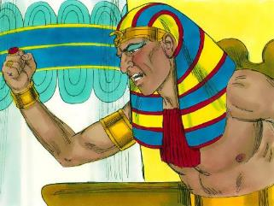
YANKHO LA FARAO
“Koma Farao anati, “Yehova ndani kuti ine ndimumvere ndi kulola Aisraeli kuti apite? Ine Yehova sindikumudziwa ndipo sindilola kuti Aisraeli apite.” (Eksodo 5:2)
Thutmose Wachitatu anali mwana wamng’ono pamene anayikidwa pa mpando wachifumu pansi pa ulamuliro wa Hatshepsut kuti alepheretse Mose kukhala Farao. Mose anathawa ku Igupto Thutmose ali wachinyamata.
Patapita zaka 40, Mose anapezekanso ku bwalo la mfumu. Kodi iye anabwera kudzatenga ufulu wake okhala mfumu? Ayi ndithu. Pempholo linali losavuta: “Aloleni anthu anga apite” (Eksodo 5:1).
Yankho la Thutmose linali chitokoso, osati kwa Mose, koma kwa Mulungu mwini. Mwachidule, ankatsutsa zoti Mulungu alipo (Eksodo 5:2 ).
Makhalidwe ake amagwiritsidwa ntchito mu Chivumbulutso ngati chizindikiro choyimira dziko la France pa nthawi ya chisokonezo cha m’zaka za m’ma 1700 (Chivumbulutso 11:8). Monga Farao, Boma la Ufumu wa France linalengeza kuti chipembedzo chathetsedwa ndipo inadzitcha mtundu wosakhulupirira kuti kuli Mulungu.

Slide 6


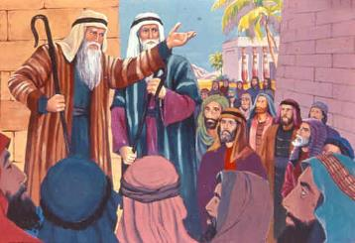
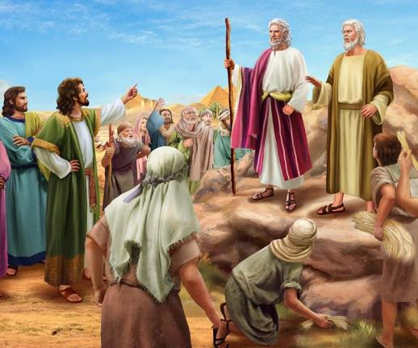
YANKHO LA ANTHU
“ndipo iwo anati, “Yehova akupenyeni ndi kukuweruzani popeza mwachititsa Farao ndi nduna zake kuti anyansidwe nafe ndipo mwayika lupanga mʼmanja mwawo kuti atiphe.’” (Eksodo 5:21)
Pamene Mose anachita zizindikiro zimene Mulungu anamupatsa pamaso pa anthu, iwo anakhulupilira ndi kulambira (Eksodo 4:29-31). Titha kungoganiza mmene ankayembekezera mwachidwi yankho la Farao pa pempho lawo.
Yankho la Farao linali lodabwitsa kwambiri. Farao sanangokana, koma anawakakamiza kugwira ntchito popanda kuwapatsa zipangizo zofunika, koma akufunabe zotsatira zomwezo (Eksodo 5:6-8). Kodi anapereka chifukwa chotani chopereka lamulo losamveka ngati limenelo?
Malinga ndi Thutmose, Mose ndi Aaroni anachititsa Aisraeli “kupuma [shabati] ku ntchito zawo” (Eksodo 5:5). Ngati anali ndi nthawi yolankhula za chipembedzo ndi ufulu, ndiye kuti anali ndi nthawi yosakanso udzu (Eksodo 5:9, 17).
Pamene ankamangidwa ndi kuzunzidwa, atsogoleri a ntchito anapita kukadandaula kwa Farao, koma sanamvetseredwe. Kenako anatembenukira Mose ndi Aroni, ndikumawaimba mlandu kuti achititsa kuti zinthu ziipireipire (Eksodo 5:20-21).

Slide 7


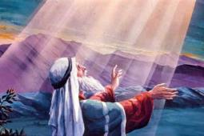
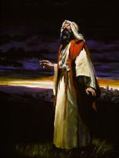
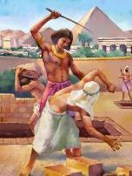
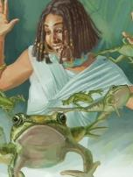
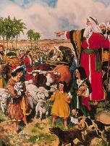
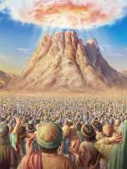
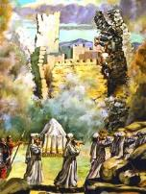
KUYANKHA KWA MULUNGU
“Yehova anawuza Mose kuti, “Tsopano udzaona zimene ndimuchite Farao: Chifukwa cha dzanja langa lamphamvu adzalola anthu anga kuti atuluke. Chifukwa cha dzanja langa lamphamvu adzawatulutsa mʼdziko lake.” (Eksodo 6:1)
Farao anakwiyira Mose. Anthu nawonso anakwiyira Mose. Koma Mose… sanakwiye, koma anavutika mtima, ndipo anatembenukira kwa Mulungu ndi mafunso ake: “Chifukwa chiyani mukuzunza anthu anu? Kodi munanditumira zimenezi?” (Eksodo 5:22 ).
Tiyeni tisanthule yankho la Mulungu (Eksodo 6:1-8):
Zomwe ndinachita
Ndinaonekera kwa aneneri
Zomwe ndidzachite
Ndidzachotsa chiphyinjo cha Aigupto pa iwo
Ndidzawamasula ku ukapolo
Ndinakhazikitsa pangano langa ndi iwo
Ndinawalonjeza kuwapatsa dziko la Kanani
Ndamva kulira kwa anthu
Ndakumbukira lonjezo langa
Ndidzagwiritsa ntchito mphamvu yanga
Ine ndiwapanga iwo kukhala anthu anga
Ine ndidzakhala Mulungu wawo
Ndidzawapatsa dziko la Kanani

Slide 8


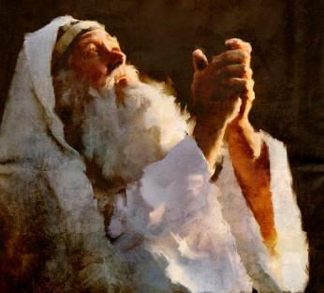

YANKHO LA MOSE
“Koma Mose ananena kwa Yehova kuti, “Ngati Aisraeli sanandimvere, Farao akandimvera chifukwa chiyani, pajatu sinditha kuyankhula bwino?” (Eksodo 6:12)
Mulungu atamulankhula mawu olimbikitsa, Mose analankhulanso ndi anthu, koma iwo sanamvere (Eksodo 6:9 ). Kenako Mulungu anamuza kuti alankhulenso ndi Farao kuti apemphe ufulu wa Aisiraeli (Eksodo 6:10-11).
Mose anakana, nabwerezanso kuwiringula, nati, Ngati anthu anga sakundimvera, kodi Farao angandimvere bwanji, pamene ndilankhula monga ndimalankhuliramu? (Eksodo 6:12 ).
Mose anali okhumudwa, olemedwa mu mtima, ndi wodzaza ndi chisoni. Koma monga anthu ena otchuka mu Baibulo amene anamvanso chimodzimodzi—monga Asafu ndi Yobu—ye sanataye mtima. Chikhulupiliro chake mwa Mulungu chinali cholimba kuposa momwe ankamvera panthawiyo.
Pamene tikhumudwitsidwa, tiyeni tipange mawu a Asafu kukhala athu: “Komabe ineyo ndili ndi Inu nthawi zonse; mumandigwira dzanja langa lamanja.Inu mumanditsogolera ndi malangizo anu ndipo pambuyo pake mudzanditenga ku ulemerero.Kodi kumwamba ndili ndi yani kupatula Inu?
Ndipo dziko lapansi lilibe chilichonse chimene ndimachilakalaka koposa Inuyo.Thupi ndi mtima wanga zitha kufowoka, koma Mulungu ndiye mphamvu ya mtima wanga ndi cholandira changa kwamuyaya” (Masalimo 73:23-26).

Slide 9

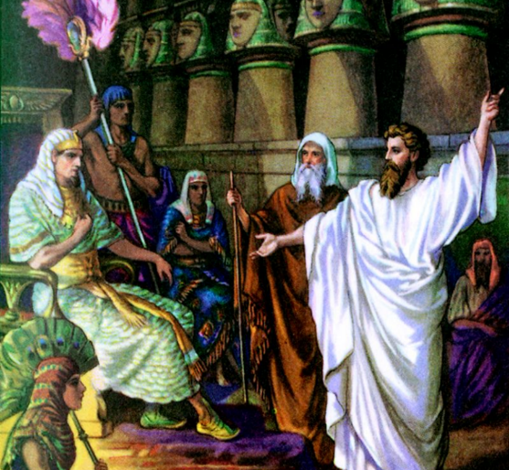
UDINDO
WA MOSE
NDI ARONI

Slide 10

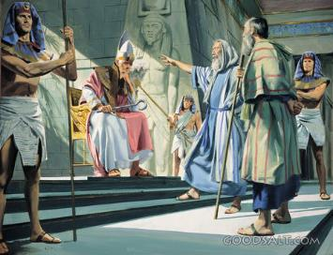
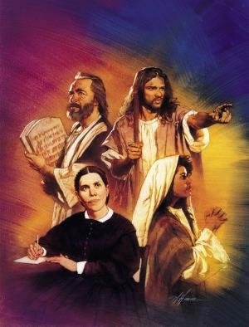
“Ndipo Yehova anati kwa Mose, “Taona ine ndakuyika kuti ukhale ngati Mulungu kwa Farao, ndipo mʼbale wako Aaroni adzakhala mneneri wako. et.’” (Eksoso 7:1)
Zikuoneka kuti “sindidziwa kulankhula” chinali chowiringula chimene Mose ankachikonda kwambiri. Anakwiyitsanso Mulungu ndi ameneyu! Koma Mulungu ali ndi yankho la chilichonse: Aroni, m’bale wake wolankhula, ndiye “pakamwa” pa Mose. Mose analankhula ndi mbale wake, ndipo iye analankhula ndi ena (Eksodo 4:10-16).
Pambuyo pa kulephera koyamba ku Igupto, Mulungu anayenera kukumbutsanso Mose za udindo wa Aroni monga womuthandizira ndi womulankhulira (Eksodo 7:1-2 ).
Pa nthawiyi, anayerekezera udindo wa aneneri. Amalandira uthenga wochokera kwa Mulungu ndipo amaupereka kwa ife. Mulingaliro limeneli, Mose ali ndi udindo wa Mulungu, ndipo Aroni ndi wa mneneri.
Monga mmene zidzakhalire pambuyo pake kwa aneneri ambiri, Mulungu anachenjeza kuti uthenga wake sudzamveka, ndi kuti adzachita ndi mphamvu zazikulu (Eksodo 7:3).
Mofanana ndi aneneri apambuyo pake, Mose anayenera kulankhula ndi anthu ndi Farao, “kaya amvera, ngakhale atembenuka, pakuti ali opanduka.” (Ezekiel 2:7) Pamenepa, Mose anayenera kulankhula ndi anthu ndi Farao. Izi ziri chonchonso kwa ife, chifukwa ndife mawu omveka a Mulungu padziko lapansi pano.

Slide 11

“Ahebri ankayembekezera kuti adzapeza ufulu wawo popanda mayesero apadera a chikhulupiriro, popanda kuvutika kapena kuzunzika. Koma anali asanakonzekere kutulutsidwa. Anali ndi chikhulupiliro chochepa mwa Mulungu ndipo sanali okonzeka kupilira kuvomereza zowawa zawo mpaka nthawi imene Mulungu ankaona kuti ndi yoyenera kuchita kanthu ku mbali yawo. Ena anali okhutira kukhala mukaundula kuposa kukumana ndi zovuta zomwe zikanabwera chifukwa chochoka mu dziko lachilendo; ndipo makhalidwe a ena anali osasintha, anakhala ngati a Aigupto, moti ankafuna kukhala ku Igupto. Chifukwa chake, Ambuye sanawapulumutse nthawi yomwe anawonetsera koyamba mphamvu zake pamaso pa Farao. Iye anakonza zinthu moti mzimu wa nkhanza wa mfumu ya ku Igupto uwululidwe mokwanira, ndipo Iye adzazidziwitsa yekha kwa anthu Ake. Pamene adzaona chilungamo chake, mphamvu zake, ndi chikondi chake, adzasankha kuchoka ku Igupto ndi kudzipereka mu utumiki wake.”
EGW (Patriarchs and Prophets, p. 236)

