Slide 1
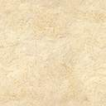
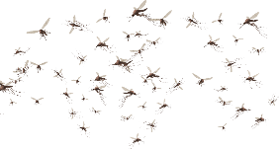
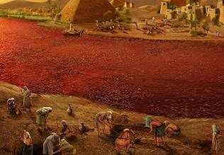
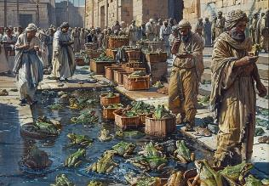
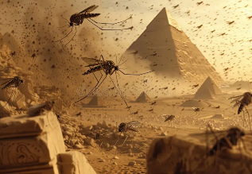
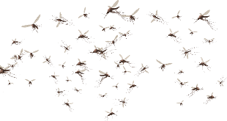
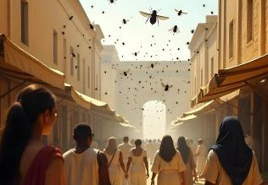
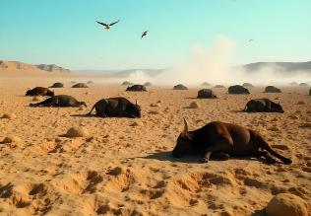
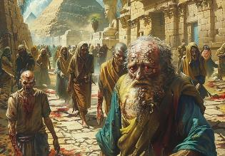
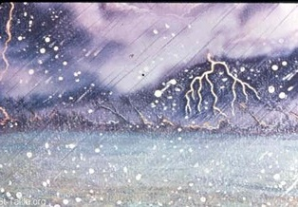
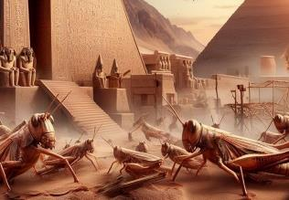
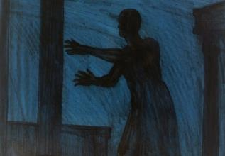
MILIRI
Phunziro 4, July 26, 2025

Slide 2
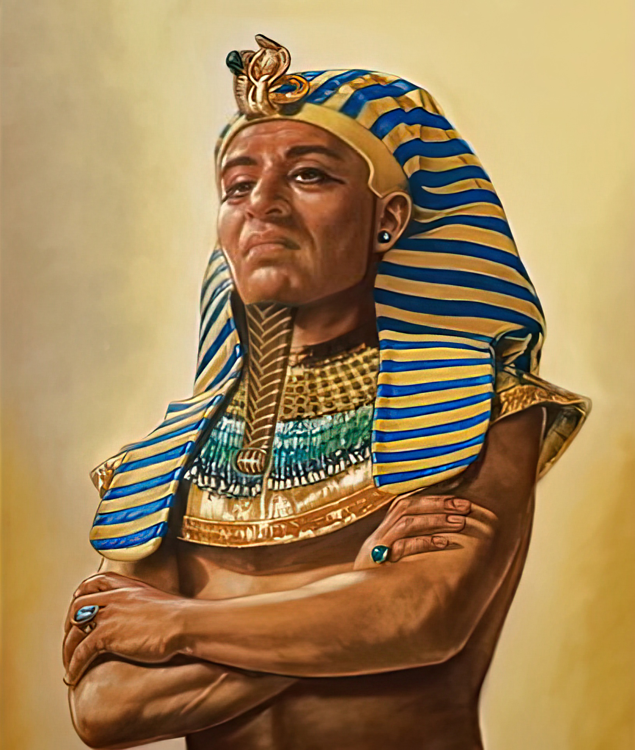
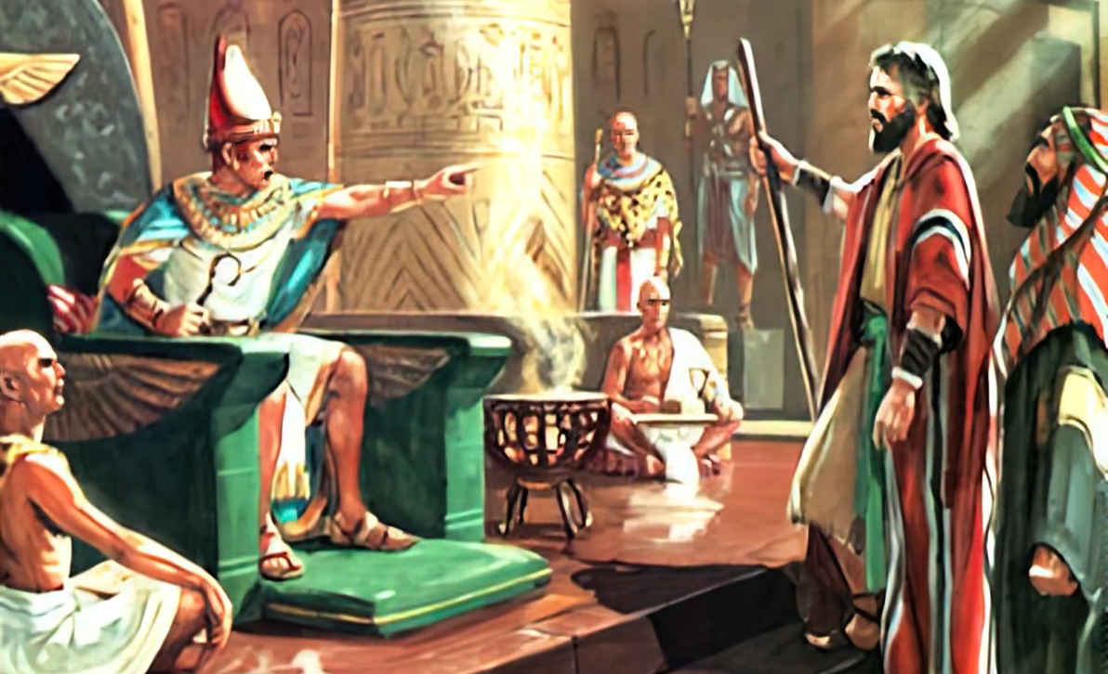
“Choncho Farao sanalole kuti Aisraeli apite monga momwe Yehova anamuwuzira Mose.”
Eksodo 9:35

Slide 3

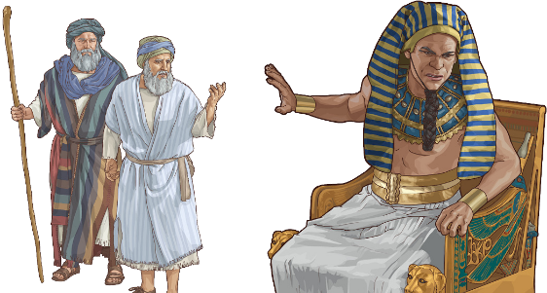
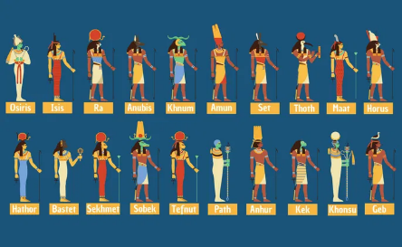
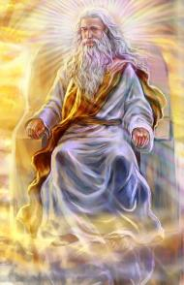




Pamene anthu a Mulungu ankakumana ndi nkhondo, Mulungu anawalangiza kuti ⁠adziyamba akambirana za mtendere. Ngati sangafikire pa mgwirizano, ndiye kuti ayenera kuchita zinthu zina (Deuteronomo 20:10-12).
Umu ndi mmene Mulungu anachitira ndi Aigupto. Anayesa njira yamtendere poyamba, koma Thutmose anakana kuvomera. Nthawi yoti achitepo kanthu inali itakwana.
Pamene miliri inagwa, palibe mulungu aliyense mugulu lalikulu la milungu ya ku Igupto amene anatha kuteteza Igupto ku mphamvu ya Mulungu m’modzi woonai.
Mawu oyamba:
  Nkhondo ya Njoka (Eksodo 7:8-12)
  ⁠ ⁠Mtima owuma (Eksodo 7:13)
Miliri:
  Miliri itatu yosaopysa (Eksodo 7:14-8:19)
  Miliri itatu yoopysa (Eksodo 8:20-9:12)
  Miliri itatu yowononga (Eksodo 9:13-10:29)

Slide 4

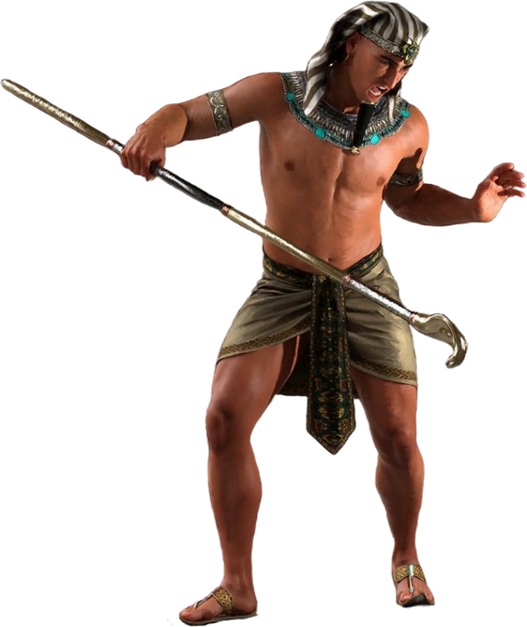
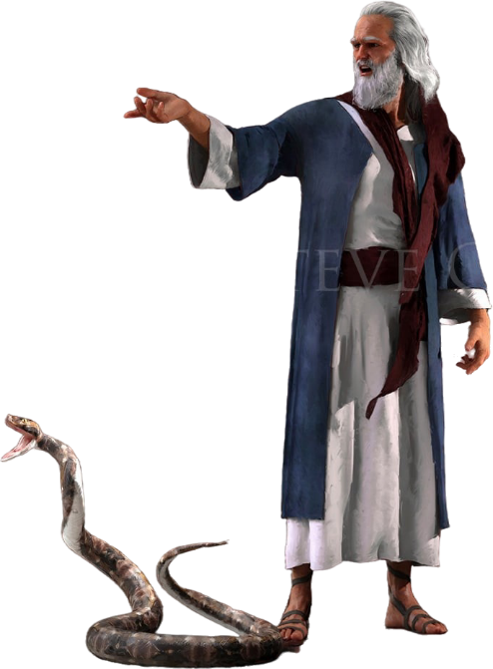
ZOYAMBA

Slide 5

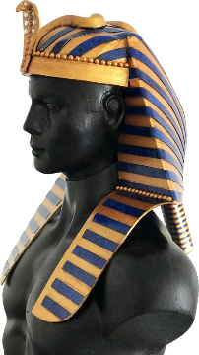
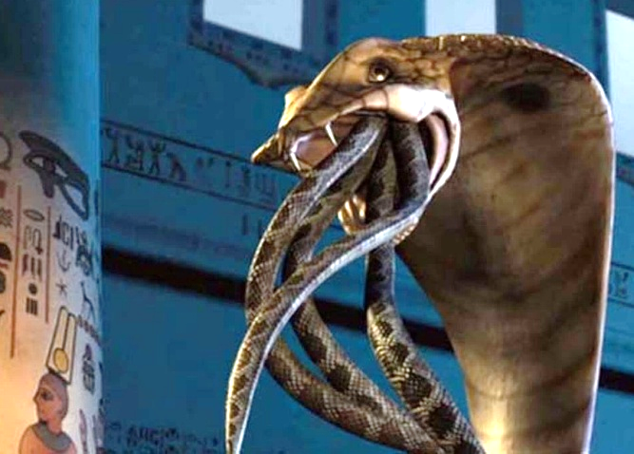
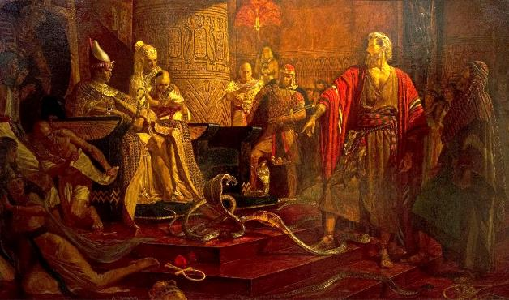
NKHONDO YA NYOKA
“Aliyense wa iwo anaponya ndodo yake pansi ndipo inasanduka njoka. Koma ndodo ya Aaroni inameza ndodo zawo.” (Eksodo 7:12)
Mulungu ananena kuti kupulumutsidwa kwa Aisiraeli inali nkhondo yomwe Iye mwini anamenya motsutsana ndi milungu ya ku Igupto (Eksodo 12:12; Numeri 33:4 ).
Pa korona wake, panali chizindikiro cha mphamvu yake, Farao ankavala njoka ya mamba yokongola yomwe imayimira mulungu wamkazi Uadyet.
Posandutsa ndodo kukhala njoka, Mulungu ankatsutsa mwachindunji mulungu ameneyu (Eksodo 7:10). Kodi iye akanatha kuteteza Farao?
Satana anatsanzira chozizwitsacho kudzera mu amatsenga (Eksodo 7:11). Koma iye sangapange moyo; njoka zake zinkangofanana ndi njoka. Koma Mulungu anapanga njoka yamoyo, yomwe inkatha kumeza zinthu zopanda moyo (Eksodo 7:12 ).
Motero Mulungu anasonyeza kuti Iye, osati milungu ya Aigupto, ndiamene ali ndi mphamvu ndi ulamuliro.

Slide 6
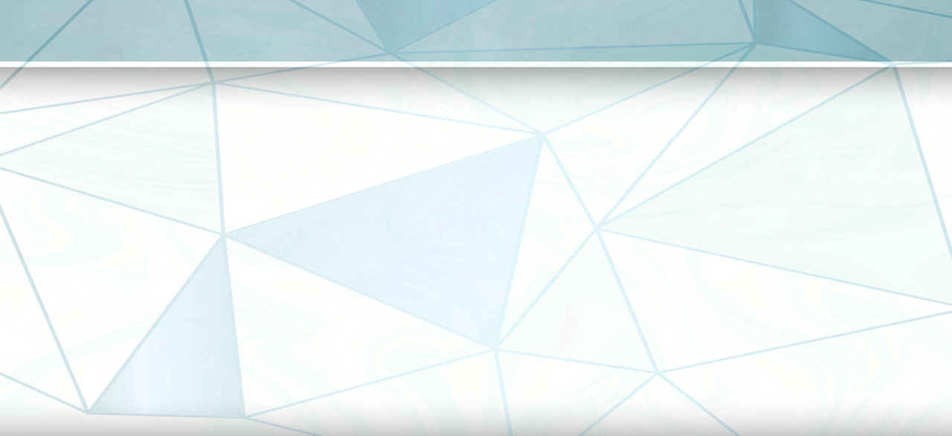
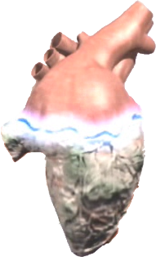
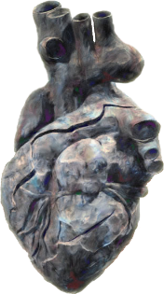


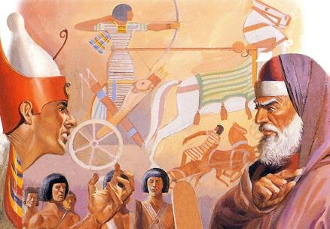

MTIMA WOUMA
“Koma mtima wa Farao unawuma ndipo sanawamvere monga momwe Yehova ananenera.” (Eksodo 7:13)
Mubuku la Eksodo, mau akuti Mulungu anaumitsa mtima wa Farao kunenedwa nthawi zisanu ndi zinayi ( Eksodo 4:21; 7:3; 9:12; 10:1; 10:20; 10:27; 11:10; 14:4; 14:8 ), ndipo nthawi zina zisanu ndi zinayi zimanenedwanso kuti Farao mwamwake anaumitsa mtima wake Eksodo 7:14; 7:22; 8:19; Zikugwirizana! Ndani amene anaumitsa mtima wa Farao?
Itatha miliri isanu yoyambirira, Baibulo limanena momveka bwino kuti Farao anaumitsa mtima wake. Izi zikutanthauza kuti anakana kuyankha moyenera kuitana kwa Mzimu Woyera kuti alole Aisraeli apite mwaufulu.
Utatha mliri wachisanu ndi chimodzi, Mulungu ndiye anaumitsa mtima wa Farao (Eksodo 9:12). Zikuwoneka kuti Farao anali atadutsa malire a kulapa. Komabe, pa mliri wachisanu ndi chiwiri, anapatsidwanso mwayi wina, koma anaumitsanso mtima wake (Eksodo 9:34–35).
Kuyambira pamenepo, tsogolo lake linali latsimikizika. Mulungu anaumitsa mtima wa Farao chifukwa iye anali ataganiza motsimikizika kuti sadzalapa.

Slide 7

EGW ( The Review and Herald , February 17, 1891)
“Pa nthawi iliyonse imene Farao ankakana kuwona kuwala, Ambuye ankawonjezera kuwonetsa mphamvu zake momveka bwino. koma kuuma mtima kwa mfumu kunakula ndi umboni uliwonse watsopano wa mphamvu ndi ukulu wa Mulungu wa Kumwamba, mpaka muvi wotsiriza wachifundo chaumulungu chinatha . Pamenepo, munthuyo anauma mtima kwathunthu chifukwa cha kukana kosalekeza. Farao anadzala kukhota mtima, ndipo anakolola khalidwe lomwelo m’moyo wake. Ambuye sanaone china chilichonse chimene akanachitanso kuti amutsimikizire, chifukwa anali atadzikwirira ndi kukhota mtima kwake, moti Mzimu Woyera sanaone njira yotha kufikira mtima wake. Farao anaperekedwa ku kusakhulupirira ndi kuuma mtima kwake.”

Slide 8

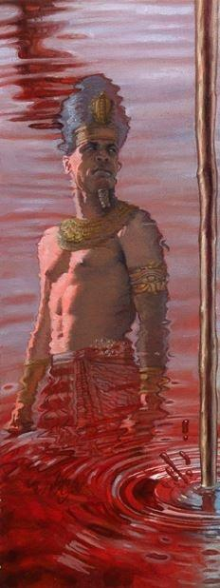
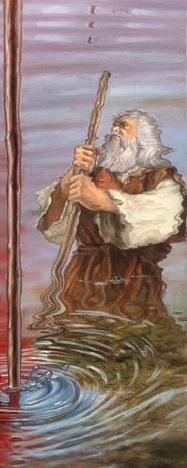
MILIRI

Slide 9

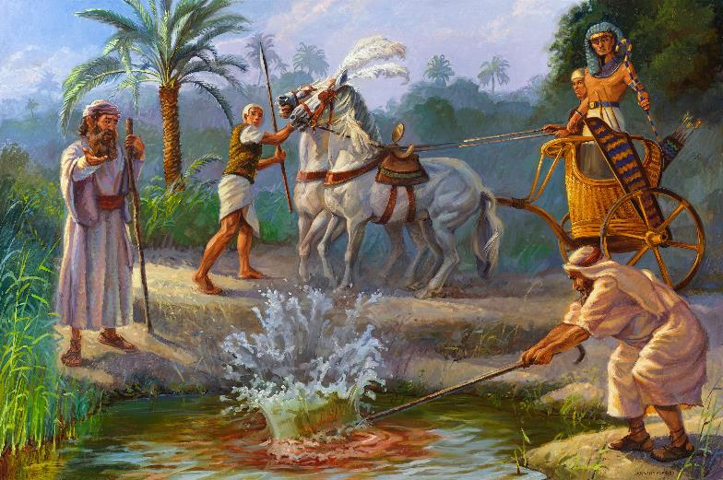
MLIRI WOYAMBA (WOSAPYSA): MWAZI
“Izi ndi zimene Yehova akunena: Ndi ndodo imene ili mʼdzanja langa ndidzamenya madzi a mu Nailo, ndipo madzi adzasanduka magazi. Ndikadzachita ichi udzadziwa kuti Ine ndine Yehova: (Eksodo7:17)
Hapi, mulungu wa Nailo
Eksodo 7:14-25
Mtsinje wa Nailo, ndi kusefukira kwake, unapatsa moyo Aigupto. Koma ndani anapanga gwero la madzi? Amatsenga anayerekeza kutembenuka kwa madzi, koma sanathe kubwezeretsa kusinthaku.

Slide 10

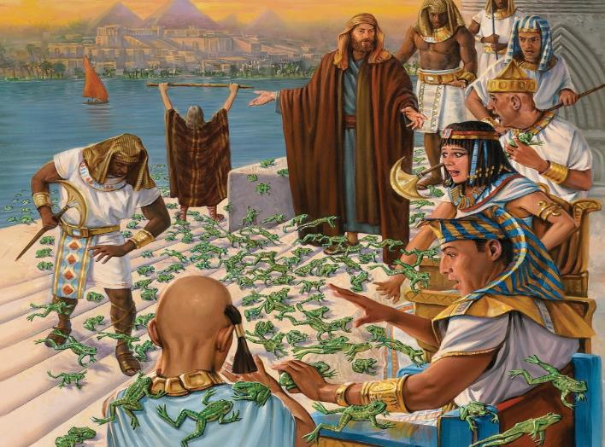
MLIRI WACHIWIRI (WOSAOPYSA): ACHULE
“Ndipo Yehova anati kwa Mose, “Uza Aaroni kuti, ‘Loza ndodo yako ku mitsinje, ku ngalande ndi ku zithaphwi ndipo pakhale achule pa dziko lonse la Igupto.’ ” (Eksodo 8:5)
Heketi, mulungu wa achule
Eksodo 8:1-15
Apanso amatsenga anachitanso zofanana ndi mliriwo, koma sanathe kuuletsa.

Slide 11

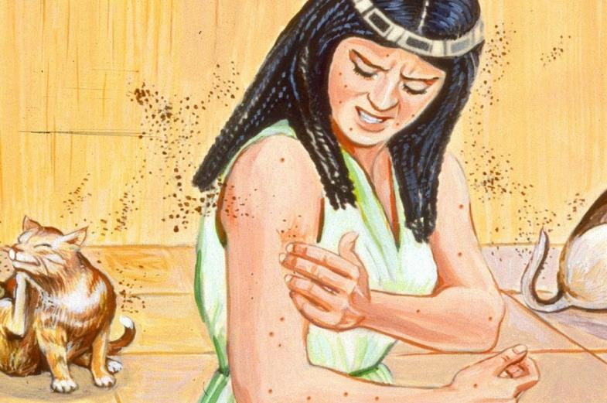
MLIRI WACHITATU (WOSAOPSYA): NSABWE
“Kenaka Yehova anati kwa Mose, “Uza Aaroni kuti akweze ndodo yake ndi kumenya fumbi la pa nthaka, ndipo fumbilo lidzasanduka nsabwe pa dziko lonse la Igupto.’” (Eksodo 8:16)
Gebu, mulungu wa nthaka
Eksodo 8:16-19
Kulenga moyo kuchokera ku fumbi la nthaka (Genesis 1:24)? Panalibenso chikaiko ponena za chiyambi cha miliri: “Ichi ndi chala cha Mulungu” (Eksodo 8:19 ). Ndipo pamapeto pake, amatsenga anangokhala chete.

Slide 12

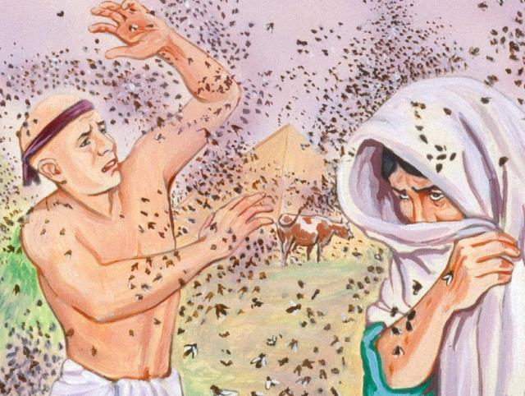
MLIRI WACHINAYI (WOWOPYSA): NTCHENTCHE
“Kenaka, Farao anayitanitsa Mose ndi Aaroni ndipo anati, “Pemphera kwa Yehova kuti achulewa achoke kwa ine ndi anthu anga, ndipo ine ndidzalola kuti anthu anu apite kukapereka nsembe kwa Yehova.” (Eksodo 8:24)
Uatchit, mulungu wamkazi wa madambo
Eksodo 8:20-32.
Kwa nthawi yoyamba, Aisraeli anatetezedwa ku mliri. Izi zinachititsa Farao kuti ayambe kukambirana, koma potsiriza analephera kukwaniritsa mbali yake ya mgwirizano.

Slide 13

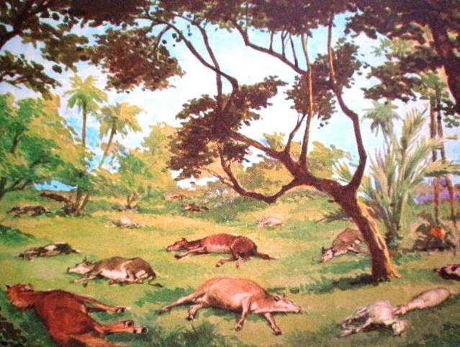
MLIRI WACHISANU (WOWIRI): IMFA YA NG’OMBE
“dzanja la Yehova lidzakantha ziweto zako zimene zili ku munda, pamodzi ndi akavalo, abulu, ngamira, ngʼombe, nkhosa ndi mbuzi ndi mliri woopsa kwambiri.” (Eksodo 9:3)
Khunumi, mulungu wolenga
Eksodo 9:1-7.
Milungu yambiri inali ndi mitu ya nyama, choncho mliri umenewu unachititsa manyazi yambiri ya mulunguwo.

Slide 14

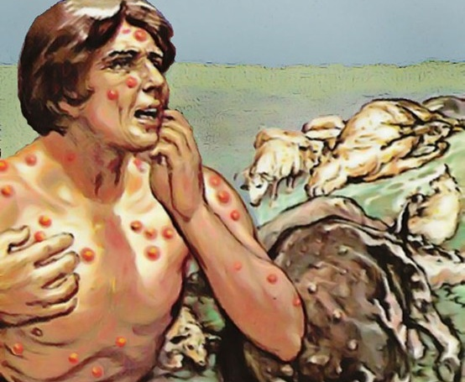
MLIRI WACHISANU NDI CHIMODZI (WAKUCHITA): ZILONDA
“Kotero anatenga phulusa la pa moto ndi kuyima pamaso pa Farao. Mose analiwaza mmwamba, ndipo panabuka zotupa zophulika zokha pa munthu aliyense ndi pa ziweto.” (Eksodo 9:10)
Sekhmeti, mulungu wamkazi wochiritsa
Eksodo 9: 8-12 .
Ngakhale amatsenga sanathe kudzichiritsa okha (Eksodo 9:11). Farao sanakayikire chilichonse chokhudza komwe miliri imene ija inachokera. Koma anaganiza zokana kugwadira Mulungu, ndipo Mulungu anamulola kukolola zipatso za kupanduka kwake (Eksodo 9:12 ).

Slide 15

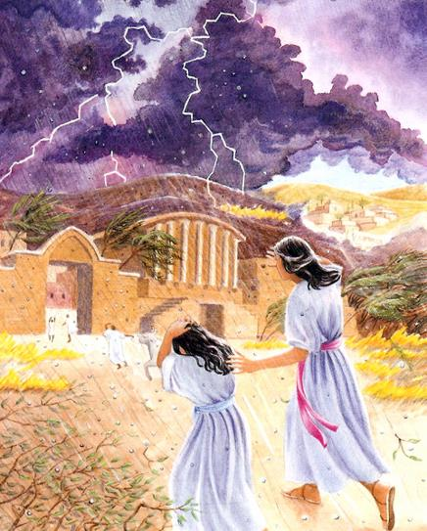
MLIRI WA CHISANU NDI CHIWIRI (WOWONONGA): DZAMALI
“Nʼchifukwa chake mawa, nthawi ngati ino, ndidzagwetsa matalala amphamvu amene sanagwepo pa Igupto, kuyambira pachiyambi mpaka lero” (Eksodo 9:18)
Nati, mulungu wa mlengalenga
Eksodo 9:13-35.
Chikhulupiriro cha Aigupto chinayesedwa. Iwo amene anakhulupilira anapulumutsa miyoyo ya akapolo awo ndi ziweto zawo (Eksodo 9:20). Farao sanakhulupirire, ndipo ngakhale anaulula tchimo lake, kuvomereza kwake sikunali koona (Eksodo 9:27-30).
Seti, mulungu wa mikuntho

Slide 16

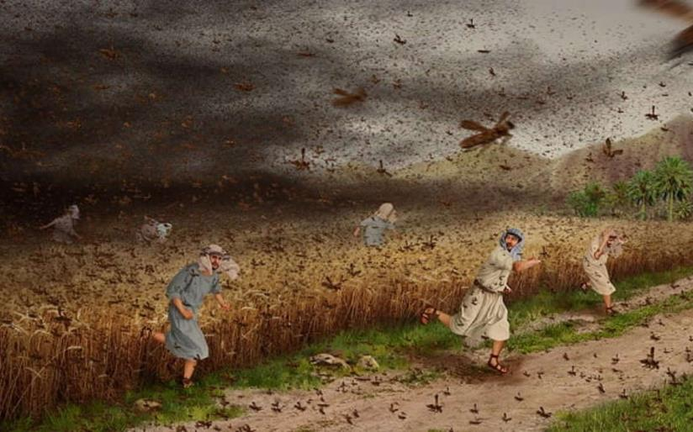
MLIRI WACHISANU NDI CHIWIRI (OWONONGA): DZAMALI
“Ngati ukana kuwalola, ndigwetsa dzombe mʼdziko lako lino mawa. ” (Eksodo 10:4)
Nepa, mulungu wa tirigu
Eksodo 10:1-20.
Pamene Aigupto anali ataonongedwa, Aigupto nawonso anachonderera Farao kuti awalole Aisrayeli amuke ( Eksoko 10:7 ).

Slide 17

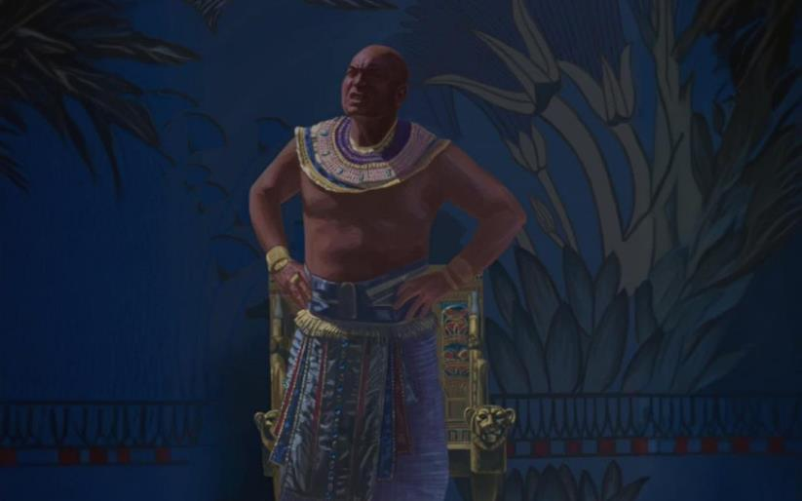
MLIRI WACHISANU NDI CHINAI (WOWONONGA): MDIMA
“Kenaka Yehova anati kwa Mose, “Tambasulira dzanja lako kumwamba kuti kukhale mdima umene udzaphimba dziko lonse la Igupto, mdima wandiweyani.’” (Eksodo 10:21)
Ra, mulungu wa dzuwa
Eksodo 10:21-29.
Moyo ku Aigupto unayima kwa masiku atatu (Kupatula ku Gosheni). Mulungu anapereka nthawi yosinkhasinkha, imene Farao sanaigwiritse ntchito moyenerera.

Slide 18

EGW (Patriarchs and Prophets, p. 263)
“Mliri uliwonse usanagwe, Mose anayenera kufotokoza chikhalidwe chake ndi zotsatira zake, kuti mfumu idzipulumutse yokha ku chilangocho ngati isankha.Chilango chilichonse chokanidwa chidzatsatiridwa ndi china choopsa, mpaka mtima wake wodzikuza udzachepetsedwa, ndipo adzavomereza Mlengi wa kumwamba ndi dziko lapansi monga Mulungu woona ndi wamoyo. Ambuye anapatsa Aigupto mwayi woti awone momwe nzeru za amuna amphamvu zawo zinali zopanda ntchito, ndiponso kufooka kwa mphamvu za milungu yawo, pamene akamatsutsana ndi malamulo a Yehova, iye akanalanga anthu a ku Igupto chifukwa cha kulambira mafano kwawo ndi kulethetsa kudzitamandira kwawo pa madalitso amene analandira kuchokera kwa milungu yawo yopanda nzeru, kuti mitundu ina imve za mphamvu Yake ndi kunthunthumira pa ntchito Zake zamphamvu, ndi kuti anthu Ake atembenuke kusiya kulambira mafano ndi kumulambira koyera.”

