Slide 1

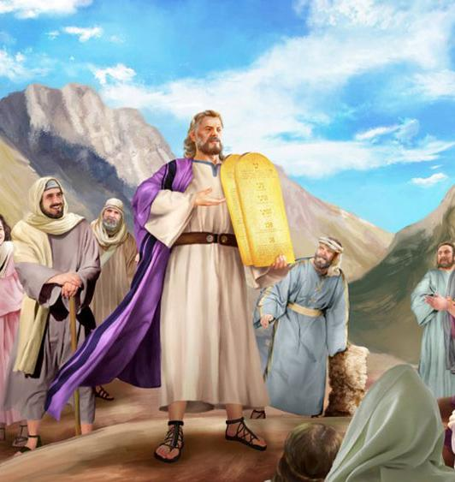
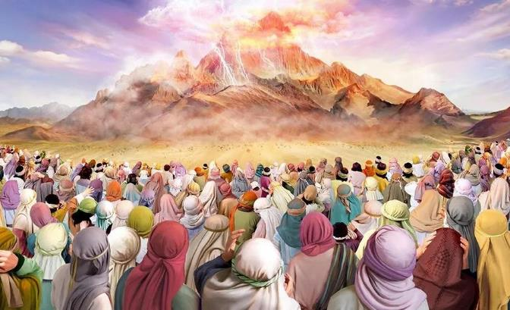
PANGANO LOPANGIDWA PA SINAI
Phunziro 8, August 23, 2025

Slide 2
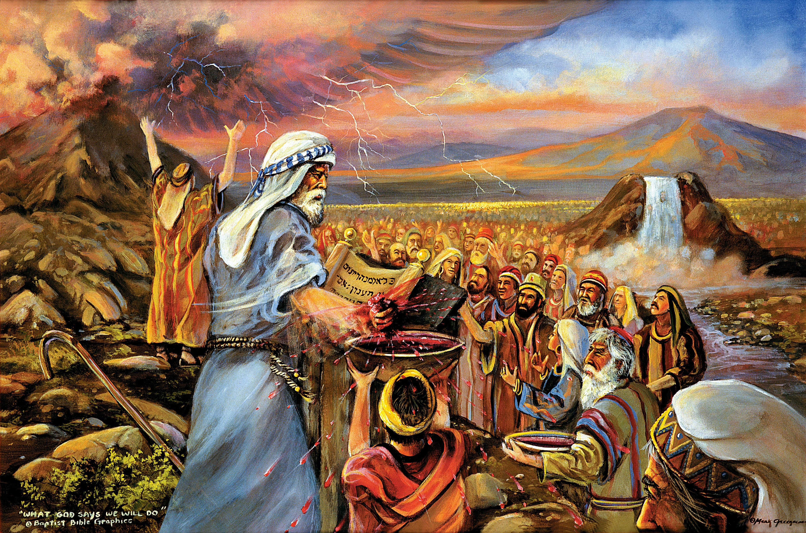
“‘Inu eni munaona zimene ndinawachitira Aigupto ndiponso mmene ndinakunyamulirani, monga mmene chiwombankhanga chimanyamulira ana ake pa mapiko,’ ndikukubweretsani kwa Ine. Tsopano, ngati mumveradi mawu anga ndi kusunga pangano langa, mudzakhala chuma changa chapamtima pakati pa mitundu yonse. Ngakhale kuti dziko lonse lapansi ndi langa, inu mudzakhala ansembe achifumu ndi mtundu woyera mtima. Awa ndi mawu amene uyenera kuwawuza Aisraeli;” Eksodo 19:4–6

Slide 3

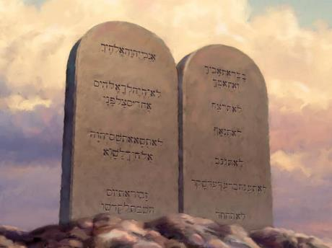
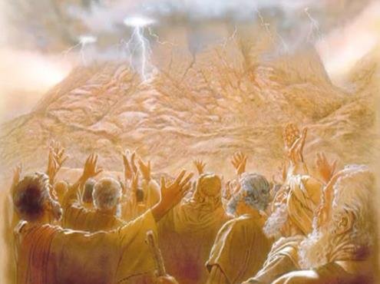








Kuwoloka Nyanja Yofiira kunali chipambano kwa Aisraeli. Chipambano chachiwiri chinali kulengezedwa kwa Lamulo kudzera pakamwa pa Mulungu mwini.
Pa nthawi imeneyo, Israeli anabadwa kukhala mtundu woyera. Analandira malamulo omwe adzalamulire tsogolo lake.
Koma sanali malamulo a chipembedzo, a boma, kapena aumoyo okha. Malamulo Khumi, omwe ndi maziko a malamulo onsewa, ndi chithunzi cha khalidwe la Mulungu mwiniwake, ndipo chifukwa chake, sagwira ntchito kwa Aisraeli okha, koma kwa ana onse a Mulungu.
Kuperekedwa kwa Lamulo:
  Olandira Lamulo (Eksodo 19:1-8)
  Wopereka Lamulo (Eksodo 19:9-25)
  Malamulo Khumi (Eksodo 20:1-17)
Tanthauzo la Lamulo :
  Ntchito ya Lamulo.
  Lamulo monga lonjezo.
  Lamulo monga mathero.

Slide 4

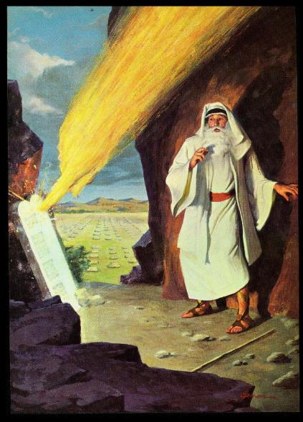
KUPEREKEDWA KWA MALAMULO

Slide 5

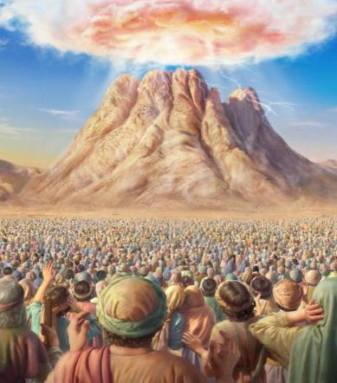
OLANDIRA LAMULO
“Inu eni munaona zimene ndinawachitira Aigupto ndiponso mmene ndinakunyamulirani, monga mmene chiwombankhanga chimanyamulira ana ake pa mapiko,’ ndikukubweretsani kwa Ine.” (Eksodo 19:4)
Chifukwa chiyani Mulungu adatulutsa Aisraeli ku Igupto?
Kuti akamutumikire (Eksodo 5:1; 7:16; 8:1, 20; 9:1, 13; 10:3). Pochita zimenezi, adzalandira madalitso ochukula (kuphatikizapo dziko la Kenani).
Itatha miyezi itatu, anamanga misasa yawo pafupi ndi Phiri la Sinai. Pamenepo, maziko a dziko la Aisiraeli anakhazikitsidwa. Mulungu anawapatsa pangano, ndipo iwo analivomera (Eksodo 19:1-8).
Povomera pangano, Aisiraeli adzakhala chiyani (Eksodo 19:5-6)?
ANTHU OYERA
Iwo akanadzipatulira okha kwa Mulungu, ndikuonetsera khalidwe Lake.
UFUMU WA ANSEMBE
Adzalumikiza anthu ena ndi Mulungu, ndi kuwaphunzitsa malamulo ake.
CHUMA CHAPADERA CHOCHOKERA KWA MULUNGU
Mulungu adachititsa Aisiraeli kukhala njira yowunikira dziko lonse ndi chidziwitso chonena za Iye

Slide 6

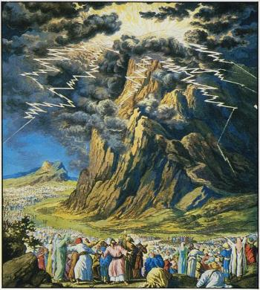
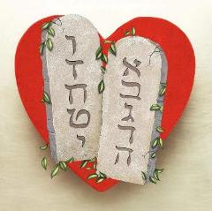
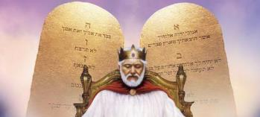
WOPEREKA LAMULO
“Phiri la Sinai linakutidwa ndi utsi, chifukwa Yehova anatsika ndi moto pa phiripo. Utsi unakwera ngati wochokera mʼngʼanjo yamoto ndipo phiri lonse linagwedezeka kwambiri” (Eksodo 19:18)
Kuperekedwa kwa Lamulo la Mulungu pa Sinai kunali kopambana ndi kochititsa mantha (Ahebri 12:18-21). Palibe amene angakonzekere chinthu chotero. Choncho, anthuwo anafunikira kudziyeretsa poyamba ndi kusunga mtunda woyenera kuti ulemerero wa Mulungu usawaononge (Eksodo 19:10-12).
Chifukwa chiyani njira ngati imeneyi inali yofunika?
Mawu amene Mulungu anali atatsala pang’ono kuwalankhula anali chionetsero cha makhalidwe ake. Kumvera mawu amenewa ndi moyo; kusamvera ndi imfa. Aisiraeli anafunika kukhala ndi chidwi chathunthu ndi kufunika kwa ‘mawu a pangano, Malamulo Khumi” (Eksodo 34:28).
Mitundu iwiri ya Lamulo inalembedwa: umodzi pachiyambi cha Kutuluka mu Iguputo, ndipo wina monga gawo la mawu omaliza a Mose asanalowere ku Kenani.
Ngakhale pakuperekedwa kwake zingaoneke zochititsa mantha, Lamulo limaonetsa khalidwe labwino kwambiri la Mulungu: chikondi (Aroma 13:10).

Slide 7
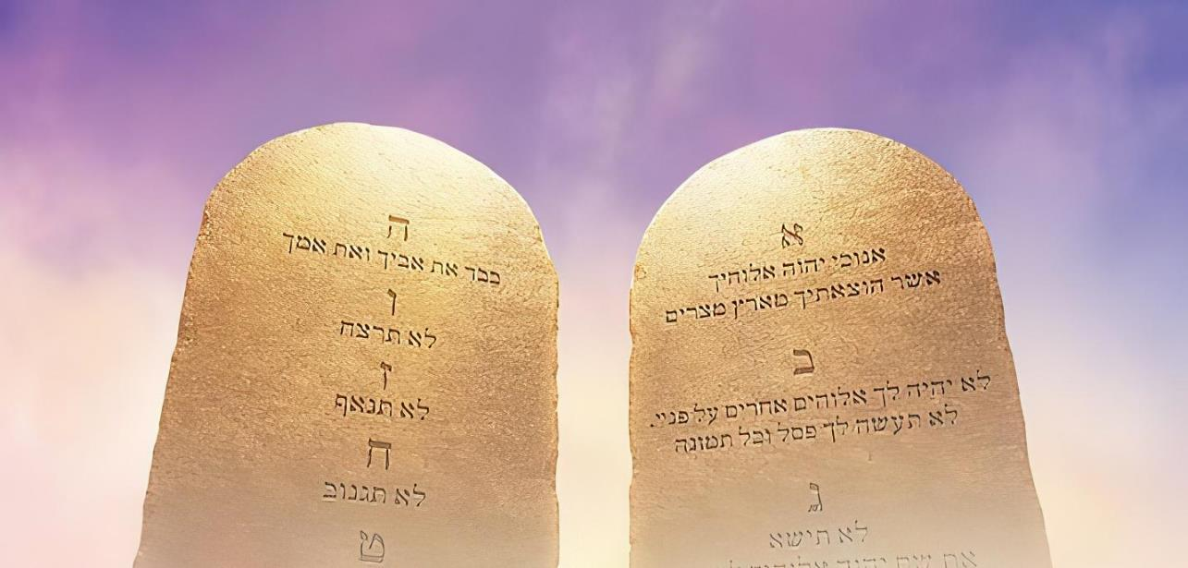

MALAMULO KHUMI
“Ine ndine Yehova Mulungu wako amene ndinakutulutsa ku Igupto, mʼdziko la ukapolo” (Eksodo 20:2)
Mulungu anayambitsa Lamulo powonetsera ntchito yake yayikulu: ‘Ndakupulumutsani ku tchimo, choncho kuyambira tsopano ichi ndi chimene muyenera kuchita’ (Eksodo 20:2). Kutsatira Lamulo kwathu ndi yankho ku Chipulumutso chathu. Ndi yankho la chikondi ku chikondi chimene talandira.
“chikondi ndiko kukwaniritsa kwa lamulo” (Aroma 13:10)
Konda Mulungu (Deuteronomo 6:5; Eksodo 20:3-11)
Konda mzako (Livitiko 19:18; Eksodo 20:12-17)
Kudzilemekeza tokha kuti chilakolako chadyera chisawononge khalidwe lathu.
Kulemekeza tsiku Lake la kupuma ndi kupembedza, Sabata
Kulemekeza Mulungu pomupatsa malo oyamba m’miyoyo yathu.
Kulemekeza Mulungu posayika fano lililonse m’malo mwake
Kulemekeza dzina la Mulungu, mbiri yake, ndi khalidwe lake
Kulemekeza Makolo
Kulemekeza Moyo
Kulemekeza Mabanja
Kulemekeza katundu wa mwini
Kulemekezambiri ya ena

Slide 8

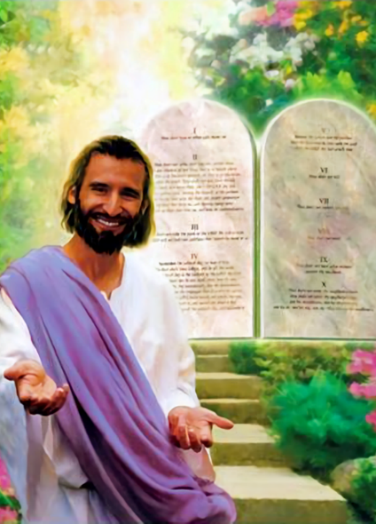

TANTHAUZO LA LAMULO

Slide 9


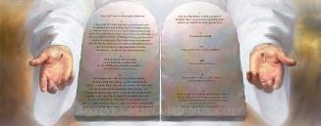

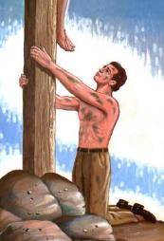
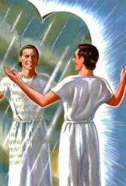
NTCHITO YA PANGANO
“Choncho lamulo linayikidwa kukhala lotiyangʼanira kuti lititsogolere kwa Khristu kuti tilungamitsidwe mwachikhulupiriro” (Agalatiya 3:24)
Kodi ntchito zina za Lamulo ndi chiyani?
Chipulumutso sichikuphatikizidwa m’ntchito zake (Agalatiya 2:16). Lamulo ndi ngati kalilole lomwe machimo athu amawonekeramo (Yakobo 1 :23-25).
Limatiteteza ku zoipa (Masalimo 119:104)
Limatipatsa nzeru (Deut. 4:6)
Limatipatsa ufulu (Yakobo 2:12)
Limatipatsa mtendere (Masalimo 119:165)
Limatipatsa chuma ndi zabwino (Yoswa 1:8)
Limaonetsera tchimo lathu (Aroma 7:7)
Limatitsogolera Kwa Yesu
(Agalatiya 3:24)
Kuswa kalilole sikuchotsa madontho omwe tilinawo; kunyalanyaza izo sikuchotsanso. Koma popanda “kalirole” [Lamulo] sitingadziwe kuti ndife odetsedwa [ndi uchimo], ndi kuti timafunikira “nsalu” [Khristu] kuti atiyeretse.
Baibulo limanena momveka bwino kuti Lamulo ndi labwino (Aroma 7:12); Kusinkhasinkha za ilo ndichisangalalo (Masalimo 1:2). “Ndithu, ine ndimakonda malamulo anu! Ndimalingaliramo tsiku lonse” (Masalimo 119:97).

Slide 10


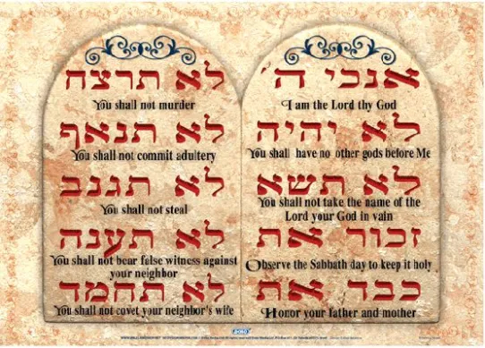

LAMULO MONGA PANGANO
“Iye anakuwuzani Malamulo Khumi omwe ndi pangano lake limene anakulamulirani kuti mutsatire. Ndipo anawalemba malamulowo pa mapale awiri a miyala” (Deuteronomo 4:13 )
MuChiheberi, nthawi zitatu zomwe Malamulo Khumi amatchulidwa kuti “mau khumi” (Eksodo 34:28; Deuteronomo 4:13; 10:4).
Tiyeni tiganizire za izi. Kodi timatanthauza chiyani tikamauza munthu wina kuti, ‘Ndakupatsani mawu anga”?
M'malo mwake, sikuti tikupatsani kalikonse; Tikukutsimikizirani kuti tidzachita chinachake motsimikizika.
Chotero, liwu lachihebri lakuti “dabar” lingatanthauziridwe kuti ‘mawu’ kapena “lonjezano.”
Chitsanzo: “Palibe mawu [dabar] ndi amodzi omwe amene anapita pachabe pa malonjezo [dabar] ake onse abwino amene anawapereka kudzera mwa mtumiki wake Mose” (1 Mafumu 8:56).
Malamulo Khumi ndi malonjezo khumi amene Mulungu walonjeza kwa ife, cholinga chake ndi kutitsogolera munjira yoyenera.

Slide 11

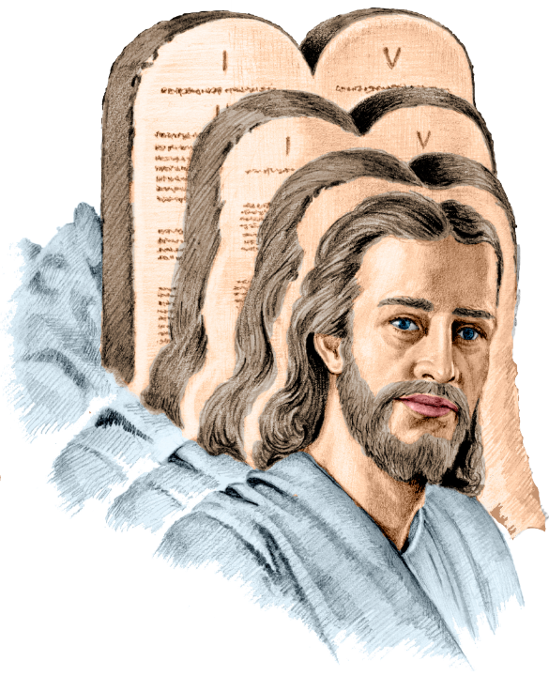
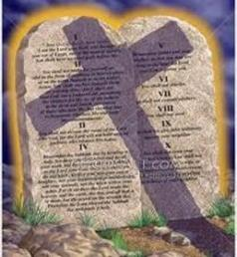
LAMULO MONGA MATHERO
“Khristu ndiye mathero amalamulo kuti aliyense amene akhulupirira akhale olungama pamaso pa Mulungu” (Aroma 10:4)
Mawu oti “mathero” amene Paulo anagwiritsa ntchito pa Aroma 10:4 ndi “telos.” Kodi tanthauzo la mawu amenewa ndi chiyani?
Tanthauzo lalikulu ndi: mfundo yomwe ikuwonetsa malire kapena cholinga. Mwachindunji (tanthauzo lachachiwiri): mapeto, kumaliza, zotsatira, cholinga. Tanthauzo lake lenileni liyenera kudziwika kudzera mu chiganizo chomwe liwuli likugwiritsidwa ntchito.
Ngati timamasulira kuti ‘Khristu ndiye mathero amalamulo,’ palibenso lamulo lililonse kuyambira pa imfa ya Yesu. Choncho, sizikhala tchimo lililonse. Choncho palibe tchimo. Paulo akanakhala akudzitsutsa (Aroma 7:7).
Ngati timamasulira kuti “Khristu ndiye mfundo yomwe Lamulo likuwonetsa,” Paulo akunena chinthu chimodzi, chifukwa lamulo likugwirabe ntchito, ndipo limatitsogolera kwa Khristu (Aroma 3:31; Agalatiya 3:24).

Slide 12

EGW (Patriarchs and Prophets, p. 305)
“Lamulo silinalankhulidwe pamenepo kuti lipereke phindu kwa Aheberi okha. Mulungu anawalemekeza powapanga kukhala oteteza ndi osunga malamulo ake, koma lidzakhala chuma chapadera choyenera dziko lonse. Malamulo Khumi adapangidwa kuti agwiritsidwe ntchito kwa anthu onse, ndipo anaperekedwa kuti aphunzitse ndiponso atsogolere onse. Malamulo khumi, achidule, omveka bwino, ndi olamulira, amasonyeza udindo wa munthu kwa Mulungu ndi kwa mnzake; zonsezi zokhazikika pa mfundo yayikulu yofunikira ya chikondi.”

