Slide 1
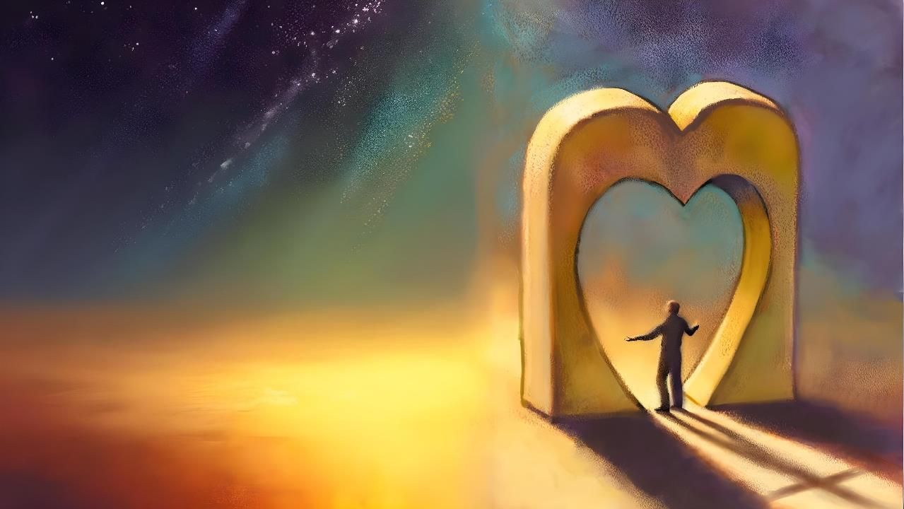
KUKHALA MOLINGANA NDI LAMULO
Phunziro 9, August 30, 2025

Slide 2
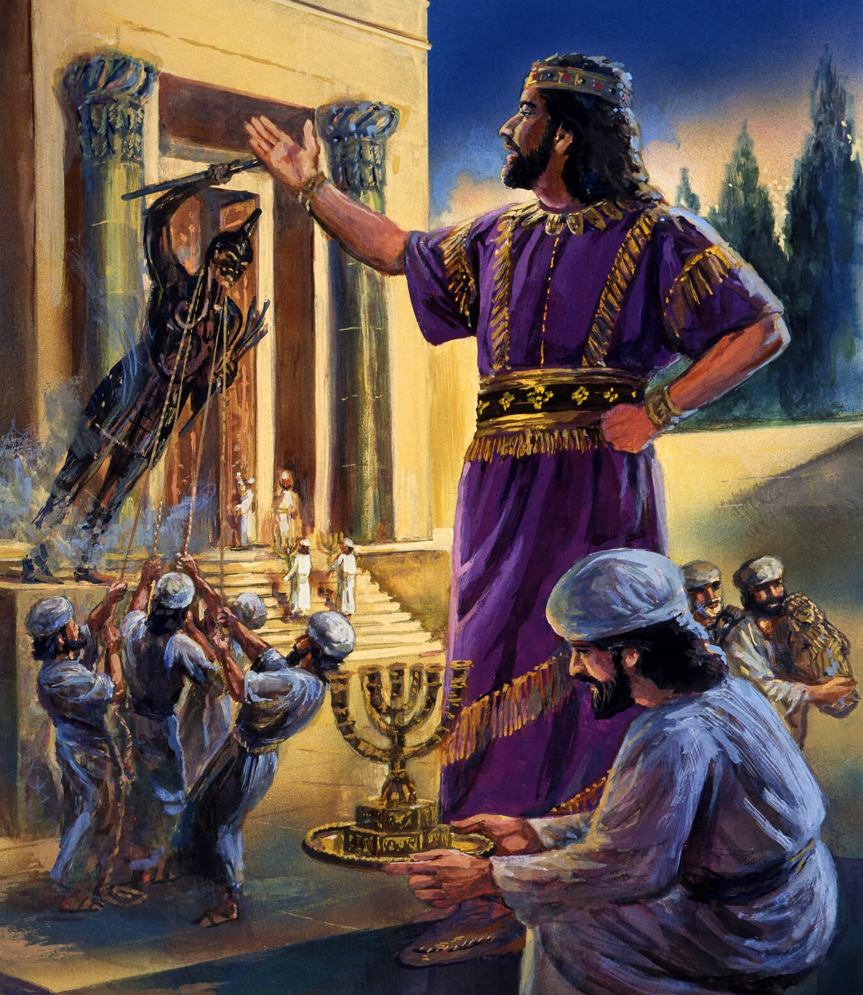
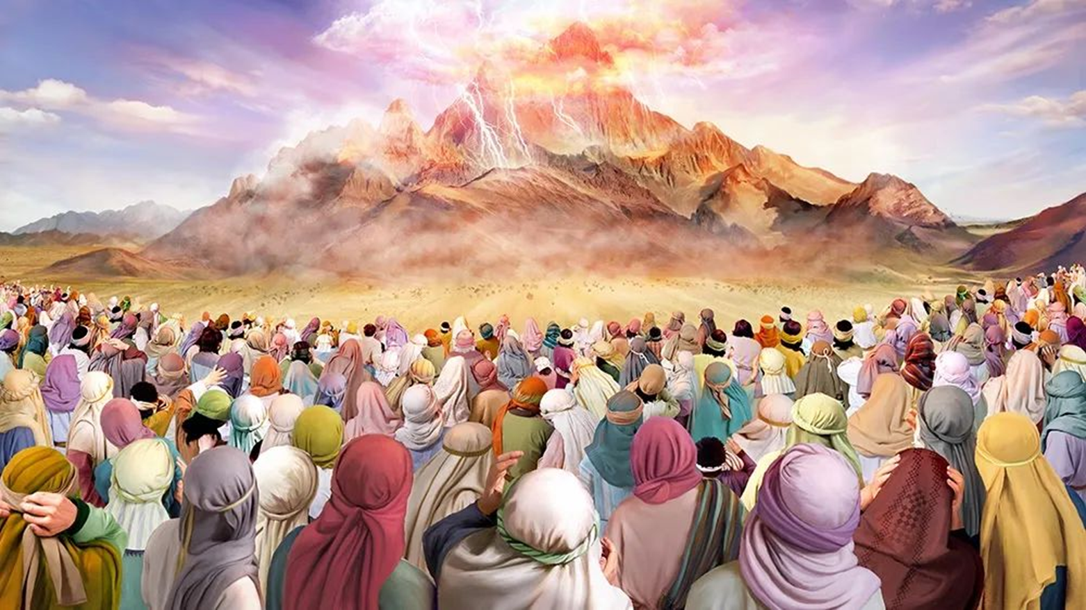
“Ndipo Yehova anati kwa Mose, “Awuze izi Aisraeli: ‘Inu mwaona nokha kuti Ine ndakuyankhulani kuchokera kumwamba. Choncho musadzipangire milungu yasiliva kapena yagolide kuti muziyipembedza pamodzi ndi Ine’” Eksodo 20:22, 23

Slide 3

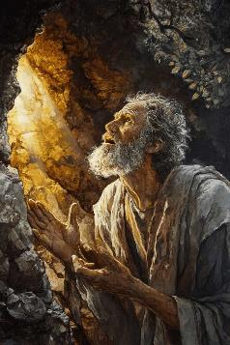
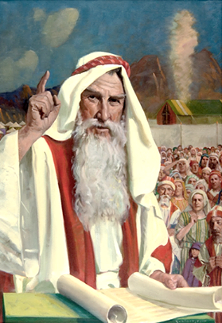
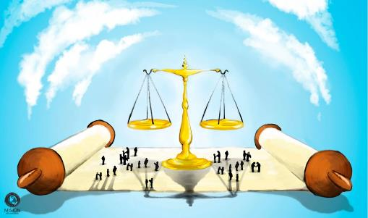


Atalengeza Malamulo Khumi, anthu anapempha Mose kuti akhale mkhalapakati pakati pawo ndi Mulungu (Eksodo 20:19). Kuyambira nthawi imeneyo, Mulungu anapereka malamulo kwa Mose, ndipo iye anawapereka kwa anthu.
Malamulo amenewa, otchedwa ‘Malamulo a Pangano,’ anapatsidwa kuti azilamulira moyo wa anthu a Israeli, ndipo motero amakhudzanso moyo wathu masiku ano (pamodzi ndi kusintha koyenera mogwirizana ndi moyo wathu wa lero).
Mwachidule, ndi kugwiritsa ntchito Malamulo Khumi munjira yothandiza pa nkhani zenizeni za moyo wa tsiku ndi tsiku..
Kukhala M’malamulo:
  M’mene Tingathetsere Chiwawa (Eksodo 21:1-32)
  M’mene Tingakhalire Mmagulu (Eksodo 21:33-23:19)
  M’mene Tingapezere Chipambano (Eksodo 23:20-33)
M’mene tingamvetsetsere Malamulo:
  Lamulo Lakubwereza.
  Mphotho ndi Chilango.

Slide 4

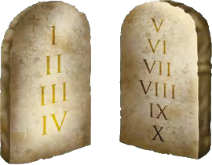

KUKHALA M’MALAMULO

Slide 5
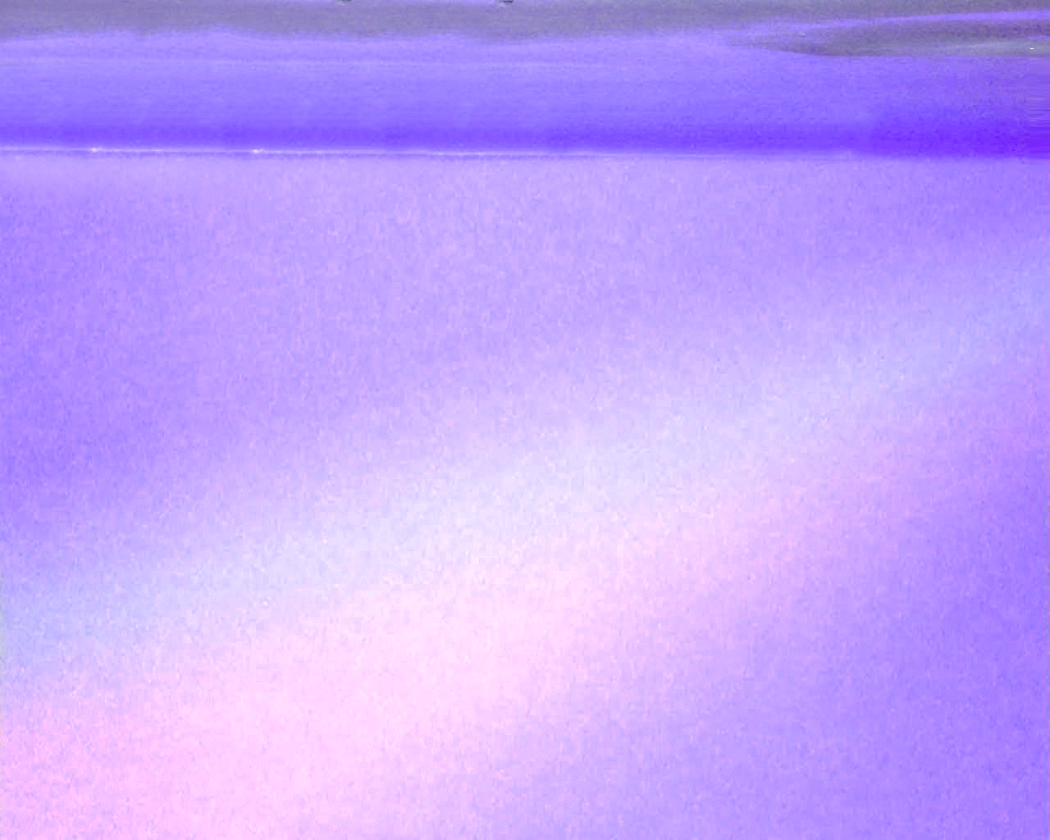
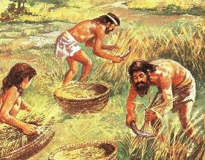
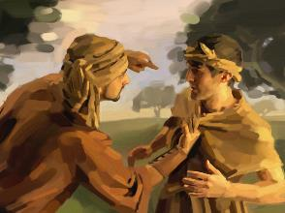
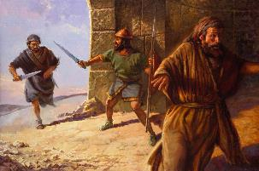
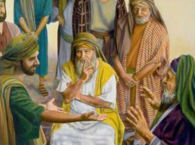
M’MENE TINGATHETSERE CHIWAWA
“Munthu aliyense amene amenya mnzake namupha, iyenso ayenera kuphedwa” (Eksodo 21:12)
Malamulo a Panganoli anayamba ndi kuwongolera zinthu zitatu zofunika kwambiri pa moyo wa Ahebri. :
Ukapolo (Eksodo 21:2-11)
  Amuna ankamasulidwa pakutha pa chachisanu ndi chiwiri.
  Akazi, ngati sanakwatire, analinso afulu.
  Munthu ankatha kukhalebe kapolo ngati atafuna.
Chilango cha Imfa (Eksodo 21:12-17)
  Kwa wakupha mwadala
  Kwa amene avulaza kapena kutemberera makolo ake
  Kwa wakuba anthu
Kuvulala (Eksodo 21:18-32)
  Udindo wa malipiro a zachuma
  Ngati kuchotsa mimba kuchitika, oweruza ndi mkaziyo (Pamodzi ndi mwamuna wake) amapereka chilango kwa olakwayo.
Malamulo onsewa amafuna kuthetsa nkhanza ndi chiwawa pakati pa anthu.

Slide 6

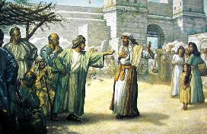
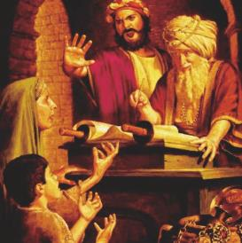
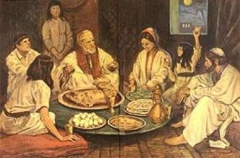
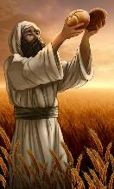
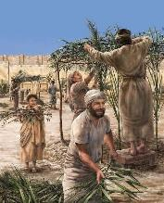
M’MENE TINGAKHALIRE PAGULU
“Ngati munthu anyenga namwali wosadziwa mwamuna amene sanapalidwe ubwenzi ndi kugona naye, munthuyo ayenera kulipira malowolo ndipo adzakhala mkazi wake” (Eksodo 22:16)
Mulungu sanali okhutitsidwa kuti angotisiya ndi malamulo ‘oyambirirawo’ ndikuti tizigwiritsa ntchito monga tikufunira. Anathandiza kuunikira zinthu zenizeni kudzera muzitsanzo kuti tithe kugwiritsa ntchito malamulo moyenera.
Zitsanzo izi zimaphatikizapo kukangana kwa nyama ndi nyama inzake (Eksodo 21:35-36); kubwereketsa ndi kubwereka (Eksodo 22:14-15 ); maubwenzi akunja kwa banja (Eksodo 22:16 ), ndi zina.
Kutsindika kwapadera kumayikidwa pa kuteteza ofooka komanso osalidwa mopanda chinyengo, komwe kuli kusasokoneza chilungamo kuti chiwapindulire kapena kuwavulaza (Eksodo 22:21-23; 23:2-3, 6).
Pokhala pangano la pakati pa Mulungu ndi anthu ake, malamulo amenewa anaphatikizanso momwe tiyenera kulumikizana naye. Kuwonjezera pa mpumulo wa Sabata, panalinso udindo wosunga maphwando omwe amatikumbutsa za kumasulidwa ku tchimo, chitetezo cha Mulungu, ndi tsogolo lowala lomwe tikuliyembekeza.

Slide 7

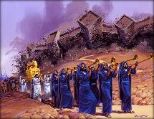
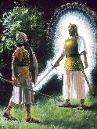

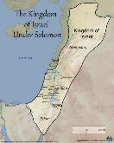
M’MENE TINGAPEZERE CHIPAMBANO
Mulungu akuwuza Aisraeli zochita
Mverani mawu ake, kuti Mulungu akhale mdani wa adani ake
(23:21-22)
Tumikirani Mulungu yekha, kuti Iye achotse matenda onse (23:24-26)
Musapange mgwirizano ndi Akanani, kuti musalambire milungu yawo (23:32-33)
Mulungu akuwuza Aisraeli zomwe adzachite
Mngelo adzawatsogolera ndi kuwafikitsa ku Kanani [kuwongolera] (23:23)
Adzachititsa mantha kwa okhala m’dzikolo (23:27)
Adzatumiza mavu kuti awathamangitse(23:28)
Adzawathamangitsa pang’onopang’ono (23:29-30)
Iye adzawapereka m’manja mwa Aisiraeli mpaka atayamba kulamulira kuchokera ku Nyanja ya Mediteraniyani kukafika ku mtsinje wa Firate(23:31)
Adzatumiza Mngelo Wake kuti awasunge ndi kuwalowetsa m’menemo[chitetezo] (23:20)
“Taona Ine ndikutuma mngelo wanga patsogolo panu kuti akutetezeni mʼnjiramo ndi kukakufikitsani ku malo amene ndakonza” (Eksodo 23:20)
Ndichifukwa chiyani Mulungu sanapereke dziko la Akanaan kwa Abrahamu? “popeza tchimo la Aamori silinafike pachimake kuti alangidwe” (Genesis 15:16).
Pakutha pa zaka mazana anayi za chisomo, Akanaani sanasinthe njira zawo. Panali nthawi yopereka dzikolo kwa Aisraeli… mwamtendere! (Eksodo 13:17)
Mulungu anadawatulutsa mu Igupto popanda iwo kumenya nkhondo, analekanitsa nyanja pakati, kuwadyetsa mozizwitsa, ndi kuwatsogolera ndi Mngelo Wake… Kodi akanalephera kuwapatsa Kanani popanda iwo kumenyanso nkhondo?

Slide 8
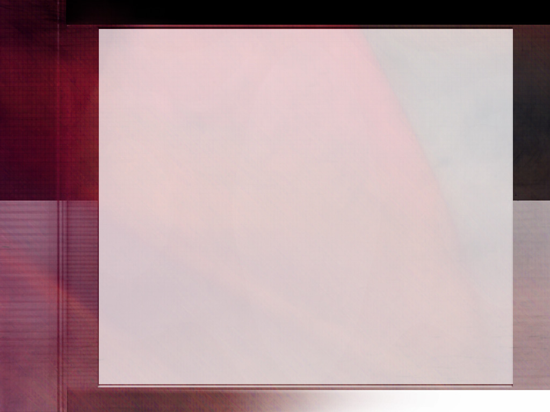
“Kupyolera m’mibadwo, lamulo la Mulungu lasungidwa monga muyezo wapamwamba kwambiri wa makhalidwe abwino. Palibe chinthu chilichonse chosinthidwa ndi sayansi kapena malingaliro a anthu anzeru chomwe chapeza udindo wofunikira womwe lamulo ili silikukuphimba. Lamulo la Mulungu ndi chitetezo cha moyo, chuma, mtendere, ndi chimwemwe. Linaperekedwa kuti liteteze ubwino wathu wa masiku ano komanso wosatha.”
EGW (The Upward Look. October 7)

Slide 9

M’MENE TINGAMVETSETSERE MALAMULO

Slide 10

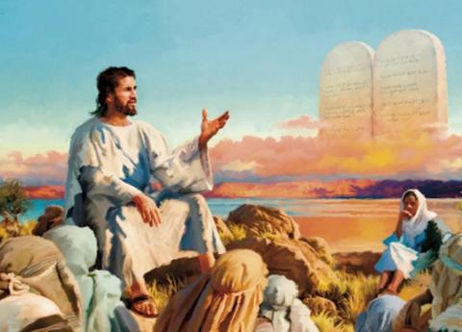


LAMULO LAKUBWEREZA
“diso kulipira diso, dzino kulipira dzino, mkono kulipa mkono, phazi kulipa phazi,” (Eksodo 21:24)
Pamene Yesu anapereka Uthenga pa Phiri, anachotsa lamulo la kubwezera (Mateyu 5:38-42)… kapena sanatero?
Mawu akuti “Munamva kuti kudanenedwa… koma Ine ndikuuzeni’ sanachotse lamulo lililonse (Yesu anagwiritsa ntchito mawu amodzimodziwo ponena za “usaphe” kapena “usachite chigololo,” koma sachinali cholinga chake kuwathetsa). Yesu nthawi zonse ankafutukula Lamulo, kulifotokozera bwino, komanso kulipatsa tanthauzo lake lenileni.
Sichinali cholinga chenicheni cha lamulo lakubwezera kuti munthu ataye diso kapena dzanja lake chifukwa chovulaza mnzake.
Lamulo ili linapangidwa ndi cholinga choteteza choletsa kubwezera, kuthetsa nkhondo zokhetsa mwazi, ndi kubwezera popanda kuchita kafukufuku wokwanira. Zowonongeka zinayenera kuyesedwa ndi oweruza, chipukuta misozi choyenera chimakhazikitsidwa ndi kulipidwa. Njirayi inachitika kuti anthu asatengere chilungamo m’manja mwawo. Chilungamo chiyenera kuchitika, koma chokhazikika mogwirizana ndi Lamulo la Mulungu.

Slide 11




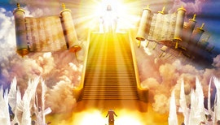
MPHOTHO NDI CHILANGO
“Koma ngati sanachite dala, ndipo Mulungu analola kuti zichitike, iyeyo athawire ku malo kumene ndidzakupatsani” (Eksodo 21:13)
Chikhumbo chofuna kubwezera chimakhala chokhazikika kwambiri m’mitima yathu. Ndipo nthawi zonse zimakhala zosagwirizana ndi zolakwika zomwe talandira: "Ngati wandichitira izi, ndidzamuchitira zochuluka.”
Yesu akutiitana ife kuchita zosiyana ndi zomwe timafuna: kubwezera choipa ndi chabwino (Mateyu 5:44). Ndiye chilungamo chiri kuti? Ndani yemwe adzamlipire wolakwirayo zolakwa kwake?
Mulungu samatiuza kuti wochita zolakwikayo sadzalangidwa, kapena kuti adzabwezera chilango. Koma amatiuza momveka bwino kuti Iye ndiye wobwezera chilango (Aroma 12:19-21).
Ngakhale kuti kubwezera kwaumwini kumavomerezedwa mu Malamulo a Pangano, kunachepetsedwa popanga dongosolo lachiweruzo loletsa nkhanza (Eksodo 21:12-13, 22; 22:8-9).
Palibe munthu amene angakhale oweruza, gulu la ozenga mlandu, ndi wopereka chilango nthawi imodzi. Ngati chilango chiyenera kuperekedwa, chiyenera kuchitidwa mwachilungamo. Ndipo Khristu adzakhala Woweruza wamkulu ndi wotsiriza.

Slide 12

“Monga Mlengi wa zonse, Mulungu ndiye wolamulira wa zonse, ndipo ali wokakamizika kuonetsetsa kuti lamulo lake litsatiridwa m’chilengedwe chonse. Kufuna zochepa kwa zolengedwa Zake kuposa kumvera lamulo Lake kukanakhala kuzisiya kuti ziwonongeke. Kulephera kulanga anthu olakwira lamulo lake kukanakhala kusokoneza chilengedwe chonse. Lamulo la makhalidwe ndi chotchinga cha Mulungu pakati pa munthu ndi uchimo. Choncho nzeru zopanda malire zayika pamaso pa anthu kusiyana pakati pa chabwino ndi choipa, pakati pa tchimo ndi chiyero.”
EGW ( The Signs of the Times , June 5, 1901)

