Slide 1
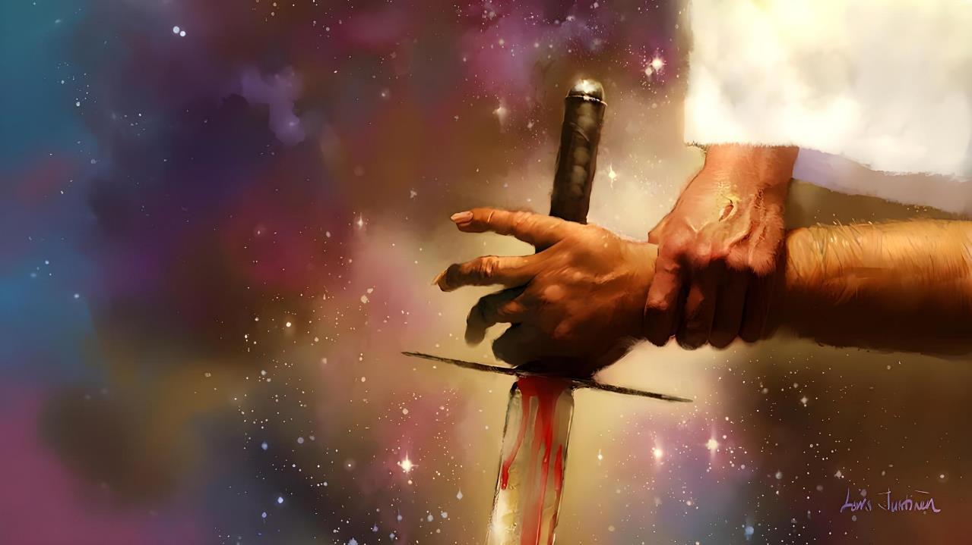
MKANGANO WOMWE ULI KUMBUYO KWA MIKANGANO YONSE
Phunziro 4, October 25, 2025

Slide 2
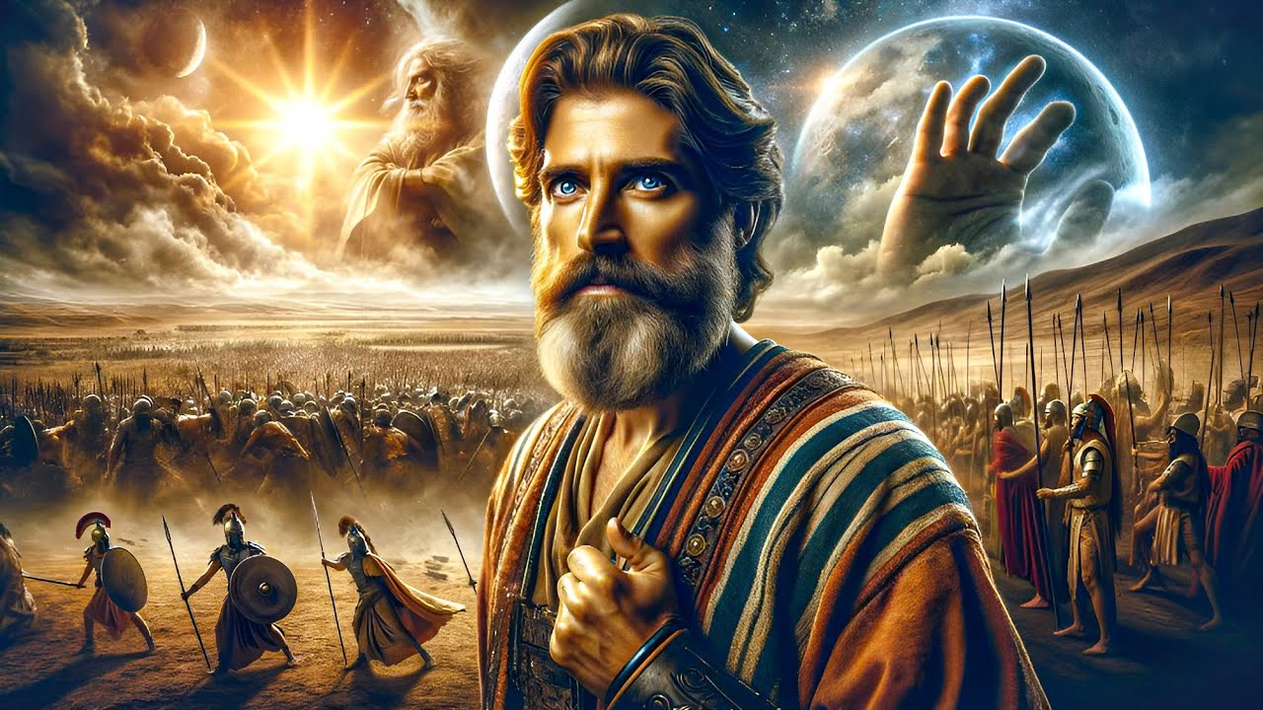
“Sipanakhaleponso tsiku ngati limeneli kuyambira kale, tsiku limene Yehova anamvera munthu. Izi zinatero chifukwa Yehova ankamenyera nkhondo Aisraeli”
Yoswa 10:14, CCL

Slide 3

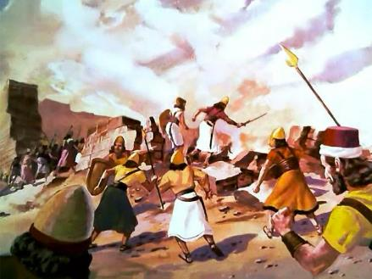
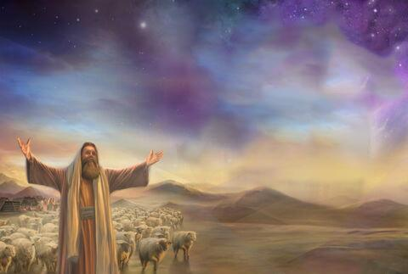
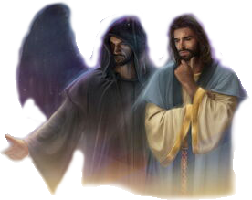
Kugonjetsedwa kwa Kanani inali nkhondo yochotsa mtundu onse, imene Mulungu analamula. Koma ngati Mulungu ndi wachikondi, ndichifukwa chiyani analamula kupha anthu ambiri choncho?
Kuti timvetse pang’ono chifukwa cha zochitikazi, tikuyenera kuunikira mozama za nkhaniyi.
Tikuyenera kukulitsa masomphenya athu kupyola pa zomwe zimaoneka, kufikira titatha kuona mkangano womwe uli kumbuyo kwa mikangano yonse (kuphatikizapo kulanda dziko la Kanani): nkhondo yayikulu pakati pa Khristu ndi Satana, pakati pa zabwino ndi zoipa.
Mbali ziwiri zomwe zikukangana:
  Kalonga wa ankhondo a Mulungu.
  Kalonga wa ankhondo a zoipa.
  Wankhondo wamphamvu kwambiri.
Njira yoyendetsera mkangano:
  Mulungu akutimenyera nkhondo.
  Timamenyera Mulungu.

Slide 4
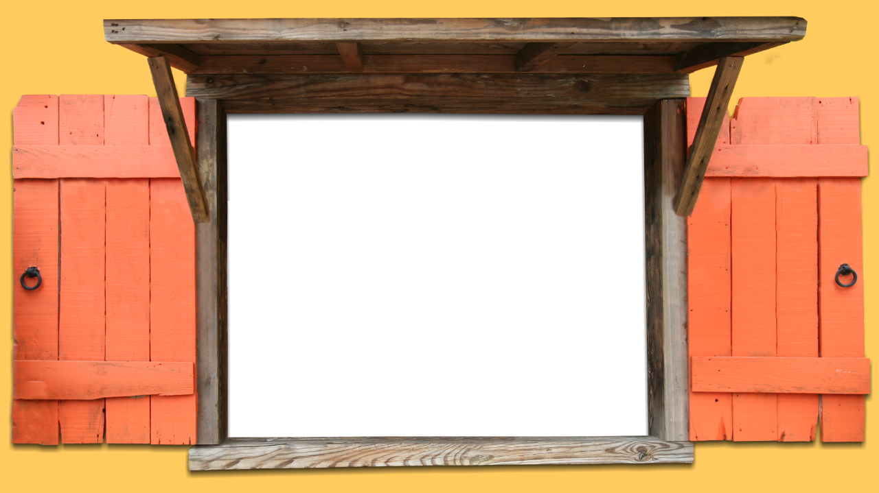
MBALI ZIWIRI ZOMWE ZIKUKANGANA

Slide 5


KALONGA WA ANKHONDO A MULUNGU
“Iye anayankha kuti “Sindili mbali iliyonse. Ndabwera monga mkulu wa asilikali a Yehova.” Pomwepo Yoswa anadzigwetsa chafufumimba kupereka ulemu, ndipo anamufunsa, “Kodi mbuye wanga muli ndi uthenga wotani kwa mtumiki wanu?”(Yoswa 5:14)
Pamene Yoswa ankapemphera pafupi ndi Yeriko pofuna kuti Mulungu amutsogolere kuti alande mzindawo, munthu wina wankhondo amene anali ndi lupanga atasolola anaima pamaso pake (Yoswa 5:13).
Pamene Yoswa anamufunsa, munthuyo anakana kuti ndi wa gulu lirilonse la anthu padziko lapansi. Iye anali Mtsogoleri wa gulu lankhondo la Mulungu (Yoswa 5:14).
Pofuna kulambidwa, Iye anasonyeza kuti anali Mulungu mwini, ku thupi la Yesu — amene amadziwika kuti Mikaeli m’buku la Danieli (Yoswa 5:15; Danieli 12:1).
Pempherolo linali litayankhidwa. Yoswa anasangalala kwambiri chifukwa chakuti Mulungu mwini anatenga utsogoleri wa ntchito yonseyo. Popeza Yoswa anali mtsogoleri wawo wodziwika, anali kutsatira malamulo ochokera kwa Mtsogoleri Wamkulu Weniweni: Mulungu.

Slide 6

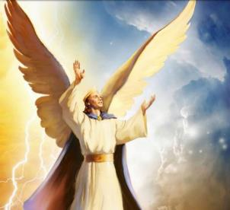
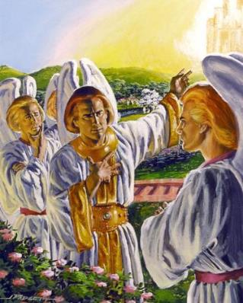
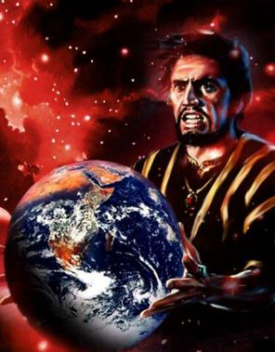
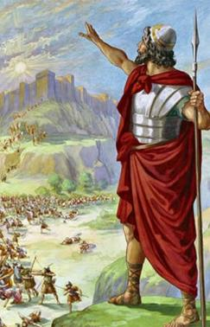
KALONGA WA ANKHONDO A ZOYIPA
“Wagwa pansi bwanji kuchoka kumwamba, iwe nthanda, mwana wa mʼbandakucha! Wagwetsedwa pansi pa dziko lapansi, Iwe amene unagonjetsapo mitundu ya anthu!” (Yesaya 14:12)
Tinganene iye ndiye amene anayambitsa nkhondo. Anabadwa kalonga; anali kerubi waudindo wapamwamba; ankakhala pafupi ndi Mulungu; ankayenda pa makala oyaka moto; wamtengo wapatali, wangwiro… (Ezekieli 28:12–15).
Popeza anali ndi ufulu wosankha — monga mmene ziliri kwa zolengedwa zonse zanzeru za Mulungu — Lusifala anasankha kupanduka ndi kufuna kutenga mpando waufumu wa Mulungu(Yesaya 14:12-14).
Ngakhale kuti kupanduka kwake kunalephera, chilengedwe chonse chakhala munkhondo kuyambira nthawi imeneyo. Atalanda dziko lapansi, Satana ndi angelo ake ali ndi cholinga chimodzi: kulepheretsa zolinga za Mulungu zopulumutsa anthu.
Kugonjetsa Kanani inali nkhondo yofunika kwambiri pankhondo imeneyi.

Slide 7

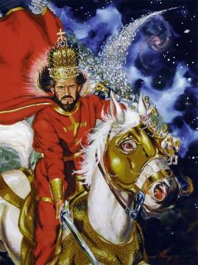
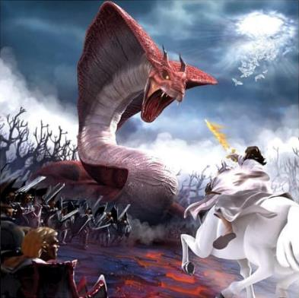
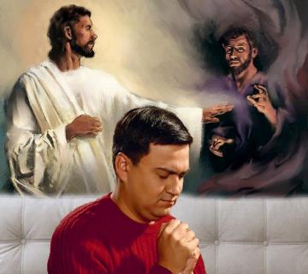
WANKHONDO WAMPHAMVU KWAMBIRI
“Yehova ndi wankhondo;Yehova ndilo dzina lake” (Eksodo 15:3)
Mulungu mwini amasonyezedwa ngati ‘munthu wa nkhondo,’ ngwazi yamphamvu kwambiri pankhondo. (Eksodo 15:3; Masalimo 24:8).
Koma Mulungu sali pankhondo ndi anthu, koma ndi mphamvu zauzimu zimene anthu amamangirira. Chifukwa chake, miliri ija imasonyezedwa ngati nkhondo yolimbana ndi milungu ya ku Igupto, kutanthauza ziwanda (Eksodo 12:12; Deutoronomo 32:17).
Mulungu akufuna kuchotsa zoyipa padziko lapansi. Chifukwa chake, anathamangitsa okhala m’dziko la Kanani amene anasankha kukhala mbali ya Satana, ndipo anapereka dzikolo kwa anthu amene anasankha kukhala mbali yake.
Lero nkhondoyo ikupitilirabe, koma osati chifukwa cha dziko. Nkhondoyi ndi ya banja lirilonse, ndi munthu aliyense payekha. Palibe malo apakati. Tiri mbali ya Mulungu, kapena mbali ya mdani.

Slide 8
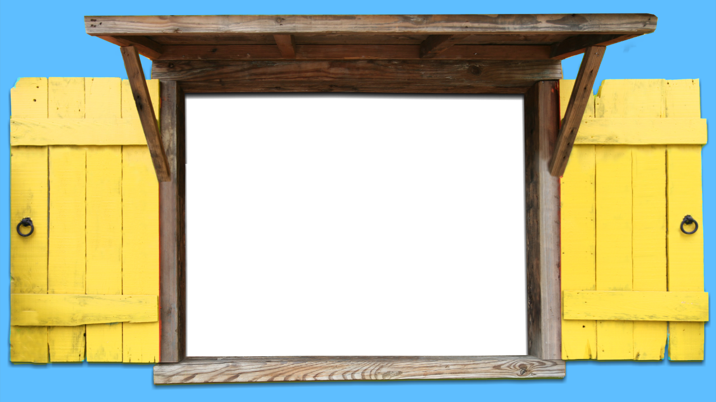
NJIRA YOYENDETSERA MKANGANO

Slide 9

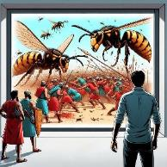
MULUNGU AKUTIMENYERA NKHONDO
“Yehova adzakumenyerani nkhondo. Inu mungokhala chete” (Eksodo 14:14)
Anamiza gulu lankhondo la Aigupto m’nyanja yofiira (Eksodo 14:24-28)
Anagwiritsa ntchito mvula ya matalala polimbana ndi Akanani
(Yoswa 10:11)
Anawononga anthu amene ankanyoza Eliya (2 Mafumu 1:9-10)
Anatumiza zimbalangondo kwa iwo amene ankanyoza Elisa
(2 Mafumu 2:23-24)
Adapeza mtendere pochititsa khungu ankhondo a Syria (2 Mafumu 6:14-23)
Adapanga Aamoni ndi Amoabu kuti alimbane okha pakati pawo (2 Mbiri 20:15-17, 22-24)
Anapha Asuri 185,000 usiku umodzi wokha
(2 Mafumu 19:35)
Anatumiza matenda owopsa kwa Herode
(Machitidwe 12:21-23)
Cholinga choyambirira cha Mulungu chinali kulanda dziko la Kanani m’njira zauzimu, popanda Aisraeli kumenyanso nkhondo (Eksodo 23:28). Kukanakhala kuti anthu sanakhale osakhulupirira, izi zikanachitika.
Baibulo limalemba zitsanzo zingapo za zimene Mulungu angachite populumutsa anthu ake, popanda iwo kutenga zida zankhondo kulimbana ndi adani awo:

Slide 10

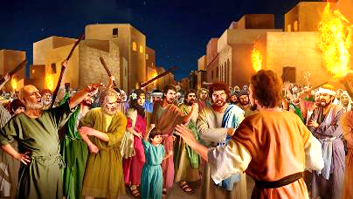
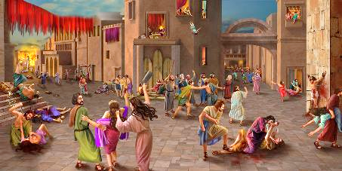

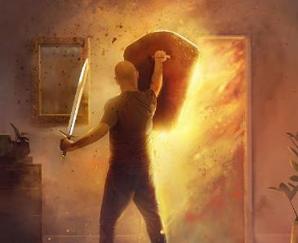
WE FIGHTING FOR GOD
“Iwo analowa mu mzindawo nawononga ndi lupanga chilichonse chamoyo kuyambira amuna, akazi, ana ndi akulu, ngʼombe, nkhosa ndi abulu” (Yoswa 6:21)
Monga mmene zinalili ndi anthu a nthawi ya chigumula, kapenanso Sodomu ndi Gomora, Akanani anapyola malire a chisomo, ndipo anadziphatika kwa Satana ( Genesis 6:5; 18:20-21; 15:16 ).
Onsewo anayenera imfa yachiwiri — imfa yamuyaya. Ngakhale akanapitirizabe kukhala ndi moyo padziko lapansi, sizikanasintha tsogolo lawo. Ndipo Mulungu analola kuti Aisraeli, pa nthawi imeneyi (polanda dziko la Kanani), atenge nawo gawo pa kupha anthuwo.
Ndichifukwa chiyani Mulungu sanachite yekha monga momwe anakonzera? Chifukwa cha kusakhulupilira kwawo. Aisiraeli analawa nkhondo koyamba atanena kuti:, ‘Kodi Yehova ali pakati pathu kapena ayi?” (Eksodo 17:7-9).
Potenga nawo mbali mokangalika munkhondoyo (yakuthupi kwa iwo, yauzimu kwa ife), timaphunzira kukhala ndi chikhulupiriro chopanda malire muthandizo la Mulungu.

Slide 11

“Nkhondo zimayenera kumenyedwa tsiku lililonse. Pali nkhondo yayikulu yomwe ikuchitika pa moyo wa munthu aliyense, pakati pa kalonga wa mdima ndi Kalonga wa moyo. … Monga othandizira a Mulungu, muyenera kudzipereka kwa Iye, kuti akonze, atsogolere, ndi kumenyera nkhondo m'malo mwanu, pamodzi ndi mgwirizano wanu. Kalonga wa moyo ali patsogolo pa ntchito yake. Ali nanu pa nkhondo yanu ya tsiku ndi tsiku yolimbana inu mwini, kuti mukhale okhulupirika ku mfundo zolungama; kuti zilakolako, pamene zikulimbana kufuna kulamulira, zigonjetsedwe ndi chisomo cha Khristu; kuti mutulukemo ngati opambana koposa kudzera mwa Iye amene anatukonda.”
EGW (Conflict and Courage, April 21)

