Slide 1
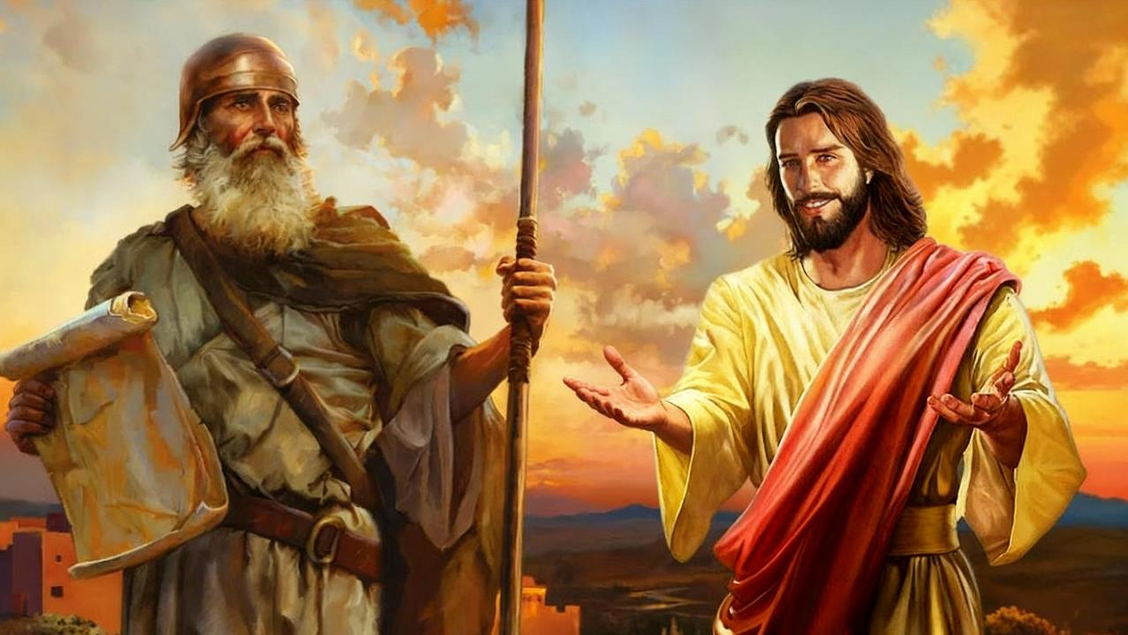
YOSWA WENIWENI
Phunziro 10 December 6, 2025

Slide 2
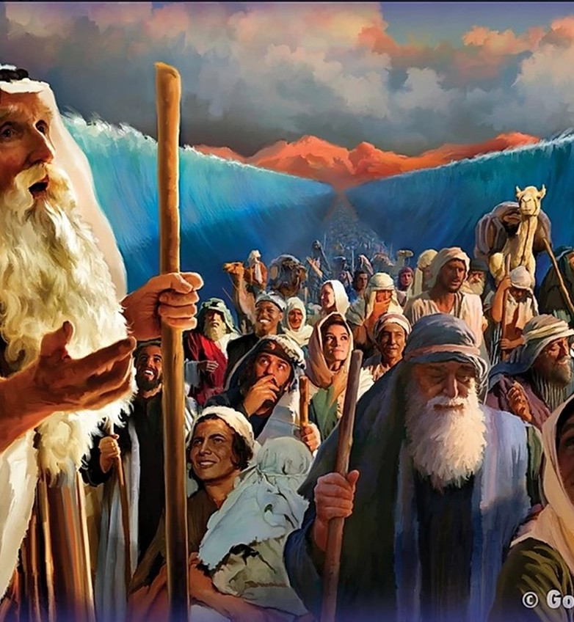
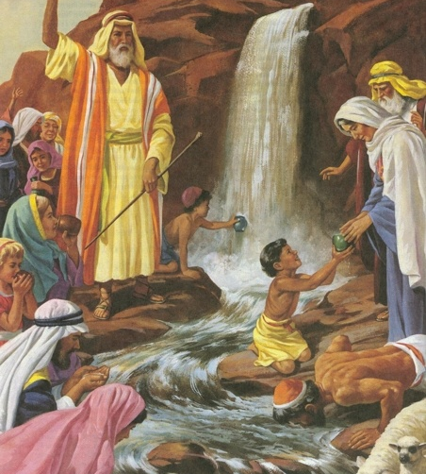
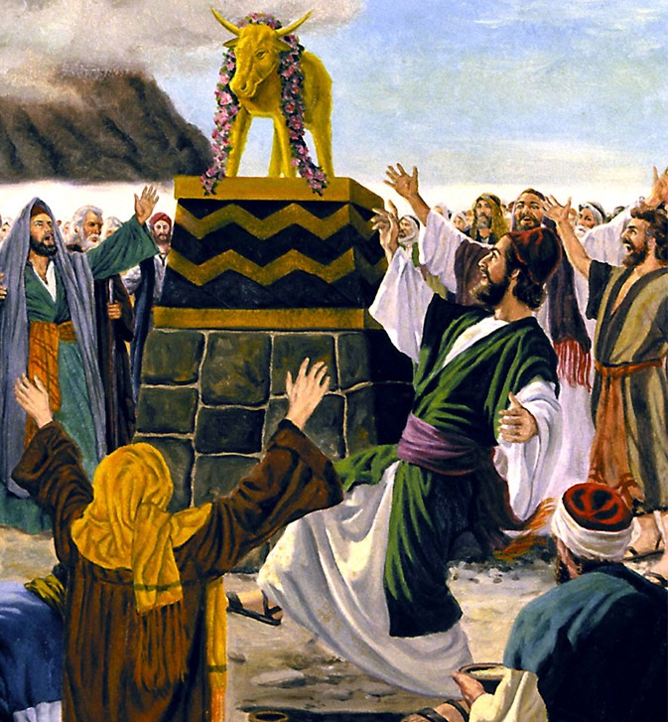
“Zinthu izi zinawachitikira kuti zikhale chitsanzo ndipo zinalembedwa kuti zikhale chenjezo kwa ife, amene tiyandikira nthawi ya kutha kwa zonse.” (1 Akorinto 10:11)

Slide 3

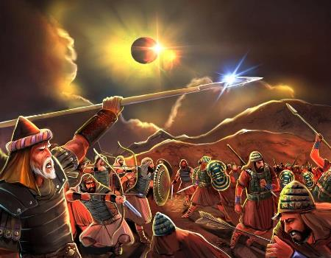
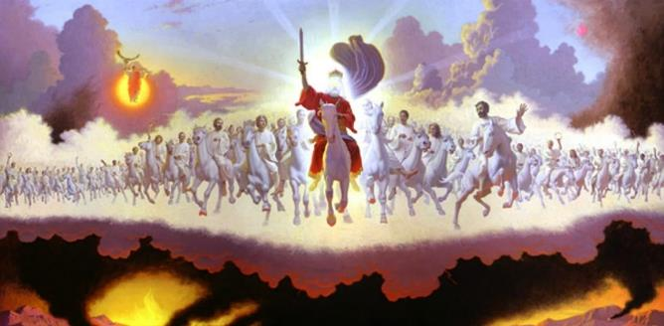







Tingathe kuwerenga za moyo wa Yoswa, womwe ukufotokozedwa m’Malemba asanu oyambirira komanso m’buku la Yoswa, munjira ziwiri zosiyana (koma zolumikizana) : monga mbiri yakale, komanso monga zophiphiritsa.
Kuti tithe kutanthauzira molondola chithunzi cha Yoswa, choyamba tiyenera kudziwa malamulo omwe amalamulira zophiphiritsa za m'Baibulo: mthunzi ndi kukwaniritsidwa kwake.
Izi zikachitika, tidzatsatira chophiphiritsira cha Yoswa mu Baibulo lonse kuti tipeze mauthenga amene Mulungu watisiyira kudzera m’Mawu ake okhudza “Yoswa wophiphiritsira”.
Zifaniziro za m'Baibulo :
Kodi zifaniziro ndi chiyani?
Mitundu ya zifaniziro
Chizindikiro cha Yoswa:
Yoswa monga chitsanzo
Wokwaniritsa wa Yoswa
Yoswa monga chitsanzo cha mpingo

Slide 4

ZIFANIZIRO ZA
M’BAIBULO

Slide 5


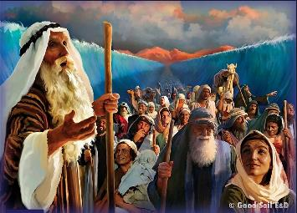
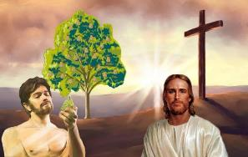
KODI ZIFANIZIRO NDICHIYANI?
“Zinthu izi zinawachitikira kuti zikhale chitsanzo ndipo zinalembedwa kuti zikhale chenjezo kwa ife, amene tiyandikira nthawi ya kutha kwa zonse.” (1 Akorinto 10:11 CCL)
Paulo — komanso alembi ena a Baibulo — amagwiritsa ntchito mawu oti ‘chitsanzo’ kutanthauza munthu kapena chochitika cha mbiri chimene chimayimira china kapena wina wa nthawi yake kapena wa m’tsogolo (omwe amatchedwa ‘chokwaniritsa’).
Mwachitsanzo, lemba la Aroma 5:14 limanena za Adamu monga “chifanizo” cha “iye amene anali nkudza,” kutanthauza Yesu—chokwaniritsa.
Chitsanzo
Davide (Psalm 22:1)
Kulengeza kwa chokwaniritsa
Davide watsopano (Yeremiya 23:5)
Chokwaniritsa
Yesu (Mateyu 27:46)
Chitsanzo
Nsembe (Levitiko 1:3-5)
Kulengeza kwa chokwaniritsa
Mtumiki ovutika (Yesaya 53:5-7)
Chokwaniritsa
Imfa ya Yesu (Yohane 19:16-18)
Nthawi zambiri, mu Chipangano Chakale timapeza zizindikiro zosonyeza kuti anthu ena kapena zochitika zina zinali zitsanzo za zinthu zimene zidzachitike mtsogolo. Tiyeni tione zitsanzo ziwiri :

Slide 6

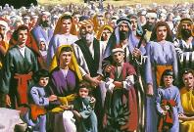
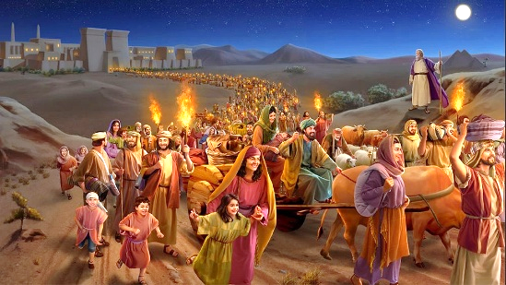
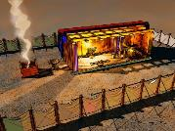
MITUNDU YA ZIFANIZIRO
“nakhala kumeneko mpaka Herode atamwalira. Ndipo zinakwaniritsidwa zomwe ananena Ambuye mwa mneneri kuti, ‘Ndinayitana mwana wanga kuti atuluke mu Igupto’ ” (Mateyu 2:15 CCL)
Zitsanzo za mu Chipangano Chakale zimalozera ku mitundu itatu yosiyanasiyana ya zinthu zomwe zimawakwaniritsa mu Chipangano Chatsopano: Khristu;Mpingo; ndi nthawi yotsiriza.
ZITSANZO NDI ZOKWANIRITSA
Israeli
Kutuluka mu Igupto
Malo Opatulika
Khristu
Mpingo
Nthawi ya kumapeto
Khristu
Mpingo
Nthawi ya kumapeto
Khristu
Mpingo
Nthawi ya kumapeto
Anatengedwa kupita ku Igupto
Mateyu 2:13-15
Israeli watsopano
Agalatiya 6:16
Anthu144,000
Chivumbulutso 7:4
Masiku 40 mu chipululu
Mateyu 3:16-4:2
Kubatizidwa ndi kusungidwa ndi Khristu
1 Akorinto 10:1-6
Kutuluka mu mipingo yopanduka
Chivumbulutso 18:4
Anali ngati kachisi pakati pathu
Yohane 1:14; 2:21-22
Ndife kachisi wa Mulungu
1 Akorinto 3:16-17
Yerusalemu watsopano, kachisi wathu
Chivumbulutso 21:2-3
ZITSANZO
ZOKWANIRITSA

Slide 7

CHIZINDIKIRO CHA
YOSWA

Slide 8


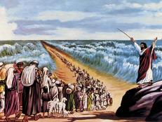
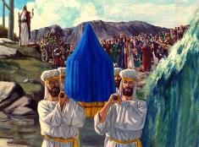
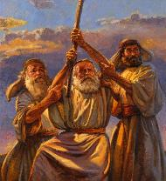
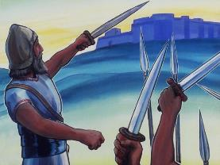
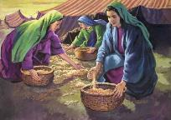
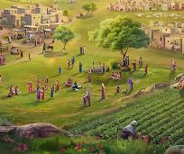
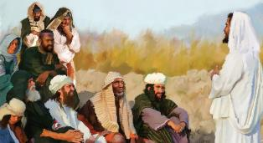
YOSWA MONGA CHITSANZO
“Yehova Mulungu wanu adzawutsa pakati pa abale anu mneneri ngati ine. Muyenera kumumvera ameneyo.” (Deuteronomo 18:15 CCL)
Yoswa anakwaniritsa pang’ono ulosi wa Mose wonena za mneneri wachiwiri wina yemwe adzatsogolere anthu (Deuteronomo 18:15–19).
Monga Mose, Yoswa analandira mauthenga mwachindunji ochokera kwa Mulungu; anachita chikondwerero cha Paska; anawoloka madzi; anaona Mngelo wa Yehova; dzanja lake lotambasulidwa linabweretsa chigonjetso; ndipo analimbikitsa anthu kukhala okhulupirika ngakhale iye akadzamwalira; ndi zina zotero.
Pamene mana anayamba kugwa nthawi ya Mose, analeka kugwa nthawi ya Yoswa. Komanso, Yoswa ndiyemwe anakwaniritsa malangizo amene Mose anaperela okhudza kugawa dziko ndi mizinda yopulumukirako.
Koma anthu anamvetsa kuti ulosi wa Mose unapitirira kuposa pa Yoswa (Yohane 1:21). Choncho, Mose ndi Yoswa onse awiri amakhala zitsanzo(type) za Wokwaniritsa Weniweni (antitype) yemwe anakwaniritsa mokwanira ulosi umene Mose anapatsidwa wokhudza ‘Mneneri’: Yesu (Machitidwe 3:22–26).

Slide 9


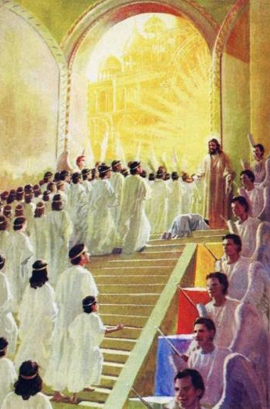
WOKWANIRITSA WA YOSWA
“Yehova akuti, “Pa nthawi imene ndinakukomera mtima ndinakuyankha, ndipo pa tsiku lachipulumutso ndinakuthandiza; ndinakusunga ndi kukusandutsa kuti ukhale pangano kwa anthu, kuti dziko libwerere mwakale ndi kuti cholowa changa chowonongeka chija ndichigawegawenso” (Yesaya 49:8 CCL )
Cholinga cha nkhondo zomwe Yoswa ankatsogolera chinali kukhazikitsa Aisraeli mu Dziko la Lonjezano. Yesaya amawonetsa ntchito ya Mesiya ngati yopereka ‘cholowa chabwinja [kwa anthu ake]’ (Yesaya 49:8), pogwiritsa ntchito mawu ofanana ndi omwe amagwiritsidwa ntchito m’buku la Yoswa.
Kodi moyo ndi ntchito ya Yoswa (monga chitsanzo) zikusonyezedwa molingana bwanji ndi moyo komanso ntchito ya Yesu (Wokwaniritsa)?
Atabatizidwa mumtsinje wa Yorodani, Yesu anayamba kulimbana ndi mphamvu za zoyipa
Anayamba ntchito yake patatha masiku 40 ali m’chipululu
Anagonjetsa mdani pa mtanda
Amatipatsa chigonjetso pa adani athu
Amatipatsa mpumulo weniweni
Amatipatsa cholowa chosatha, chosawonongeka

Slide 10

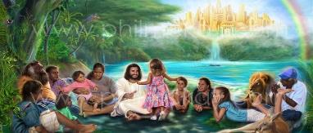
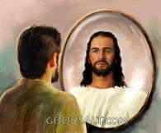
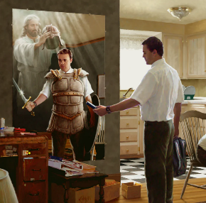

YOSWA MONGA CHITSANZO CHA MPINGO
“Chifukwa kuti kulimbana kwathu sitilimbana nao mwazi ndi thupi, komatu nao maukulu, ndi maulamuliro, ndi akuchita zolimbika a dziko lapansi a mdima uno, ndi auzimu a choipa m'zakumwamba.” (Aefeso 6:12 BLP)
YOSWA NDI MPINGO
Masiku ano tili ndi nkhondo yoti timenyane, ndipo otsogolera wathu ndi ‘Yoswa’ wathu, amene amatipatsa zida zonse zofunikira pa nkhondoyi (Aefeso 6:10–12).
Komanso, Iye amatipatsa kale cholowa, ndiponso amatidzadza ndi madalitso auzimu (Aefeso 1:3, 11).
YOSWA NDI NTHAWI YA KUMAPETO
Koma kukwaniritsidwa kwathunthu kwa chithunzi cha Yoswa kudzachitika kumapeto, pamene magulu onse a zoyipa adzawonongedwa, ndipo ife tidzalandira kwathunthu cholowa chathu: dziko limene tikhala momasuka ndi mwa mtendere (Chivumbulutso 20:7–9; Ezekieli 28:26).
Mpaka nthawi imeneyo itafika, tiyeni tikule muchisomo monga momwe Yoswa anachitira, ndikulola Mulungu kuti asinthe miyoyo yathu tsiku ndi tsiku kuti pang’onopang’ono tikhale ofanana naye.

Slide 11

“Israeli wa Mulungu, akuyenda kupita ku Kenaani wakumwamba, ali ndi Mkulu wa Ankhondo yemwe sanasowe maphunziro a munthu kuti akonzekere ntchito yake ngati mtsogoleri waumulungu; komabe anapangidwa wangwiro kudzera mu kuvutika; ndipo ‘popeza Iye Mwiniwakeyo anavutitsidwa ndi mayesero, angathandize iwo omwe akuyesedwa.’ Ahebri 2:10, 18. Mombolo wathu sanasonyeze kufooka kulikonse kwaumunthu kapena chilema; komabe anamwalira kuti atitsegulire njira yolowera ku Dziko Lolonjezedwa.”
EGW (Patriarchs and Prophets, p. 480)

