Slide 1
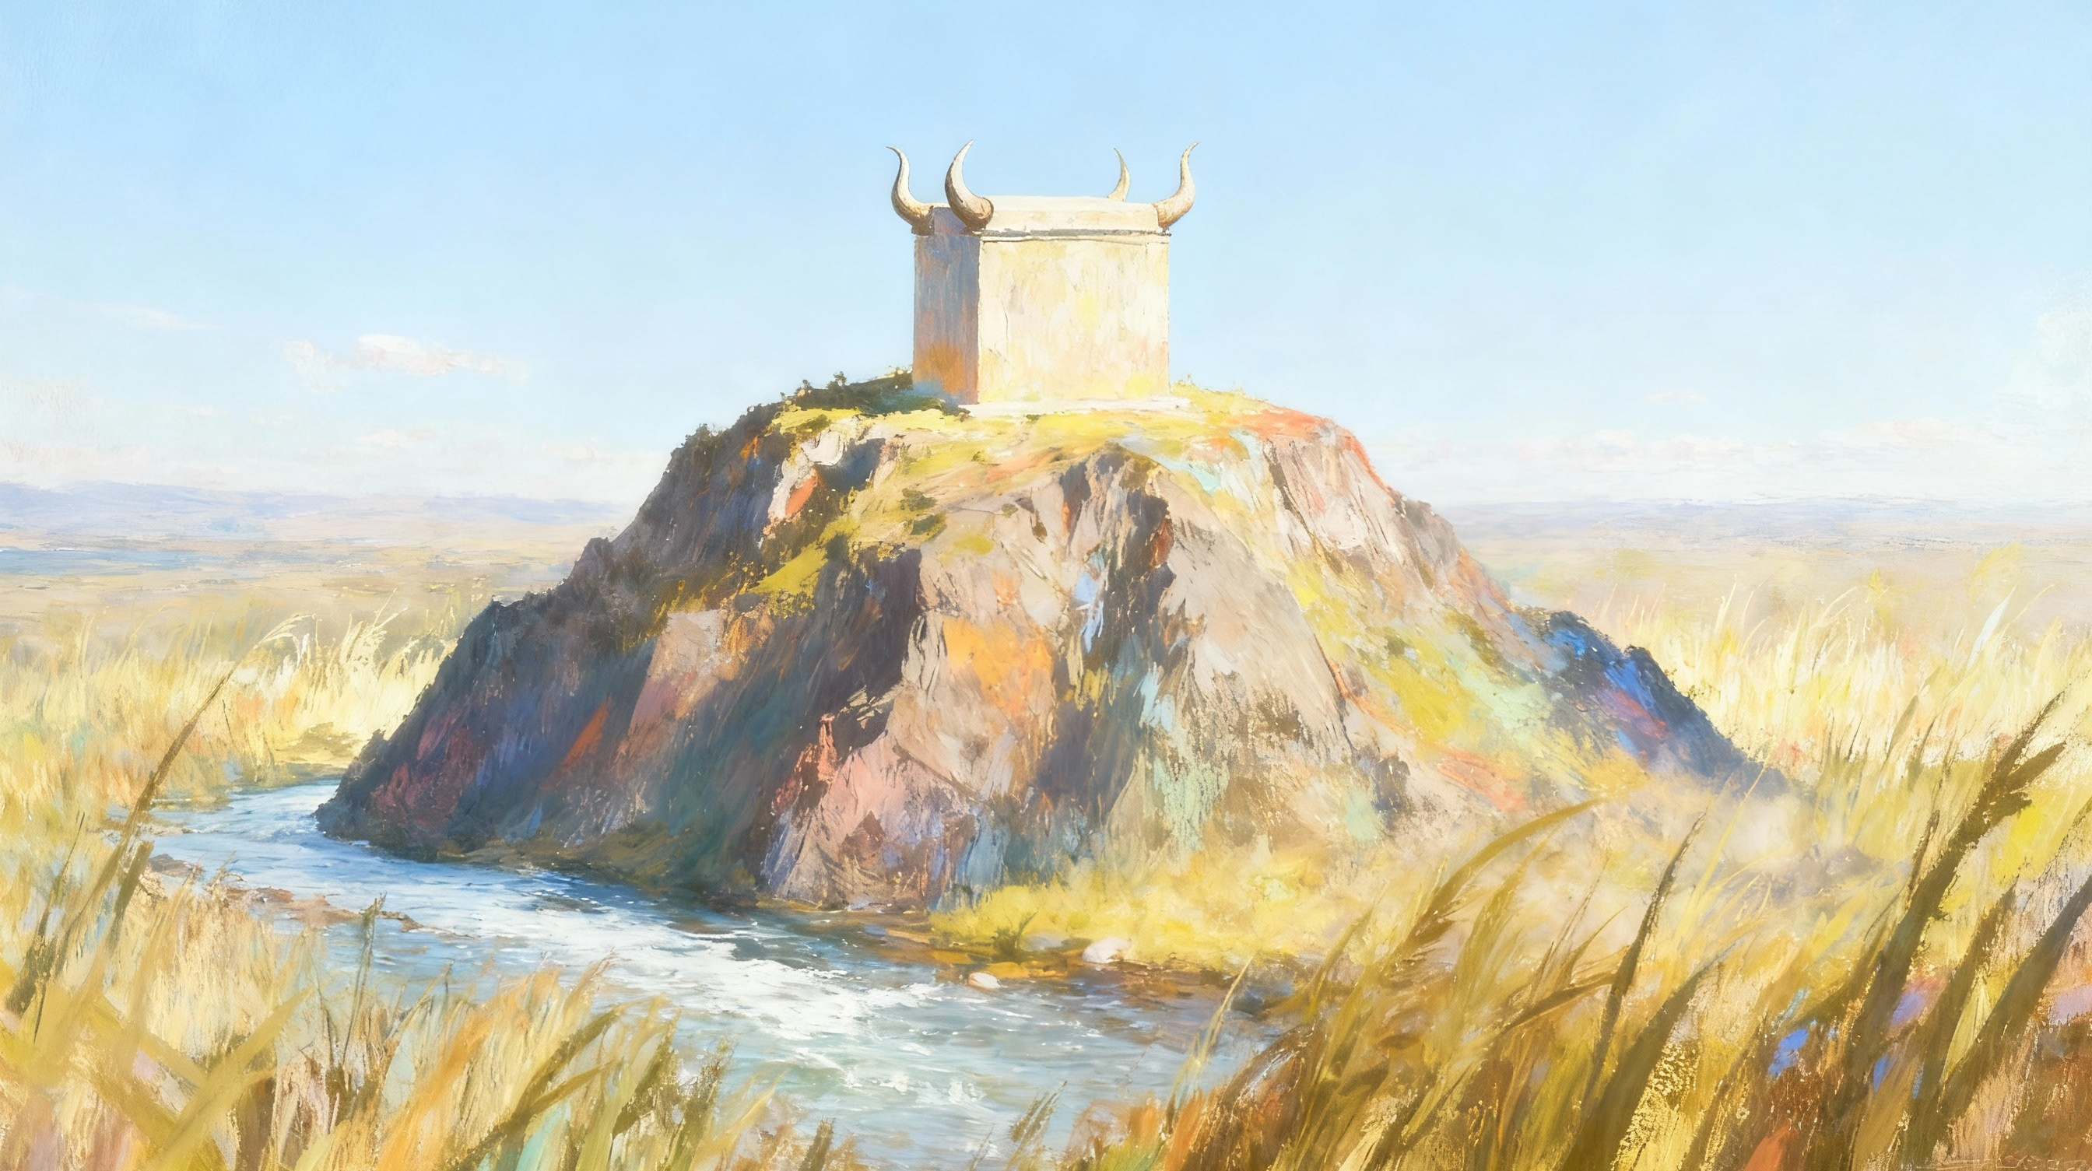
KUKHALA M’DZIKO
Phunziro 11, December 13, 2025

Slide 2
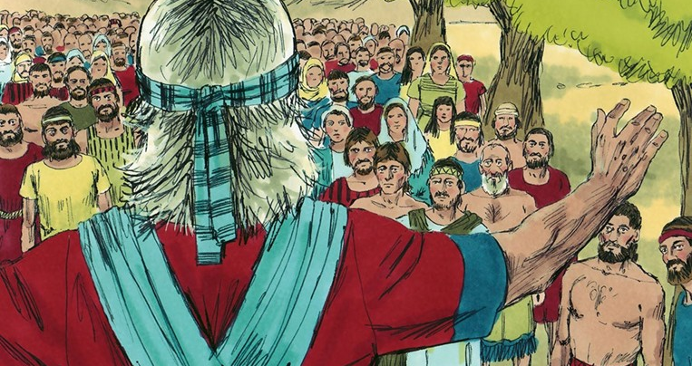

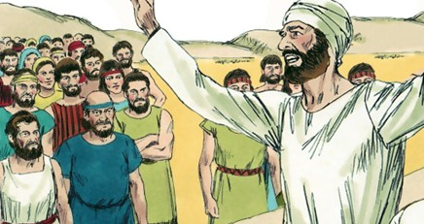
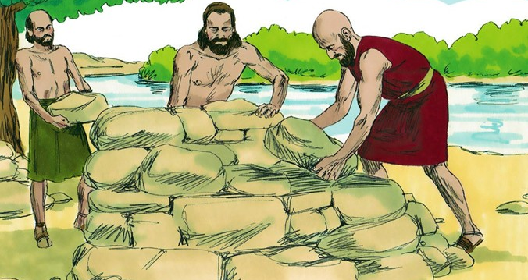
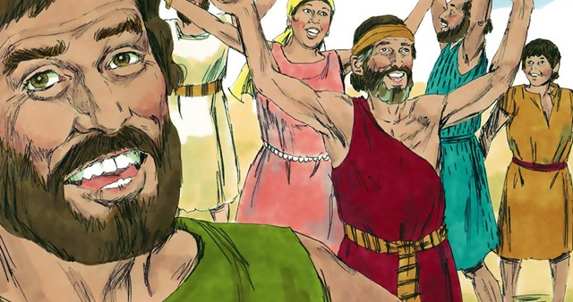
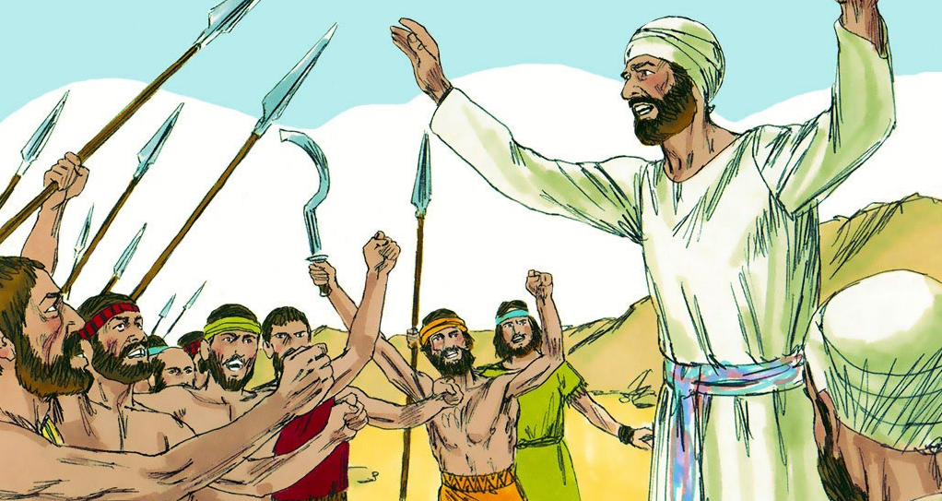
“A gentle answer turns away wrath, but a harsh word stirs up anger” (Proverbs 15:1, NIV)

Slide 3

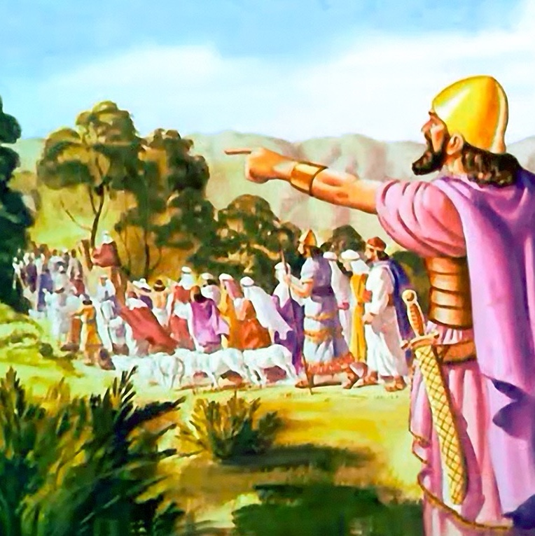
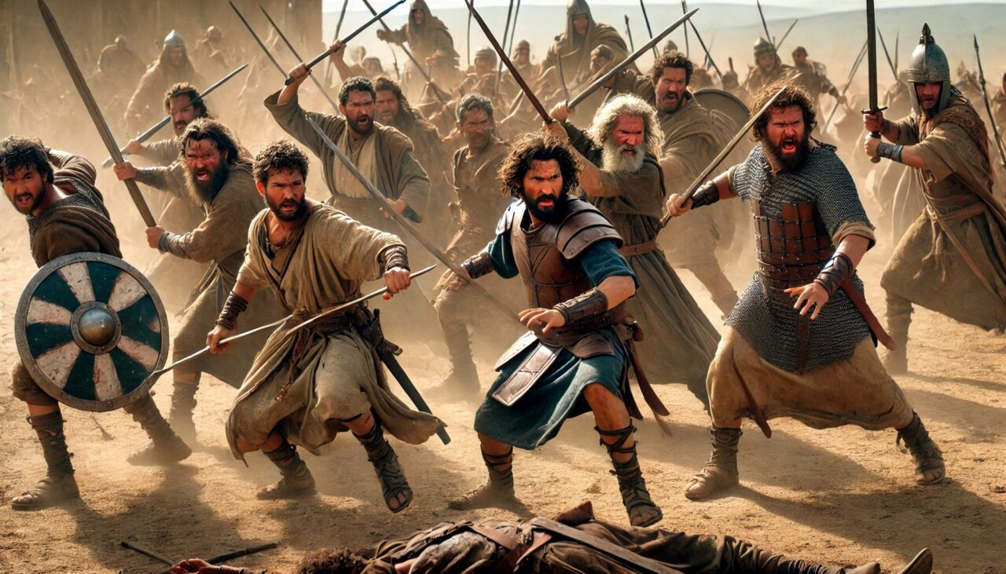





Zitatha zaka zambiri za nkhondo, Israeli anagonjetsa Kenaani, ngakhale kuti sanathamangitse nzika zonse za m’dzikolo.
Mitundu iwiri ndi theka imene inatenga gawo lakum’mawa kwa Yorodani (Ruubeni, Gadi, ndi theka la fuko la Manase), ndipo inawoloka Yorodani kudzathandiza pogonjetsa dzikolo, linakhulupirika pokwaniritsa lonjezo lawo.
Potsiriza nthawi yoti asiyane inafika. Atawadalitsa ndiponso ndikuwalangiza kuti apitirize kuyenda m’njira ya Mulungu, Yoswa anawalola kuti apite. Koma, mwambo wotsanzikana umenewu unasokonezedwa ndi kusamvetsetsana koopsa komwe kukanatha kuononga umodzi wa Aisraeli.
Mau Otsanzikana (Yoswa 22:1-8)
Chifukwa cha Mkangano (Yoswa 22:10-12)
Zoneneza (Yoswa 22:13-20)
Yankho Labwino (Yoswa 22:21-29)
Kuyanjanitsa (Yoswa 22:30-34)

Slide 4


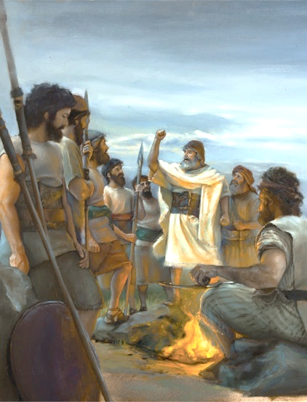
MAU OTSANZIKANA
“Koma samalirani bwino kuti muchite chilangizo ndi chilamulo zimene Mose mtumiki wa Yehova anakulamulirani, kukonda Yehova Mulungu wanu, ndi kuyenda m'njira zake zonse ndi kusunga malamulo ake, ndi kumuumirira Iye, ndi kumtumikira Iye ndi mtima wanu wonse ndi moyo wanu wonse.”(Yoswa 22:5)
Popeza mtsinje wa Yorodani ukanapangitsa kuti mafukowa asiyane, Yoswa anapereka kwa mitundu iwiri ndi theka malangizo anzeru kuti akhalebe okhulupirika (Yoswa 22:5):
Kondani Yehova Mulungu wanu
Yendani mukumvera Iye
Sungani Malamulo Ake
Mummamatireni Iye
Mtumikireni ndi mtima wanu wonse ndi moyo wanu wonse
Chikondi ndicho mfundo yoyenera kutitsogolera kwa Mulungu. Timamukonda chifukwa Iye anatikonda koyamba (1 Yohane 4:19)
Umu ndi momwe Yoswa akusonyezera khalidwe lomwe anthu osankha kuyenda ndi Mulungu ayenera kukhala nalo
Kumvera kumabwera mwachibadwa kuchokera m’mtima woyamika, umene umamvetsetsa zimene Mulungu wachita
Tiyenera kumamatira kwa Mulungu, osalola chilichonse kutisokoneza kapena kuononga mgwirizano umenewo
Timapeza cholinga chenicheni cha moyo, kukhutira, ndi moyo wochuluka tikamatumikira Mlengi wathu mwakufuna kwathu, m’chikondi

Slide 5


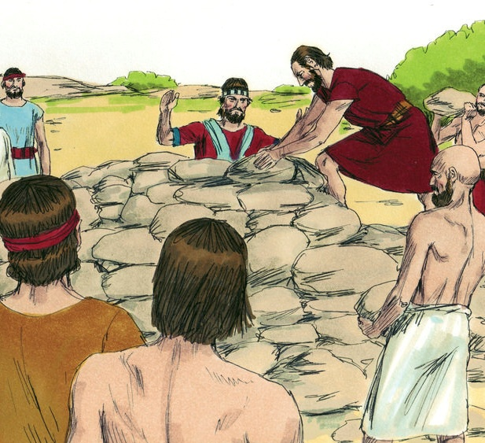
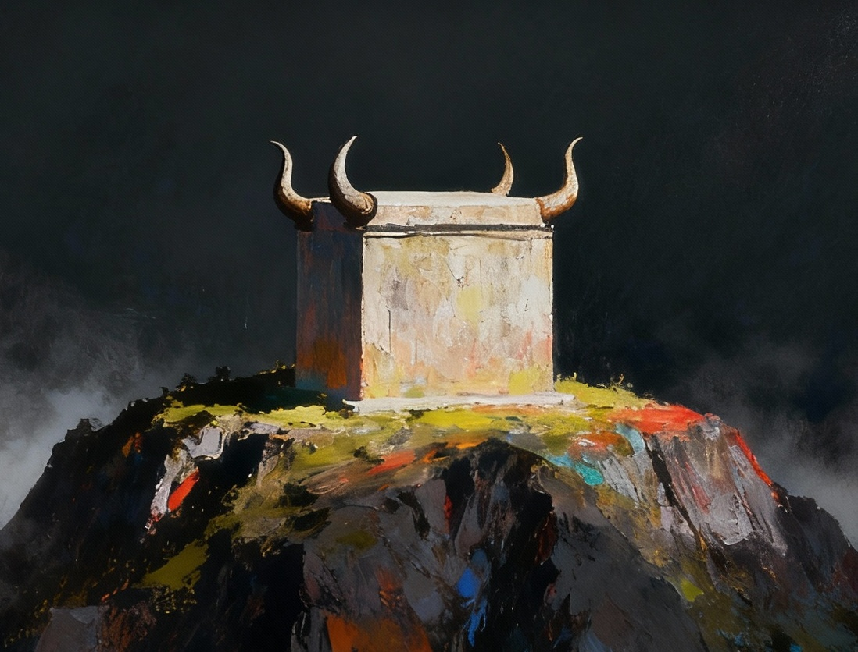
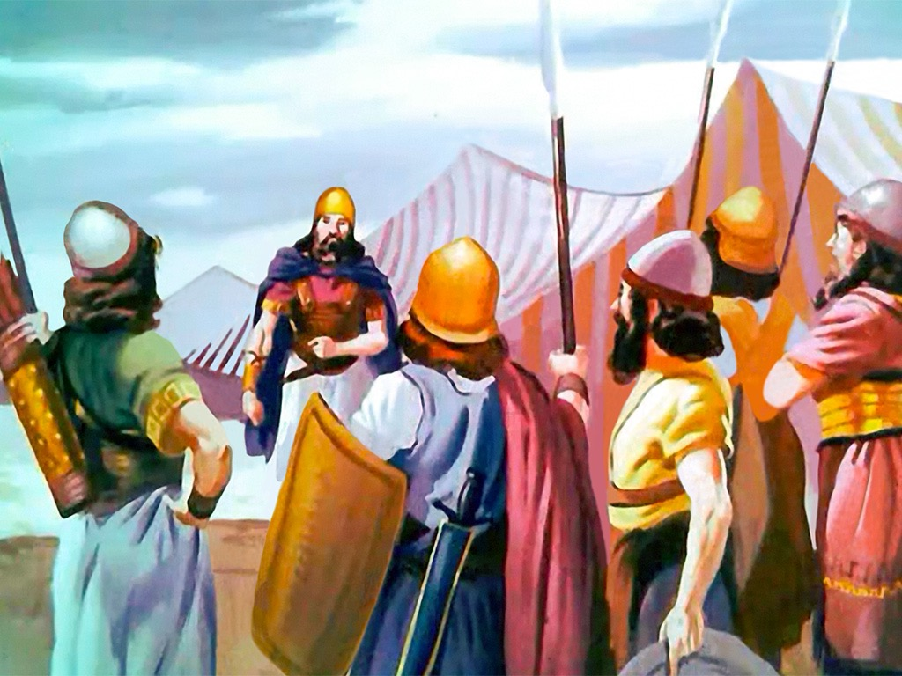
CHIFUKWA CHA MKANGANO
“Atafika ku Geliloti, malo amene ali mʼmbali mwa mtsinje wa Yorodani mʼdziko la Kanaani, fuko la Rubeni, fuko la Gadi ndi theka la fuko la Manase anamanga guwa lansembe lalikulu pamenepo” (Yoswa 22:10)
Pafupi ndi malo amene Yoswa anamanga chikumbutso cha kuwoloka mozizwitsa kwa Yordano, mafuko awiri ndi theka anamanga guwa lofanana ndi guwa lansembe la Malo Opatulika (Yoswa 22:10, 28).
Zochita zimenezi zinatanthauzidwa ngati kuphwanya lamulo limene linaletsa kupereka nsembe pamalo ena kupatula guwa la nsembe zopsereza mu Malo Opatulika (Levitiko 17:8-9).
Aisraeli ena onse anaganiza zochotsa tchimoli poukira abale awo (Yoswa 22:12). Koma Mulungu analowererapo kuti alepheretse nkhondo yoopsa yapachiweniweni. Anadzutsa anthu omwe sanasankhe kuweruza popanda umboni wonse; amene anapereka mwayi wokayikira; ndipo anaganiza zopereka kwa abale awowa mwayi wofotokoza zomwe zinali zolinga zawo (Yoswa 22:13-14).
Potsiriza zinapezeka kuti cholakwa chawo chinali kusawauza abale awo zolinga zawo kokha… koma zimenezo sizinali tchimo.

Slide 6

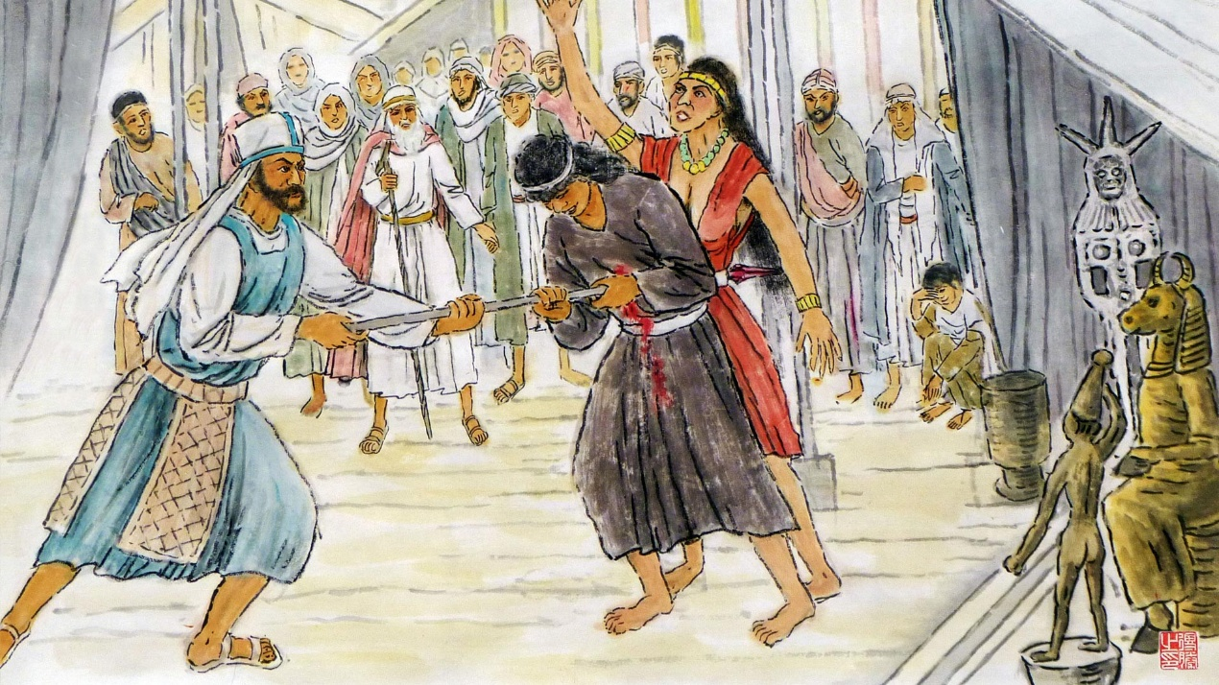
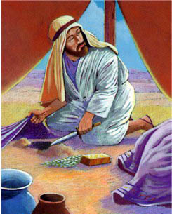
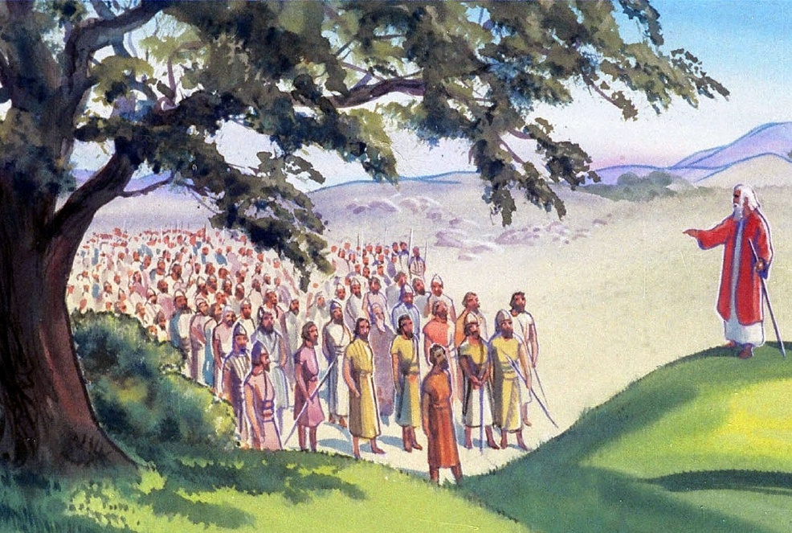
ZONENEZA
“Gulu lonse likukufunsa kuti, ‘Chifukwa chiyani mwachita chinthu chonyansa chotere potsutsana ndi Mulungu wa Israeli? Nʼchifukwa chiyani mwapatuka ndi kuleka kutsata Yehova podzimangira nokha guwa lansembe? Mwapandukiratu Yehova?’ ” (Yoswa 22:16)
N’chifukwa chiyani Finehasi anasankhidwa kukhala mtsogoleri wa komiti yofufuza (Yoswa 22:13-14)?
Finehasi, mwana wa wansembe wamkulu, anali wosalekerera pothetsa tchimo ku Baala-Peori (Numeri 25:7–8). M’mawu ake, analumikiza tchimolo ndi tchimo la Akani, ndipo analiyerekeza ndi limene ankaganiza kuti lachitika ndi mitundu iwiri ndi theka (Yoswa 22:16–20).
Mawu a Finehasi anali omveka bwino. Ngati nsembe zikaperekedwa pa guwa lansembe lomwe linangomangidwa kumene, Mulungu akanalanga Israyeli yense chifukwa cha zimenezo (Yoswa 22:18b).
Koma, anawapatsa mwayi wokonza cholakwikachi, asanachite tchimolo: anawapatsa mwayi wobwerera kumbali ya Yordano komwe kunali Malo Opatulika (Yoswa 22:19).

Slide 7


YANKHO LABWINO
“Ngati tinapandukira Yehova ndi kuleka kumutsata pamene tinadzimangira guwa loti tizipserezerapo nsembe kapena kupereka nsembe zaufa, kapena nsembe za mtendere, Yehova yekha ndiye atilange.” (Yoswa 22:23)
Mafuko a Rubeni ndi Gadi, ndi theka la fuko la Manase, ataimbidwa mlandu, anachita zinthu zabwino kwambiri:
Anamvetsera milandu yonseyo mwakachetechete
Anaitanira Mulungu kukhala mboni yawo
Anavomera kulangidwa ngati anachimwa
Anawulula zolinga zawo zenizeni
Pamene Aisrayeli sanadziwe cholinga cha abale awo chomangira guwa la nsembe, anangoganiza kuti zinali: kupandukira Mulungu, kufuna kudzipatula, ndi kubweretsa chilango chaumulungu.
Koma cholinga chenicheni chinali ichi: ankafuna kukhalabe ogwirizana ndi abale awo, ndiponso kupewa kugawanika kwa m’tsogolo pakati pa Aisraeli (Yoswa 22:24–26).
Ngakhale kuti mafuko omwe akuimbidwa mlandu akanatha kukhumudwa ndi zomwe ananenezedwazo ndipo akanayankha mwankhanza podziteteza, chifukwa cha mayankho awo aubwenzi, nkhondo inapewedwa.

Slide 8

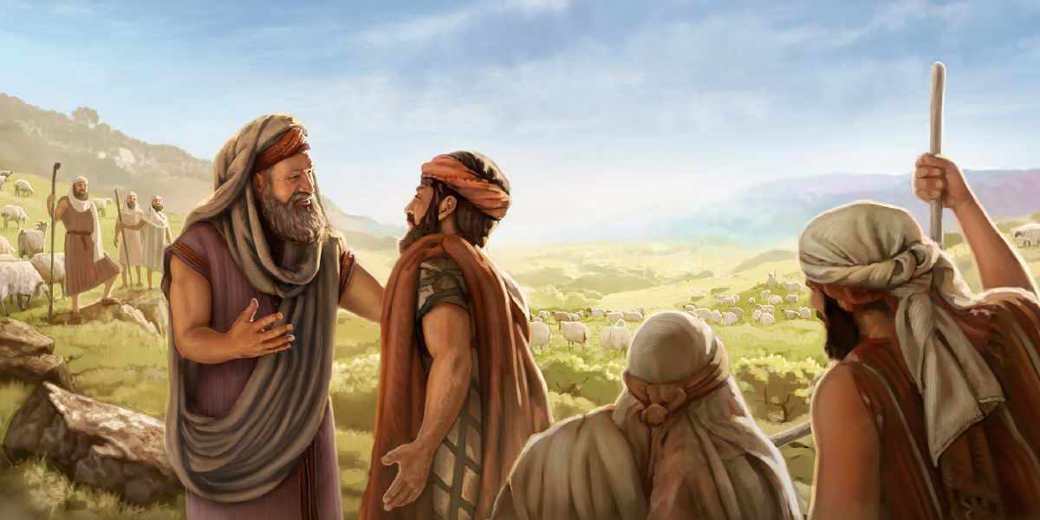
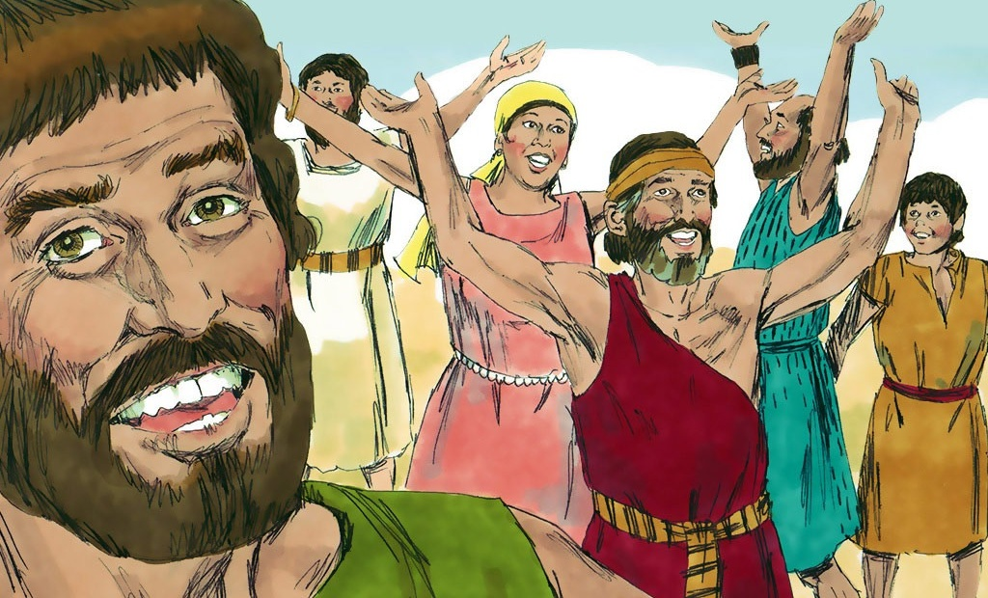
KUYANJANITSA
“Mawu amenewa anakondweretsa Aisraeli onse ndipo anayamika Mulungu. Choncho sanakambenso zopita ku nkhondo kukawononga dziko limene Arubeni ndi Agadi ankakhalamo.” (Yoswa 22:33)
Atazindikira kuti milanduyo inalibe maziko, Finehasi ndi gulu la Aisraeli lomwe linatumizidwa anasangalala kwambiri (Yoswa 22:30–31). Nawonso Aisraeli atadziwa chowonadi, anasangalala ndi kutamanda Mulungu (Yoswa 22:32–33).
Kudzera mu chitsanzo chawo, tikhoza kuona njira zofunikira zobwezeretsa mtendere m'mikhalidwe yofanana pankhani ya banja, mpingo, ndi dera.:
Musamangofika pa chiganizo mwachangu
Kambiranani za mavutowo musanachitepo kanthu
Khalani okonzeka kudzichepetsa ndi kulolerana kuti mukwaniritse umodzi
Yankhani milandu mwaulemu ndi mofatsa
Sangalalani ndi kutamanda Mulungu pamene mtendere wabwezeretsedwa
Kulankhulana maganizo athu

Slide 9

“Ana a Gadi ndi a Rubeni anaika chizindikiro pa guwa lansembe lawo kuti afotokoze chifukwa chimene analimangira. Iwo ananena kuti, ‘Lidzakhale umboni pakati pathu kuti Yehova ndiye Mulungu.’ Motero anayesetsa kupewa kusamvetsetsana mtsogolo ndi kuchotsa chilichonse chimene chikanabweretsa mayesero.
Nthawi zambiri mavuto aakulu amabuka chifukwa cha kusamvetsetsana chabe, ngakhale pakati pa anthu amene ali ndi zolinga zabwino. Ngati palibe ulemu, kulekerana, ndi kuleza mtima, kusamvana kumeneku kungabweretse zotsatira zoopsa, ngakhale zowononga kwambiri.
Palibe amene anabwezeretsedwapo kuchoka munjira olakwika podzudzulidwa ndi kunyozedwa. M’malo mwake, zimenezi nthawi zambiri zimawachititsa kupatuka kwambiri ndi kuumitsa mitima yawo. Koma mzimu wachifundo, mawu aulemu, ndi khalidwe lofatsa lingapulumutse olakwa ndikubisa machimo ambiri”
EGW (Patriarchs and Prophets, pp. 519)

