Slide 1
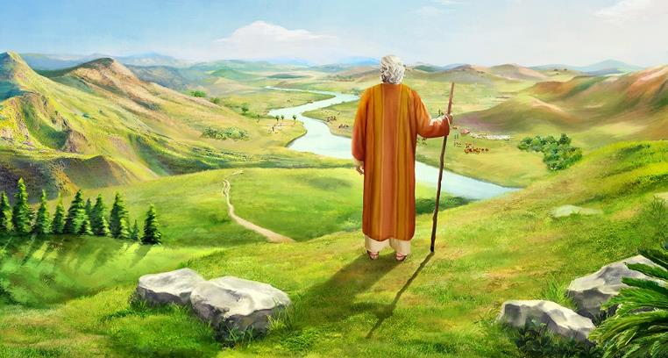
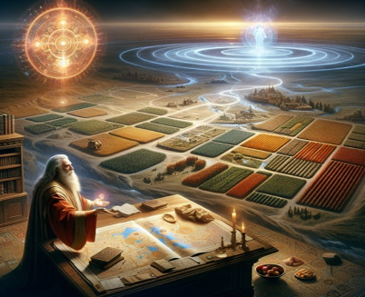
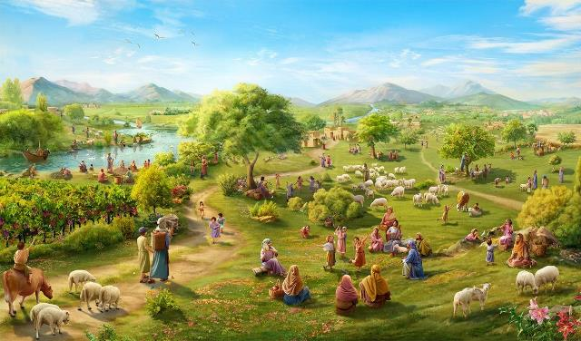
MULUNGU
NDI OKHULUPIRIKA!
Phunziro 12, December 20, 2025

Slide 2

“Yehova anakwaniritsa zonse zimene analonjeza kwa Aisraeli” (Yoswa 21:45 CCL)

Slide 3

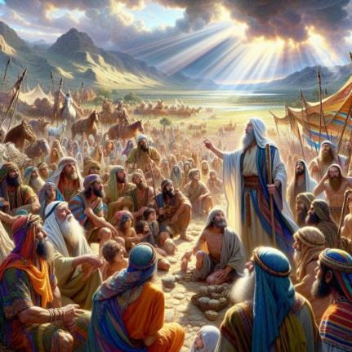
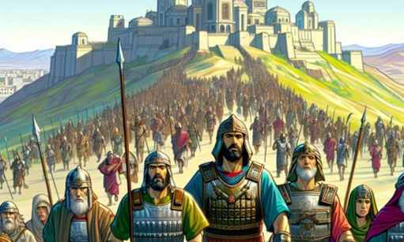
Yoswa anali atakalamba kale, ndipo panali madera ena ambiri oti agonjetsedwe. Iye anasonkhanitsa atsogoleri atsopano kuti awalimbikitse kupitiriza kugonjetsa dzikolo.
Mphamvu yakupambana kwao sinali mwa iwo eni, koma mwa Mulungu. Choncho, Yoswa anawakumbutsa za kukhulupirika kumene Mulungu anali atasonyeza kale, ndipo anawatsimikizira kuti adzapitirizabe kukhala wokhulupirika.
Koma anawachenjezanso za zoopsa zomwe zinalipo. Zoona zake n’zakuti, panali chiopsezo chimodzi chokha, chomwenso ife tiyenera kukumana nacho lerolino: kusiya kukhala okhulupirika kwa Mulungu; ndi kubwezera kukhulupirika kwake ndi kusakhulupirika kwathu.
Kukhulupirika kwa Mulungu (Yoswa 21:43-45)
Zomwe Mulungu wachita ndi zomwe adzachite (Yoswa 23:1-5)
Mphoto ya kukhulupirika (Yoswa 23:6-10)
Zomwe tikuyenera kuchita (Yoswa 23:11-14)
Chilango cha kusakhulupirika (Joshua 23:15-16)

Slide 4


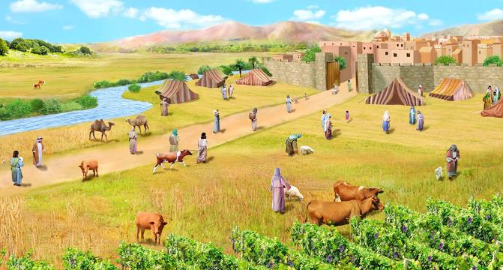
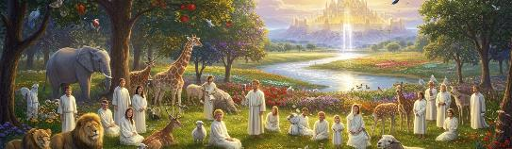
KUKHULUPIRIKA KWA MULUNGU
“Yehova anakwaniritsa zonse zimene analonjeza kwa Aisraeli.” (Yoswa 21:45)
Mulungu anapereka kwa Aisraeli ‘dziko lonse’ (Yoswa 21:43), ndipo anawapereka ‘adani awo onse’ m’manja mwawo (Yoswa 21:44). Motero, ‘lonjezo lirilonse’ limene Yehova anapereka linakwaniritsidwa (Yoswa 21:45).
Kugwiritsa ntchito mawu oti “onse” mobwerezabwereza kumatsindika kukhulupirika kwa Mulungu pokwaniritsa malonjezo ake. Adani awo anagonjetsedwa ndi Mulungu. Iwo akanatha kukhala m’dzikolo chifukwa Mulungu anali atalitenga kale. Choncho, anali ndi chitsimikizo chakuti adzamaliza kuthamangitsa Akanani onse amene anali kukhalabe m’dzikolo chifukwa Mulungu anali atasunga kale malonjezo ake, ndipo adzapitiriza kuwasunga m’tsogolo.
Zonsezi zimatichitira ife ubwino. Mulungu akali wokhulupirika (Deuteromo 7:9; Masalimo 117:2; Maliro 3:22–23). Iye walonjeza kutipulumutsa ndi kutipatsa dziko lapansi kukhala cholowa chathu, ndipo adzakwaniritsa lonjezoli (Afilipi 1:6; 1 Petro 1:5; Masalimo 37:29).

Slide 5

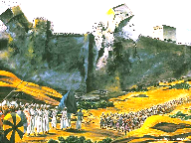
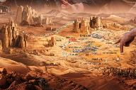
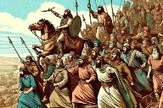
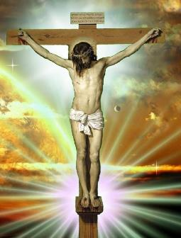
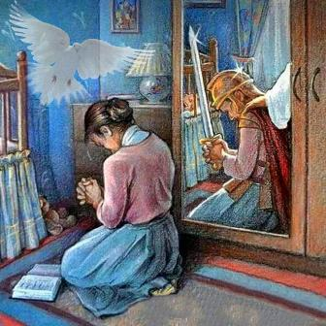
ZOMWE MULUNGU WACHITA NDI ZOMWE ADZACHITE
“Inu mwaona zonse zimene Yehova Mulungu wanu wachita kwa mitundu yonseyi chifukwa cha inu. Ndi Yehova Mulungu wanu amene anakumenyerani nkhondo” (Yoswa 23:3 CCL)
M’mawu ake kwa akuluakulu, Yoswa anayamba powakumbutsa zimene Mulungu anali atachita kale komanso zimene ankatsalira kuchita :
Iye anamenyana ndi mitundu ya anthu
(Yoswa 23:3)
Iye anagawa dzikolo pakati pa mafuko (Yoswa 23:4)
Iye adzathamangitsa mitundu ya anthu yotsala(Yoswa 23:5)
Zonsezi (zomwe zinali zitachitika kale ndi zomwe zinali zisanachitike) zinali zodalira chinthu chimodzi chokha kwa Aisraeli: kumvera (Yoswa 23:6).
Mbiri ya Aisraeli ndi phunziro kwa ife lerolino. Mulungu wagonjetsa kale tchimo ndipo watipatsa chitsimikizo cha chipulumutso kudzera mu nsembe ya Yesu Khristu (Akolose 2:15).
Ndi udindo wathu kupitiriza nkhondoyi, ndikudalira Mzimu Woyera kuti tikhale tipambane m’moyo uno (2 Akorinto 10:3-5; Aefeso 6:11-18).

Slide 6

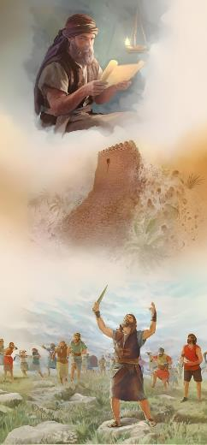
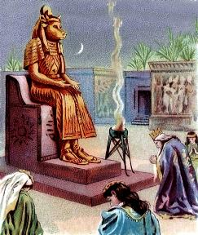

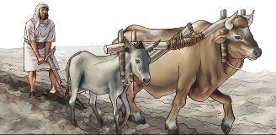
MPHOTO YA KUKHULUPIRIKA
“Aliyense wa inu atha kuthamangitsa anthu 1,000 chifukwa Yehova Mulungu wanu ndiye amakumenyerani nkhondo, monga momwe analonjezera.” (Yoswa 23:10)
Mphoto ya kukhulupirika kwa Aisraeli inali kugonjetsa adani awo onse kwathunthu komanso kotheratu (Yoswa 23:6, 10).
Ponena za kugonjetsedwa kwa Kanani, kukhulupirika kwa Mulungu kunayenera kuonekera m'njira zitatu zenizeni:
Musakwatirane ndi anthu okhala m’dzikolo
(Yoswa 23:7a)
Musatchule mayina a milungu yawo
(Yoswa 23:7b)
Musamapembedze milungu yawo (Yoswa 23:7c)
Anayenera kukhala oyera muuzimu. Ngati akadakwatirana ndi anthu okhala m’dzikolo, akanayamba kulankhula za milungu yawo, ndipo potsiriza akanayamba kuipembedza. Kupanduka kwa Solomoni kunayamba motero (1 Mafumu 11:4).
Choncho, ifenso Akhristu tikulangizidwa kutsatira malangizo omwewo, osati kukwatira osakhulupirira (2 Akorinto 6:14-16).

Slide 7


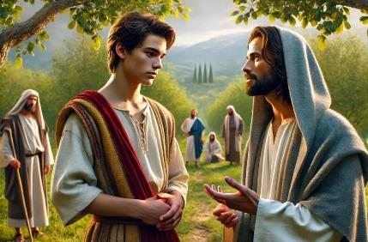
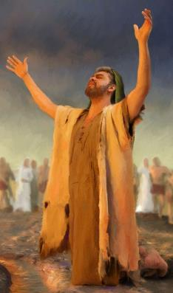
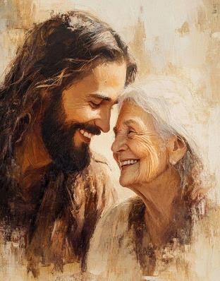
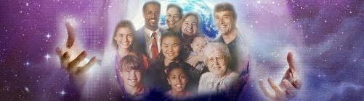
ZOMWE TIKUYENERA KUCHITA
“Choncho samalitsani kuti mukonde Yehova Mulungu wanu” (Yoswa 23:11)
Tikhoza kunena mosakayika kuti mfundo yaikulu ya nkhani ya Yoswa ikupezeka mu vesi 11: kukonda Mulungu.
Aisraeli anayenera kusonyeza chikondi chawo posakonda milungu ina, chifukwa kuchita zimenezi kukanawabweretsera mavuto aakulu (Yoswa. 23:12-13).
Kuphatikiza apo, Yoswa akupereka chilimbikitso chothandiza kulera chikondi chimenechi: kukhulupirika kwa Mulungu (Yoswa 23:14).
Lero tili ndi chilimbikitso chachikulu koposa: chitsanzo cha Yesu (Yohane 13:34).
Mulungu akufuna kukhala paubwenzi wapamtima ndi munthu aliyense amene amayankha ku chikondi Chake.
Choncho, chikondi chake kwa anthu onse chimakhala maziko a kuonekera kwa chikondi chathu chakudzipereka tokha ndi mgwirizano wathu ndi Iye.

Slide 8

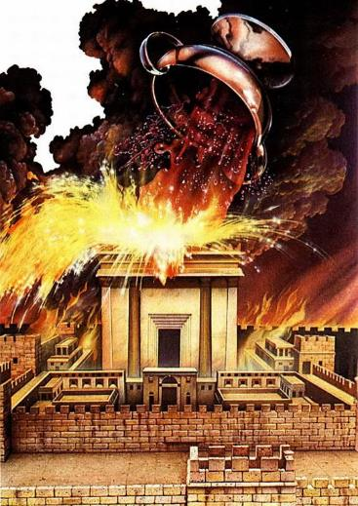
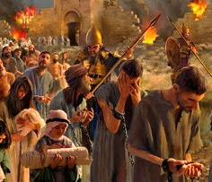
CHILANGO CHA KUSAKHULUPIRIKA
“Monga momwe Yehova Mulungu wanu wakuchitirani zabwino zonse zimene ananena kuti adzachita, Yehovayo angathenso kukuchitirani zoyipa zonse zimene waopseza, mpaka kukuchotsani mʼdziko lokoma limene anakupatsani.” (Yoswa 23:15)
Yoswa amaliza mawu ake ndi mawu amphamvu ochenjeza za zotsatira za kusamvera : kulandira mkwiyo wa Mulungu (Yoswa 23:15-16).
Komanso pokhala mu Dziko la Lonjezano ankadziwa bwino zotsatira zake zokwiyitsa Yehova pophwanya pangano mwadala.
Chikondi chomwecho chomwe chinapangitsa Mulungu kupereka Mwana wake chifukwa cha ife, ndi chomwe chimaonekera mu mkwiyo wake kwa amene amakakamira mwadala kuchita tchimo (Yohane 3:16; Aroma 2:5).
Aisraeli analephera ndipo analandira chilango chawo. Ife lerolino tili ndi mwayi wolemba nkhani yosiyana: kukhalabe okhulupirika ndi kukhalabe m’chikondi chake (Yohane 15:9).

Slide 9

“Chimwemwe chanu chonse, mtendere, chisangalalo, ndi kupambana kwanu m’moyo uno zimadalira chikhulupiliro chenicheni mwa Mulungu. Chikhulupiliro ichi chidzakulimbikitsani kumvera malamulo a Mulungu moona mtima. Chidziwitso komanso chikhulupiriro chanu mwa Mulungu ndicho chotchinga champhamvu kwambiri choletsa zoipa zonse, komanso ndicho chilimbikitso chathu kuchita zabwino zonse.
Khulupilirani Yesu ngati amene amakukhululukirani machimo anu, komanso amene akufuna kuti mukhale achimwemwe m’nyumba zaulemerero zimene wapita kukukonzerani. Iye akufuna kuti mukakhale naye, kuti mukhale ndi moyo wosatha ndi korona wa ulemerero.”
EGW (Messages to Young People, p. 410)

