Slide 1

UMODZI KUDZERA MU KUDZICHEPETSA
Phunziro 4, January 24, 2026

Slide 2

“Tsono tsirizani chimwemwe changa pokhala amaganizo ofanana, achikondi chimodzimodzi, amodzi mu mzimu ndi acholinga chimodzinso”
Afilipi 2:2,CCL

Slide 3







Paulo wangolimbikitsa okhulupirira a ku Filipi kuti aime nji pomwe akukumana ndi zovuta pa moyo wawo wachikhristu. Iye wawapempha kuti akhale ndi khalidwe loyenerera nzika za Kumwamba, kutsimikiza umodzi
Pogwiritsa ntchito mawu akuti ‘tsono,’ Paulo akuyamba gawo latsopano limene amatipatsa makiyi oti timvetsetse mmene tingakwaniritsire umodzi wangwirowo: potsatira chitsanzo cha Yesu.
Chiyambi cha kusagwirizana (Afilipi 2:1-3a)
Umodzi kudzera mukudzichepetsa (Afilipi 2:3b-4)
Ganizani ngati Yesu (Afilipi 2:5)
Khalidwe la Yesu (Afilipi 2:6-8)

Slide 4



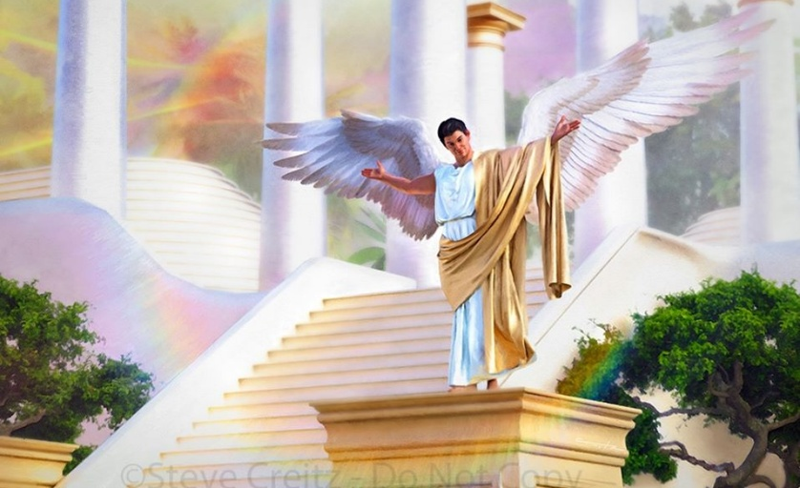

CHIYAMBI CHA KUSAGWIRIZANA
“Musachite kalikonse ndi mtima odzikonda chabe kapena odzitukumula chabe.” (Afilipi 2:3a)
Asanayambe kudzudzula vuto lenileni, posonyeza zifukwa za kusagwirizana komwe kunkaoneka pakati pa Afilipi, ndi malangizo otani amene Paulo anawapatsa kuti akwaniritse umodzi, potero kukwaniritsa chimwemwe chake (Afilipi 2:1-2 )?
Chitonthozo mwa Khristu
Chitonthozo m'chikondi
Chiyanjano cha Mzimu
Chikondi chochokera pansi pamtima
Chifundo
Umodzi mumaganizo ndi chikondi
Iye akuwalimbikitsa kuti aphunzire ndi kutsatira moyo wachitsanzo wa Khristu
Chikondi chawo pa Khristu chimakhala ndi mphamvu yolimbikitsa maganizo awo
Ayenera kugonjera ulamuliro wa Mzimu Woyera
Ayenera kusonyeza chikondi cha umunthu
Aloleni aonetse kuti ali ndi chikondi chenicheni kudzera mu ntchito za chifundo zimene amachitira munthu aliyense payekha
Chikondi cha pakati pa okhulupirira chimapangitsa maganizo awo kukhala ofanana, ndipo chimawatsogolera kuchita zinthu mogwirizana
Zonsezi akanatha kuzichita pokhapokha atasiya zinthu zimene zinkawagawanitsa: kudzikuza ndi mikangano (Afilipi 2:3a).
Kudzikuza ndi mikangano zinali pachimake pa kupanduka kwa Lusifala, ndipo kufikira lero zikadali mavuto oopsa kwambiri pa maubwenzi a anthu (Agalatiya 5:26; Yakobo 3:16 ).

Slide 5




UMODZI KUDZERA MU KUDZICHETSA
“… Koma khalani odzichepetsa ndipo aliyense aziona mnzake ngati womuposa iyeyo. 4Musamangofuna zokomera inu nokha koma aliyense azifuna zokomeranso ena.in ” (Afilipi 2:3b-4)
Njira ya imodzi yomwe Paulo akupereka si chinthu chakutali, koma kumachokera mkati mwamtima: kudzichepetsa. Kupatula kuti kudzichepetsa kunali khalidwe la Yesu mwiniwake, iye analimbikitsa omvera ake kukhala odzichepetsa (Mateyu 11:29; 18:4; 23:12 ).
Kuti tipeze kudzichepetsa kumeneku, Paulo akunena kuti tiziona ena kukhala ofunika kuposa ife eni (Afilipi 2:3). Koma tonsefe sitili ofanana pamaso pa Mulungu? Kodi sipakuyenera kukhala kufanana kuti pakhale umodzi?
Paulo sanena kuti ife ndife otsika kuposa ena, koma kuti tizidziona tokha ngati otsika. Monga mmene wantchito amafunira zabwino mbuye wake, ifenso tiyenera kufunira zabwino anthu amene timawaona kuti ndi ofunika kuposa ifeyo (Afilipi 2:4).
Kuti tithe kuthandiza ena, tiyenera kuphunzira kuwamvetsera ndi kumvetsetsa maganizo awo. Zonsezi mosakayikira ndi ntchito ya Mzimu Woyera.

Slide 6

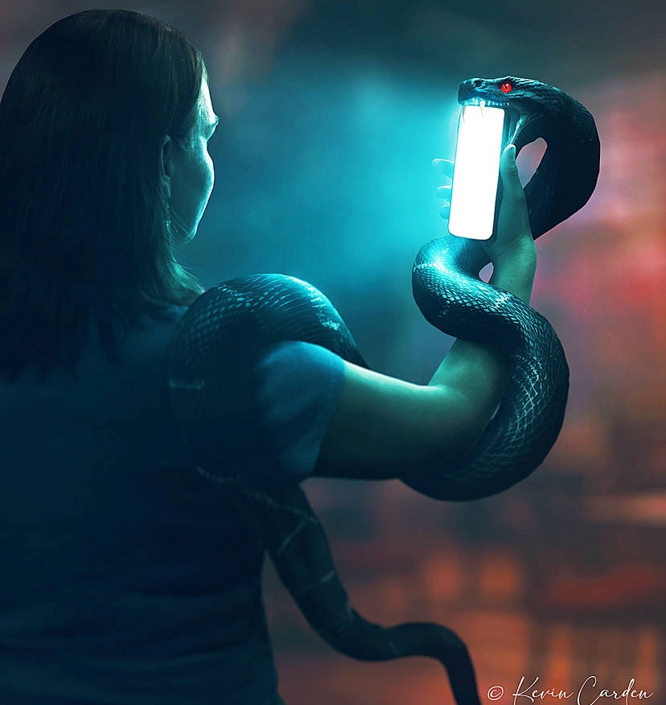


GANIZANI NGATI YESU
“Pa ubale wanu wina ndi mnzake, mukhale ndi mtima wofanana ndi wa Khristu Yesu:” (Afilipi 2:5 )
Kodi maganizo athu amapangidwa bwanji? Kupyolera mu “njira za moyo,” ndiko kuti, mphamvu zathu. Chilichonse chimene timawerenga, kuona, kapena kumva chimatiumba ndi kutisintha mwanjira ina. Ndipo, zoonadi, Satana amagwiritsira ntchito mphamvu zathu kuti aumbe maganizo athu kuti agwirizane ndi mmene iye amaganizira.
Paulo ndi wosasintha maganizo. Sangotipempha kuti tizisamalira maganizo athu, koma amatipempha kuti tiziganiza monga mmene Khristu ankaganizira (Afilipi 4:8; 2:5).
Mwina ndi khama lalikulu tingathe, kukwaniritsa choyambacho. Koma kusintha maganizo athu kuti agwirizane ndi maganizo a Yesu kungatheke mwa ife ndi Mzimu Woyera yekha.
Izi zili choncho chifukwa maganizo athu ndi akuthupi, ndipo mtima wathu ndi wonyenga (Yeremiya 17:9). Mzimu adzasintha maganizo athu akuthupi kukhala maganizo auzimu, monga a Khristu (Aroma 8:1, 5).

Slide 7

EGW (Patriarchs and Prophets, p. 436)
“Komabe, tili ndi ntchito yoti tichite yolimbana ndi mayesero. Iwo amene safuna kugwera mu misampha ya Satana ayenera kusamalira bwino njira za moyo wawo; ayenera kupewa kuwerenga, kuona, kapena kumva zinthu zimene zingayambitse maganizo osayera. Maganizo sayenera kuloledwa kumangoyendayenda mopanda malire pa nkhani iliyonse imene mdani wa miyoyo angapereke

Slide 8

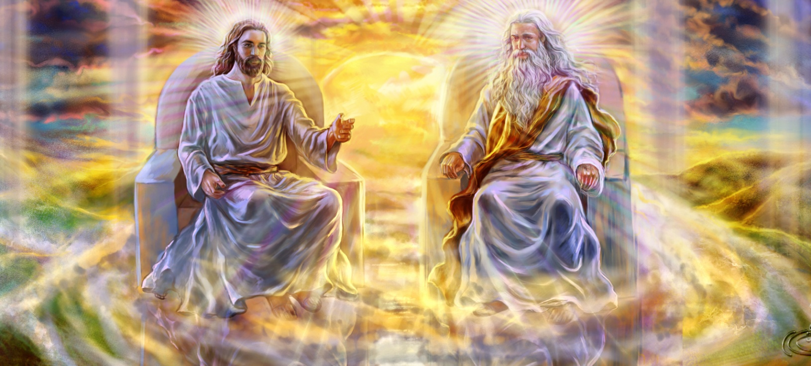


MAKHALIDWE A YESU (1)
“Iyeyu, pokhala Mulungu ndithu,
sanatenge kufanana ndi Mulungu kukhala chinthu choyenera kuchigwiritsa.” (Afilipi 2:6)
Paulo anatchula makhalidwe atatu a Yesu:
Iye anasiya udindo wake waumulungu (Afilipi 2:6)
Anakhala munthu kuti atitumikire (Afilipi 2:7)
Iye anadzichepetsa, namvera mpaka kufikira imfa (Afilipi 2:8)
Ngakhale anali Mlengi, Iye anadzichepetsa nʼkukhala cholengedwa. Iye analola kuzunzidwa ndi kufa pa mtanda kuti atiwombole.
Ngakhale anali wofanana ndi Anthu ena awiri a Umulungu, Yesu nthawi zonse anagonjera chifuniro cha Atate mwangwiro nthawi zonse. Panalibe nthawi iliyonse imene Iye anakana kumvera.
Tikaganizira izi, sitingachite china chilichonse koma kugwadira ndi kulambira Mpulumutsi wathu wodabwitsa.
Iye ndi chitsanzo chathu. Tiyenera kukhala okonzeka kudzichepetsa ndi kudzipereka tokha chifukwa cha ubwino wa ena.

Slide 9


MAKHALIDWE A YESU (2)
“Mosakayikira, chinsinsi cha chikhulupiriro chathu chachikulu: Khristu anaonekera ali ndi thupi la munthu, Mzimu anamuchitira umboni, angelo anamuona,
analalikidwa pakati pa mitundu yonse, dziko lapansi linamukhulupirira, anatengedwa kupita kumwamba mwa ulemerero” (1 Timothy 3:16)
Kudzichepetsa kodabwitsa kwa Khristu pokhala munthu kudzakhala phunziro lophunzira owomboledwa kwamuyaya.
Ndizodabwitsa kwambiri kuti Munthu Wopanda malire ndi wamuyaya anakhala munthu wokhala ndi malire, wogonjera imfa. Ichi ndi chimene Paulo amachitcha “chinsinsi cha umulungu” ( 1 Tim. 3:16 ).
Yesu anachoka pa ulamuliro wa chilengedwe chonse ndikukhala kapolo weniweni. Izi ndizosiyana kotheratu ndi zimene Lusifala ankalakalaka, amene ngakhale anali mtumiki, anafuna ulamuliro wa chilengedwe chonse.
Chitsanzo chimenechi chimatiitana ife kusiya kudzikonda ndi khumbo lathu lofuna kutumikiridwa, ndipo m'malo mwake mumalowa kudzichepetsa ndi kufunitsitsa kutumikira ena.

Slide 10

“Mulungu amalola munthu aliyense kusonyeza umunthu wake. Iye safuna kuti wina aliyense aike maganizo ake m’maganizo mwa munthu mnzake.” Amene akufuna kusandulika m’maganizo ndi m’makhalidwe sayenera kuyang’ana kwa anthu, koma ku Chitsanzo cha umulungu.” Mulungu amapereka kuyitanidwa uku: “Mukhale ndi maganizo amene analinso mwa Khristu Yesu.” Kupyolera mu kutembenuka mtima ndi kusintha, anthu ayenera kulandira maganizo a Khristu.”
EGW (That I May Know Him, May 8)

