Slide 1
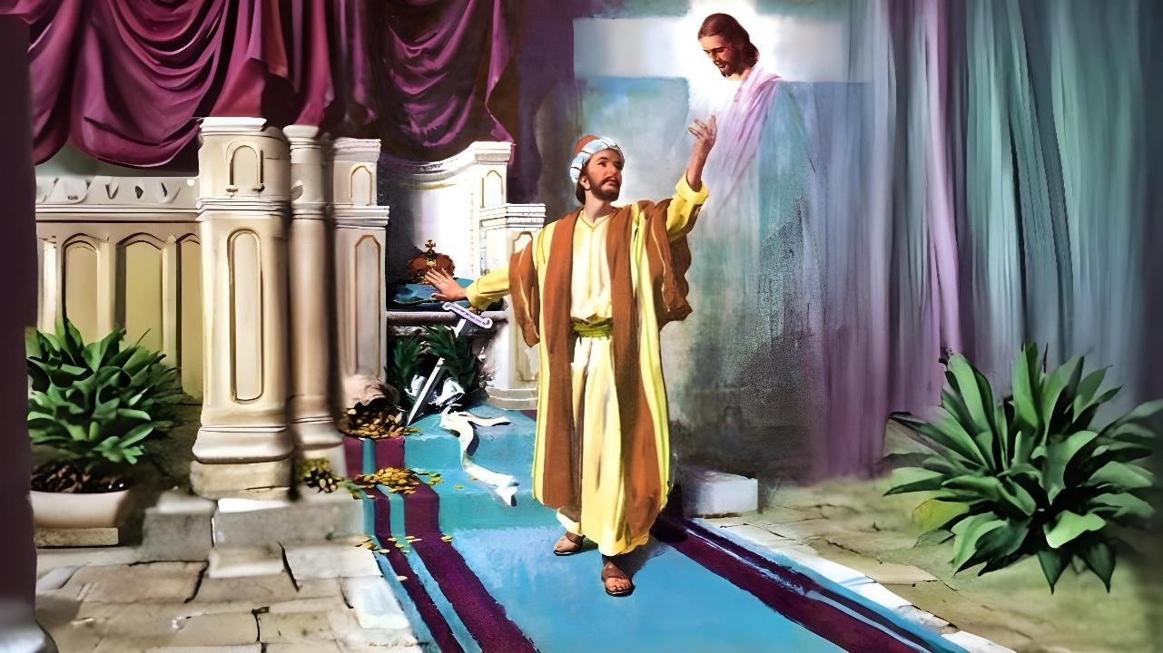
Phunziro 6 February 7, 2026
KUDALIRA MWA KHRISTU YEKHA

Slide 2


“Ine ndikufuna kudziwa Khristu, ndithu, kudziwa mphamvu zake za kuuka kwa akufa. Ndikufuna kuyanjana naye mʼmasautso ake, kufanana naye pa imfa yake kuti nanenso ndidzaukitsidwe kwa akufa.”
Afilipi 3:10, 11, CCL

Slide 3










Afilipi ankadziwa njira ya chipulumutso, monga momwe Paulo ndi Sila adafotokoza momveka bwino kwa mmodzi wa otembenuka mtima oyamba mumzindawo: woyang'anira ndende (Machitidwe 16: 30-31).
Tsopano popeza kuti mpingounali utakhazikitsika bwino, panali chiopsezo chakuti akanatha kutsogoleredwa kutali ndi njira ya chipulumutso.
Pachifukwa chimenechi, Paulo akuwakumbutsa za mizati yofunikira ya chipulumutso mwa chikhulupiriro.
Malangizo oti musataye chipulumutso chanu:
Zoyenera kupewa (Afilipi 3:1-3)
Zomwe zasiyidwa m’mbuyo (Afilipi 3:4-6)
Chofunika kwambiri (Afilipi 3:7-8)
Malangizo oti mukhalebe mu chipulumutso
Chikhulupiriro cha Khristu (Afilipi 3:9)
Kumudziwa Khristu (Afilipi 3:10-16)

Slide 4

MALANGIZO OTI MUPEWE KUTAYA CHIPULUMUTSO CHANU

Slide 5

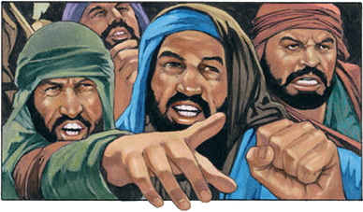

ZOYENERA KUPEWA
“Chenjerani ndi agalu amenewa, anthu ochita zoyipa, anthu amene amadula thupi lawo.” (Afilipi 3:2)
Asanakambirane za zoopsa zimene zimayika chikhulupiriro pachiwopsezo, Paulo akutipatsa uphungu wakuti : “Kondwerani mwa Ambuye” (Afilipi 3:1a). Pa izi akuwonjezerapo chinthu chofunika: ndikwabwino kubwerezabwereza chowonadi chimene tili nacho, ngakhale tikuchidziwa bwino kale (Afilipi 3:1b).
Kulandira chifundo cha Mulungu ( Masalimo 31:7 )
Kuyika chikhulupiriro chathu mwa Iye ( Masalimo 5:11 )
Kulandira madalitso a chipulumutso (Masalimo 9:14)
Kusunga Malamulo a Mulungu (Masalimo 119:14; Yesaya 58:13, 14)
Kukhulupirira Mawu Ake (Masalimo 119:162)
Kulera Ana Oopa Mulungu (Miyambo 23:24, 25 ).
Kodi tingakondwere bwanji mwa Ambuye?
Paulo akufotokoza za chiopsezo chachikulu ku mpingo mu nthawi imeneyo: phunzitsi abodza amene ankaphunzitsa kumamatira kwambiri pa lamulo la miyambo (Afilipi 3:2). Amatchula zimenezi munjira zitatu zosiyana: agalu (Masalimo 22:16; 2 Petro 2:21-22 ); ochita zoipa; ndi odula thupi, kudzera mu mdulidwe.

Slide 6

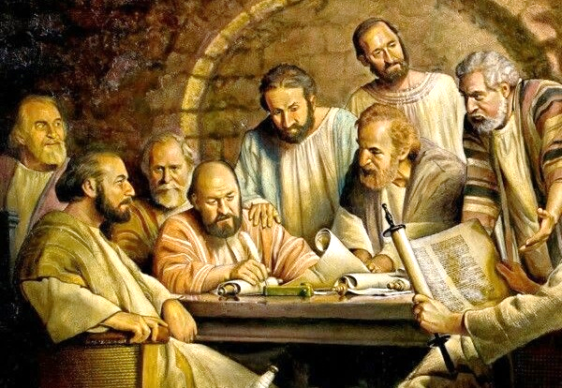
ZOMWE ZASIYIDWA MMBUYO
“Ndinachita mdulidwe pa tsiku lachisanu ndi chitatu nditangobadwa. Ndine wa mtundu wa Israeli, wa fuko la Benjamini, Mhebri wa Ahebri, kunena za malamulo, ndinali Mfarisi.” (Afilipi 3:5)
Pa msonkhano wa ku Yerusalemu, lamulo linaperekedwa kuti anthu amitundu asavutike ndi nkhani zokhudza malamulo a miyambo yachiyuda (Machitidwe 15:19-21). Komabe, aphunzitsi ena anafika ku Filipi kuphunzitsa kufunika kwa mdulidwe (Afilipi 3:2-3 ).
Poyangána za m’mbuyo, Paulo amawakumbutsa mmene moyo wake unali wangwiro pamene ankatsatira njira za aphunzitsi amenewo (Afilipi 3:4-6 ):
Odulidwa pa tsiku lachisanu ndi chitatu; mwana wa makolo opembedza
Mhebri wa Ahebei m’Benjamini weni weni
Ponena za chilamulo, anali Mfarisi wotsatira masamalitsa kwambiri
Ponena za changu chake, anali wozunza mpingo
Wosunga Lamulo mopanda cholakwa
Koma anadzitamandira pa zonsezi asanadziwe Yesu. Tsopano anadziwa kuti sanamvetsetse ngakhale Lamulo lenileni (Mateyu 5:21–22). Tsopano anadziwa kuti ndi Khristu yekha amene amapulumutsa (Afilipi 3:7).

Slide 7

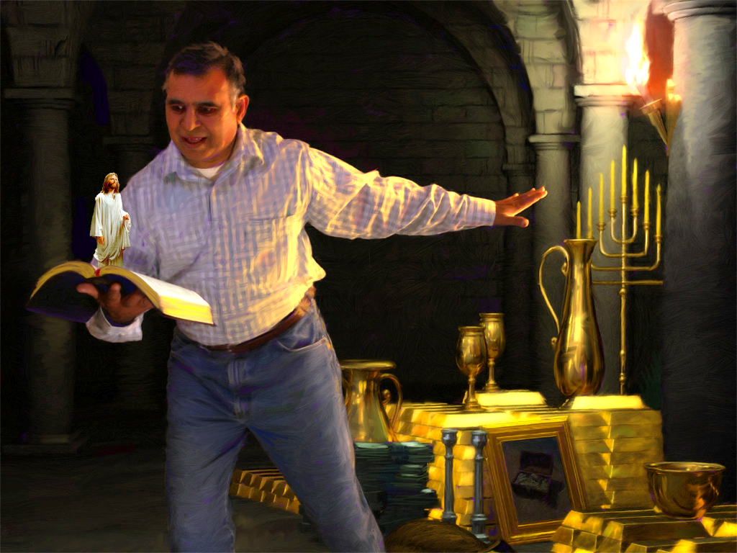



CHOFUNIKA KWAMBIRI
“Koma zonse zimene ndinkaziyesa zaphindu, tsopano ndikuziona kuti nʼzosapindulitsa chifukwa cha Khristu.” (Afilipi 3:7)
Paulo amaika pa mlingo moyo wake wakale ndi moyo wake watsopano. Kumbali imodzi amaika chidziwitso chake chonse; tsogolo lake lowala ngati mwana wophunzira wapadera wa Gamaliyeli; ndi mphatso zake zodabwitsa za Chifarisi. Zonsezi zinali phindu.
Tsopano, kumbali ya mlinngowo ikanipo moyo wake kuyambira pamene anakumana ndi Khristu. Phindu lonse linasanduka zinyalala, chifukwa palibe chimene chingafanane ndi chikondi cha Khristu (Afilipi 3:7-8).
Kodi ndichiyani chingakhale chamtengo wapatali kuposa moyo wosatha kumwamba ndi dziko lapansi latsopano? Koma, chuma cha dziko lapansi chimachititsa ambiri kukhala akhungu pa chowonadi chimenechi. Pali mpikisano pakati pa zinthu zimene zimawonedwa ngati zofunika pa dziko lapansi lino ndi zimene Kumwamba kumayamikira kwambiri: khalidwe lofanana ndi la Khristu ndi chipulumutso cha moyo wa munthu.

Slide 8

MALANGIZO OTI MUKHALEBE MU CHIPULUMUTSO

Slide 9



CHIKHULUPIRIRO CHA KHRISTU
“ndi kuti ndipezeke mwa Iyeyo, osati ndi chilungamo changa chobwera chifukwa chotsata malamulo, koma chimene chimabwera chifukwa chokhulupirira Khristu. Chilungamochi nʼchochokera kwa Mulungu, timachilandira mwachikhulupiriro.” (Afilipi 3:9)
Paulo, odalira chilungamo cha iye mwini, anapita ku Damasiko kuti akabwezeretse ampatuko a gulu lotchedwa "Njira" ku njira ya chipulumutso (Machitidwe 9:1-2 ). Koma adalowa ku Damasiko atagonjetsedwa ndi chilungamo china, chilungamo cha Mulungu: "chomwe chimabwera kudzera mu chikhulupiriro mwa Khristu " (Afilipi 3: 9).
Kuyambira nthawi imeneyo, sanadalirenso chilungamo chake. Pakuti nʼkopanda phindu kudalira zochita zathu kuti tipeze chipulumutso (Agalatiya 2:16).
Iye ankafunitsitsa “kupezeka mwa [Khristu]” (Afilipi 3:9). Kodi zimenezi zikutanthauza chiyani?
Malinga ndi 1 Akorinto 1:30, kukhala “mwa Khristu” kumaphatikizapo zonse zimene zimapanga dongosolo la Chipulumutso, kuyambira kuchiyambi kwa kuzindikira kwathu mwa uzimu (nzeru), kudzera mu kulungamitsidwa mwa chikhulupiriro (chilungamo) ndi kukonzekera kumwamba (kuyeretsedwa), mpaka, potsiriza, kulemekezedwa pa Kudzanso kwachiwiri (chipulumutso).

Slide 10


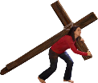




KUMUDZIWA KHRISTU
“Ine ndikufuna kudziwa Khristu, ndithu, kudziwa mphamvu zake za kuuka kwa akufa. Ndikufuna kuyanjana naye mʼmasautso ake, kufanana naye pa imfa yake ” (Afilipi 3:10)
Kodi tingamudziwe bwanji Khristu? (Afilipi 3:10-16)
Pamene tiphunzira Mawu Ake
Pamene titsogozedwa ndi Mzimu Woyera
Pamene tigawana nawo mazunzo Ake
Pamene tipitiriza cholinga chake
Moyo wa Mkhristu uli ngati mpikisano wothamanga. Tiyenera kukumbukira bwino cholinga chathu. Sitikungokhala pa dziko pano kuti tingosangalala ndi moyo uno wokha. Tikuyembekeza kufika pa kuuka kwa akufa (Afilipi 3:11).
Mpaka nthawiyo itafika, timayesetsa “kuti ndipeze chimene Khristu Yesu anandiyitanira.” (Afilipi 3:12 ) Choncho, tiyenera kuyesetsa “kugwira ntchito imene Khristu Yesu anagwira. Yesu anandipeza kuti andipatse mzinda; mphotho; ndi moyo wosatha wokhala naye pamodzi (Ahebri 11:10; Afilipi 3:14; 1 Atesalonika 4:17).

Slide 11

“Cholinga chachikulu chimene chinamukakamiza Paulo kuti apitebe patsogolo ngakhale anakumana ndi masautso ndi zovuta chiyenera kutsogolera wantchito aliyense Wachikristu kudzipatulira kotheratu ku utumiki wa Mulungu. Zokopa za dziko lapansi zidzaperekedwa kuti zimukopeke mtima wake kuchoka kwa Mpulumutsi, koma ayenera kulimbikira kuti afikile cholinga, kusonyeza dziko lapansi, angelo, ndi anthu kuti chiyembekezo chowona nkhope ya Mulungu ndichamtengo wapatali kuposa khama ndi nsembe zonse zimene kukwaniritsidwa kwa chiyembekezochi kumafuna.
Ngakhale wophunzira wochepa kwambiri wa Khristu akhonza kukhala mzika ya kumwamba, wolandira cholowa cha Mulungu, chosawonongeka.”
EGW (Conflict and Courage, December 13)

