Slide 1
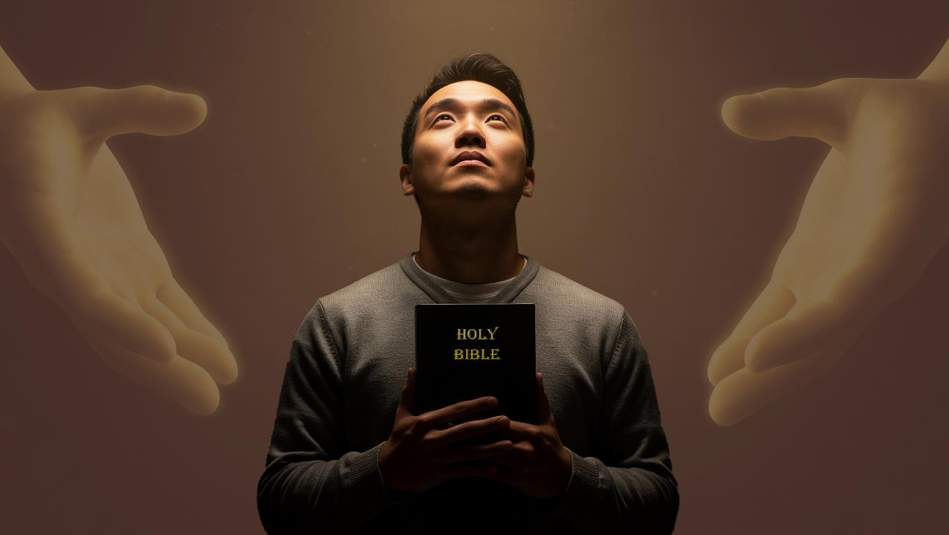
CHIYANJANO NDI CHIYEMBEKEZO
Phunziro 9, February 28, 2026

Slide 2


2 Akorinto 5:21
“Chifukwa cha ife, Mulungu anasandutsa wopanda tchimoyo kukhala tchimo, kuti mwa Iye ife tikakhale chilungamo cha Mulungu.

Slide 3


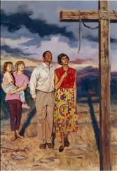
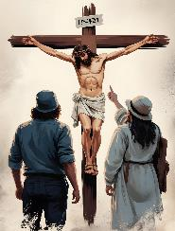
Paulo atatha kunena kuti mtanda wa Khristu unayanjanitsa Kumwamba ndi Dziko Lapansi (Akolose 1:20), akupitiriza kufotokoza zotsatira zenizeni kwa ife za kuyanjanitsidwa kumeneku.
Kodi zimenezi zatisintha motani? Kodi Mulungu anadzioneratu zonsezi bwanji? Kodi tingatani kuti tithandize ena kutenga nawo mbali ku kuyanjanitsidwa ndi kupeza chiyembekezo?
CHIYANJANO NDI CHIYEMBEKEZO KUDZERA MUUTHENGA WABWINO
Kulengeza Uthenga Wabwino (Akolose 1:28-29)
Kubweretsa chiyembekezo (Akolose1:24-25)
Chinsinsi cha Mulungu (Akolose 1:26-27)
Mphamvu ya Uthenga Wabwino
Chiyembekezo
Zotsatira za chiyanjano
Kuchokera kwa ochita zoipa kufika kwa oyera mtima (Akolose 1:21-22)
Wokhazikika komanso osagwedezeka (Akolose 1:23)

Slide 4

ZOTSATIRA ZA CHIYANJANO

Slide 5

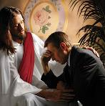
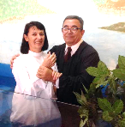

KUCHOKERA PA OCHITA ZOIPA KUFIKA PA WOYERA MTIMA
“Kale inu munali kutali ndi Mulungu ndipo munali adani a Mulungu mʼmaganizo mwanu chifukwa cha khalidwe lanu loyipa. Koma tsopano Iye anakuyanjanitsani mʼthupi la Khristu kudzera mu imfa kuti akuperekeni pamaso pake oyera, opanda banga ndi opanda chotsutsidwa nacho—.” (Akolose 1:21-22)
Nkhani yake ndi yosavuta. Tinali ochita zoipa, choncho tinkayenera kuweruzidwa ku imfa yamuyaya (Aroma 6:23; Chivu 21:8).
Anafa pamtanda kuti alipire dipo la machimo athu ( Aroma 5:8 )
Kudzera mu chikhulupiriro, kulapa, ndi ubatizo, timamasulidwa ku uchimo wathu ndipo tili opanda chilema ndi opanda mlandu pamaso pa Mulungu [kuyesedwa olungama] ( Aroma 5:10; Akolose1:22 )
Kupyolera mu ntchito ya Mzimu Woyera miyoyo yathu imasandulika pang’onopang’ono ndipo timakhala oyera pamaso pa Mulungu [kuyeretsedwa] ( Aroma 8:1; 2 Akorinto 5:17 )
Pa ife tokha sitikanatha kusintha mkhalidwe limeneli, kapena kulipira mtengo wa chipulumutso chathu (Masalimo 49:7-8).
Koma Mulungu anatikonzera ife dongosolo lalikulu :

Slide 6

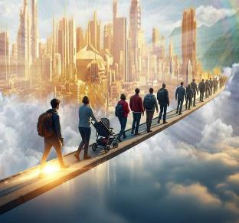
OKHAZIKIKA NDI OSAGWEDEZEKA
“ngati mupitirirabe kukhala mʼchikhulupiriro chanu, okhazikika ndi olimba, osasunthidwa kuchoka pa chiyembekezo chimene munachigwira mu Uthenga Wabwino” (Akolose 1:23a)
Talungamitsidwa kale, ndipo tikupitiriza kuyeretsedwa ndi kupatulidwa, koma ulendo sunathebe. Timakhala pachiwopsezo chosochera ndikulephera kufikira cholinga. Ndichifukwa chake Paulo akutilangiza pa zinthu zitatu ( Akolo 1:23a )
Pitirizani Muchikhulupiriro
Khalani wolimbikira, monga momwe Petro anachitira pamene, atatuluka m’ndende, anagogoda pachitseko kufikira chinamtsegulira.
( Machitidwe 12:11-16 )
Okhazikika
Chikhulupiriro chathu chiyenera kukhala cholimba, chozikidwa pa choonadi chimene taphunzira m’Baibulo
Osagwedezedwa
Tiyenera kukhala osagwedezeka, osaleka kudalira “chiyembekezo cha Uthenga Wabwino”

Slide 7

CHIYEMBEKEZO

Slide 8

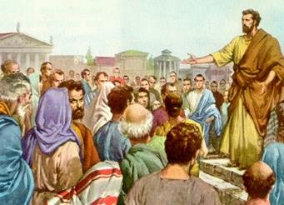
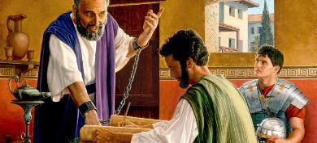
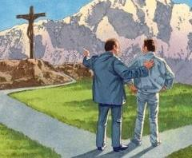
KUBWERETSA CHIYEMBEKEZO
“Ine ndakhala mtumiki wake mwa lamulo limene Mulungu anandipatsa kuti ndipereke Mawu a Mulungu athunthu,” (Akolose 1:25)
Monga tanaonera, dongosolo la Mulungu la chipulumutso chathu limakhazikika pa imfa ya Yesu ndipo limaphatikizapo kuwerengedwa olungama ndi Koma panali china chofunika chimene chinkasowa: m’njira ina tiyenera kudziwa dongosololi kuti tililandire. Tiyenera kukhala ndi munthu wotiuza ndi kutivumbulutsira dongosololi.
Apa ndipamene “makonzedwe a Mulungu” [njira ya Mulungu yoyendetsera zinthu, maganizo, anthu, ndi zina zotero] imabwera, imene Paulo anali mtumiki wake (Akolose 1:25).
Paulo anasangalala kukhala mbali ya dongosolo limeneli, ngakhale kuti linali ndi zowawa, (Akolose 1:24). Kuyambira pamene anamangidwa ku Roma kufikira imfa yake, iye analemba pafupifupi makalata asanu ndi awiri mwa makalata khumi ndi anayi osungidwa m’Chipangano Chatsopano.
Paulo anali gawo lofunika kwambiri la dongosolo la Mulungu, ndipo anasangalala nalo. Ifenso tingakhale mbali ya dongosololi potsogolera ena kuti adziwe Khristu. Chimenechi ndicho chimwemwe chathu!

Slide 9

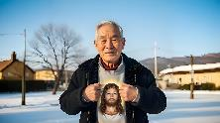
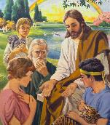

CHINSINSI CHA MULUNGU
“chinsinsi chimene chakhala chikubisika kwa nthawi ndi mibado, koma tsopano chawululidwa kwa oyera mtima.”Akolose 1:26)
Paulo akunena za chinsinsi chimene chavumbulutsidwa kwa mpingo Khristu atauuka (Akolose 1:26). Kufikira pa nthawi imeneyi, panangokhala zionetsero zochepa chabe za chinsinsicho. Koma kodi chinsinsicho n’chiyani? “Khristu mwa inu, chiyembekezo cha ulemerero” (Akolose 1:27).
Linapangidwa dziko lapansi lisanakhazikitsidwe (1 Petro 1:20)
Anauzidwa pang'ono ndi angelo (1 Petro 1:12)
Chitsanzo choyamba chinaperekedwa kwa Adamu ndi Hava (Genesis 3:15)
Zinawululidwa kwa aneneri (1 Petro 1:10-11)
Poyamba Yesu anaulula kwa Ayuda (Mateyu 15:24)
Kenako chinaululidwa kwa anthu onse (Akolose 1:27).
Pali magawo ena amene akadali kufotokoledwa m’chinsinsi chimenechi. Tsopano tikukhala m’chiyembekezo cha kudzalandira ulemerero. Nkusintha kotani! N’chinsinsi chotani! Anthu ochimwa amawerengedwa olungama, amayeretsedwa ndi kupatulidwa, ndipo amalandira ulemerero chifukwa cha mwazi a Yesu amapulumutsidwa. Chinsinsi chimenechi chidzapitirirabe kukhala mutu wophunziridwa mpaka muyaya.

Slide 10

MPHAMVU YA UTHENGA WABWINO

Slide 11

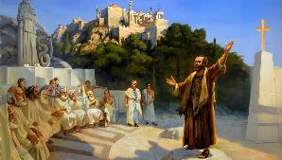
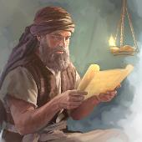
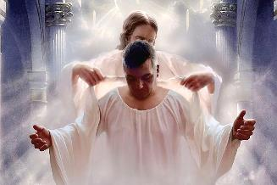
KULENGEZA UTHENGA WABWINO
“Him we preach, warning every man and teaching every man in all wisdom, that we may present every man perfect in Christ Jesus.” (Akolose 1:28)
Kodi Paulo analalikira bwanji uthenga wabwino? Chimene chinali choyamba mu ulaliki wake chinali Khristu wopachikidwa (1 Akorinto 1:23). Anthu atangolandira Yesu, iye ankawachenjeza ndi kuwaphunzitsa mpaka atakhala angwiro (Akolose 1:28-29). Kodi anachita bwanji zimenezi?
Anawafotokozera chiphunzitso chachikhristu ndi machitidwe (2 Atesalonika 2:15)
Anawachenjeza za zotsatira za kukana uthenga wabwino ( Ahebri 10:25-29 )
Anawachenjeza za kuopsa kwa aphunzitsi onyenga (Machitidwe 20:29-30)
Dikirani kaye… kuwapanga kukhala angwiro? Ndipo osati ochepa chabe… “munthu aliyense”! ( Akolose 1:28b ).
Mawu achi Greek omasuliridwa kuti “okhwima” (teleios) amatanthauza wangwiro komanso wopanda chilema. Kudzera mu njira ya kukula kwa Chikhristu, timazindikira bwino kwambiri kuya kwa lamulo la Mulungu ndi zofunikira zake. Choncho cholinga chathu ndi kukhala angwiro mwa Khristu Yesu.

Slide 12

“Poyang’ana pa Mpulumutsi wopachikidwa, timamvetsetsa bwino kwambiri kukula ndi tanthauzo la nsembe imene Ukulu wa Kumwamba unapereka. Dongosolo la chipulumutso limawoneka lolemekezeka pamaso pathu, ndipo kuganizira za Kalvare kumadzutsa m’mitima mwathu malingaliro amoyo ndi opatulika.
EGW (The Desire of Ages, p. 661)

Slide 13
“Kutamanda Mulungu ndi Mwanawankhosa kudzakhala m’mitima mwathu ndi m’kamwa mwathu; chifukwa kunyada ndi kudzikunza sizingakule m’mtima wa munthu amene nthawi zonse amakumbukira m’maganizo mwake zochitika za Kalvare.”
EGW (The Desire of Ages, p. 661)

