Slide 1

KUMUDZIWA MULUNGU
Phunziro 2, April 11, 2026

Slide 2
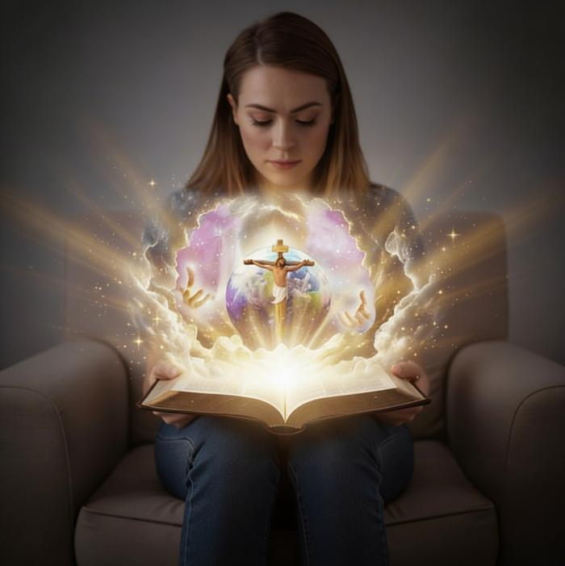
“Tsono moyo wosathawo ndi uwu: Iwo akudziweni Inu, Mulungu yekhayo woona, ndi Yesu Khristu, amene Inu mwamutuma.”
(Yohane 17:3, CCL)

Slide 3

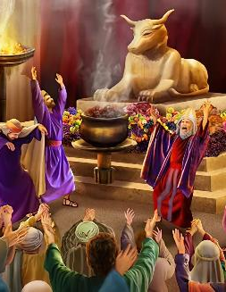

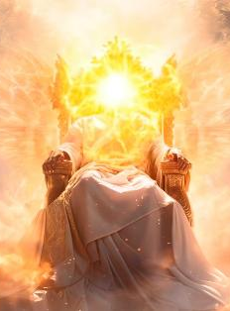

Kumvetsa kwathu za Mulungu kwayipitsidwa chifukwa cha tchimo. Tayesera kumuimira ndi mafano opangidwa ngati nyama kapena anthu. Wafotokozedwa ngati wosasamala kapena wolamulira mwankhanza. Pomaliza pake, anthu apanga chithunzi cha Mulungu chofanana ndi iwo eni.
Koma Mulungu ali wotani kwenikweni? Kodi ndi wamkulu kwambiri kotero kuti ndikosatheka kwa ife kumumvetsetsa Iye? Zoonadi, ngakhale titayesetsa motani, maganizo athu sangathe kumumvetsetsa Mulungu. Tikufunika thandizo.
Koma thandizo lafika. Kodi mukufuna kudziwa kuti Iye ali bwanji? M'Baibulo, tili nacho chivumbulutso chenicheni cha chikhalidwe cha Mulungu.
Makhalidwe a Mulungu.
Mkhalidwe wa Mulungu:
Mulungu ndi woyera
Mulungu ndi chikondi
Kumudziwa Mulungu:
Mulungu wavumbulutsidwa mu Chilengedwe
Mulungu wavumbulutsidwa mwa Yesu (Emanueli)

Slide 4


MAKHALIDWE A MULUNGU

Slide 5


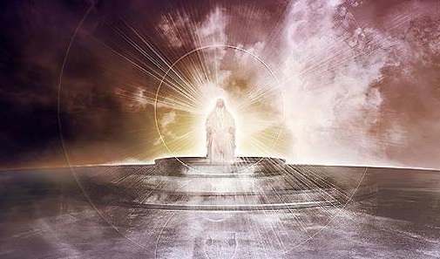

“Inu Yehova Mulungu Wamphamvuzonse, ndani wofanana nanu?
Yehova ndinu wamphamvu ndipo kukhulupirika kwanu kwakuzungulirani” (Masalimo 89:8)
MAKHALIDWE A MULUNGU
Baibulo limapereka chithunzi chokhulupirika kwambiri, chomveka bwino, ndi chokhazikika cha Mulungu. Imodzi mwa njira zimene limatilola kudziwa Iye ndi kudzera mu makhalidwe ake.
MAKHALIDWE ENA A MULUNGU
Wolungama (Masalimo 11:7)
Wachifundo (Deuteronomo 4:31)
Woleza mtima ndi wotonthoza (Aroma 15:5)
Wopereka chisomo (Aroma 3:24)
Wokhululukira (Masalimo 86:5)
Waufumu (Masalimo 47:8)
Wamuyaya (Genesis 21:33)
Wamphamvu zonse (Genesis 17:1)
Wodziwa zonse (1 Yohane 3:20)
Wodziwa zamtsogolo (Yesaya 46:10)
Kumbali yake, Satana wakhala akuyesera kuyambira pachiyambi kusokoneza khalidwe la Mulungu, kumuwonetsa ngati Mulungu wodzikonda, amene amangofuna zabwino zake zokha (Genesis 3:4-5).

Slide 6

MKHALIDWE WA MULUNGU

Slide 7

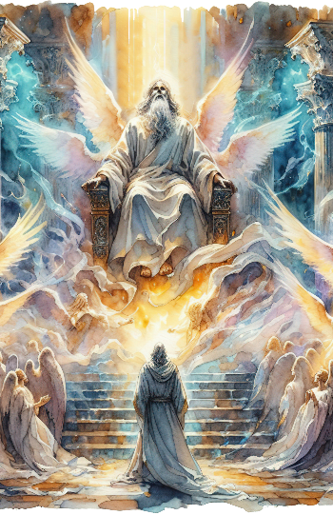
MULUNGU NDIYE WOYERA
“Ndipo Aserafiwo amafuwulirana kuti
“Woyera, woyera, woyera Yehova Wamphamvuzonse.Dziko lonse lapansi ladzaza ndi ulemerero wake.” (Yesaya 6:3 CCL)
Angelo amene amaima pafupi ndi Mulungu amamulemekeza ponena kuti, “Woyera, woyera, woyera” (Yesaya 6:3; Chivumbulutso 4:8). Khalidwe limeneli limalumikizana kwambiri ndi umunthu wake kotero kuti Yesaya amagwiritsa ntchito ngati dzina lenileni la Mulungu: “atero Woyera” (Yesaya 40:25; 57:15).
Kodi kukhala woyera kumatanthauza chiyani? Kumatanthauza kukhala wopatulika, wosiyidwa padera, woyera mtima. Ifenso timakhala oyera tikatembenuka kusiya zoipa ndi kuchita ntchito imene Mulungu watipatsa (Numeri 15:40; Levitiko 11:44; 1 Petro 2:9).
Koma zimenezi zikugwirizana bwanji ndi Mulungu? ye ali wosiyana kotheratu ndi zoipa ndipo alibe chiyanjano chilichonse ndi tchimo.
Izi zikutanthauza kuti, chifukwa chakuti Iye ndi Woyera, chikondi Chake n'choyera, chopanda banga, ndiponso chopanda dyera. Chifukwa chakuti Iye ndi Woyera, mphamvu Zake zonse nzoyera, zopanda banga, ndiponso zopanda dyera. Makhalidwe Ake onse adzaza ndi chiyero.

Slide 8


MULUNGU NDIYE CHIKONDI
“Tikudziwa ndipo timadalira chikondi chimene Mulungu ali nacho pa ife. Mulungu ndiye chikondi. Aliyense amene amakhala moyo wachikondi, ali mwa Mulungu ndipo Mulungu amakhala mwa iye.” (1 Yohane 4:16 CCL)
Mulungu samangokhala ndi chikondi kapena kupereka chikondi (ngakhale amachita zonse ziwiri), koma “Mulungu NDIYE chikondi” (1 Yohane 4:8, 16). Monga chiyero, chikondi ndi mbali yofunika kwambiri ya makhalidwe a Mulungu.
Chifukwa cha chikondi, analenga anthu mwamuna ndi mkazi, ndipo “anawalamula” kuti azikondana (Genesis 2:24)
Chifukwa cha chikondi, Adamu ndi Hava atachimwa, Iye anawafunafuna ndi kuwapatsa chiyembekezo (Genesis 3:9, 15)
Chifukwa cha chikondi, Iye anapanga pangano ndi Abrahamu ndipo analonjeza madalitso kwa anthu onse(Genesis 26:4)
Chifukwa cha chikondi, Iye anapereka Mwana Wake—Yesu Khristu—kuti afe chifukwa cha machimo athu (Yohane 3:16)
Kodi ndingayankhe bwanji ku chikondi Chake?
“Ife timakonda Mulungu chifukwa ndiye anayamba kutikonda” (1 Yohane 4:19).
Notes:
SmartArt with large images (the four “for love”)

Slide 9

KUMUDZIWA MULUNGU

Slide 10



MULUNGU WAVUMBULUTSIDWA MU CHILENGEDWE
“Zakumwamba zimalalikira ulemerero wa Mulungu;
ndipo thambo lionetsa ntchito ya manja ake.” (Masalimo 19:1, BLP)
Baibulo limayamba potchula Mulungu kuti אֱלֹהִ֑ים (elohim). Ngakhale tanthauzo lenileni la dzinali ndi “milungu,” limagwiritsidwa ntchito ngati liwu limodzi. Monga kuti, “Pachiyambi, Mulungu analenga kumwamba ndi dziko lapansi” (Genesisi 1:1).
Limatipatsa chithunzi cha Mlengi amene, kudzera mwa Mawu [Yesu Khristu], komanso ndi kulowererapo kwa Mzimu, ali ndi mphamvu yopanga zonse zomwe zilipo (Genesisi 1:1-3; Yohane 1:1-3).
Mu Genesisi chaputala 2, dzina lenileni la Mulungu limawonjezedwa: יְהוָ֥ה (Yahweh). Tsopano sakungonena kuti, “Zikhale.” Iye anatenga munthu ndi kumuumba ndi manja ake. Mulungu wamphamvu akudziwonetsera ngati Mulungu wa pafupi ndi wofikirika.
Iye amatikhudza, amalankhula nafe, amatiphunzitsa, amatipatsa ntchito yathu… amatikonda.

Slide 11

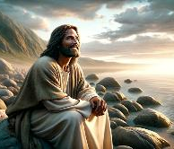
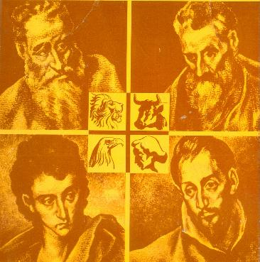
MULUNGU WAVUMBULUTSIDWA MWA YESU (EMANUELI)
“Palibe munthu amene anaona Mulungu, koma Mwana mmodzi yekhayo amene ali wa pamtima pa Atate, ndiye anafotokoza za Iye.” (Yohane 1:18)
Ngati tikufuna kudziwa mmene Mulungu alili, tiyeni timudziwe Yesu. Iye ndi Mulungu wobadwa m'thupi (Yohane 1:14), amene anadziulula yekha mwa kuvala umunthu kuti athe kuwoneka ndi kumveka kwa ife (Yohane 1:18; 14:9; 1 Yohane 5:20).
Iye analengezedwa ndi dzina laulosi lomwe limasonyeza cholinga cha moyo wake: Emmanuel, Mulungu ali nafe (Isaiah 7:14; Matthew 1:23). Alaliki anayiwa amamuwonetsa kwa ife m'mbali zosiyanasiyana..
Mateyu
Kuchokera kwa Myuda kupita kwa Ayuda
Marko
Kuchokera kwa Myuda kupita kwa Amitundu
Luka
Kuchokera kwa Wamitundu kupita kwa Amitundu
Yohane
Kuchokera kwa Myuda kupita kwa Ayuda ndi Amitundu
Iye ndiye Mesiya amene amakwaniritsa zimene analonjeza
Nthawi zonse wokonzeka kutumikira ena
Wachifundo komanso waumunthu
Wopatsa moyo wa thupi ndi wa uzimu

Slide 12

“Anthu ambiri ambiri ali ndi maganizo olakwika pa za Mulungu ndi makhalidwe Ake… Mulungu ndi Mulungu wa choonadi. Chilungamo ndi chifundo ndi makhalidwe a mpando Wake wachifumu. Iye ndi Mulungu wa chikondi, wa chisoni, ndi chifundo chachikulu. Momwemonso amawonetsedwa mwa Mwana wake, Mpulumutsi wathu. Iye ndi Mulungu woleza mtima ndi wopirira nthawi yaitali. Ngati ameneyu ndiye amene timamulambira ndipo tikuyesera kutsanzira makhalidwe ake, ndiye kuti tikulambira Mulungu woona.”
EGW (God Cares for Us, August 8)

