Slide 1
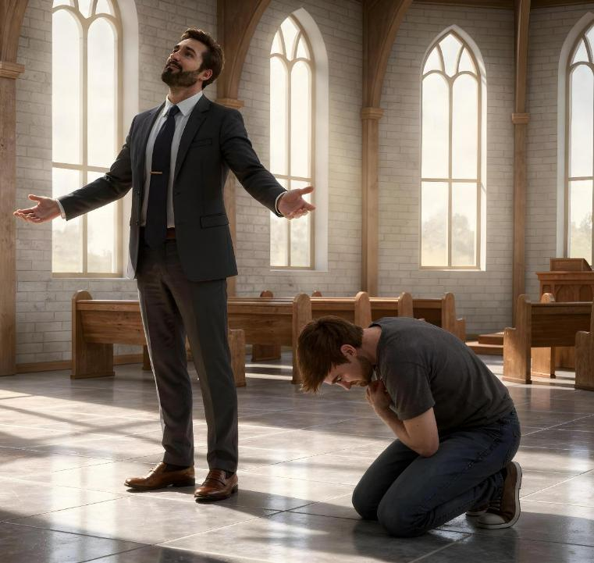
KUDZIKWEZA KAPENA KUDZICHEPETSA
Phunziro 3, April 18, 2026

Slide 2

“Pakuti aliyense wodzikuza adzamuchepetsa, ndipo aliyense wodzichepetsa adzamukweza.”
(Luka 14:11, CCL)

Slide 3


Kodi ndi chiyani chomwe chili chamtengo wapatali mwa ine? Iri ndifunso lovuta kuyankha.
Ngati ndinena zambiri (kudzikuza), ndimavomereza kuti zonse zomwe ndili nazo ndazipeza ndekha.
Nanga ndikanena zambiri chifukwa choti ndine mwana wa Mulungu?
Ngati sindinena kanthu (kudzichepetsa), ndimavomereza kuti zonse zomwe ndili nazo zimachokera kwa Mulungu.
Nanga bwanji ndikakhala chete osalankhula chifukwa chodzidelera?
Zitsanso za Kudzikuza
Lusifala
Ophunzira a Yesu
Zitsanzo za Kudzichepetsa
Wokhometsa misonkho
Mose
Yesu, chitsanzo changwiro

Slide 4

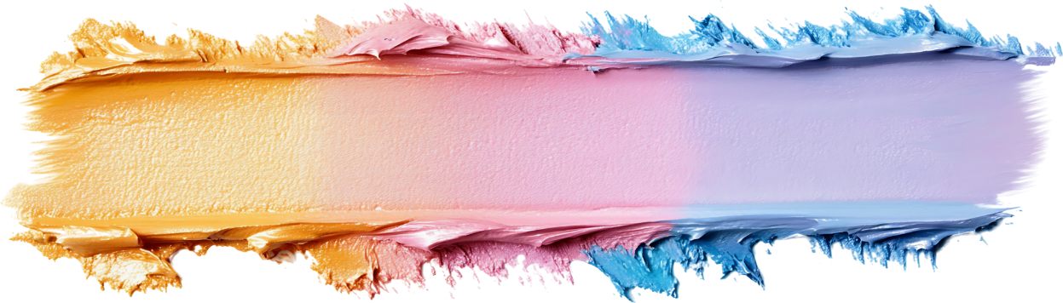
ZITSANZO ZA KUDZIKUZA

Slide 5





LUSIFALA
“Pakuti zonse za mʼdziko lapansi, zilakolako za thupi, zinthu zimene maso amakhumbira ndiponso kuyandikira zinthu za moyo uno, zonsezi sizichokera kwa Atate, koma ku dziko lapansi” (1 Yohane 2:16)
Ngati tikamba za kudzikuza, tiyenera kulankhula za amene maganizo amenewa anayambira: Lusifala. Iye anasankha kusakhutira ndi udindo wake, koma ankafuna kukwera kukhala paudindo wapamwamba. Patapita nthawi, analakalaka kukwezedwa kwambiri moti anayamba kufuna kukhala pa mpando wachifumu wa Mulungu (Yesaya 14:12-14).
Talandira "cholowa" cha chikhumbo chofuna kuchita chilichonse chimene chatikondweretsa, kukhala ndi chilichonse chimene tikufuna, ndi kufunafuna maudindo amene amatilola kupeza kutchuka kapena chuma. Izi ndi zomwe dziko limatipatsa! (1 Yohane 2:16).
Koma si zilakolako zonse zimene zili kudzikuza. Chisangalalo chochokera pa kupambana kwa mwana, kapena kukwaniritsidwa kwa zokhumba za munthu, sizitanthauza kudzikuza.
Chofunika kukumbukira ndi chakuti zinthu zathu, maluso athu, ndi zimene takwaniritsa sizimatsimikizira kufunika kwathu. Kudzikuza kumatanthauza kusapereka ulemerero kwa Mulungu chifukwa cha zimene Iye akuchita m’miyoyo yathu.

Slide 6



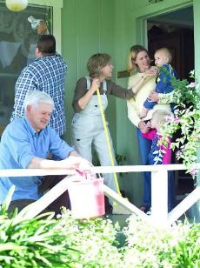

OPHUNZIRA AYESU
“Komanso mkangano unabuka pakati pawo kuti ndani mwa iwo amene amaganiziridwa kukhala wamkulu” (Luka 22:24)
Iwo anali atakhala zaka zoposa zitatu ndi Yesu. Iye anali atangotsuka kumene mapazi awo ndikuwauza za mwazi Wake wokhetsedwa chifukwa cha onse. Komabe, pamene ankadya chakudya chamadzulo, zokambirana zawo sizinali zokhudza zimenezi: ndani mwa iwo anali wamkulu kuposa ena? (Luke 22:24).
Kudzikuza kwawo kunawachititsa kukhulupirira kuti iwo ndi oyenera kukhala pamalo apamwamba. Iwo analephera kumvetsa kuopsa kwa maganizo awo. Iwo anali kukankhira Mulungu kutali ndi mitima yawo chifukwa cha kudzikuza kwawo.
Yesu ananena mwachindunji kuti: “Koma ndili pakati panu ngati mmodzi wokutumikirani.” (Luka 22:27). M’mawu ena: ngati mukufuna kukhala wamkulu ngati Mbuye wanu, tumikirani ena.
Kudzikuza kwathu kumatitsimikizira kuti ndife oyenera kutumikiridwa ndi ena (ndife abwino kuposa iwo). Tikufunika chisomo cha Mulungu kuti tikhale atumiki odzichepetsa.

Slide 7

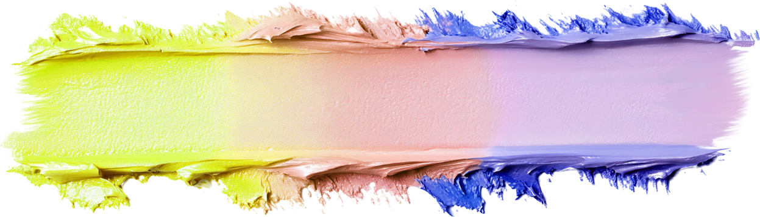
ZITSANZO ZA KUDZICHEPETSA

Slide 8





WOKHOMETSA MISONKHO
“Koma wolandira msonkhoyo ali chiyimire potero, sanathe nʼkomwe kuyangʼana kumwamba; koma anadziguguda pachifuwa ndipo anati, ‘Mulungu, chitireni chifundo, ine wochimwa!’ ” (Luka 18:13)
Mfarisi anali kuuza Mulungu za ntchito zabwino zimene ankachita komanso za makhalidwe amene anali nawo pamaso pa Mulungu. Koma Yesu ananena kuti iye “anapemphera kwa iye yekha,” osati kwa Mulungu (Luka 18:11-12). Chitsanzo changwiro cha kudzikuza.
Wokhometsa msonkho anali kupempha Mulungu kuti amuthandize, chifukwa anali wochimwa (Luka 18:13). Podzipereka yekha kwa Mulungu, “anapita kunyumba kwake wolungamitsidwa,” chifukwa “yense wodzikuza adzachepetsedwa; ndipo wodzichepetsa adzakwezedwa.” (Luka 18:14).
Kudzichepetsa kwenikweni kumayamba tikavomereza machimo athu ndi kupempha thandizo la Khristu. Kenako …
Sitidzaona ena ngati otsika kuposa ife (Afilipi 2:3)
Sitidzafuna kudziwika ndi anthu onse (Luka 14:7-11)
Tidzalola ena kutipatsa ulemu (Masalimo 27:2)
Tidzalandira chisomo cha Mulungu (Yakobo 4:6)
Tidzapereka chisomo chimenecho kwa ena (1 Petro 4:10)

Slide 9

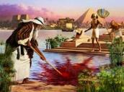






“Ndi chikhulupiriro Mose atakula, anakana kutchedwa mwana wa mwana wamkazi wa Farao, Iye anasankha kuzunzika nawo limodzi anthu a Mulungu kuposa kusangalala ndi zokondweretsa za uchimo kwa nthawi yochepa.” (Ahebri 11:24-25)
MOSE
Mose anaphunzitsidwa kukhala Farao wotsatira wa ku Igupto. Anali katswiri wa zandale komanso anali ndi nzeru zochuluka (Machitidwe 7:22). Ali ndi zaka 40, iye anasankha kusiya zonsezi ndikugwirizana ndi anthu ake (Ahebri 11:24-25).
Iye anali womasula! Dzanja lake lamphamvu likanamasula abale ake! Cholakwika chachikulu. Mulungu sakanamugwiritsa ntchito pamene anali ndi kudzikuza koteroko.
Zaka zina 40 ali m’chiyanjano ndi Mulungu m’chipululu zinamupanga kukhala munthu wodzichepetsa kwambiri (Numeri 12:3). Tsopano akanatha kugwiritsidwa ntchito ndi Mulungu kutumiza miliri; kuwoloka nyanja; kulandira malamulo khumi; kulankhula ndi Mulungu maso ndi maso; kumenya thanthwe… Anathanso kuvomera modzichepetsa chilango cha ntchito yake ya kunyada, podzitengera ulemerero pa zimene anachita (Numeri 20:10-12 (Numeri 20:10-12).
Chitsanzo cha Mose chikutisonyeza kuti kudzichepetsa sikumangobwera mwa ife tokha, koma tiyenera kupempha Mulungu kuti atidzadze nako tsiku ndi tsiku.

Slide 10





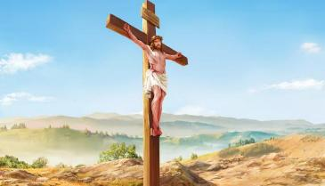
YESU, CHITSANZO CHANGWIRO
“Ndipo pokhala munthu choncho anadzichepetsa yekha ndipo anamvera mpaka imfa yake, imfa yake ya pamtanda!!” (Afilipi 2:8)
Palibe munthu m’dziko lino amene anakhalapo—kapena adzakhalepo—ndi ukulu umene Yesu anali nawo asanabadwe monga munthu. Koma, anasiya zonse chifukwa cha chikondi chake pa ife. Tikayang’anizana ndi kudzichepetsa kotereku, zonse zimene tili nazo, zonse zimene tili, kapena zonse zimene tingathe kukhala, zimaoneka zopanda pake poyerekezera ndi zimenezo.”
Yesu anasiya Kumwamba kuti adzafe m’malo mwa anthu ndi chiyembekezo choti tidzamvetsa ntchito yake ya chisomo ndikuvomereza kuitana kwake kuti tikhale naye pa ubwenzi (Afilipi 2:5-8). Mosakayikira, Iye ndiye chitsanzo changwiro cha kudzichepetsa.
“Maganizo awa akhale mwa inu amene analinso mwa Khristu Yesu” (Afilipi 2:5).
Potsatira chitsanzo Chake, “Musachite kalikonse ndi mtima odzikonda chabe kapena odzitukumula chabe. Koma khalani odzichepetsa ndipo aliyense aziona mnzake ngati womuposa iyeyo. Musamangofuna zokomera inu nokha koma aliyense adzifuna zokomeranso ena” (Afilipi 2:3-4).

Slide 11

“Ndidzakuyamikani Yehova ndi mtima wanga wonse;
ndidzayimba nyimbo zokutamandani pamaso pa “milungu.”
Ndidzagwada kuyangʼana ku Nyumba yanu yoyera
ndipo ndidzayamika dzina lanu
chifukwa cha chikondi chanu ndi kukhulupirika kwanu,
pakuti Inu mwakuza dzina lanu ndi mawu anu
kupambana zinthu zonse.
Pamene ndinayitana, munandiyankha;
munandisandutsa wamphamvu ndi wolimba mtima.
Mafumu onse a dziko lapansi akuyamikeni Yehova,
pamene amva mawu a pakamwa panu.
Iwo ayimbe za njira za Yehova,
pakuti ulemerero wa Yehova ndi waukulu.
Ngakhale kuti Yehova ngokwezeka, amasamalira odzichepetsa,
koma anthu onyada amawadziwira chapatali.
Ngakhale ndiyende pakati pa masautso,
mumasunga moyo wanga;
mumatambasula dzanja lanu kutsutsana ndi mkwiyo wa adani anga,
mumandipulumutsa ndi dzanja lanu lamanja.
Yehova adzakwaniritsa cholinga chake pa ine;
chikondi chanu chosasinthika Yehova, ndi chosatha
musasiye ntchito ya manja anu!”
Masalimo 138 CCL

Slide 12

“M’kudzikuza, kudzitamandira, ndi kunyada muli kufooka kwakukulu; koma m’kudzichepetsa muli mphamvu zazikulu. Ulemu wathu weniweni siungasungidwe pamene timadziganizira ife tokha kwambiri, koma pamene Mulungu ali m’maganizo mwathu onse ndipo mitima yathu ikuyaka ndi chikondi kwa Mpulumutsi wathu komanso chikondi kwa anthu anzathu. Kukhala makhalidwe wosavuta ndi mtima wodzichepetsa kudzabweretsa chimwemwe, pamene kudzikuza kudzabweretsa kusakhutira, kudandaula, ndi kukhumudwa kosalekeza. Kuphunzira kuganiza zochepa za ife tokha ndi kuganizira kwambiri kusangalatsa ena kumene kudzabweretsa kwa ife mphamvu yaumulungu.”
EGW (Testimonies for the Church, vol. 3, p. 476)

