Slide 1

ANTHU OPEMPHERA
Phunziro 6, May 9, 2026

Slide 2

“Ndimakonda Yehova pakuti Iyeyo amamva mawu anga; Iye amamva kulira kwanga kopempha chifundo. Pakuti ananditchera khutu, ndidzayitana Iye masiku onse a moyo wanga.” (Masalimo 116:1, 2, CCL)

Slide 3


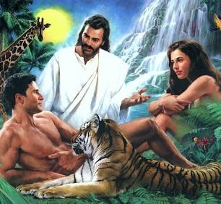

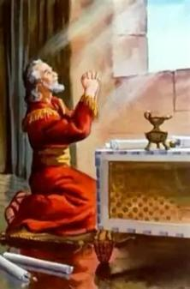
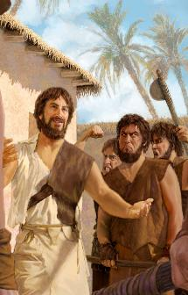
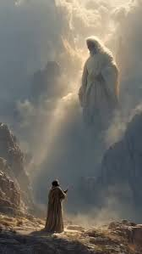


Zolengedwa zonse, kuphatikizapo anthu, zinalengedwa ndi Mulungu ndi kuthekera kolankhulana wina ndi mnzake, komanso ndi Iye.
Mwatsoka, anthu anataya mwayi olankhula ndi Mulungu mwachindunji pamene Adamu ndi Hava anachimwa.
Koma Mulungu anatisiyira mphatso. “telefoni” imene imatithandiza kupitiriza kulankhula ndi Iye: pemphero.
Danieli, Enoke, ndi Mose ndi zitsanzo za mmene tingagwiritsire ntchito mphatso yamphamvu imeneyi.
Danieli:
  Kupemphera pa nthawi zoopsa
  Pempherani moyenera
Enoke:
  Moyo wopempherera
Mose:
  Kulankhula ndi Mulungu
  Pemphero lopembedzera

Slide 4

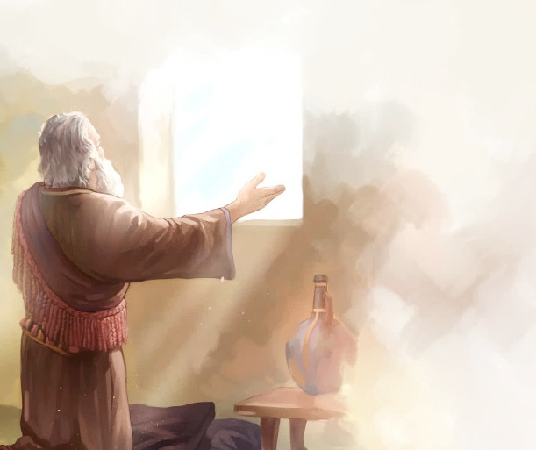
DANIELI

Slide 5

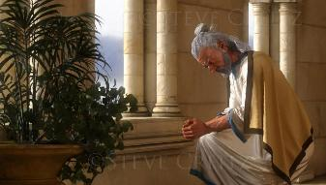
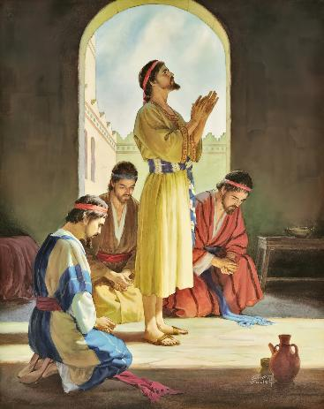
















KUPEMPHERA PA NTHAWI YOOPSA
“Choncho ndinatembenukira kwa Ambuye Mulungu ndipo ndinamudandaulira ndi kupempha posala kudya, ndi kuvala chiguduli ndi kudzola phulusa”.(Danieli 9:3)
Chifukwa chodalira Mulungu, Danieli analandira nzeru, luso lomasulira maloto, ndi chidziwitso (Danieli 1:8, 17, 20). Pamene moyo wake ndi wa anzake unali pa chiopsezo, anatembenukira kwa Mulungu mu pemphero (Danieli 2:17-23).
Atakhala moyo wa pemphero, kodi ndi makhalidwe otani amene Danieli anali nawo (Danieli 6:3-5 )?
WOYANG’ANIRA
WABWINO
WOKHULUPIRIKA
WAKHAMA
WOSAPSYA
WODALIRIKA
WOLEMEKEZEKA
WOKHULUPIRIKA NDI WODALIRIKA
WOKPANDA KHALIDWE
LOIPA

Slide 6

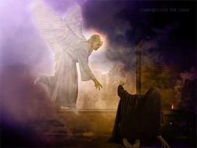
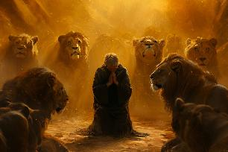
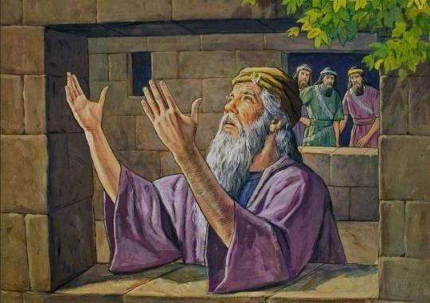
KUPEMPHERA PA NTHAWI YOOPSA
“Choncho ndinatembenukira kwa Ambuye Mulungu ndipo ndinamudandaulira ndi kupempha posala kudya, ndi kuvala chiguduli ndi kudzola phulusa.” (Daniel 9:3)
Kumwamba kunali tcheru kumvetsera pemphero la Danieli (Danieli 9:20-23; 10:12 ). Pokhapokha ngati mgwirizano umenewu utachotsedwa adani ake akanatha kumupweteka (Danieli 6:5-7).
Poyang’anizana ndi chiwopsezo cha imfa chatsopanochi, Danieli anapitirizabe chizolowezi chake chopemphera (Danieli 6:10 ):
Anali wokhazikika, amapemphera katatu patsiku
Zinali zodziwika, amatsegula zenera lake kuloza ku Yerusalemu
Anali ndi zizolowezi zapadera; amapemphera atagwada
Linali lolunjika pa chiyamikiro ndi kupempha

Slide 7

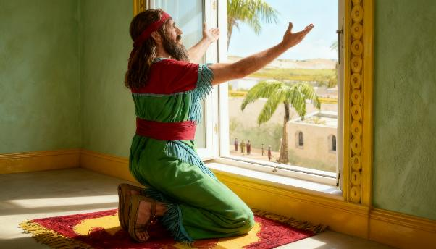


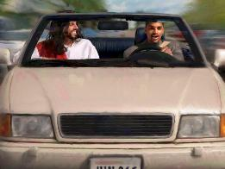
PEMPHERANI MOYENERA
“Danieli atamva kuti lamulo lasindikizidwa, anapita ku nyumba kwake nalowa mʼchipinda chapamwamba chimene mazenera ake anali otsekula kuloza ku Yerusalemu. Katatu pa tsiku iye ankagwada pansi pa mawondo ndipo amapemphera, kuyamika Mulungu wake, monga momwe ankachitira kale. ” (Daniel 6:10)
Pamene tikupemphera, timalankhula ndi Mulungu ngati kuti tikulankhula ndi bwenzi lathu. Koma, Mulungu sali ngati ife. Iye ndiye Mfumu ya Chilengedwe Chonse.
Pachifukwa chimenechi, chinali chizolowezi cha Danieli kugwada pamaso Pake popemphera, kumuzindikira Iye kukhala Wolamulira wake Wamphamvuyonse.
Popeza tingapemphere kwa Mulungu mulimonse momwe zinthu zilili komanso nthawi iliyonse, nthawi zina sizingatheke kapena sikofunikira kuchita izi.
Kutseka maso athu kumatithandiza kuti tiganizire kwambiri papemphero, koma nthawi zina sizingatheke (kuyenda, kuyendetsa galimoto, ndi zina zotero).
Chofunika ndi chakuti mapemphero athu aziperekedwa mwa ulemu umene Mulungu ayenera kulandira.

Slide 8

PEMPHERANI MOKHAZIKIKA
“Danieli atamva kuti lamulo lasindikizidwa, anapita ku nyumba kwake nalowa mʼchipinda chapamwamba chimene mazenera ake anali otsekula kuloza ku Yerusalemu. Katatu pa tsiku iye ankagwada pansi pa mawondo ndipo amapemphera, kuyamika Mulungu wake, monga momwe ankachitira kale.” (Danieli 6:10)
M’Baibulo timapezamo zitsanzo za anthu amene anapemphera mosiyanasiyana malinga ndi mmene zinthu zinaliri pa moyo wawo.
Yehosafati anapemphera ataimirira pamaso pa anthu (2 Mbiri 20:5)
Davide anakhala pamaso pa Mulungu kuti ayamike
(2 Samuel 7:18 )
Solomoni anapemphera atagwada, manja ake ali m’mwamba
(1 Mafumu 8:54)
Anthu anagwada pansi ndi kupemphera
(Nehemiya 8:6 )
Davide anapemphera chafufumimba pakama wake
(1Mafumu 1:47 )
Nehemiya anayima ndipo anapemphera mwakachetechete pamaso pa mfumu
(Nehemiya 2:1-4)
Mosasamala kanthu za kaimimidwe ngakhale kugwada kwathu, Baibulo limatilimbikitsa kupemphera mosalekeza (1 Atesalonika 5:17), molimbika (Akolinto 4:2, Aroma 12:12 ).

Slide 9

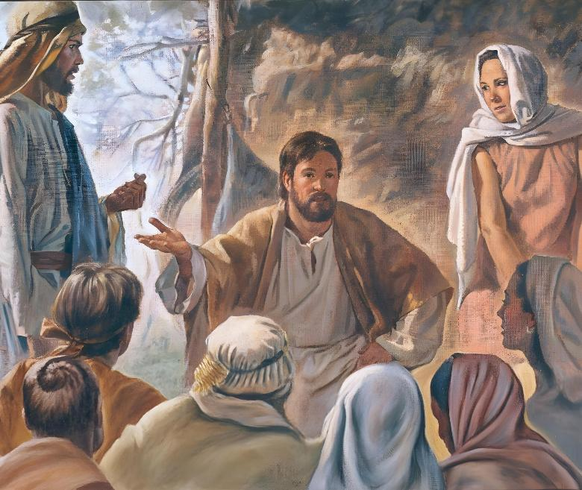
ENOKI

Slide 10

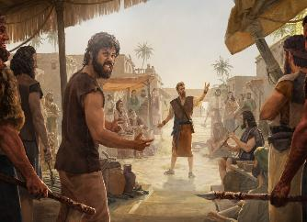
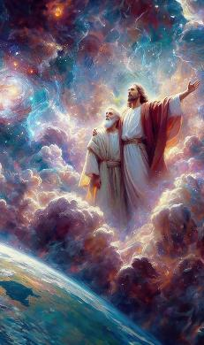
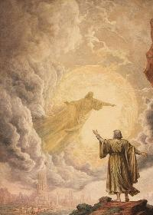
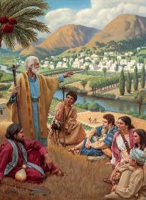

MOYO WOPEMPHERA
“Enoki anayenda ndi Mulungu; ndipo iye sanaonekenso chifukwa Mulungu anamutenga.” (Genesisi 5:24)
Enoki ankakhala munthawi zovuta, pamene kuipa kwa anthu a m’nthawi ya chigumula kunapitirira kukula. Ndi kubadwa kwa mwana wake wamwamuna, kumvetsetsa kwake za Mulungu kunakula, ndipo kuyanjana kwake ndi Iye kunakula kwambiri (Genesis 5:21-24).
Pemphero linali gawo lofunika pa ubale umenewo. Pamene ntchito yake inkakhala yofunika ndi yadzidzidzi kwambiri, mapemphero ake ankakhala okhazikika komanso achangu kwambiri. Nthawi zina, iye ankapatuka kupita m'malo apadera kuti akhale kwambiri m’kuyanjana ndi Mulungu. Koma, nthawi zonse ankabwerera kwa anthu kuti agawane nawo zimene amadziwa za Mulungu.
Mulungu amatimva m’chipwirikiti cha moyo watsiku ndi tsiku komanso m’malo abata. Palibe malo padziko lapansi amene Iye sangathe kutiona kapena kutimva. Titha kufotokoza pemphero lathu ndi mawu (zomwe zimatithandiza kuti tiganizire kwambiri zimene tikunena), kapena titha kuchita zimenezi mwakachetechete (zomwe zimatithandiza kufotokoza maganizo athu). Chofunika kwambiri ndicho kusasiya kulankhulana ndi Mulungu mupemphero.

Slide 11

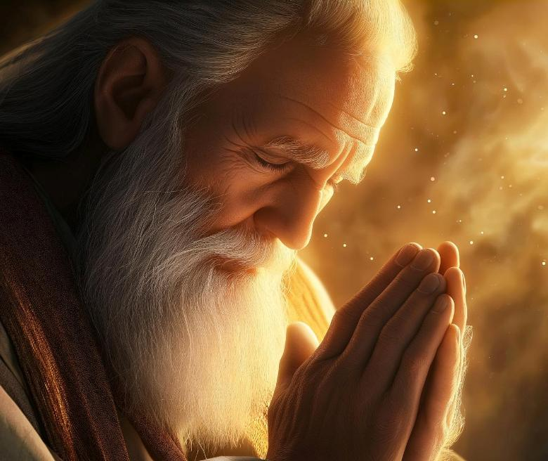
MOSE

Slide 12


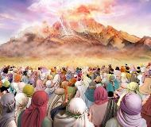
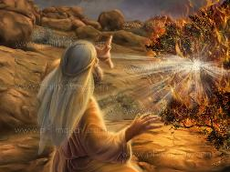
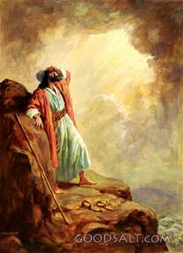
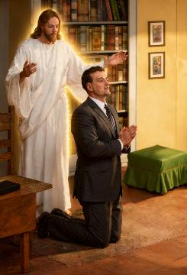
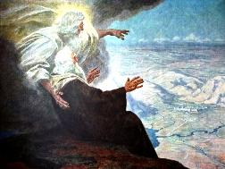
KULANKHULANA NDI MULUNGU
“Kuyambira nthawi imeneyi, mu Israeli simunakhalepo mneneri wina aliyense wofanana ndi Mose, amene Yehova amayankhula naye maso ndi maso.” (Deuteronomo 34:10)
Aisiraeli atamva mawu a Mulungu akulankhula ku Sinai, anapempha kuti asalankhulenso naye maso ndi maso, chifukwa ankaopa kufa chifukwa cha mawu ake (Eksodo 20:18-19).
Izi zinali zosiyana ndi Mose, yemwe amalankhula ndi Mulungu maso ndi maso (Deuteronomo 34:10). Kwa zaka 40 (kuyambira pa chitsamba choyaka moto mpaka imfa yake), Mose ndi Mulungu anali kukhala ndi zokambirana zokhazikika (Eksodo 33:9-11).
Baibulo limatchula nthawi zingapo za masiku 40 zimene Mulungu anapereka kwa Mose malangizo apadera okhudza kumanga chihema komanso kumufotokozera malamulo osiyanasiyana. Pa zokambirana zimenezi ankapempherera komanso kupembedzera anthu.
Tilibe mwayi wolankhula ndi Mulungu maso ndi maso, koma pemphero litseka vuto limeneli potilola kulankhulana naye mwachindunji.

Slide 13



PEMPHERO LOPEMBEDZERA
“Ndipo Yehova anakwiya ndi Aroni ndipo akanamuwononga, koma ine ndinamupemphereranso Aaroniyo. ” (Deuteronomo 9:20)
Pemphero lopembedzera ndi limene timapempherera anthu ena (Yakobo 5:16; Mateyu 5:44; 1 Timoteo 2:1-4).
Mose anapembedzera Mulungu kwa ena nthawi zosiyanasiyana komanso pazifukwa zosiyanasiyana:
KWA ABANJA LAWO
⁕ Chifukwa cha tchimo la Aroni
(Deuteronomo 9:20)
⁕ Chifukwa chong’ung’udza kwa Maria
(Numeri 12:10-13)
KWA ANTHU
⁕ M’mene anali ndi ludzu
(Eksodo 15:24-25)
⁕ M’mne anali ndi njala (Numeri 11:11-13)
⁕ M’mene analakwa
(Eksodo 32:30-32)
N’chiyani chinachititsa Mose kupempherera ena?
Chinthu chomwecho chiyenera kutilimbikitsa: kukonda anthu amene timawapempherera.

Slide 14

“Tiyenera kupemphera m’banja, koma koposa zonse sitiyenera kunyalanyaza pemphero lachinsinsi, chifukwa liri moyo wa mzimu. Ndikosatheka kuti moyo wa uzimu utukuke pamene pemphero lanyalanyazidwa. Pemphero la pabanja kapena la pagulu lokha silikwanira. M’malo a mtseri, lolani moyo wanu wutseguke pamaso pa Mulungu amene amaona zonse. Pemphero lachinsinsi liyenera kumveka ndi Mulungu yekha amene amamva mapemphero. Palibe khutu lachidwi limene liyenera kulandira kulemera kwa zopempha zimenezo. Mu pemphero lachinsinsi, mzimu umakhala womasuka ku zinthu zozungulira, womasuka ku chisokonezo. Mwakachetechete koma mwachangu, umayandikira kwa Mulungu. Mphamvu yofatsa komanso yokhalitsa idzachokera kwa Iye amene amaona zachiinsinsi, amene khutu lake lili lotseguka kumva pemphero lotuluka m’mtima.”
EGW (Steps to Christ, p. 98)

