Slide 1





Phunziro 11 June 13, 2026
ZOPINGA

Slide 2


“Koma si pokhapo ayi, koma ife tikukondweranso mʼmasautso athu chifukwa tikudziwa kuti masautso amatiphunzitsa kupirira. Ndipo kupirira kumabweretsa makhalidwe, makhalidwe amabweretsa chiyembekezo. Ndipo chiyembekezo chimenechi sichitikhumudwitsa chifukwa Mulungu mwa Mzimu Woyera, amene Iye anatipatsa, wadzaza mʼmitima mwathu ndi chikondi chake”(Aroma 5:3–5, CCL)

Slide 3
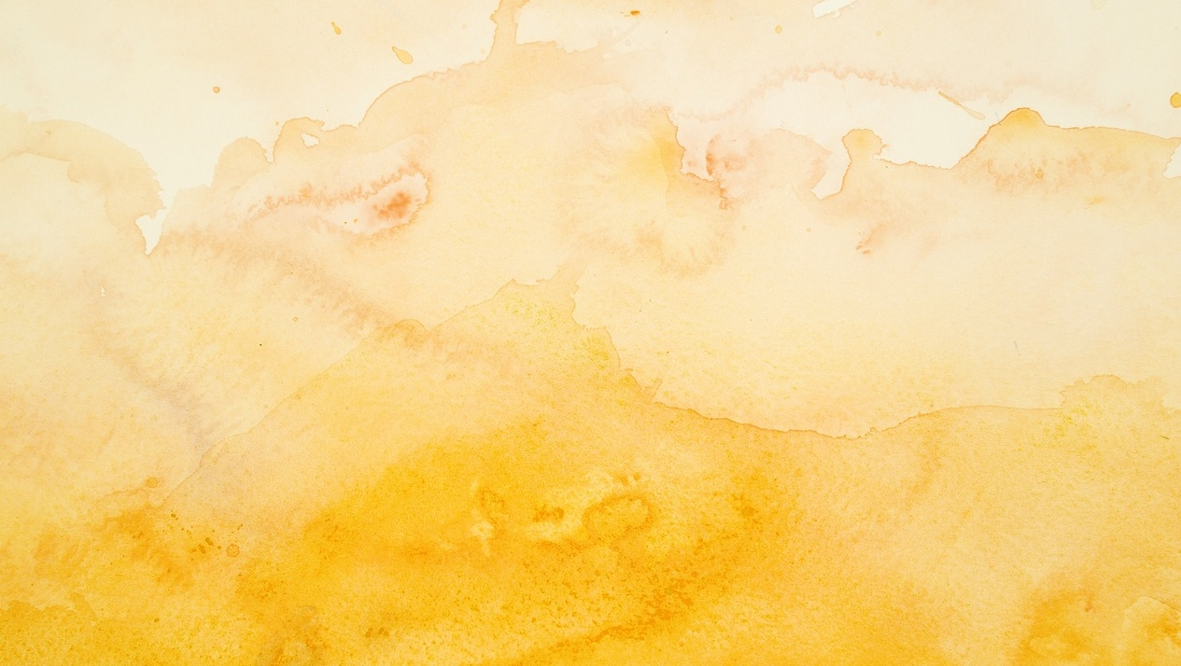

Tikukhala m'dziko lodzala ndi uchimo ndi kuvutika. Tonsefe timakumana ndi mavuto nthawi zina omwe angatipangitse kukayikira chikondi cha Mulungu.
Kodi timatani tikakumana ndi zovuta zimenezi?
Tiphunzira momwe anthu ena omwe anatchulidwa m'Baibulo anayankhira pa zochitika zosiyanasiyana zovuta, komanso mmene chitsanzo chawo chingatithandizire kuthana ndi mavuto ofanana nawo.
Mkuntho wa moyo
Matenda
Matsoka
Zokhumudwitsa
Kuona Yesu

Slide 4




MKUNTHO WA MOYO
“Mphepo yamkuntho inabuka, ndipo mafunde anawomba bwatolo, kotero kuti linali pafupi kumira” (Marko 4:37)
Kuwoloka Nyanja ya Galileya pakati pa usiku, ngakhale mu mkuntho, chinali si chinthu chachilendo kwa Petro, Andreya, Yakobo ndi Yohane, omwe anali asodzi odziwa bwino ntchito yawo.
Koma, mkunthowo udawapitirira mphamvu. Mphepo yamphamvu inachititsa mafunde kukwera kwambiri moti bwato linayamba kudzaza ndi madzi, ndipo miyoyo yawo inali pa chiopsezo. Kenako anayamba kudzifunsa kuti: ‘Kodi Yesu ali kuti? Kodi akugona? N’chifukwa chiyani sakutithandiza? Kodi sasamala zimene zikuchitika kwa ife?’ (Marko 4:35-38)."
Nafenso m'miyoyo yathu timakumana ndi mikuntho ya moyo. Timapempha Yesu kuti atithandize, koma nthawi zina zimaoneka ngati akugona. Sitimva kupezeka kwake, koma iye amakhala nafe nthawi zonse.
Akuyembekezera nthawi yoti adzudzule mphepo yamkuntho ya moyo wathu kuti: “Khala bata, chete!” (Marko 4:39). Iye amatisamalira (1 Petro 5:7). Iye akhoza kutonthoza mphepo yamkuntho m’moyo wathu. Musaiwale kumutamanda Iye akatero (Marko 4:40-41).

Slide 5





MATENDA
“chifukwa anaganiza kuti, “Ngati nditangokhudza mkanjo wake, ndidzachiritsidwa, ”(Marko 5:28 NIV)
Mayi ameneyu anavutika ndi matenda otaya magazi kwa zaka khumi ndi ziwiri. Anawononga zonse zimene anali nazo pofuna kupeza chithandizo, koma sanapeze dokotala amene akanamuchiritsa. Zimenezi zinamupanga kukhala wosauka komanso wopanda chiyembekezo (Marko 5:25-26). Masiku ano, pali mayiko omwe mulibe thandizo laulere la zamankhwala, ndipo nkhani imeneyi ikhoza kukhala ikuchitikabe mpaka pano.
Kaya zikhale bwanji, tonse titha kukumana ndi zochitika zimene matenda amanditsekera m'ndende komanso kutipanikiza, popanda kupeza mpumulo.
Mayi ameneyo anaona kuti Yesu ndiye yankho la mavuto ake, ndipo chifukwa cha chikhulupiriro chake anachiritsidwa ndi kupulumutsidwa (Marko 5:27-29).
Tiyenera kukhala ndi chikhulupiriro kuti Yesu angagwiritse ntchito madokotala odziwa bwino ntchito yawo kuti atichiritse, komanso angathe kuchita zozizwitsa mwachindunji m'miyoyo yathu.
Mulimonsemo, Yesu amatipempha kuti tipereke kwa Iye zolemetsa zathu zonse ndi nkhawa zathu zonse.
(Mateyu 11:28-30).

Slide 6





MATSOKA
“Ndipo khungu langa litaonongeka,
pamenepo wopanda thupi langa, ndidzapenya Mulungu, (Yobu 19:26)
Nkhondo, chiwawa, ndi masoka achilengedwe zinasintha kwambiri moyo wa Yobu (Yobu 1:13-19). Tonsefe tili pachiwopsezo chokumana ndi masoka, kaya achilengedwe kapena oyambitsidwa ndi kuipa komwe kuli m’dziko lino.
Kodi tingadzatani? Kodi Yobu anatani?
Sanamuimbe mlandu Mulungu kapena kumukana
Anamamatira kwa Iye ndi mphamvu zake zonse
Iye ankadalira ngakhale nthawi zovuta kwambiri
Iye anaika maganizo ake pa tsogolo labwino
(Yobu 19:25-27)
Ngati sititaya mtima, tidzaona kuti ngakhale m’mayesero athu ovuta kwambiri, Mulungu amakhala nafe nthawi zonse. Iye amatikonda ndipo amatipatsa mphamvu kuti tipeze mphamvu m’kufooka, chilimbikitso m’kukhumudwa, ndi chiyembekezo pakati pa tsoka (Yoweli 3:10; Aroma 5:3-5).
Ngati mukukumana ndi mavuto, ganizirani mfundo yakuti chikondi ndi chisamaliro cha Mulungu pa inu ndiye chinthu chotetezeka komanso chokhazikika kwambiri pamoyo wanu.

Slide 7






ZOKHUMUDWITSA
“Ndipo tinayembekeza ife kuti Iye ndiye wakudzayo kudzaombola Israele. …” (Luka 24:21a)
Chiyembekezo chinali ichi: Yesu ndiye Mesiya amene adzawombola Israeli. Koma zenizeni zake zinali izi: Iye anamwalira (Luka 24:18-21).
Kukhumudwa kwawo kunali kwakukulu kwambiri moti sanathe kuvomereza ngakhale umboni woonekeratu wa kuuka kwa Yesu kwa akufa (Luka 24:22-24).
Moleza mtima, Yesu anawathandiza kuti akhalenso ndi chiyembekezo. Pomaliza, “maso awo anatseguka” (Luka 24:31), ndipo anathamanga kukalimbikitsa omwe anali okhumudwabe (Luka 24:32–35; 2 Akorinto 1:4). Kodi tingaphunzire chiyani kuchokera ku zomwe adakumana nazo?
Sitiyenera kulola kukayikira kuzika mizu m'maganizo mwathu
Yesu amayenda nafe ngakhale titakhumudwa.
Iye adzathetsa mavuto athu, ngati titamulola kutero
Yesu amadziwa bwino kuposa ife momwe zinthu zilili pa moyo wathu
Notes:
Jesus died and was resurrected

Slide 8


KUONA YESU
“Pakuti ndiyesa kuti masauko a nyengo yatsopano sayenera kulinganizidwa ndi ulemerero umene udzaonetsedwa kwa ife. ” (Aroma 8:18)
Pamene Ellen G. White anali m’chisoni chachikulu kwambiri ndi kutaya mtima, analandira masomphenya omwe mwa iwo anaona Yesu.
Anazindikira kuti Yesu amamvetsa zonse zimene ankadutsamo. Panthawi ina, Yesu anaika dzanja lake pamutu pake nati kwa iye, ‘Usaope.”
Iye anaona zinthu zokongola, ndipo zinkaoneka ngati wapeza chitetezo ndi mtendere wakumwamba.
Maloto amenewa adamupatsa chiyembekezo ndi chikhulupiriro, komanso chitsimikizo chakuti akhoza kudalira Mulungu.

Slide 9


“Ndipo tidziwa kuti m'zonse Mulungu agwirira ntchito ubwino kwa iwo amene amamukonda, iwo amene aitanidwa monga mwa cholinga chake.” (Aroma 8:28)
“Musadere nkhawa ndi chilichonse, koma nthawi zonse, mwa pemphero ndi pembedzero, pamodzi ndi chiyamiko, zopempha zanu zidziwike kwa Mulungu. Ndipo mtendere wa Mulungu, wopambana luntha lonse, udzasunga mitima yanu ndi maganizo anu mwa Khristu Yesu." (Afilipi 4:6-7)
“Muchiyese chimwemwe chenicheni, abale anga, pamene mukukumana ndi mayesero amitundumitundu, podziwa kuti kuyesedwa kwa chikhulupiriro chanu kumabweretsa chipiriro. Lolani chipiriro chimalize ntchito yake kuti mukhale angwiro ndi angwiro, osasowa kanthu. […] Wodala iye amene apirira mayesero; pakuti, atapirira mayesero, adzalandira korona wa moyo, amene Ambuye adalonjeza iwo akumkonda Iye.” (Yakobo 1:2-4, 12)
“Koma anati kwa ine, Chisomo changa chikukwanira; pakuti mphamvu yanga imakwaniritsidwa m’ufoko.” Chifukwa chake, ndidzadzitamandira mokondwera kwambiri ndi zofoka zanga, kuti mphamvu ya Khristu ikhale pa ine.” (2 Akorinto 12:9)

Slide 10

“M'zochitikira za anthu onse pamakhala nthawi zokhumudwa kwambiri komanso kutaya mtima kotheratu—masiku amene chisoni chimatengapo gawo pa moyo wake, ndipo zimakhala zovuta kukhulupirira kuti Mulungu akadali Atate wachifundo ndi wokoma mtima kwa ana ake a padziko lapansi. Ndi masiku amene mavuto amazunza mtima kwambiri moti imfa imaoneka yabwino kuposa moyo. Pa nthawi zoterezi, anthu ambiri amataya kugwiritsitsa kwawo pa Mulungu ndipo amagwera mu ukapolo wa kukayika ndi kusakhulupirira.
Koma tikadatha kuona, ndi maso auzimu, tanthauzo la momwe Mulungu akuyendetsera zinthu m'miyoyo yathu, tikanawona angelo akuyesetsa kutipulumutsa kwa ife tokha, akulimbikira kukhazikitsa mapazi athu pa maziko olimba kuposa mapiri osatha. Ndipo chikhulupiriro chatsopano ndi moyo watsopano zikanabadwa ndi kuyamba kukula mwa ife.”
EGW (Prophets and Kings, pg. 163)

