Slide 1
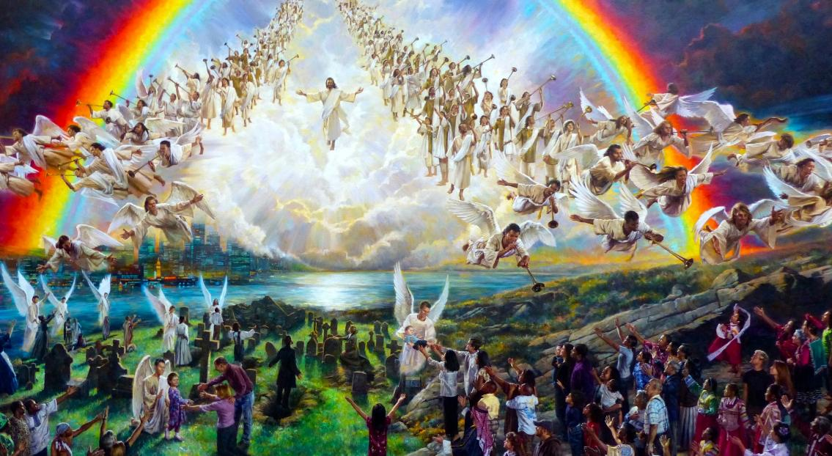
KUFIKIRA MUYAYA
Phunziro 13 June 27, 2026

Slide 2
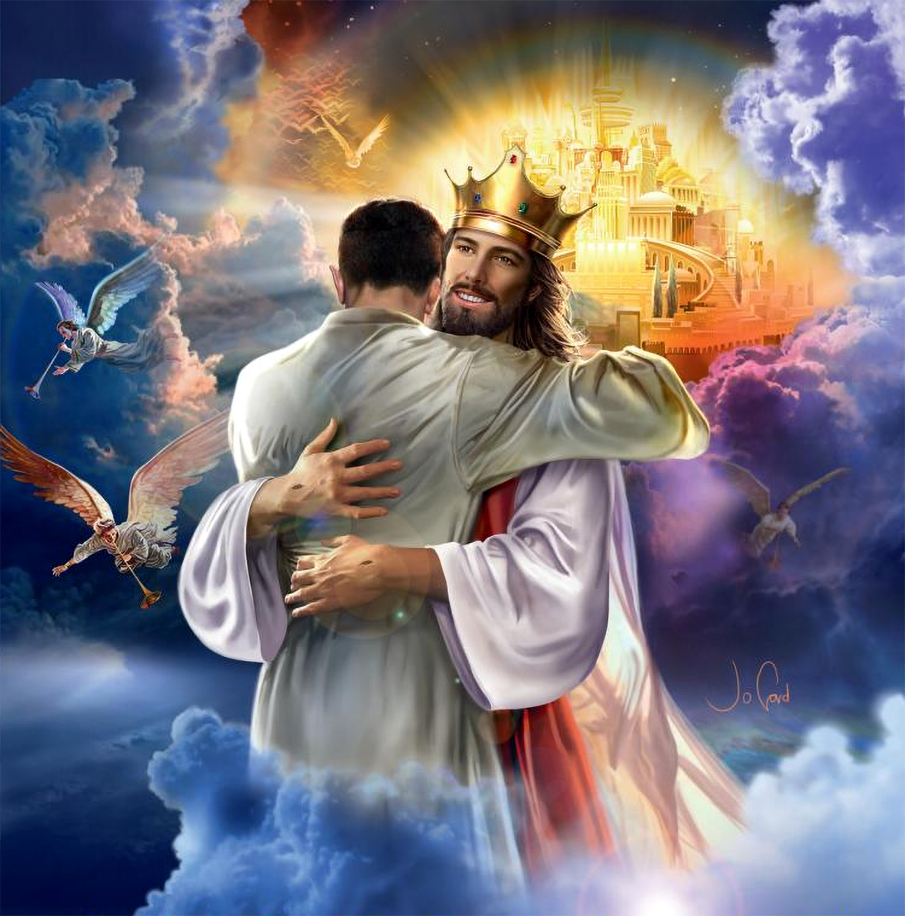

“Abale okondedwa, tsopano ndife ana a Mulungu, ndipo sichinaoneke chimene tidzakhala. Koma tikudziwa kuti Yesu akadzaonekera, tidzafanana naye, pakuti tidzamuona Iyeyo monga momwe alili”
(1 Yohane 3:2, CCL)

Slide 3
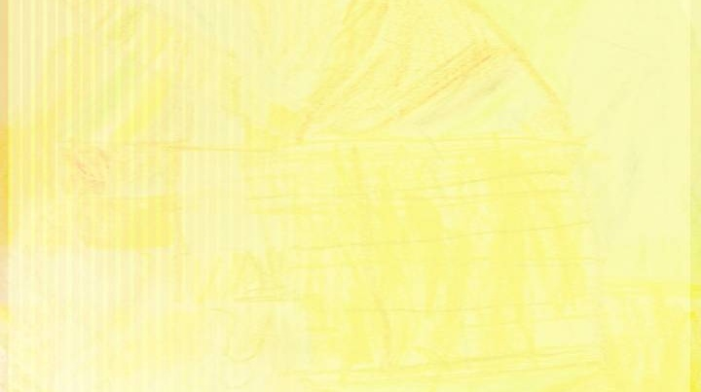
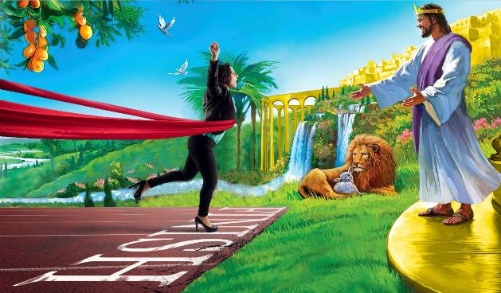
Ngakhale kukhala paubale ndi Mulungu komanso kumudziwa bwino m'moyo wathu wonse kuli kofunika kwambiri, chimenecho si cholinga chenicheni cha Mkhristu.
Nthawi yodikira
Kubwera Kachiwiri
Kufika kwathu
Zomwe tidzachite kwamuyaya?
Udindo wathu
Timayembekezera china choposa pamenepo. Tikufuna kudzakumana maso ndi maso ndi Iye amene tamudziwa ndi kukhala naye paubwenzi pano padziko lapansi.
Kodi kwatsala nthawi yayitali bwanji kuti nthawi imeneyo ifike? Nchiyani chidzachitike pambuyo pake? Kodi chidziwitso ichi chikusintha bwanji moyo wanga wa tsiku ndi tsiku?

Slide 4

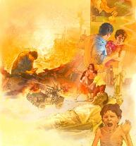
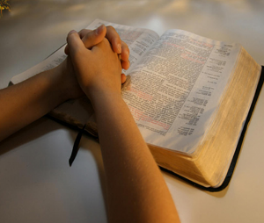
NTHAWI YODIKIRA
“Koma dziwa izi: Mʼmasiku otsiriza kudzafika nthawi zoopsa kwambiri.” (2 Timoteo 3:1)
Yesu anatipatsa zizindikiro zomwe zidzachitike Kubwera Kachiwiri kusanachitike. Ndi mndandanda wa zochitika zomwe zidzazika pafupi ndi nthawi imeneyo (Mateyu 24:6-11):
Nkhondo ndi mbiri za nkhondo
Mitundu kuukirana
Miliri, njala, ndi zivomerezi
Akhristu adzadedwa
Mpatuko waukulu
Aneneri onyenga osocheretsa
Mapu a nkhondo zimene zikuchitikabe:
  Nkhondo Zikuluzikulu(imfa 10,000 kapena kuposa)
  Nkhondo zing’onozing’ono (imfa 1,000-9,999)
  Mikangani (imfa 100-999)
  Mikangano ndi kumenyana(imfa 1-99)
Kuti tisungebe chidaliro chathu m’masiku ovutawa (2 Timoteyo 3:1), tiyenera kukhala ndi ubale wabwino ndi Mulungu, komanso kukhala ndi chitsimikizo chakuti watikhululukira machimo athu ndipo watipulumutsa.
Pakufunika chitsitsimutso chauzimu. Tiyenera kupemphera monga Asafu kuti: ”Mutibwezeretse, Inu Mulungu; muwalitse nkhope yanu pa ife, kuti tipulumuke” (Masalimo 80:3).

Slide 5


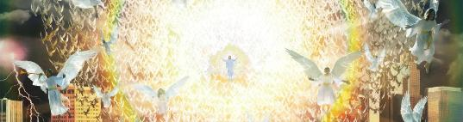
KUBWERA KACHIWIRI
Masoka akuluakulu agwedeza dziko lapansi
(Chivumbulutso 6:12-14)
Chizindikiro cha Mwana wa Munthu chaonekera
(Mtambo waung'ono)
Yesu akuonekera kuchokera m'mitambo
(Chivumbulutso 1:7)
Mau ake adzautsa akufa ndi kusintha amene ali amoyo
(Yohane 5:28; 1 Thessalonians 4:16; 1 Akorinto 15:51-52)
Angelo asonkhanitsa owomboledwa ndi kuwabweretsa kwa Yesu (1 Atesalonika 4:17)
“Ndipo adzatuma angelo ake, ndi kulira kwa lipenga kwakukulu, nadzasonkhanitsa osankhidwa ake kuchokera ku mphepo zinayi, ndi kuchokera kumathero a thambo kufika mbali ina.” (Mateyu 24:31)
Mateyu 24:29–31 akufotokoza mwachidule zochitika zazikulu za Kubwera Kwachiwiri kwa Khristu, ndipo chithunzi cha chochitikachi chimakwaniritsidwa ndi mavesi ena a m’Baibulo:
Pa nthawi imeneyo, pamene lipenga lidzalira ndipo munthu aliyense adzaona Yesu, tidzadziwa kuti kudikira kwathu kunali koyenera. Pemphero lirilonse limene lopirira, nthawi iliyonse imene tinapatulira kwa Iye, nthawi iliyonse imene tinamuyimira molimba mtima, ndi mayesero onse amene tinapirira—zonse zidzafika pachimake pamene tidzaona nkhope yake.

Slide 6

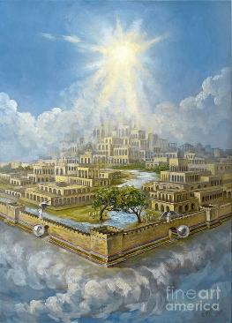
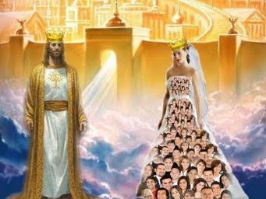
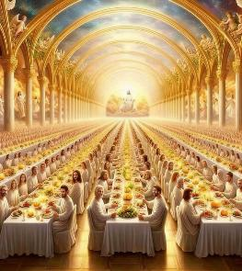

KUFIKA KWATHU
“Mʼnyumba mwa Atate anga muli zipinda zambiri. Kukanakhala kuti mulibemo ndikanakuwuzani. Ine ndikupita kumeneko kukakukonzerani malo?.” (Yohane 14:2)
Kumwamba kuli malo amene Yesu watikonzera, mzinda umene tidzakhalamo: Yerusalemu Watsopano (Yohane 14:2; Ahebri 11:10; Chivumbulutso 21:10).
Mzinda umenewu, pamodzi ndi anthu ake—ife—umatchedwa ‘mkwatibwi wa Mwanawankhosa’ (Chivumbulutso 21:2, 9; 19:7–8).
“Chochitika choyamba chimene tidzakakhale nacho m’nyumba yathu yatsopano chidzakhala chosaiwalika: phwando la ukwati wa Mwanawankhosa (Chivumbulutso 19:9).”
Koma kuti tidzakhale mkwatibwi wa Khristu, tiyenera kuyamba kukhala mkwatibwi wake pano padziko lapansi. Tiyenera kukhala ndi ubale wapamtima ndi Yesu kuyambira tsopano. Kumudziwa. Kulankhula naye tsiku lililonse. Kumukhulupirira. Ndiponso kulakalaka tsiku limene tidzakhala naye kwamuyaya.

Slide 7

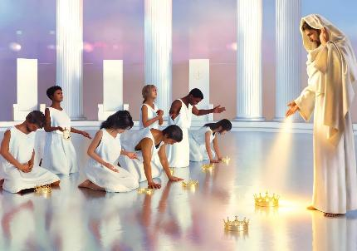
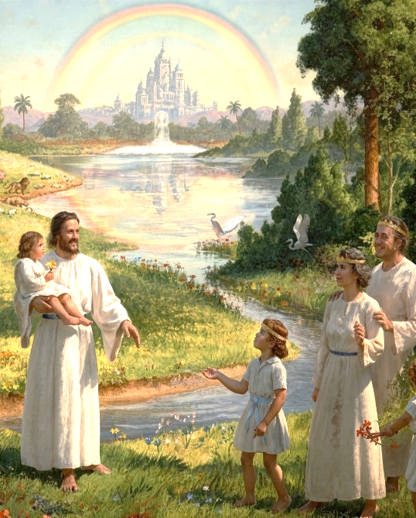
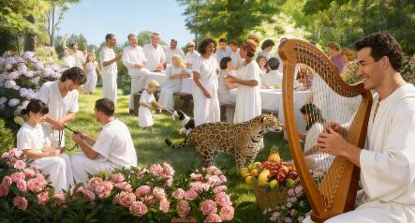
ZOMWE TIDZACHITE KWAMUYAYA?
“Pakuti Mwana Wankhosa amene ali pakati pa mpando waufumu adzakhala mʼbusa wawo. ‘Iye adzawatsogolera ku akasupe a madzi amoyo.’ ‘Ndipo Mulungu adzawapukuta misozi yonse mʼmaso mwawo.” (Chivumbulutso 7:17)
Dalitso lalikulu kwambiri limene tidzakhala nalo Kumwamba lidzakhala kuona Yesu maso ndi maso ndi kumuthokoza chifukwa cha zonse zimene watichitira.
Koma sitidzakhala Kumwamba nthawi zonse. Idzafika nthawi imene tidzatsikira padziko lapansi, komwe kudzakhala kwathu kwamuyaya (Chivumbulutso 21:1–3; Masalimo 37:9). Ngakhale kuti choipa sichidzakhalaponso kumeneko, Yesu adzakhalabe M’busa wathu, ndipo adzatisamalira mwachikondi ndi mwachifundo (Yesaya 25:8; Chivumbulutso 7:17).
Zowonadi, sikhala moyo wopanda chochita. Monga momwe Mulungu anamupatsira munthu ntchito pamene anamulenga, aliyense wa ife adzakhala ndi cholinga kumeneko. Tidzatha kukulitsa chidziwitso chathu ndipo tidzapitiriza kutulukira zozizwitsa zatsopano nthawi zonse.
Mosiyana ndi zomwe zikuchitika masiku ano, nthawi imeneyo maganizo athu adzakhala 100% kwa Mulungu, yemwe chikondi chake chidzasefukira m'ziwalo zonse za thupi lathu (Chivumbulutso 14:1).

Slide 8

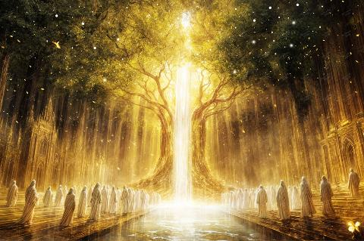
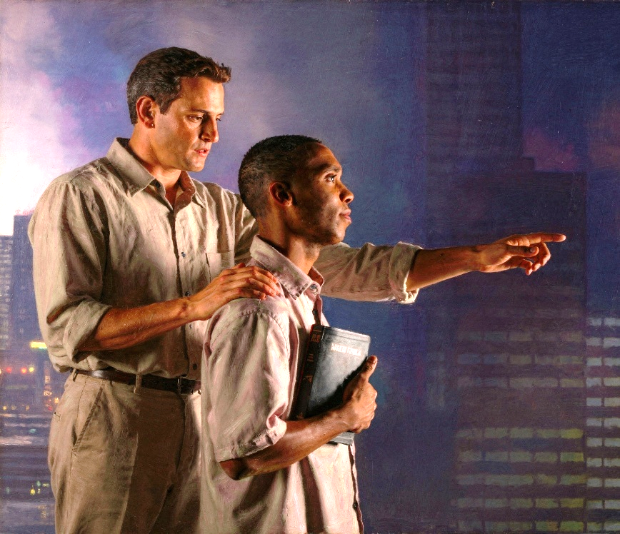
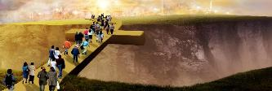
UDINDO WATHU
“Mzimu Woyera ndi mkwatibwi akuti, “Bwerani!” Ndipo amene akumva anena kuti Bwerani! Iye amene ali ndi ludzu abwere, ndipo aliyense amene afuna alandire mphatso yaulere ya madzi amoyo.” (Chivumbulutso 22:17)
Mu Yerusalemu Watsopano—kwathu kwamuyaya—mumayenda mtsinje wa madzi a moyo wochokera ku mpando wachifumu wa Mulungu, umene umathirira mtengo wa moyo (Chivumbulutso 22:1–2). Moyo wochuluka, moyo wosatha.
Kufika kwa Iye ndi kwaulere. Yesu adalipira mtengo wake. Ife tidayankha tsiku lina ku mayitanidwe a Mzimu Oyera ndipo tikudziwa momwe tingafikire kumeneko, koma ena samaziwabe njira.
Tili ndi udindo kwa iwo omwe amalakalaka moyo wamuyaya koma sadziwa momwe angaupezere. Tiyenera kulengeza mokweza kuti: “Aliyense amene ali ndi ludzu, abwere; ndipo wofuna atenge mphatso yaulere ya madzi a moyo” (Chivumbulutso 22:17).
Pamene tikuyembekezera nthawi yoti tidzamwe madzi amenewo, tisatopetsedwe ndi kudikira. Tisunge chiyembekezo ndi chikhumbo chimenechi chiri chamoyo m’mitima mwathu. Bwerani, Ambuye Yesu.”

Slide 9

“Mkangano waukulu watha. Tchimo ndi ochimwa kulibenso. Chilengedwe chonse chatsukidwa. Kugunda kumodzi kwa mgwirizano ndi chimwemwe kumamveka mu chilengedwe chonse. Kuchokera kwa Iye amene adalenga zonse, moyo, kuwala ndi chisangalalo zimayenda m'malo onse osawoneka. Kuyambira pa tinthu tating’ono kwambiri kufikira ku dziko lalikulu kwambiri, zinthu zonse—zamoyo ndi zopanda moyo—mu kukongola kwawo kopanda chilema ndi chisangalalo chawo changwiro, zimalengeza kuti Mulungu ndiye chikondi.”
EGW (The Great Controversy, p. 678)

