Slide 1

ZONSE KU ULEMERERO WA MULUNGU
Phunziro 5, August 1, 2026

Slide 2

(1 Akorinto 10:31, CCL)
“Nʼchifukwa chake chilichonse mungadye kapena kumwa, kapena chimene mungachite, chitani zonse ku ulemerero wa Mulungu”

Slide 3
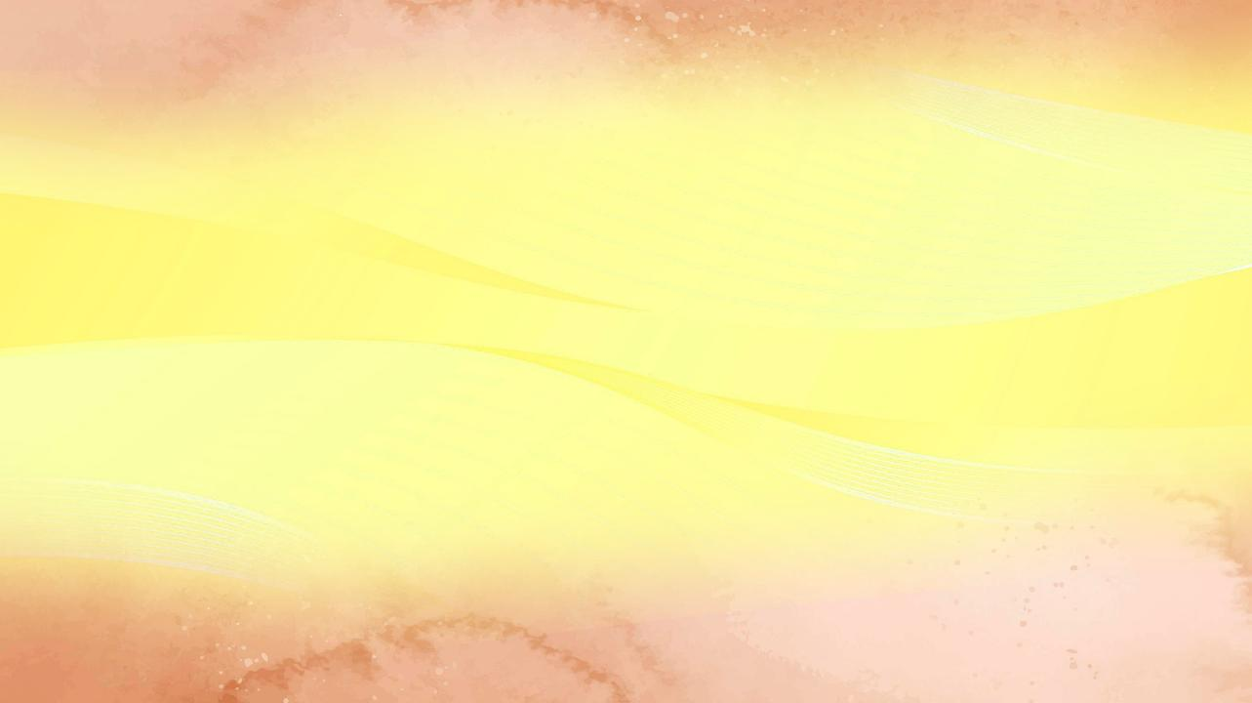

Kuyambira ndi 1 Akorinto 7, Paulo akudzipatula yekha kuti ayankhe ndandanda wa mafunso omwe Akorinto anamutumizira kudzera mu kalata (1 Akorinto 7:1a).
1 Akorinto 8
Chakudya choperekedwa nsembe kwa mafano
(Chidziwitso ndi chikondi)
1 Akorinto 9
Paulo akana ufulu wake
(Ufulu wa uthenga wabwino)
1 Akorinto 10:1-13
Chenjezo lokhudza kupembedza mafano
(Maphunziro ochokera m’mbuyomu)
1 Akorinto 10:14-22
Chikho cha Ambuye ndi chikho cha ziwanda
(Siyani kupembedza mafano)
1 Akorinto 10:23-33
Chitani zonse ku ulemerero wa Mulungu
(Zololedwa ndi zoyenera ndi chiyani)
Chifukwa cha ichi, ngakhale kuti mu chaputala 8 kufikira 10 akuchita ndi nkhani yopembedza mafano, Paulo akulowetsapo mutu wina wosagwirizana ndi tchimo limeneli.
Komabe, iye akuyetsetsa kusunga momwe nkhani zonse zikuyendera pa mutu uliwonse: chikondi ndi ulemu, zomwe zingapangitse mpingo kukhala ogwirizana.
Pamodzi ndi mfundo imeneyi, Paulo akutsindika kuti chilichonse chimene timachita—kaya mumpingo kapena pa moyo wathu wa tsiku ndi tsiku—chiyenera kuchitidwa kuti Mulungu alemekezedwe.

Slide 4





CHIDZIWITSO NDI CHIKONDI
1 Akorinto 8 (Chakudya choperekedwa nsembe kwa mafano
)
“Komatu chidziwitso chokha chimadzitukumula, koma chikondi ndicho chimapindulitsa.” (1 Akorinto 8:1b)
Paulo ‘amagawa’ mpingo m'magulu awiri: ‘amphamvu’ ndi ‘ofooka
1 Akorinto 8:4-7a
Amphamvu amamvetsa kuti mafano si kanthu, chifukwa pali Mulungu mmodzi yekha woona.
Ofooka sanamvetsebe mfundo imeneyi.
1 Akorinto 8:7b
Amphamvu amadya nyama yoperekedwa nsembe kwa mafano chifukwa amadziwa kuti mafano sangathe kuipitsa chakudyacho.
Ofooka amakhulupirira kuti amachimwa akamadya nyama imeneyo.
Koma amphamvu, chifukwa cha chidziwitso chawo ndi chitsanzo chawo, angachititse ofooka kugwa (1 Akorinto 8:10). Chifukwa cha chikondi pa mbale wake, wamphamvu ayenera kudziletsa (1 Akorinto 8:11–13).
Akhristu ayenera kuika chikondi patsogolo pa chidziwitso pamene chidziwitsocho chingakhale chokhumudwitsa kapena chingachititse mbale ‘wofooka’ (amene akadali kukula mwauzimu) kugwa.

Slide 5


UFULU WA UTHENGA WABWINO
1 Akorinto 9 (Paulo akana ufulu wake)
“Chomwechonso Ambuye akulamula kuti wolalikira Uthenga Wabwino azilandira thandizo lawo polalikira Uthenga Wabwinowo.” (1 Akorinto 9:14)
Chifukwa chokonda ofooka, Paulo anasiya maufulu osachepera atatu
⁕ Ufulu wodyetsedwa ndi mpingo (1 Akorinto 9:4)
⁕ Ufulu woyenda limodzi ndi mkazi wake (1 Akorinto 9:5)
⁕ Ufulu wosagwira ntchito yamanja kuti apeze zofunika pa moyo (1 Akorinto 9:6)
Paulo anasiya ufulu wake monga mtumwi wolandira chithandizo kuchokera ku mipingo imene ankaitumikira, monga momwe atumwi ena ankachitira.
Chinali chizolowezi cha atumwi ambiri kuyenda limodzi ndi akazi awo kuti aziwasamalira komanso kuwathandiza mu utumiki. Mkazi ameneyu, monga mwamuna wake, anali ndi ufulu wolandira chithandizo kuchokera ku mpingo.
Paulo anafuna kudzipezera yekha zofunika pa moyo wake kuti anthu asaganize kuti akufuna kupindula nawo, komanso kuti awasonyeze chitsanzo cha kusadzikonda.
Ngakhale Yesu ananena momveka bwino kuti amene amalalikira uthenga wabwino ayenera kukhala ndi moyo wochokera ku uthenga wabwino, Paulo ndi Barnaba anasiya okha ufulu umenewu kuti asakhale chopunthwitsa kwa okhulupirira (1 Akorinto 9:12–14; Luka 10:7).

Slide 6










MAPHUNZIRO OCHOKERA M’MBUYOMU
1 Akorinto 10:1-13 (Chenjezo lokhudza kupembedza mafano)
“Musakhale anthu opembedza mafano, monga analili ena mwa iwo. Pakuti zalembedwa kuti, “Anthuwo anakhala pansi nayamba kudya ndi kumwa. Kenaka anayimirira nayamba kuvina mwachilendo’ ” (1 Akorinto 10:7)
Zochitika za pa nthawi ya Eksodo, tikazimvetsetsa mwauzimu, zikufanana ndi zimene ife timakumana nazo. Kuwoloka Nyanja Yofiira kuli ngati pangano lathu la ubatizo (1 Akorinto 10:1–2).
Chakudya ndi chakumwa chimene Aisraeli analandira m’chipululu chikufanana ndi kutenga nawo mbali pa Mgonero Woyera, pamene ife timadya ndi kumwa, mwauzimu, thupi ndi mwazi wa Yesu (1 Akorinto 10:3–4).
Chenjerani! Ngakhale kuti Aisraeli anali ndi zokumana nazo zimenezi, anagwera m’machimo akuluakulu, kuphatikizapo kupembedza mafano ndi chiwerewere. Zimenezo zisachitikenso kwa ife! (1 Akorinto 10:5–10).”
Choncho mtumwiyu akumaliza gawo limeneli ndi uphungu wamphamvu uwu: “Choncho, ngati mukuganiza kuti mwayima mwamphamvu, samalani mungagwe!” (1 Akorinto 10:12).

Slide 7



SIYANI KUPEMBEDZA MAFANO
1 Akorinto 10:14-22 (Chikho cha Ambuye ndi chikho cha ziwanda)
“Choncho abwenzi anga okondedwa, lekani kupembedza mafano” (1 Akorinto 10:14)
Ngati nyama yoperekedwa nsembe kwa mafano ingadyedwe popanda nkhawa, n’chifukwa chiyani Paulo akuoneka ngati akulangiza kuti tisadye mu 1 Akorinto 10:20?
Ndi chinthu china kudya nyama kunyumba popanda kudzimva wolakwa, ndipo ndi chinthu china kudya nyama imeneyo pa mwambo woonekera umene mafano akupembedzedwa. Potenga nawo mbali pa miyambo yotereyi, wokhulupirira amakana chikhulupiriro chake ndipo amavomera kupembedza mafano.
Potenga nawo mbali pa Mgonero Woyera, timakhala mbali ya thupi la Khristu (mpingo). Koma potenga nawo mbali pa miyambo ya kupembedza mafano, timakhala ogwirizana ndi ziwanda (1 Akorinto 10:16–20).
Sitingamwe chikho cha Mgonero Woyera, tikuyamika Yesu, ndipo nthawi yomweyo kumwa chikho chimene chimayamikira ziwanda (1 Akorinto 10:21).

Slide 8
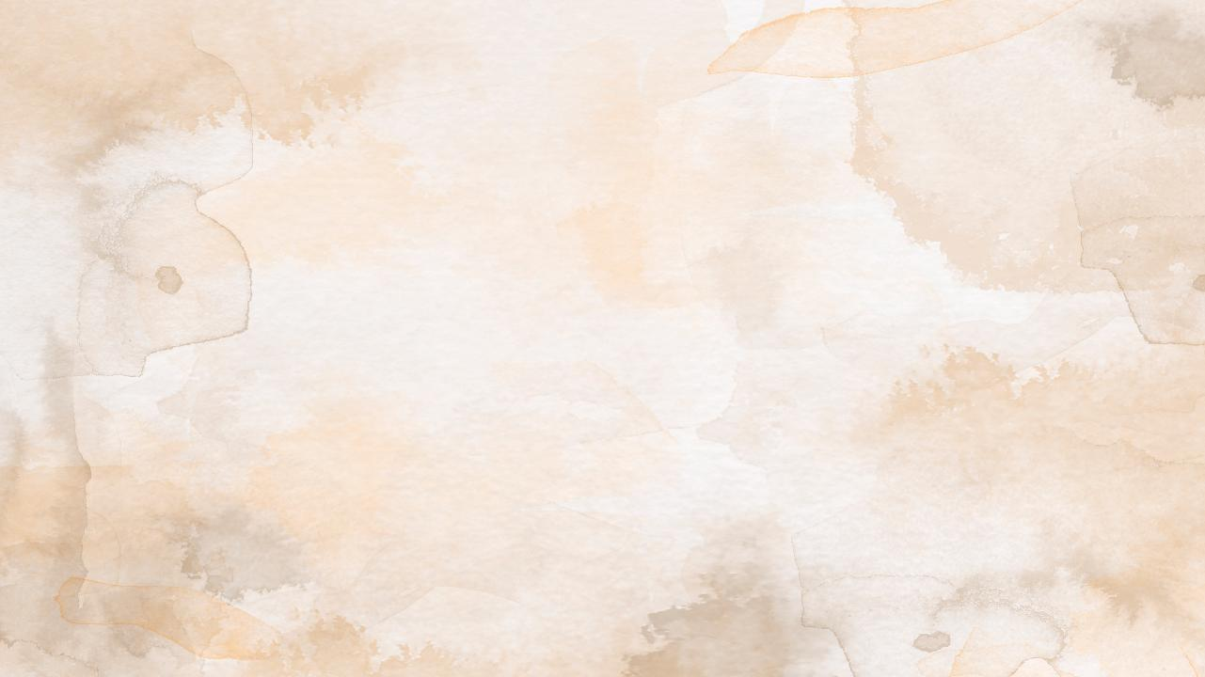


ZOLOLEDWA NDI ZOYENERA NDI CHIYANI
1 Akorinto 10:23-33 (Chitani zonse ku ulemerero wa Mulungu)
“Nʼchifukwa chake chilichonse mungadye kapena kumwa, kapena chimene mungachite, chitani zonse ku ulemerero wa Mulungu.” (1 Akorinto 10:31)
“Zinthu zonse nzololedwa, koma si zonse zimene zimapindulitsa” (1 Akorinto 10:23).
Zitsanzo ziwiri zomveka bwino:
M’malo ogulitsa nyama munkagulitsidwa nyama yoperekedwa nsembe kwa mafano komanso yosaperekedwa. Wokhulupirira sayenera kufunsa komwe nyamayo yachokera, kuti asasonyeze ngati akuiona kuti ndi koletsedwa kudya nyama yotereyo (1 Akorinto 10:25).
Munthu wosakhulupirira anaitanira wokhulupirira kudzadya. Wokhulupirirayo anadya popanda kufunsa mafunso (popeza zonse zinali zololedwa kwa iye). Koma mwini nyumbayo ananena kuti nyamayo inali itaperekedwa nsembe kwa fano. Choncho, kuti asakhumudwitse chikumbumtima cha mwini nyumbayo, zinali zosayenera kuti wokhulupirirayo adye nyamayo (1 Akorinto 10:27–29).
Mfundo zazikulu zimene zili kumbuyo kwa malangizowa ndi ziwiri: kulemekeza Mulungu pa chilichonse chimene timachita (1 Akorinto 10:31), ndi kufunira ena zabwino, osati za ife tokha (1 Akorinto 10:24, 32).
Ndiko kuti, kukonda Mulungu kuposa zinthu zonse, ndi kukonda mnansi wako monga umadzikondera wekha (monga momwe Yesu anauzira mnyamata wachuma).

Slide 9

“Mtumwiyu anachenjeza Akorinto kuti, ‘Amene akuganiza kuti wayima, asamale kuti angagwe.’ Ngati atayamba kudzikuza ndi kudzidalira, ndikunyalanyaza kukhala maso ndi kupemphera, adzagwera mu tchimo lalikulu ndipo adzadzibweretsera mkwiyo wa Mulungu. […]
Paulo analimbikitsa abale ake kudzifunsa kuti mawu awo ndi zochita zawo zidzakhudza bwanji ena, ndipo asachite chilichonse—ngakhale chikhale chololedwa chokha—chimene chingaoneke ngati chikuvomereza kupembedza mafano kapena chokhumudwitsa chikumbumtima cha amene ali ofooka mu chikhulupiriro. ‘Choncho, kaya mukudya, kaya mukumwa, kapena chilichonse chimene mukuchita, chitani zonse ku ulemerero wa Mulungu. Musakhumudwitse Ayuda, kapena Amitundu, kapena mpingo wa Mulungu.”
EGW (The Acts of the Apostles, p. 316)

