Slide 1

MLENGI AKULANKHULA
Phunziro 1, October 3, 2026

Slide 2


" Kale lija Mulungu ankayankhula ndi makolo athu pa nthawi zosiyanasiyana ndiponso mwa njira zosiyanasiyana kudzera mwa aneneri. Koma masiku otsiriza ano, Mulungu wayankhula nafe kudzera mwa Mwana wake. Mwanayu anamusankha kuti akhale mwini wa zinthu zonse, ndiponso Mulungu analenga dziko lonse kudzera mwa Iye.“ (Ahebrew 1:1-2)

Slide 3



Kodi munayamba mwalankhulapo ndi Mulungu maso ndi maso? Kodi munayamba mwamvapo Mulungu akulankhula nanu? Mwachidziwikire, yankho lake ndi lakuti: “Ayi.”
Tingalankhule ndi Mulungu kudzera m'njira zosalunjika (pemphero, Baibulo, aneneri, …)
Kodi ndichifukwa chiyani sitingathe kulankhula ndi Mulungu mwachindunji? Kodi kuyambira kale zakhala zili chonchi? Kodi nthawi idzafika yomwe tidzathe kulankhula naye mwachindunji?
Kodi poyamba Mulungu ankalankhulana bwanji ndi anthu?
1
Chinachitika n’chiyani kuti anthu asiye kulankhulana ndi Mulungu?
2
Mulungu anachita chiyani kuti ayambirenso kulankhulana ndi anthu?
3
Ndichifukwa chiyani panopa sitingathe kulankhulana ndi Mulungu maso ndi maso?
4
Kodi masiku ano tingalankhulane bwanji ndi Mulungu?
5

Slide 4






KODI POYAMBA MULUNGU ANKALANKHULANA BWANJI NDI ANTHU?
“Ndipo Yehova Mulungu analamula munthu uja kuti, ‘Uzidya zipatso za mu mtengo wina uliwonse mʼmundamu’ ” (Genesis 2:16 CCL)
Pachiyambi, Mulungu analenga dziko lapansi kuti anthu azikhalamo (Yesaya 45:18).
Zinthu zonse zitakonzeka, Mulungu analenga Adamu kuchokera ku fumbi la nthaka (Genesis 2:4-7).
Tsiku lomwelo, Mulungu analenga Hava kuchokera ku nthiti imodzi ya Adamu (Genesis 2:18, 21-22).
Anthu tsopano anali okwanira komanso okonzeka kukhala m'dziko latsopano lomwe linalengedwa (Genesis 1:27).

Slide 5




KODI POYAMBA MULUNGU ANKALANKHULANA BWANJI NDI ANTHU?
“Ndipo Yehova Mulungu analamula munthu uja kuti, “Uzidya zipatso za mu mtengo wina uliwonse mʼmundamu’ ” (Genesis 2:16 CCL)
Pa nthawi yonseyi, Mulungu ndi Adamu ankalankhulana kwambiri :
Anamupatsa malangizo okhudza ntchito imene anayenera kugwira m’munda wa Edeni (Genesis 2:15).
Anamuuza zinthu zimene sanayenera kuchita (Genesis 2:16-17).
Anamuuza kuti atchule mayina a nyama (Genesis 2:19).
Anamubweretsera Hava, ndipo anawalumikiza mu ukwati (Gen. 2:22-24

Slide 6




KODI POYAMBA MULUNGU ANKALANKHULANA BWANJI NDI ANTHU?
“Ndipo Yehova Mulungu analamula munthu uja kuti, “Uzidya zipatso za mu mtengo wina uliwonse mʼmundamu’ ” (Genesis 2:16 CCL)
Mulungu analangiza Adamu ndi Hava mmene anayenera kukhalira komanso zimene anayenera kudya (Genesis 1:28-29).
Iye anawalenga ngati zolengedwa zocheza ndi ena, zokhala ndi luso lolankhulana, osati pakati pa iwo okha, komanso ndi zolengedwa zina, monga angelo).
Kenako adalenga tsiku lachisanu ndi chiwiri kuti tsiku lonselo akhala nawo limodzi ndi kusangalala pocheza nawo.
Kuyambira nthawi imeneyo, ankakumana nawo tsiku lililonse nthawi ya madzulo (Genesis 3:8).

Slide 7






CHINACHITIKA N’CHIYANI KUTI ANTHU ASIYE KULANKHULANA NDI MULUNGU?
“Iye anayankha, “Ndinakumvani mʼmundamo, ndipo ndimaopa chifukwa ndinali maliseche; choncho ndinabisala” (Genesis 3:10 CCL)
Adamu ndi Hava analengedwa ndi mphamvu zosankha mwaufulu. Kuti azitha kugwiritsa ntchito ufulu umenewu, Mulungu adawapatsa chilichonse, koma adadzipatula mtengo umodzi kukhala wake (Genesis 2:16-17).
Pamtengo womwewo, wonyengayo, atadzibisa ngati njoka ndi kunamizira kuti ankafunira Adamu ndi Hava zabwino, adanena mabodza otsatizanawa (amene Hava anauzanso Adamu): ndinu osafa ("simudzafa"); mudzakhala milungu ("mudzakhala ngati Mulungu"); Mulungu amakubisirani choonadi ("Mulungu akudziwa kuti ...")(Genesis 3:1-5).
Hava atakopeka ndi chipatso choletsedwacho, anachidya ndipo anapatsanso Adamu, nayenso anadya (Genesis 3:6).
Nthawi yomweyo, ulemerero umene unawaphimba unachoka; anazindikira kuti anali amaliseche, ndipo anayamba kufunafuna njira yobisa kulakwa kwawo (Genesis 3:7).
Chotsatira chake chinali chakuti anaona olakwa kwambiri chifukwa cha kusamvera kwawo kotero kuti sanafunenso kulankhulana ndi Mulungu (Genesis 3:8).

Slide 8





MULUNGU ANACHITA CHIYANI KUTI AYAMBIRENSO KULANKHULANA NDI ANTHU?
“Yehova Mulungu anayitana munthu uja kuti, “Uli kuti?’ ” (Genesis 3:9 CCL)
Mulungu ankadziwa kuti Adamu ndi Hava anachimwa. Komabe, monga mwa chizolowezi chake, anapita kwa iwo kuti akalankhule nawo. Koma kwa nthawi yoyamba, m’malo moti iwo atuluke mwachimwemwe kukakumana naye, Mulungu anafunika kuwaitana kuti abwere kwa Iye (Genesis 3:8-9).
Ngakhale kuti iwo sanafunenso kulankhulana ndi Mulungu, Mulungu ankafunabe kulankhulana nawo. Sanawapewe chifukwa chakuti anali ochimwa, koma anawathandiza kuzindikira tchimo lawo kuti alape (Genesis 3:10-11).
Patapita zaka zambiri, Mulungu anayang’ananso wochimwa wina ndi cholinga chomutsogolera ku kulapa: Petro (Luka 22:61-62
Mosiyana ndi Petro, amene anavomereza tchimo lake, Adamu ndi Hava anayamba kudzilungamitsa pamaso pa Mulungu ndi kuimba mlandu ena chifukwa cha zolakwa zawo (Gen. 3:12-13).
Masiku anonso, anthufe timachita chimodzimodzi. Timakakamira uchimo ndipo timayesetsa kudzilungamitsa. Ngakhale kuti uchimo “umatimamatira,” Mulungu akufunabe kutibwezeretsa kwa Iye, ndipo akutiitana kuti: “Bwerani kwa Ine” (Yesaya 55:3).

Slide 9




NDICHIFUKWA CHIYANI PANOPA SITINGATHE KULANKHULANA NDI MULUNGU MASO NDI MASO
“Atamuthamangitsa munthu uja, Yehova anayika Akerubi mbali ya kummawa kwa Munda wa Edeni ndi lupanga lamoto limene limayendayenda ponsepo, kuteteza njira ya ku mtengo wopatsa moyo” (Genesis 3:24 CCL)
Zotsatira kwa :
Mulungu anafotokozera Adamu ndi Hava zotsatira za tchimo lawo. Chimodzi mwa zotsatira zake chinali chakuti, atathamangitsidwa m’munda wa Edeni, sakanathanso kulankhulana ndi Mulungu maso ndi maso monga kale (Genesis 3:16-24).
Hava
Ululu panthawi yobereka
Kutaya kukhala ofanana ndi Adamu
Adamu
Kugwira ntchito molimbika
Kulima zakudya
Onse
Imfa
Kulekana ndi Mulungu
Asanafotokoze zotsatira za tchimo, Mulungu anawauza kaye njira yothetsera vutolo: mbadwa ya Hava idzagonjetsa mphamvu ya mdierekezi ndi kubwezeretsa anthu kwa Mulungu (Genesis 3:15).
Kudzera mwa aneneri, Mulungu anafotokoza mmene chipulumutso chidzakwaniritsidwire: Mulungu mwini anakhala munthu, anafa chifukwa cha machimo athu, anaukanso kwa akufa, ndipo amatipatsa moyo wosatha (Yesaya 9:6; 53:6, 10-11).
Uchimo litangoyamba, lonjezo la Mpulumutsi linaperekedwanso nthawi yomweyo.

Slide 10







KODI MASIKU ANO TINGALANKHULANE BWANJI NDI MULUNGU ?
“Tsono iwe mwana wa munthu, ndakuyika kuti ukhale mlonda wa Aisraeli. Choncho imva mawu amene ndikuyankhula ndipo uwachenjeze.”
(Ezekieli 33:7 CCL)
Kuti alankhule nafe lerolino, Mulungu watipatsa “mabuku” awiri amene tingaphunzirepo za Iye: Chilengedwe ndi Baibulo (Aroma 1:20; 2 Timoteyo 3:15).
Ngakhale kuti Chilengedwe chimatiuza za Mlengi, chinawonongeka kwambiri chifukwa cha uchimo. Koma Baibulo lili ndi malangizo omveka bwino komanso achindunji, amene anaperekedwa kudzera mwa aneneri amene analandira mauthengawo kuchokera kwa Mulungu. M’Baibulo timapezanso kuwonekera kwangwiro kwa Mulungu kudzera mu moyo ndi utumiki wa Yesu (Ahebri 1:1-2).
M’Baibulo timazindikira kuti ndife ndani, tinachokera kuti, ndiponso kumene tikupita. Mmenemo timapezanso cholinga cha Mulungu pa moyo wathu
Kuwonjezera pamenepo, Mulungu amalankhulana nafe kudzera m’pemphero (Masalimo 5:2); angelo (Machitidwe 8:26); aneneri (Yoweli 2:28); komanso makamaka kudzera mwa Mzimu Woyera (Yohane 14:26).

Slide 11
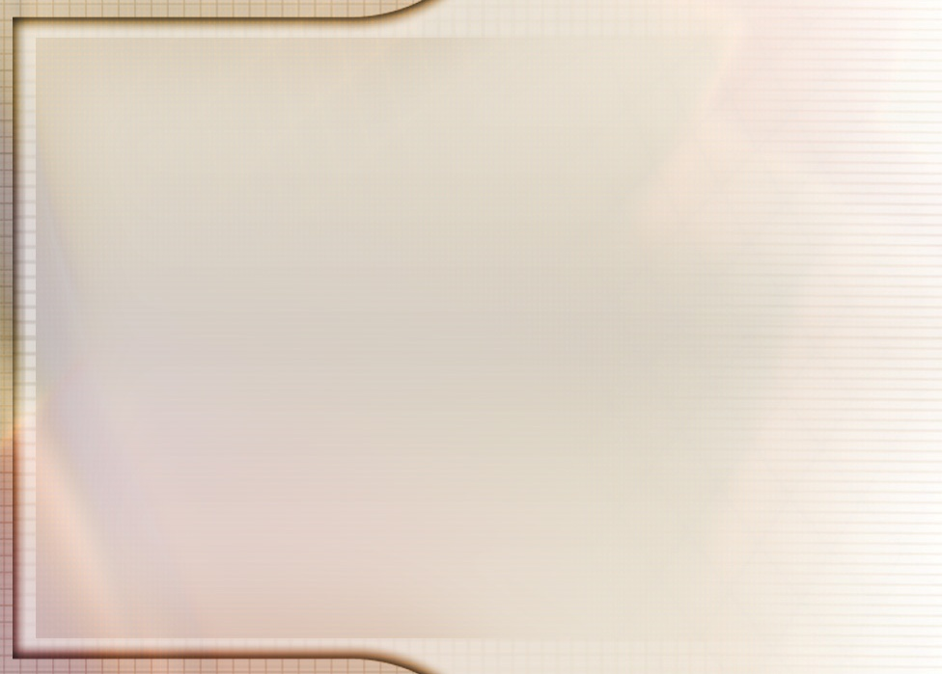
“Panayenera kukhala mgwirizano pakati pa munthu ndi Mulungu. Koma dongosolo limeneli linasokonezedwa kwambiri chifukwa cha kulakwa kwa Adamu. Satana anamutsogolera ku uchimo, ndipo Adamu atachimwa, Ambuye sakanathanso kulankhulana naye monga mmene ankachitira pamene anali asanachimwe.
Adamu atachimwa, Khristu anakhala mphunzitsi wake. Iye anaimirira Mulungu pochita ndi anthu, ndipo anapulumutsa mtundu wa anthu kuti usafe nthawi yomweyo. Iye anatenga udindo wokhala Mkhalapakati. Adamu ndi Hava anapatsidwa nthawi yoti alape ndi kubwerera ku kumvera Mulungu, ndipo dongosolo limeneli limakhudzanso mbadwa zawo zonse.
Popanda nsembe ya Mwana wa Mulungu yotetezera machimo, sipakanakhala njira yoti madalitso kapena chipulumutso zichokere kwa Mulungu kufika kwa munthu. Mulungu anali wofunitsitsa kusunga ulemu wa lamulo Lake. Kuswa lamulolo kunabweretsa kulekana kwakukulu pakati pa Mulungu ndi munthu. Adamu asanachimwe anali ndi mwayi wolankhulana ndi Mlengi wake maso ndi maso, momasuka, ndiponso mwachimwemwe. Koma atachimwa, Mulungu ankayenera kulankhulana ndi anthu kudzera mwa Khristu ndi angelo okha.”
EGW (Conflict and Courage, January 14)

Slide 12
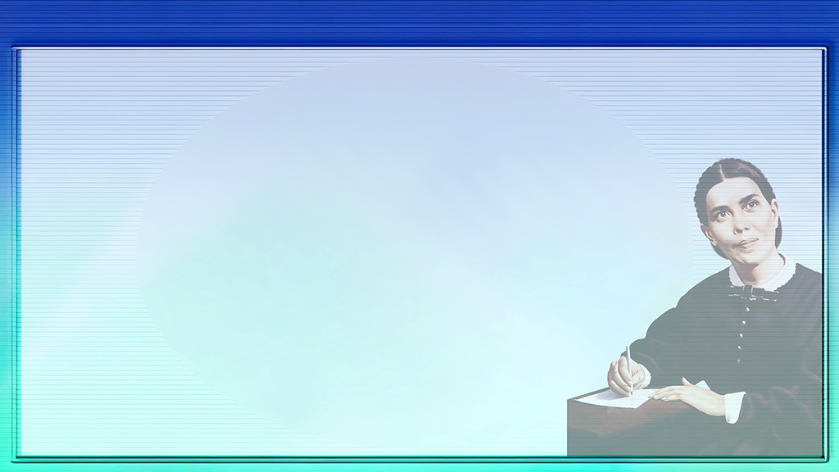



ZOWONJEZERA: MBIRI YA MOYO WA ELLEN G. WHITE
Ellen Gould ndi Elizabeth Harmon, ana aang’ono kwambiri mwa ana asanu ndi atatu a Eunice ndi Robert Harmon, anabadwa pa 26 November 1827 ku Gorham, Maine, ku Amerika.
Patangopita nthawi yochepa, banjali linasamukira ku Portland, mzinda waukulu ku Maine, kuti akakulitse bizinesi yawo yopanga zipewa.
Ellen ali ndi zaka zisanu ndi zinayi, mnzake wa kusukulu anamuponya mwala umene unamuvulaza kwambiri kumaso. Kuvulala kumeneku kunamusiya ndi mavuto amene anakhalapo kwa nthawi yaitali, moti anasiya sukulu komanso sankathanso kucheza kwambiri ndi anthu ena.
Banjali linalandira ziphunzitso za William Miller, ndipo mu 1842 Ellen anabatizidwa mu Mpingo wa Methodist.
Koma Ellen ankadziona ngati wotayika ndipo ankakhulupirira kuti sanali woyenera kupulumutsidwa, kufikira pamene M’busa Levi Stockman anamuthandiza kumvetsa chikondi chenicheni cha Mulungu.
Kuyambira nthawi imeneyo, anayamba kukonda Yesu ndi mtima wake wonse ndipo anamutumikira kwa moyo wake wonse.

