Slide 1

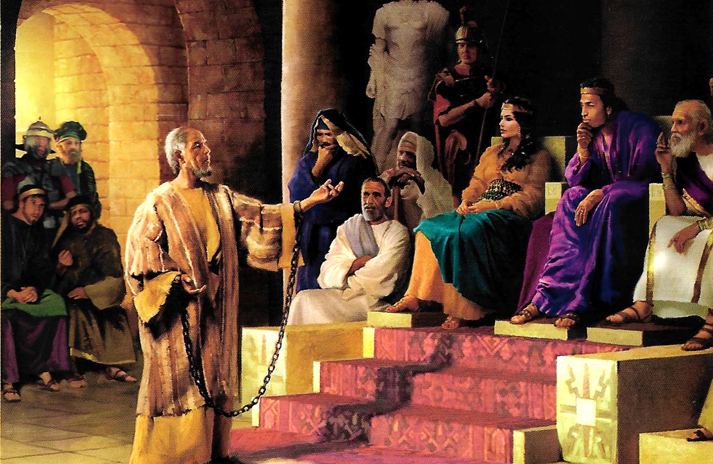
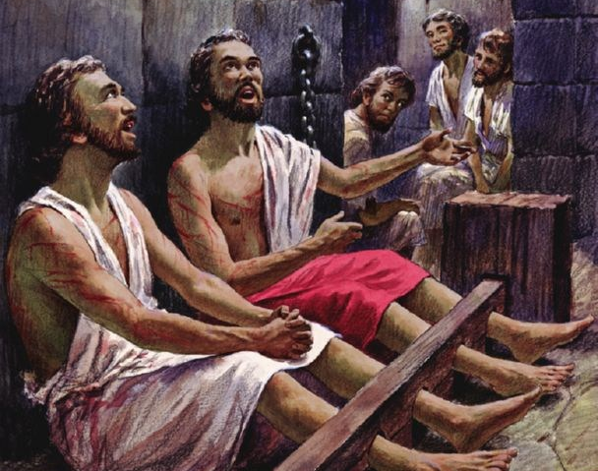
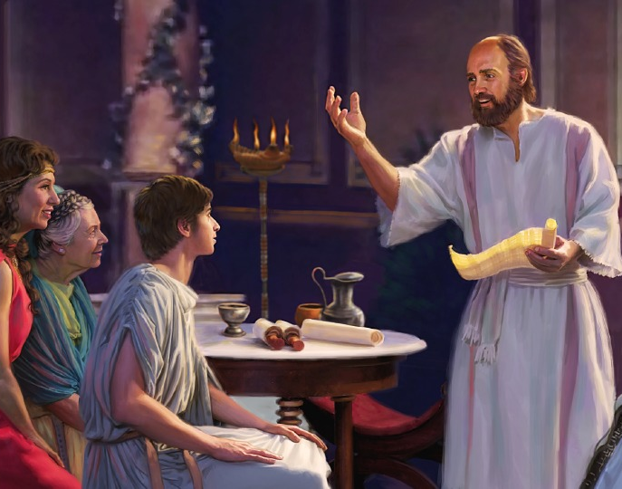
“Nthawi zonse muzikondwa mwa Ambuye. Ndikubwerezanso; muzikondwa!”
Filipi 4:4, CCL

Slide 2


“Sindikukayika konse kuti Iye amene anayamba ntchito yabwino mwa inu adzayipitiriza ndi kuyimaliza mpaka pa tsiku la kubweranso kwa Khristu Yesu”
Afilipi 1:6, CCL

Slide 3

“Pakuti kwa ine kukhala moyo ndi Khristu ndipo kufa ndi phindu”
Afilipi 1:21, CCL

Slide 4

“Tsono tsirizani chimwemwe changa pokhala amaganizo ofanana, achikondi chimodzimodzi, amodzi mu mzimu ndi acholinga chimodzinso”
Afilipi 2:2, CCL

Slide 5

“Muzichita zonse mosawiringula kapena mosatsutsapo, kuti mukhale wopanda cholakwa ndi angwiro, ana a Mulungu wopanda cholakwika mu mʼbado uno wachinyengo ndi wosocheretsa. Mukatero mudzawala pakati pawo ngati nyenyezi zakumwamba”
Afilipi 2:14, 15, CCL

Slide 6


“Ine ndikufuna kudziwa Khristu, ndithu, kudziwa mphamvu zake za kuuka kwa akufa. Ndikufuna kuyanjana naye mʼmasautso ake, kufanana naye pa imfa yake kuti nanenso ndidzaukitsidwe kwa akufa”
Afilipi 3:10, 11, CCL

Slide 7

“Musadere nkhawa konse; komatu m'zonse ndi pemphero, ndi pembedzero, pamodzi ndi chiyamiko, zopempha zanu zidziwike kwa Mulungu”
Afilipi 4:6, BLP-2018

Slide 8
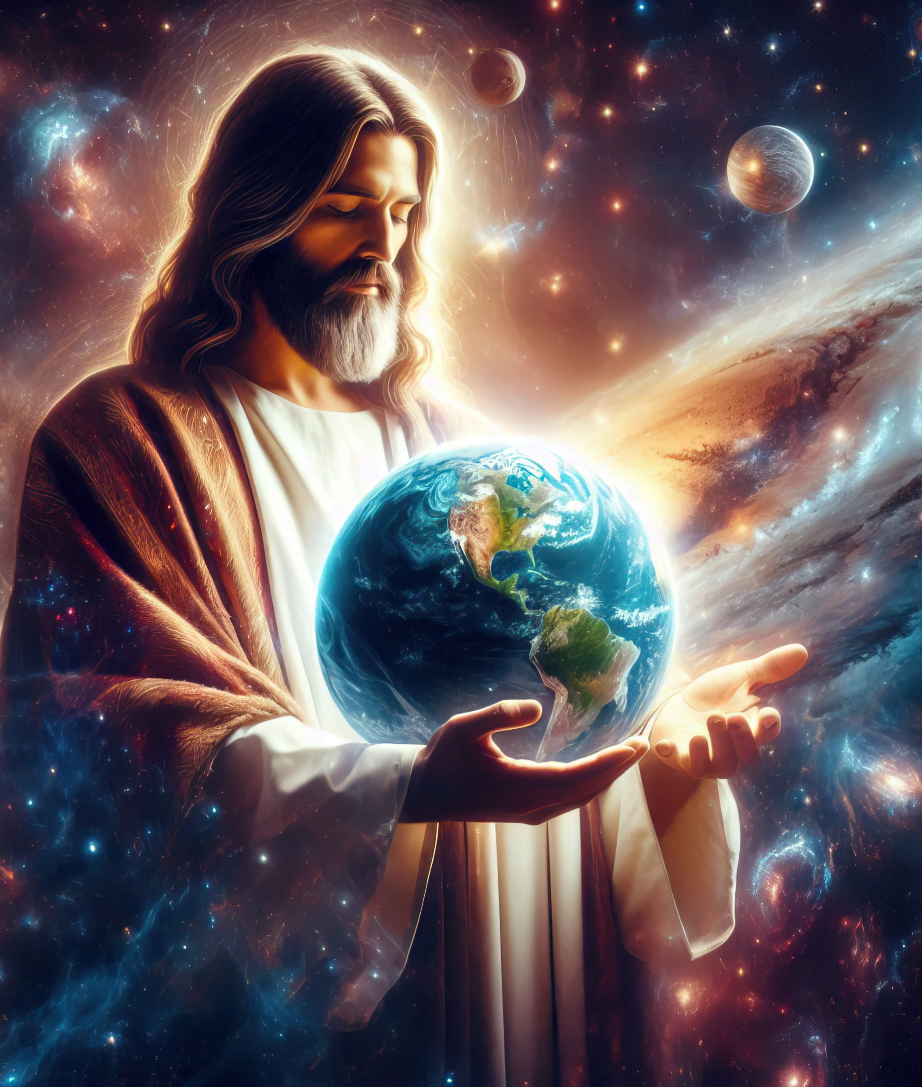
“Mwanayu ndiye chithunzi cha Mulungu wosaonekayo. Iye ndiye Mwana wake woyamba kubadwa ndi wolamulira zolengedwa zonse. Pakuti zinthu zonse zinalengedwa kudzera mwa Iye. Zinthu zakumwamba ndi za pa dziko lapansi, zooneka ndi zosaoneka, maufumu, akuluakulu, aulamuliro ndi amphamvu. Zinthu zonse zinalengedwa kudzera mwa Iye ndipo anazilengera Iyeyo. Iyeyo analipo zinthu zonse zisanalengedwe ndipo zinthu zonse zimamangika pamodzi mwa Iye”
Akolose 1:15–17, CCL

Slide 9


2 Akorinto 5:21 CCL
“Chifukwa cha ife, Mulungu anasandutsa wopanda tchimoyo kukhala tchimo, kuti mwa Iye ife tikakhale chilungamo cha Mulungu”

Slide 10
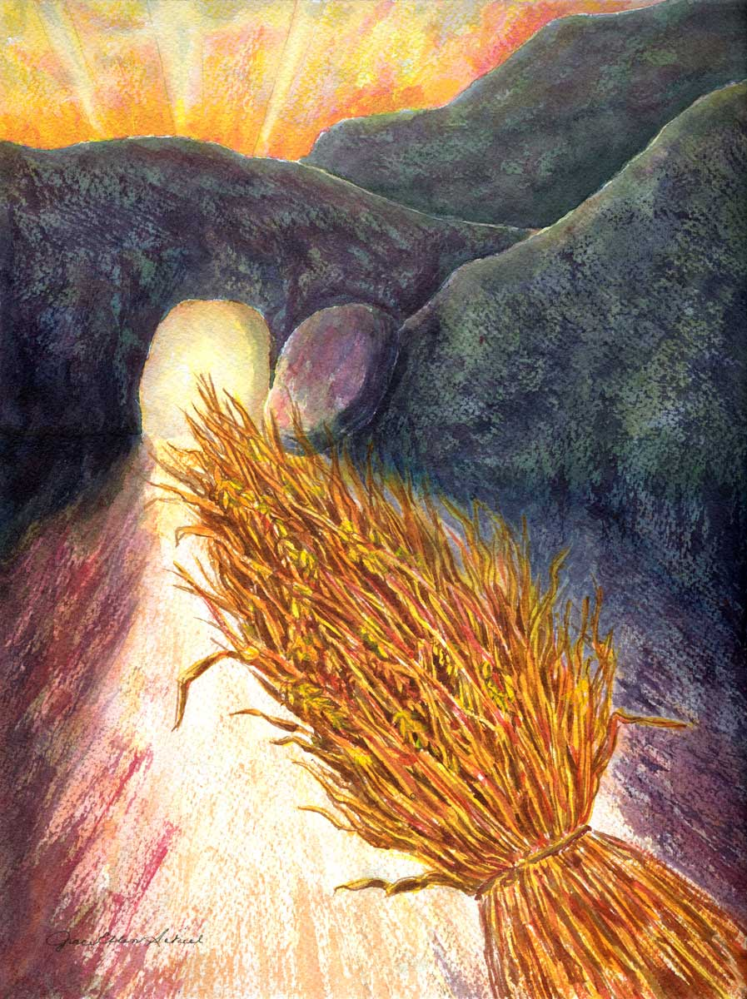
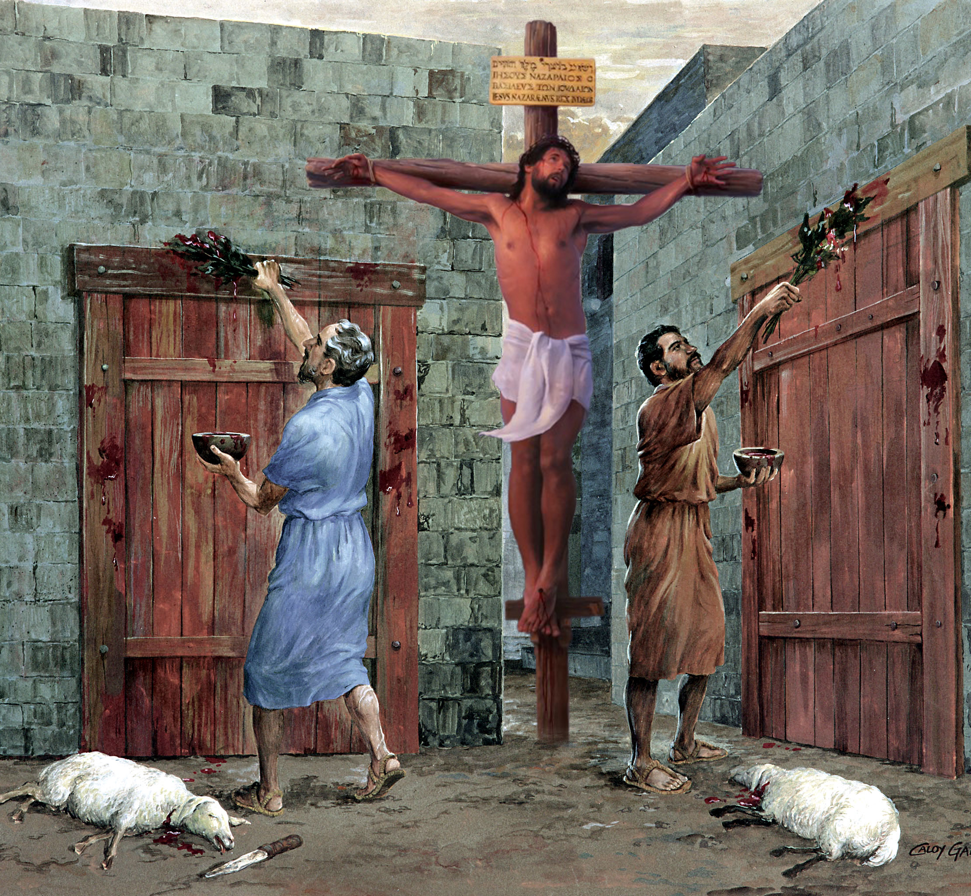
“Nʼchifukwa chake musalole wina aliyense kukuzengani mlandu chifukwa cha zimene mumadya kapena kumwa, kapena za masiku achikondwerero cha chipembedzo, za chikondwerero cha mwezi watsopano, kapena za tsiku la Sabata. Zimenezi ndi chithunzithunzi chabe cha zinthu zimene zikubwera, koma choonadi chenicheni chikupezeka mwa Khristu” Akolose 2:16, 17, CCL

Slide 11

“Ndipo kuwonjezera pa zonsezi valani chikondi, chimene chimangirira zonsezi pamodzi mu mgwirizano wangwiro”
Akolose 3:14, CCL

Slide 12


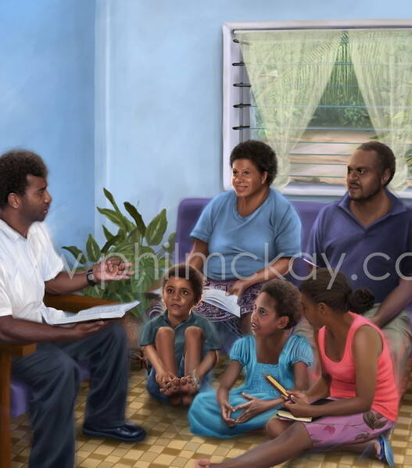

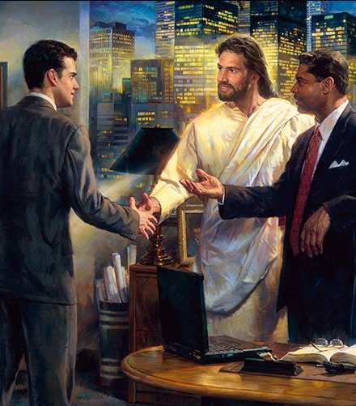

“Mayankhulidwe anu nthawi zonse akhale odzaza ndi chisomo ndi okoma, kuti mudziwe kuyankha aliyense”
Akolose 4:6, CCL

Slide 13




“Yamikani mu zonse, pakuti ichi ndi chifuniro cha Mulungu kwa inu mwa Khristu Yesu”
1 Atesalonika 5:18, CCL

