Slide 1
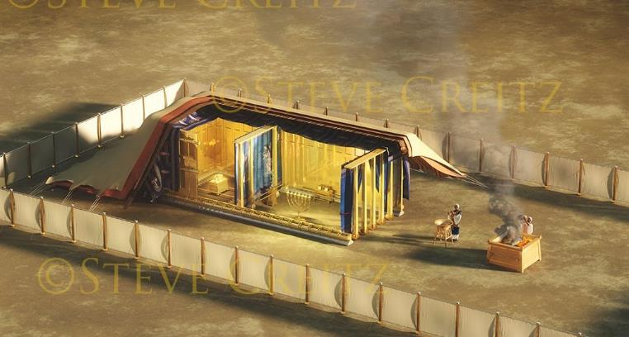
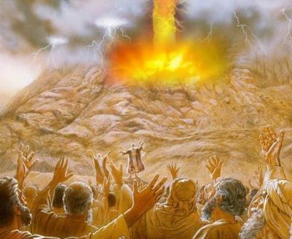
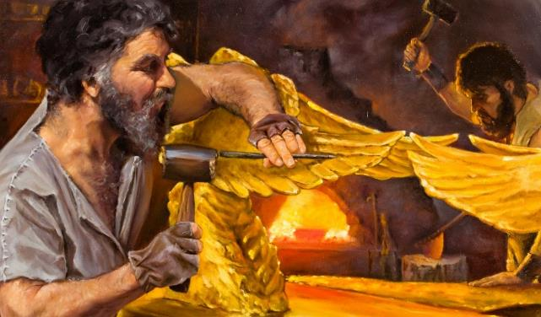
Barnoota 10ffaa, Fulbaana 6, 2025
KAKUCHAA FI TOORICHA

Slide 2
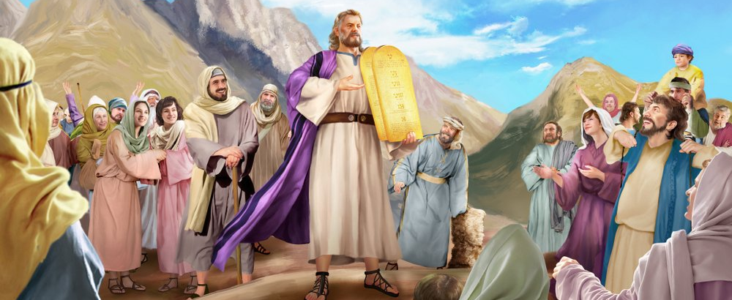
“Museenis dhaqee dubbii fi seera WAAQAYYOO hunda saba sanatti hime; sabni sunis ‘Nu waan WAAQAYYO jedhe hunda ni goona’ jedhee afaan tokkoon deebise.”
Ba’uu 24:3

Slide 3

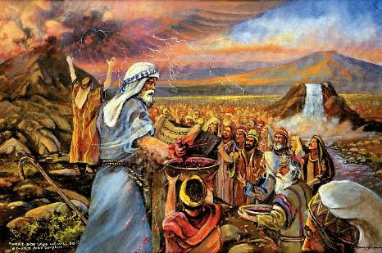
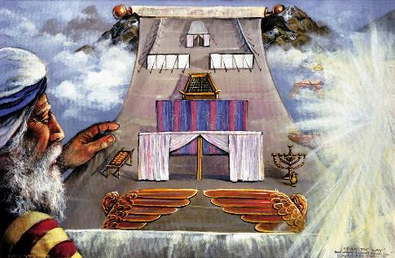


Abboommii kudhanan erga sagalee guddaadhaan labsee tuuta seerota bu’uuraa Museetti kennee booda, Waaqayyo Israa’elii wajjin kakuu dhaabuu barbaade.
Kakuun sun salphaa dha: Ani Waaqa keessan nan taa’a, isin nan eega, isin nan eebbisa; isin immoo seera Koo eegaa.
Erga kakuun sun maraa macaafaa irratti barreeffamee booda, qaamni lamaanuu mirkaneessuu qabu. Sabni ni eegna jechuudhaan mirkaneesse. Waaqayyohoo akkamitti mirkaneesse? Dhiigaan; ayyaaneffannaadhaan; fakkeenya kakuu sana hubachuu isaan dandeessisuun.
Kukucha:
  Dhiiga kakuchaa (Ba’uu 24:1-6, 8)
  Raawwii kakuchaa (Ba’uu 24:7)
  Nyaata kakuu (Ba’uu 24:9-18)
Fakkeenyicha:
  Kaayyoo fakkeenyichaa (Ba’uu 25:1-9)
  Qophii fakkeenyichaa (Ba’uu 31:1-18)

Slide 4
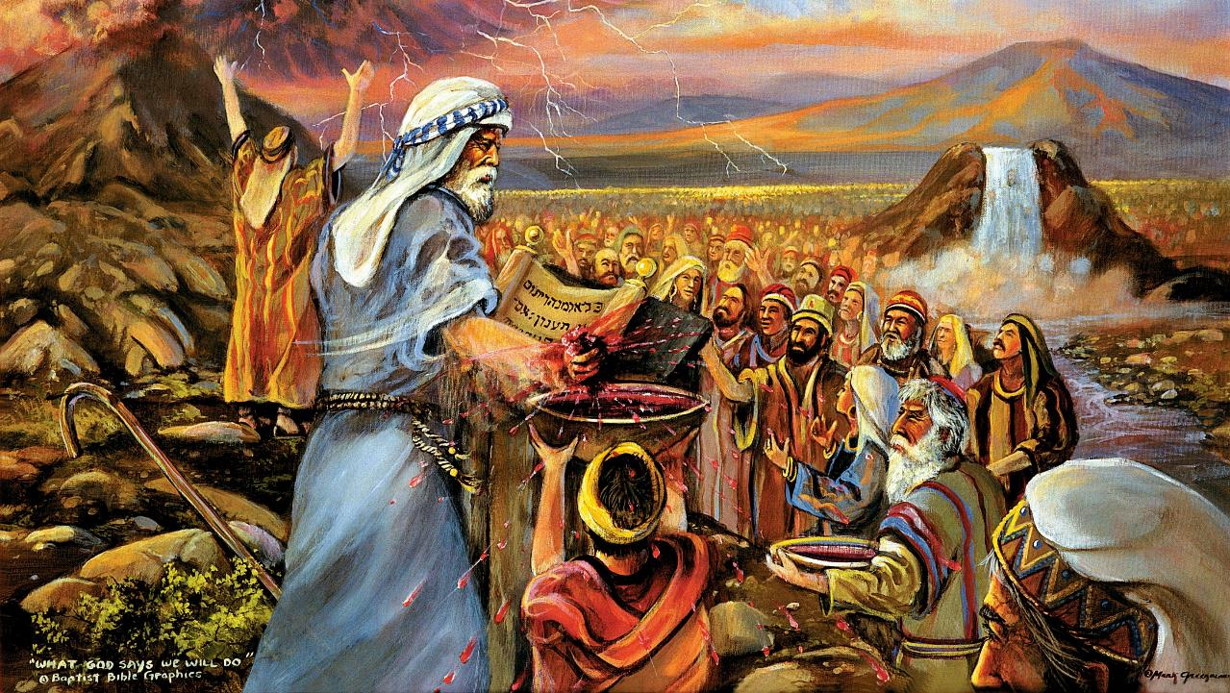
KAKUCHA

Slide 5

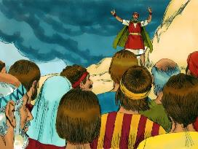
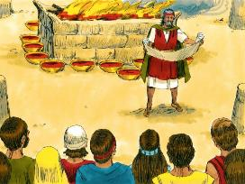
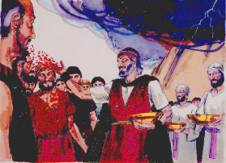
DHIIGA KAKUCHAA
Yommus Museen dhiiga sana fuudhee sabatti faffacaasee, ‘Kunoo kun dhiiga kakuu kan WAAQAYYO akkuma dubbii kana hundaatti isinii dhaabee dha’ jedhe” (Ba’uu 24:8)
Kakuchi akkamitti hojjetame?
Kakuchi ni dubbifame (Ba’uu 24:3a)
Sabni deebiidhaan mirkaneessan (Ba’uu 24:3b)
Barreeffamaan taa’e (Ba’uu 24:4a)
Iddoon aarsaa ni ijaarame (Ba’uu 24:4b)
Utuboota 12tu dhaabate (Ba’uu 24:4c)
Aarsaa gubatutu dhihaate (Ba’uu 24:5)
Walaakkaan dhiigichaa iddoo aarsaatti facaafame (Ba’uu 24:6)
Kakuchi irra deebiin dubbifame (Ba’uu 24:7a)
Sabni ammas deebii kennuudhaan mirkaneesse (Ba’uu 24:7b)
Dhiigichi walakkaan isaammoo sabatti facaafame (Ba’uu 24:8a)
Museen “kun dhiiga kakuuti” jedhee labse (Ba’uu 24:8b; Mat. 26:28)
Kakuu sana mirkaneessuuf nyaatatu nyaatame (Ba’uu 24:9-11)
Waaqayyo Israa’eliin akka sabaatti beekamtii kenneef (Utuboota 12); keessumaa dargaggootaaf iddoo kennu; dhuunfaatti nama hundumaaf Of kenne (dhiiga Isaa isaan irratti facaasuu dhaan).
Waaqayyo walitti dhufeenya nu wajjin qabaachuu hawwa, akka dhuunfaattis akka hawaasa amantootaattis.

Slide 6

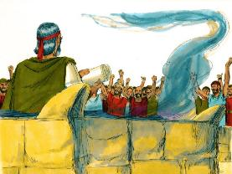
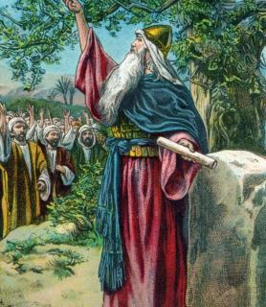
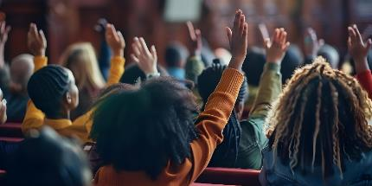

RAAWWII KAKUCHAA
“Innis kitaaba kakuu fuudhee saba sanaaf dubbise. Isaanis, “Nu waan WAAQAYYO jedhe hunda ni goona; ni ajajamnas’ jedhanii deebisan.” (Ba’uu 24:7)
Garraamummaa guutuu ta’een, sabni kakuu sana eeguuf of kennan. Of kennuun kun garuu yeroo xiqqoof ture (Ba’uu 32:8).
Dhalootni itti aanus kakuu sana eeguuf of kenne (Iyya. 24:18b). Garuu Iyyaasuun ifa godhee isaan akeekkachiise: “Waaqayyoof dandeessanii hin hojjettan” (Iyyaasuu 24:19).
Utuma kaayyoo gaarii qabnuu, maaltu Waaqayyoof abboomamuu nu dhowwa?
Uumamaan, nuy hin abboomamnu (Rom. 7:18), Duufuu keenya kana jijjiiruuf garuu homaayyuu gochuu hin dandeenyu (Rom. 7:24).
Garuu, yoo nuy Isaaf heyyamne, Waaqayyo uumama keenya geedderuu ni danda’a (Hisq. 36:26-27). Inni akka nuy Isaaf abboomamuu dandeenyuuf, nu qulleessa, nurraa fuudha, nuu kenna, nu hojjeta. Isa qofatu nu jabeessa (2 Qor. 12:10).

Slide 7

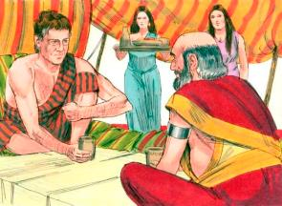
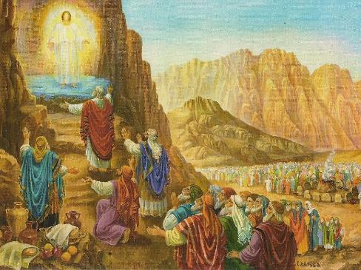
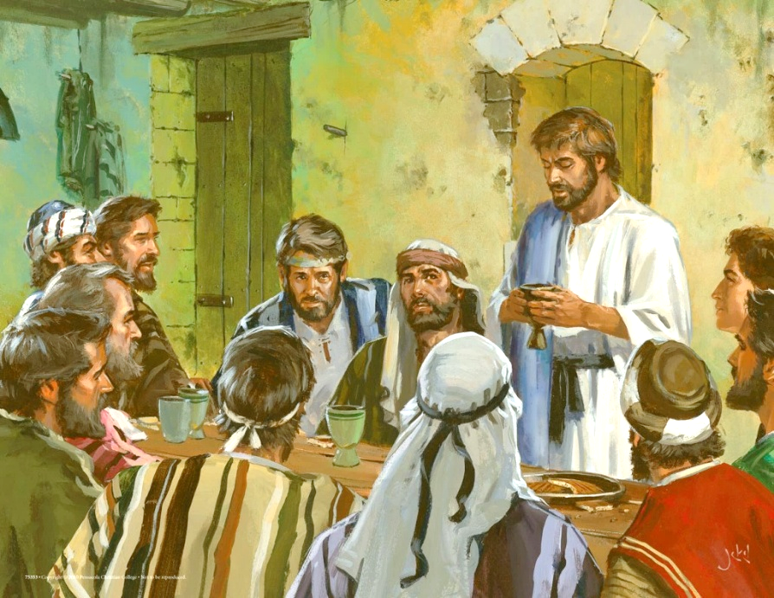
NYAATA KAKUU
“Musee fi Aroon, Naadaabii fi Abiihuu, maanguddoonni Israa’el torbaatamnis ol ba’anii; […] isaan Waaqa argan; ni nyaatan; ni dhuganis.” (Ba’uu 24:9, 11b)
Akkuma fakkeenya Yaaqoobii fi Laabaaniin agarru, warra Bahaa durii keessatti kakuu mirkaneessuun gama lamaanuutii nyaata waliin nyaachuu dabalata (Uum. 31:44-54).
Siinaa irratti, Waaqayyo “nyaata kakuu” namoota 74f dhiheesse: Musee, Aroon, Naadaab, Abihuu, fi maanguddoota 70 saba hundumaa bakka bu’aniif (Ba’uu 24:9-11).
Yesuus yeroo kakuu isa haaraa dhaabe, bartoota 12n wajjin irbaata nyaachuudhaan kakucha dhaabe (Mat. 26:26-28).
Yeroo Irbaata Gooftaatti hirmaannu hundumaatti, kakuu keenya Waaqayyoo wajjin haareffanna. Daabboo fi wayinii sanatti hirmaachuudhaan, dhiifamaa fi fayyina Yesuus keessatti qabnu ayyaaneffanna (1 Qor. 11:26).
Ifaadhumatti fayyina kan dhiitan utuma taa’anii jiranii, Naadaabis, Abihuunis, Yihudaanis, “nyaata kakuu” sanaa nyaachuu ala hin taasifamne.

Slide 8
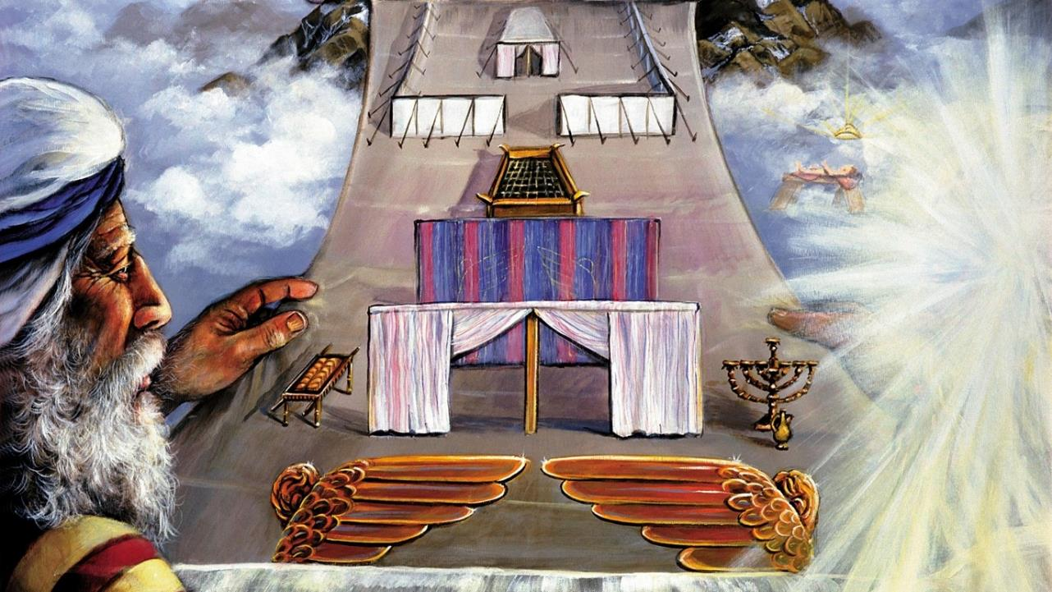
FAKKEENYICHA

Slide 9

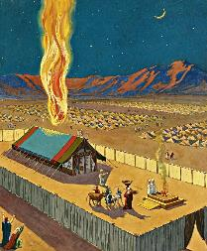
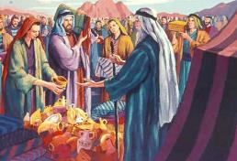
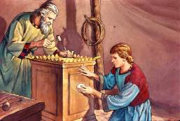
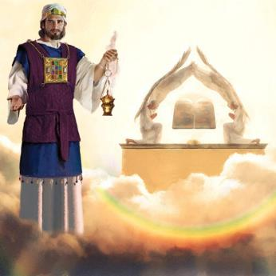
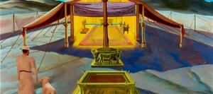
KAAYYOO FAKKEENYICHAA
“Ergasii akka isaan iddoo qulqulluu naa qopheessan godhi; anis gidduu isaanii nan jiraadha” (Ba’uu 25:8)
Gama Isaatiin kakuu Isaa raawwachuuf jecha, Waaqayyo dhaqee saba Isaa gidduu jiraachuuf murteesse.
Garuu, Waaqayyo qaamaan achitti argamuu jechuun saba sanaaf du’a battalaa taa’a (Ba’uu 33:20). Kanaaf, argama Isaa mul’isuuf akka isaan mana qulqullummaa Isaaf ijaaraniif abboome. Argamni kun fakkeenyaan mul’ate, Waaqayyo qaaman mana qulqullummaa lafa irraa kamiin keessallee waan hin jiraanneefi dha (H.Erg. 17:24 ).
Museetti fakkeenyichi itti agarsiifamee, ijaarsicha ilaalchisee qajeelfamni kallattii kennameef. Sabni immoo meeshaa barbaachisu akka dhiheessaniif gaafataman (Ba’uu 25:2-7).
Manni qulqullummaa inni dunkaanaas ta’e inni Solomon ijaare, fakkeenya mana qulqullummaa samiitiin ijaarame (Ibr. 8:1-2; 1Moot. 8:27, 30).
Israa’el yeroo mana qulqullummaa seenu—fakkeenyichi—bakka argama Waaqayyoo seenuu isaa agarsiisa… kunis hamma golgaan sun gaafa Yesuus du’e tarsa’etti ture.

Slide 10

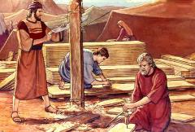
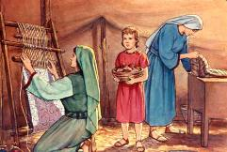
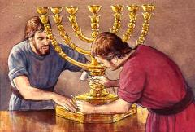
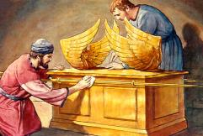
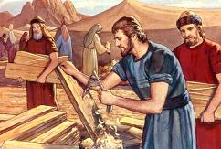
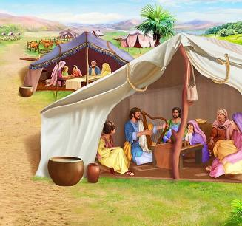
QOPHII FAKKEENYICHAA
“Ilaa, ani gosa Yihudaa keessaa Bezali’eel ilma Uuri, ilma Huuri filadheera; ani Hafuura Waaqaatiin, ogummaadhaan, dandeettii fi beekumsa hojii harkaa gosa hundumaan isa guuteera;” (Ba’uu 31:2-3)
Gadi fageenya ijaarsa sanaa, Waaqayyo yoo Museedhaaf kenne iyyuu, gadi fageenya waan hundumaa itti hin himne. Waciitiin meetii maal ta’uu qaba, kiruub, uffanni lubootaa fi kkf maal fakkaachuu qaba? Inni kun Hafuura Qulqulluutiif carraa kennaa ijaartotni qabanii wajjin hojjechuu kenneef.
Gadi fageenyaa kanaatiif, Hafuurri Qulqulluun kennaa addaa kenneef:
Bazali’el, nama guutummaa hojichaa ooggane (Ba’uu 31:2)
Aholiiyab, gargaaraa isaa olaanaa (Ba’uu 31:6a)
Namoota biroo kan hojicha keessatti gargaaran (Ba’uu 31:6b)
Qajeelfama mana qulqullummaa sana ijaaruuf kenname gidduutti, tuqaa addaa Sanbata ilaalutu jira (Ba’uu 31:12-17). Kana hundumaa keessatti Sanbanni maal hojjeta?
Qulqullummaan furtuu dha. Waaqa qulqulluutti dhihaachuuf, akka Isaa qulqulloota ta’uu qabna. Sanbanni mallattoo qulqullummaa sanaati (Ba’uu 31:13; Hisq. 20:12, 20).
Notes:
Exodus 31:2
See, I have called by name Bezalel the son of Uri, the son of Hur, of the tribe of Judah;
Exodus 31:6a
And behold, I have set with him Aholiab the son of Ahisamach , of the tribe of Dan;
Exodus 31:6b
and I have put wisdom in the minds of every wise-hearted person, so that they may do all that I have commanded you;
Exodus 31:12-17 And the LORD spake unto Moses, saying, (13) Thou shalt speak unto the children of Israel, saying, Ye shall surely keep my sabbaths: for it is a sign between me and you throughout your generations, that ye may know that I am the LORD that sanctifies you. (14) Therefore ye shall keep the sabbath day, for it is holy unto you: whoso profaneth it shall surely be put to death: for whosoever doeth any work in it, that soul shall be cut off from among his people. (15) Six days shall work be done: but the seventh day is a sabbath of rest holy to the LORD: whosoever doeth any work on the sabbath day shall surely be put to death. (16) Therefore shall the children of Israel keep the sabbath, to observe the sabbath throughout their generations for a perpetual covenant. (17) It is a sign between me and the children of Israel for ever: for in six days the LORD made heaven and earth, and on the seventh day he rested, and was refreshed.

Slide 11

“Ijaarsa mana qulqullummaa isa akka iddoo jireenyaa Waaqaatti ilaalamu keessatti, Museen waan hundumaa akka fakkeenya isa waaqa irraatti akka godhuuf qajeelfame. Waaqayyo gara gaaraatti ol isa waamee, waantota samii ittti mul’ise, waan isa ilaallatu hundumaan akka sanatti hojjetame.
Kanaaf Israa’el, isa bakka jireenya Isaatii godhachuu hawweef, amalli Isaa inni ulfina qabeessi maal akka fakkaatu itti agarsiise. […] Garuu yaadni kun ofii isaatiin waan barbaadame milkeessuuf human hin qabu. Mul’atni siinaa irratti kenname dhaba isaanii fi gargaarsa kan hin qabne ta’uu isaaniitiif qofa isaan gargaara.”
EGW (Education, p. 35-36)

