Slide 1
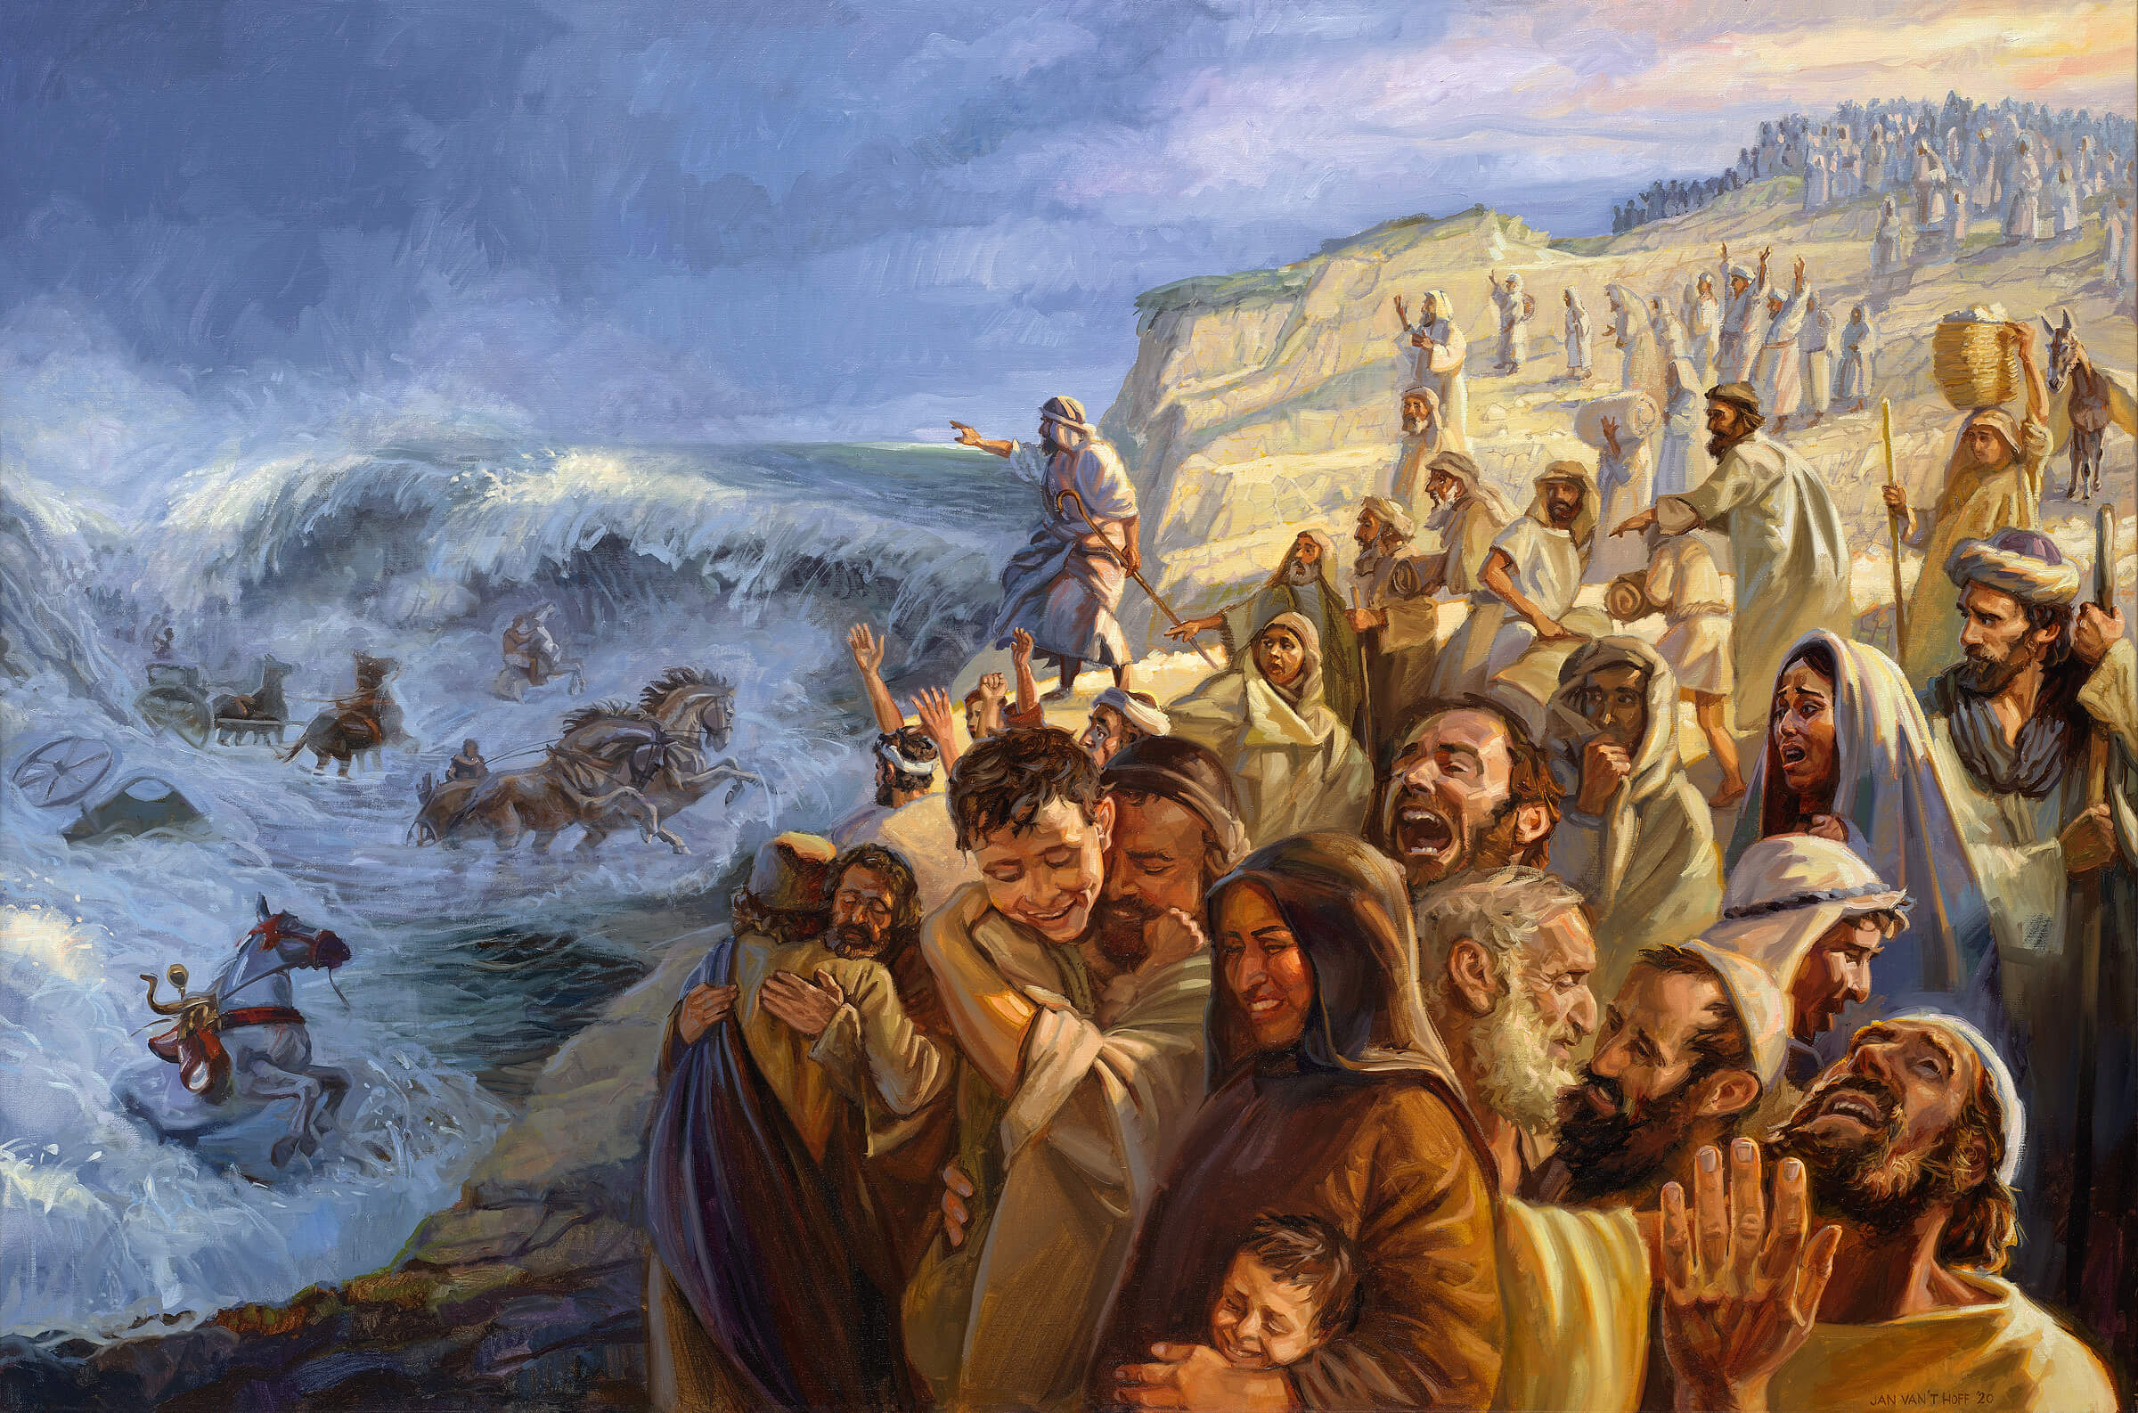
Faarfannaa Musee
Ba’uu 15:1-18

Slide 2
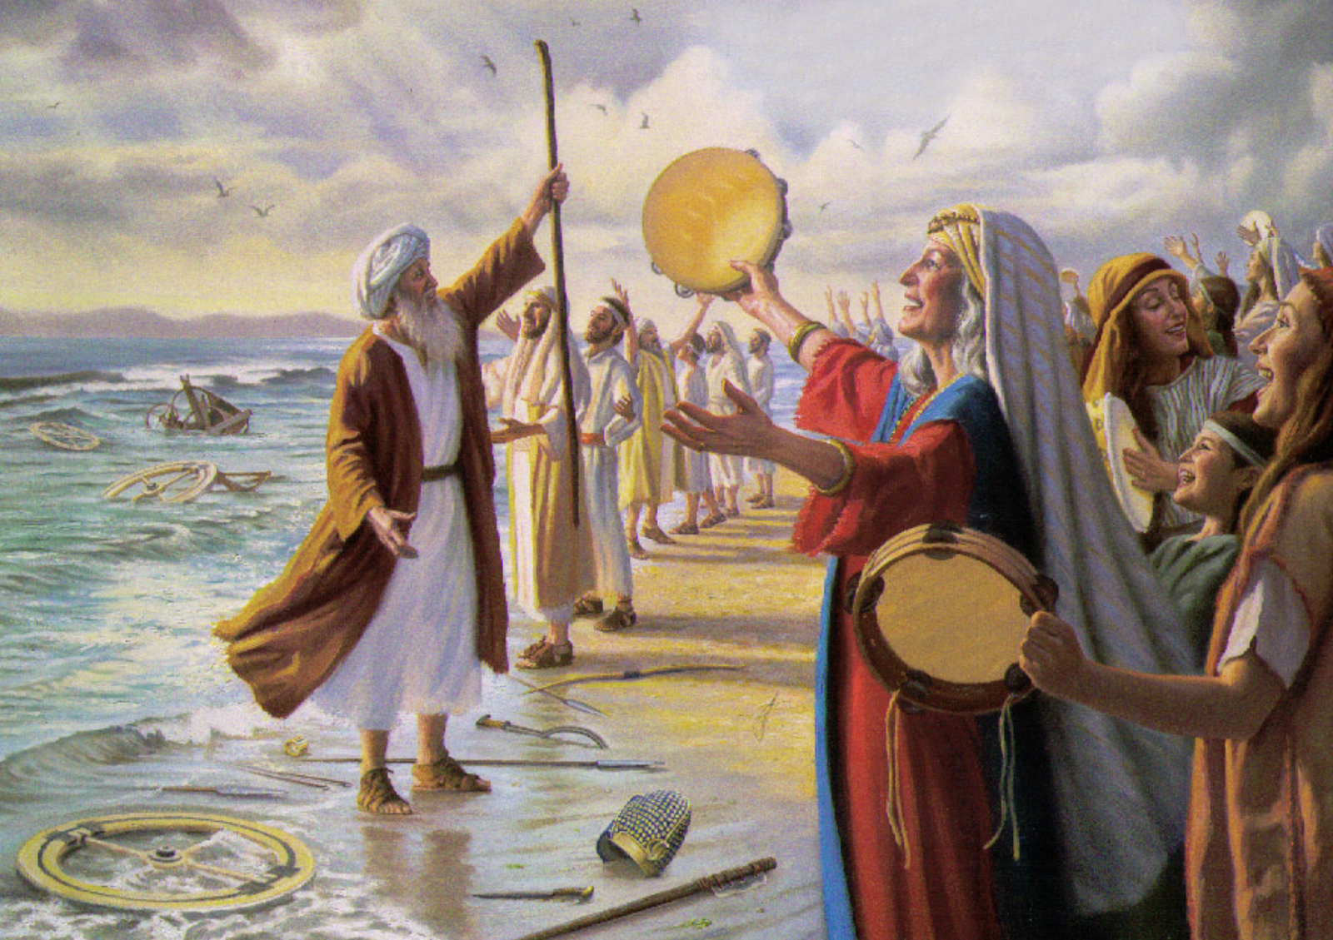
Waaqayyoon ol qabuu (lak. 1-3)
Yommus Musee fi Israa’eloonni Faarfannaa kana WAAQAYYOOF faarfatan:
Ani WAAQAYYOON nan faarfadha; Inni ol ol jedheeraatii. Inni fardaa fi namicha farda yaabbate galaanatti gadi darbateera.
WAAQAYYO jabinakootii fi faarfannaa kooti; Inni fayyina koo ta’eera.
Inni Waaqa koo ti; anis isa nan jajadha; Inni Waaqa abbaa kootii ti; anis isa ol ol nan qaba.
WAAQAYYO goota waraanaa ti; maqaan Isaa WAAQAYYO.

Slide 3
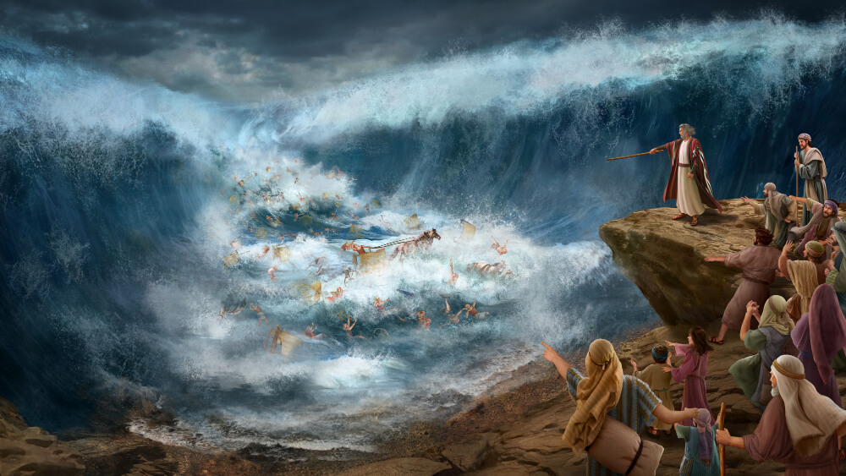
Injifannoo Waaqayyo Fara’on irratti argate (lak. 4-5)
Inni gaariiwwan Fara’onii fi loltoota isaa galaanatti gad darbateera. Qondaaltota Fara’on keessaa filatamtoonni, galaana diimaa keessa dhidhimaniiru. Tuujjubni isaan irra gara gale; isaanis akkuma dhagaa tuujjubatti gad dhidhiman.

Slide 4

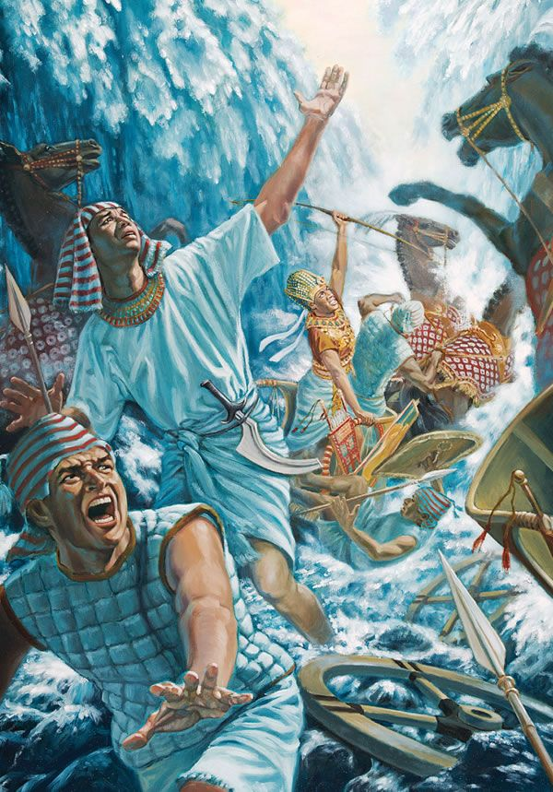
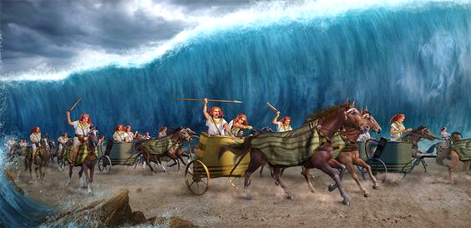
Surraa guddina Waaqayyoo (lak. 6-7)
Yaa WAAQAYYO, harki kee mirgaa humnaan ulfina qabeessa. Yaa WAAQAYYO, harki kee mirgaa diina ni hurreessa. Ati guddina ulfina keetiitiin warra siin morman gad darbatte. Aarii kee boba’aa ni ergite; innis akkuma habaqiitti gubee isaan fixe.

Slide 5

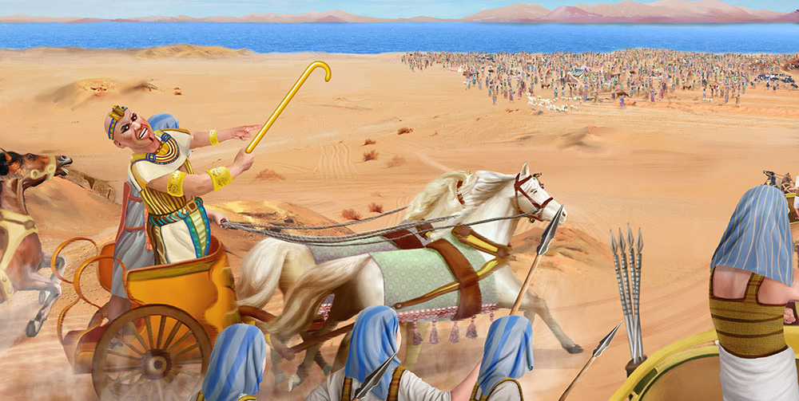
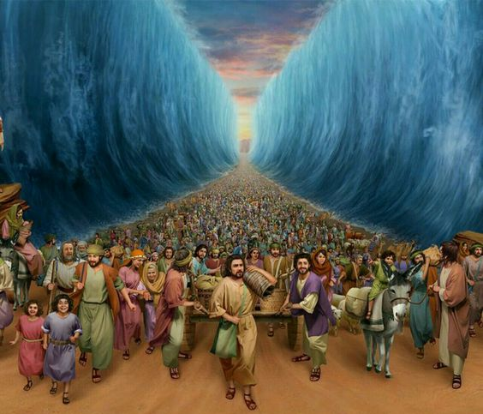
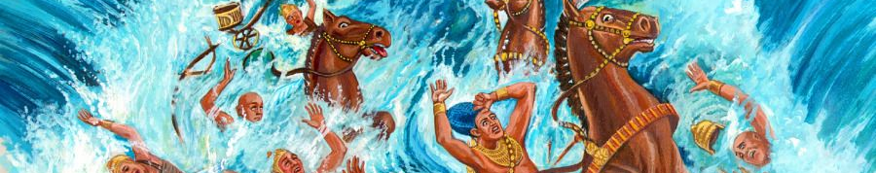
The Lord’s creative power and judgment (v. 8-10)
And with the blast of Your nostrils the waters were gathered together;
the floods stood upright like a heap;
the depths were curdled in the heart of the sea.
The enemy said,
I will pursue, I will overtake, I will divide the spoil;
my lust shall be satisfied upon them,
I will draw my sword, my hand shall destroy them.
You blew with Your wind; the sea covered them.
They sank like lead in the mighty waters.

Slide 6

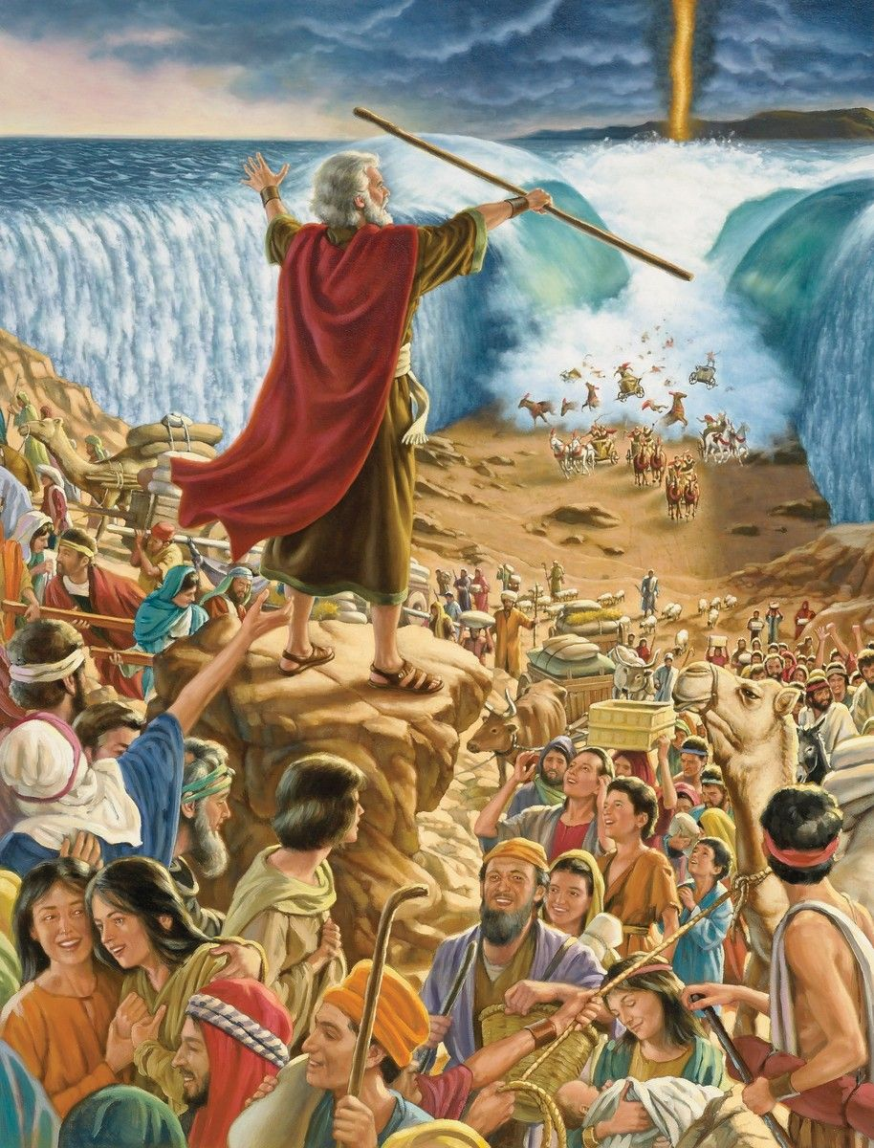
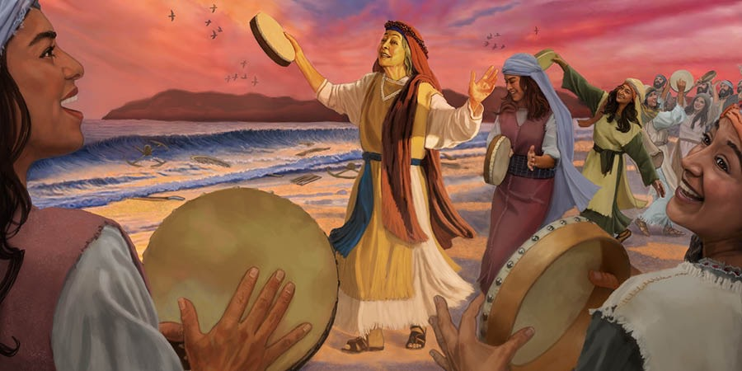
The Lord’s uniqueness (v. 11)
Who is like You, O Jehovah, among the gods?
Who is like You, glorious in holiness,
fearful in praises, doing wonders?

Slide 7

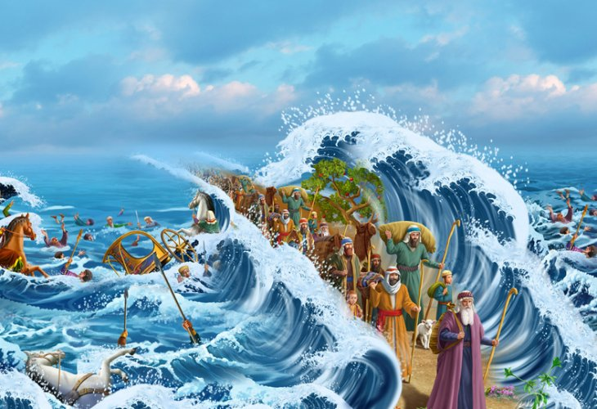
Jaalala Waaqaa fi diina jalaa oolchuu Isaa (lak. 12-16a)
Ati harka kee mirgaa diriirfannaan, lafti isaan liqimsite. Ati saba furte sana, jaalala kee hin geeddaramneen geggeessita. Jabina keetiinis gara iddoo jireenya keetii qulqulluutti isaan qajeelchita. Saboonni dhaga’anii hollatu; muddamsuunis saba Filisxeem qabate. Hangafoonni Edoom ni rifatu; bulchitoota Mo’aabis naasuutu qabata; warri Kana’aanis bishaanuma ta’u; soda fi abdii kutachuun isaan irra bu’a.

Slide 8
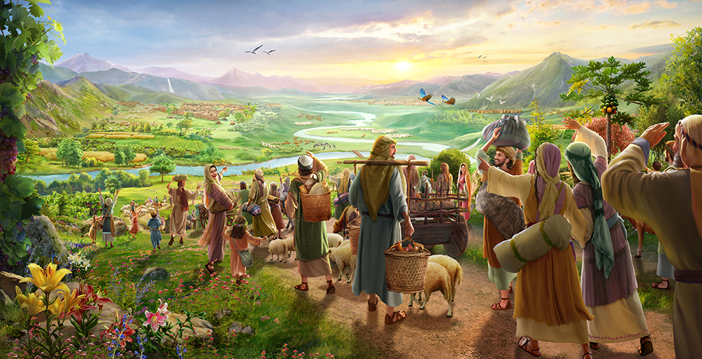
Waaqayyo mootii dha, saba Isaatiifis biyya abdachiise keessatti boqonnaa in kenna (lak. 16b-18)
Yaa WAAQAYYO, hamma sabni kee darbutti, hamma sabni ati bitatte sun darbutti jabina harka keetiitiin isaan akkuma dhagaa callisu. Yaa WAAQAYYO, ati gara tulluu dhaala keetiitti, gara lafa iddoo jireenya keetii godhachuuf tolfatteetti, yaa Gooftaa ati gara iddoo qulqulluu harki kee hundeesseetti ol galchitee isaan dhaabda. WAAQAYYO bara baraa hamma bara baraatti mo’a.”

Slide 9
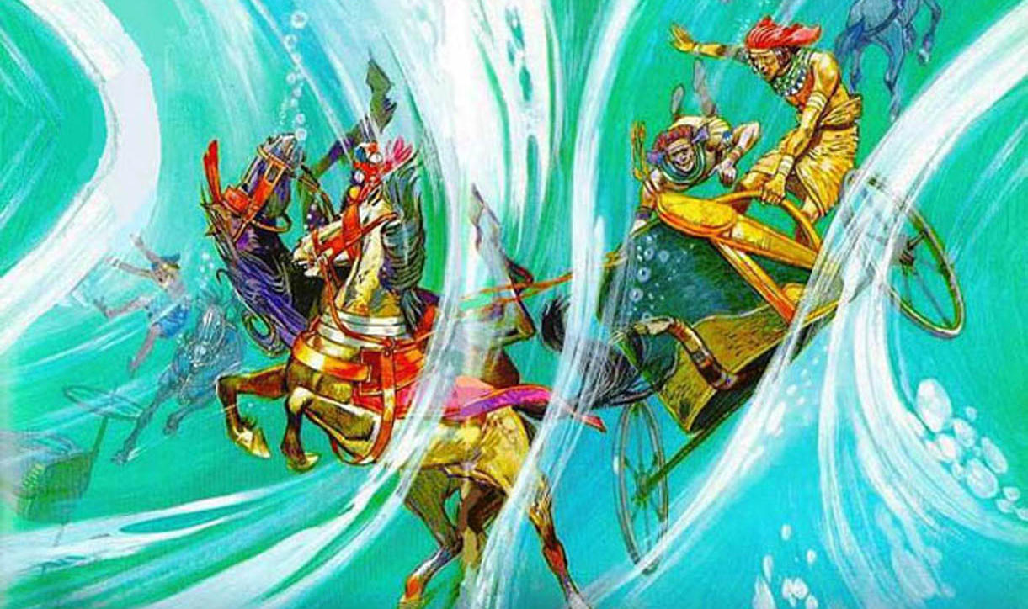
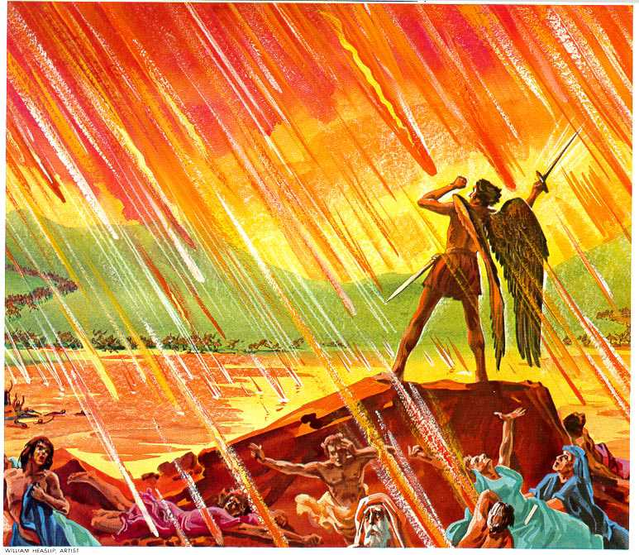
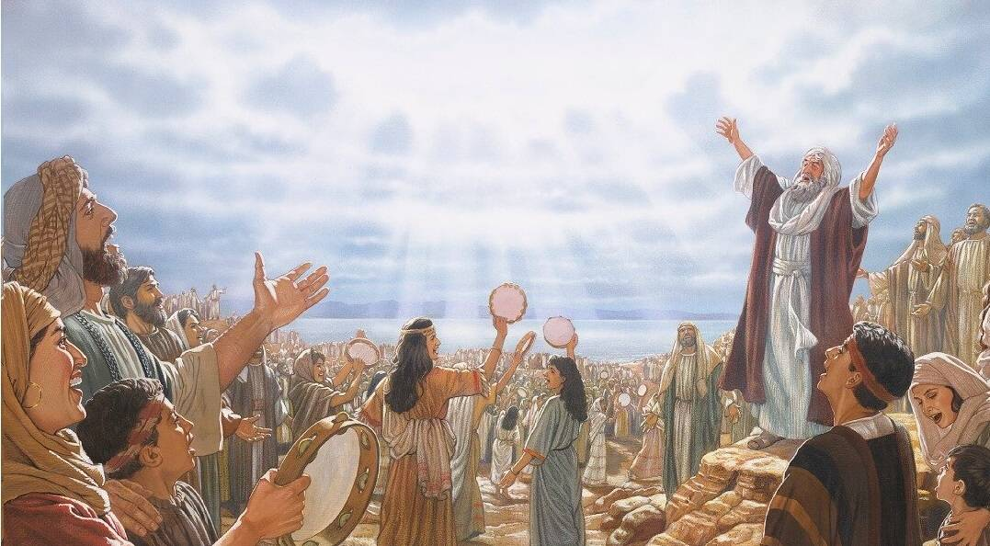
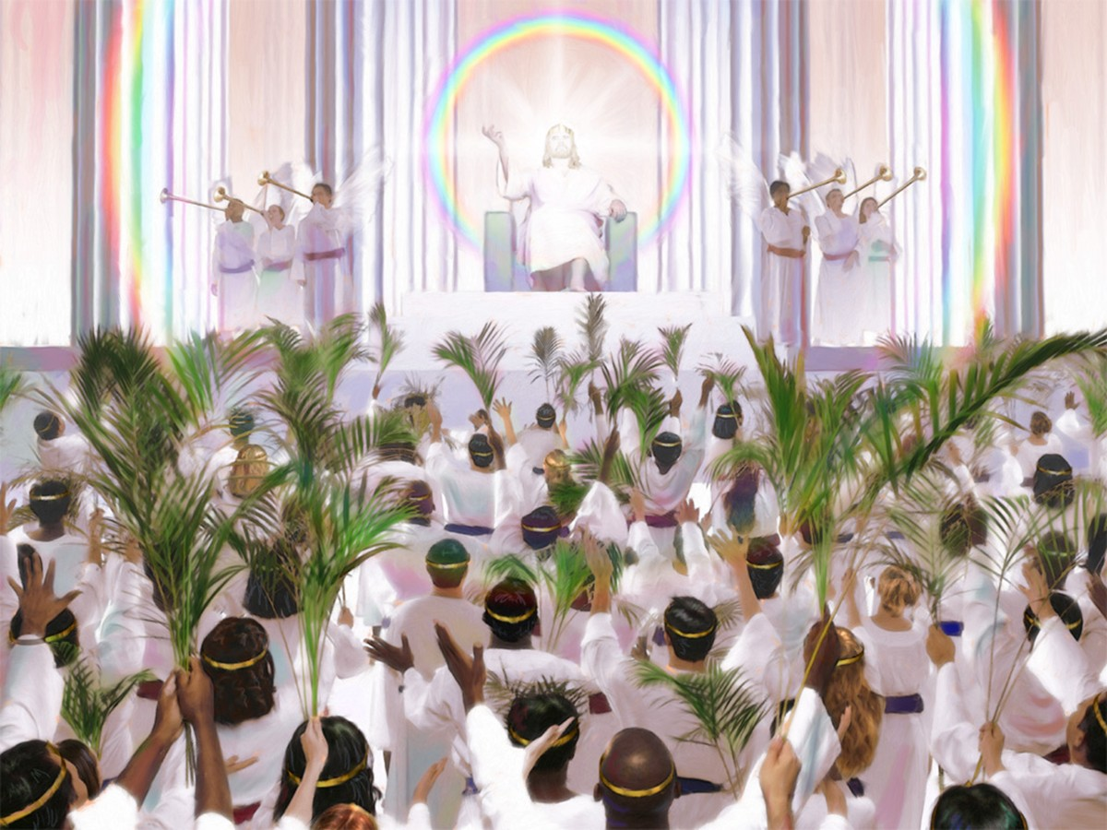
Ba’uu 15:1-18
Mul’ata 20:7-10; 15:1-4

