Slide 1
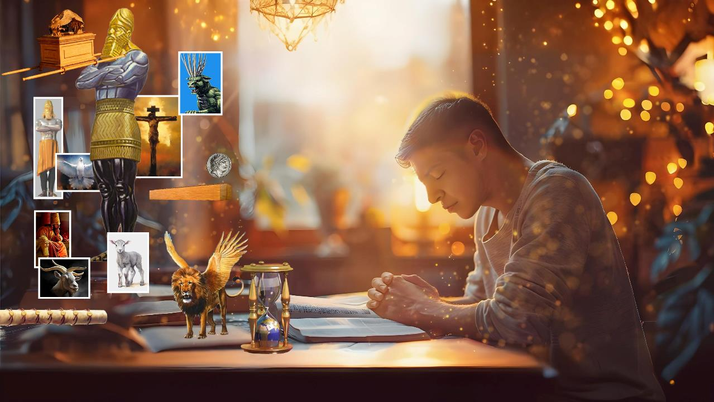
ZIMWE MU NGINGO NGENDERWAKO Z’UBUHANUZI
Icigwa ca 1 co kuwa 5 Ndamukiza 2025

Slide 2

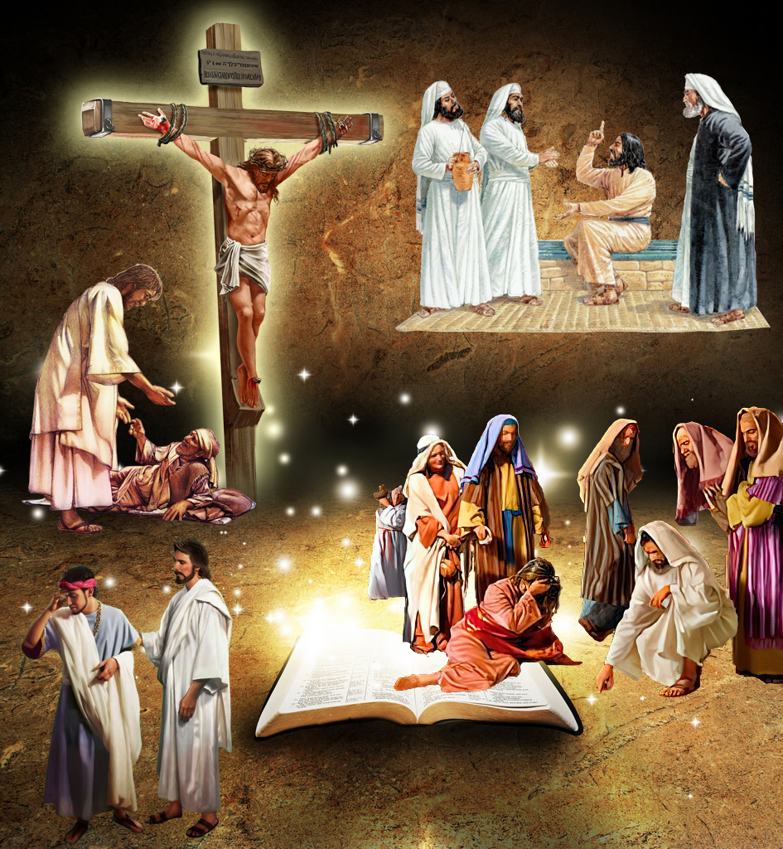
“arik' uwirata, ni yirate ibi, ko yammenye, akantahura, yuko nd' Uhoraho nkunda kugira imbabazi no guca iziroranye n'izigororotse mw isi: kukw ivyo ari vyo bimpimbara, ni jewe Uhoraho mbivuze.”
Yeremiya 9:24

Slide 3

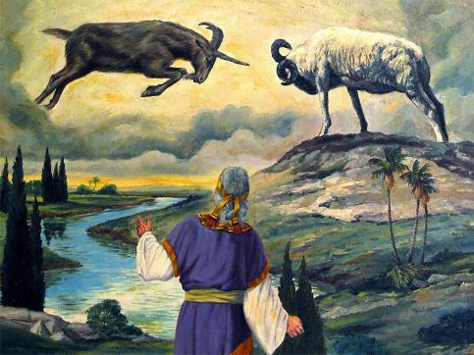
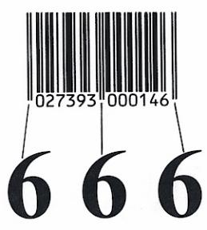
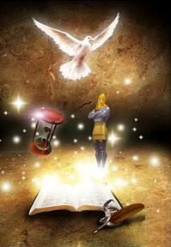
Ibimenyetso, amajambo adatomoye, ukugereranya, ibikorwa bidasanzwe ku ruhande rw’umuhanuzi... Uko ni ko ubuhanuzi bwa Bibiliya bumeze.
Bamwe ntibagira ubwoba bwo kugerageza gutahura insobanuro yabwo, bagahimbarwa n’ivyo uwundi muntu ababwira. Abandi bafata interuro imwe canke zibiri bagahingura insobanuro y’agatangaza ata shingiro n’imwe ifise.
Ariko abayisoma kandi bakayitahura neza barakura mu bumenyi bwerekeye Imana kandi bakaronka imigisha myinshi. Ni izihe ngingo ngenderwako zishobora kudufasha kwiga no gutahura neza ubuhanuzi bwo muri Bibiliya?
Ingingo ya 1: Nusome ufise inyifato ibereye.
Ingingo ya 2: Vumbura iciyumviro nyamukuru.
Ingingo ya 3: Gukoresha ubuhinga.
Ingingo ya 4: Ibijanye vyose hamwe n’ibivugwa.
Ingingo ya 5: Insobanuro hamwe n’ibimenyetso.

Slide 4

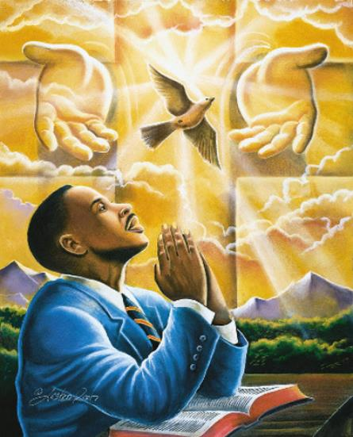
INGINGO YA 1: SOMA UFISE INYIFATO IBEREYE
“Hahirwa usoma, hahirwa n’abumva amajambo y’uku kuvugishwa n’Imana, bakitondera ivyanditswe muri yo: kukw igihe kiri hafi.’’ (Ivyahishuriwe Yohana 1:3)
Hariho umugisha wasezeraniwe abasoma ubuhanuzi (Ivyah. 1:3a). Ariko rero, ni bake cane bumva ko bahezagiwe mu gusoma ubuhanuzi buri mu Vyahishuriwe Yohana, Daniyeli, Yesaya, Zekariya, n’ahandi.
Ni kubera iki ivyo bishika? Kuko ntibabisoma bafise inyifato ibereye. Igihe Yesu yavuga ngo: "Uwusoma niyiyubare" (Matayo 24:15,) yariko aratubwira ko dushobora kubitahura, ariko mu gihe ivyangombwa bimwe bimwe vyubahirijwe:
Kwitegurira kwumviriza ivyo ubuhanuzi butwigisha (Ivyah. 1:3)
Gutahura ko tutagira ubumenyi bukwiye kugira ngo tubitahure, ahubwo ko twizigira ubwenge buva ku Mana kugira ngo tubitahure (Mt. 11:25; Yer. 9:23)
Gusoma ubuhanuzi kugira ngo nsigure ukuntu mbona uko ibintu bimwe bimwe bizogenda, canke sinumvemwo ijwi ry’Imana rivugira muri bwo, si uburyo bubereye.

Slide 5

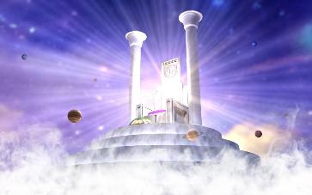
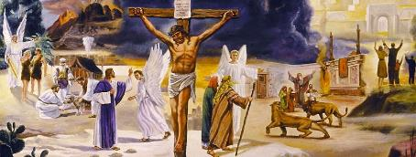
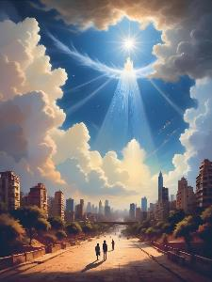
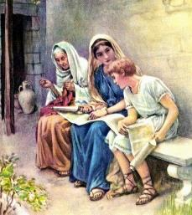
INGINGO YA 2: KUVUMBURA ICIYUMVIRO NYAMUKURU
“kand' uzi yuk' uhereye mu buto bgawe wamye uzi ivyanditswe vyera bishobora kukumenyesha ubgenge bgo kukuzanira agakiza gaheshwa no kwizera Kristo Yesu.” (2 Timoteyo 3:15)
Umwanditsi wa Zaburi yaremeye ko adashobora gutahura ubumenyi bw’Imana, kuko ubumenyi bwayo butagira iherezo (Zab. 139:6; 147:5). Paulo atubwira ko ibikorwa vy’Imana “bidashobora guserangurwa,” ni ukuvuga ko bidashobora kwigwa no gutahurwa (Rom. 11:33).
Ni nk'aho bidashoboka ko dutahura iciyumviro c’Imana nk’uko bidashoboka ko dukora ku kwezi n’ukuboko kwacu (Yes. 55:9).
Igishimishije, Imana yaragize utwigoro two kumanuka ku rugero rwacu, idufashe gutahura ikintu kijanye n'ivyiyumviro vyayo. Muri Bibiliya, Ijambo ry’Imana, n’ubwenge busanzwe burashobora gutahura urukundo rw’Imana n’agakiza iduha (2 Tim. 3:15).
Umugambi w’Agakiza ni yo ngingo nyamukuru ya Bibiliya, kandi birumvikana ko ari yo dusanga mu buhanuzi buri muri yo.

Slide 6

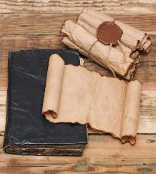
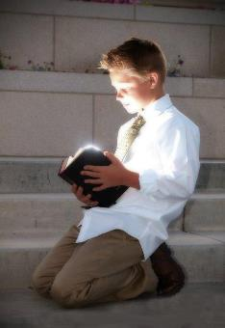
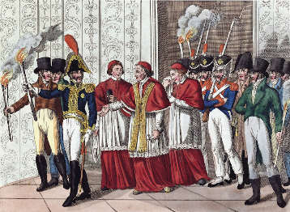
INGINGO YA 3: KORESHA UBUHINGA
“Nuko rero wewe Daniyeli, gumiza ayo majambo muri ntibate, umatanishe ishashara igitabo cavyo udomemw' ikimenyetso, gushitsa igihe c'iherezo; ni ho benshi bazoserangura muri co, kand' ubgenge buzogwira.” (Daniyeli 12:4)
Hamwe n’itegeko ryo kwugara ico gitabu—guhisha ibirimwo—gushika mu gihe c’iherezo, Daniyeli yabwiwe ivy’ukwiyongera kw’ukurondera ubumenyi—ubumenyi bukenewe—kugira ngo umuntu agitahure (Dan. 12:4).
Igihe Yesu yigira umuntu, ico kidodo caratanguye kumaturwa. Bumwe mu buhanuzi bwa Daniyeli ubu bwari gushobora gutahurwa (Matayo 24:15). Mu nyuma, bwarongeweko n’ubundi buhanuzi bwanditswe mu gitabu "kitadomweko ikimenyetso": Ivyahishuriwe Yohana (Ivyahishuriwe Yohana 22:10).
Mu mwaka wa 1798, igihe Napoléon yarangiza ubutegetsi bwa papa bwari bwagumye bufise ububasha nk’ubw’icuma mu binjana n’ibindi, benshi babonye ko ivyo ari ukuranguka kw’ubuhanuzi bwa Daniyeli. Imana yari yafunguye igitabu ca Daniyeli mu buryo bwuzuye, itanga ubumenyi bukenewe kugira ngo umuntu agitahure.
538
1,260
1798
Si ubuhanuzi gusa bwatahuwe neza kuva ico gihe, ahubwo n’ibindi bintu (nk’akarorero, Isabato, canke uko abapfuye bamera) vyarasubiye gutahurwa neza.
Daniyeli 7:25
Reka dusabe Nyenubuhanuzi aduhe ubuhinga bukenewe kugira ngo tubutahure.

Slide 7

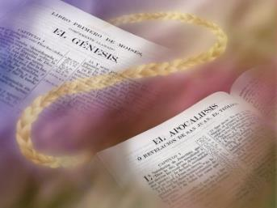
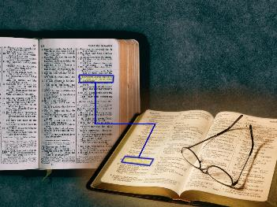
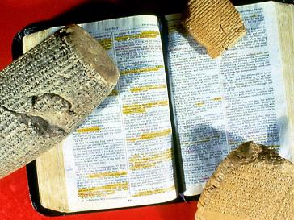
INGINGO YA 4: KUJANISHA N’INTUMBERO
“Atangurira kuri Mose no ku bavugishwa n'Imana bose, abasobanurira mu vyanditswe vyose ivyanditswe kuri we.” (Luka 24:27)
Gusoma ubuhanuzi bwonyene bizokujana gusa ku nsobanuro zitangaje, ziri kure cane y’insobanuro yabwo nyakuri.
Yesu yatwigishije kwiga Bibiliya yose uko ingana, ni ukuvuga kuyibona yose uko ingana (Luka 24:27).
Gufata igice kimwe gusa (nk’akarorero, ubuhanuzi) maze ugashika ku nsozero ushingiye kuri ico gice gusa, ni uburyo butari bwo bwo kwiga Ijambo ry’Imana. Uburyo bubereye ni ukugereranya ivyo vyanditswe n’ibindi bivuga ku ciyumviro kimwe mu bice bitandukanye vya Bibiliya.
Ikindi kintu co kurimbura ni ikintu gikikuje icanditswe, ni ukuvuga ikintu gikikuje icanditswe kiriko kirigwa. None ivyanditswe biri imbere n’inyuma yavyo bivuga iki? Ni nde yavyanditse, ryari kandi kubera iki?
Gukura umurongo mu vyo uvuga birashobora gutuma uvuga ivyo ushaka vyose, ariko ntuvuge ukuri ushaka kutwigisha.

Slide 8

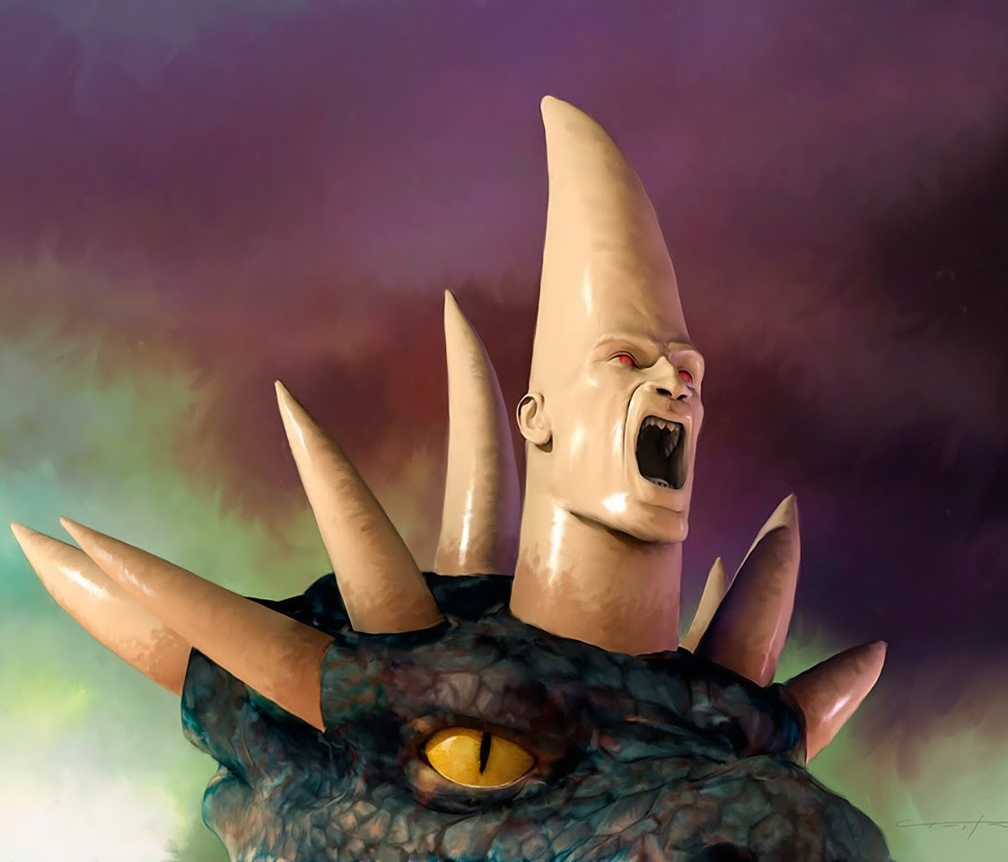
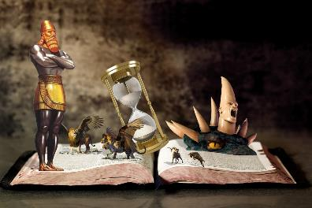
INGINGO YA 5: UBUSOBANURO BW’IBIMENYETSO
“ibanga ry'inyenyeri ndwi izo umbonanye mu kuboko kwanje kw'i buryo, n'ivy' ibiterekwakw amatara ndwi vy'izahabu. Inyenyeri ndwi ni zo bamarayika b'ayo mashengero ndwi, ibiterekwakw amatara ndwi na vyo ni vyo mashengero ndwi.” (Ivyahishuriwe Yohana 1:20)
Ubuhanuzi bwo muri Bibiliya bwuzuyemwo ibimenyetso hamwe n’amashusho. Mu bihe bimwe, ubwo buhanuzi ubwabwo buratubwira ubusobanuro bwabwo (Dan. 8:20; Ivyah. 1:20). Ariko rero, kenshi na kenshi, ubusobanuro bwabwo yabwo ntibutangwa.
Amahembe y’igikoko giteye ubwoba kiri muri Daniyeli 7:7-8 asobanura iki?
Ni abami, hamwe n’ubwami bahagarariye (Dan. 7:24; 8:21).
Inkota iva mu kanwa ka Yesu mu Vyahishuriwe Yohana 1:16 isobanura iki?
Bibiliya ( Ef. 6:17; Heb. 4:12)
Uwo mugore wo mu Vyahishuriwe Yohana 12:1 ni nde?
Abantu b’Imana b’Abizerwa (Ef. 5:31-32; 2 Kor. 11:2)
Kugerageza gufata ayo mashusho nk’uko biri ni ubujuju. Yesu ntagira inkota ikarishe y’ubugi bubiri iva mu kanwa kiwe (Ivyah. 1:16).
Kugira dutahure neza ivyo bimenyetso, dutegerezwa kuraba mu bindi bice vyo muri Bibiliya aho hakoreshwa ivyiyumviro bisa n’ivyo canke ibimenyetso bisa n’ivyo. Reka turabe ingero zimwezimwe:
Imana yarijeje ko uwuzosesangura ubuhanuzi wese azoshobora kubutahura.

Slide 9

“Uko umuntu yoba ateye imbere mu bwenge kwose, ntaze yiyumvire n’akanya na gato ko atari nkenerwa gusesangura Ivyanditswe kugira ngo aronke umuco mwinshi. Nk’ihanga twahamagariwe umwumwe wese kuba abanyeshure b’ubuhanuzi. Dutegerezwa kwama tugavye kugira ngo dushobore gusobanukirwa buri mushwarara wose w'umuco Imana izodushikiriza. Dutegerezwa gucakira ugukayangana kwa mbere na mbere kw'ukuri; kandi biciye ku kwiyigisha mw’isengesho umuntu arashobora kuronka umuco utomoye kuruta, uwo na wo ukaba ushobora gushikirizwa abandi.”
EGW (Testimonies for the Church, volume 5, page 708)

