Slide 1

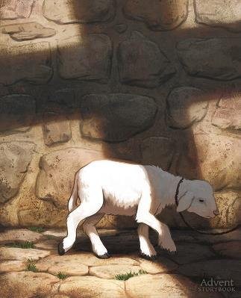
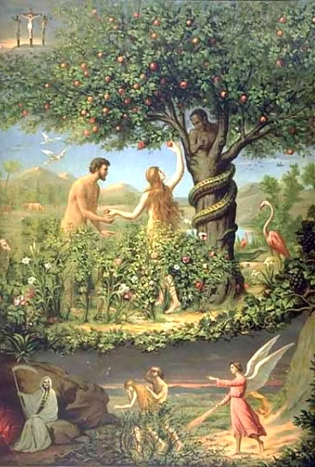
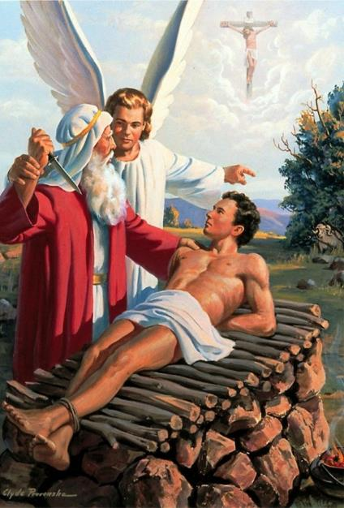
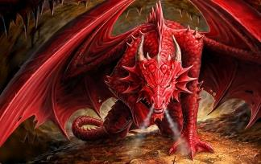
UMUSHINGE MW’ITANGURIRO
Icigwa ca 2 co kuwa 12, Ndamukiza 2025

Slide 2
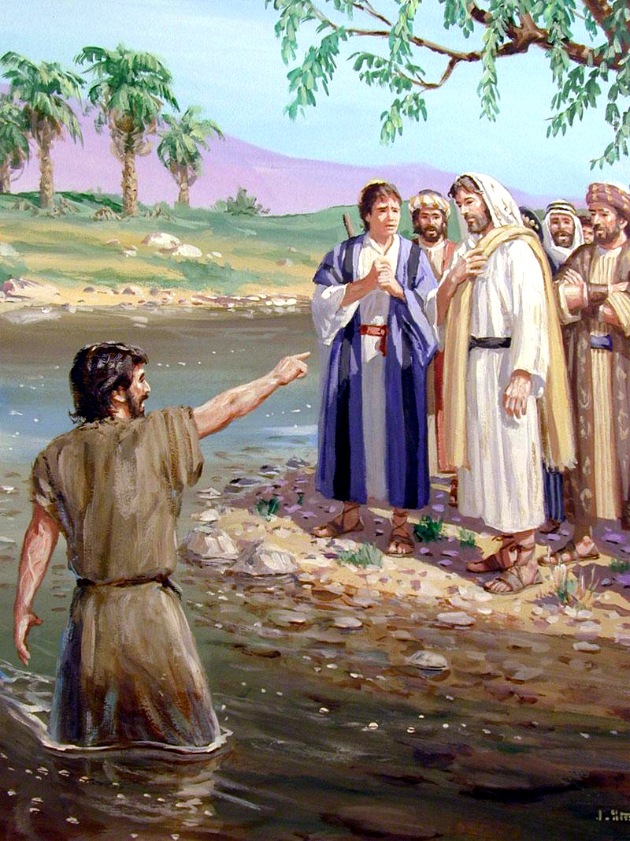
“Bukeye bg'aho abona Yesu aza kuri we, aravuga, ati Nguyu Umwagazi w'intama w'Imana ukurah' icaha c'abari mw isi.”
Yohana 1:29

Slide 3

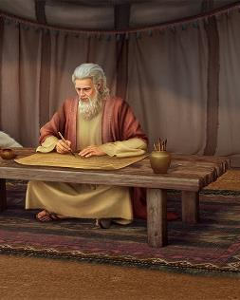
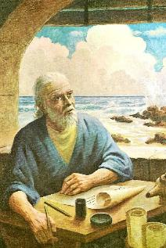
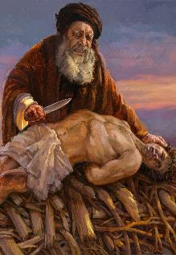
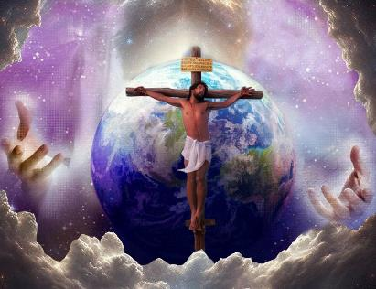







Bibiliya igizwe n’ibitabu 66 vy’ubwoko butandukanye, kandi yanditswe n’abantu barenga 40 mu kiringo c’imyaka 1.500.
Twoshobora kwitega ko hoba ukutumvikana n’ukuvuguruzanya hagati y’abanditsi batandukanye. Ariko rero, ico twihweza igihe tuyiga ni uguhuza. Vyongeye, hariho ibice vyo muri Bibiliya umuntu adashobora gutahura ataravye ibindi bice vyayo.
Tugiye kwiga ingingo ngenderwako y’ugusobanura izodufasha kumenya insiguro y’ikimenyetso canke y’ukubangabanganisha, mu guca muri Bibiliya yose.
Ingingo ngenderwako y’icavuzwe ubwa mbere.
Itanguriro 22: Urukundo n’Umwagazi w’intama.
  “uwo UKUNDA”
  “UMWAGAZI w’INTAMA uri hehe?”
Itanguriro 2-3: Urupfu n’Inzoka.
  “Nta kabuza muzoPFA”
  “INZOKA yari inyabugunge”

Slide 4

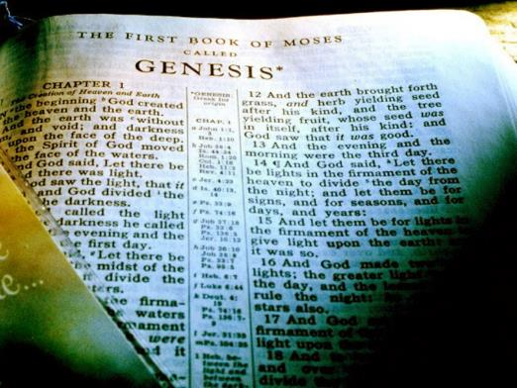
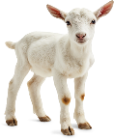


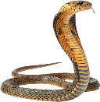
INGINGO NGENDERWAKO Y’ICABANJE KUVUGWA
“Yesu Kristo uko yar' ar' ejo, n'uyu musi ni kw akiri, ni kw azokwama ibihe bidashira.” (Abaheburayo 13:8)
Ivyigwa vyose vyigishwa bitangurana n’icigwa ca mbere. Mu bisanzwe, ni co kidondora ingingo ngenderwako zizoshigikira izo nyigisho.
Muri Bibiliya, tubona ico "cigwa ca mbere" mw'Itanguriro. Aho, amajambo menshi y’ingenzi araboneka ku ncuro ya mbere, adufasha gutahura Umugambi w’Agakiza mu bindi bice vyose vya Bibiliya.
Imana ntihinduka (Mal. 3:6a; Heb. 13:8). Ijambo ryayo ntirihinduka (Yes. 40:8). Rero, nta bivuguruzanya biri muri Bibiliya. Umugambi w’Agakiza urasigurwa muri yo buhoro buhoro, gushika utahuwe neza—canke n’imiburiburi, kugeza ku gutahura dukeneye ubu (2 Pet. 1:19).
Turashobora gutahura neza Yesu, n’ivyo yadukoreye, biciye mu kuvuga ubwa mbere, mw’Itanguriro, amajambo amwe amwe y’ingenzi: URUKUNDO, UMWAGAZI W'INTAMA, URUPFU, n’INZOKA.

Slide 5
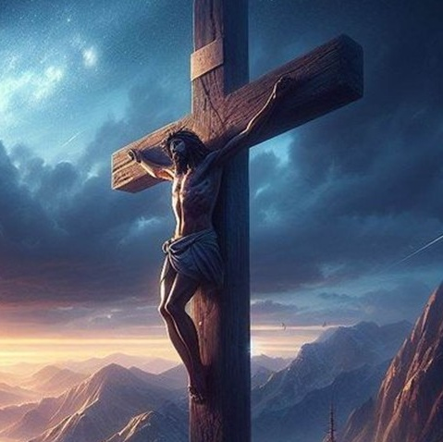
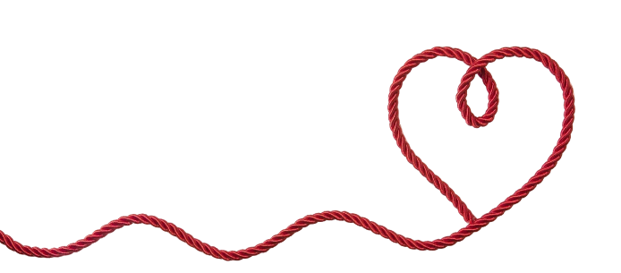

ITANGURIRO 22:
URUKUNDO N’UMWAGAZI W’INTAMA

Slide 6

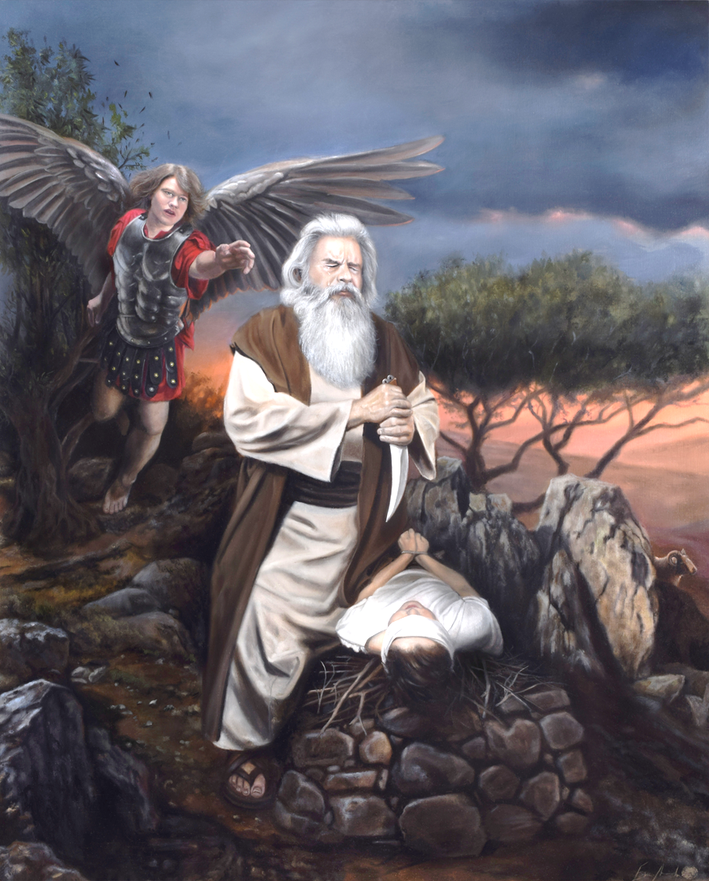
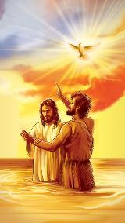
“uwo UKUNDA”
“Iramubgira, it' Enda jana umwana wawe, umwana wawe w'ikinege ukunda, Isaka nyene, uje mu gihugu c'i Moriya; umutangireyo kw ikimazi co kwoswa, ku musozi nzokubarira.” (Itanguriro 22:2)
Urukundo! None urukundo turusobanura gute? Iciyumviro cacu ku bijanye na rwo kiragoramye bimwe bigaragara kubera icaha. None dushobora gute gutahura urukundo rw'Imana rutyoroye kandi rweranda?
Ikigabane ca mbere aho Bibiliya ivuga urukundo, yerekeza ku bucuti buri hagati ya se n’umuhungu wiwe: Aburahamu na Isaka (Ita. 22:2.) Umuntu aravye neza, ivyo bivugwa bisa n’ibiteye ubwoba: Aburahamu yari akwiye gutanga umuhungu wiwe yakundwa! (Ntuhagarike umutima, ntiyarangije kubikora).
Gereranya uku kuvugwa n’ukuvugwa kwa mbere kw’urukundo dusanga mu butumwa bwiza: “Uyu [Yesu] ni Umwana wanje nkunda” (Mt. 3:17; Mk. 1:11; Lk. 3:22).
Kandi ntucikwe n’aho havugwa ubwa mbere mu butumwa bwiza bwanditswe na Yohana (Yohana 3:16.) Ico gikorwa ca Aburahamu co gutanga umwana wiwe nk’ikimazi kirerekana ingene Imana yadukunze gushika aho itanga Umwana wayo bwite kugira ngo tubeho ibihe bidashira.

Slide 7

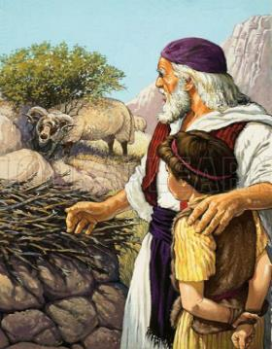
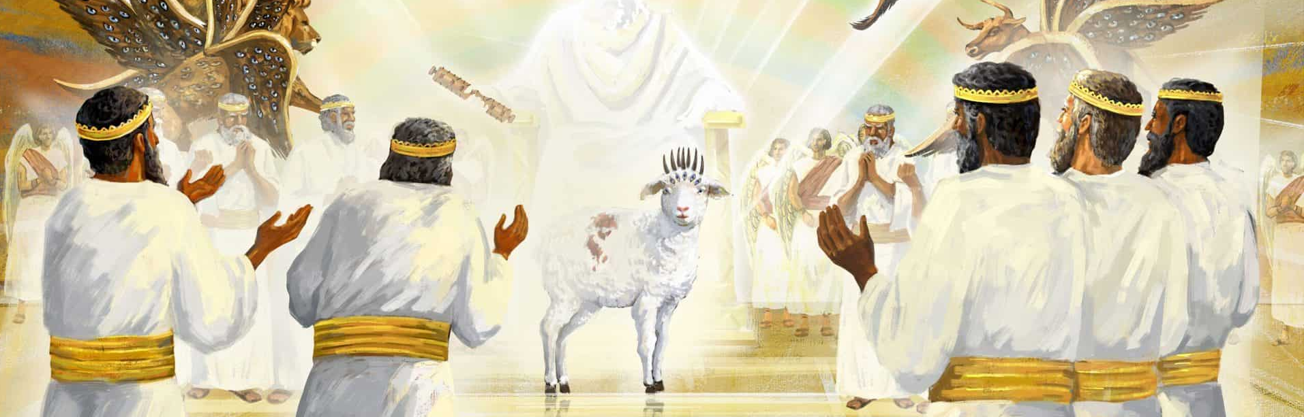
“UMWAGAZI W’INTAMA uri he?”
“Isaka abaza se Aburahamu, ati Mbega da? Aramwitaba, ati N'iki ga mwana wanje? Ati Mbeg' umuriro n'inkwi kw ari ngibi, non' umwagazi w'intama uri hehe, wo gutanga kw ikimazi co kwoswa?” (Itanguriro 22:7)
Ijambo UMWAGAZI w'INTAMA mu kuvugwa ubwa mbere si impanuka (Itanguriro 22:7). Ni ryo shingiro ryo gutahura ukuntu Umwagazi w’intama uvugwa kenshi mu Vyahishuriwe Yohana (Ivyah. 5:6).
Warakinze urupfu ku bana b’imfura (Kuv. 12:13)
Ryari ishikanwa Imana yama ifise ku muzirikanyi (Kuv. 29:38-41)
Nabwirizwa gupfa kubera ivyaha vyanje (Yes. 53:6-8)
Yohana umubatizi yarerekanye Umwagazi w’intama (Yoh. 1:29)
Zirikana ko umwagazi w'intama Imana yatanze mu vy’ukuri yari impfizi y’intama (Ita. 22:8, 13). Ku musi mukuru wa Pasika, umwagazi w'intama watangwako ikimazi, naho nyene washobora kuba umwagazi w'intama canke umwagazi w’impene (Kuv. 12:3, 5). Ni ukuvuga ko ijambo “intama” ryaje gusobanura impera n'imperuka ikimazi. Bukebuke, Bibiliya iragura insobanuro y’ikigereranyo c’umwagazi w’intama:
Ntibitangaje rero ko Ivyahishuriwe Yohana bidasigura akaranga k’Umwagazi w’intama. Umwagazi w’intama ni Yesu, yatanzwe kubera ivyaha vyanje kandi yama ansabira imbere ya Data (Heb. 7:25).

Slide 8

“Vyari bigoye mbere no ku bamarayika gutahura ibanga ry’ugucungurwa—gutahura ko Umutware w’ijuru, Umwana w’Imana, ategerezwa gupfa kubera umuntu w’umunyavyaha. Igihe itegeko ryahabwa Aburahamu ngw'atange umwana wiwe, hari ku neza y'ivyaremwe vyose vyo mw'ijuru. Bafise amatsiko menshi, barihweje intambuko ku yindi ishirwa mu ngiro ry'ico cagezwe. Igihe ku kibazo ca Isaka kivuga ngo “Umwagazi w’intama w’ikimazi co kwoswa uri hehe?” maee Aburahamu akishura ati: “Imana iri bwironkere umwagazi;” kandi igihe ukuboko kwa se kwahagarikwa hejuru igihe yagira ngo yice umuhungu wiwe, maze iyo mpfizi y’intama Imana yari itanze igashikanirwa mu kibanza ca Isaka—ni ho umuco warasa ku bijanye n'ibanga ry’ugucungurwa, mbere n’abamarayika baratahura neza cane intunganyo itangaje Imana yari yarashizeho kugira ngo umuntu akizwe.”
EGW (Abakurambere n’Abahanuzi, pg. 155)

Slide 9
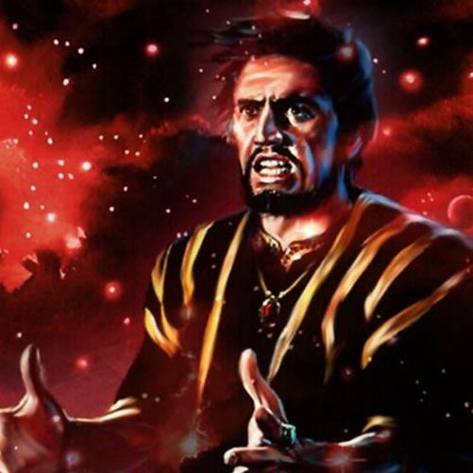
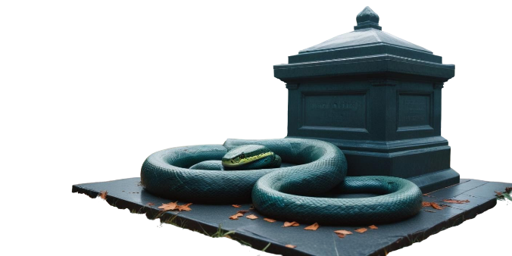
ITANGURIRO 2-3:
URUPFU N’INZOKA

Slide 10

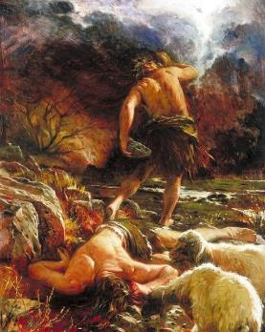
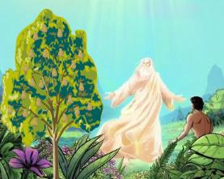
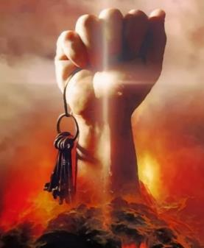
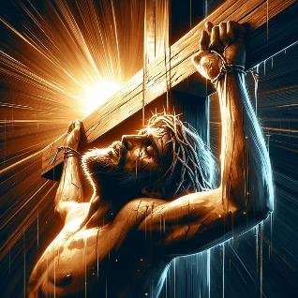
“nta kabuza muzoPFA”
“arikw igiti kimenyekanisha iciza n'ikibi ntuz' ukiryeko: kuk' umusi wakiriyeko, uzopfa nta kabuza.” (Itanguriro 2:17)
Imana ni yo yabanje kuvuga urupfu (Itanguriro 2:17). Ariko urupfu rwashobora kubaho gusa nk’ingaruka y’icaha (Rom. 5:12).
Urupfu akenshi rujanye n’ubusaza. Ariko urupfu rwa mbere rwanditswe ni urw’umusore: Abeli (Itanguriro 4:8). We, naho yari umugororotsi, yapfiriye mu maboko y’umuntu w’umubisha (Heb. 11:4; 1 Yoh. 3:12).
Amateka yarisubirije haciye ibinjana n'ibindi, igihe Umugororotsi yapfira mu maboko y'abanyavyaha (Mark 15:14). Mu buryo buhushanye n'ubwa Abeli, Yesu—uwari gushobora kwikingira urupfu rwiwe —yaremeye kwicwa (Ef. 5:2).
Yesu yarakoze ivyo Abeli atashoboye: yaranesheje urupfu ( Rom. 6:9). Kandi, nk’uko Ivyahishuwe 1:18 havyerekana, yararonse “imfunguruzo z’urupfu,” izo yashobora gukoresha mu kwugurura imva (“gihenomu” canke “Hadesi”).

Slide 11

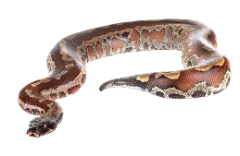
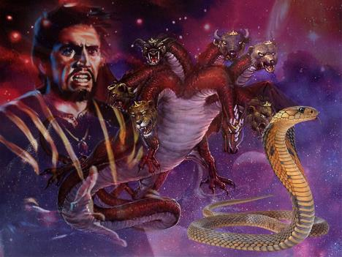
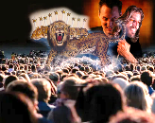
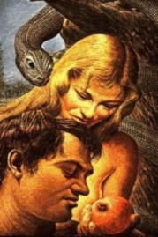
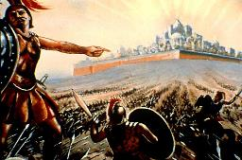
“INZOKA yari inyabugunge”
“Inzoka yarusha ubugunge ibikoko vyose vyo mw ishamba Uhoraho Imana yaremye.” (Itanguriro 3:1a)
Ivyahishuriwe Yohana harerekana igisato (Ivyah. 12:3-4). Hatubwira kandi ko ico gisato ari ikigereranyo ca Satani (Ivyah. 12:9).
Mu kugaragaza ibiranga ca gisato ivyo ari vyo, yongerako ikindi kigereranyo gishasha: Satani ni “ya nzoka ya kera”. None ariko yerekeza ku nzoka iyihe?
Ego cane, inzoka ya mbere ivugwa muri Bibiliya (Itanguriro 3:1). Muri Edeni, Satani (inzoka) yahenze isi yose (ni ukuvuga Adamu na Eva).
Mu Vyahishuriwe Yohana, twibutswa ko iyo ari yo ntumbero yiwe kuva kera na rindi, kandi ko ari yo azoba ari yo ntumbero yiwe idasanzwe mu bihe vy'imperuka (Ivyahishuriwe Yohana 13:14). Azogerageza mbere guhenda umuntu wese imbere y’Imana nyene (Ivyahishuriwe Yohana 20:8).
None twokwikingira gute amayeri yiwe? Uburyo bumwe ni ubwo kwiga ingene yabigize ubwa mbere. Amayeri yiwe y’ishimikiro ntiyahindutse mu binjana n’ibindi.

Slide 12

EGW (Manuscript) Releases, vol. 10, pg. 156)
“Ubutumwa bwiza bwahishuwe mu buhanuzi bwose bwerekeza ku kuza kwa mbere kwa Kristo nk'Umukiza w'abantu. Igikorwa cose co mu gihe ca kera co gukura abantu mu vyaha canke kubaronsa imbabazi cakozwe cerekeza ku Mukiza yari agiye kuza. Yari ibuye rigumya imfuruka umuntu yari akwiye gushira hejuru.”

