Slide 1
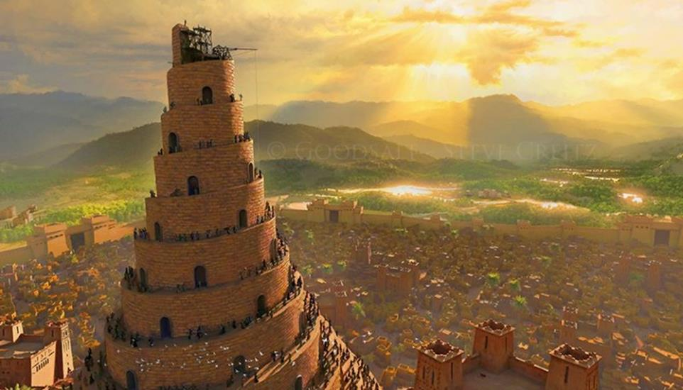
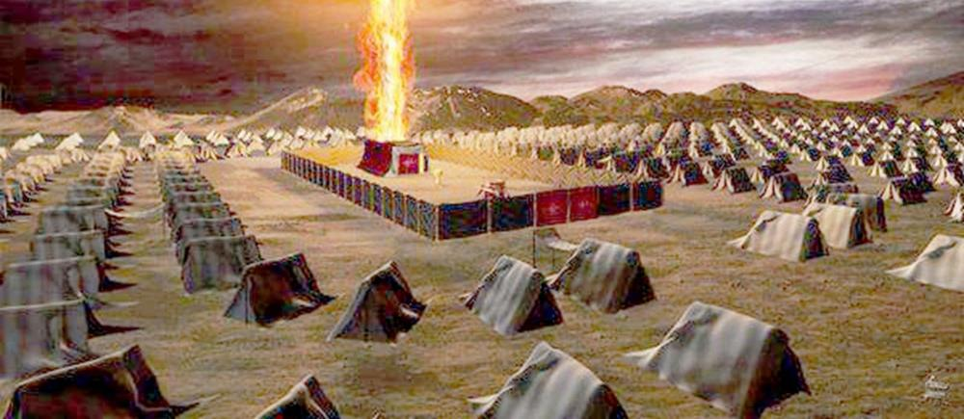
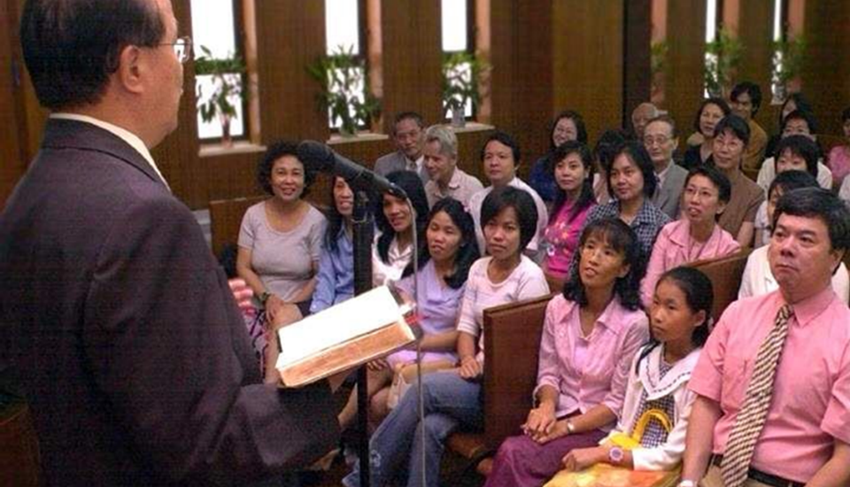
AMAHANGA
IGICE CA 1
Icigwa ca 4 co kuwa 26 Ndamukiza 2025

Slide 2
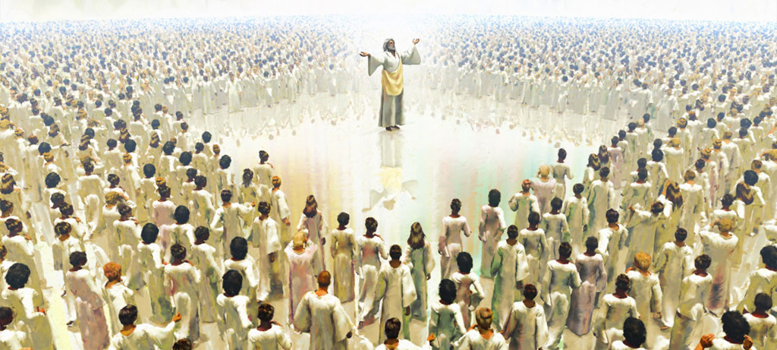
“Aca ahabga inganji n'icubahiro n'ubgami, kugira ngw amoko yose n'amahanga n'abavuga indimi zitari zimwe bamusabe: ingoma yiwe n'ingoma itazovaho, kand' ubgami bgiwe n'ubgami butazohangura.” Daniyeli 7:14

Slide 3

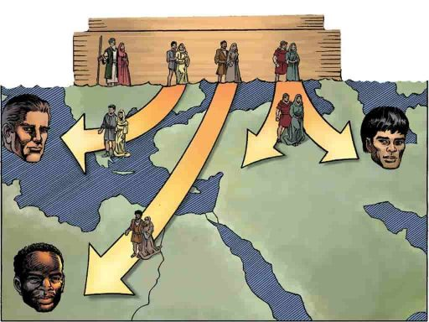
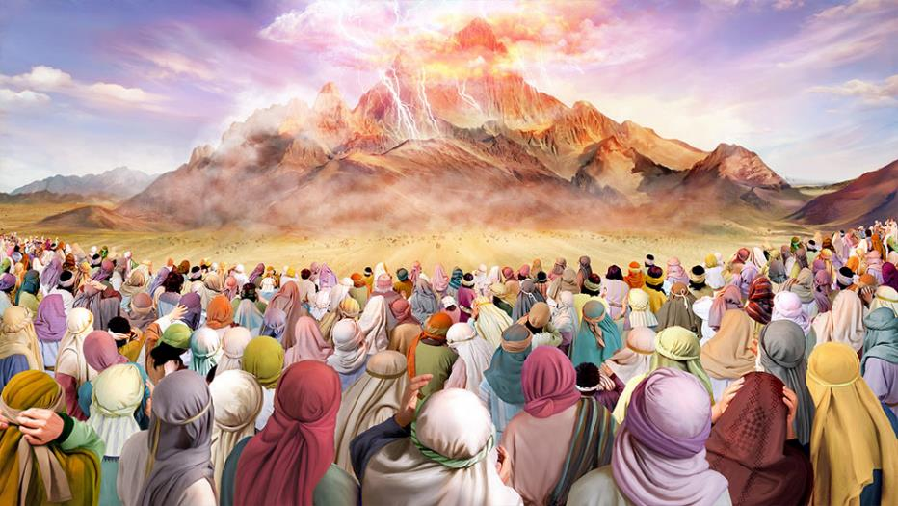







Uhereye mu bana ba Nowa ni ho amahanga yatanguye kuvuka kw’isi inyuma y’umwuzure.
Abenshi muri bo bari abansi b’Imana, basenga izindi mana, bakabaho bisunga ivyagezwe vyabo bwite.
Ariko Imana yatanguje ihanga rishasha, iriha amategeko yotuma riba ihanga rikomeye kuruta ayandi yose kw’isi, amahanga yose yo kw’isi akazogendera mu muco waryo.
Inkomoko y'amahanga:
  Amahanga ya mbere.
  Ihanga ryavyawe n’Imana.
Ubwoko bwatoranijwe:
  Amateka ya Isirayeli.
  Amateka y'Ishengero.
  Uruhara rw’ubwoko bwatoranijwe.

Slide 4

INKOMOKO Y’AMAHANGA

Slide 5

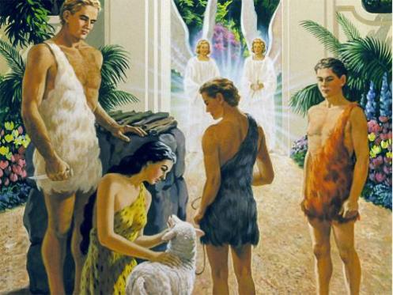
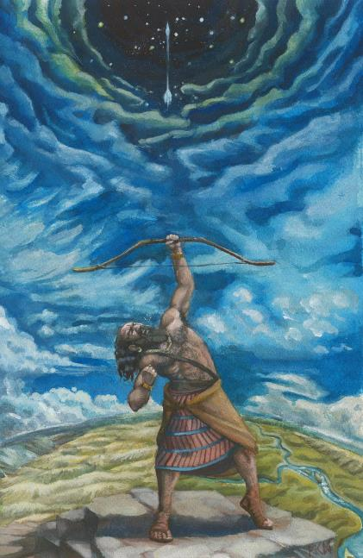
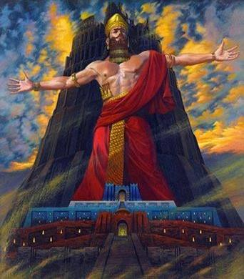
AMAHANGA YA MBERE
“Iyo ni yo miryango ya bene Nowa, nk'uko yagiye ivyarirana, ukw amahanga yabo ari: kand' amahanga yabakomotseko ni yo yakwiye isi yose, wa mwuzure uvuyeho.” (Itanguriro 10:32)
Kubera icaha cabo, Adamu na Eva barirukanwe muri Edeni, barabuzwa no kuyinjiramwo. Bo n’uruvyaro rwabo babandanije kuza ku bwinjiriro bwa Edeni, bwari burinzwe n’abakerubi, kugira ngo bashikanire Imana ibimazi.
Muri ubwo buryo, abantu, mu kiringo kinaka, barabandanije kwemera ko Imana ari yo mutware wabo mukuru.
Igihe Imana yafata ingingo yo gutikiza Isi ikoresheje umwuzure, kubera ikibi cari gikomeye, yarakuyeho n’Itongo rya Edeni. Inyuma y’umwuzure, abantu nka Nimurodi baciye bafata ingingo yo kwiremera ibihugu vyabo hanze y’Imana, birongowe na bo nyene (Itang. 10:6-12).
Nimurodi bavuga ko yari “umuhigi w’igihangange imbere y’Uhoraho Imana” (Itang. 10:9 LXX). Mu bisagara yubatse harimwo Babeli na Ninewe, aho havuye amahanga yamenyekanye ko ari abansi b'ubwoko bw’Imana.

Slide 6

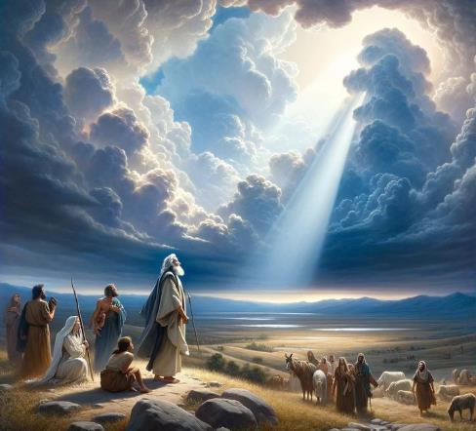
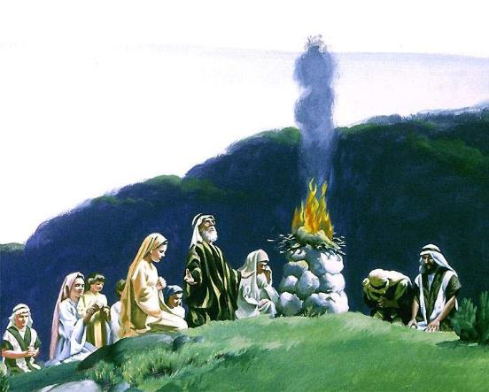
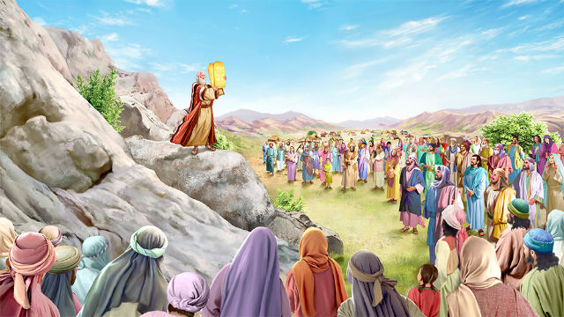
IHANGA RYAVYAWE N’IMANA
“Nanje nzoguhindura ubgoko bukomeye, nzoguha umugisha, izina ryawe ndarigire rurangiranwa; n'abandi baze bagire umugisha kubgawe.” (Itanguriro 12:2)
Itanguriro 10 rikoresha ijambo ry’igiheburayo goyim kugira ngo ryerekeze ku mahanga. Iryo jambo nyene rikoreshwa mu kwerekeza ku banyamahanga, ni ukuvuga abari kure y’Imana.
Kugira ngo ayo mahanga asubire ayigarurire, Imana yafashe ingingo yo kuzana ihanga rishasha, ari ryo Isirayeli, biciye ku bakomotse kuri Aburamu/Aburahamu (Itanguriro 12:1-3).
Ni kuki yahisemwo Aburahamu? “Kukw ari we nahisemwo kugira ngw aze yihanikirize abana biwe n'ab' inzu yiwe bazokwaruka hanyuma, ngo bakomeze inzira yanje” (Itang. 18:19.) Muri ubwo buryo, Imana yari gushobora kwereka isi ibiba iyo twemeye kuyoborwa na yo.
Yabahaye ingingo ngenderwako zotangaza amahanga, zigakabura muri yo icipfuzo co kuza guhura na Isirayeli kugira ngo ayigane, gutyo agahabwa umuhezagiro Imana yipfuza kuyaha ( Gus. 4:5-8).

Slide 7

UBWOKO BWATORANIJWE

Slide 8

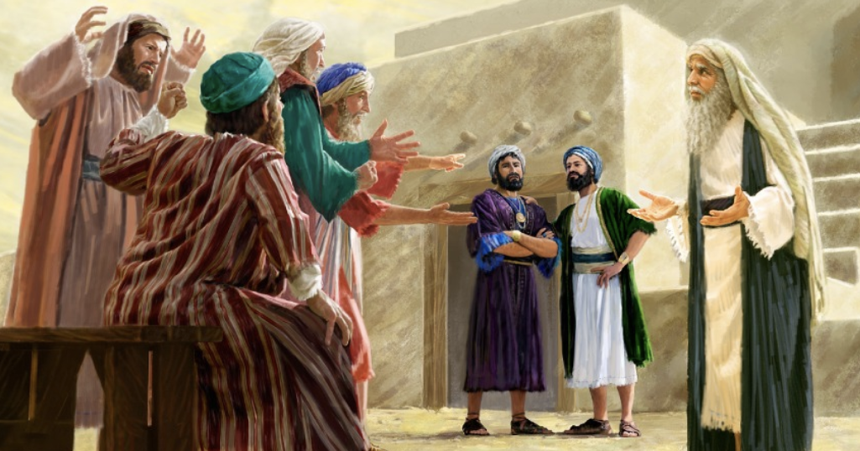
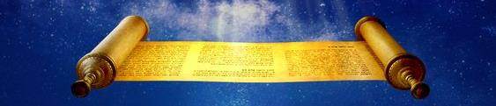
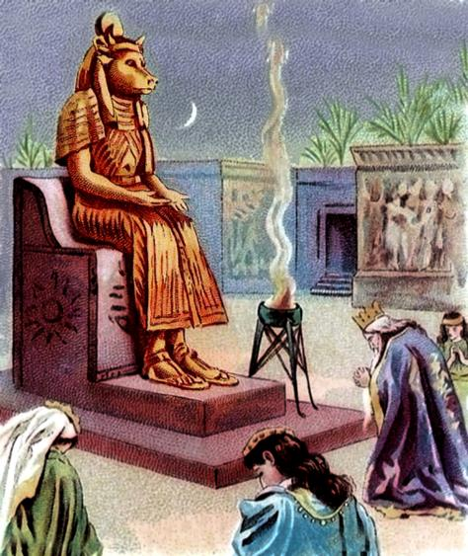
AMATEKA YA ISIRAYELI
“baramubarira, bat' Ehe raba urashaje, kand' abahungu bawe ntibafise ingeso nk'izawe; none rer' utwimikire umwami wo kuducira imanza nk'ayandi mahanga yose.” (1 Samweli 8:5)
Ikibabaje ni uko aho gushaka kuba ihanga ry’akarorero, rirongowe n’Imana ata guca ku ruhande, Isirayeli yashaka kuba nk’ayandi mahanga (1 Sam. 8:5).
Mu gusaba umwami, banse Imana (1 Sam. 8:7). Naho bari baburiwe ingaruka zo kugira umwami, bakomeje kuba mu bugarariji bwabo (1 Sam. 8:9, 19).
Kubera ko Imana yari izi imbere y’igihe ukuntu Isirayeli izovyifatamwo, yari yarategetse amategeko, iyo yubahirizwa, yari gutuma umwami basavye aguma hafi cane y’iciyumviro c’Imana (Gus. 17:14-20).
Naho vyari ukwo, mbere n’abami beza kuruta abandi bose bari bafise amakosa akomeye. Benshi muri bo bavugwa ko bakoze ibibi (1 Abami 11:6).
Nakare, bari abanyavyaha barongoye abanyavyaha. Kubera iyo mpamvu, nta ntwaro igororotse iriho atari iyizoza: Ubwami bw’Imana (Dan. 2:44).

Slide 9

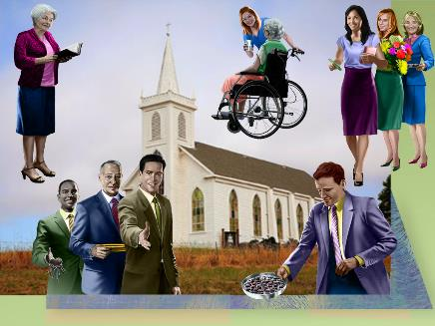
AMATEKA Y’ISHENGERO
“Muri mwebge si ko biri. Arik' ugomba kuba mukuru muri mwebge az' abe umukozi wanyu”. (Matayo 20:26)
Inyuma y’ubuhakanyi bwa Isirayeli, Yesu yimitee ubwoko bushasha: Ishengero. Ariko abo bantu ntibari bakwiye kugira umwami canke ubwenegihugu bunaka. Abarongozi baryo bategerezwa kubigira mu gukorera abandi (Mt. 20:25-28).
Mu myaka 300 y'agahamo, Ishengero ryagumye ari intahemuka rwose canke buhoro.
Ariko umwidegemvyo warashitse. Konstantino (mu kinjana ca 4) yaremeye ubukristo. Kandi aca aba umutware wabwo "yiyimitse"! Yararongoye amakoraniro yongera aratanga amategeko agenga Ishengero.
Mu kinjana ca 5 n’ica 6, Ishengero ryararushirije kwizigira Leta, maze Umusenyeri w’i Roma ahabwa ububasha bwinshi. Igikorwa nticari kikigengwa n'itegeko rya Leta.
Mu kiringo c'imyaka y'umwiza, umuntu wese atumvira ububasha bw'Ishengero yategerezwa kwishura ubugarariji bwiwe mu kwicwa, mu gutotezwa canke mu gufungwa.
Ishengero rero naryo ryarakoze amakosa nk’ayo ubwoko bw’Abisirayeli bakoze.

Slide 10

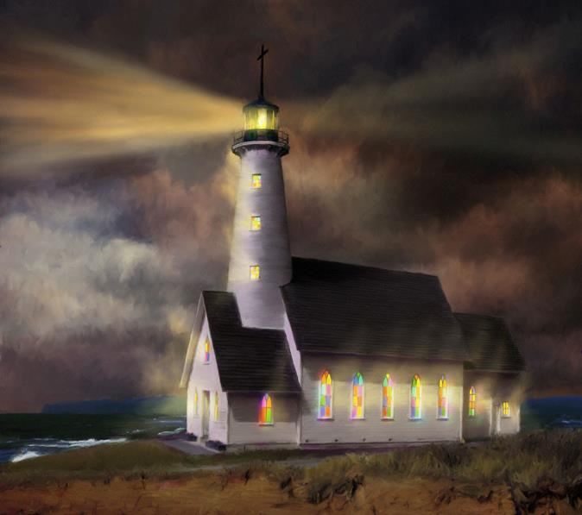
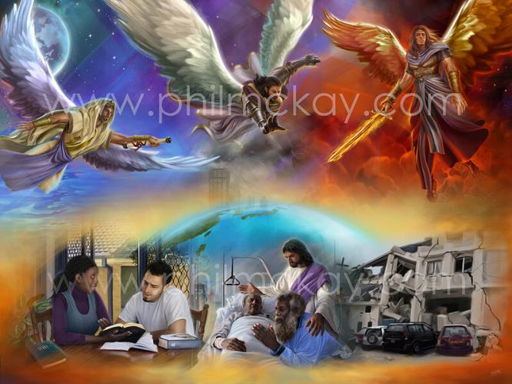
URUHARA RW’UBWOKO BWATORANIJWE
“Jewe Uhoraho naguhamagaye mu bugororotsi: nzogufata nkuzigame, ngutange ng' ubere abantu isezerano, n'abanyamahanga ubabere umuco” (Yesaya 42:6)
None Isirayeli yari gushobora gute kuba “umuco w’amahanga” (Yes. 42:6)? Ni gute Ishengero rishobora kuba “umuco w’isi” (Matayo 5:14)?
Biciye mu kwumvira kwabo (Gus. 4:6; Mt. 5:16)
Mu kwerekana inyishu ku caha (Lew. 4:27-29; Yoh. 3:16)
Mu gutangaza umuzo wa kabiri wa Yesu (Yes. 40, 9-10; Ivyah. 14, 6-11)
Ukuri kw’amateka kw’abantu b’Imana kwabaye ukw’abantu bananiwe gushitsa igikorwa Imana yari yarabageneye.
Naho ari ukwo, isi yarahezagiwe, biciye muri Isirayeli no mw'Ishengero, kubw’ubutumwa bw'umugisha bw’Agakiza.
Tubayeho mu gihe ca nyuma c’amateka. Akaryo ka nyuma ko gushitsa umugambi wacu wo kuba umuco w’isi, no kwamamaza agakiza k’Imana (Yes. 52:7).

Slide 11

EGW (Ikete rya 108, 1902)
“Yoo mbega ububasha bw’ivyiza umuntu yahindutse—agahindurwa ku musi ku musi—ashobora gukoresha kugira ngo azane umugisha n’umunezero mw’isi! Iyo ishengero ryuzuye impwemu y’ukugamburuka n’urukundo, abagize ishengero bazogira mw’isi ububasha bwo gukiza, kandi Imana nta kintu na kimwe izobima kizotuma ubwo bushobozi bugira igitsibo c’uguterimbere n’intsinzi. Abagabo n’abagore ni Inzego zayo kubwo agakiza k'imitima. Abafise icipfuzo gikomeye co kwegereza abanyavyaha kuri Kristo baragira impuhwe n’ugufashanya kw’isi yose aho iva ikagera.”

