Slide 1

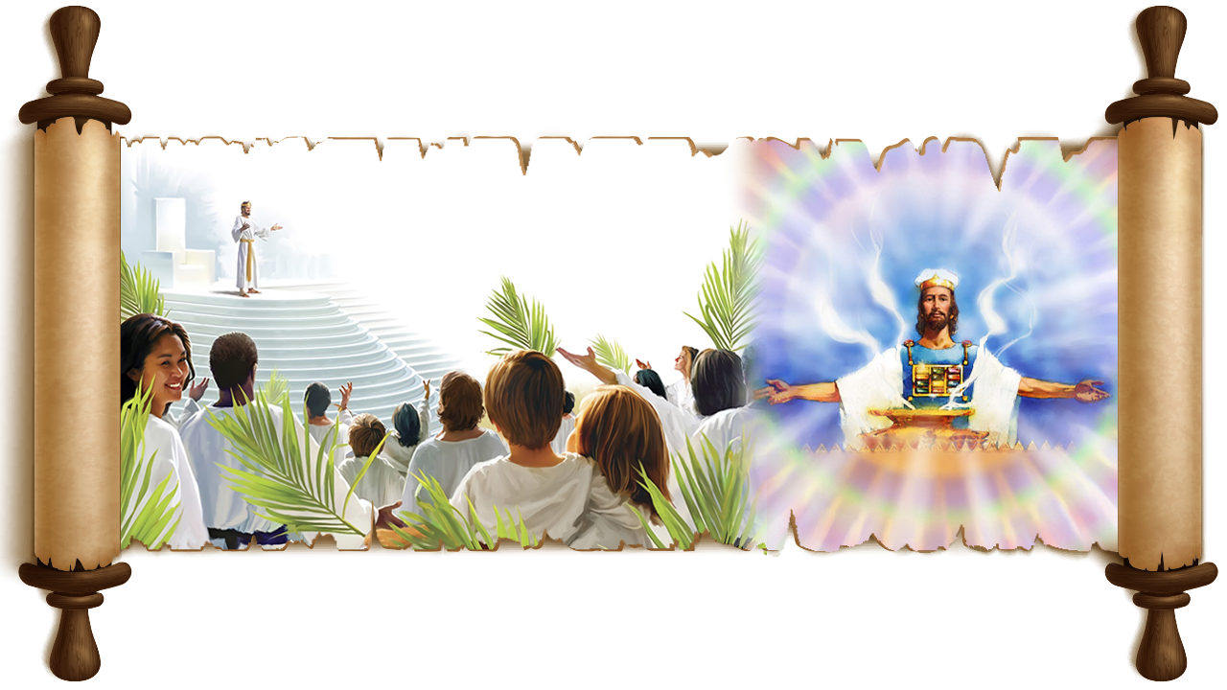

MU MAZABURI
IGICE CA 1
Icigwa ca 8 co kuwa 24 Rusama 2025

Slide 2
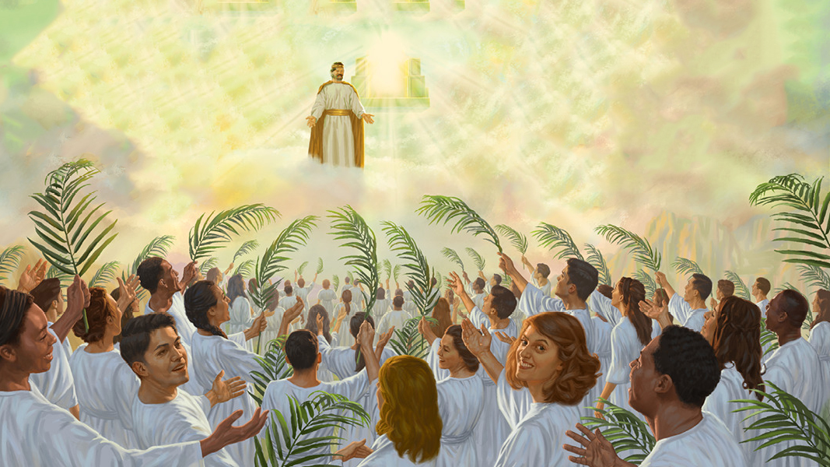
“Kandi mbona Umwagazi w'Intama, ahagaze ku musozi Siyoni, ahagararanye n'abantu ibihumbi ijana na mirongwine na bine, bafise izina ryiwe n'izina rya Se yanditswe mu ruhanga rwabo.” Ivyahishuriwe Yohana 14:1

Slide 3

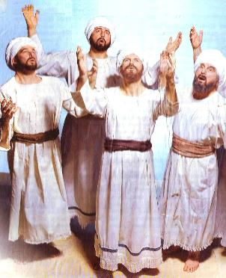
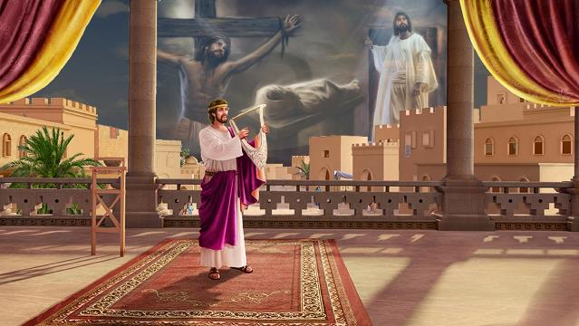





Uretse igikorwa caco co kuba igitabu c’indirimbo zo gukoresha mu gusenga mu ruhame canke mu mwiherero, igitabu ca Zaburi ni igitabu c’ubuhanuzi gihambaye cane, canditswe n'abavugishwa (Ivyakozwe n’intumwa 2:30-31).
Abanditsi b’Isezerano Rishasha bagikoresheje nk’igisomwa c’ubuhanuzi kugira ngo berekane ko Yesu ari Mesiya (nk’akarorero, Ivyakozwe n’intumwa 13:33; Abaheburayo 1:8).
Ariko Amazaburi ntagarukiriza ku kuvuga ubuhanuzi bw'igikorwa ca Yesu co kw’isi gusa, ahubwo atunze ingingo zitandukanye zijanye n’amateka y’Ugucungurwa.
Zaburi ya 122: Ihema ryera ryo mw’ijuru
Zaburi ya 15 n’iya 24: Umusozi wera
Zaburi ya 119: Izina ry’Imana
Zaburi ya 5: Abacunguwe
Zaburi ya 51: Ukwamamaza Ubutumwa bwiza

Slide 4

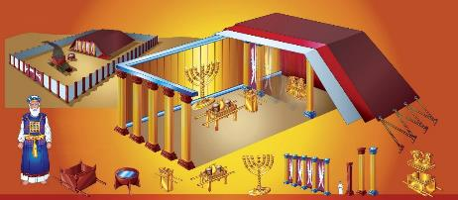
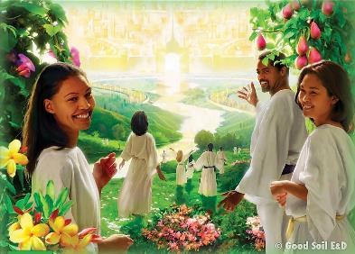
IHEMA RYERA RYO MW’IJURU
“Naranezerewe hamwe bambgira,Bati Tugende tuje ku ngoro y'Uhoraho” (Zaburi 122:1)
Mu kwiga ido n’ido ry'Ihema ryera n’Urusengero vya Isirayeli, turabona ingene Imana yashikirana n’abantu bayo n’ingene yigishije Umugambi w’Ugucungurwa.
Mu kwimura iyo sandugu, Dawidi yashinze ihuriro rimwe ry'ugusenga Imana i Yerusalemu. Aho ni ho hari ingoro y’Imana.
Zaburi ya 122 yerekana mu buhanuzi ko abacunguwe bazokoranira muri Yerusalemu Nshasha kugira ngo basenge mu rusengero nyarwo, rwo mw’ijuru (Abaheburayo 8:1-2; 9:11-12, 24; Ivyah. 14:17; 21:3).
Ivyahishuriwe Yohana biratanga iyerekwa ryinshi ry’ico Kibanza C’Ijuru (aho Urugo, rugereranya Isi (Ivyah. 11:2) rutarimwo):
IGITEREKO C’AMATARA
Ivyahishuwe 4:5
IGICANIRO C’INZAHABU
Ivyahishuwe 6:9; 8:3; 14:18; 16:7
ISANDUGU
Ivyahishuwe 11:19
Dusesenguye neza Zaburi ya 122, turashobora kandi gutahura izindi ngingo zifitaniye isano cane n’ubutumwa bwo mu Vyahishuriwe Yohana: uguhimbaza (umur. wa 4); urubanza (umur. wa 5); amahoro (umur. wa 6, 8); umutekano (umur. wa 7).

Slide 5

“Kristo, Umuherezi wacu mukuru ahambaye, “akorera ahera, no mw ihema nyakuri, ryashinzwe n'Uhoraho atar' abantu.” Abaheburayo 9:9, 23 . Umuhanuzi yemerewe kuraba mu cumba ca mbere c'ihema ryo mw'ijuru; N'uko yahabonye “amatara indwi yaka” hamwe n'“igicaniro c'inzahabu” bigereranya igiterekwako amatara hamwe n'igicaniro c'imibavu vyari mw'Ihema ryera ryo kw'isi. […] Aho yahabonye “isandugu y'isezerano” (Ivyahishuriwe Yohana 11:19), igereranywa n’isandugu yarobanuwe yakozwe na Mose kugira ngo ibikwemwo ivyagezwe vy’Imana. Mose yakoze Ihema ryera ryo kw’isi, “yisunze ikigereranyo yari yabonye.” Paulo amenyesha yuko “ihema n'imbombovu zose z'ivy' ubuherezi,” igihe vyari vyarangiye, vyari “ibigereranyo vy’ibintu vyo mw’ijuru.” Ivyakozwe n’intumwa 7:44; Abaheburayo 9:21, 23. Kandi Yohana avuga ko yabonye Ihema ryera mw’ijuru. Iryo hema, aho Yesu akorera ku bwacu, ni ryo rihambaye rya mbere na mbere, aho Ihema ryubatswe na Mose ryari ikigereranyo caryo.”
EGW (Abakurambere n’Abahanuzi, urup. 324)

Slide 6

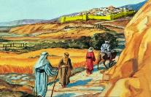
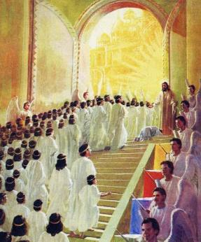
“Uhoraho, ni nde azosembera mw ihema ryawe?Ni nde azogerera ku musozi wawe wera?” (Zaburi 15:1)
UMUSOZI WERA
Uwugendera mu bitunganye, agakora ivy' ukugororoka, ntavuge ibinyoma (Zab. 15:2)
Utarementanisha ururimi rwiwe, Atagirira nabi mugenzi we, Adakaza inkuru y'umubanyi wiwe. (Zab. 15:3)
Uwubaha abatinya Uhoraho; Ico yarahiye naho comugirira nabi, atirahuruza. (Zab. 15:4)
Uwutaguranira amahera kuzohabga ay' inyungu, Atemera ingurire. (Zab. 15:5)
Uwufise amaboko akeye n’umutima utanduye, Aterekeza umushaha wiwe ku vy’ ukubesha, Atarahira ibinyoma. (Zab. 24:4)
Umusozi wa Siyoni wari wubatsweko igice c’igisagara ca Yerusalemu, kandi, mu kwagura, warakoreshwa mu kuwita umusozi aho Urusengero rwari rwubatswe (mu ntango witwa umusozi Moriya). Witwa kandi umusozi wera (Zab. 2, 6), nk’aho ari ikimenyetso c’intebe y’Imana (Yes. 8, 18).
Mu nyandiko za gihanuzi, ukoreshwa mu gusobanura ahantu abacunguwe bazokoranira (Yes. 37:32; Zab. 74:2; Ivyah. 14:1). Ni nde azoshobora guhagararana na Yesu ku musozi Siyoni?
Zaburi ya 15 n'iya 24 zirasigura ibiranga ababereye kuba ng’aho.
Biragaragara ko ata n’umwe muri twebwe, kubwiwe, ashobora gukwiza ivyo bisabwa vyose. Rero, dushobora kuhashikanwa gusa kubera ubuntu n’ububasha bwa Yesu. N'ashimwe!

Slide 7

“Iyerekwa ry’umuhanuzi riberekana bahagaze ku musozi Siyoni, bakenyeye umukanda w’igikorwa cera, bambaye impuzu nziza zera, ari zo bugororotsi bw’abera. Ariko abo bose bakurikira wa Mwagazi mw’ijuru bategerezwa kuba babanje kumukurikira kw’isi, batababaye canke ngo bikebagure, ariko mu kwizigira, gukunda, kwumvira ku bushake, nk’uko umukuku ukurikira umwungere.”
EGW (Ivyakozwe n’Intumwa, urupapuro rwa 591)

Slide 8

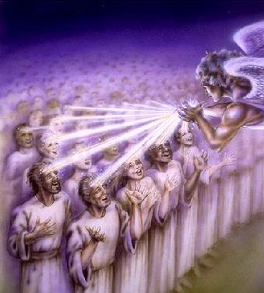
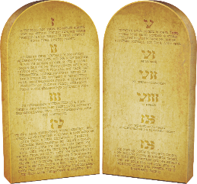
IZINA RY’IMANA
“Uhoraho, nama nibuka izina ryawe mw ijoro,Nkitondera ivyagezwe vyawe.” (Zaburi 119:55)
Umusozi Siyoni na wo nyene ufitaniye isano rya hafi n’izina ry’Imana (Yes. 18:7; Ivyah. 14:1). Izina, cane cane mu bihe vya Bibiliya, ryari rifatanijwe n’ingeso z’umuntu (Itanguriro 32:28).
Ni co gituma izina ry’Imana ryanditswe ku ruhanga rw’abacunguwe rirengeye inyuguti zine z’igiheburayo zirisobanura: יהוה (YWHW).
Izina ry’Imana ni akaranga kayo kadasanzwe kandi kadasubirwamwo: “NDI UWO NDI” (Kuv. 3, 14). Izina ryayo—ari ryo kamere yayo—ni ubwiza bwayo n’ineza yayo (Kuv. 33:18-19).
Igihe umwanditsi wa Zaburi yavuga izina ry’Imana (azirikana ku mico yayo), yaratsinzwe n’icipfuzo co gukurikiza Ivyagezwe vy’Imana (Zab. 119:55).
Kubera iki? Kubera ko Ivyagezwe vy’Imana ari ishusho nyayo ya kamere yayo. Izina ry’Imana rizokwandikwa mu ruhanga rw’abakunda Imana kandi bipfuza kwumvira Ivyagezwe vyayo.

Slide 9

“Ubwiza bwa Kristo ni kamere yiwe, kandi kamere yiwe ni ukugaragazwa kw'ivyagezwe vy’Imana. Yarashikije ivyagezwe mu buryo bwose, kandi aha isi mu buzima bwiwe akarorero keza k’ico umuntu ashobora gushikako biciye mu gukorana n’ubumana. Mu bumuntu bwiwe, Kristo yagengwa na Se, ni nako nk'abantu uyu musi bagengwa n'Imana kubwo ububasha mvajuru kugira ngo bashikire ugutungana kw’ingeso.”
EGW (Ibimenyetso vy’Ibihe, kuwa 12 Kigarama 1895)

Slide 10

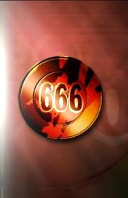
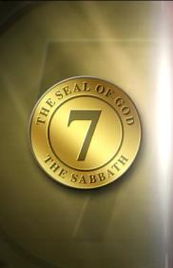
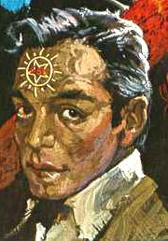
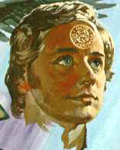
ABACUNGUWE
“Kuk' utar' Imana y'intambirakibi; Umunyakibi ntazobana nawe.” (Zaburi 5:4)
Zaburi ya 5 irerekana itandukaniro rikomeye hagati y’abemera Imana n’abayihakana. Iyi zaburi ishika kure ku busobanuro bw’imigwi ibiri ihanganye mu gihe c’iherezo: abahabwa izina ry’Imana, canke izina ry’igikoko (Ivyah. 13 na 14).
IZINA RY’IGIKOKO
Ntibazobana n’Imana (Zab. 5:4)
Basenga igikoko (Ivyah. 13:8)
IZINA RY’IMANA
Bazobana n’Imana (Ivyah. 14:1)
Basenga Imana (Zab. 5:7)
Ni abanyabinyoma (Zab. 5:9)
Bamenyesha agakiza n’umunezero (Zab. 5:11; Ivyah. 14:6-7)
Bazohanwa (Zab. 5:10)
Ntibavuga ibinyoma (Ivyah. 14:5)
Bazocungurwa (Ivyah. 14:4)
Barogota ku Mana (Ivyah. 13:6)

Slide 11

“Ingorane zizokwaduka zizoza kugerageza ukwizera n’ukwihangana vyanyu. Nimuhangane na zo n’ubutwari. Nimwitegereze uruhande rwiza. […] Ijuru ryuzuye umunezero. Risamirana amashimwe y’Uwatanze ikimazi gitangaje cane ku bw’ugucungurwa kw’abantu. Mbega ishengero ryo kw’isi ntirikwiye kwuzura amashimwe ? Abakristo ntibari bakwiriye gutangaza mw’isi umunezero wo gukorera Kristo? […]
Nimwakora ikosa, ukwo kunanirwa kwanyu guhinduremwo intsinzi. Ivyigwa Imana irungika bizokwama, igihe cose vyizwe neza, bizana ubufasha mu gihe kibereye. Nimushire ivyizigiro vyanyu mu Mana. Nimusenge cane, kandi mwizere. Mwizigiye, murindiriye, mwizeye, mufashe ukuboko kw’Ububasha Butagira Iherezo, muzorushiriza kuba abaneshi.”
EGW (Ibishingira intahe Ishengero, umuzingo wa 7, urupapuro rwa 244)

Slide 12

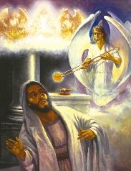
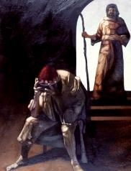
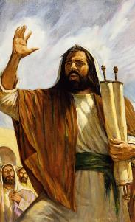
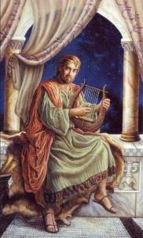
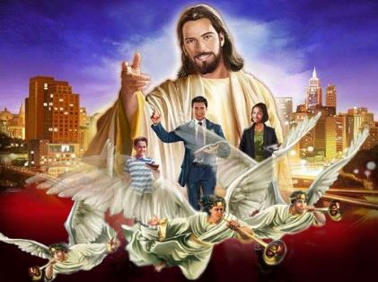
UKWAMAMAZA UBUTUMWA BWIZA
“Ni ho nzokwigisha inzira yawe abacumura,Abanyavyaha baguhindukirire.” (Zaburi 51:13)
Ntidukwiriye kwihenda ubwacu: twese turi abanyavyaha (Zab. 14, 3; Rom. 3, 10; 1Yoh. 1, 8). Nk'abanyavyaha, ntitubereye kwamamaza ubutumwa bwiza bw'agakiza. Ukwo ni ko Yesaya (Yes. 6, 5) hamwe n’Umwami Dawidi (Zab. 51, 3-5) biyumva.
Ariko hariho inkuru nziza: ivyo twaciyemwo birashobora kuba nk’ivyo abo bahanuzi babiri baciyemwo. Bompi barababariwe icaha cabo (Yes. 6:7; Zab. 51:12); kandi bompi batangura gutangariza isi ubutumwa bw’Imana (Yes. 6:8; Zab. 51:13).
Mu butumwa butatu bwamenyeshejwe isi mu rungande rwa nyuma, bubiri bwa nyuma ni umuhamagaro wo guheba icaha (Ivyah. 14:8-10). Ni ngombwa rero ko, imbere yo kwerekana icaha, umuti waco umenyeshwa biciye mu butumwa bwa mbere: ubutumwa bwiza butazoshira (Ivyah. 14, 6-7).

Slide 13

“Ubuhanuzi buri mu gice ca cumi n’umunani c’Ivyahishuwe bugiye kuranguka vuba. Mu gihe c'ugutangazwakw'ubutumwa bw’umumarayika agira gatatu, “uwundi mumarayika” ategerezwa “kumanuka avuye mw’ijuru, afise ububasha bwinshi,” isi na yo itegerezwa “kumurikirwa n'ubwiza bwiwe.” Mpwemu w’Uhoraho azohezagira mu buntu ibikoresho-bantu bayiyeguriye ku buryo abagabo, abagore n’abana bazofungura iminwa yabo mu guhimbaza no gukenguruka, buzuze isi ubumenyi bw’Imana, n'ubwiza bwayo butagira uko bungana, nk’uko amazi atwikira ikiyaga.”
EGW (Maranatha: Umumarayika wo mu Vyahishuwe 18, kuwa 29 Mukakaro)

Slide 14
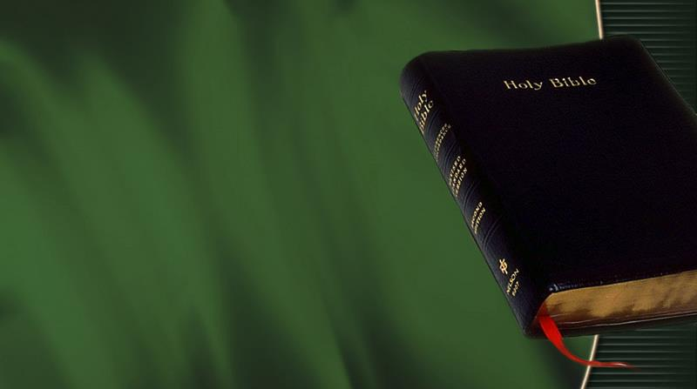
EGW (Uburezi, p. 125)
«Ingingo nyamukuru ya Bibiliya, ingingo izindi zose mu gitabu zenenako, ni umugambi w’ugucungura, ugusubiza itoto mu mutima w’umuntu ishusho y’Imana. Uhereye ku nsiguro ya mbere y’ivyizigiro mu rungane ryavuzwe muri Edeni gushika kuri rya sezerano rya nyuma ry'ubwiza ryo mu Vyahishuriwe Yohana, “bazoraba mu nyonga hayo, izina ryayo rizokwandikwa mu ruhanga rwabo” (Ivyahishuriwe Yohana 22:4), umutwaro wa buri gitabu cose n’igice cose ca Bibiliya ni uguhishurirwa kw'iyi ngingo y'agatangaza—ukuzamurwa kw'umuntu, —ubushobozi bw'Imana, “buduha gutsinda kubw’Umwami wacu Yesu Kristo.”»

