Slide 1
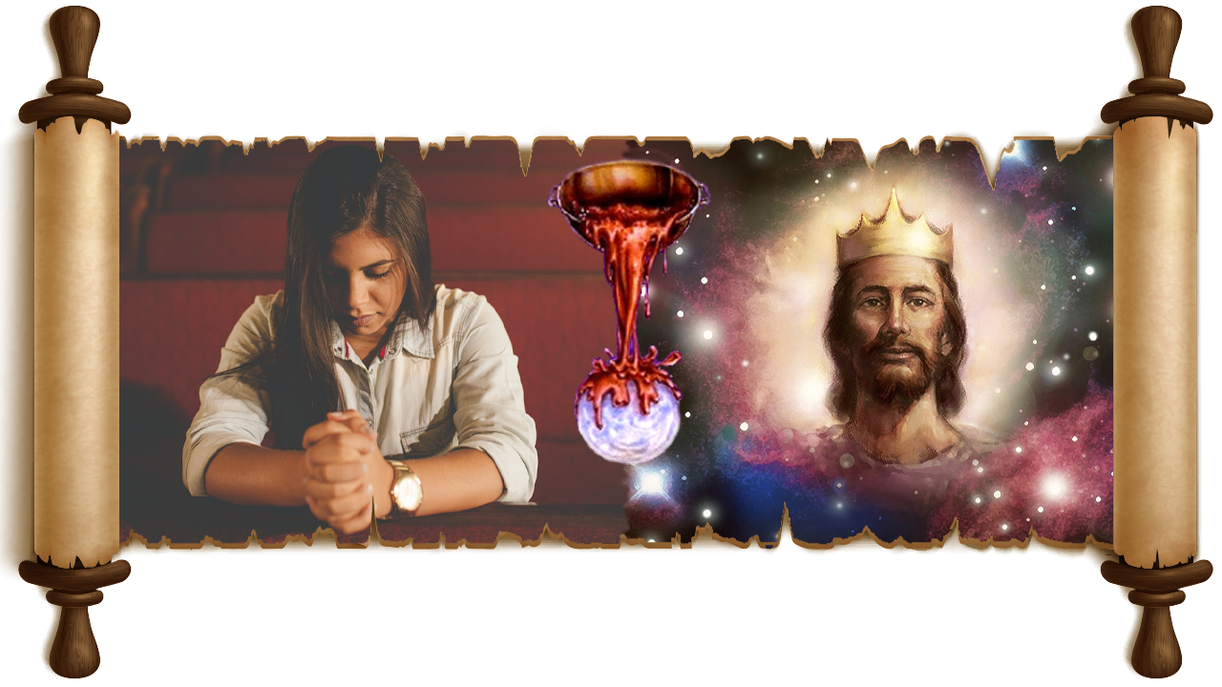

MU MAZABURI
IGICE CA 2
Icigwa ca 9 co kuwa 31 Rusama 2025

Slide 2
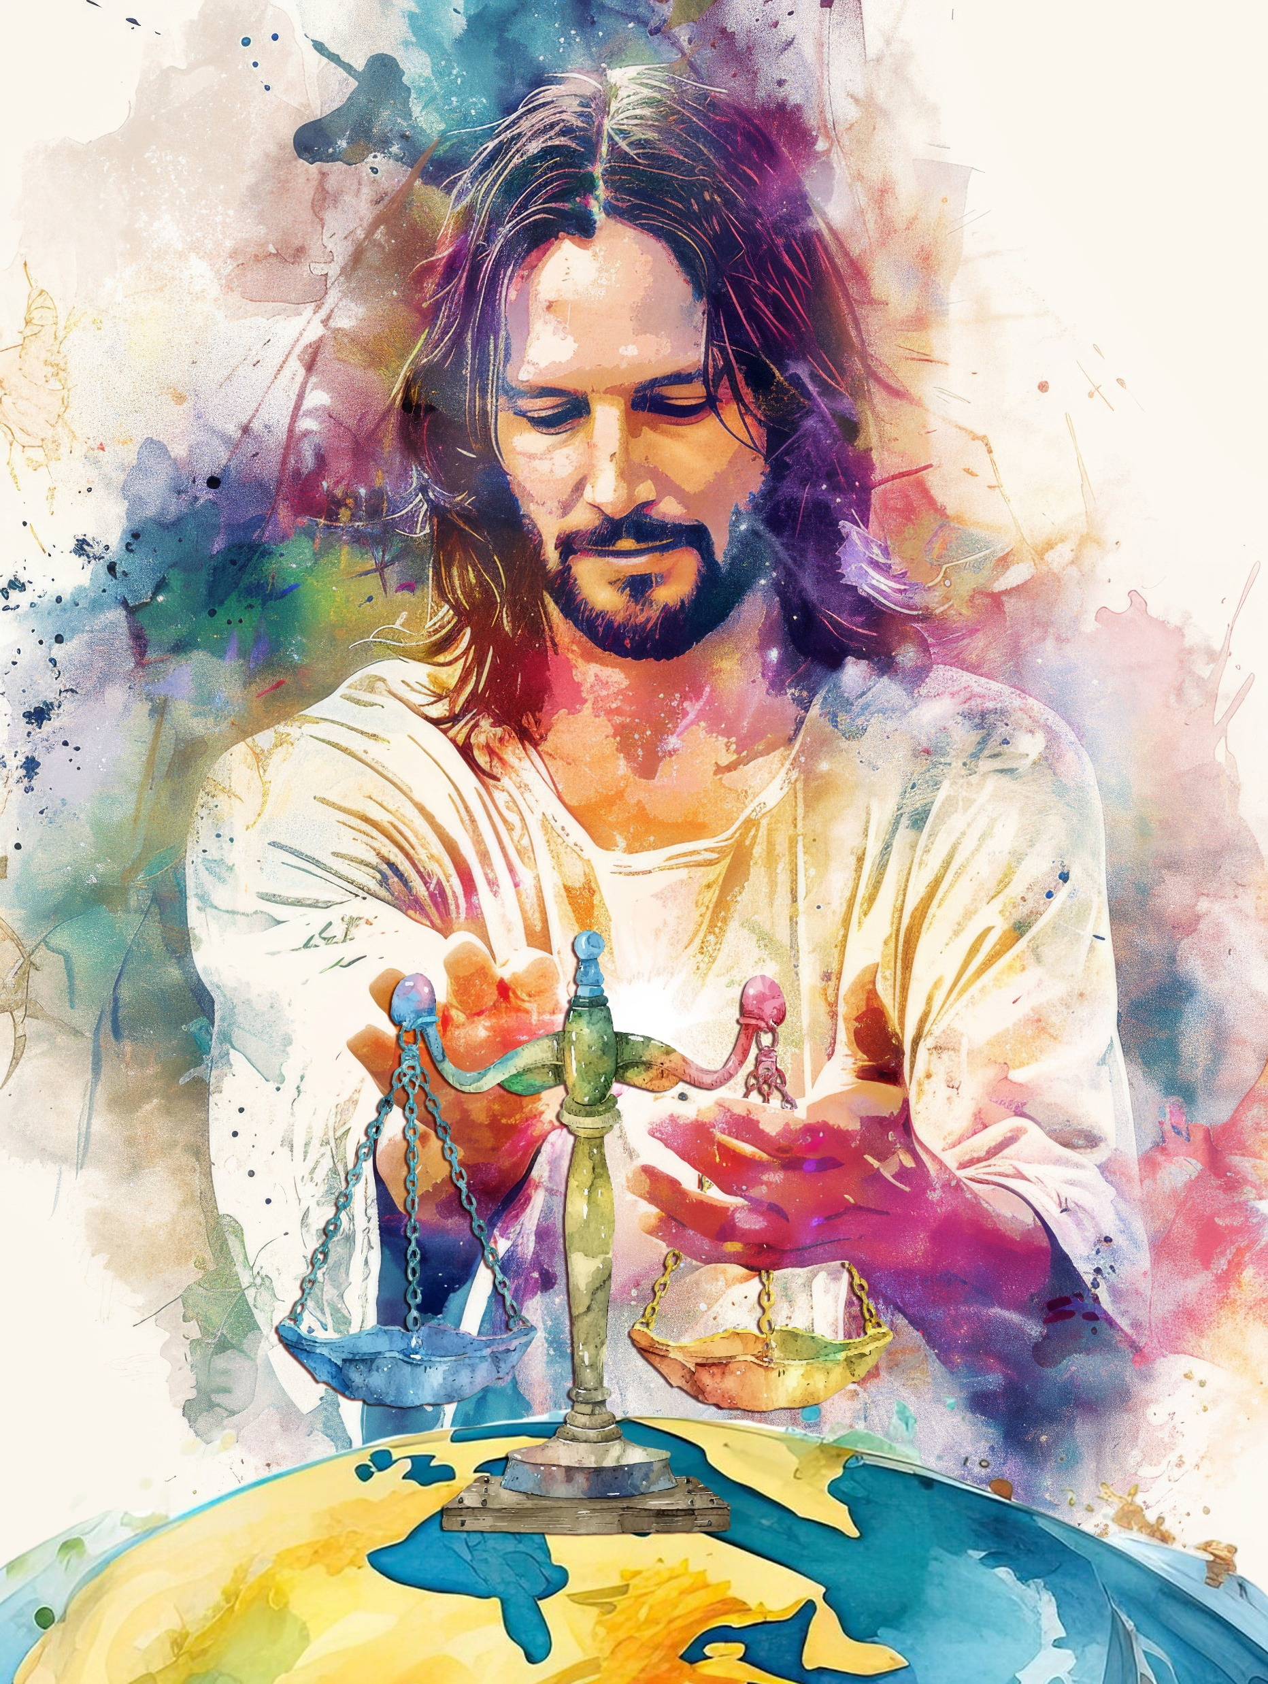
“Mana, amoko agushime,Amoko yose agushime. Amahanga anezerwe, aririmbishwe n'akanyamuneza:Kuk' uzocira amoko imanza ziroranye,Kand' uzorongora amahanga mw isi. Sela .”
Zaburi 67:3, 4

Slide 3

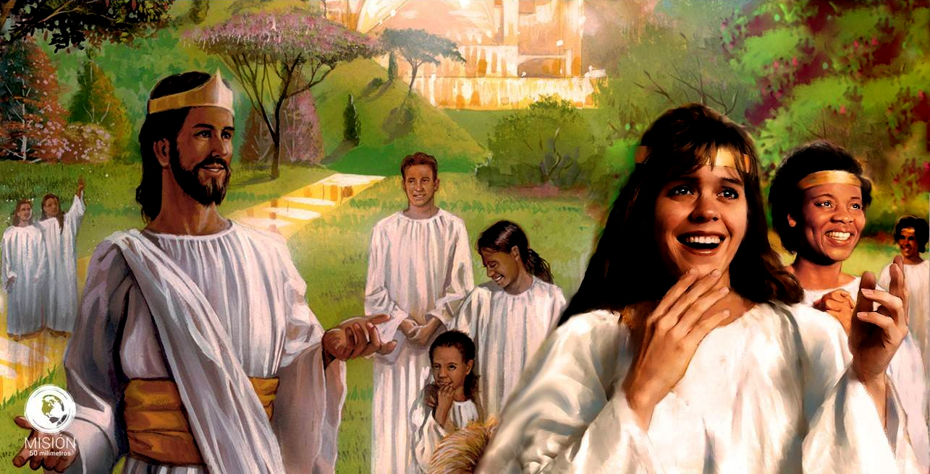




Mu buhanuzi dusanga muri Zaburi, turashobora gushima ibintu vya nyuma bizoba maze bigashikana ku gushingwa burundu kw’intwaro y’Imana kuri iyi Si.
Mu mazaburi atandukanye tuzokwiga, tuzobona ingene ibintu bizogenda kuva mu bihe vy’imbere y’Ukuza kwa Kabiri gushika ku gutikizwa kw’icaha inyuma y'Ikinyagihumbi.
Dufise ku muzirikanyi ivyo bintu bizoshika, mbega igikorwa cacu ni ikihe?
Zaburi ya 46: Ivyizigiro mu bibazo.
Zaburi ya 47: Intsinzi ya nyuma.
Zaburi ya 75: Iherezo ry’icaha.
Zaburi ya 67: Igikorwa cacu uyu musi.

Slide 4

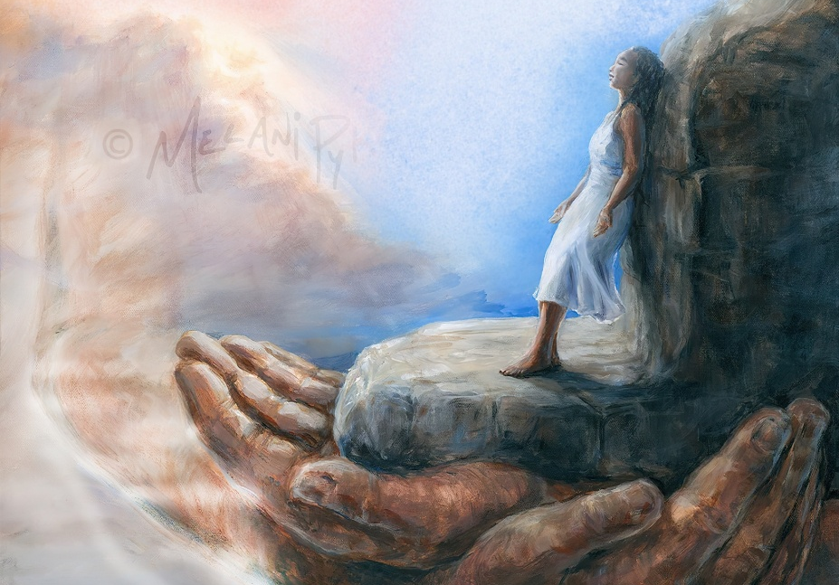
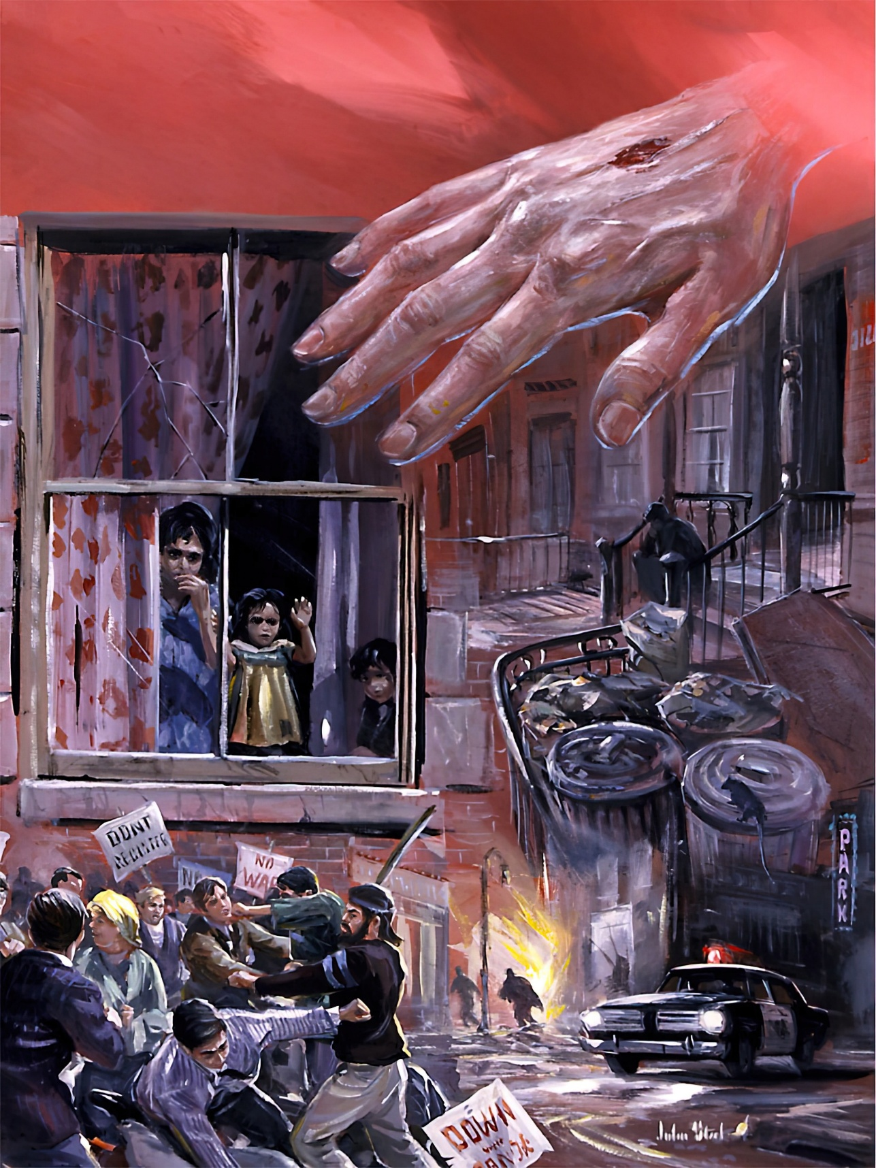
IVYIZIGIRO MU BIBAZO (1)
“Imana ni yo buhungiro bgacu n'inkomezi zacu,N'umufasha atabura guseruka mu magorwa.” (Zaburi 46:1)
Ni ibihe bintu bizobaho Zaburi ya 46 ivuga imbere y’igihe? Bifitaniye isano irihe n’ubuhanuzi bwo mu Vyahishuwe 6:14 canke mu 2 Petero 3:12 ? None ni gute bizogira bizongirako ubwaku?
Ni ibiki biriko bizoshika kw’isi?
Ikurwaho
Imisozi irahunga
Ni igiki Imana ikora?
Iradukingira kandi ikadukomeza
Iradufasha mu marushwa kandi ikaduha umunezero
Ni igiki nokora?
Niwihweze ibikorwa vy'Imana
Ntutinye
Amazi arasuriranya
Amahanga araboroga
Ishongesha isi
Ni yo buhungiro bwacu
Ishira kw'iherezo intambara
Ishirwa hejuru kandi igashirwa hejuru mu mahanga
Nuhwekere kandi umenye Imana
Hungira mu Mana

Slide 5
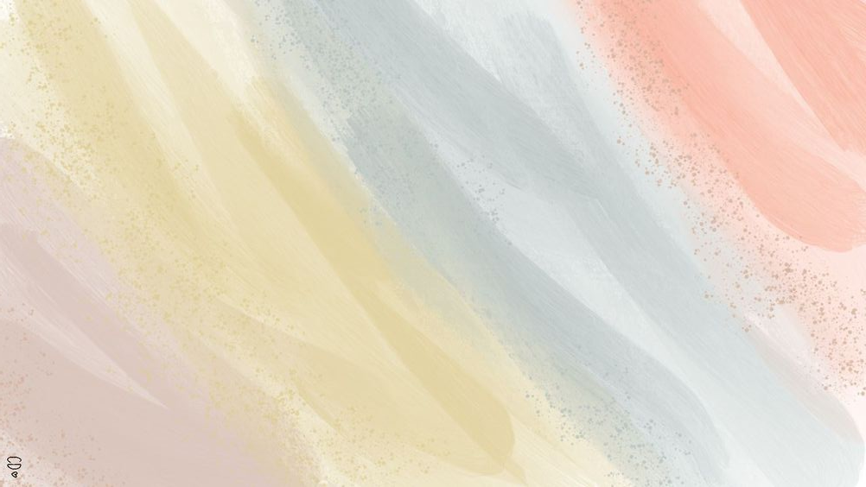
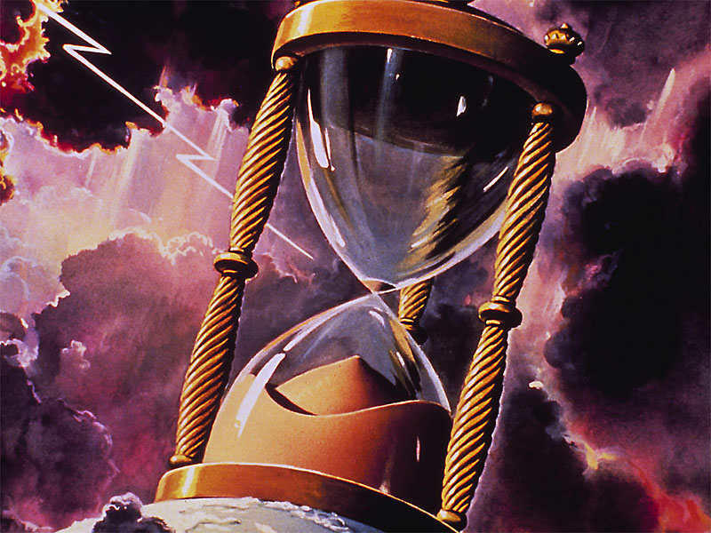
IVYIZIGIRO MU BIBAZO (2)
“Abanyamahanga bavugije urwamo, ibihugu vy'abami biravuguswe;Ivuze ijwi ryayo, isi irashonga.” (Zaburi 46:6)
Mu murongo umwe gusa, umurongo wa 6, Zaburi ya 46 idondora ingene iherezo ry’isi izwi rizoba rimeze:
Amahanga ari mu rwamo
Ubwami burahangurwa
Imana iduza ijwi ryayo
Isi irashonga
Kubera imivurungano y’ibidukikije n’iya politike ibandanya, amaleta azokwifataniriza mw'ishusho y’umubiri umwe (igishushanyo c’Igikoko) arondera inyishu zidasanzwe. Ivyo bizogira ingaruka mbi ku bwoko bw’Imana, kuko bazohamwa bahorwa ko ari bo bateza iyo mivurungano.
Ivyago vya nyuma bizosangangura kandi bihungabanye amahanga, maze na yo azohindukirana (Ivyah. 17:16).
Yesu, “hamwe n'akamo [...] n'inzamba y’Imana” azoza gusozera amateka y’amahanga (1 Tes. 4:16).
Nk’uko Yeremiya avyerekana, igihugu kizosigara ari umusaka kandi kiriko ubusa (Yer. 4:23-26).

Slide 6


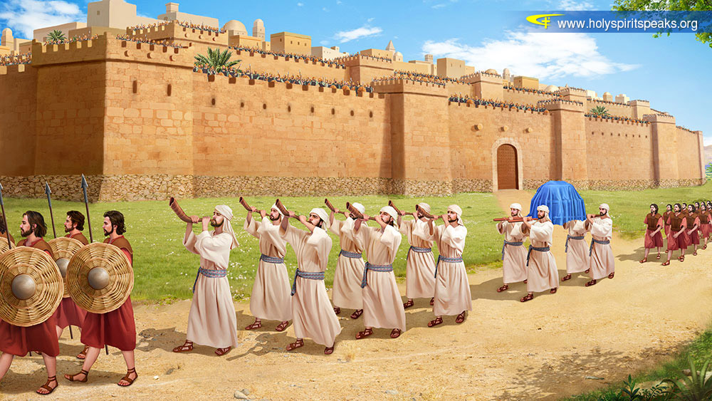
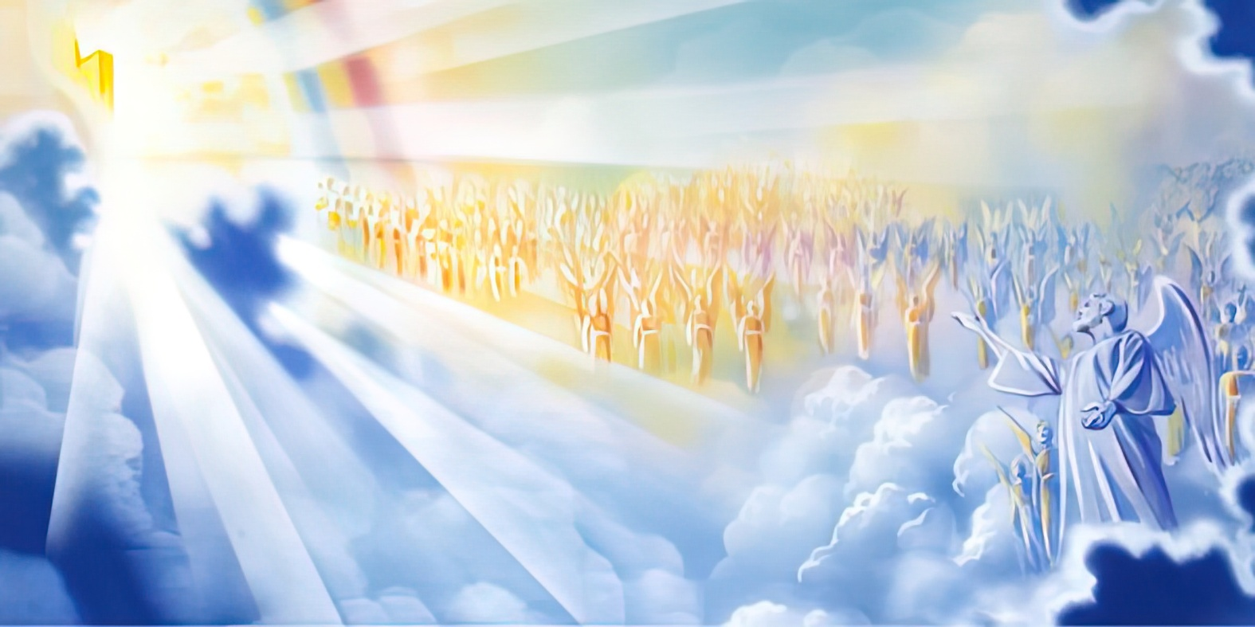
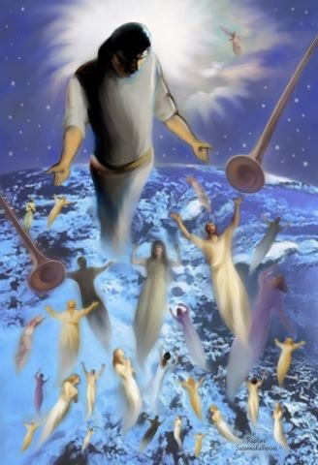
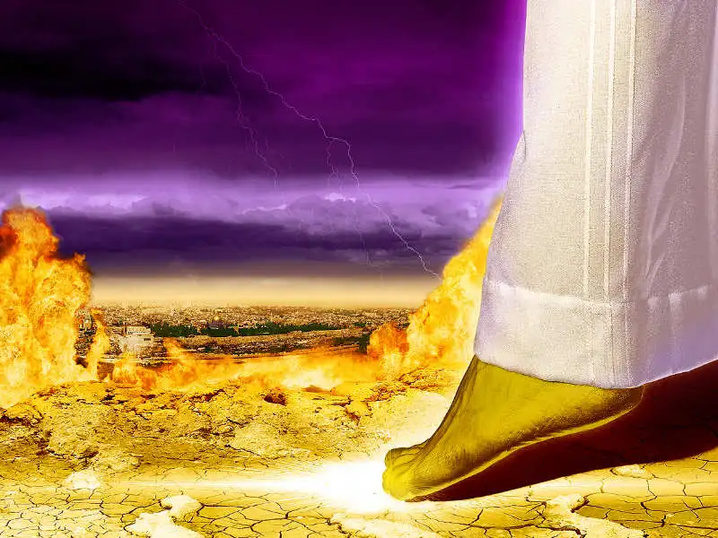
INTSINZI YA NYUMA
“Aduha guhagarara amahanga ku gakanu,Ashira amoko musi y'ibirenge vyacu.” (Zaburi 47:3)
Guhonyoza ikirenge mu kibanza mu bihe vya kera vyari uburyo bwo kugaragaza uburenganzira bwo kwigarurira ako karere (Gus. 11:24), ikintu gisa n’ico gikorwa ubu mu gushinga canke kuduza hejuru ibendera mu kibanza kinaka.
Igihe Satani yahagarara imbere y’Imana akavuga ko yaje “Avuye gukwiragira mw'isi no kuyigendagendamwo” (Yobu 1:7), yariko yerekana ko ari we afise mu minwe uwu mubumbe wacu.
Umusi uzoshika aho ivyo yanyaze bizosubizwa uwubifitiye uburenganzira. Ariko ntibizoba ku kuza kwa kabiri, aho Yesu atazohonyoza kw’isi ikirenge ciwe, ahubwo nyabuna ni twebwe tuzoduga tukamusanganira (1 Tes. 4:16-17).
Bizoba inyuma y’Ikinyagihumbi, aho Yesu azokoza ikirenge ciwe kw’isi, agategura ikibanza co Yerusalemu Nshasha izoshikiramwo – imbere y’abansi biwe – maze akabatsinda burundu (Zek. 14:4-5; Ivyah. 14:4-5; Ivyah. 14:7-9).

Slide 7

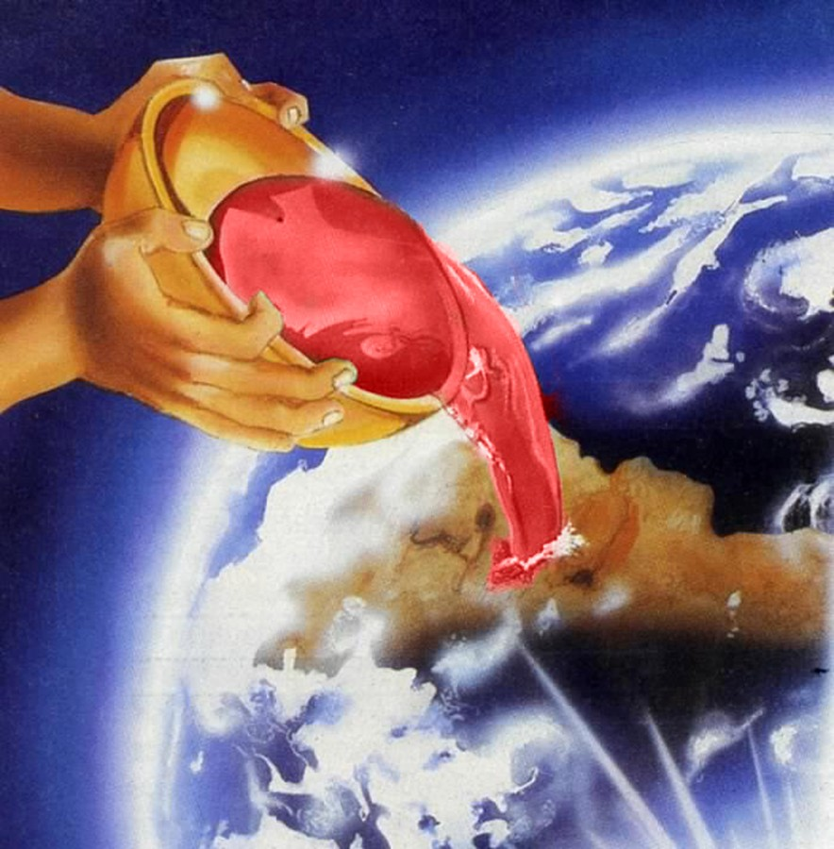
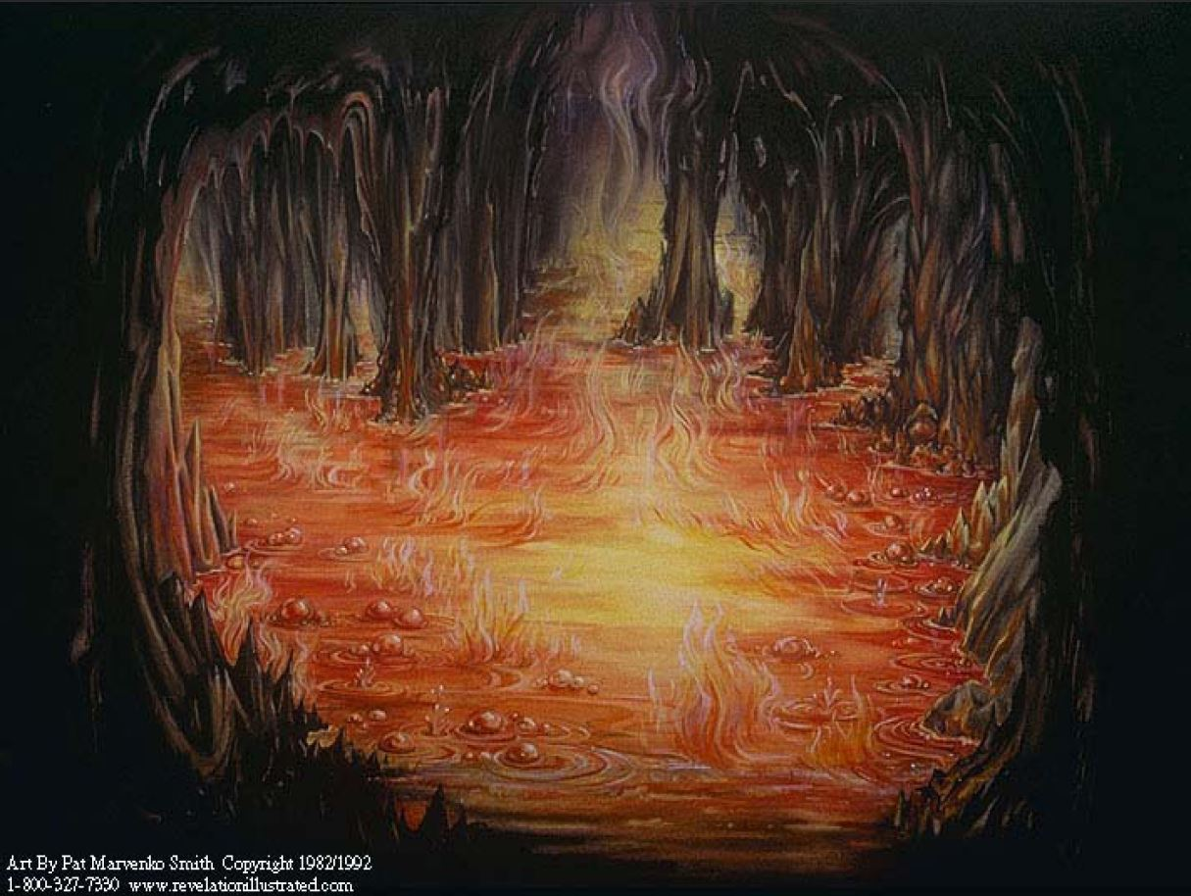
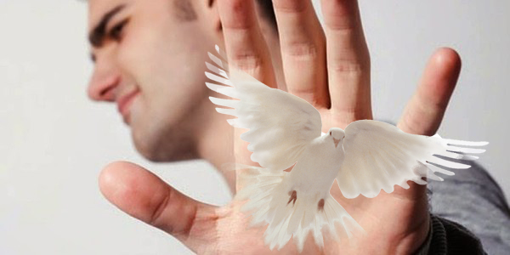
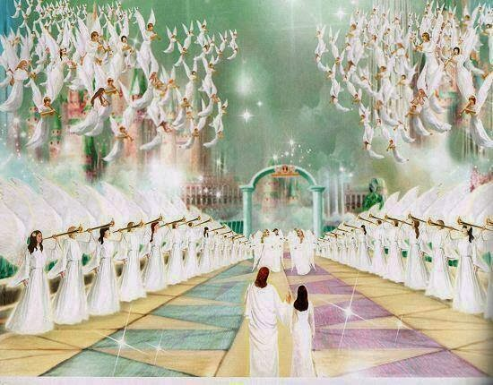
IHEREZO RY’ICAHA
“Kuko mu ntoke z'Uhoraho har' agakarabo, karimwo vino ibira:Kuzuye vino ituriranije, arayisuka:N'ukuri abanyakibi bo mw isi bazokwiranguza urukoma rwayo, barunywe.” (Zaburi 75:8)
Zaburi ya 75 ivuga ibihwanye cane n’ubutumwa bw’umumarayika wa gatatu, aho abanyakibi bategerezwa kunywa ku gikombe c’uburake bw’Imana (Zab. 75:8; Ivyah. 14:9-10).
Iciyumviro gihambaye kigena iherezo ry’abantu n’amahanga ni ubwibone (Zab. 75:4-5). Ubwibone bw’abarongozi, barondera gukomeza no kwongerera ububasha bwabo; n’ubwibone bw’abantu ku giti cabo, butuma banka Imana n’ubutagondwa, bakishira hejuru (n’ivyaha vyabo vy’ububisha kuruta ibindi vyose, ivyo berekana mu bwibone).
None ivyo bizoshika ryari? Inyuma y’urubanza rwa nyuma, aho abanyakibi bose bazorandurwa mu kiyaga c’umuriro, ari rwo rupfu rwa kabiri (Zab. 75:2, 7; Ivyah. 20:11-15).
Ariko ku bicisha bugufi bakumvira Imana, kazoza kazoba gatandukanye cane, kuko tuzoshirwa hejuru n’Imana imbere y’ibiriho vyose (Zab. 75:10; Yakobo 4:10).

Slide 8

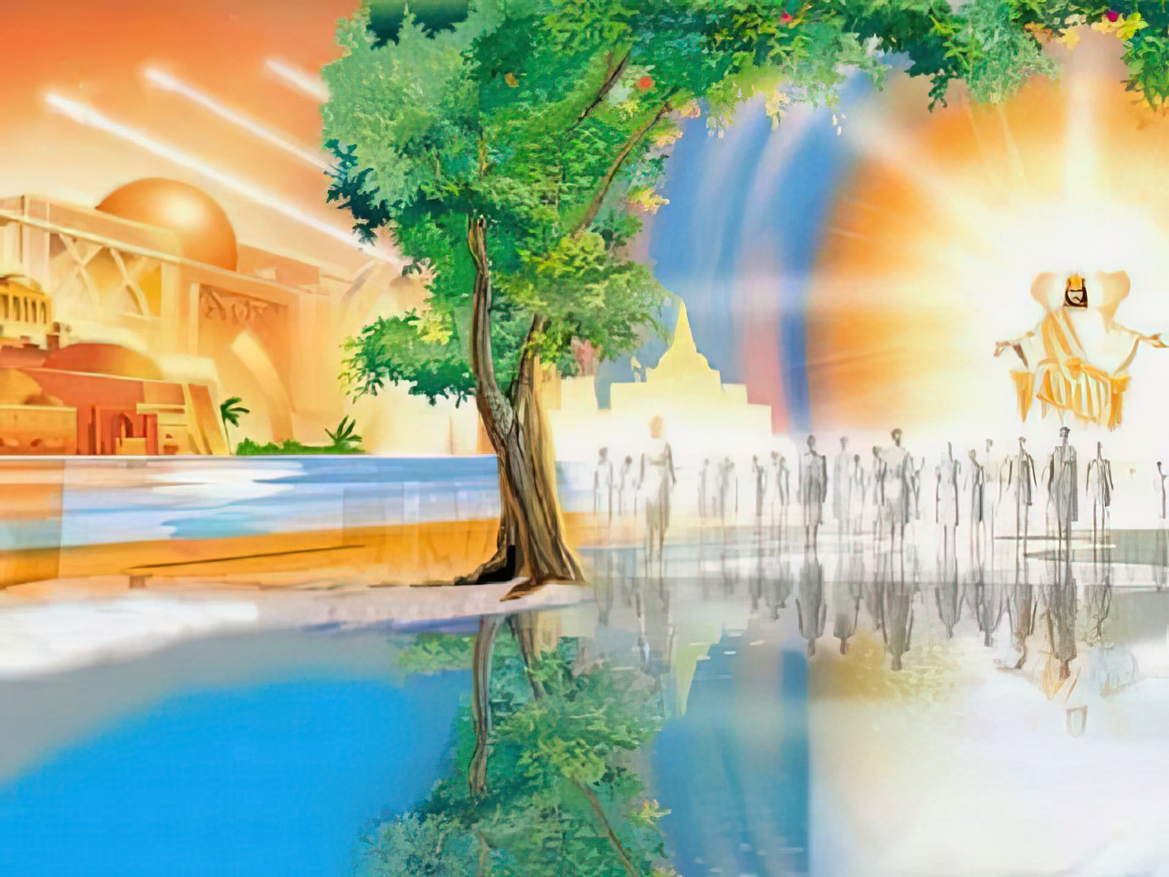
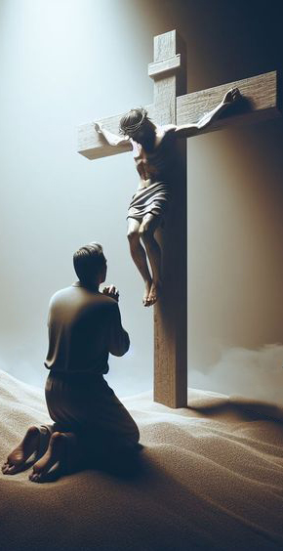
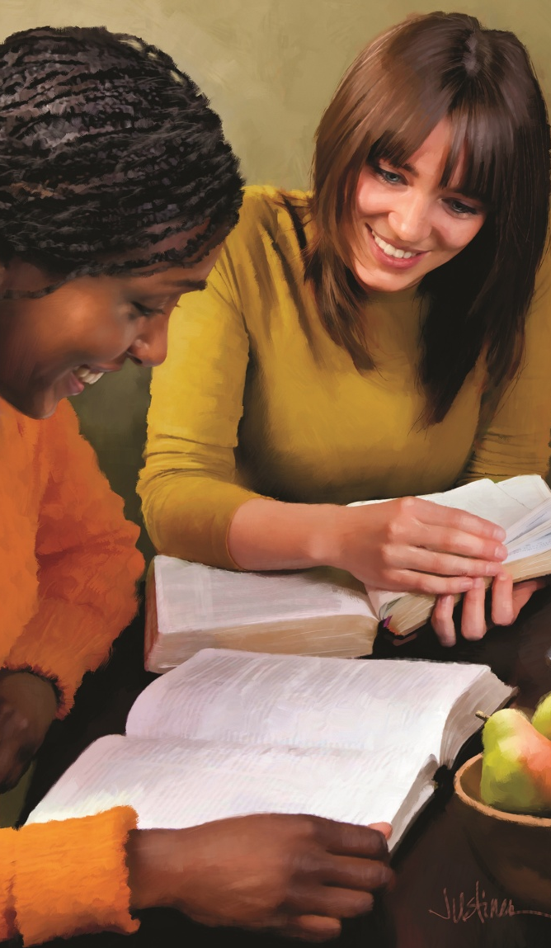
IGIKORWA CACU UYU MUSI
“Kugira ngw inzira yawe imenyekane mw isi,N'agakiza kawe mu mahanga yose.” (Zaburi 67:2)
Ivyahishuriwe Yohana bitubwira umusi ubuninahazwa bw’Imana buzokayangana cane ku buryo tutazokenera umuco w’izuba (Ivyah. 22:5).
Zaburi 67:1 isa n'iyivuga imbere y'igihe uwo mwanya, igasaba Imana ngo “itumurikishirize mu nyonga zayo.” Ico ciyumviro kiri no mu muhezagiro w’abaherezi (Guharura 6:25).
Urupfu rwa Kristo ku musaraba ni rwo rwonyene rutuma mu maso h’Imana hatumurikira. Biragaragara ko ivyo bizoshika bimwe bishitse gusa iyo turi kumwe na We. Ariko none ubu mu nyonga h’Imana hoshobora kutumurikira?
Egome! Ariko ntibigira kugira ngo gusa idushimishe kandi ituremeshe. Mu nyonga h’Imana haratumurikira kugira ngo dushobore kwerekana ubwiza bwayo ku neza y’abandi, isi imenye Imana kandi iyihimbaze (Zab. 67, 3-7).

Slide 9

“Mugenzi, turacari hagati y’ibitutu n’umuvurungano w’ibikorwa vyo kw’isi; ariko vuba Umukiza wacu azoboneka kugira ngo azane ugucungurwa n’ikiruhuko. Reka mu kwizera twitegereze hirya y’inyuma y’urupfu h’umugisha nk’uko herekanywe n’ukuboko kw’Imana. Uwapfuye kubwo ivyaha vy’isi azugururira inzugi za Paradiso abo bose bamwizigira. Vuba, intambara izohagarara, intsinzi nayo iboneke. Vuba tuzobona uwo ivyizigiro vyacu vy’ubugingo budashira bushingiyeko. Kandi mu kuba kumwe na We ibigeragezo n’imibabaro vy’ubu buzima bizosa n’ubusa gusa.”
EGW (Abahanuzi n’Abami, urup. 732)

