Slide 1
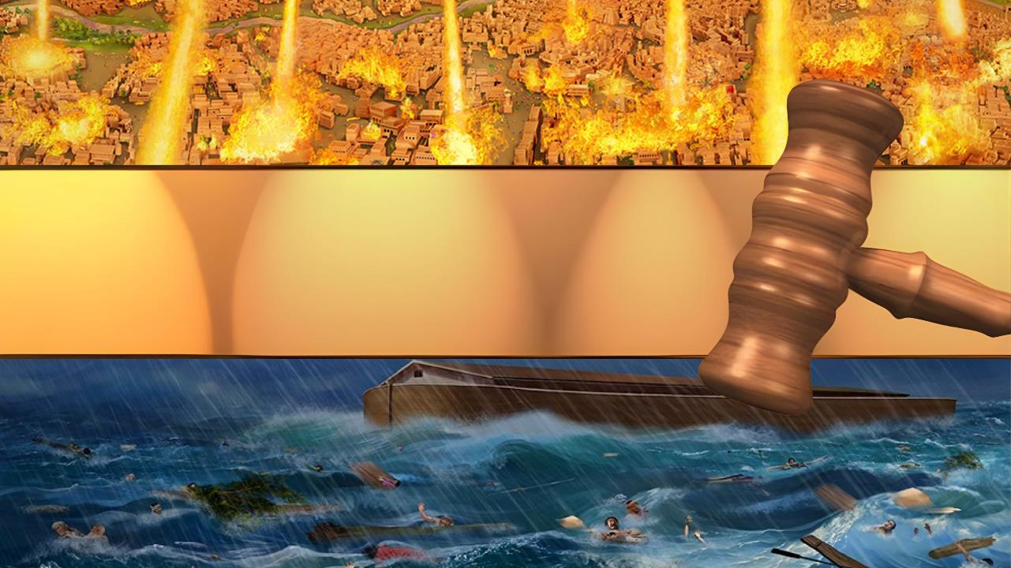
ABASHIKWAKO N’AMAHEREZO Y’IBIHE
Icigwa ca 10 co kuwa 7 Ruheshi 2025

Slide 2
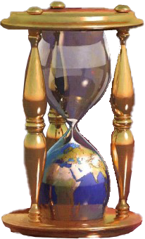
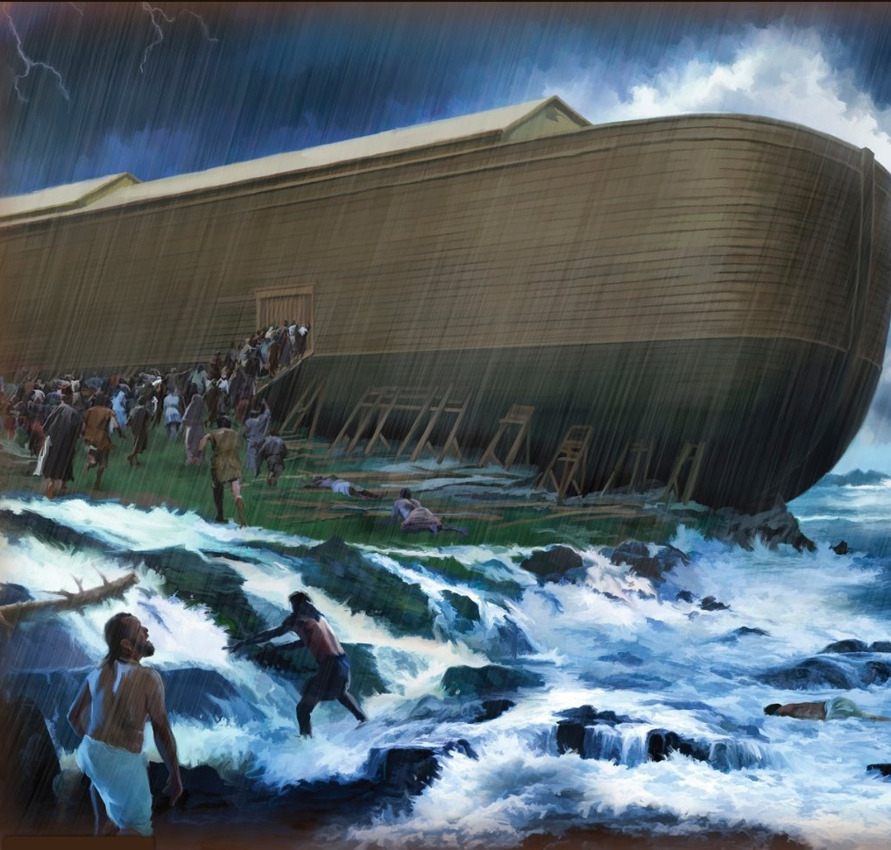
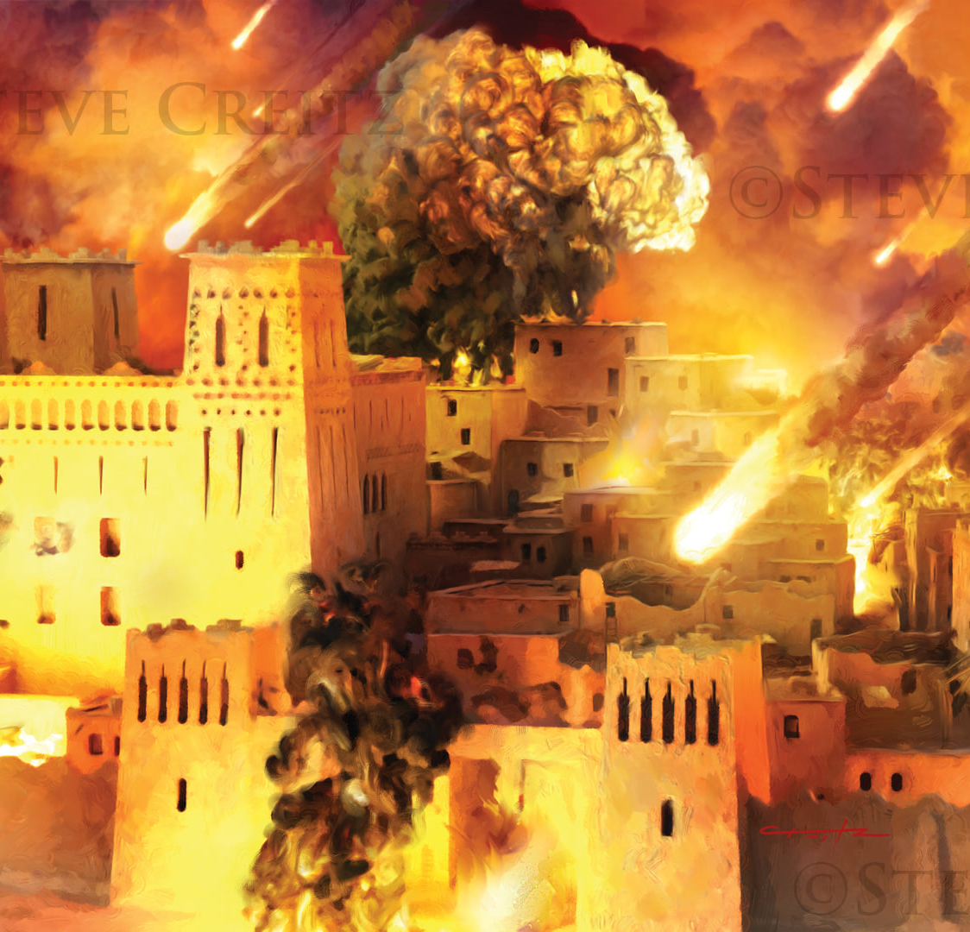
“Arikw ivyo vyababayeko kugira ngo bitubere akarorero, kandi vyandikiwe kuduhanura twebge, abashikwako n'amaherezo y'ibihe. Nuko rer' uwiyumvira kw ahagaze ni yiyubare ntagwe.”
1 Ab'i Korinto 10:11, 12

Slide 3

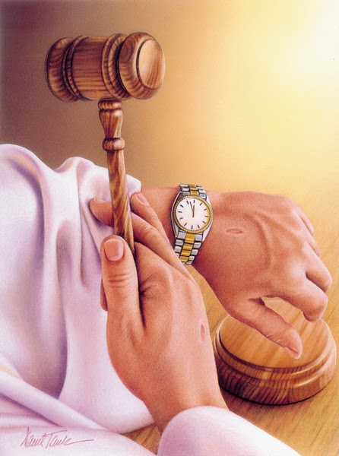
Incuro zitari nke, Yesu yaravuze ibijanye n’iherezo ry’isi yacu.
Igihe yavuga kuri iyo nkuru, yatanze akarorero k'ibihe Imana yategerezwa gutikiza isi y'imbere y'umwuzure, n'ibisagara vya Sodomu, Gomora, Adima na Zeboyimu.
Ivyo bihe bibiri vy’akahise vyari bihambaye cane mu buzima bw’abantu. Ni akarorero gatomoye k’urubanza rw’Imana n’imburi ku bijanye n’iherezo ry’ubuntu bucungura.
Iherezo riraje kw’isi y’imbere y’umwuzure:
  Iherezo ryatangajwe kuva kera
  Ukwugarwa kw'urugi rw'imbabazi
Iherezo riraje ku bisagara vya Sodomu na Gomora:
  Imvo z’ugutikizwa
  Urubanza rw’imbere y’ugutikizwa
Iherezo ry'isi yacu riraje:
  Urubanza imbere y’uko ubuntu burangira

Slide 4

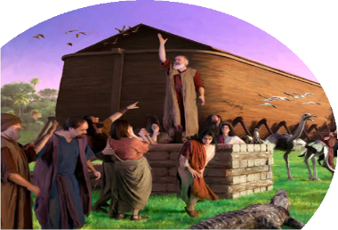
IHEREZO RIRAJE KW’ISI Y’IMBERE Y’UMWUZURE

Slide 5

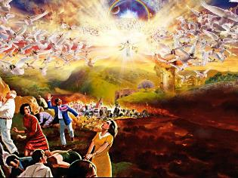
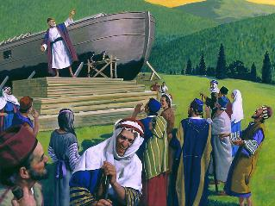
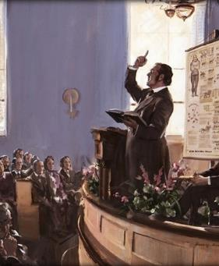
IHEREZO RYATANGAJWE KUVA KERA
“Kand' uko vyari biri mu misi ya Nowa ni ko bizoba mu kuza kw'Umwana w'umuntu.” (Matayo 24:37)
Isi irazunguruka nk’aho yoba iriko irazunguruka iva mu nzira yayo. Ibintu vyose birahungabana. Mu kanya nk’ako gukubita urugohe, ijuru ririzinga nk’umuzingo uzingwa... Isaha irashitse. Yesu araseruka, yuzuza amajuru icubahiro ciwe (Ivyah. 6:12-14).
Ariko benshi ntibavyakira n’amajwi y’umunezero n’agahimbare, ahubwo bavyakira n’amajwi y'uguta umutwe n’ubwoba: “Duhishe mu nyonga [...] z’Umwagazi w’intama [Yesu]” (Ivyah. 6:16).
Yesu yagereranije iherezo ry’isi n’imisi ya Nowa (Matayo 24:37). Ni ibiki usanga bisa n’ivyo mu Vyahishuriwe Yohana?
Isi yaranyiganyize. Mu kugwa kw'imvura, amazi yasokorotse mw’isi ubwayo (Itanguriro 7:11-12). Ariko ntivyabaye ata n’umwe agabishijwe. Uwo “muvugabutumwa w'ivyo ubugororotsi” yari amaze imyaka 120 agabisha ivy’umwuzure wari ugiye kuza (Itanguriro 6:3; 2 Pet. 2:5).
Muri ubwo buryo nyene, kuva mu mpera z’ikinjana ca 18, abantu barabwirijwe ivy’ukuza kwa Yesu kwegereje. Rero, abahunga Yesu ico gihe ntibazoba ari kubera ubujuju ahubwo bazoba ari kubera batashatse kumwizera.

Slide 6

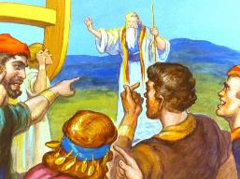
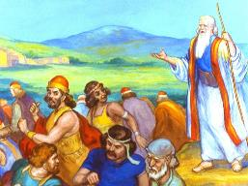
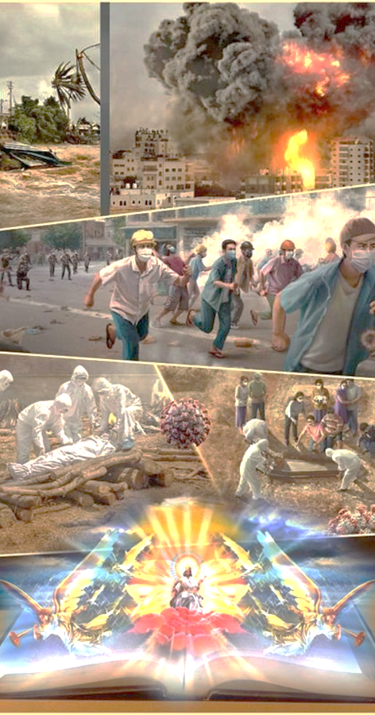
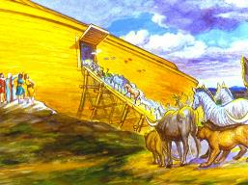
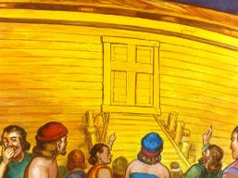
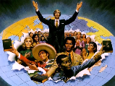
UKWUGARWA KW’URUGI RW’IMBABAZI
“Ukwizera ni kwo kwatumye Nowa yubaha, amaze kuburirwa n'Imana ibitaribgaboneke, akabaza ubgato bgo kurokora abo mu nzu yiwe, kandi ni kwo kwamuhaye gutsindisha abari mw isi, no kuragwa ukugororoka kuzanwa n'ukwizera.” (Abaheburayo 11:7)
Igihe Nowa yariko arategura ubwo bwato, yaraburiye bagenziwe ku bijanye n’isangangurwa ryari ryegereje, yongera arabahamagarira kwihana. Hasigaye imisi indwi ngo ivyo bibe, Nowa yinjiye mu bwato, maze Imana irugara urugi ( Itanguriro 7:1-4, 15-16 ).
Naho babonye ibintu bidasanzwe, nk’ukwinjira kw’ibikoko mu bwato mu mahoro, barabandanije ibikorwa vyabo vya misi yose ( Luka 17:27 ). Nta n’umwe yashaka kwinjira mu bwato urugi rutarakingwa.
Ibintu bibera kw’isi biratuburira yuko Yesu agiye kuza. Ni inshingano yacu kuburira iyi si no kuyiha akaryo ko kwakira Yesu imbere y’uko urugi rw’ubuntu bw’Imana rwugarwa. Benshi bazotwenga, ariko abandi bazovyemera. Muhumure, umwimbu wa nyuma uzoba mwinshi cane kuruta uwo Nowa yimbuye!

Slide 7
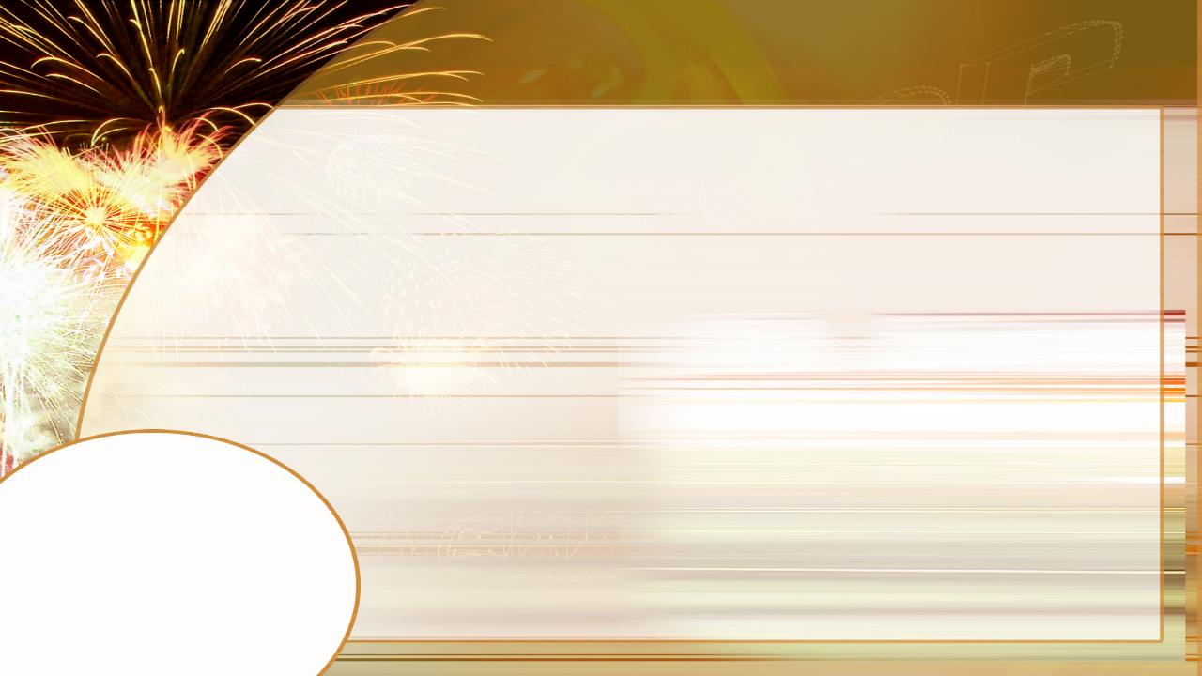
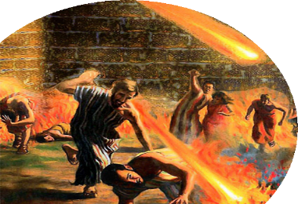
IHEREZO RIRAJE KU BISAGARA VYA SODOMU NA GOMORA

Slide 8

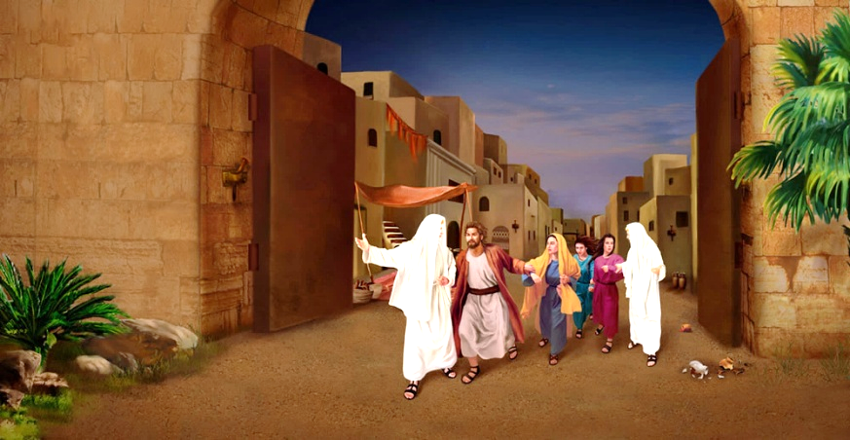
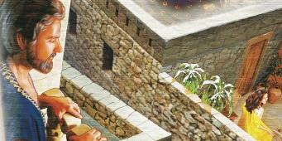
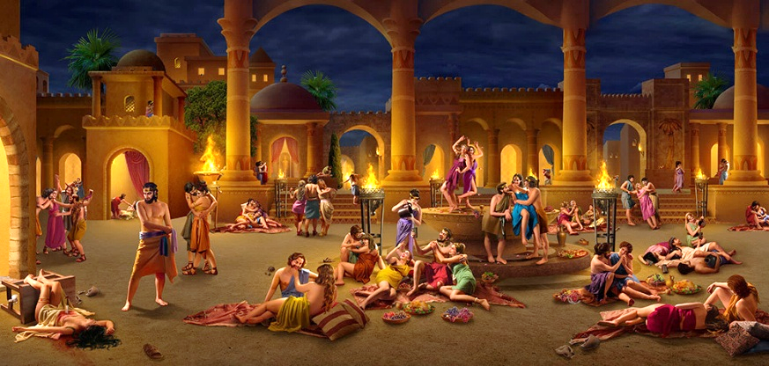
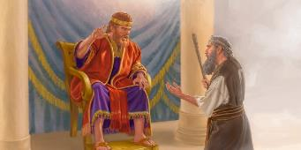

IMVO Z’UGUTIKIZWA
“Kandi n'abantu b'i Sodomu n'i Gomora bo n'ibisagara vyari bihereranye na ho, kuko bitanze bakiha ubusambanyi nka ba bandi, ukw imibiri itaremewe, ivyo bisagara vyashiriweho kuba akabarore, bibabazwa n'igihano c'umuriro utazima.” (Yuda 1:7)
Yesu yagereranije ukuza kwiwe kwa kabiri n’igihe Loti yakurwa i Sodomu, maze umuriro ukayigiza igisagara ( Luka 17:28-30 ).
Nimba ukugereranya n’igihe ca Nowa bitubwira ukutizera, ibihe vya Loti bitubwira ubusambanyi n'akajagari mu kibano ( Yuda 1:7; Ezk. 16:49-50; 2P. 2:6-8).
Imitima y’abantu yamye ari mibi (Yer. 17:9; Rom. 1:24-32). Mbere n’abakristo barakoze ibikorwa vy’agaterasoni. Ariko rero, muri iyi misi ububisha bwerekanwa ko ari ingeso nziza, kandi ingeso nziza ubwayo iratwengwa. Ijwi ryo mu mutima, nk’irya Dawidi, ryaranigiwe mu menshi.
Isi yacu irakeneye abantu nka Natani bazovyura iyo mitimanama, bakayiremesha n’ubutumwa bugira buti: «Uhoraho yagukuyeko icaha cawe, ntugipfuye» (2 Sam. 12:13).

Slide 9

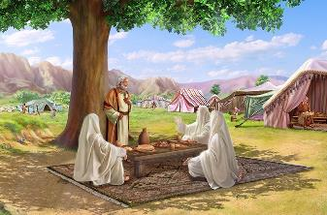
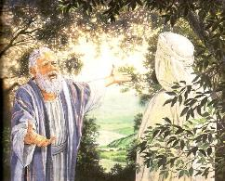
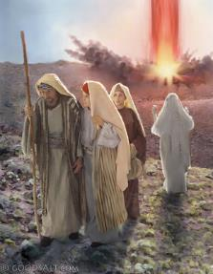
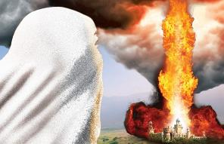
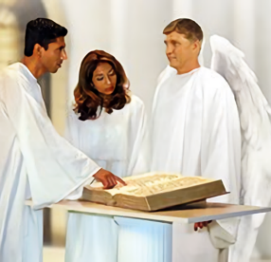
URUBANZA RW’IMBERE Y’UGUTIKIZWA
“ndamanutse ndabe yuko bakora ibihwanye rwose n'ukw induru zaho zanshikiriye; kandi namb' atari ko biri, ndabimenye.” (Itanguriro 18:21)
Ububisha bw’i Sodomu bwari bwibonekeje. Ariko imbere y’uko Imana ihatikiza, yashize ahabona urubanza rw’itohoza (Itanguriro 18:21). Iherekejwe n’abamarayika babiri, yagiye i Sodomu, ica iruhande y’inzu ya Aburahamu n’ibigirankana.
Kubera ko itashaka guhisha Aburahamu imigambi yayo, yamubwiye ivyo yari igiye gukora ( Itanguriro 18:17-21; Amosi 3:7 ). Hanyuma ikintu kitari citezwe kiraba: kamere y’Imana ubwayo yaraciriwe urubanza ( Itanguriro 18:23-25 ).
Bukeye mu gitondo, Aburahamu yarabonye yuko Imana yari Umucamanza agororoka vy’ukuri. Yashize mu ngiro ubutungane, icira urubanza ababi, kandi ikiza abagororotsi ( Itanguriro 18:27–29 ).
Mu myaka igihumbi, tuzoronka akaryo ko gusubiramwo urubanza rw’Imana, no kumenya ubwacu kamere y’ubutungane y’Imana mu vyo ikora ku caha (Ivyah. 20:4).

Slide 10

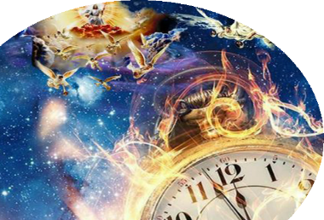
IHEREZO RY’ISI YACU RIRASHITSE

Slide 11


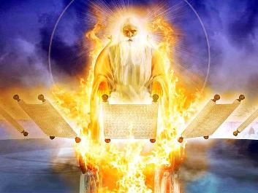
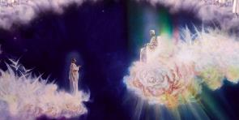
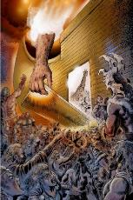
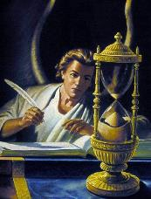
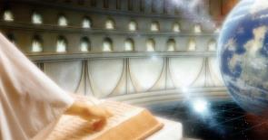
URUBANZA IMBERE Y’UKO UBUNTU BURANGIRA
“bakiriko barashirah' intebe z'ubgami; maze haza Uwa mbere na mbere, aravyagira. Imanza zirashingwa, ibitabo birazingururwa.” (Daniyeli 7:9-10)
Daniyeli agaragaza amashusho y’urubanza rwabaye mw’Ijuru mu gihe ibikorwa vy’abantu bibandanya, ataco binona ku biriko biraberayo ( Dan . 7:9-12 ).
Muri urwo rubanza imbere y’Ukuza kwa Kabiri, Yesu yemerwa ko akwiriye “inganji, icubahiro n’ubwami” ( Dan . 7:14 ). Niho azoza gusozera amateka y’iyi si ( Dan 7:26) maze atugire abasangira na We ubwami bwiwe buzokwamaho ( Dan 7:27).
Mbega Imana irakeneye guca urubanza kugira imenye abazokizwa? Ntaco biyimariye, ariko abamarayika biwe birakibamariye. Ni co gituma yarungitse abamarayika i Sodomu ngo baje gutohoza ( Itanguriro 18:21-22 ).
Igihe kiri hagati y’iherezo ry’Urubanza n’Ukuza kwa Kabiri cagereranijwe n’ukwugarwa kw’urugi rw’ubwato imisi indwi imbere y’umwuzure. Ikintu cose kizoba cafatiwe ingingo, kandi ubuntu bw’Imana buzoba butwikiriye twese ababwumiyeko ( Yakobo 2:12-13; 1 Yohana 4:7).

Slide 12

EGW ( Ukuri kwa none, kuwa 4 Munyonyo 1886)
“Nimba abera bo mw’Isezerano rya Kera bategerezwa kuba umuco wakayangana kandi ukamurikira kw’isi, natwe duhamagarirwa gukayangana kubasumvya, kuko dufise umuco wose bari bafise ukayanganira mu nzira yacu kubwo akahise ka gihanuzi hamwe n’umuco w’inyongera waje kuri twebwe biciye mu buzima bwa Kristo. Ubuhanuzi bwuzuye neza buhishura Yehova w'ukuri kuri abo bari hafi yo gushika ku muhero w'isi. Imana irafise umuco udasanzwe muri iki gihe c’isi, ubutumwa budasanzwe bwo gutwara biciye mu kwamamaza ubutumwa bw’umumarayika wa gatatu—ivyagezwe n’Imana be n'ibishingira intahe Yesu Kristo.”

