Slide 1

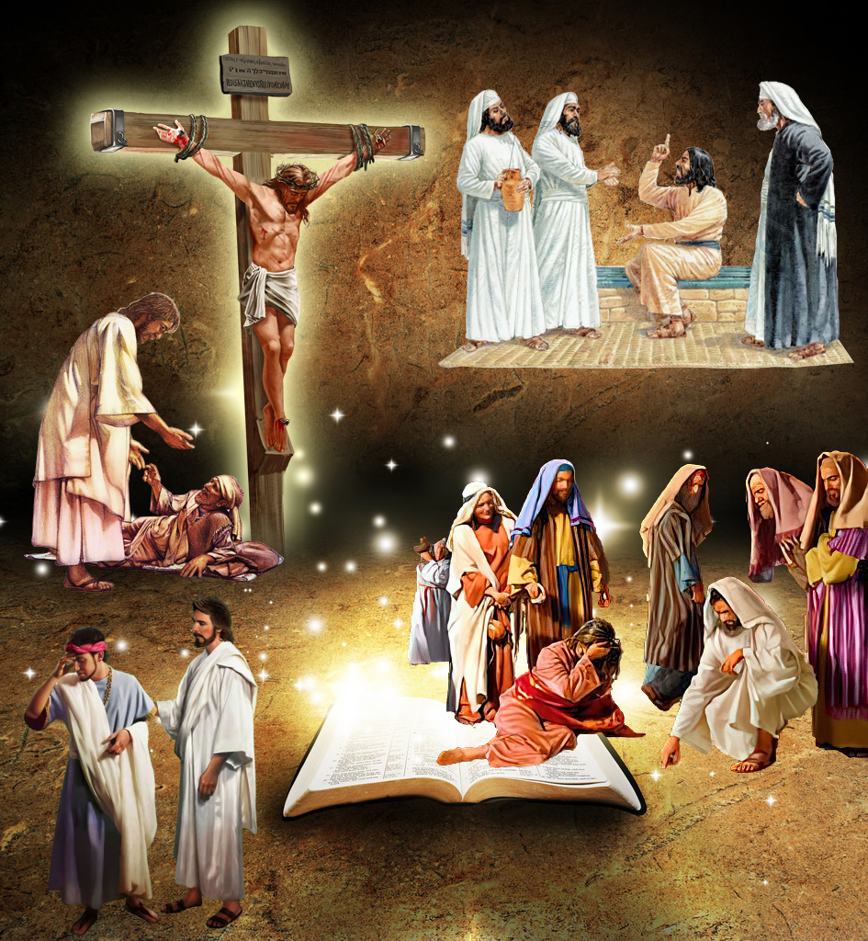
“arik' uwirata, ni yirate ibi, ko yammenye, akantahura, yuko nd' Uhoraho nkunda kugira imbabazi no guca iziroranye n'izigororotse mw isi: kukw ivyo ari vyo bimpimbara, ni jewe Uhoraho mbivuze.”
Yeremiya 9:24

Slide 2
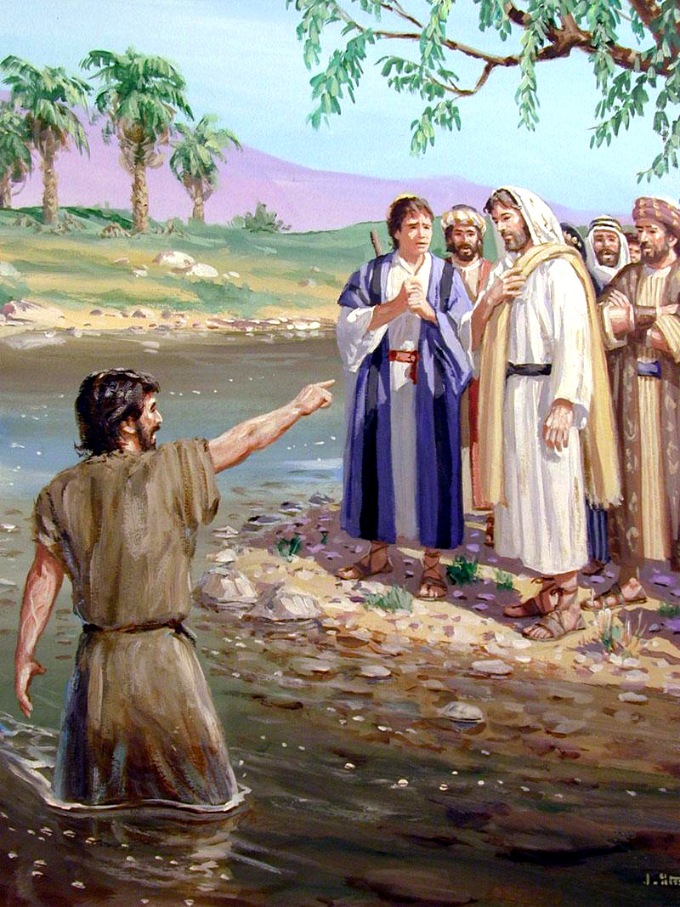
“Bukeye bg'aho abona Yesu aza kuri we, aravuga, ati Nguyu Umwagazi w'intama w'Imana ukurah' icaha c'abari mw isi.”
Yohana 1:29

Slide 3
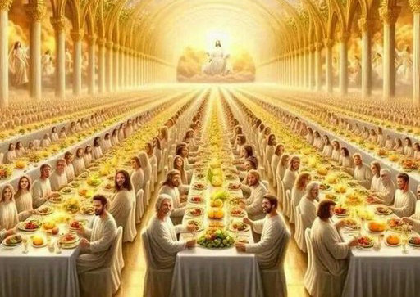
“Umumarayika arambarira, at' Andika, uti Hahirwa abatorewe gutaha ubukwe bga wa Mwagazi. Kand' arambarira, at' Ayo n'amajambo y'ukuri y'Imana.”
Ivyahishuriwe Yohana 19:9

Slide 4
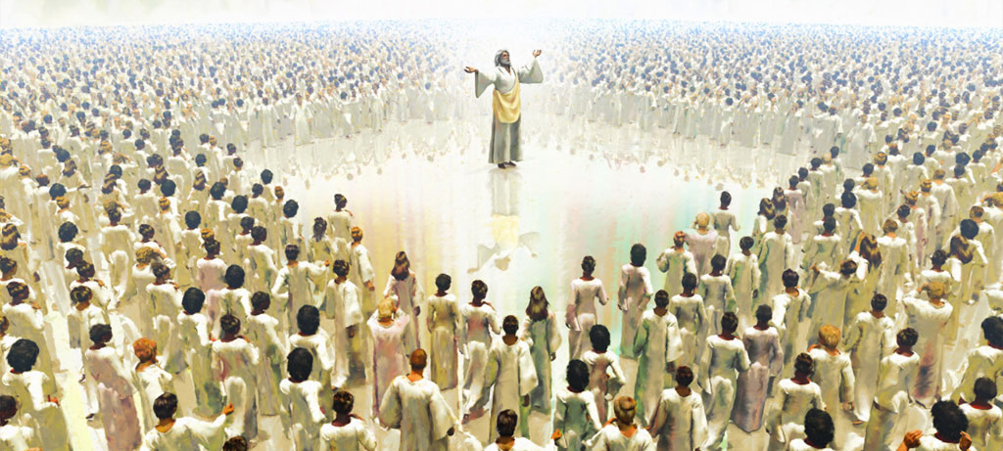
“Aca ahabga inganji n'icubahiro n'ubgami, kugira ngw amoko yose n'amahanga n'abavuga indimi zitari zimwe bamusabe: ingoma yiwe n'ingoma itazovaho, kand' ubgami bgiwe n'ubgami butazohangura.” Daniyeli 7:14

Slide 5
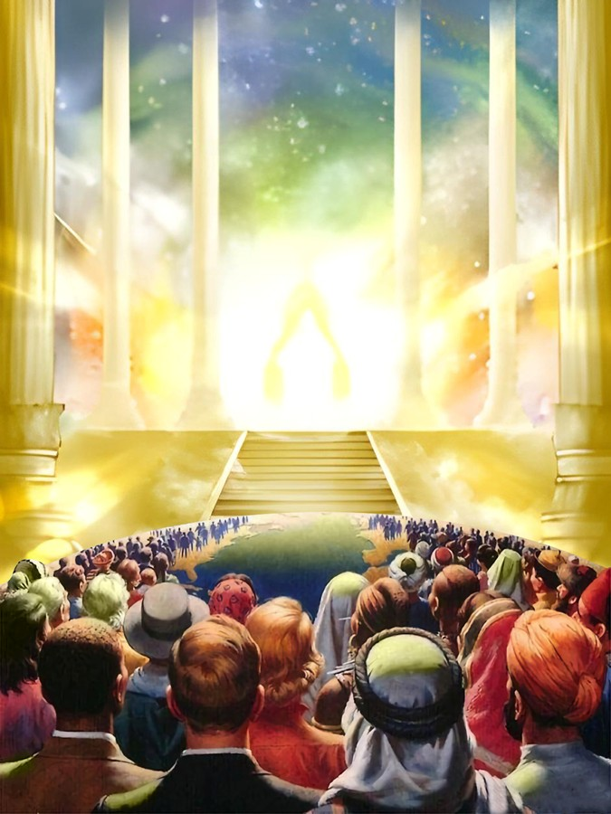
“Ni mwisigireho, mumenye kw ari jewe Mana;Nzoshirwa hejuru mu mahanga, nzoshirwa hejuru mw isi.”
Zaburi 46:10

Slide 6
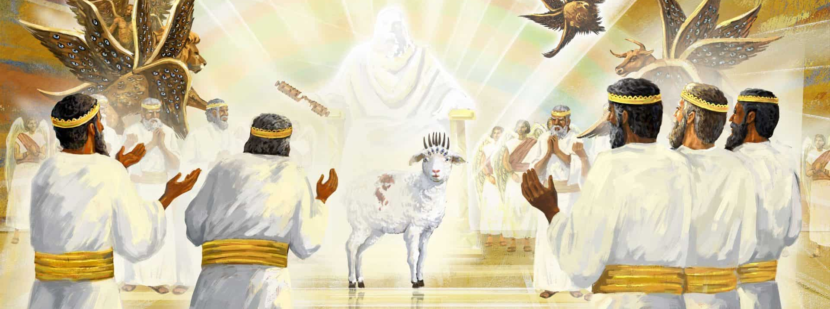
“Baririmba indirimbo nsha, bati Birakubereye kwabira igitabo, no kumena ibikimatanije, kuko wishwe, ugacungurira Imana abo mu miryango yose no mu ndimi zose no mu moko yose no mu mahanga yose, ubacunguje amaraso yawe.” Ivyahishuriwe Yohana 5:9

Slide 7
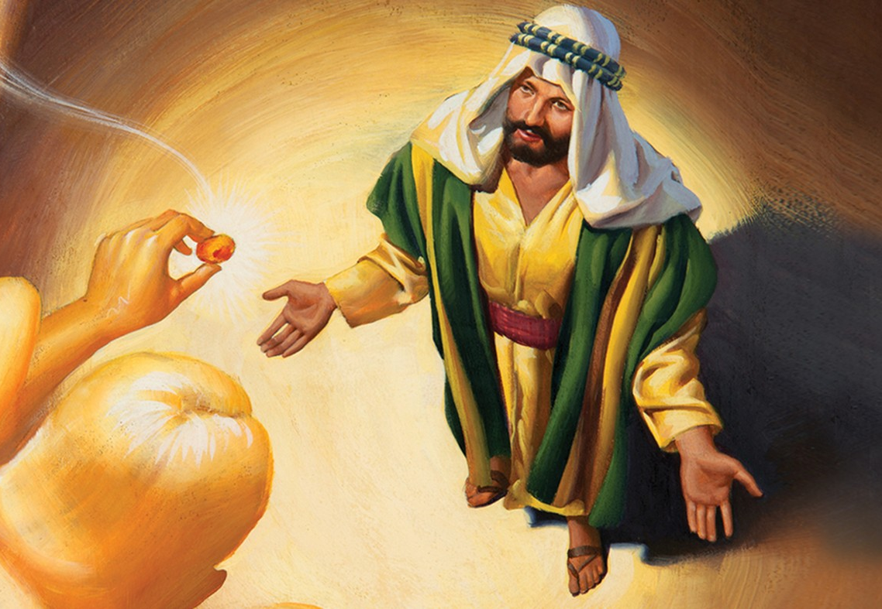
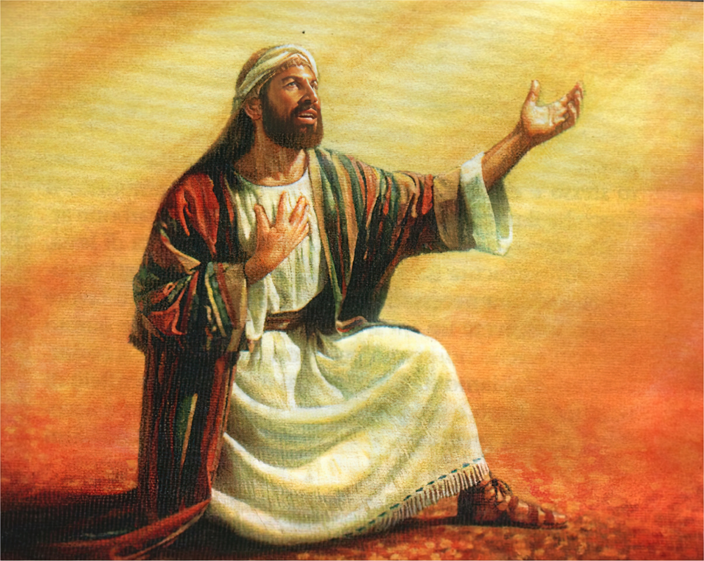
“Numva ijwi ry'Umwami Imana rivuga, riti Ndatuma nde, ni nde yotugira? Maze ndavuga, nti Ndi hano, ba ari jewe utuma.”
Yesaya 6:8

Slide 8
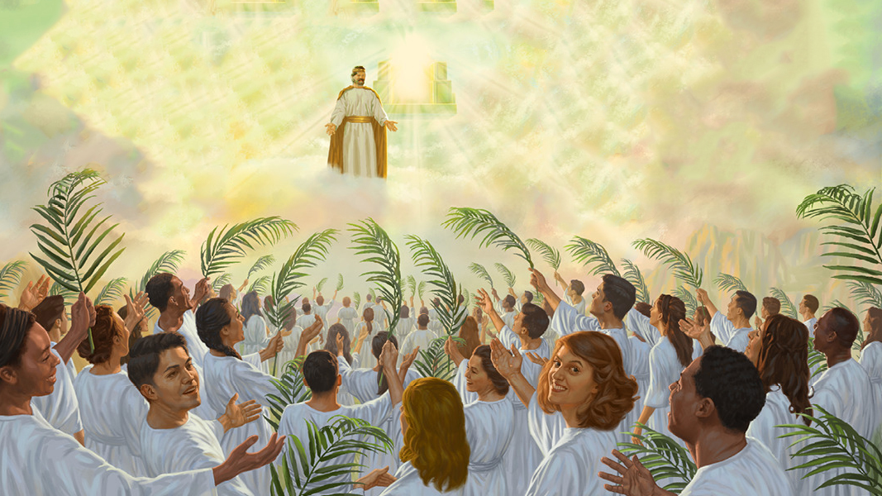
“Kandi mbona Umwagazi w'Intama, ahagaze ku musozi Siyoni, ahagararanye n'abantu ibihumbi ijana na mirongwine na bine, bafise izina ryiwe n'izina rya Se yanditswe mu ruhanga rwabo.”
Ivyahishuriwe Yohana 14:1

Slide 9
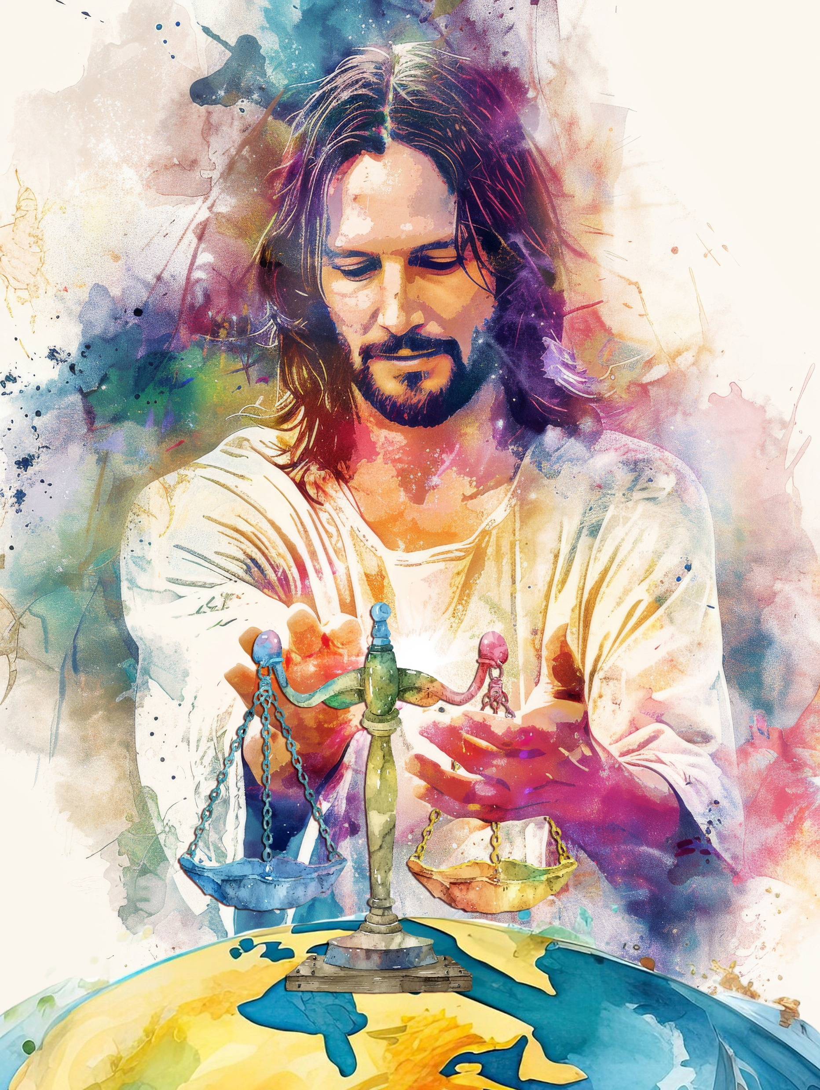
“Mana, amoko agushime,Amoko yose agushime. Amahanga anezerwe, aririmbishwe n'akanyamuneza:Kuk' uzocira amoko imanza ziroranye,Kand' uzorongora amahanga mw isi. Sela .”
Zaburi 67:3, 4

Slide 10
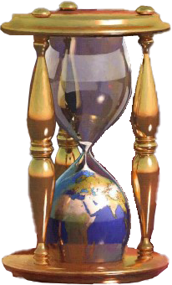
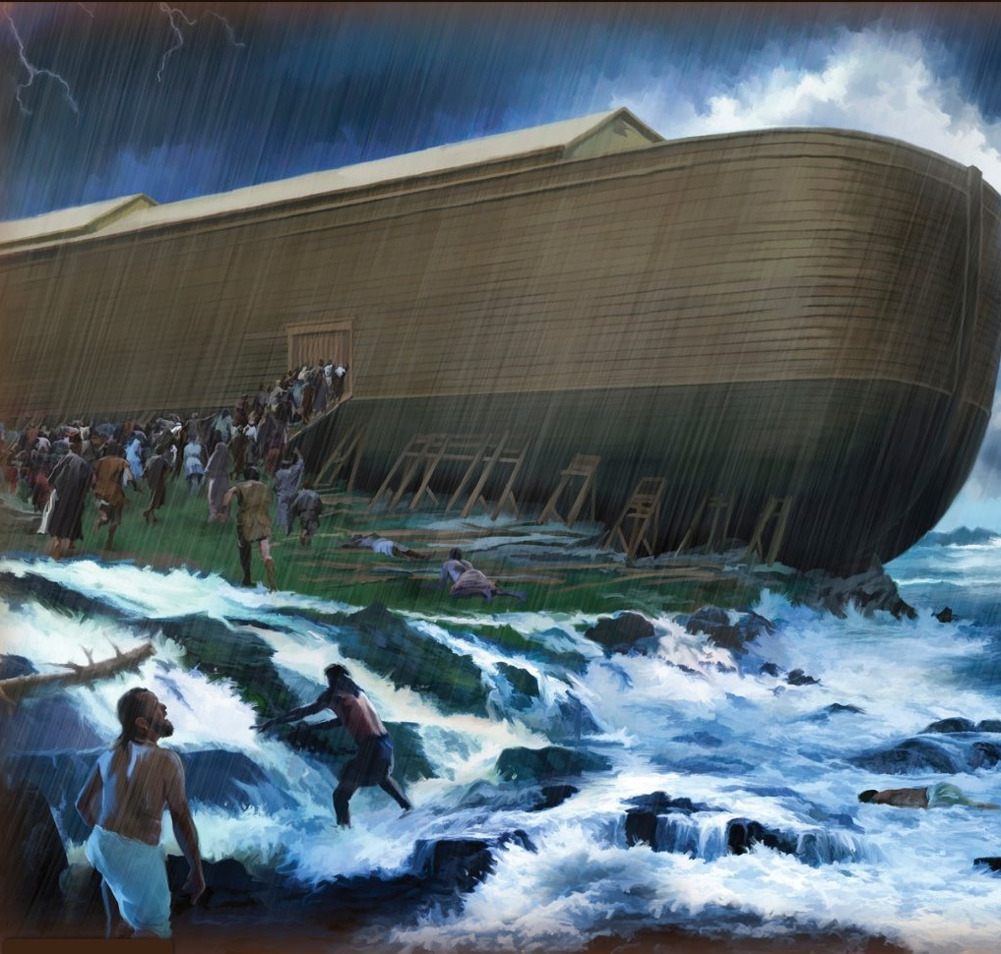
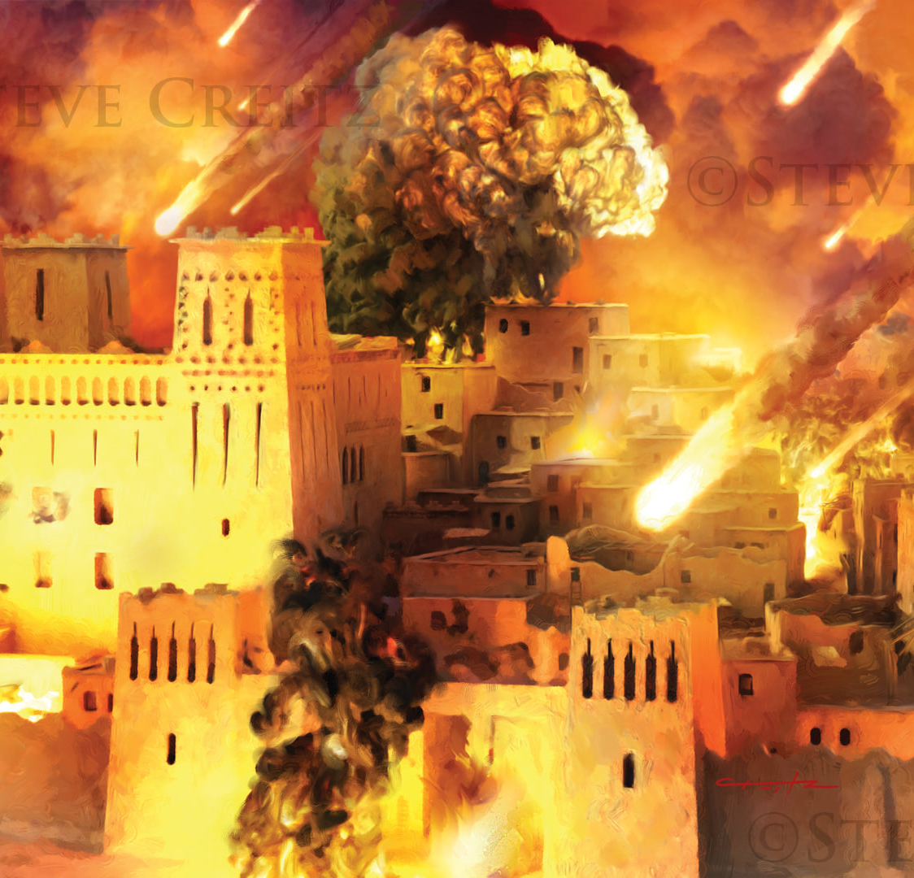
“Arikw ivyo vyababayeko kugira ngo bitubere akarorero, kandi vyandikiwe kuduhanura twebge, abashikwako n'amaherezo y'ibihe. Nuko rer' uwiyumvira kw ahagaze ni yiyubare ntagwe.”
1 Ab'i Korinto 10:11, 12

Slide 11
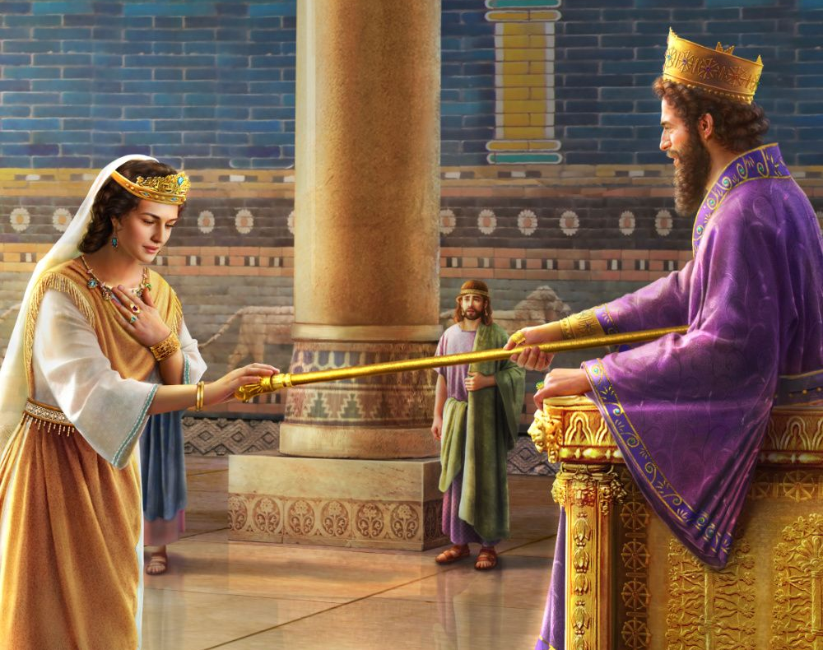
“Nuk' umwami abonye umwamikazi Esiteri ahagaze mu karusha, Esiteri agira ubutoni imbere yiwe; umwami atunga Esiteri inkoni y'izahabu yar' afise mu minwe. Maze Esiteri aca yigira hafi, akora ku mutwe w'iyo nkoni.”
Esiteri 5:2

Slide 12

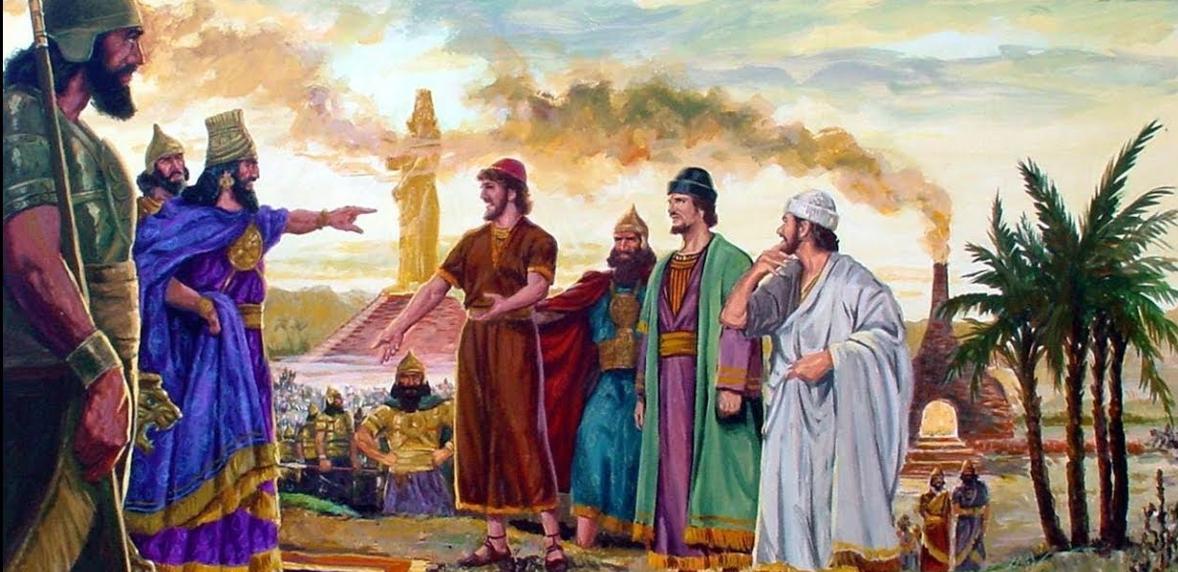
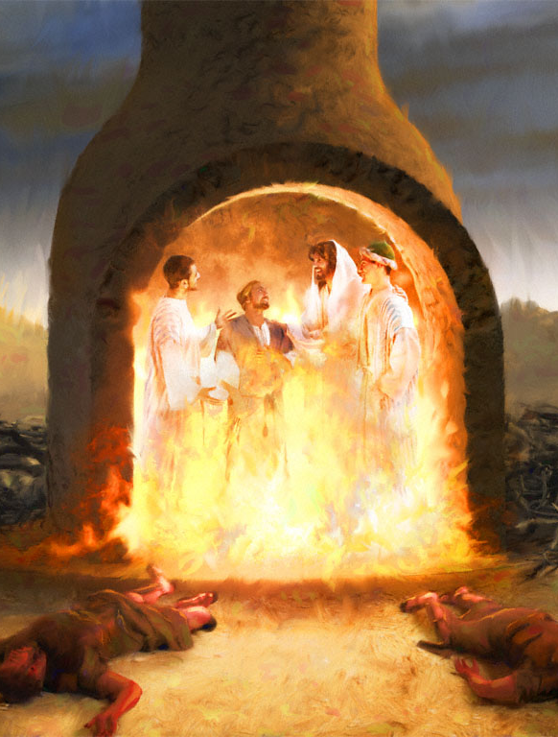
“Kukw Imana itaduhaye umutima w'ubujora: ariko yaduhaye uw' ubushobozi n'urukundo n'ukwirinda.”
2 Timoteyo 1:7

Slide 13
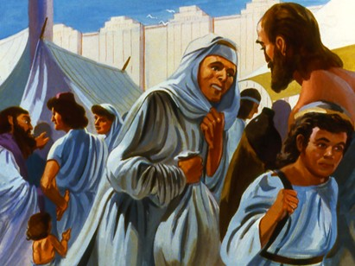
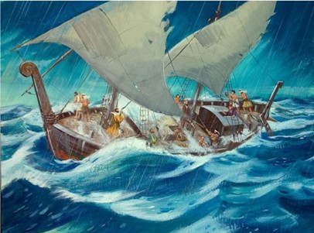
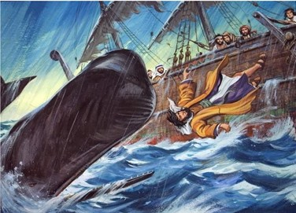
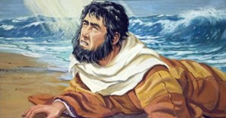
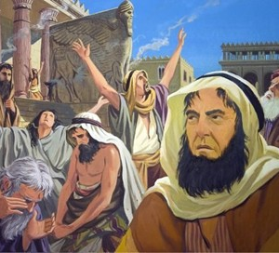
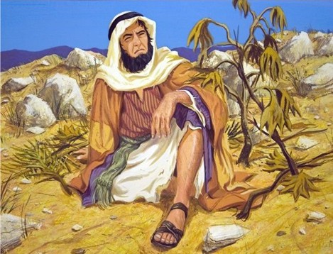
“Arabishura, ati Nd' Umuheburayo, nubaha Uhoraho, Imana Nyen' ijuru, yaremye ikiyaga n'i musozi.” Yona 1:9

