Slide 1
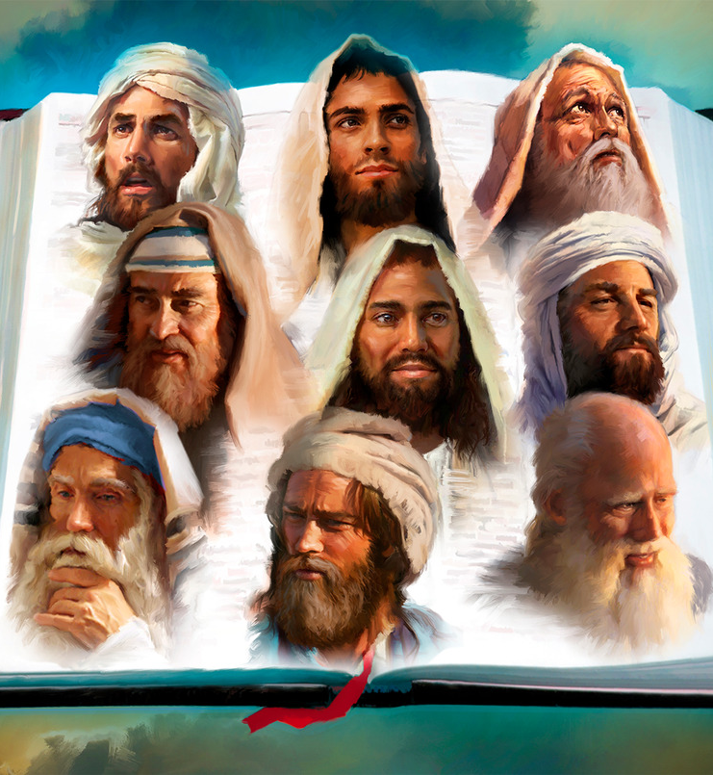
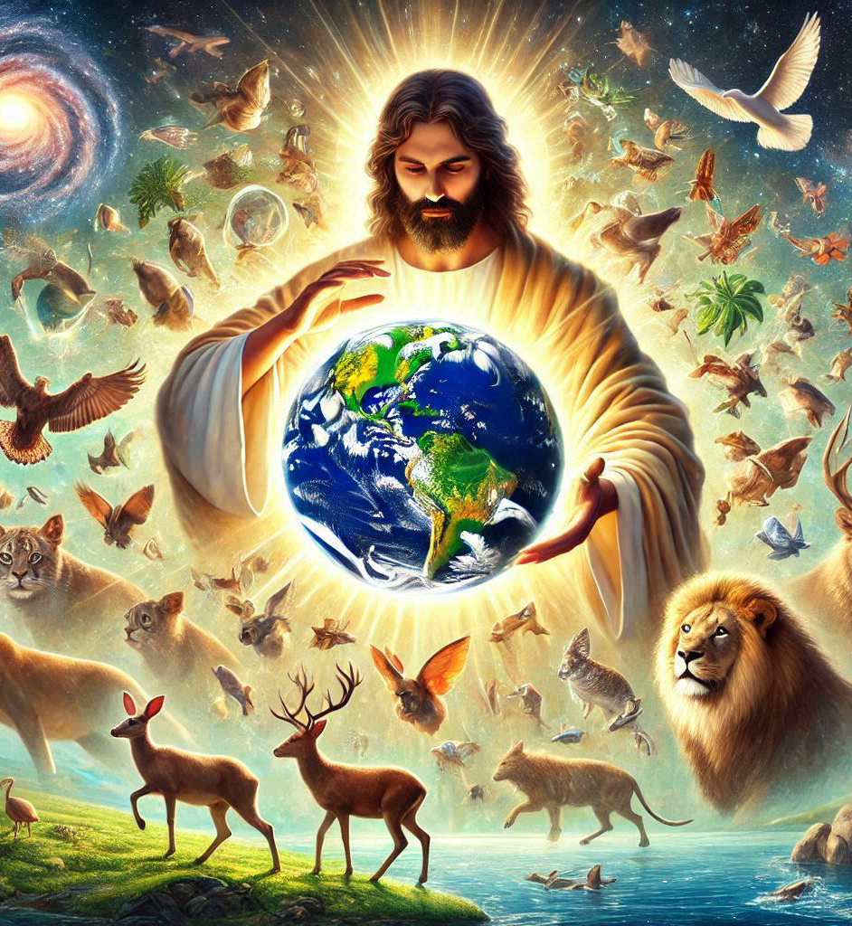
“Kera Imana yavuganye na ba sogokuruza kenshi kandi mu buryo bwinshi iciye ku bavugishwa na yo. Ariko muri iyi misi yʼiherezo, yavuganye natwe iciye ku Mwana wayo. Uwo ni we Imana yagize samuragwa wʼibintu vyose, kandi ivyaremwe vyose yabiremye iciye muri we.” (Abaheburayo 1:1-2)

Slide 2

«Nca numva ijwi ryʼImana ribaza riti: “Ni nde notuma? Ni nde yogenda mu gishingo cacu?”Nanje nca ndishura nti: “Ndi hano ntuma!”»
(Yesaya 6:8)

Slide 3

«Bagisohoka, Yehoshafati arahagarara avuga ati: “Nimunyumvirize, yemwe Bayuda namwe ababa i Yerusalemu! Nimwizere Uhoraho Imana yanyu muzohagarara mushikamye; nimwizigire abavugishwa na we muzoronka intsinzi.”»
(2 Ngoma 20:20)

Slide 4
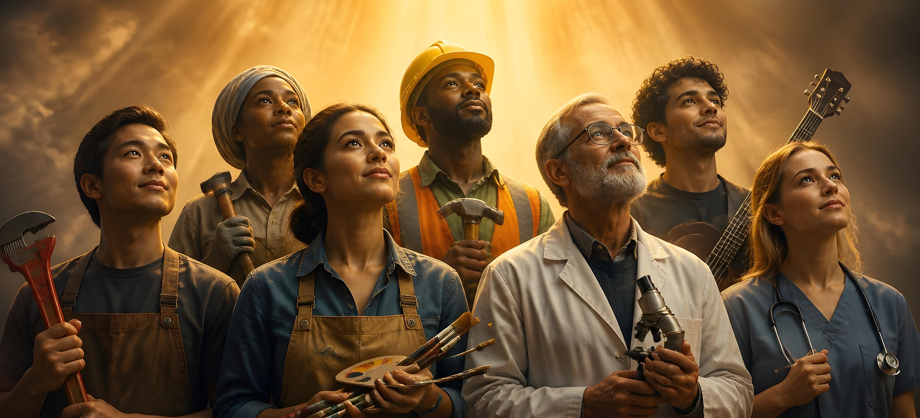
“Hari ingabire zitandukanye ariko Mpwemu azitanga ni umwe. Imirimo ni myinshi ariko Umwami dukorera ni umwe. Ibikorwa vyʼImana ni vyinshi, ariko iyo Mana nyene ni yo ibikorera muri twebwe twese.” (1 Korinto 12:4-6)

Slide 5

“Uguhishura kwa Yesu Kristo, ukwo yahawe n'Imana ngo yereke abagurano biwe ibigira bibeho vuba, agatuma umumarayika wiwe akabimenyesha umugurano wiwe Yohana, yashingiye intahe ivyo yabonye vyose, ni vyo jambo ry'Imana, no gushinga intahe kwa Yesu Kristo.” (Ivyahishuriwe Yohana 1:1-2)

Slide 6


“Kukw ivyanditswe kera vyose vyandikiwe kutwigisha, kugira ngo kwihangana no guhumurizwa guheshwa n'ivyanditswe biduhe kwizigira ibizoba.” (Abaroma 15:4)

Slide 7







“Ivyo vyashitse kugira ngo bitubere akarorero ko kutuburira, twebwe abo mu gihe ca nyuma.” (1 Korinto 10:11)

Slide 8

“Nuko ahera ku vyanditswe na Mose nʼabavugishwa bose, abasigurira ico Ivyanditswe bimuvugako.”
(Luka 24:27)

Slide 9
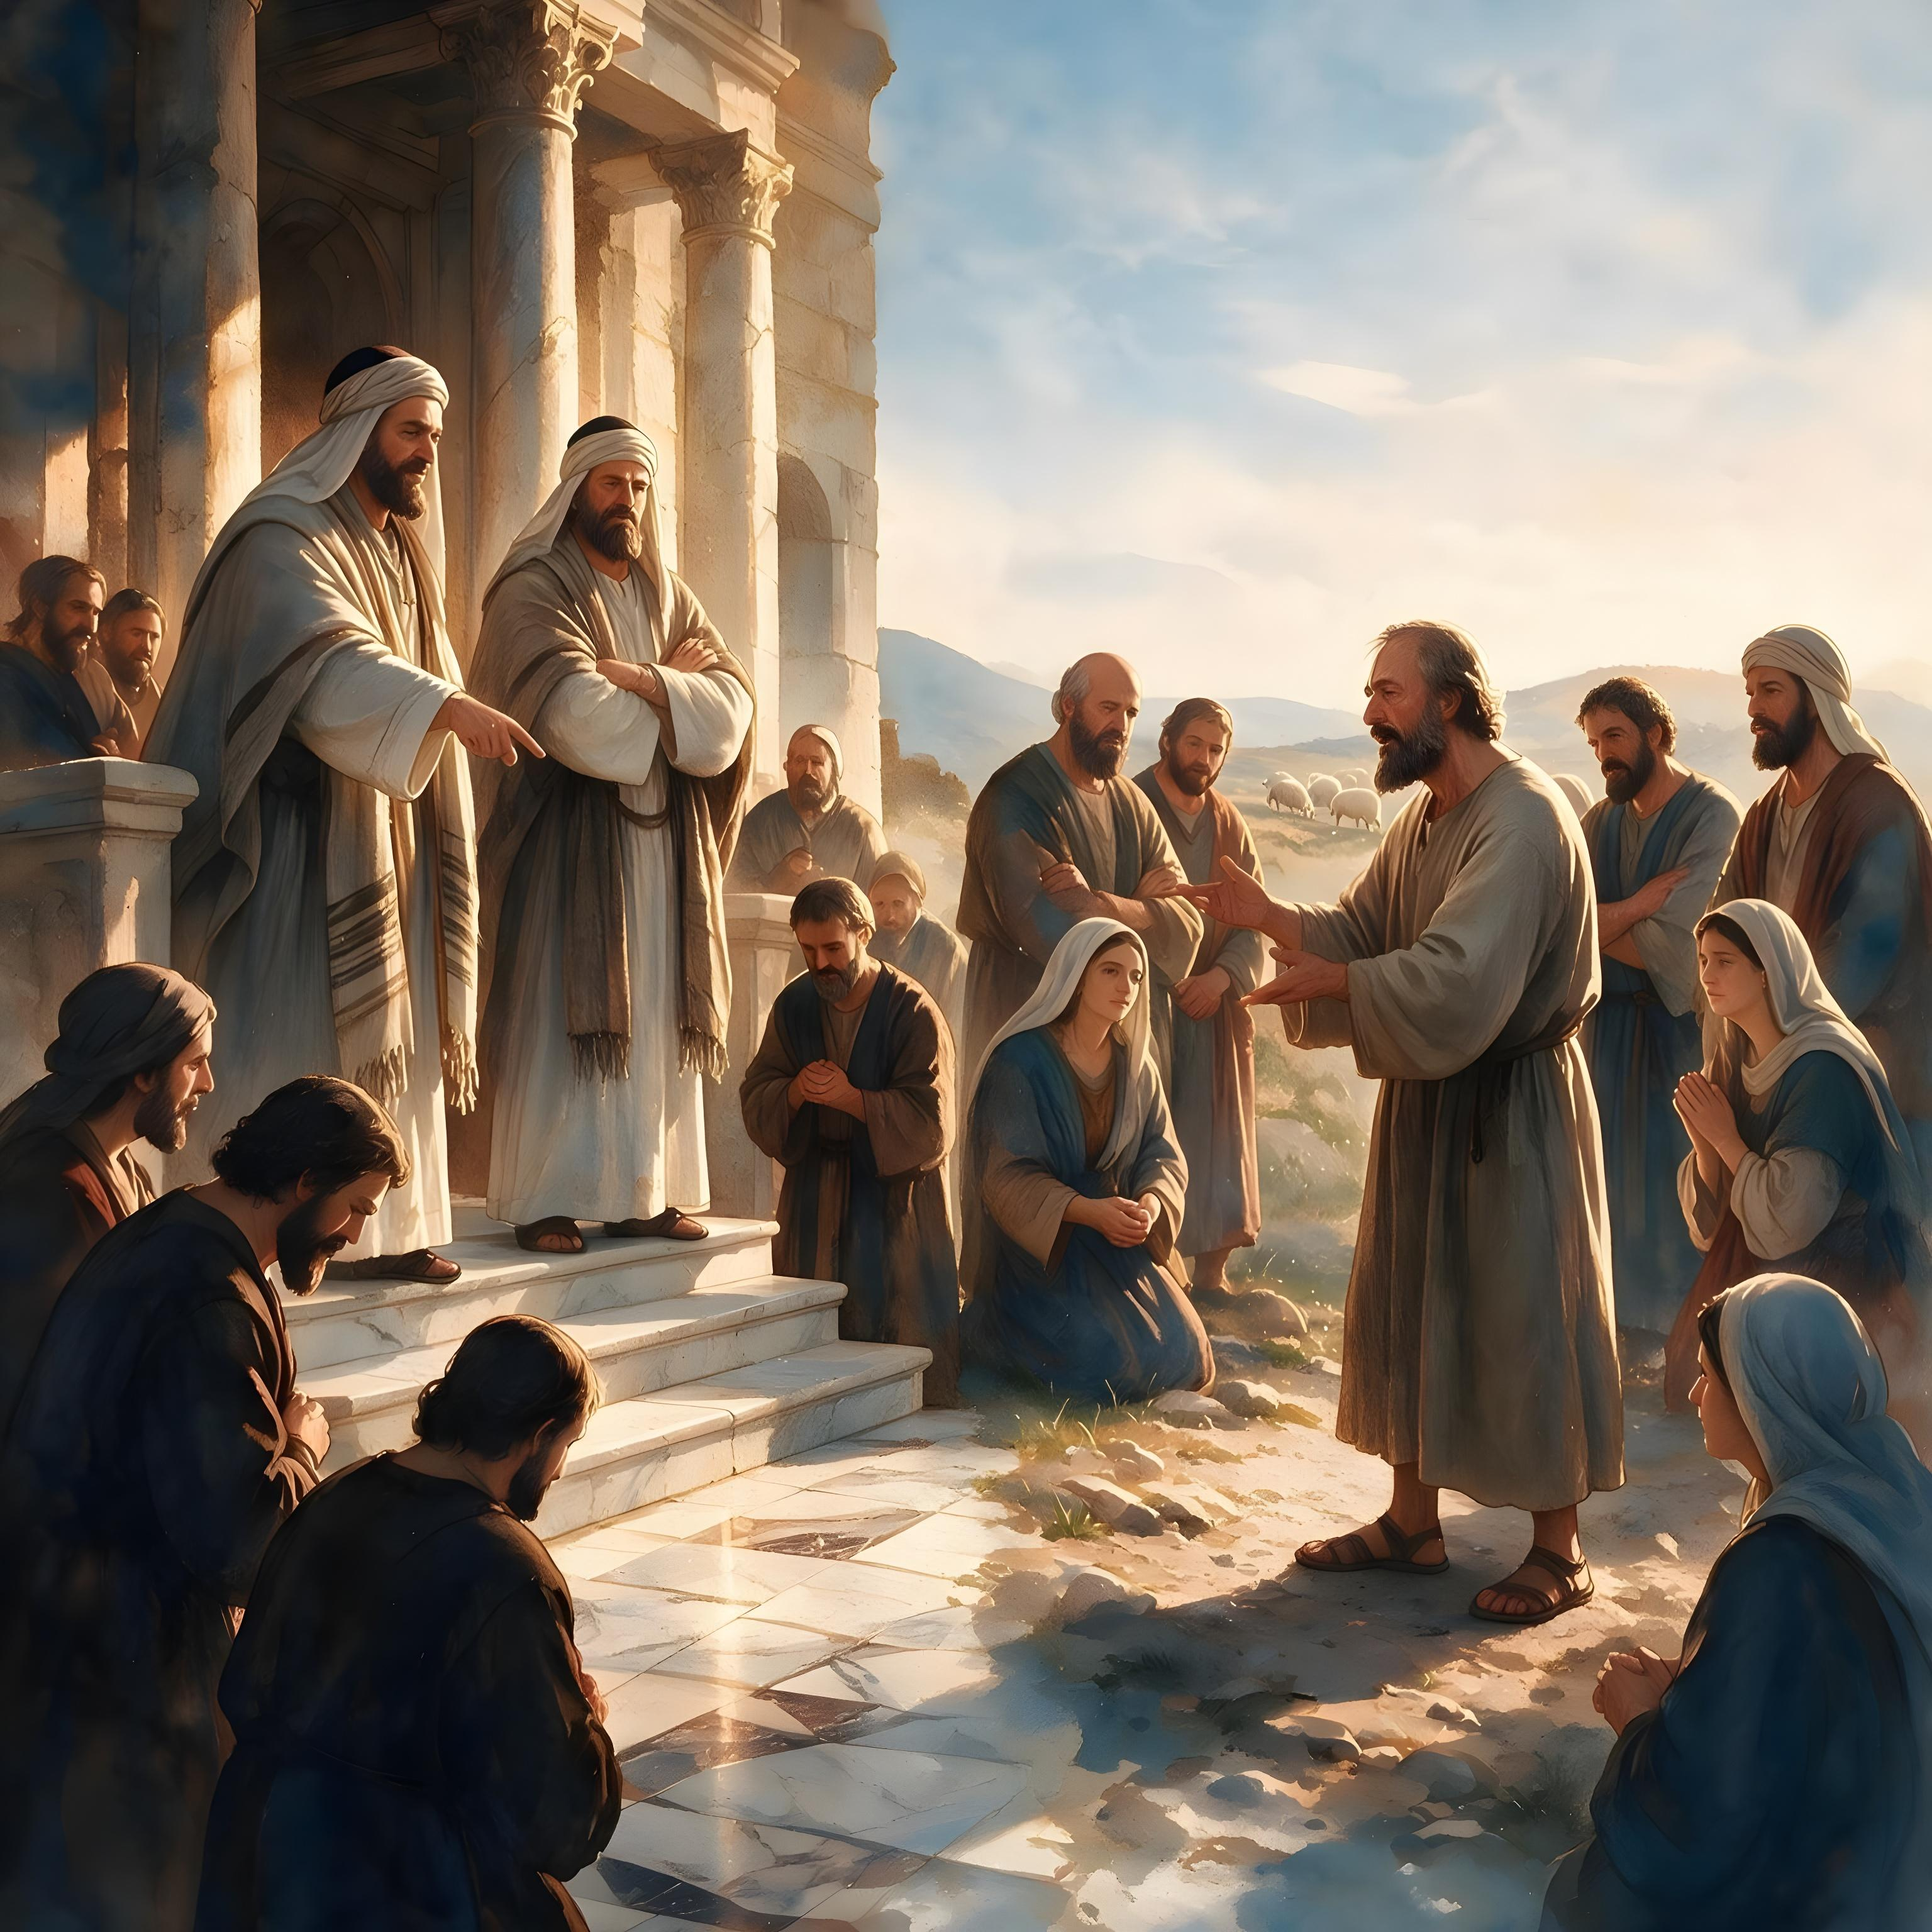

“Bakundwa, ntimukizere abantu bose bavuga ko bavugishwa. Ariko mubageze kugira ngo murabe ko impwemu ibakoresha iva ku Mana. Kuko hari abavugishwa bʼibinyoma benshi bakwiragiye mwʼisi.”
(1 Yohana 4:1)

Slide 10
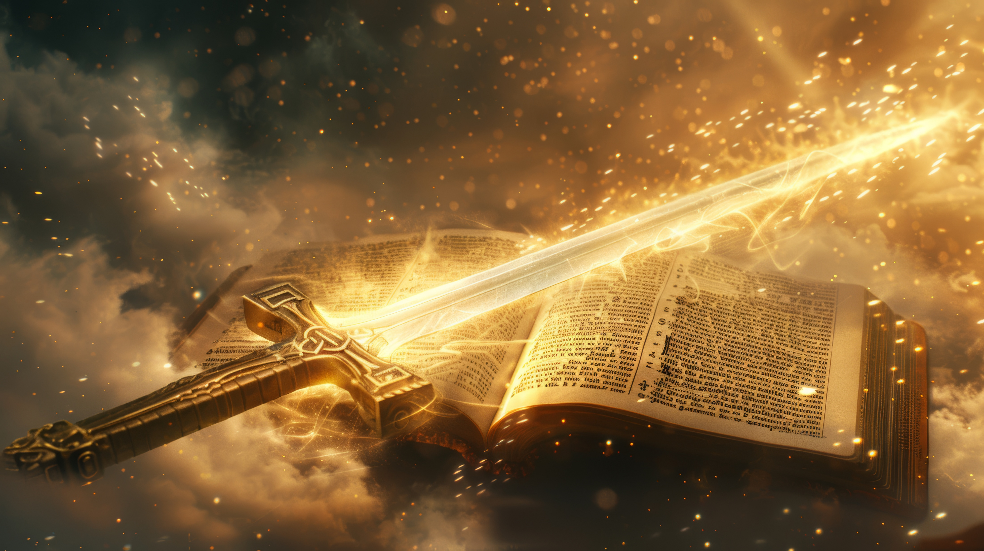
“Kuko ijambo ryʼImana ni rizima kandi ryuzuye ubushobozi. Rikarishe kurusha inkota yʼubugi bubiri; ririnjira rigashika aho ritandukanya umushaha nʼimpwemu, nʼingingo nʼimisokoro. Rishira ahabona ivyipfuzo nʼivyiyumviro vyʼumutima wʼumuntu.” (Abaheburayo 4:12)

Slide 11

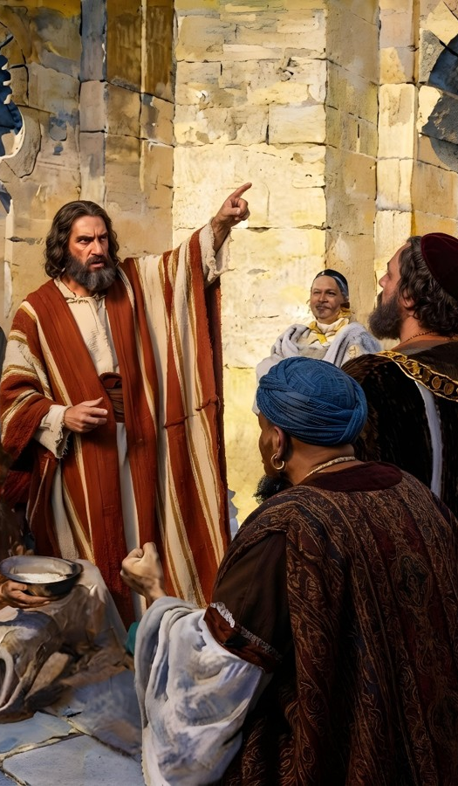
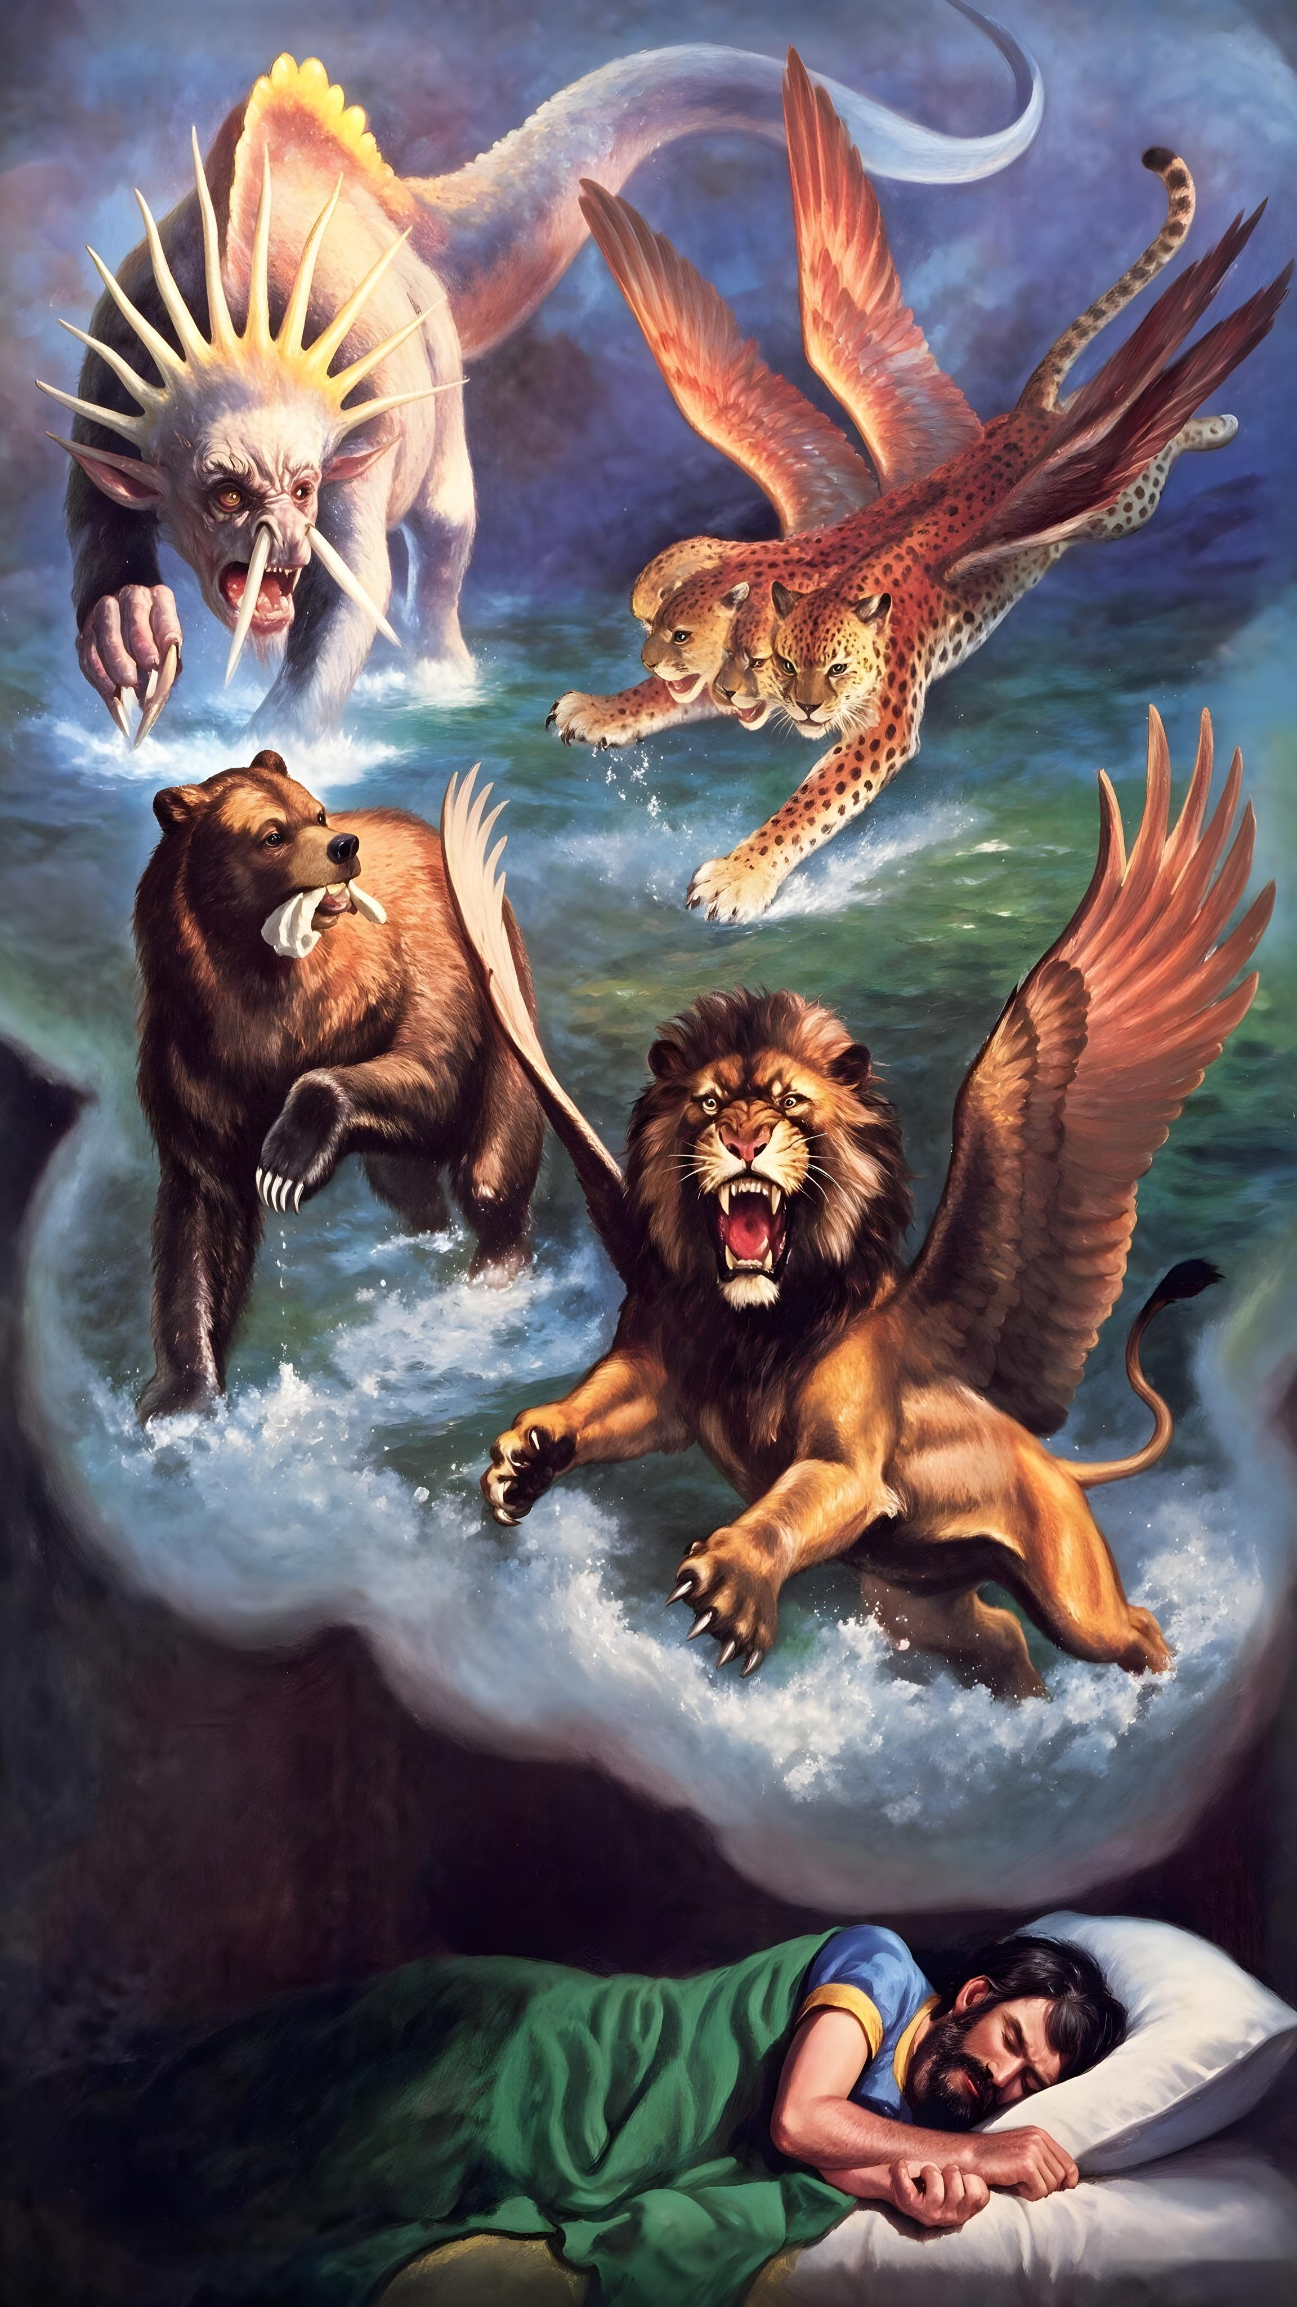
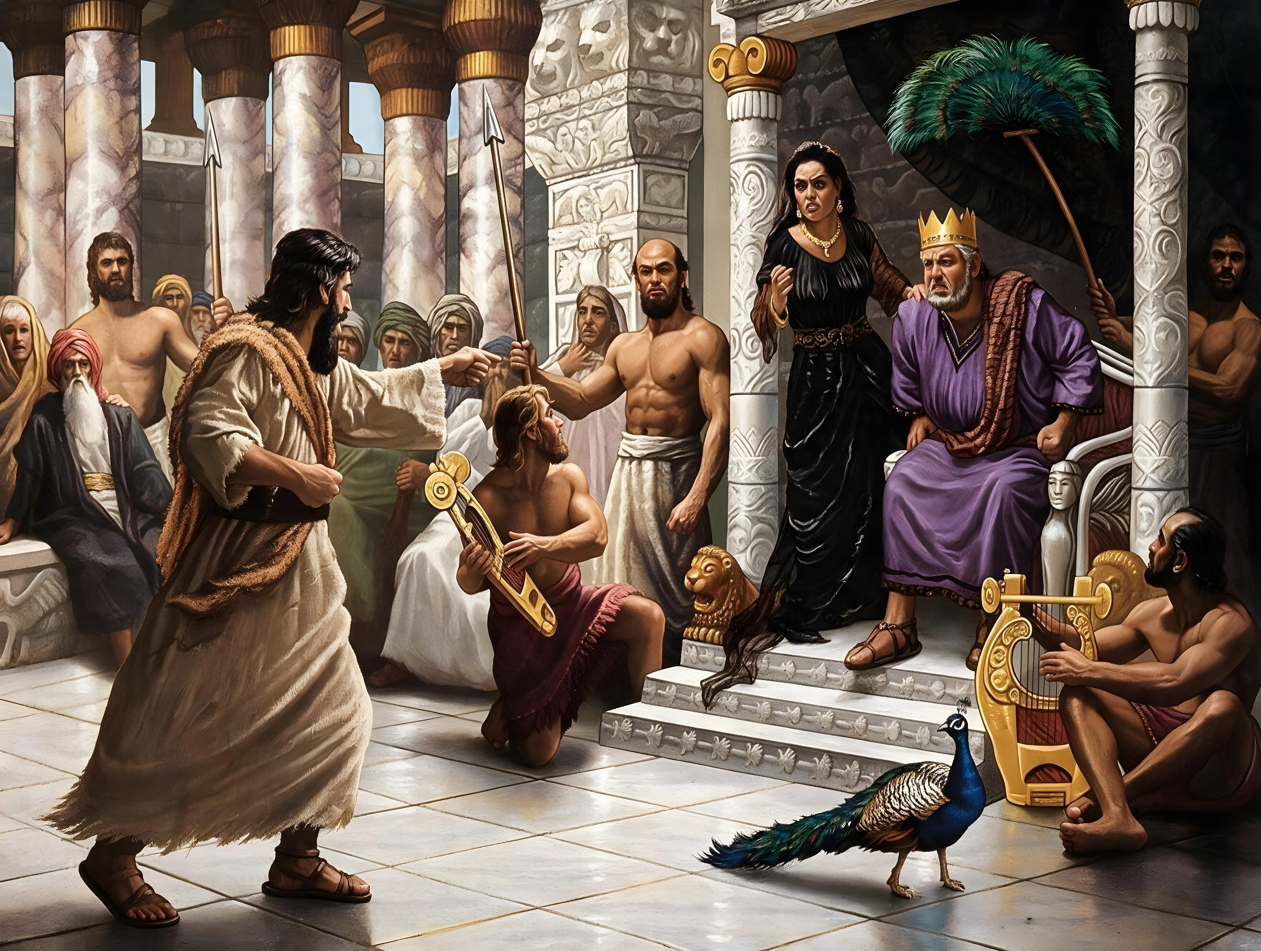
“Ni ukuri, Uhoraho Nyeninganji nta co akora
atabanje kugihishurira
abasavyi biwe bʼabavugishwa.”
(Amosi 3:7)

Slide 12
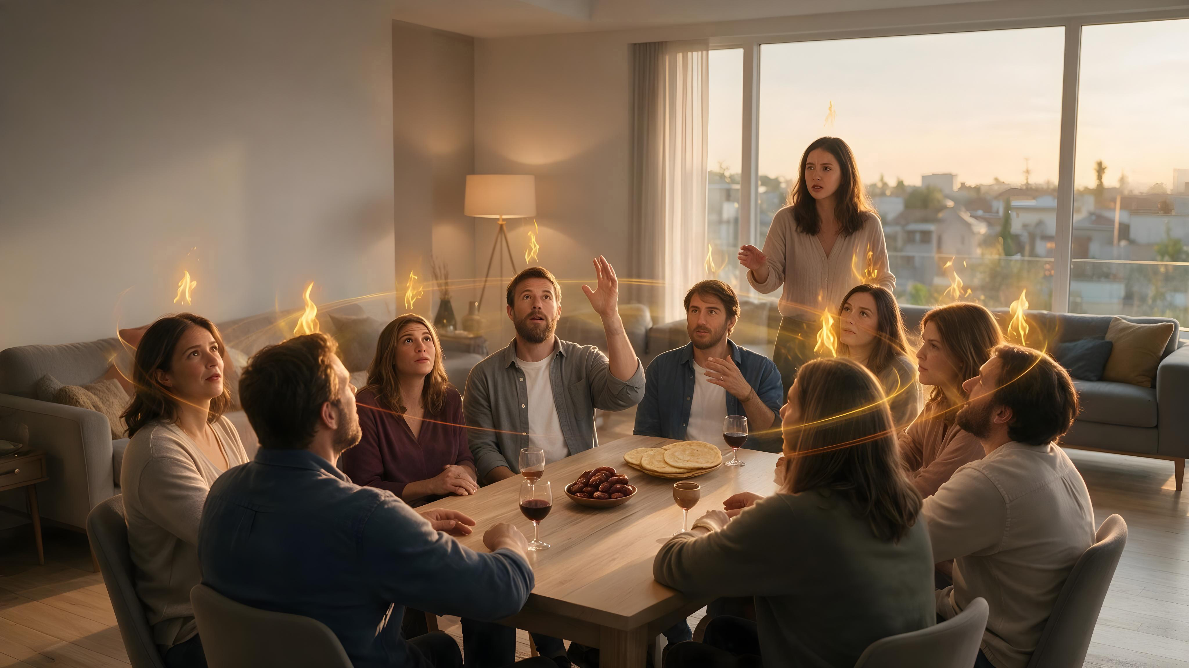
“Kandi hanyuma yʼivyo,
nzosuka Mpwemu wanje ku bantu bose.
Abahungu banyu nʼabakobwa banyu bazovugishwa,
abatama banyu bazorota indoto,
nʼabasore banyu bazobona ivyo beretswe.
Nʼabasavyi banje, abagabo nʼabagore,
nzobasukako Mpwemu wanje muri iyo misi.”
(Yoweli 2:28-29)

Slide 13
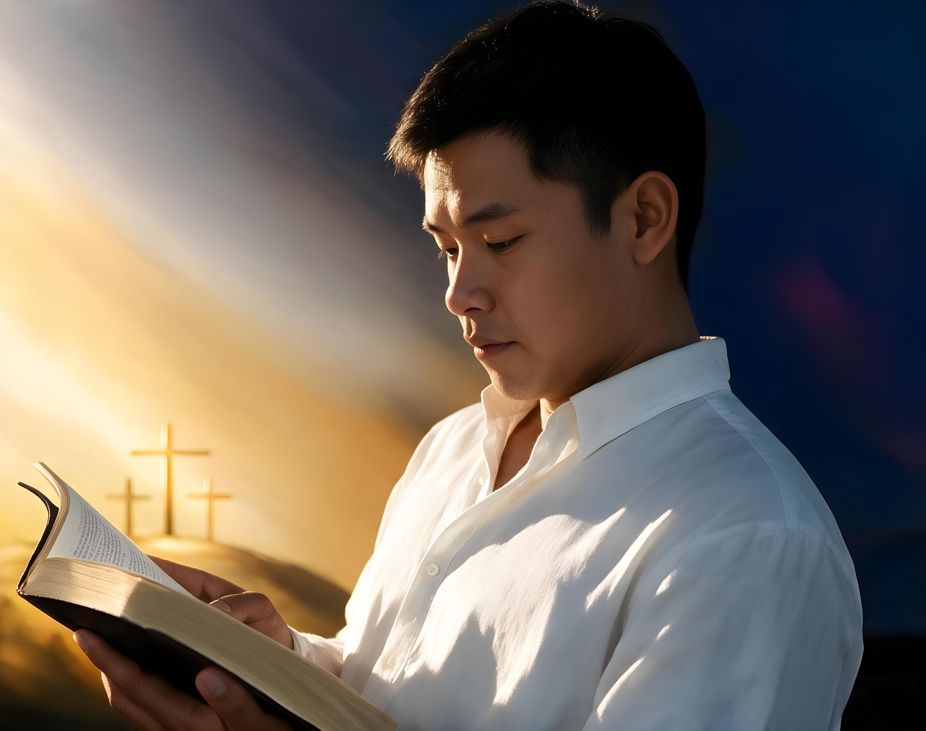
“Ivyanditswe vyose vyahumetswe nʼImana kandi bifise akamaro ko kwigisha ukuri, kwiyamiriza ibibi, gukebura no gutoza indero nziza mu bugororotsi, kugira ngo umuntu wʼImana atunganywe rwose, agire ibikwiye ku bwʼigikorwa ciza cose.”
(2 Timoteyo 3:16-17)

