Slide 1
INTAMBARA IHATSE IZINDI ZOSE
Icyigisho cya 1 cyo ku wa 6 Mata 2024

Slide 2
“Mu ijuru habaho intambara. Mikayeli n’abamarayika be batabarira kurwanya cya kiyoka, ikiyoka kirwanana n’abamarayika bacyo, Ntibanesha kandi mu ijuru ahabo ntihaba hakiboneka.” (Ibyahishuwe 12:7, 8)

Slide 3
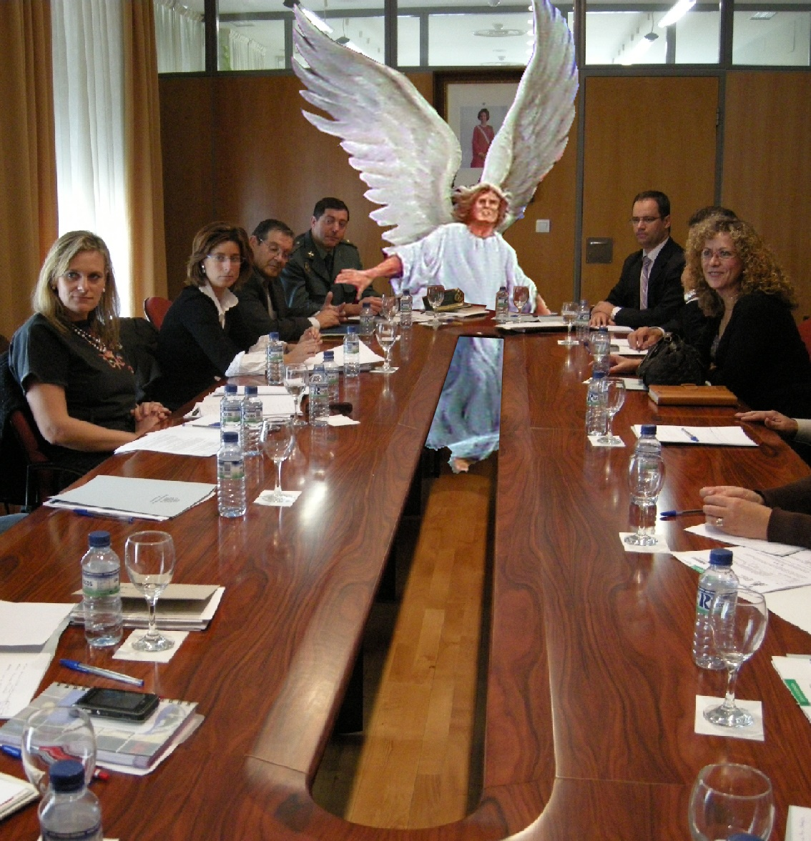
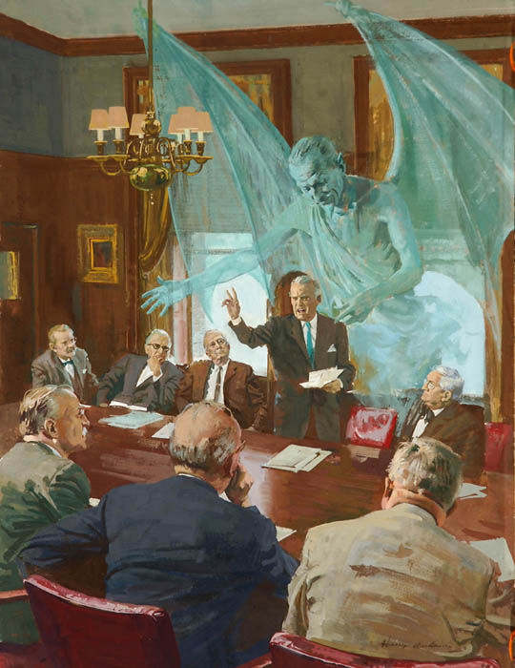
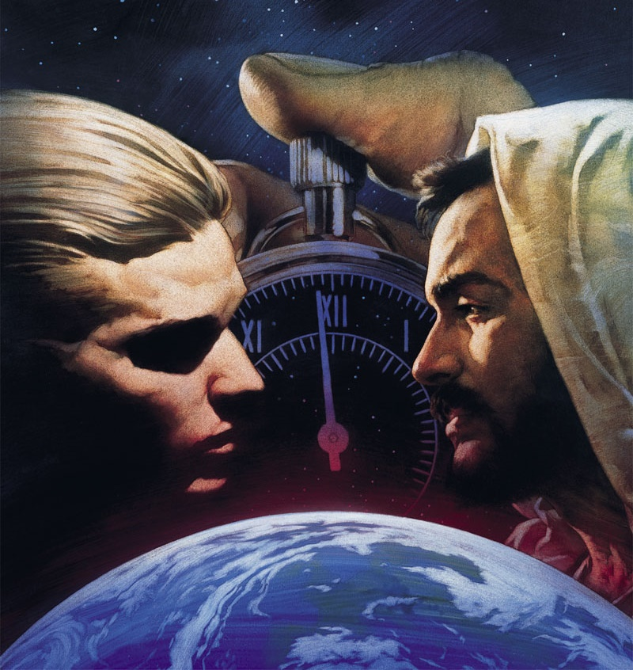
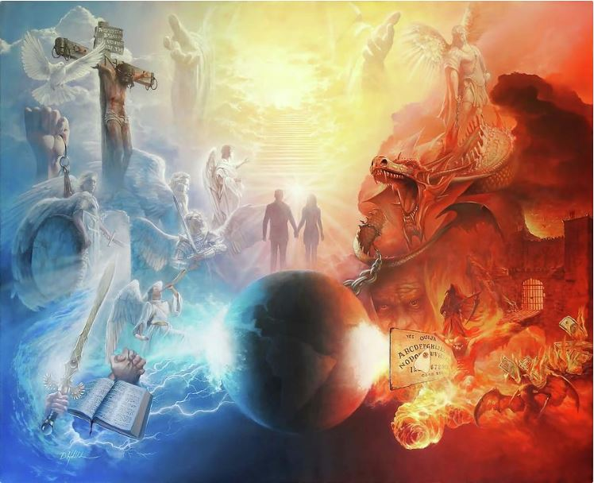
Turiho twibasiwe n’intambara y’isanzure yose. Nubwo twaba tutabizi, cyangwa tukaba tutizera ko ibyo bishoboka, ni ukuri, intambara irahari.
Imbaraga zihanganye ni izo mu buryo bwa mwuka, zitatugaragarira (Abefeso 6:12). Nyamara dushobora kubona ingaruka z’intambara: ibiza, ubuhenebere, urupfu …
Icyari kigenderewe ni ubutegetsi bw’Imana, ubudahemuka bw’abamarayika n’amasi ataracumuye. Uyu munsi, ubudahemuka bwawe n’ubwanjye ni bwo bugenderewe.
Intangiriro y’intambara
Ubwigomeke mu Ijuru
Ubwigomeke mu Isi
Urukundo rwitanga
Intambara uyu munsi

Slide 4
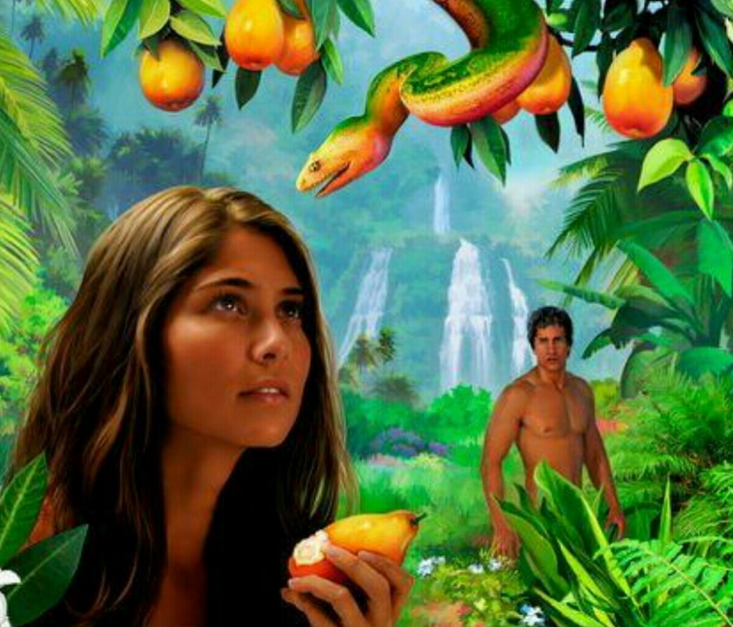
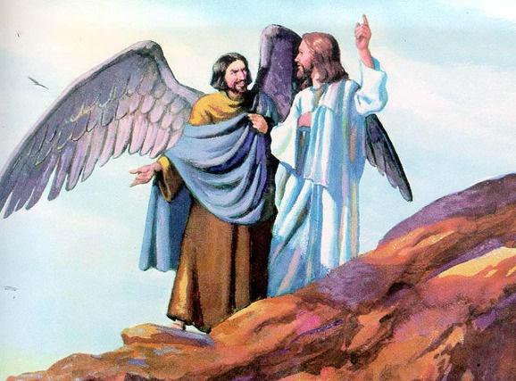
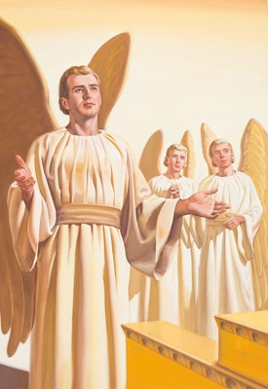
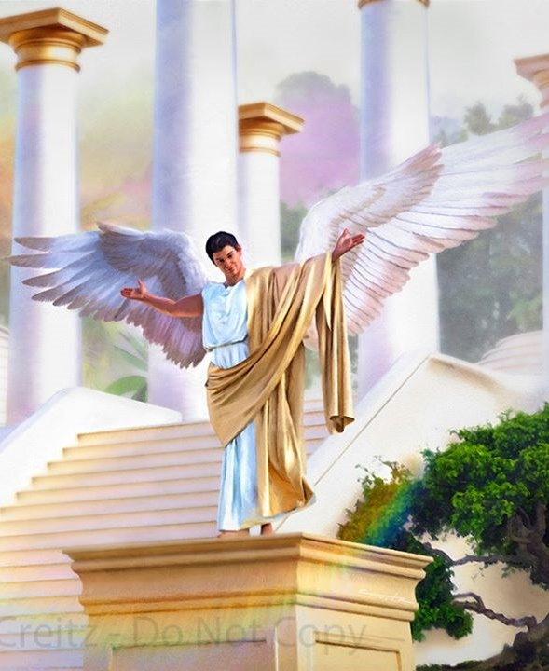
INTANGIRIRO Y’INTAMBARA
“YWari utunganye bihebuje mu nzira zawe zose uhereye umunsi waremweho, kugeza igihe wabonetsweho gukiranirwa” (Ezekiyeli 28:15)
Kuba muri Edeni harabonetse ikiremwa cyashukishije Eva kutizera Imana, bivuze ko kwigomeka ku Mana byabayeho mbere yuko ikiremwamuntu kibaho (Itangiriro 3:1).
Iki kiremwa cyabibye kutizerana hagati y’Imana n’ibiremwa byayo, cyavuzweho na Yesu ko ari “umwanzi”, ari we Satani (Matayo 13:39).
Ikibazo cya mbere twagombye kwibaza ni iki: ese Imana yaremye umubi, mu yandi magambo, ese Imana yaremye ikiremwa kibi?
Bibiliya itubwira ko umubi ari umumarayika witwa Lusiferi (Yesaya 14:12). Uyu mumarayika yaremwe atunganye kandi ari mwiza (Ezekiyeli 28:12). Yashyizwe mu mwanya wo hejuru umumarayika yashoboraga kwifuza: umukerubi urinda (Ezekiyeli 28:13–14).
Niba Lusiferi yari atunganye, yahindutse umubi ate? Intambara hagati ye n’Imana yatangiye ite? Kimwe n’ibiremwa byose Imana yaremye, Imana yamuhaye umudendezo wo guhitamo kandi, mu buryo tudashobora gusobanura, Lusiferi yahisemo kwigomeka, yifuza kwigarurira intebe y’Imana (Ezekiyeli 28:15; Yesaya 14:13–14).

Slide 5
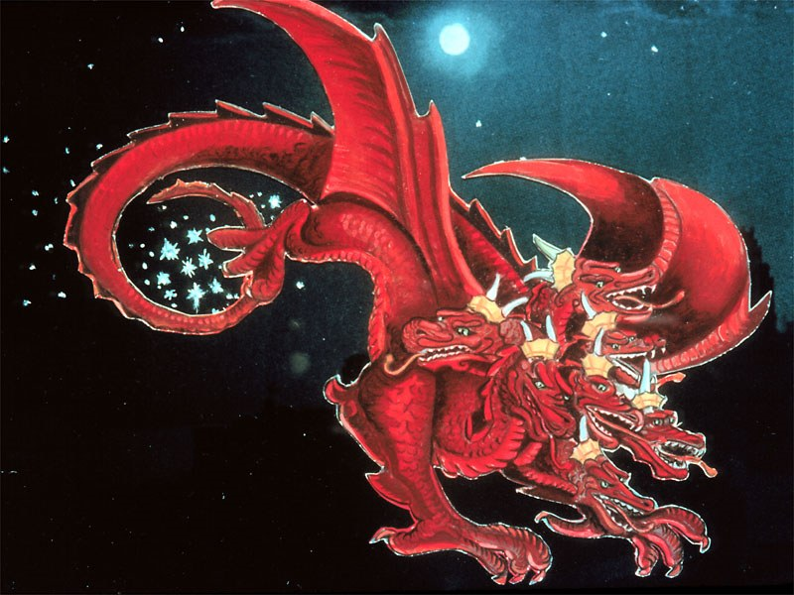
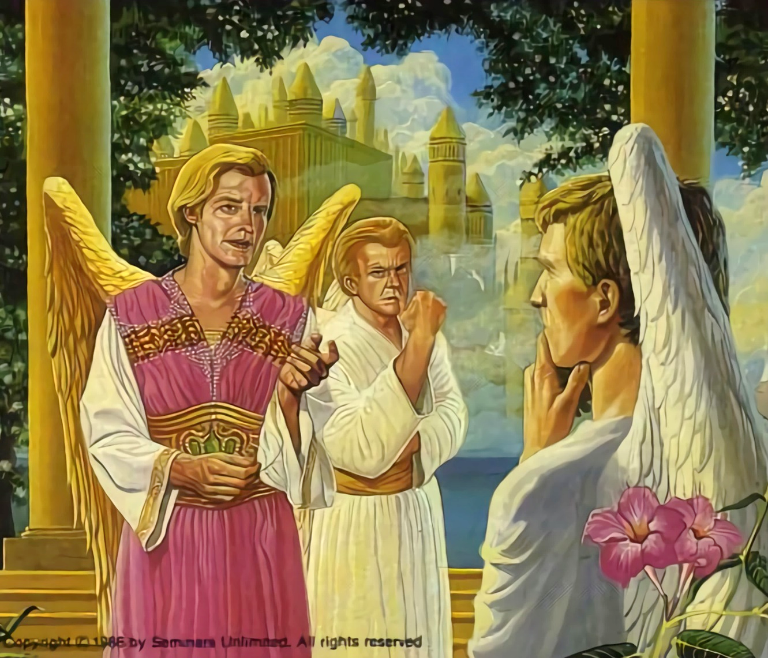
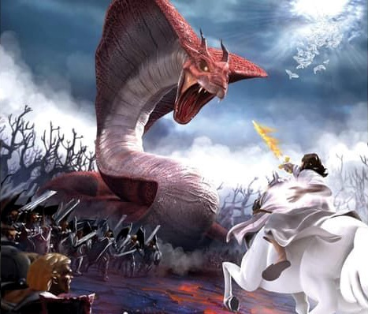
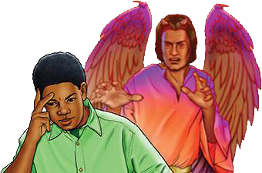
UBWIGOMEKE MU IJURU
“Umurizo wacyo ukurura kimwe cya gatatu cy’inyenyeri zo ku ijuru, uzijugunya mu isi…” (Ibyahishuwe 12:4a)
Mu cyifuzo cya Lusiferi cyo kwigarurira intebe y’Ijuru, yateye abamarayika gushidikanya ku butabera bw’ubutegetsi bw’Imana. Ese bose ntibari bafite umudendezo? Kuki bagombaga kugandukira amategeko akarishye kandi, ahari, arenganya cyangwa adashinga?
Lusiferi yahindutse Satani, umurezi (Ibyahishuwe 12:10; Yobu 1:6, 9–10). Yanze irarika ryose ry’Imana ryuje urukundo ryamurarikiraga guhindura inyifato.
Kwigomeka kwahindutse intambara yeruye, aho buri mumarayika yagombaga gufata umwanzuro. Icya gatatu cy’abamarayika bakurikiye Satani, naho abasigaye bakomeje kuba indahemuka ku Mana (Ibyahishuwe 12:4a).
Uyu munsi intambara irakomeje. Satani aracyafite umwete. Agerageza gukururira abantu bose mu kwigomeka ku Mana. Hariho impande ebyiri gusa. Abashaka kumvira Amategeko y’Imana, cyangwa abayanga. Umwanzuro ni uwacu (Gutegeka 30:11, 16, 19; Yosuwa 24:15).

Slide 6
“Imana ikomeye yashoboraga guhita yirukana mu ijuru uyu mushukanyi ruharwa; ariko uyu si wo wari umugambi wayo. Yahaye abigometse amahirwe yo kugera imbaraga n’ububasha byabo ku by’Umwana wayo bwite hamwe n’abamarayika bayo b’indahemuka. Muri iyi ntambara buri mumarayika yahisemo uruhande ahereramo kandi akabigaragariza bose. […] Iyo Imana iba yarakoresheje imbaraga zayo igahana uyu mwigomeke mukuru, abamarayika batanyuzwe ntibari kwigaragaza; ni yo mpamvu Imana yafashe undi murongo, ngo igaragarize mu buryo bbweruye ingabo zo mu ijuru zose ubutabera bwayo n’urubanza rwayo.”
E.G. White, The Story of Redemption, pg. 17

Slide 7
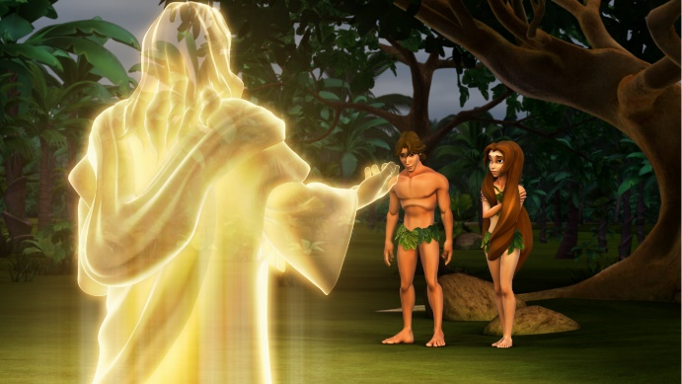
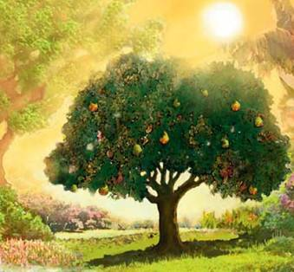
UBWIGOMEKE MU ISI
“Iramubaza iti ‘Ni nde wakubwiye ko wambaye ubusa? Wariye kuri cya giti nakubujije kuryaho?’ ” (Itangiriro 3:11)
Imana yaremeye abamarayika ahantu hatagira icyaha, hatunganye. Mu buryo nk’ubwo, Imana yaremeye ikiremwamuntu ahantu hatunganye, hatarangwamo icyaha (Itangiriro 1:31).
Nk’uko byari ku bamarayika, natwe Imana yaturemanye umudendezo wo kwihitiramo. Bityo, kugira ngo Adamu na Eva bakoreshe uwo mudendezo, bahawe amabwiriza yoroheje: “ariko igiti cy’ubwenge bumenyesha icyiza n’ikibi ntuzakiryeho, kuko umunsi wakiriyeho no gupfa uzapfa” (Itangiriro 2:17).
Aho ni ho honyine Satani yashoboraga kubatera gushidikanya. Ikigaragara nuko yageze ku ntego ye. Adamu na Eva bashidikanije ku Mana, ntibayumvira, batera umugongo isōko y’ubugingo (Itangiriro 3:6, 9–13, 19). Adamu yugururiye icyaha, bityo urupfu rugera ku bantu bose (Abaroma 5:12).
Kuva icyo gihe, tuba mu isi irangwa n’umubabaro, indwara n’urupfu. Ese twese turi kuryozwa icyaha cya Adamu?
Buri wese aryozwa icyaha cye: “kuko bose bakoze ibyaha, ntibashyikira ubwiza bw’Imana” (Abaroma 3:23).

Slide 8
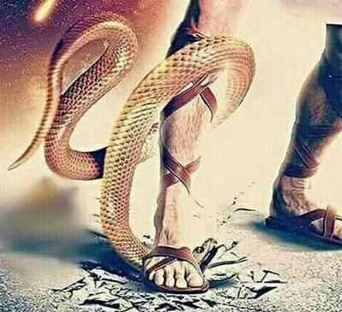
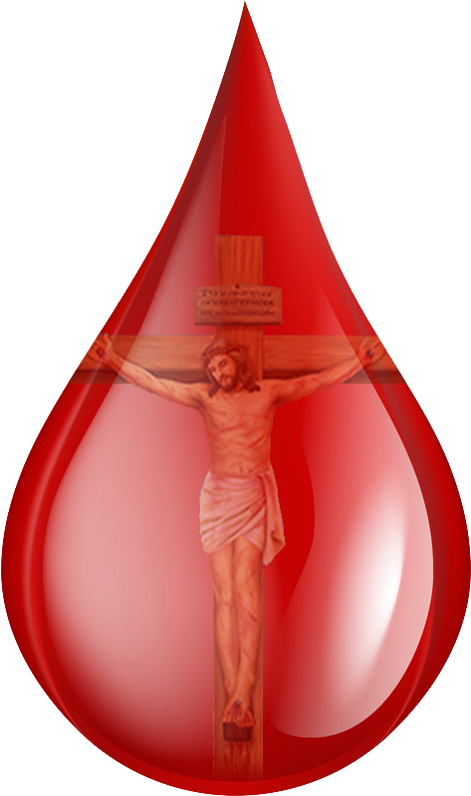
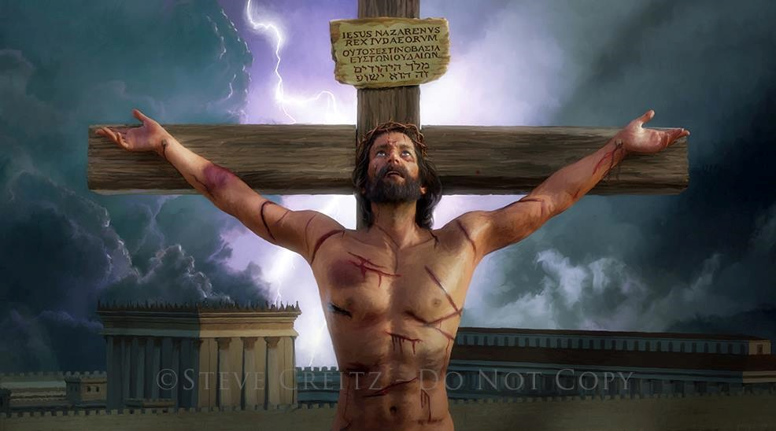
URUKUNDO RWITANGA
“Muri iki ni mo urukundo ruri: si uko twebwe twakunze Imana ahubwo ni uko Imana ari yo yadukunze, igatuma Umwana wayo kuba impongano y’ibyaha byacu” (1Yohana 4:10)
Ndetse na mbere y’uko Imana itangaza ingaruka zo kutumvira, yabwiye Adamu na Eva ko hariho umugambi wo gucungurwa kwabo (Itangiriro 3:15).
Inyokomuntu yari yitandukanije n’Umuremyi ku bushake. Ariko aho kureka abana bayo b’indashima, Imana yerekanye imico yayo y’ukuri, ibakunda birenze uko byasobanurwa (Yohana 3:16).
Urupfu ntirwagombaga kuba iherezo ry’umunyabyaha. Yesu yerekanye urukundo Rwe, yishyura ikiguzi cy’icyaha atanga ubugingo Bwe (Abaroma 5:8).
Nta kintu kiri muri twe cyatugira abakwiriye urukundo rw’Imana. Nyamara, kuri buri gitonyanga cy’amaraso Yesu yameneye i Kaluvari, Imana iraduhamiriza ngo: “Ndabakunda.”

Slide 9
URUKUNDO RWITANGA
“Muri iki ni mo urukundo ruri: si uko twebwe twakunze Imana ahubwo ni uko Imana ari yo yadukunze, igatuma Umwana wayo kuba impongano y’ibyaha byacu” (1Yohana 4:10)
Yesu yatweretse urukundo Rwe ate?
Yesu yaremye ibiriho byose (Yohana 1:3)
Yahindutse ‘ikiremwa’ (Yohana 1:14)
Yanyuze mu ngorane, kubabara, inzara n’uburibwe, nkatwe (Yesaya 53:3; Mariko 11:12)
Yageragejwe nkatwe (Abaheburayo 4:15)
Nubwo ari umukiranutsi, yemeye kubabazwa kubw’ibyaha byacu (1 Petero 3:18; Yohana 10:17–18)
Mu gupfa no kuzuka, yatwiringije ubugingo buhoraho turi kumwe na We (Abaroma 6:3–4)
Kandi ibi byose byari kubw’urukundo (1Yohana 4:10)

Slide 10
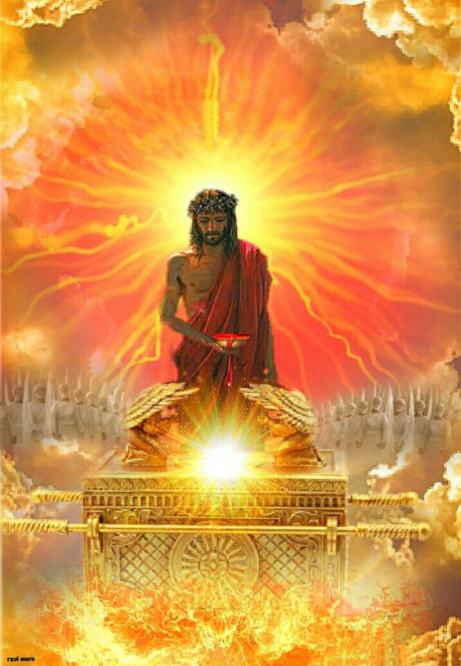
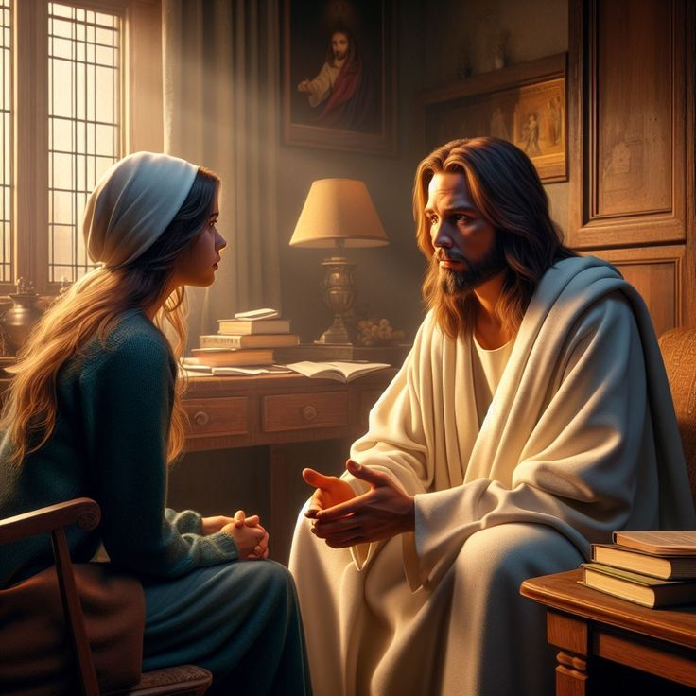
INTAMBARA UYU MUNSI
“Ni cyo gituma abasha gukiza rwose abegerezwa Imana na we, kuko ahoraho iteka ngo abasabire” (Abaheburayo 7:25)
Uyu munsi, Yesu aradusabira mu Buturo Bwera bwo mu Ijuru (Abaheburayo 9:24; 7:25).
Kubera amaraso yameneye ku musaraba, Yesu atwerekana imbere ya Data – ndetse n’abatuye isanzure bose – nk’abantu b’abakiranutsi, batunganye, bakwiriye kugira umwanya mu Ijuru.
Kubw’ibyo, turarikiwe kwegera Imana dushize amanga muri Yesu (Abaheburayo 4:15–16).
Yesu arashaka ko tumwiringira kuri buri kintu cyose dukeneye mu mibereho yacu (Yohana 14,13–14). Ahari ubwoba, ahazana amahoro; ahari ikidodo cy’icyaha, ahazana imbabazi; ahari intege nke, ahazana ugukomera.
Icyifuzo gikomeye cya Yesu ni ukubana natwe iteka ryose (Yohana 17:24). Ese iki ni na cyo cyifuzo gikomeye cyawe?

Slide 11
“Ibishuko nibigutera, guhangayika, kwiheba, n’umwijima bigasa n’ibigose ubugingo bwawe, reba aho uheruka kubona umucyo. Bonera ihumure mu rukundo rwa Kristo no mu burinzi Bwe. Icyaha nigishegera kwigarurira umutima, ikidodo cy’icyaha nigitsikamira ubugingo kandi kikaremerera umutimanama, kutizera nikwijimisha intekerezo, uzibuke ko ubuntu bwa Kristo buhagije kugira ngo buneshe icyaha kandi butamurure umwijima. Iyo twinjiye mu gusabana n’Umukiza, tuba twinjiye muri gakondo y’amahoro."
E.G. White, The Ministry of Healing, pg. 193

