Slide 1
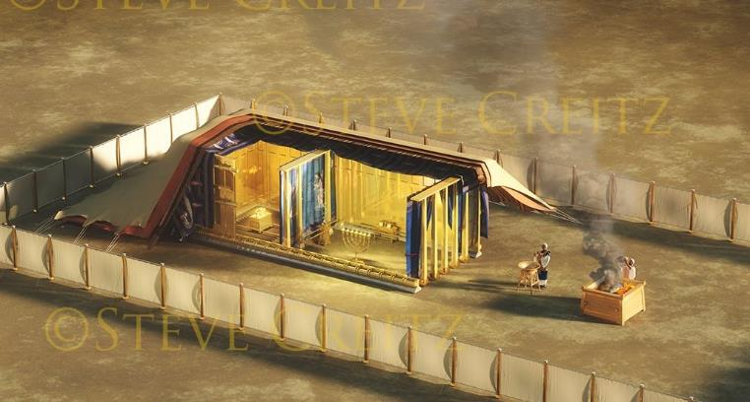
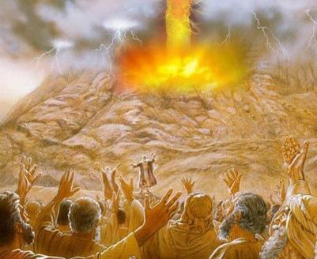
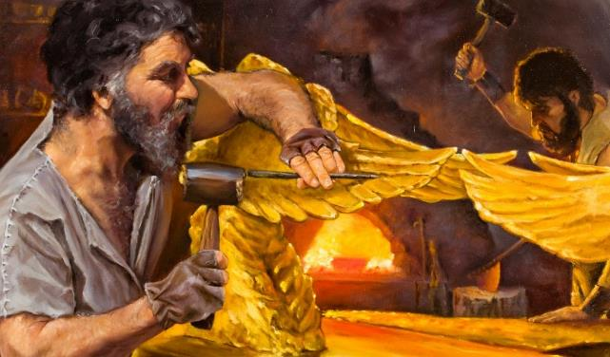
Icyigisho cya 10 cyo ku wa 6 Nzeri 2025
ISEZERANO N’IGISHUSHANYO MBONERA

Slide 2
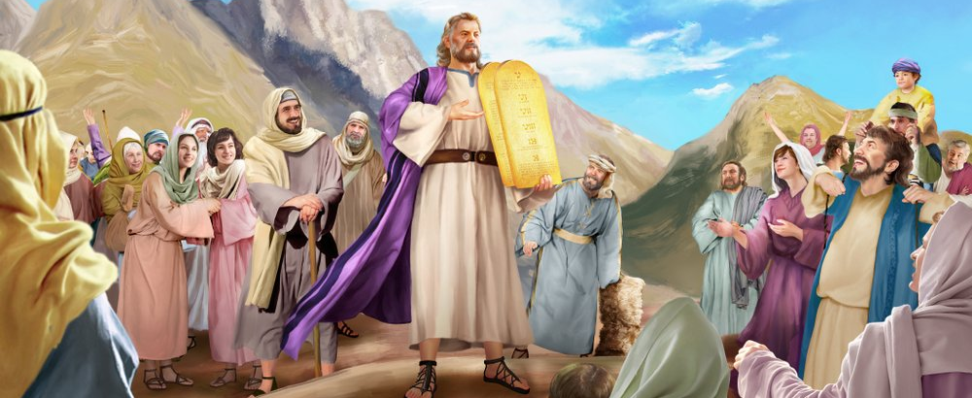
“Mose araza abwira abantu amagambo y’Uwiteka yose n’amategeko ye yose, abantu bose bamusubiriza icyarimwe bati ‘Ibyo Uwiteka yavuze byose tuzabikora.’ ” Kuva 24:3

Slide 3

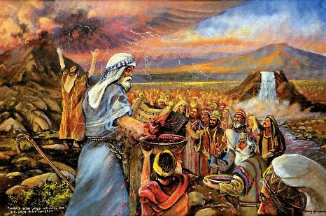
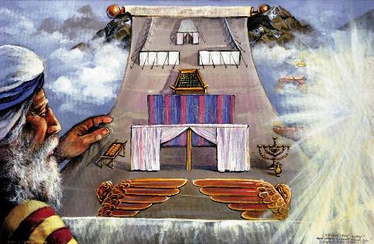


Nyuma y’uko Imana itangaje iranguruye Amategeko Cumi ikanaha Mose amategeko-shingiro, Imana yashatse kugirana isezerano na Isirayeli.
Isezerano ryari ryoroshye: Nzaba Imana yanyu, nzabarinda kandi mbahe umugisha; namwe mwumvire amategeko yanjye.
Nyuma yo kwandika isezerano ku muzingo, impande zombi zagombaga kuryemeza. Abantu bararyemeje, bavuga ko bazarikurikiza. Imana yaryemeje ite? Ikoresheje amaraso, n’umunsi mukuru, n’icyitegererezo cyo kubafasha kuryumva.
Isezerano:
  Amaraso y’Isezerano (Kuva 24:1–6, 8)
  Isohozwa ry’Isezerano (Kuva 24:7)
  Ifunguro ry’Isezerano (Kuva 24:9–18)
Icyitegererezo:
  Intego y’Icyitegererezo (Kuva 25:1–9)
  Gutegura Icyitegererezo (Kuva 31:1–18)

Slide 4
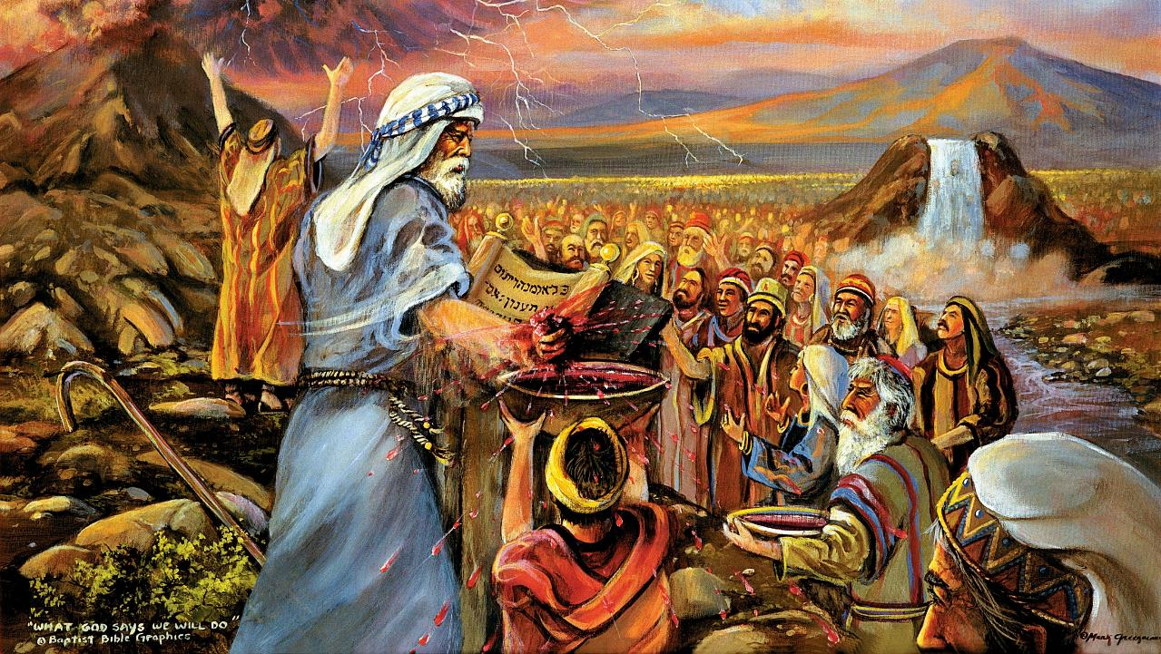
ISEZERANO

Slide 5

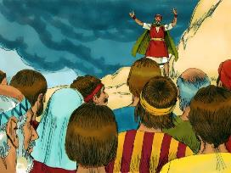
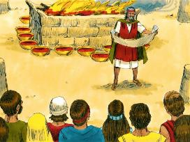
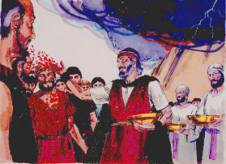
AMARASO Y’ISEZERANO
Mose yenda ayo maraso, ayamisha ku bantu arababwira ati ‘Ngaya amaraso y’isezerano Uwiteka asezeranye namwe, nk’uko ayo magambo yose ari.’ ” (Kuva 24:8)
Isezerano ryakozwe rite?
Isezerano ryarasomwe (Kuva 24:3a)
Abantu basubije baryemera (Kuva 24:3b)
Ryashyizwe mu nyandiko (Kuva 24:4a)
Hubatswe igicaniro (Kuva 24:4b)
Hashyizweho inkingi 12 (Kuva 24:4c)
Ibitambo byoswa byaratambwe (Kuva 24:5)
Kimwe cya kabiri cy’amaraso yamishwe ku gicaniro (Kuva 24:6)
Isezerano ryongeye gusomwa (Kuva 24:7a)
Abantu bongeye gusubiza ko baryemeye (Kuva 24:7b)
Ikindi kimwe cya kabiri cy’amaraso yamishwe ku bantu (Kuva 24:8a)
Mose yatangaje ko ari “amaraso y’isezerano” (Kuva 24:8b; Matayo 26:28)
Hateguwe ifunguro ryo kwemeza isezerano (Kuva 24:9–11)
Imana yemeye Isirayeli nk’ubwoko (inkingi 12); by’umwihariko yahaye agaciro cyane cyane abakiri bato; kandi yiyeguriye buri muntu ku giti cye (ibamishaho amaraso yayo).
Imana yifuza kugirana natwe umubano, haba buri wese ku giti cye, ndetse nk’umuryango w’abizera.

Slide 6

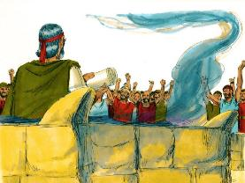
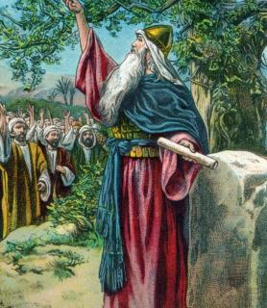
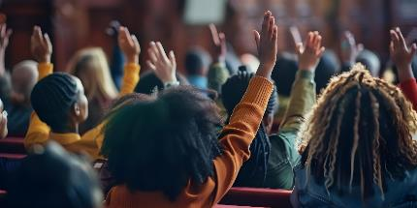
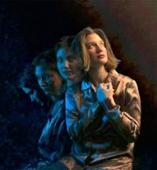
ISOHOZWA RY’ISEZERANO
“Yenda igitabo cy’isezerano agisomera abantu, baramubwira bati ‘Ibyo Uwiteka yavuze byose tuzabikora, kandi tuzamwumvira.’ ” (Kuva 24:7)
Abantu bibavuye ku mutima biyemeje kubahiriza isezerano. Uku kwiyemeza kwabaye ukw’igihe kigufi (Kuva 32:8).
Igisekuru cyakurikiyeho nacyo cyiyemeje kubahiriza isezerano (Yosuwa 24:18b). Ariko Yosuwa yababuriye yeruye ati: “Ku bwanyu ntimubasha gukorera Uwiteka” (Yosuwa 24:19).
Ni iki kitubuza kumvira Imana, nubwo dufite intego nziza?
Muri kamere yacu, ntitwumvira (Abaroma 7:18), kandi ntacyo dushobora gukora ngo duhindure imiterere yacu (Abaroma 7:24).
Ariko nitwemerera Uwiteka, ashobora guhindura kamere yacu (Ezekiyeli 36:26–27). Aratweza, akadukuraho ikibi, akatubashisha, ndetse akaduha ubushobozi bwo kumwumvira. Ni We gusa uduha imbaraga (2 Abakorinto 12:10).

Slide 7

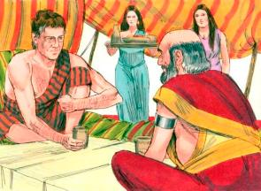
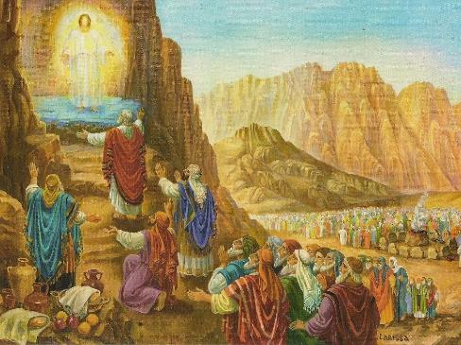
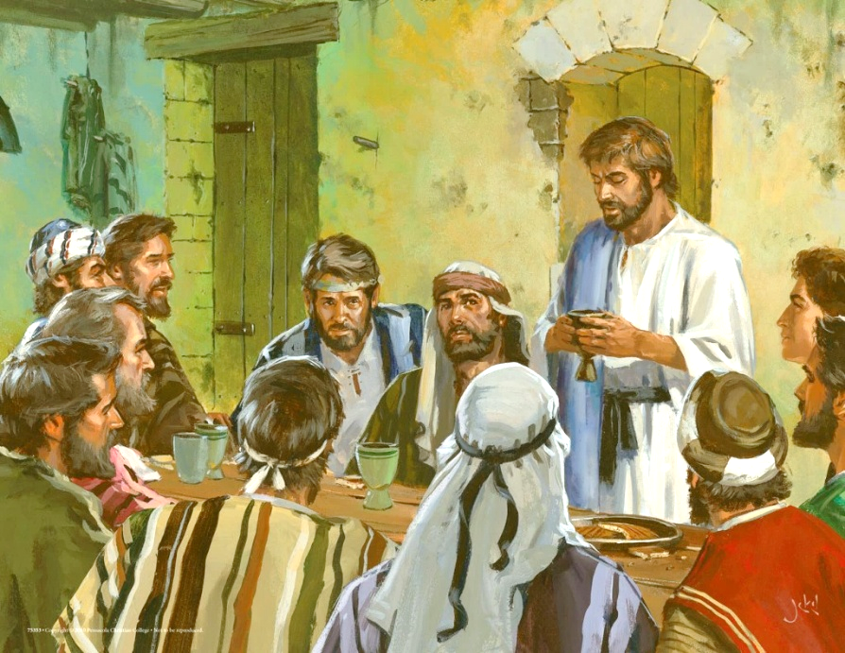
IFUNGURO RY’ISEZERANO
“Maze Mose azamukana na Aroni na Nadabu na Abihu, n’abakuru b’Abisirayeli mirongo irindwi; […] Bareba Imana, bararya, baranywa” (Kuva 24:9, 11b)
Nk’uko tubibona mu rugero rwa Yakobo na Labani, kera mu Burasirazuba, kwemeza isezerano hazagamo ifunguro rihūje impande zombi (Itangiriro 31:44–54).
Kuri Sinayi, Imana yahaye “ifunguro ry’isezerano” abantu 74: Mose, Aroni, Nadabu, Abihu, n’abakuru 70, bari bahagarariye abantu bose (Kuva 24:9–11).
Igihe Yesu yatangizaga isezerano rishya, na We yabikoze atyo asangira n’intumwa 12 ifunguro Rye (Matayo 26:26–28).
Igihe cyose dusangiye Ifunguro Ryera, twongera kwemeza isezerano twagiranye n’Imana. Mu gusangira umutsima na vino, twishimira imbabazi n’agakiza dufite muri Yesu (1 Abakorinto 11:26).
Nubwo yaba Nadabu, yaba Abihu, yaba Yuda banze rwose agakiza, ntibakuwe muri iri “funguro ry’isezerano.”

Slide 8
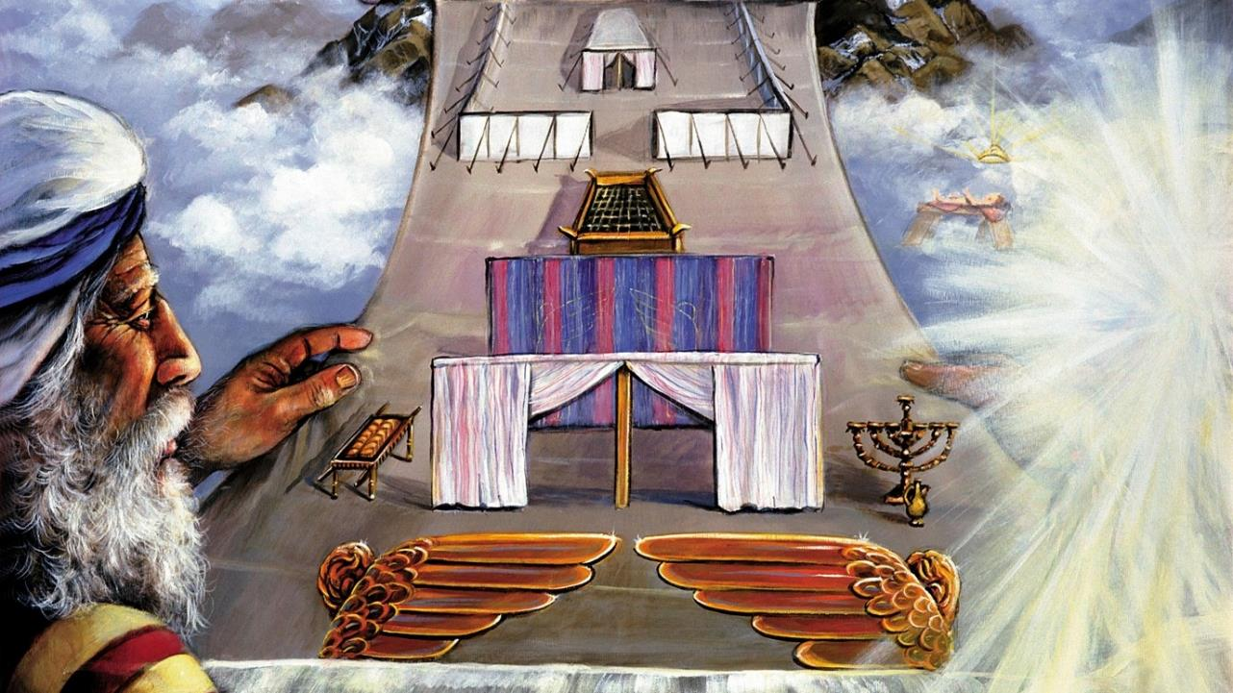
ICYITEGEREREZO

Slide 9

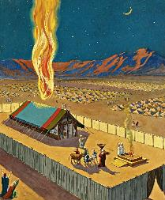
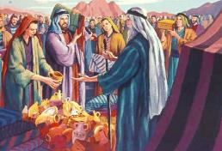
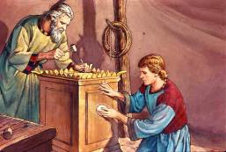
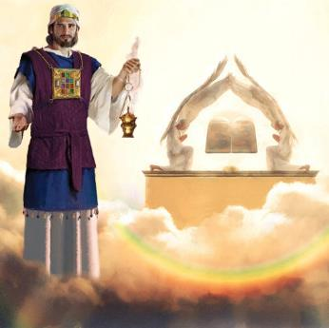
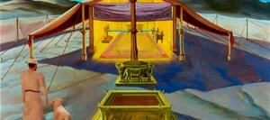
INTEGO Y’ICYITEGEREREZO
“Kandi bandemere ubuturo bwera, nture hagati muri bo” (Kuva 25:8)
Imana yahisemo kujya kuba hagati mu bantu, nk’ubwishingizi bw’uko izasohoza uruhande rwayo mu isezerano.
Ariko kuhaba igaragara n’amaso byajyaga gusobanura urupfu rwihuse ku bantu bose (Kuva 33:20). Kubw’ibyo, yabategetse kubaka ubuturo bwera aho yashoboraga kwerekanira ko ihari. Uku kuboneka kwagaragariraga mu bimenyetso, kuko Imana idatura mu rusengero urwo ari rwo rwose rwo ku isi (Ibyakozwe 17:24).
Mose yeretswe icyitegererezo kandi ahabwa amabwiriza yihariye yo kubwubaka. Abantu basabwe gutanga ibikoresho bikenewe (Kuva 25:2–7).
Bwaba ubuturo bwera, rwaba urusengero rwubatswe na Salomo, byari icyitegererezo cy’ubuturo bwera bwubatswe mu Ijuru (Abaheburayo 8:1–2; 1Abami 8:27, 30).
Igihe Umwisirayeli yinjiraga mu buturo bwera, yabaga yinjiye—mu buryo bw’ikigereranyo— imbere y’Imana… kugeza ubwo umwenda watabutsemo kabiri igihe Yesu yapfaga.

Slide 10

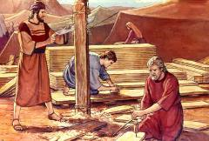
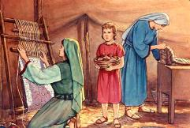
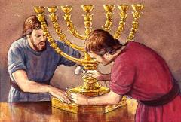
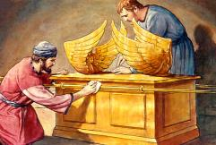
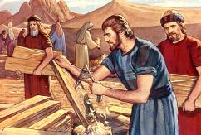
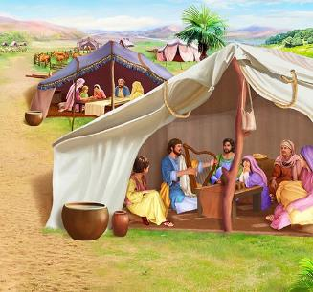
GUTEGURA ICYITEGEREREZO
“Dore mpamagaye mu izina Besalēli mwene Uri ya Huri, wo mu muryango wa Yuda, mwuzuza Umwuka w’Imana ngo agire ubwenge bwo guhimba n’ubwo gutora, n’ubuhanga n’ubukorikori bwose” (Kuva 31:2–3)
Nubwo Imana yahaye Mose amabwiriza arambuye ku byerekeye inyubako, ntabwo yamubwiye byose. Igikarabiro gicuze mu muringa, abakerubi, ibitambaro by’abatambyi byo kuzingirwa mu mutwe, n’ibindi, byagombaga kuba kumeze bite? Ibi byahaye Umwuka Wera umwanya wo gukorana n’impano z’abubatsi.
Ku bijyanye n’aka na kariya, Umwuka Wera yahaye impano zidasanzwe:
Besalēli, wayoboye umushinga wose (Kuva 31:2)
Oholiyabu, wari umwungiriza we mukuru (Kuva 31:6a)
Abandi bantu bafashije mu murimo (Kuva 31:6b)
Hagati mu mabwiriza yo kubaka ubuturo bwera, havugwa Isabato mu buryo bidasanzwe (Kuva 31:12–17). Isabato ihuriye he n’ibi byose?
Kwera ni urufunguzo. Kwegera Imana Yera, bidusaba kuba abera nka Yo. Isabato ni cyo kimenyetso cy’uko kwera (Kuva 31:13; Ezekiyeli 20:12, 20).
Notes:
Exodus 31:2
See, I have called by name Bezalel the son of Uri, the son of Hur, of the tribe of Judah;
Exodus 31:6a
And behold, I have set with him Aholiab the son of Ahisamach , of the tribe of Dan;
Exodus 31:6b
and I have put wisdom in the minds of every wise-hearted person, so that they may do all that I have commanded you;
Exodus 31:12-17 And the LORD spake unto Moses, saying, (13) Thou shalt speak unto the children of Israel, saying, Ye shall surely keep my sabbaths: for it is a sign between me and you throughout your generations, that ye may know that I am the LORD that sanctifies you. (14) Therefore ye shall keep the sabbath day, for it is holy unto you: whoso profaneth it shall surely be put to death: for whosoever doeth any work in it, that soul shall be cut off from among his people. (15) Six days shall work be done: but the seventh day is a sabbath of rest holy to the LORD: whosoever doeth any work on the sabbath day shall surely be put to death. (16) Therefore shall the children of Israel keep the sabbath, to observe the sabbath throughout their generations for a perpetual covenant. (17) It is a sign between me and the children of Israel for ever: for in six days the LORD made heaven and earth, and on the seventh day he rested, and was refreshed.

Slide 11

“Mu kubaka ubwo buturo bwera ari bwo Imana yagombaga guturamo, Mose yari yahawe amabwiriza yo gukora ibintu byose akurikije igishushanyombonera cy’ibyo mu ijuru. Imana ihamagara Mose mu mpinga y’umusozi, maze imuhishurira ibintu byo mu ijuru, kandi ihema ry’ibonaniro n’ibyajyaniranaga naryo byose byagombaga gusa n’ibyo yeretswe.
Uko ni ko Abisirayeli abo Imana yifuzaga guturamo, nabo yabahishuriye urugero ruhebuje rw’imico mbonera yashakaga ko bageraho. […] Ariko muri bo ubwabo, nta mbaraga bari bafite zo kugera kuri urwo rugero Imana ibashakira. Ihishurwa ryabereye ku musozi wa Sinayi ryashoboraga kubumvisha ubukene bwabo n’uburyo ari impezamajyo.”
E.G. White, Uburezi, p. 34—35

