Slide 1
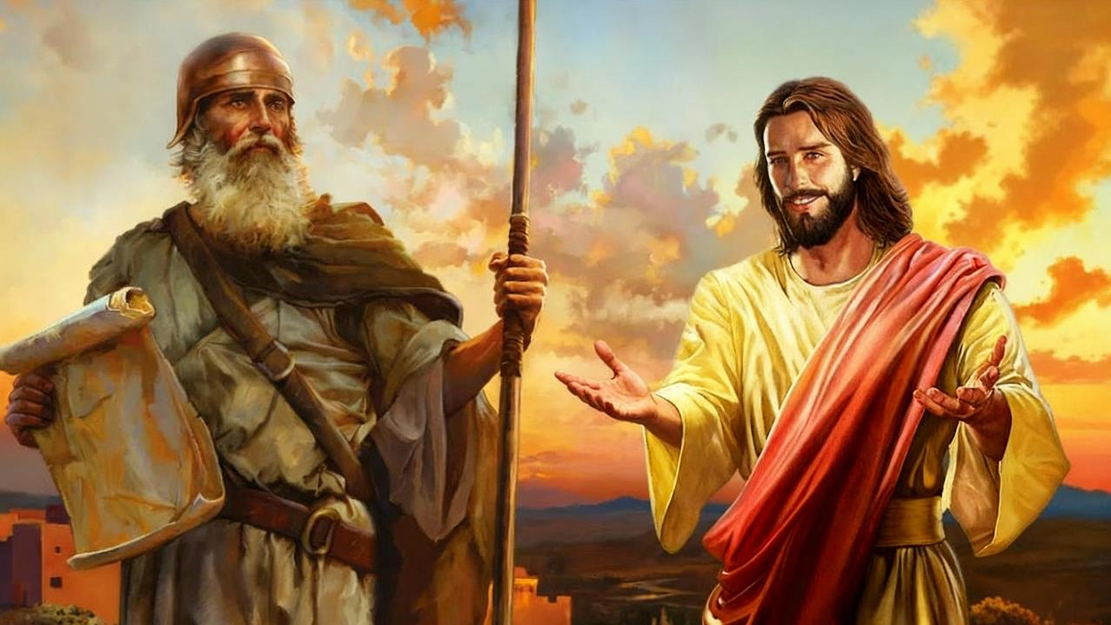
YOSUWA NYAKURI
Icyigisho cya 10 cyo ku wa 6 Ukuboza 2025

Slide 2
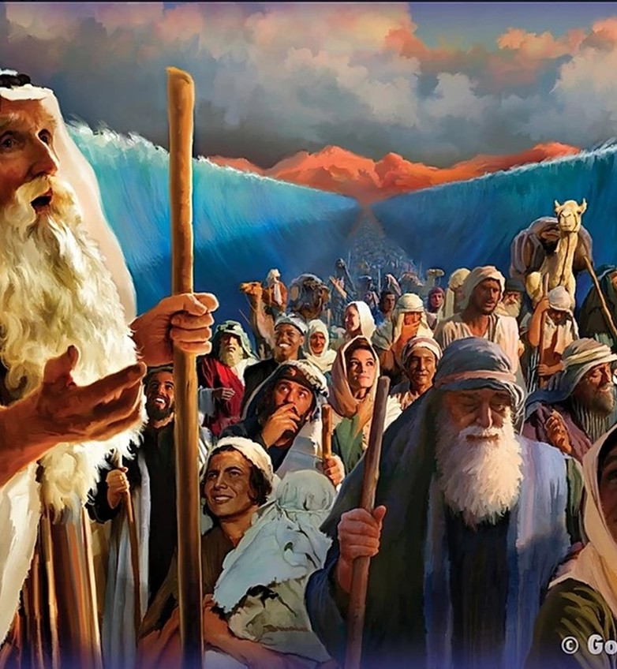
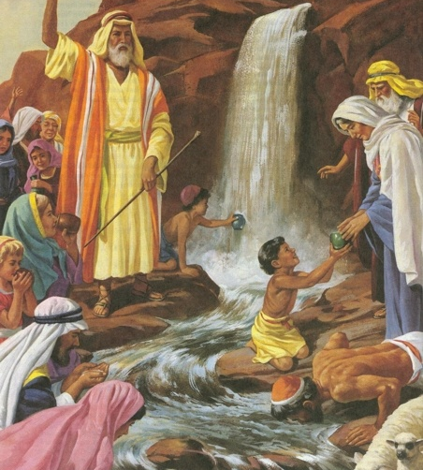
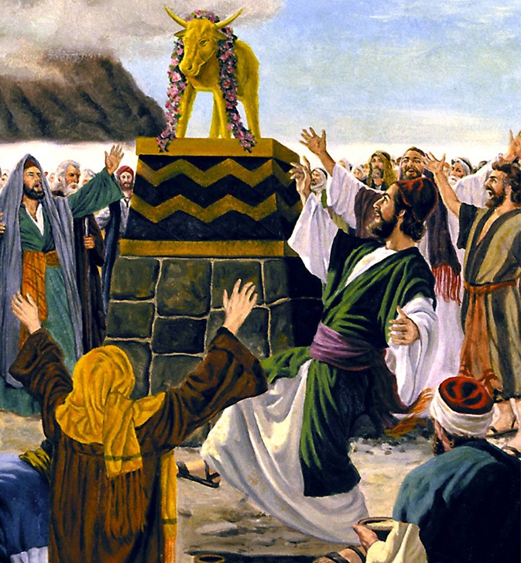
“Ibyo byababereyeho kutubera akabarore, kandi byandikiwe kuduhugura twebwe abasohoreweho n’imperuka y’ibihe” (1 Abakorinto 10:11)

Slide 3

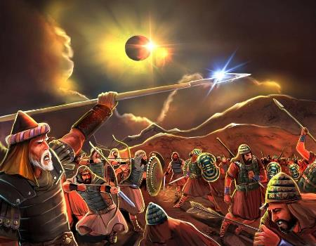
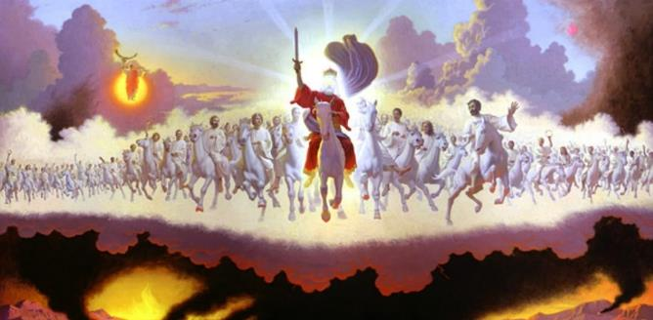







Dushobora gusoma imibereho ya Yosuwa, uko ivugwa mu bitabo bitanu bya Mose ndetse no mu cya Yosuwa ubwacyo, mu buryo bubiri butandukanye (kandi bwuzuzanya): nk’amateka ndetse n’ikigereranyo.
Kugira ngo dusobanure neza uburyo Yosuwa avugwa nk’ikigereranyo, tugomba kubanza kumenya amahame agenga ibigereranyo byo muri Bibiliya: ibishushanyo n’ibishushanywa.
Turangije ibyo, turasobanukirwa Yosuwa nk’ikigereranyo mu mugabane usigaye wa Bibiliya kugira ngo tubone ubutumwa Imana yadusigiye binyuze mu Ijambo ryayo bujyanye na “Yosuwa nk’ushushanywa”.
Ibigereranyo muri Bibiliya:
Ibigereranyo ni iki?
Amoko y’ibigereranyo
Ibigereranyo bya Yosuwa:
Yosuwa nk’ikigereranyo
Icyo Yosuwa agereranya
Yosuwa nk’ikigereranyo cy’Itorero

Slide 4

IBIGERERANYO MURI BIBILIYA

Slide 5


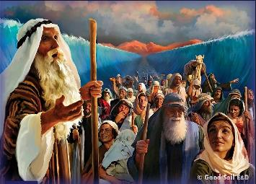
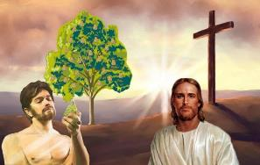
IBIGERERANYO NI IKI?
“Ibyo byababereyeho kutubera akabarore, kandi byandikiwe kuduhugura twebwe abasohoreweho n’imperuka y’ibihe.” (1 Abakorinto 10:11)
Pawulo—n’abandi banditsi ba Bibiliya—bakoresha ijambo “ikigereranyo” bashaka kuvuga umuntu cyangwa ikintu cyo mu mateka gihagarariye ikintu cyangwa umuntu wo mu gihe cye cyangwa ahazaza (cyitwa “igishushanywa”).
Urugero, Abaroma 5:14 havuga kuri Adamu nk’ikigereranyo [“ishusho” muri ngeri ya Bibiliya yitiriwe umwami Yakobo] “cy’uwagombaga kuza,” ni ukuvuga Yesu—ushushanywa.
Ikigereranyo
Dawidi (Zaburi ya 22:1)
Gutangaza ushushanywa
Dawidi Mushya (Yeremiya 23:5)
Ushushanywa
Yesu (Matayo 27:46)
Ikigereranyo
Ibitambo (Abalewi 1:3–5)
Gutangaza igishushanywa
Kubabazwa k’umugaragu (Yesaya 53:5–7)
Igishushanywa
Urupfu rwa Yesu (Yohana 19:16–18)
Kenshi na kenshi, dusanga mu Isezerano rya Kera ikimenyetso cy’uko abantu runaka cyangwa ibintu runaka ari ikigereranyo cy’ikintu cyajyaga kuza hanyuma. Mutyo turebe ingero ebyiri:

Slide 6

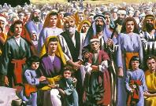
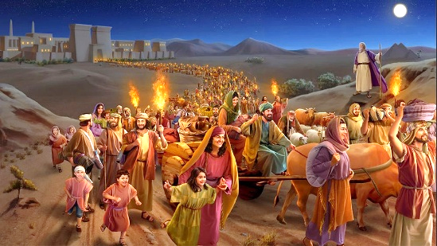
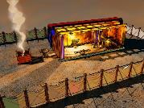
AMOKO Y’IBIGERERANYO
“Agumayo ageza ubwo Herode amaze gutanga, ngo ibyo Umwami Imana yavugiye mu kanwa k’umuhanuzi bisohore ngo ‘Nahamagaye umwana wanjye ngo ave muri Egiputa’ ” (Matayo 2:15)
Ibigereranyo byo mu Isezerano rya Kera bigaragaza ubwoko butatu butandukanye bw’ibishushanywa byo mu Isezerano Rishya: Kristo, Itorero, n’Ibihe by’Imperuka.
IBIGERERANYO N’IBISHUSHANYWA
Isirayeli
Kuva muri Egiputa
Ubuturo Bwera
Kristo
Itorero
Ibihe by’Imperuka
Kristo
Itorero
Ibihe by’Imperuka
Kristo
Itorero
Ibihe by’Imperuka
Yajyanywe muri Egiputa
Matayo 2:13–15
Isirayeli Nshya
Abagalatiya 6:16
Abantu 144 000
Ibyahishuwe 7:4
Iminsi 40 mu Butayu
Matayo 3:16–4:2
Kubatizwa no kubeshwaho na Kristo
1 Abakorinto 10:1–6
Kuva mu matorero yayobye
Ibyahishuwe 18:4
Yari nk’Ubuturo hagati muri twe
Yohana 1:14; 2:21–22
Turi urusengero rw’Imana
1 Abakorinto 3:16–17
Yerusalemu Nshya, urusengero rwacu
Ibyahishuwe 21:2–3
IKIGERERANYO
IGISHUSHANYWA

Slide 7

IBIGERERANYO BYA YOSUWA

Slide 8


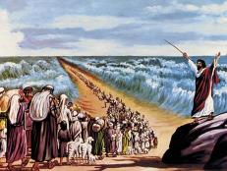
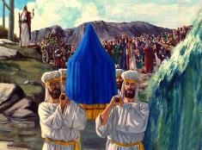
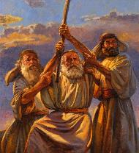
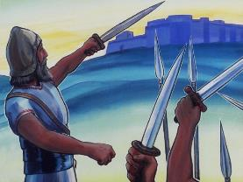
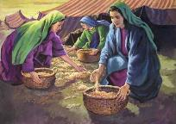
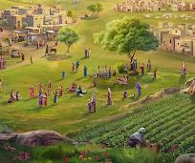
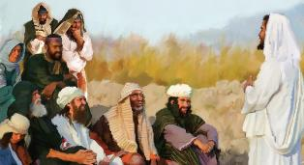
YOSUWA NK’IKIGERERANYO
“Uwiteka Imana yawe izabahagurukiriza umuhanuzi umeze nkanjye ukomotse hagati muri mwe, muri bene wanyu, azabe ari we mwumvira.” (Gutegeka kwa Kabiri 18:15)
Yosuwa yasohoje umugabane w’ubuhanuzi bwa Mose buvuga umuhanuzi wa kabiri wajyaga kuyobora ubwoko (Gutegeka 18:15–19).
Kimwe na Mose, Yosuwa yahawe ubutumwa buvuye ku Mana; yizihije Pasika; yambutse amazi; yabonye Marayika w’Uwiteka; ukuboko kwe kurambuye kwazanye kunesha; yararikiye abantu gukomeza kuba indahemuka na nyuma y’urupfu rwe; n’ibindi.
Mu gihe manu yatangiye kugwa mu gihe cy’ubuyobozi bwa Mose, yahagaze mu cya Yosuwa. Ikindi, Yosuwa yashyize mu bikorwa amabwiriza Mose yari yaramuhaye yerekeye kugabana igihugu n’imidugudu y’ubuhungiro.
Ariko abantu basobanukiwe ko ubuhanuzi bwa Mose bwarenze Yosuwa (Yohana 1:21). Bityo, Mose na Yosuwa bombi bahinduka ibigereranyo by’Ushushanywa nyakuri wasohoje neza ubuhanuzi bwahawe Mose bwerekeye “Umuhanuzi”: Yesu (Ibyakozwe n’Intumwa 3:22–26).

Slide 9


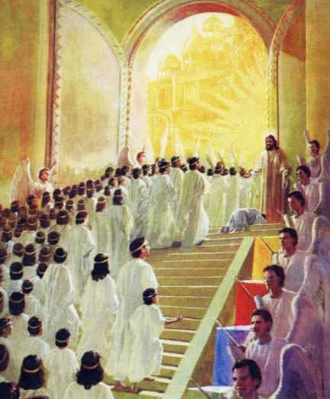
ICYO YOSUWA AGERERANYA
“Igihe cyo kwemererwamo ndagushubije, no ku munsi wo gukirizwamo ndagutabaye, kandi nzagukiza ngutange ho isezerano ry’abantu kugira ngo uhagurutse igihugu, utume baragwa gakondo yabo yabaye umwirare” (Yesaya 49:8)
Intego y’intambara zayobowe na Yosuwa kwari ugutūza Abisirayeli mu Gihugu cy’Isezerano. Yesaya, akoresheje imvugo isa n’iyo mu gitabo cya Yosuwa, agaragaza umurimo wa Mesiya wo guha “abantu be gakondo ahari harabaye umwirare” (Yesaya 49:8).
Ni mu buhe buryo imibereho n’umurimo bya Yosuwa (nk’ikigereranyo) bigaragarira mu mibereho n’umurimo bya Yesu (ushushanywa)?
Nyuma yo kubatirizwa muri Yorodani, Yesu yarwanye n’imbaraga z’ikibi
Yatangiye umurimo We nyuma yo kumara iminsi 40 mu butayu
Yanesheje umwanzi ku musaraba
Aduha kunesha abanzi bacu bo mu bya mwuka
Aduha ihumure nyakuri
Aduha kuragwa gakondo itāngīrika

Slide 10

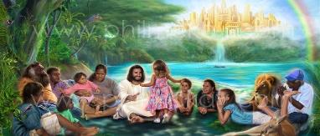
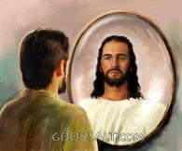
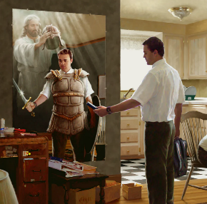

YOSUWA NK’IKIGERERANYO CY’ITORERO
“Kuko tudakirana n’abafite amaraso n’umubiri, ahubwo dukirana n’abatware n’abafite ubushobozi n’abategeka iyi si y’umwijima, n’imyuka mibi y’ahantu ho mu ijuru.” (Abefeso 6:12)
YOSUWA N’ITORERO
Uyu munsi dufite intambara tugomba kurwana, aho tuyobowe na “Yosuwa” wacu, uduha intwaro zikenewe (Abefeso 6:10–12).
Ikindi kandi, yamaze kuduha gakondo, kandi atwuzuza imigisha yo mu buryo bw’umwuka (Abefeso 1:3, 11).
YOSUWA N’IBIHE BY’IMPERUKA
Ariko gusohozwa kuzuye kwa Yosuwa kuzaba ku mperuka, ubwo ingabo zose z’ikibi zizarimbuka, maze tugafata gakondo yacu mu buryo bwuzuye: igihugu tuzaturamo dutunganiwe (Ibyahishuwe 20:7–9; Ezekiyeli 28:26).
Kugeza ubwo icyo gihe kizasohora, nimuze dukurire mu buntu nk’uko Yosuwa yabigenje, twemerere Imana kuduhindura kugira ngo buri munsi turusheho kumera nka Yo.

Slide 11

“Isirayeli y’Imana, iri mu rugendo yerekeza muri Kanani yo mu ijuru kandi ifite Umugaba udakeneye kwigishwa n’abantu kugira ngo ategurirwe umurimo we nk’umuyobozi washyizweho n’Imana. Nyamara, yateguwe binyuze mu kubabazwa; kandi “ubwo yababajwe no kugeragezwa ubwe, abasha no gutabara abageragezwa bose” (Abaheburayo 2:10,18). Nta ntege-nke cyangwa kudatungana bya kimuntu byagaragaye ku Mucunguzi wacu; nyamara yapfuye kugira ngo atubashishe kuzinjira mu Gihugu cy’Isezerano.”
E.G. White, Abakurambere n’Abahanuzi, p. 328

