Slide 1
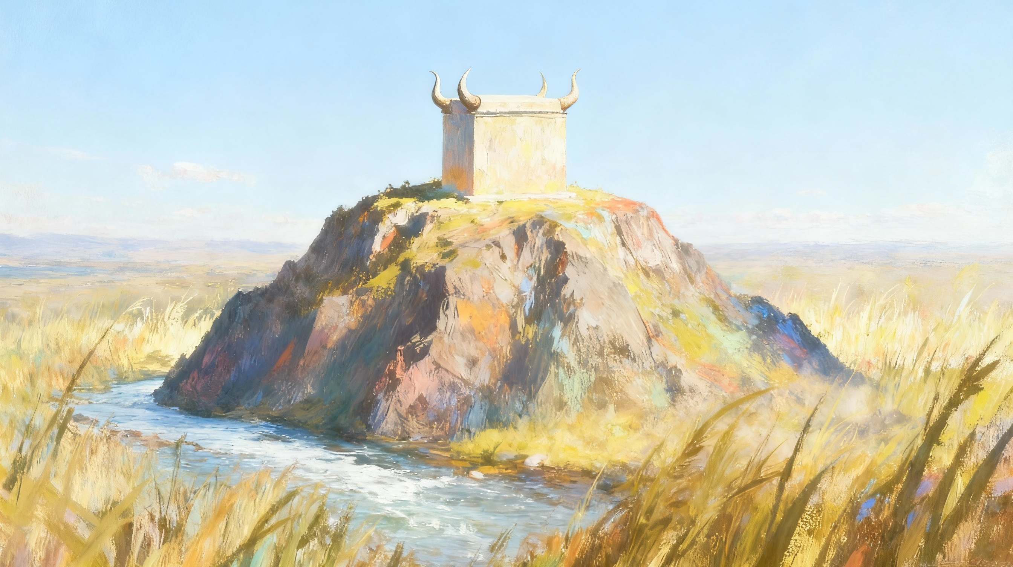
KUBA MU GIHUGU
Icyigisho cya 11 cyo ku wa 13 Ukuboza 2025

Slide 2
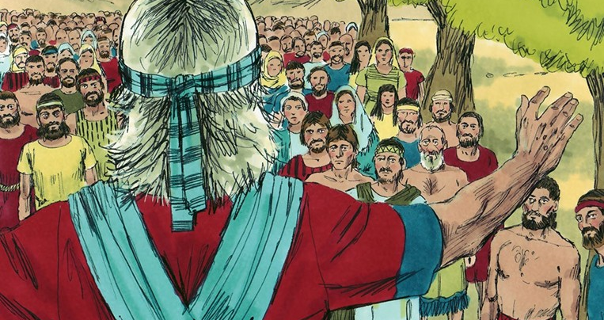

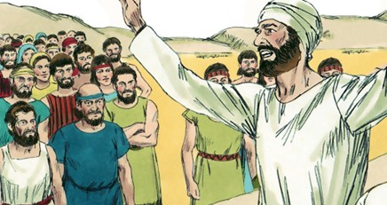
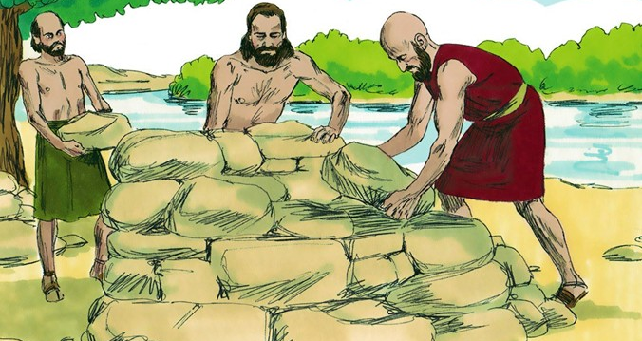
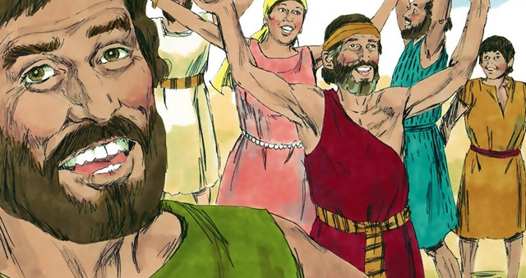
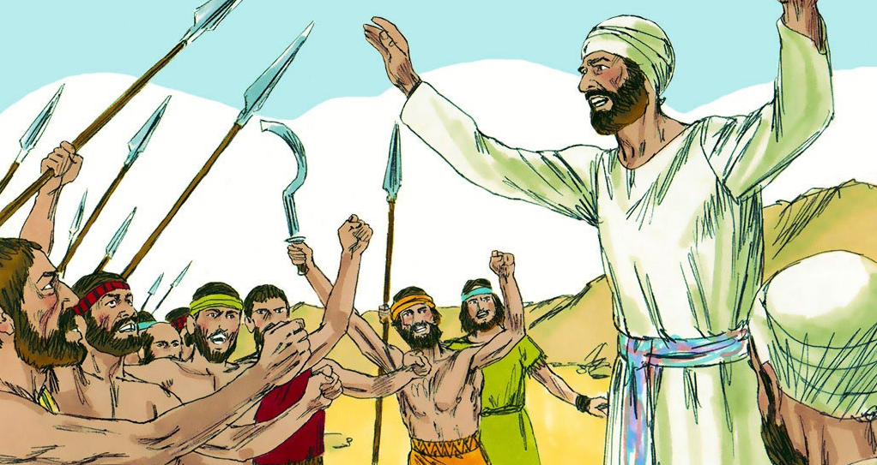
“Gusubizanya ineza guhosha uburakari, Ariko ijambo ribabaza ribyutsa umujinya” (Imigani 15:1)

Slide 3

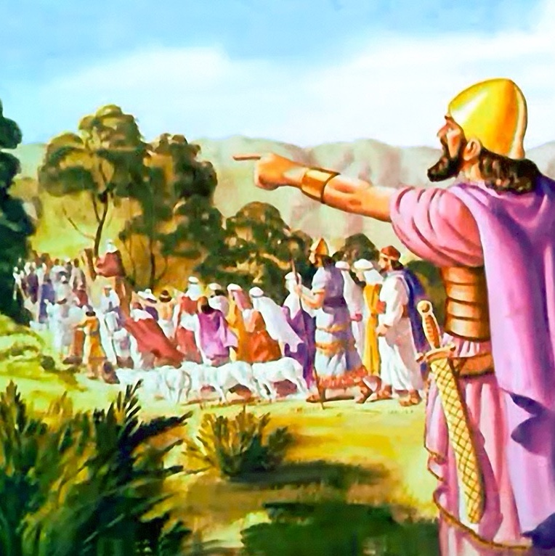
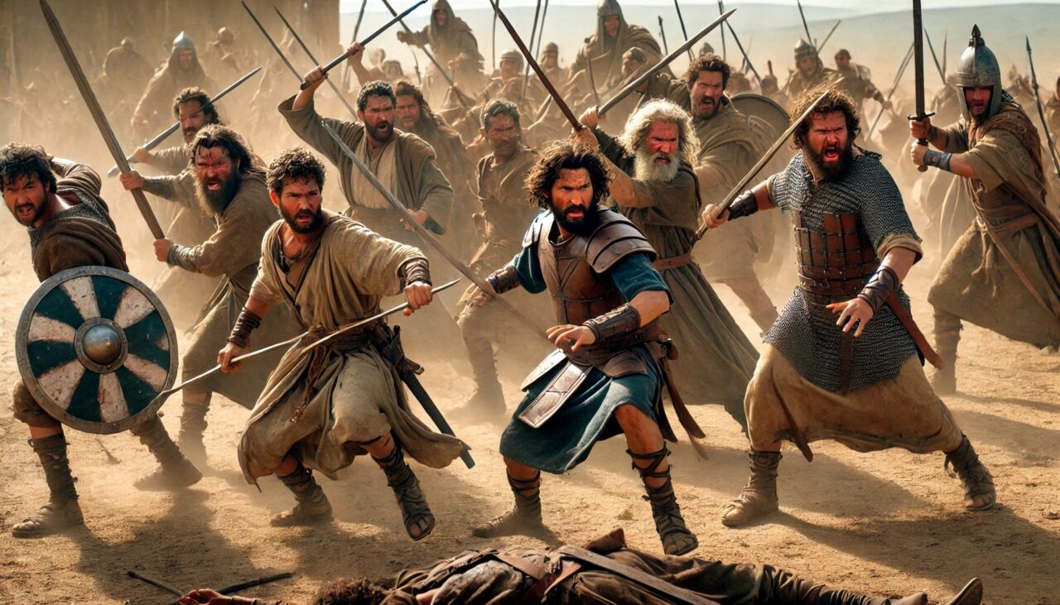




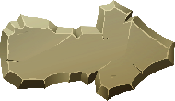
Nyuma y’imyaka myinshi y’intambara, Isirayeli yari yaramaze kwigarurira Kanani, nubwo abari bayituye batari barameneshwa bose.
Imiryango ibiri n’igice yari yarigaruriye igice cy’iburasirazuba (Abarubeni, Abagadi n’umugabane w’umuryango wa Manase), kandi yari yarambutse Yorodani kugira ngo ifashe indi mu kuhahīndūra, yari yarujuje ibyo isabwa ikiranutse.
Amaherezo, igihe cyo gutandukana cyari kigeze. Yosuwa amaze kubaha umugisha no kubagira inama yo gukomeza inzira y’Imana, arabasezerera. Ariko uko gusezererwa kwapfukiranywe n’ubwumvikane buke bukomeye bwashoboraga gusenya ubumwe bw’Abisirayeli mu buryo bworoshye.
Ijambo ryo gusezera (Yosuwa 22:1–8)
Impamvu y’amakimbirane (Yosuwa 22:10–12)
Ibirego (Yosuwa 22:13–20)
Igisubizo kirimo kwiyoroshya (Yosuwa 22:21–29)
Kwiyunga (Yosuwa 22:30–34)

Slide 4


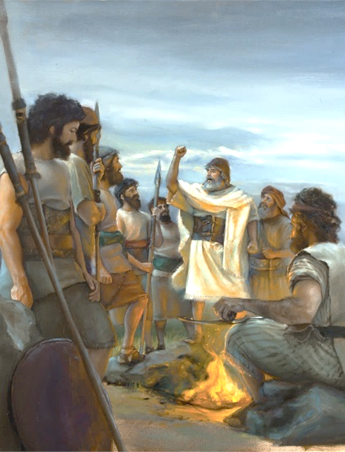
IJAMBO RYO GUSEZERA
“Icyakora mujye mugira umwete wo kwitondera amategeko, n’ibyo Mose umugaragu w’Uwiteka yabategetse ati ‘Nimukunde Uwiteka Imana yanyu, mugende mu nzira ibayoboye zose, mwitondere amategeko mwomatane na we, mukoreshereze Uwiteka Imana yanyu imitima yanyu yose n’ubugingo bwanyu bwose.’”(Yosuwa 22:5)
Kubera ko Yorodani yari igiye gutandukanya imiryango, Yosuwa yahaye imiryango ibiri n’igice inama nziza kugira ngo bakomeze kuba indahemuka (Yosuwa 22:5):
Gukunda Uwiteka Imana yawe
Kugendera mu kumwumvira
Kwitondera amategeko yayo
Kuyinambaho
Kuyikorera n’umutima wawe wose n’ubugingo bwawe bwose
Urukundo ni ryo hame rigomba kutujyana ku Mana. Turayikunda kuko ari Yo yabanje kudukunda (1 Yohana 4:19)
Uku ni ko Yosuwa yerekana imyitwarire yitezwe ku bahitamo kugendana n’Imana
Kumvira ni ingaruka zisanzwe z’umutima ushima, usobanukiwe n’ibyo Imana yakoze
Tugomba kwīkomeza ku Mana, ntitwemerere ikintu icyo ari cyo cyose guca uwo mubano
Iyo dukorera Umuremyi wacu mu rukundo bituvuye ku mutima, ni bwo tubona by’ukuri intego yacu, kunyurwa, n’ubugingo busendereye

Slide 5


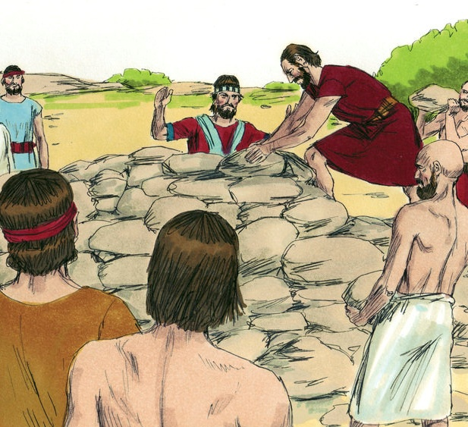
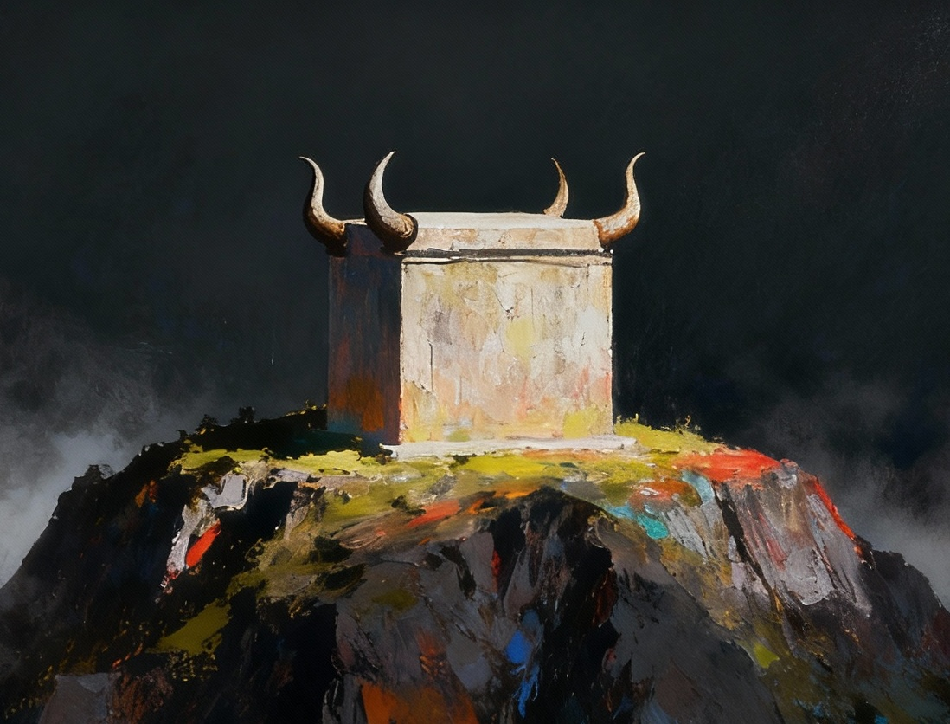
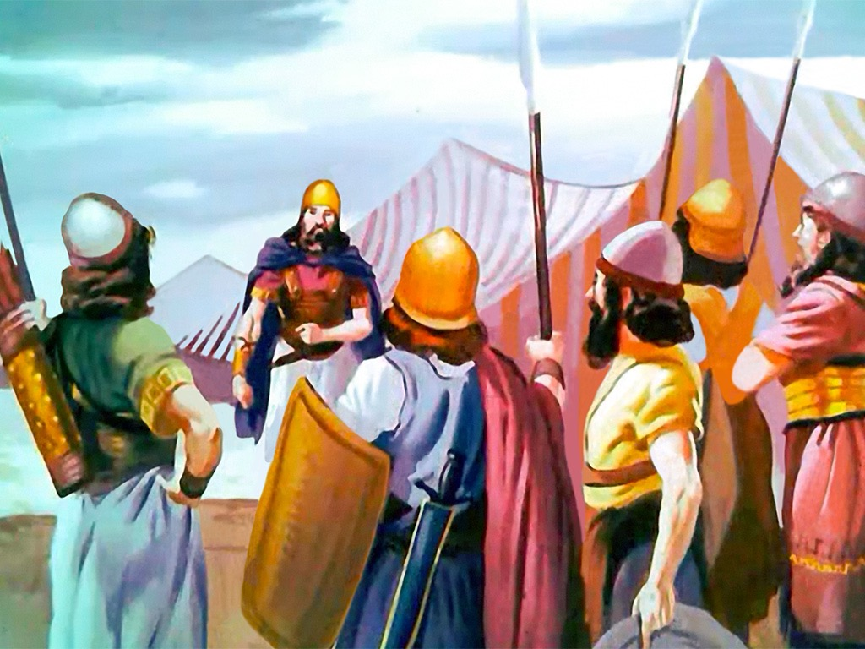
IMPAMVU Y’AMAKIMBIRANE
“Bagera [Abarubeni n’Abagadi n’ab’igice cy’umuryango wa Manase] mu gihugu gihereranye na Yorodani mu gihugu cy’i Kanāni, bahiyubakira igicaniro cy’amabuye kuri Yorodani cy’ikimenywabose” (Yosuwa 22:10)
Hafi y’aho Yosuwa yari yarashinze urwibutso rw’uko yambutse Yorodani mu buryo bw’igitangaza, imiryango ibiri n’igice yahubatse igicaniro gisa n’igicaniro cy’Ubuturo Bwera (Yosuwa 22:10, 28).
Iki gikorwa cyafashwe nk’ukurenga ku mategeko yabuzaga gutambira ibitambo ahandi hantu hatari ku gicaniro cy’ibitambo byoswa cyo mu Buturo Bwera (Abalewi 17:8–9).
Abisirayeli bandi bahisemo gukuraho iki cyaha, bakarwanya abavandimwe babo (Yosuwa 22:12). Ariko Imana yahagurukiye kuburizamo intambara y’abaturage yajyaga kumena amaraso. Yahagurukije abantu bahisemo kudaca imanza zidashingiye ku bimenyetso byuzuye; batanze impamvu y’ibyo batinyaga; kandi bahitamo guha abavandimwe babo umwanya wo kwisobanura (Yosuwa 22:13–14).
Uko byagaragaye, ikosa ryabo ryonyine kwari ukutamenyesha abavandimwe babo imigambi bari bafite… ariko icyo si icyaha.

Slide 6

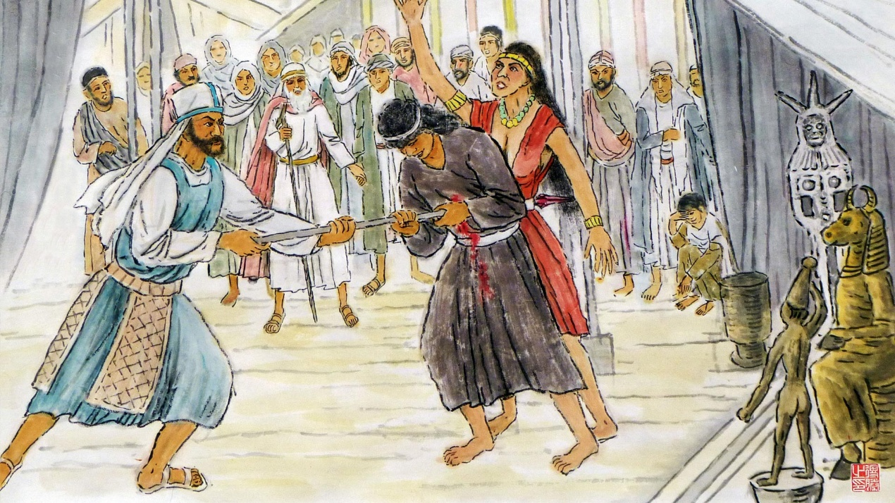
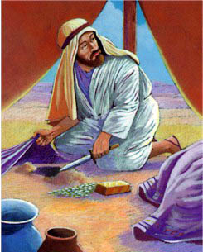
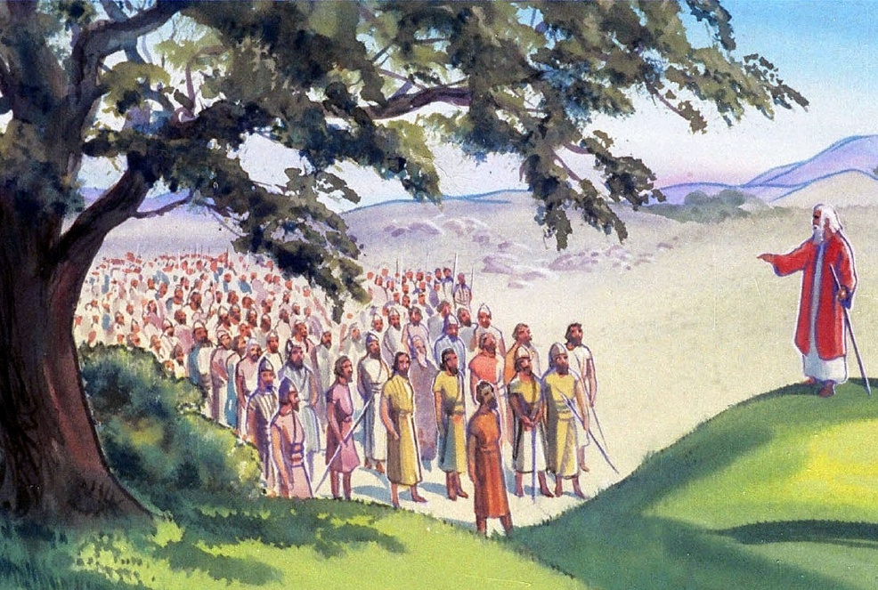
IBIREGO
“Iteraniro ryose ry’Uwiteka ryadutumye ngo ‘Iki gicumuro mwacumuye ku Mana y’Abisirayeli mwagicumuriye iki, ko muretse kuyoborwa n’Uwiteka mukiyubakira igicaniro, mukamugomera?’” (Yosuwa 22:16)
Kuki Finehasi yatoranirijwe kuyobora itsinda ryashinzwe kugenzura iki kibazo (Yosuwa 22:13–14)?
Finehasi, umuhungu w’umutambyi mukuru, ntiyari yarajenjetse mu guhagarika icyaha cyakorewe i Baali-Pewori (Kubara 25:7–8). Mu ijambo rye, yahuje iki cyaha n’icyaha cya Akani maze akigereranya n’icyakozwe n’imiryango ibiri n’igice (Yosuwa 22:16–20).
Imvugo ya Finehasi yarumvikanaga neza. Iyo ibitambo bitambirwa kuri icyo gicaniro cyari cyakozwe, Imana yari kubihanira Abisirayeli bose (Yosuwa 22:18b).
Nyamara, yabahaye amahirwe yo gukosora iryo kosa, mbere yuko bākora icyo cyaha: yabahaye amahirwe yo gusubira hakuno ya Yorodani aho Ubuturo Bwera bwari buri (Yosuwa 22:19).

Slide 7


IGISUBIZO KIRIMO KWIYOROSHYA
“Niba twariyubakiye igicaniro kugira ngo duteshuke tureke kuyoborwa n’Uwiteka, cyangwa kugira ngo dutambireho ibitambo byoswa cyangwa iby’ishimwe yuko turi amahoro, cyangwa ngo duturireho amaturo y’amafu y’impeke, Uwiteka ubwe abiduhore.” (Yosuwa 22:23)
Ubwo imiryango ya Rubeni na Gadi, n’igice cy’umuryango wa Manase yaregwaga, basubije mu buryo bw’intangarugero :
Bateze amatwi ibyo baregwa batūje
Batanze Imana ho umuhamya wabo
Bemeye ko bāhanwa niba baracumuye
Bagaragaza impamvu nyakuri z’ibyo bakoze
Igihe Abisirayeli batari bazi impamvu abavandimwe babo bubatse igicaniro, hari ibyo bibwiye: ukwigomeka, icyifuzo cyo gutandukana n’Imana, n’igihano cy’Imana.
Ukuri kwari: icyifuzo cyo gukomeza kunga ubumwe n’abavandimwe babo no kwirinda gicikamo ibice kw’Abisirayeli mu gihe kizaza (Yosuwa 22:24–26).
Nubwo imiryango iregwa yashoboraga kubabazwa n’ibyo birego maze ikirwanaho mu mahane, kubera igisubizo cyayo cyo kwiyoroshya, intambara yarakumiriwe.

Slide 8

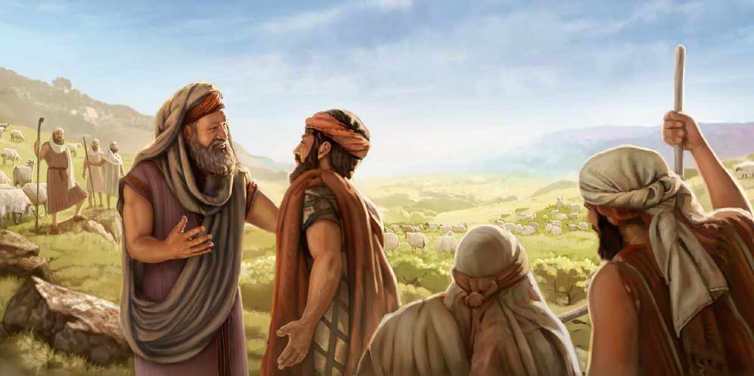
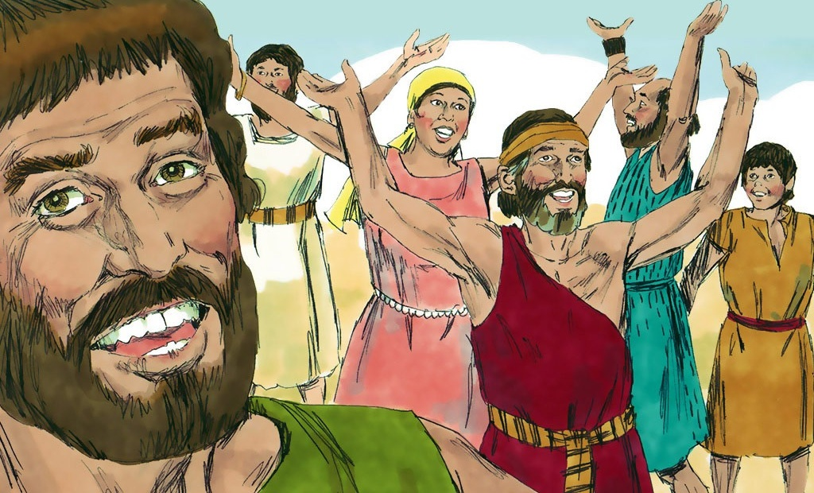
UBWIYUNGE
“Ibyo binezeza Abisirayeli bahimbaza Imana, ntibasubira kuvuga ko bazabarwanya bakarimbura igihugu Abarubeni n’Abagadi batuyemo” (Yosuwa 22:33)
Finehasi n’intumwa z’Abisirayeli babonye ko icyo kirego nta shingiro cyari gifite, bararuhutse (Yosuwa 22:30–31). Ku ruhande rw’Abisirayeli, ubwo bari bamaze kumenya ukuri, barishimye maze bahimbaza Imana (Yosuwa 22:32–33).
Muri uru rugero rwabo, dushobora kubona intambwe zikenewe ngo tugarure amahoro mu bihe nk’ibyo, haba ku muryango, itorero, n'umuryango mugari:
Kutihutira gufata imyanzuro
Kuvuga ku kibazo nyacyo, mbere yo kugira icyo dukora
Kugira ubushake bwo kugira ibyo duhara kugira ngo tugere ku bumwe
Gutanga igisubizo kirimo kwiyoroshya, igihe turezwe
Kunezerwa no gushimira Imana, igihe amahoro agarutse
Kugeza ku bandi ibitekerezo byacu

Slide 9

“Abakomoka kuri Gadi na Rubeni, bahereyeko bashyira ku gicaniro cyabo inyandiko isobanura umugambi watumye icyo gicaniro cyubakwa; maze baravuga bati: ‘Ni umuhamya wo muri twe yuko Uwiteka ari yo Mana.’ Uko ni ko bihatiye gukuraho kuzatekerezwa nabi kwashoboraga kuzabaho ndetse n’icyashoboraga kuzaba intandaro y’ikigeragezo.
Mbega uburyo kenshi ingorane zikomoka ku kudasobanukirwa koroheje, ndetse bikaba no mu bantu baba bakoreshejwe no kugira imigambi myiza! Ndetse iyo hatabayeho urukundo no kwihangana, mbega ingaruka mbi ndetse ziteye ubwoba zibasha gukurikiraho […]
Nta muntu n’umwe wigeze agarurwa mu nzira nziza kubwo kugawa no gutonganywa; ahubwo iyo bigenze bityo, benshi bajyanwa kure y’inzira itunganye, maze bagaterwa kwinangira imitima bityo ntibemere ibicumuro byabo. Umwuka w’ubugwaneza, urugwiro no kwihangana bishobora gukiza uwacumuye kandi bigatwikira ibyaha byinshi.”
E.G. White, Abakurambere n’Abahanuzi, p. 356

