Slide 1
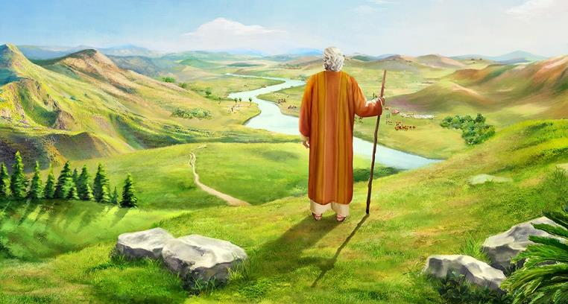
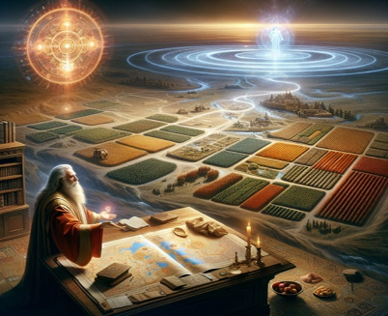
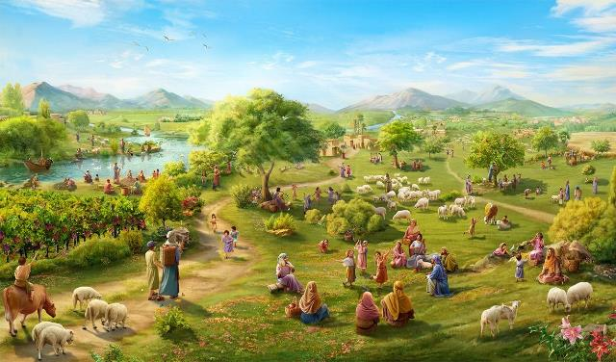
IMANA IRAKIRANUKA
Icyigisho cya 12 cyo ku wa 20 Ukuboza 2025

Slide 2

“Nta jambo ryiza na rimwe mu yo Uwiteka yasezeranyije ubwoko bw’Abisirayeli ryakūtse, ahubwo byose byarasohoye” (Yosuwa 21:45)

Slide 3

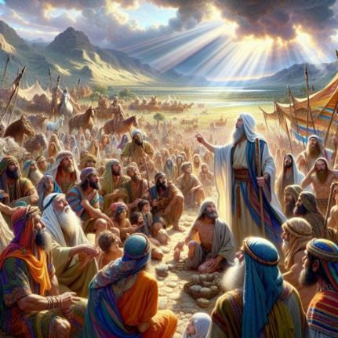
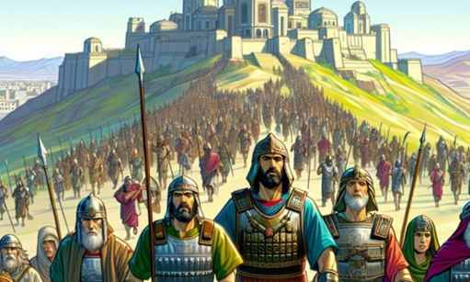
Yosuwa yari ashaje, kandi hari hakiri uturere two guhīndūra. Yateranirije hamwe abayobozi bashya kugira ngo abashishikarize gukomeza urugamba.
Ubushobozi bwo kugera ku kunesha ntabwo bwari muri bo, ahubwo bwari mu Mana. Bityo yabibukije ubudahemuka Imana yari yaramaze kugaragaza kandi abiringiza ko izakomeza kuba iyo kwizerwa.
Ariko kandi yabagaragarije akaga kābatera. Mu by’ukuri, hari akaga kamwe gusa, ari nako dushobora guhura nako uyu munsi: kureka kuba indahemuka ku Mana; kwītūra ubudahemuka bw’Imana, mu ruhande rwacu tuyihemukira.
Kudahemuka kw’Imana (Yosuwa 21:43–45)
Ibyo Imana yakoze n’ibyo izakora (Yosuwa 23:1–5)
Ingororano yo kuba indahemuka (Yosuwa 23:6–10)
Icyo tugomba gukora (Yosuwa 23:11–14)
Igihano cy’ubuhemu (Yosuwa 23:15–16)

Slide 4


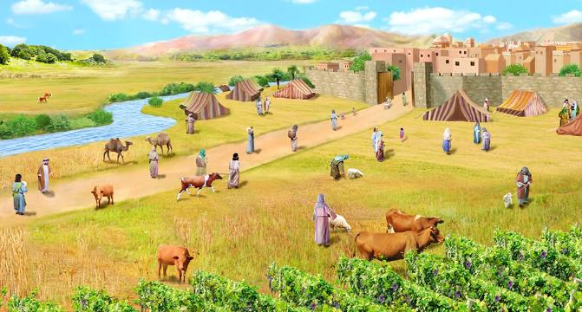
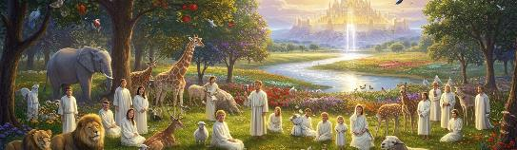
KUDAHEMUKA KW’IMANA
“Nta jambo ryiza na rimwe mu yo Uwiteka yasezeranyije ubwoko bw’Abisirayeli ryakūtse, ahubwo byose byarasohoye.” (Yosuwa 21:45)
Imana yari yarahaye Abisirayeli “igihugu cyose” (Yosuwa 21:43) kandi yari yarabagabije “ababisha babo bose” (Yosuwa 21:44), bityo “byose byari byarasohoye” (Yosuwa 21:45).
Gukoresha ijambo “byose” kenshi bishimangira ubudahemuka bw’Imana mu gusohoza amasezerano yayo. Abanzi babo bari baraneshejwe n’Imana. Bashoboraga gutura muri icyo gihugu kuko Imana yari yaragihīndūye. Bashoboraga kwizera ko bazarangiza kumenesha Abanyakanani bari bakiri muri icyo gihugu kuko Imana yari yarasohoje amasezerano yayo kugeza ubwo kandi yajyaga gukomeza kuyasohoza mu gihe cy’ahazaza.
Ibi byose bituzanira ibyiza. Imana ihora ari indahemuka. (Gutegeka 7:9; Zaburi ya 117:2; Amaganya 3:22–23). Yadusezeranyije agakiza no kuduha Isi nk’umurage, kandi izasohoza iri sezerano (Abafilipi 1:6; 1 Petero 1:5; Zaburi ya 37:29).

Slide 5

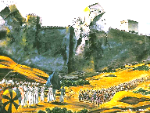
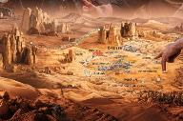
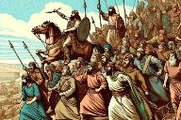
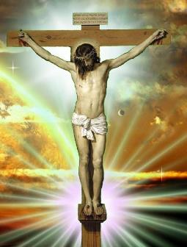
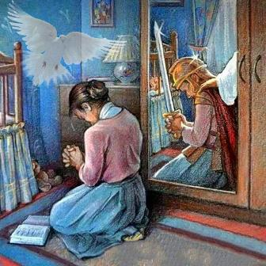
IBYO IMANA YAKOZE N’IBYO IZAKORA
“Namwe mwabonye ibyo Uwiteka yagiriye ayo mahanga yose ku bwanyu, kuko Uwiteka Imana yanyu ari we wabarwaniye” (Yosuwa 23:3)
Mu ijambo Yosuwa yagejeje ku bakuru, atangira ababwira ibyo Imana yari imaze gukora n’ibyo yari igiye gukora:
Yarwanye n’amahanga
(Yosuwa 23:3)
Imiryango yayigabanyije igihugu (Yosuwa 23:4)
Azamenesha amahanga asigaye (Yosuwa 23:5)
Ibi byose (ibyari bimaze gukorwa n’ibyajyaga kuzakorwa) byasabaga Isirayeli ikintu kimwe: kumvira (Yosuwa 23:6).
Amateka ya Isirayeli ni icyigisho kuri twe uyu munsi. Imana yamaze kunesha icyaha kandi itwiringiza agakiza binyuze mu gitambo cya Yesu (Abakolosayi 2:15).
Ni ahacu gukomeza urugamba, kandi tukiringira Umwuka Wera kugira ngo tubeho imibereho inesha (2 Abakorinto 10:3–5; Abefeso 6:11–18).

Slide 6

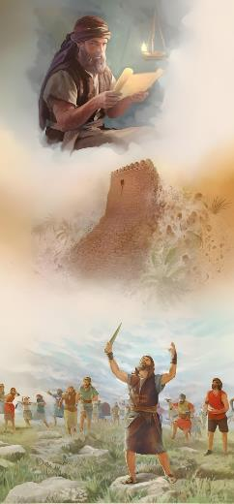
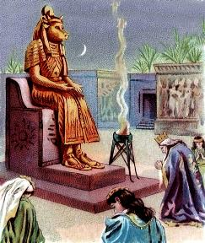
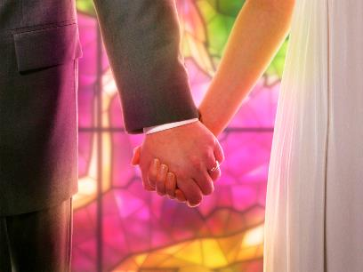
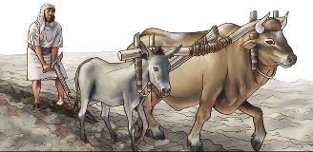
INGORORANO YO KUBA INDAHEMUKA
“Ahubwo umwe muri mwe azirukana abantu igihumbi kuko Uwiteka Imana yanyu izabarwanira nk’uko yababwiye.” (Yosuwa 23:10)
Ingororano y’ubudahemuka bw’Abisirayeli yari kuba kunesha ababisha bose mu buryo bwuzuye kandi budasubirwaho (Yosuwa 23:6, 10).
Ku bijyanye no kwigarurira Kanani, kudahemukira Imana byagombaga kugaragarira mu buryo butatu bwihariye:
Kudashyingirana n’abatuye igihugu
(Yosuwa 23:7a)
Kutavuga amazina y’imana zabo
(Yosuwa 23:7b)
Kutaramya Imana zabo (Yosuwa 23:7c)
Bagombaga gukomeza kuba abaziranenge mu bya mwuka. Iyo baza gushakana n’abahatuye, bajyaga gutangira kuvuga imana zabo, kandi bakaziramya. Uko ni ko ubuyobe bwa Salomo bwatangiye (1 Abami 11:4).
Kubw’ibyo, twebwe Abakristo turarikirwa gukurikiza inama nk’izo, no kudashakana n’abatizera (2 Abakorinto 6:14–16).

Slide 7


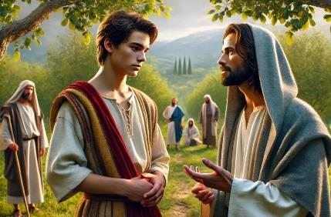
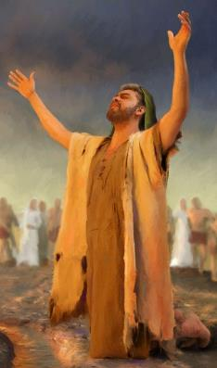
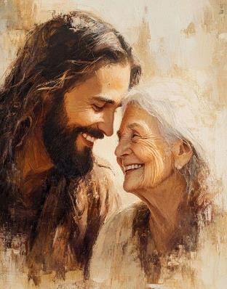
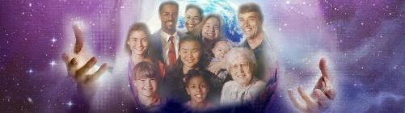
ICYO TUGOMBA GUKORA
“Nuko mugire umwete cyane wo gukunda Uwiteka Imana yanyu” (Yosuwa 23:11)
Dushobora kuvuga tudashidikanya ko ingingo ihatse izindi mu ijambo rya Yosuwa iboneka ku murongo wa 11: gukunda Imana.
Abisirayeli bagombaga kugaragaza urukundo rwabo mu kudakunda izindi mana; kuzikunda byajyaga kubaviramo ingaruka zishishana (Yosuwa 23:12–13).
Byongeye kandi, Yosuwa atanga impamvu yo kwita kuri urwo rukundo: ubudahemuka bw’Imana (Yosuwa 23:14).
Uyu munsi dufite impamvu irushaho gukomera: urugero rwa Yesu (Yohana 13:34).
Imana yifuza kugirana umubano ushyitse kandi wihariye n’umuntu wese ku giti cye, wākīra urukundo rwayo.
Bityo, urukundo rwayo kuri bose ni rwo rugize urufatiro rwo kugaragaza urukundo rwacu rutuvuye ku mutima tugirana hagati yacu.

Slide 8

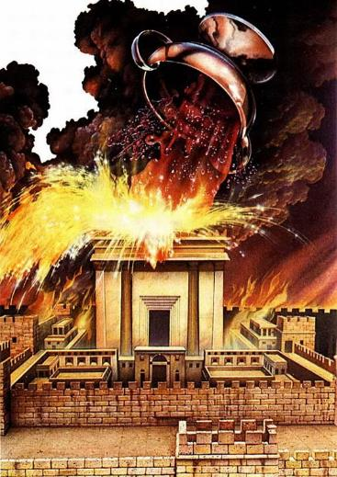
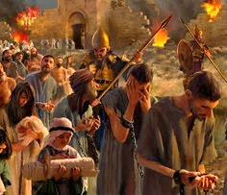
IGIHANO CY’UBUHEMU
“Nk’uko ibyiza byose Uwiteka Imana yanyu yababwiye byasohoye, ni ko Uwiteka azabasohozaho ibyago byose, kugeza aho azabarimburira mugashira muri iki gihugu cyiza Uwiteka Imana yanyu yabahaye.” (Yosuwa 23:15)
Yosuwa asoza ijambo rye n’amagambo akarishye y’umubūro ku ngaruka zo kutumvira: kugerwaho n’umujinya w’Imana (Yosuwa 23:15–16).
Nk’uko Uwiteka yari yarasohoje amasezerano Ye akiranutse ku bijyanye n’umugisha wa Isirayeli, ni nako imivumo y’isezerano yari kuba impamo, igihe Abisirayeli bari kuba barirenzeho.
Urukundo nk’urwo rwatumye Imana itanga Umwana wayo ku bwacu ni na rwo rugaragarira mu mujinya igirira abantu bakomeza kwinangirira mu cyaha (Yohana 3:16; Abaroma 2:5).
Isirayeli yaratsinzwe maze ihabwa igihano cyayo. Muri iki gihe dufite amahirwe yo kwandika amateka ahabanye n’ayo: gukomeza kuba indahemuka ku Mana no kuguma mu rukundo rwayo (Yohana 15:9).

Slide 9

“Ibyishimo byawe byose, amahoro yawe yose, umunezero wawe wose, no gutunganirwa kwawe kose muri ubu buzima bishingiye ku kwizera Imana by’ukuri ukayirunduriramo. Uku kwizera kuzagutera kumvira amategeko y’Imana by’ukuri. Kumenya Imana no kuyizera kwawe ni umurinzi ukomeye ukurinda imigenzereze mibi yose, kandi ni byo bigutera kugira icyiza cyose.
Izere Yesu nk’Ukubabarira ibyaha byawe, Ugushakira kuzishimira mu mazu yagiye kugutegurira. Arashaka ko uba imbere Ye, kugira ngo ugire ubugingo buhoraho n’ikamba ry’ubwiza.”
E.G. White, Messages to Young People, p. 410

