Slide 1
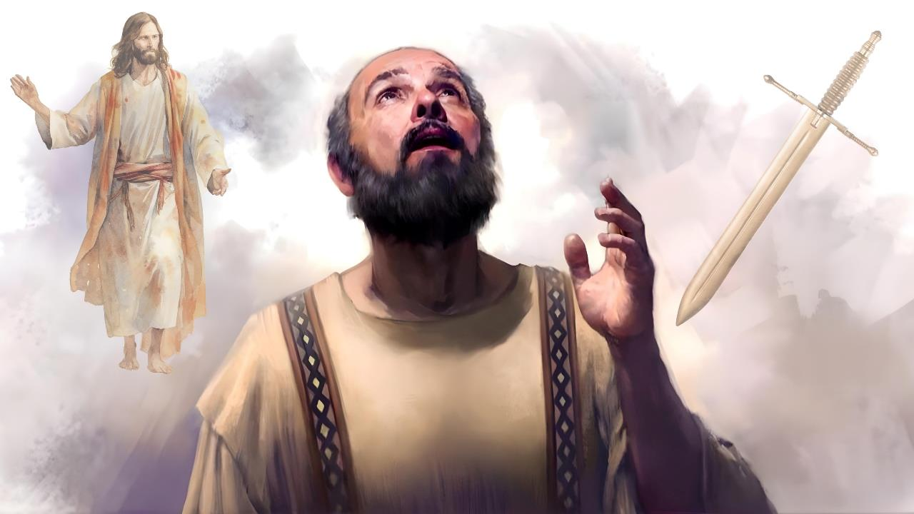
KUBAHO NO GUPFA
Icyigisho cya 3
cyo ku wa
17 Mutarama 2026

Slide 2

“Erega ku bwanjye kubaho ni Kristo, kandi gupfa kumbereye inyungu!”
Abafilipi 1:21

Slide 3


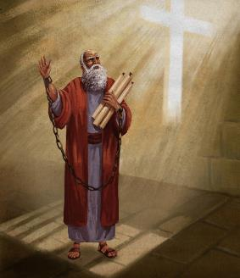


Pawulo yari ategereje gucirwa urubanza na Nero, umugome. Ahazaza he hari hashingiye cyane ku byiyumvo bya Kayisari kuruta ku butabera.
Ariko yari azi ko iherezo rye ritari mu maboko ya Nero, ahubwo ryari mu maboko y’Imana. Kubw’ibyo, yari yizeye ko kubw’amasengesho yasabirwaga n’amatorero, yajyaga kubohorwa.
Ariko, niba urupfu rwe rwari kugirira akamaro ubutumwa bwiza (nk’uko byagenze ku kubohwa kwe), yari yiteguye gutanga ubuzima bwe kubwa Kristo.
Kubaho kubwa Kristo cyangwa gupfa kubwa Kristo?
  Pawulo yerereje Kristo (Abafilipi 1:10–20, 25–26)
  Kubaho kubwa Kristo cyangwa gupfa kubwe (Abafilipi 1:21–22)
  Urungabangabo rwa Pawulo (Abafilipi 1:23–24)
Kubaho kubwa Kristo bisobanuye iki?
  Kugira ingeso zikwiriye ubutumwa bwiza (Abafilipi 1:27a)
  Ubumwe mu kurwanirira ubutumwa bwiza (Abafilipi 1:27b–30)

Slide 4

KUBAHO KUBWA KRISTO CYANGWA GUPFA KUBWA KRISTO?

Slide 5



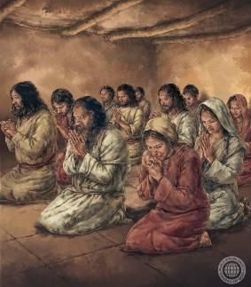
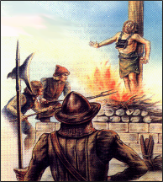
PAWULO YEREREJE KRISTO
“Kuko ntegerezanya ibyiringiro yuko ntazakorwa n’isoni z’ikintu cyose, ahubwo nzajya ngira ubushizi bw’amanga bwose, buzatuma Kristo akomeza gukuzwa n’umubiri wanjye iteka ryose nk’uko bimeze ubu, nubwo nabaho cyangwa nubwo napfa.” (Abafilipi 1:20)
Pawulo yishimiye imibabaro yihanganiye, yari myinshi cyane (Abakolosayi 1:24a; 2 Abakorinto 11:23–27). Birumvikana ko atari yishimiye imibabaro ubwayo, ahubwo yishimiye impamvu zamuteye kwihanganira ingorane, imwe muri izo mpamvu ikaba inyungu byazaniye itorero rya Kristo (Abakolosayi 1:24b; 2 Abakorinto 11:28).
Pawulo, yiganije Yesu mu mibabaro Ye—ndetse no mu rupfu Rwe—maze Kristo yererezwa muri Pawulo (Abafilipi 1:20).
Mu rwandiko Pawulo yandikiye Abafilipi, agaragaza neza ko mu gihe runaka atari yariteze ko yakwerereza Yesu binyuze mu rupfu, ahubwo yari yizeye ko binyuze mu masengesho y’itorero n’umurimo w’Umwuka Wera, azabohorwa kandi agakomeza kwerereza Kristo mu buzima bwe (Abafilipi 1:19, 25–26).
Kubw’ibibi byiganje mu isi yacu, kubaho nk’uko Kristo yabayeho akenshi bijyana no kubabara nk’uko Kristo yababaye, ndetse rimwe na rimwe, no gupfa nk’uko Kristo yapfuye (2 Timoteyo 3:12).

Slide 6



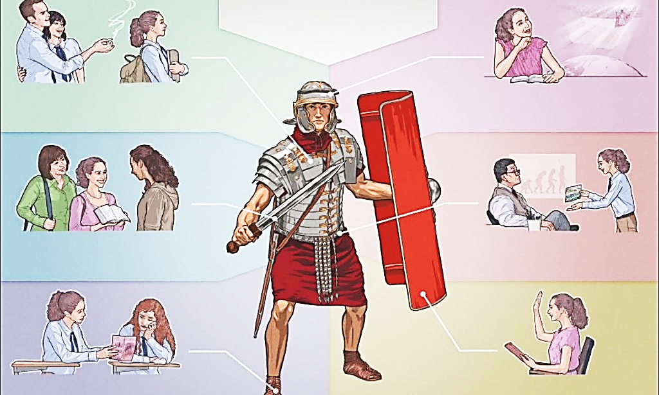

KUBAHO KUBWA KRISTO CYANGWA GUPFA KUBWE
“Erega ku bwanjye kubaho ni Kristo, kandi gupfa kumbereye inyungu!” (Abafilipi 1:21)
Intandaro y’imibabaro yose ni intambara yo mu isanzure iri kurwanwa muri iki gihe hagati y’icyiza n’ikibi, hagati ya Kristo na Satani.
Iyi intambara yo mu bya mwuka igomba kurwanwa n’intwaro z’ibya mwuka. Abambari b’umwanzi barwanya Abakristo bakoresheje intwaro zitajyanye (ibinyoma, kunenga, igitutu cy’urungano, n’ibindi).
Ariko dukoresha intwaro nk’ukuri no gukiranuka (2 Abakorinto 6:4–7). Ni intwaro zikomeye “zisenya ibihome” (2 Abakorinto 10:3–5).
Ariko se bigenda bite iyo ingaruka y’intambara ibaye urupfu rw’umukiranutsi? Dukurikije ibyo Pawulo avuga, ibi ni inyungu (Abafilipi 1:21).
Ku bo muri twe babereye Kristo indahemuka, urupfu rutugeza kure y’umwanzi, maze rukadutandukanya n’imibabaro yose (Imigani 14:32; Yesaya 57:1).

Slide 7



URUNGABANGABO RWA PAWULO
“Mpeze mu rungabangabo, kuko nifuza kugenda ngo mbane na Kristo, kuko ari byo birushaho kumbera byiza cyane; nyamara ku bwanyu ho kuguma mu mubiri ni byo binkwiriye.” (Abafilipi 1:23–24)
Nubwo Pawulo atabyanzuye, yari mu rungabangabo (Abafilipi 1:23–24):
Kugenda
Kubana na Kristo
Kugumaho
Kubera itorero inyungu
Turamutse dufatiye iri somo hejuru, twakwemeza ko Pawulo yigisha ko iyo dupfuye tuzamuka mu Ijuru kubana na Yesu, bikavuguruza izindi nyandiko zo muri Bibiliya (Umubwiriza 9:5; Zaburi ya 6:5).
Muri urwo rwandiko yandikiye Abafilipi ubwarwo, avuga ko kugira ngo abane na Kristo byuzuye, agomba gutegereza igihe cyo kuzuka (Abafilipi 3:8–11).
Ikindi gihe, Pawulo yagereranije umubiri n’ihema risenyuka (ripfa) kugira ngo ryambikwe ukudapfa (2 Abakorinto 5:1–4). Ariko, asobanura ko uyu mwambaro uzabaho mu gihe cyo Kugaruka kwa Yesu, atari mu gihe cy’urupfu (1 Abakorinto15:42, 51–54).

Slide 8

KUBAHO KUBWA KRISTO BISOBANUYE IKI?

Slide 9


KUGIRA INGESO ZIKWIRIYE UBUTUMWA BWIZA
“Icyakora, ingeso zanyu zimere nk’uko bikwiriye ubutumwa bwiza bwa Kristo” (Abafilipi 1:27a)
Imvugo ngo “ingeso zanyu” yahinduwe ivanywe mu ijambo ry’Urugiriki politeuomai, risobanura “kubaho nk’abenegihugu.” Pawulo yararikiye Abafilipi (natwe twese) kwitwara mu buryo bukwiriye abenegihugu b’Ijuru (Abafilipi 3:20).
Abakene mu mutima
Abagwaneza
Abafite inzara n’inyota byo gukiranuka
Abanyambabazi
Abafite imitima iboneye
Abakiranura
Abiteguye guhindukiza undi musaya
Gukunda abanzi bacu
Guhesha umugisha abatuvuma
Kugirira neza abatwanga
Kuba abanyarukundo n’abanyabuntu
Kugira imbabazi no kwicisha bugufi
N’ibindi
Mu kibwiriza cyo ku musozi, Yesu yatwigishije uko abaturage b’ijuru bagomba kubaho.
Mu ncamake, byavugwa bitya: “gukora ibyo gukiranuka no gukunda kubabarira, no kugendana n’Imana yawe wicisha bugufi” (Mika 6:8).
Pawulo yakoresheje iyi nama ubwo yasingiraga ingingo yamutsikaga umutima: ubumwe mu itorero.
Yari azi ko amacakubiri akunze guterwa n’ubwibone n’imyitwarire idakwiriye hagati yacu. Kubw’ibyo, aturarikira kwitwara mu buryo bukwiriye.

Slide 10



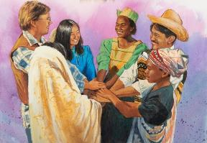
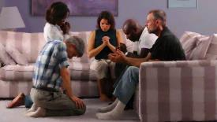
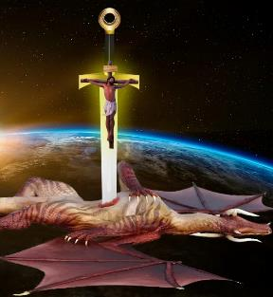

UBUMWE MU KURWANIRIRA UBUTUMWA BWIZA
“…kugira ngo ninza kubasura cyangwa nintaza, nzumve ibyanyu yuko mushikamye mu Mwuka umwe muhuje umutima, kandi murwanira hamwe ku bwo kwizera ubutumwa bwiza” (Abafilipi 1:27b)
Kuba umukiranutsi n’intungane ntibivuga imibereho izira intambara (Abafilipi 1:30). Ibinyuranye n’ibyo, Yobu ubwe, Imana yavuzeho ko ari “umukiranutsi utunganye, wubaha Imana kandi akirinda ibibi” (Yobu 1:8), yahuye n’intambara ikomeye, itewe n’ibikorwa by’umwanzi.
Mu ntambara turwana, ubumwe bugiramo uruhare runini. Pawulo adushishikariza kurwana twunze ubumwe kugira ngo turwanirire ubutumwa bwiza (Abafilipi 1:27b).
Ubu bumwe mu ntego bugomba kujyanishwa no gusenga no kwiga Ijambo ry’Imana (Abefeso 6:18; Abafilipi 2:16).
Iyo duhanganye n’ikibi, ntitugomba gutinyishwa n’abaturwanya (Abafilipi 1:28). Twibuke ko Satani ari umwanzi waneshejwe, kuko Kristo yamaze kuneshereza ku musaraba (Luka 10:18; Abakolosayi 2:15).

Slide 11

“Ese tumaze imyaka ingahe mu murima w’Uwiteka? None se ni iyihe nyungu twazaniye Umwami? Dufata dute ijisho ry’Imana ritwitegereza? Ese turimo gukura mu bijyanye no kubaha, gukunda, kwicisha bugufi, no kwiringira Imana? Ese tuyishimira imbabazi zayo zose? Ese twaba dushaka guhesha umugisha abadukikije? Ese mu miryango yacu tugaragaza umwuka wa Yesu? Ese turimo kwigisha abana bacu Ijambo Rye, kandi tukabamenyesha imirimo itangaje y’Imana? Umukristo agomba guhagararira Yesu mu kuba mwiza no gukora ibyiza. Nibwo hazabaho impumuro nziza y’ubugingo, igikundiro cy’imico myiza, ari byo bizagaragaza ko ari umwana w’Imana koko, umuragwa w’ijuru.”
E.G. White, You Shall Receive Power, December 10

